Slide 1
LGCBlunderDetection:
A script for LGCPlugin in SurveyPad
Marco Carotta
26 May 2025

Slide 2
About me ☺

Slide 3

About me ☺

Slide 4
About me ☺
Master student in Math @ Geneva and/or Pisa
TRNE @ APC
Explore Machine Learning (AI enthusiast)
B- coding skills (working on that…)

Slide 5
Flowchart of LGCBlunderDetection

Slide 6
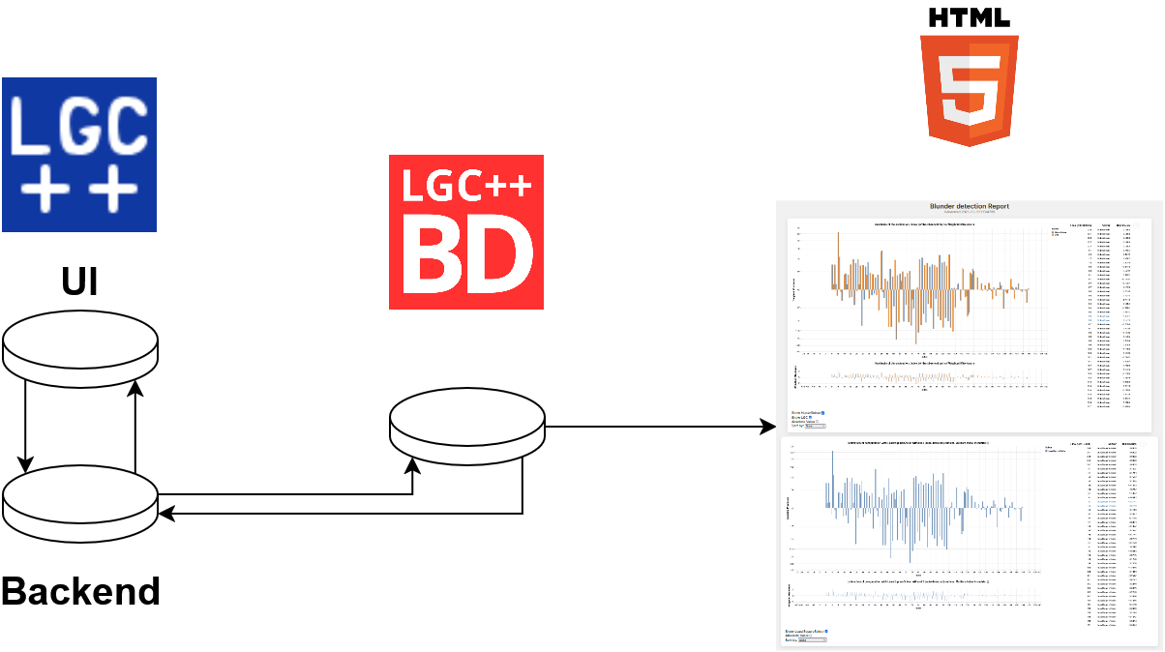
Flowchart of LGCBlunderDetection

Slide 7
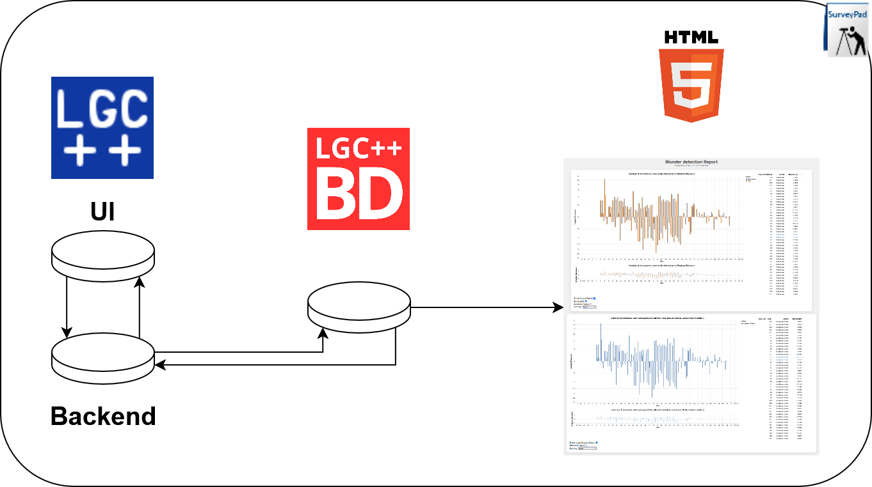
Flowchart of LGCBlunderDetection

Slide 8
Good news bad news
Bad news ☹
Good news ☺

Slide 9
Good news bad news
Bad news ☹
Good news ☺
Full power limitation..
    Full power if LGC converge with the *JSON keyword (but only for now)

Slide 10
Good news bad news
Bad news ☹
Good news ☺
Full power limitation..
    Full power if LGC converge with the *JSON keyword (but only for now)
Kinda slow
    About 20 second to launch + computation time

Slide 11
Good news bad news
Bad news ☹
Good news ☺
Full power limitation..
    Full power if LGC converge with the *JSON keyword (but only for now)
Kinda slow
    About 20 second to launch + computation time
SurveyPad integration
    Ctrl+click to go to line
    Output within SurveyPad

Slide 12
Good news bad news
Bad news ☹
Good news ☺
Full power limitation..
    Full power if LGC converge with the *JSON keyword (but only for now)
Kinda slow
    About 20 second to launch + computation time
SurveyPad integration
    Ctrl+click to go to line
    Output within SurveyPad
Multiple solvers
    Huber, L1, L2 (same in LGC), Iterative re-weighting

Slide 13
Good news bad news
Bad news ☹
Good news ☺
Full power limitation..
    Full power if LGC converge with the *JSON keyword (but only for now)
Kinda slow
    About 20 second to launch + computation time
SurveyPad integration
    Ctrl+click to go to line
    Output within SurveyPad
Multiple solvers
    Huber, L1, L2 (same in LGC), Iterative re-weighting
Nice Plots
    Up to 20k observation without lag!

Slide 14
Good news bad news
Bad news ☹
Good news ☺
Full power limitation..
    Full power if LGC converge with the *JSON keyword (but only for now)
Kinda slow
    About 20 second to launch + computation time
SurveyPad integration
    Ctrl+click to go to line
    Output within SurveyPad
Multiple solvers
    Huber, L1, L2 (same in LGC), Iterative re-weighting
Nice Plots
    Up to 20k observation without lag!
Other 3 months of me!
    I would love to get feedback
    Let’s implement just EVERYTHING

Slide 15
User guide
Small first version:
Useful links
Installation
Description
Usage
FAQs

Slide 16
User guide
Small first version:
Useful links
Installation
Description
Usage
FAQs
Download it from the indico page https://indico.cern.ch/event/1551273/

Slide 17
Live Demo

Slide 18
Live Demo
Hopefully without crashing…

Slide 19
Live Demo
Hopefully without crashing…
Contact & Feedbacks
Office: 926/1-002
Mattermost: @mcarotta
e-mail: marco.carotta@cern.ch
JIRA: issue with project=SUS and component=LGCBlunderDetection

