Slide 1
The HK Near Detectors
Thorsten Lux

Slide 2
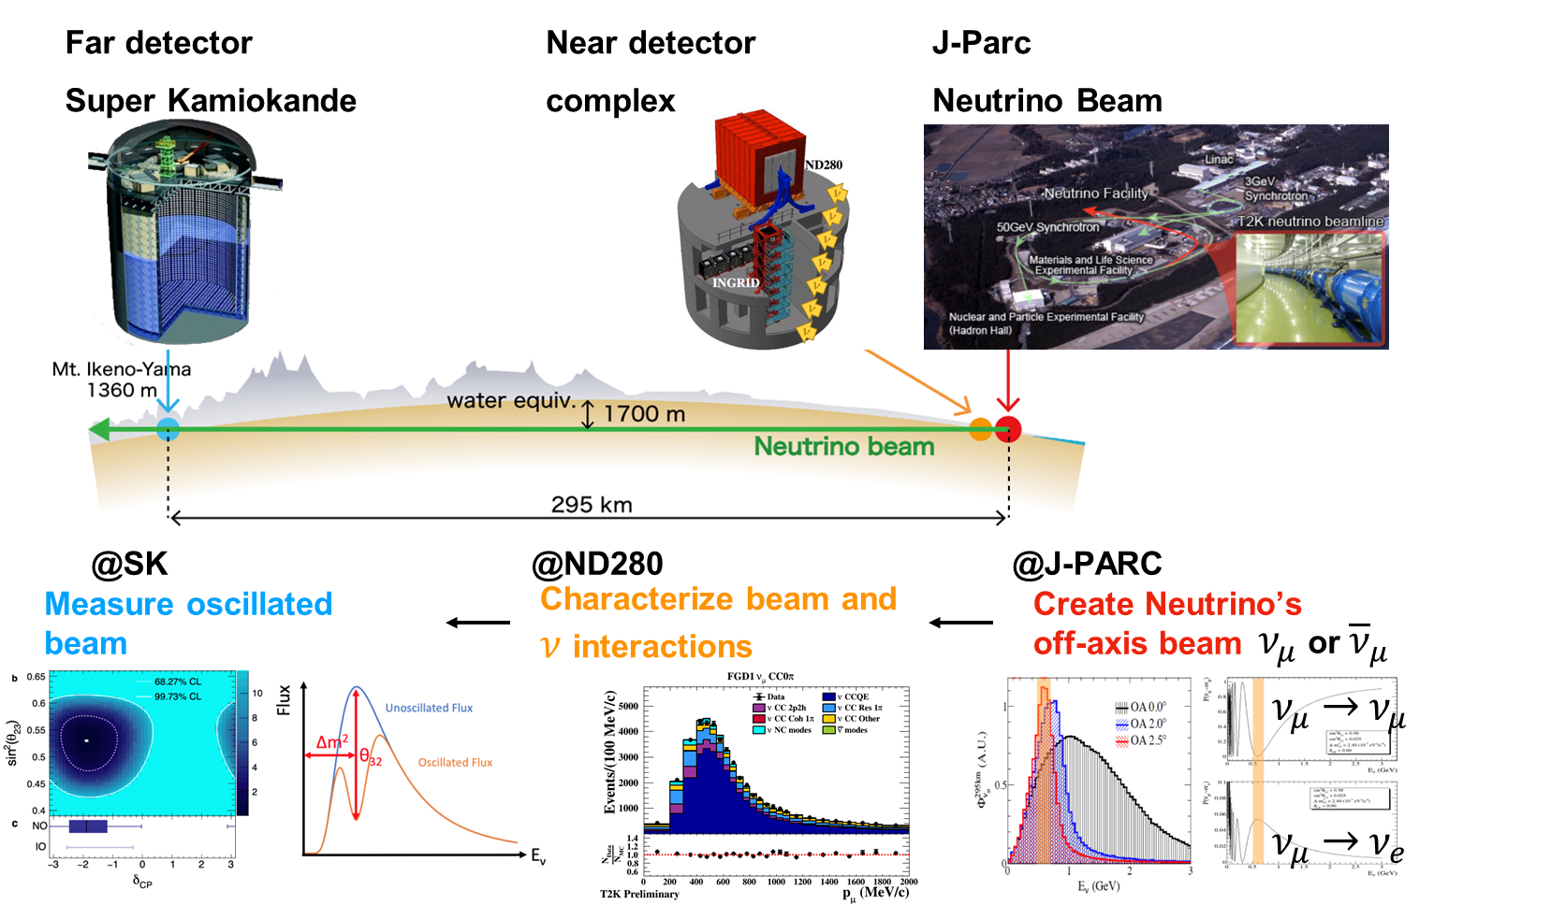
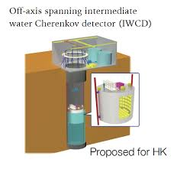
T2K/HK LBNO Concept
Planned

Slide 3
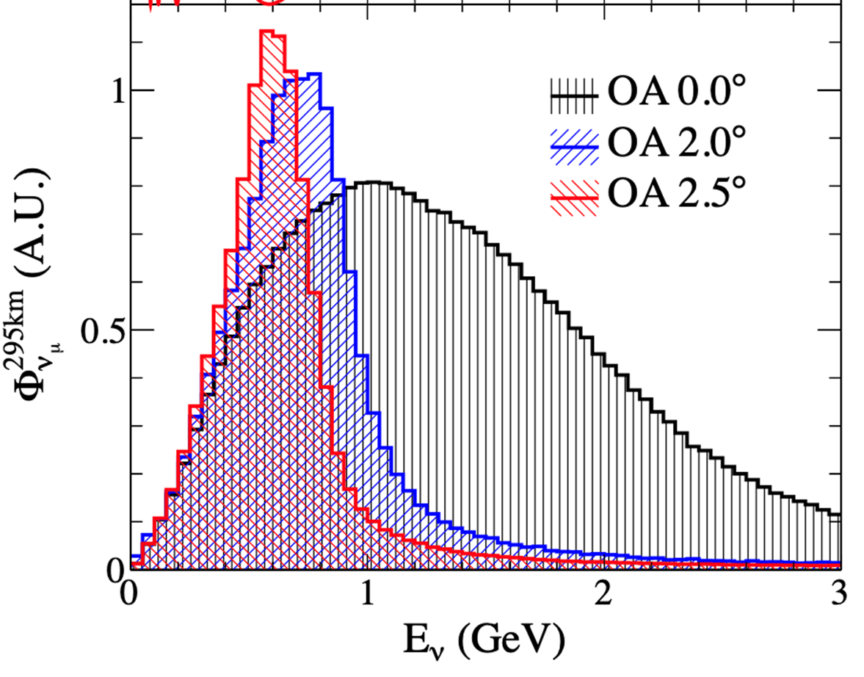
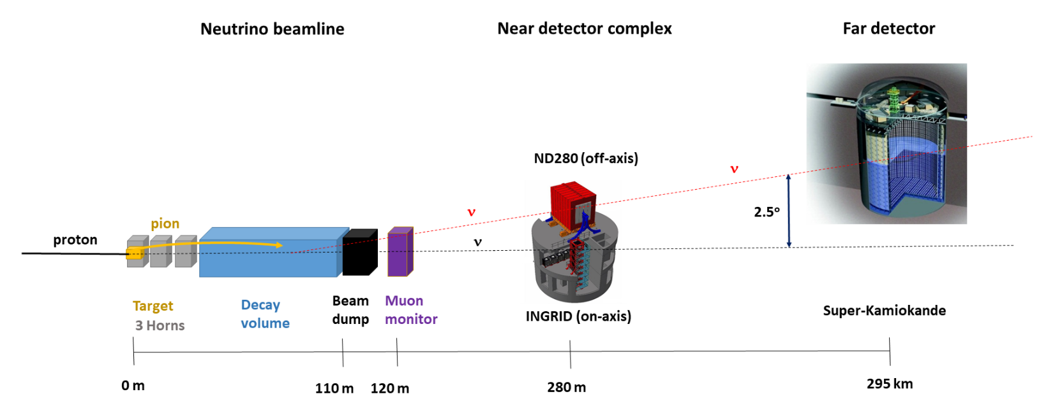
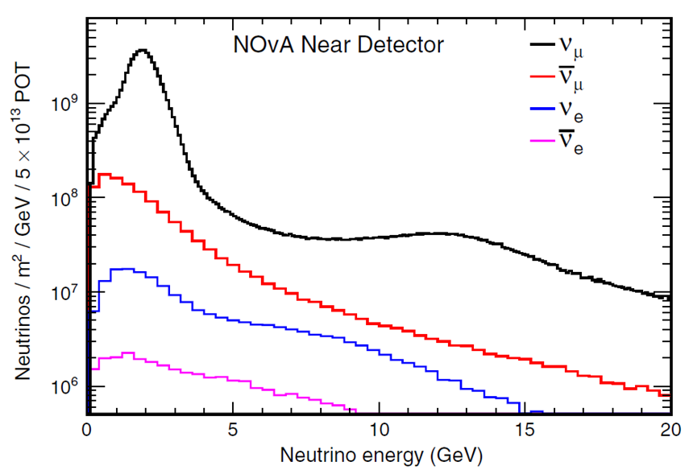
Neutrino Flux
A neutrino beam is not well focused as LHC beam
Neutrino energy depends on angle and not well defined
Not a clean muon neutrino beam but contaminations
Good to have them to measure cross-sections of electron neutrinos

Slide 4
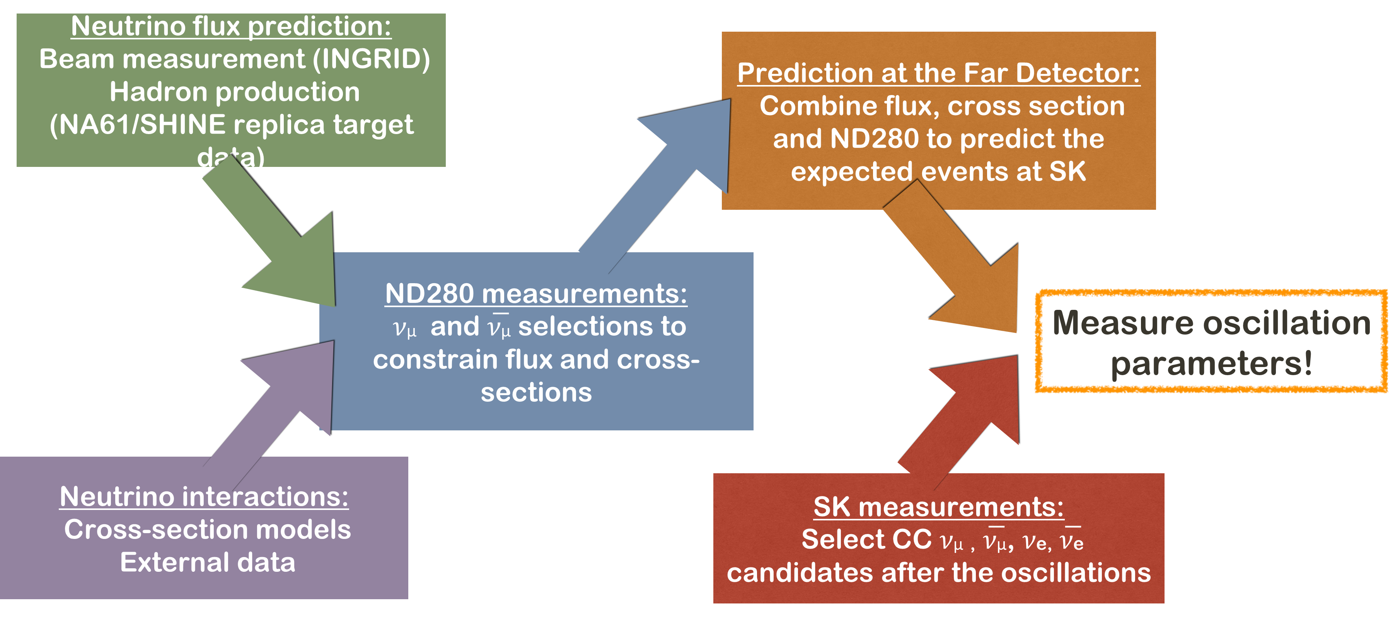
Oscillation Analysis Concept
+ IWCD

Slide 5
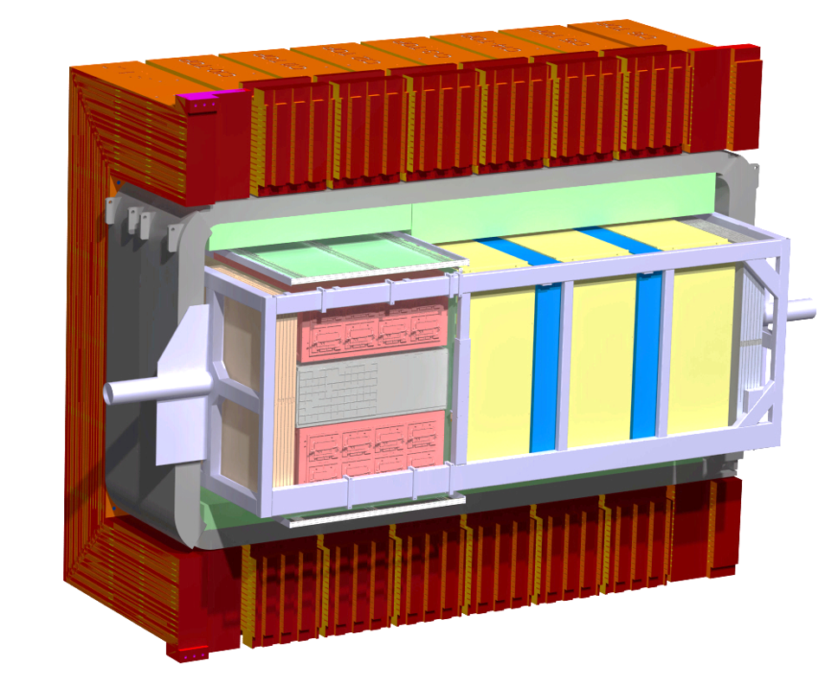
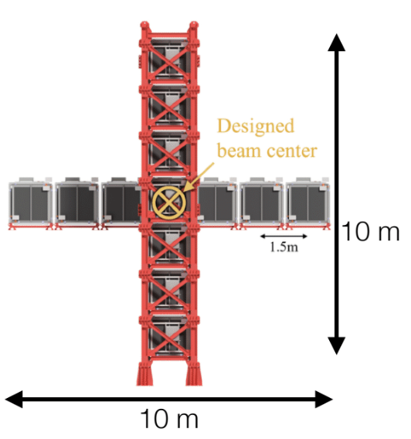

T2K Near Detector Complex
Off-Axis ND280
Constrain systematics in T2K oscillation analyses
Measure neutrino cross-sections
In operation since 2010 and upgraded in 2023
Near Detector complex at 280 m from the target
Several detectors installed to monitor the beam, reduce systematic uncertainties in oscillation analyses, and measure 𝜈 and 𝜈̅ cross-sections
E𝜈~0.6 GeV
WAGASCI/BabyMIND
Installed in 2019
Cross-sections on water
E𝜈~1.1 GeV
INGRID: on-axis detector
Monitoring 𝜈 beam profile day-by-day
Cross-section measurements
In operation since 2009
E𝜈~2.2 GeV

Slide 6
HK Near Detector Complex
Probably WAGASCI will not be used due to manpower problems
Off-Axis ND280
Constrain systematics in T2K oscillation analyses
Measure neutrino cross-sections
In operation since 2010 and upgraded in 2023
Near Detector complex at 280 m from the target
Several detectors installed to monitor the beam, reduce systematic uncertainties in oscillation analyses, and measure 𝜈 and 𝜈̅ cross-sections
E𝜈~0.6 GeV
WAGASCI/BabyMIND
Installed in 2019
Cross-sections on water
E𝜈~1.1 GeV
INGRID: on-axis detector
Monitoring 𝜈 beam profile day-by-day
Cross-section measurements
In operation since 2009
E𝜈~2.2 GeV

Slide 7
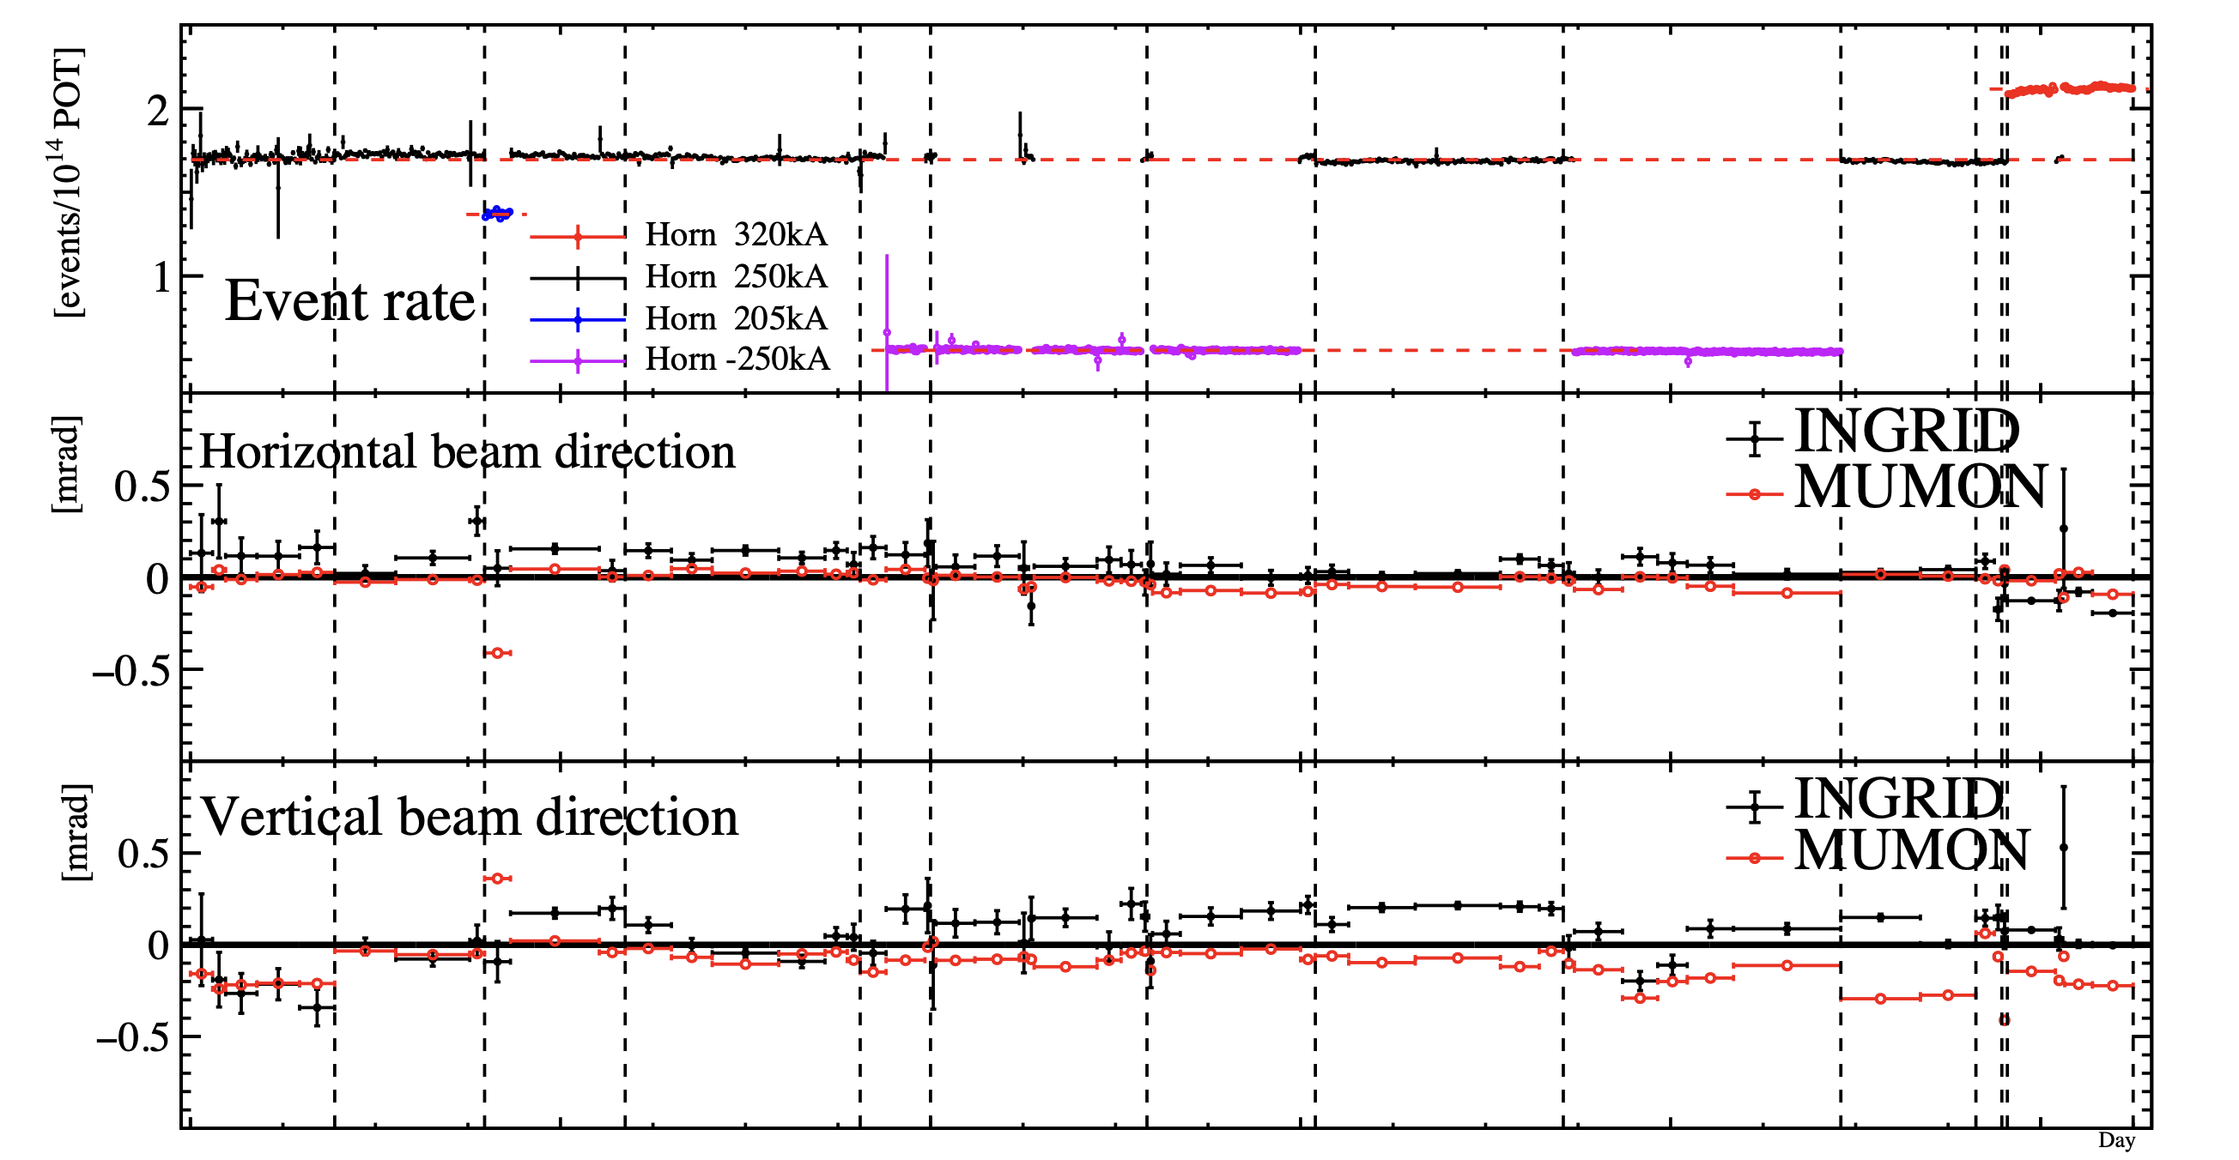
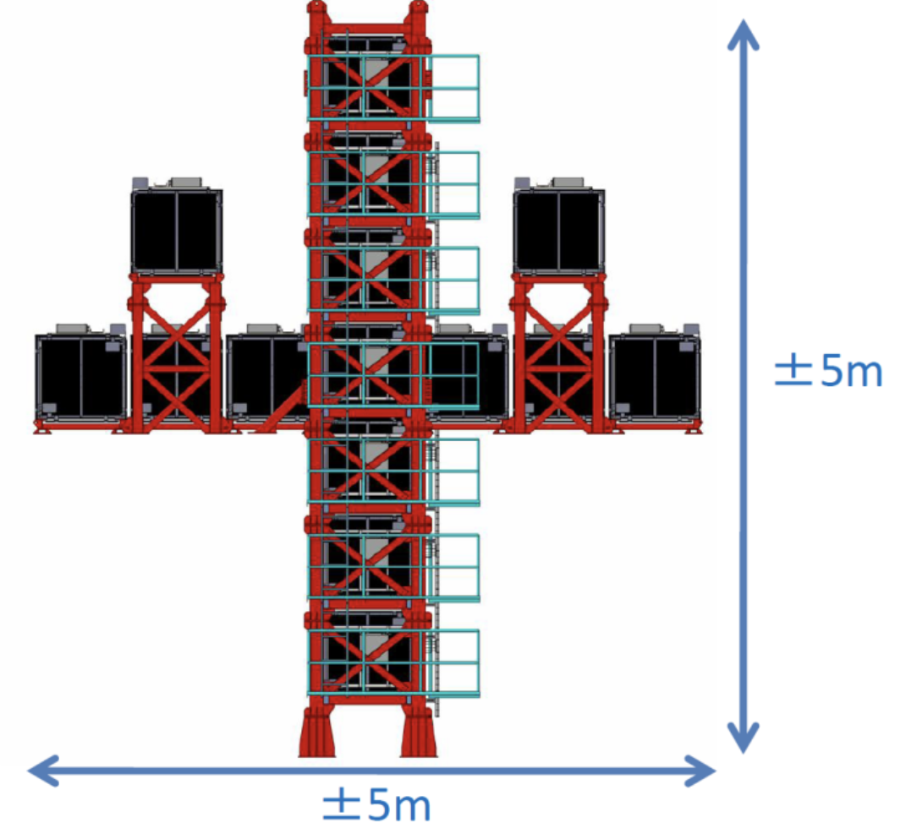
INGRID
Scintillator-Iron sandwich detector
Compute day-by-day the beam position and direction
Need reliable detector to ensure large data taking efficiency (>99% typically obtained within T2K)

Slide 8

Upgraded ND280: Hardware
Complex detector with several subdetectors:
  FGD: scintillator tracker, target
  VTPC/HAT: TPCs, PID
  ECAL: electromagnetic calorimeters, gamma and pion/muon separation
  SMRD: side muon range detector
  TOF: measures direction of particles
  SFGD: 3D scintillator tracker, target
  UA1 magnet: 0.2 T
In addition, a lot of support infrastructure (magnet chiller, gas system, DAQ, slow control, electronics cooling, …)
=> A lot of manpower required to maintain and operate ND280
TOF
VTPC
SMRD
UA1 magnet
ECAL
SFGD
FGD
HAT

Slide 9
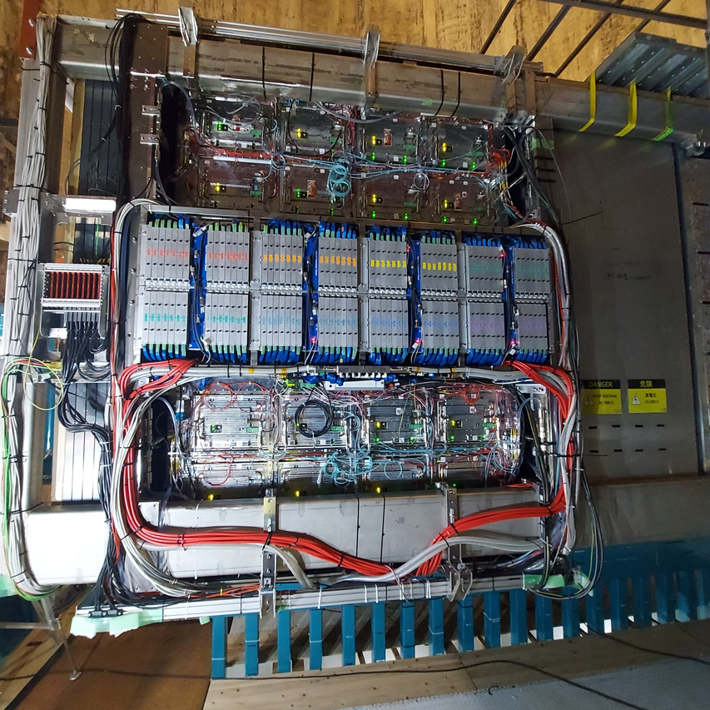
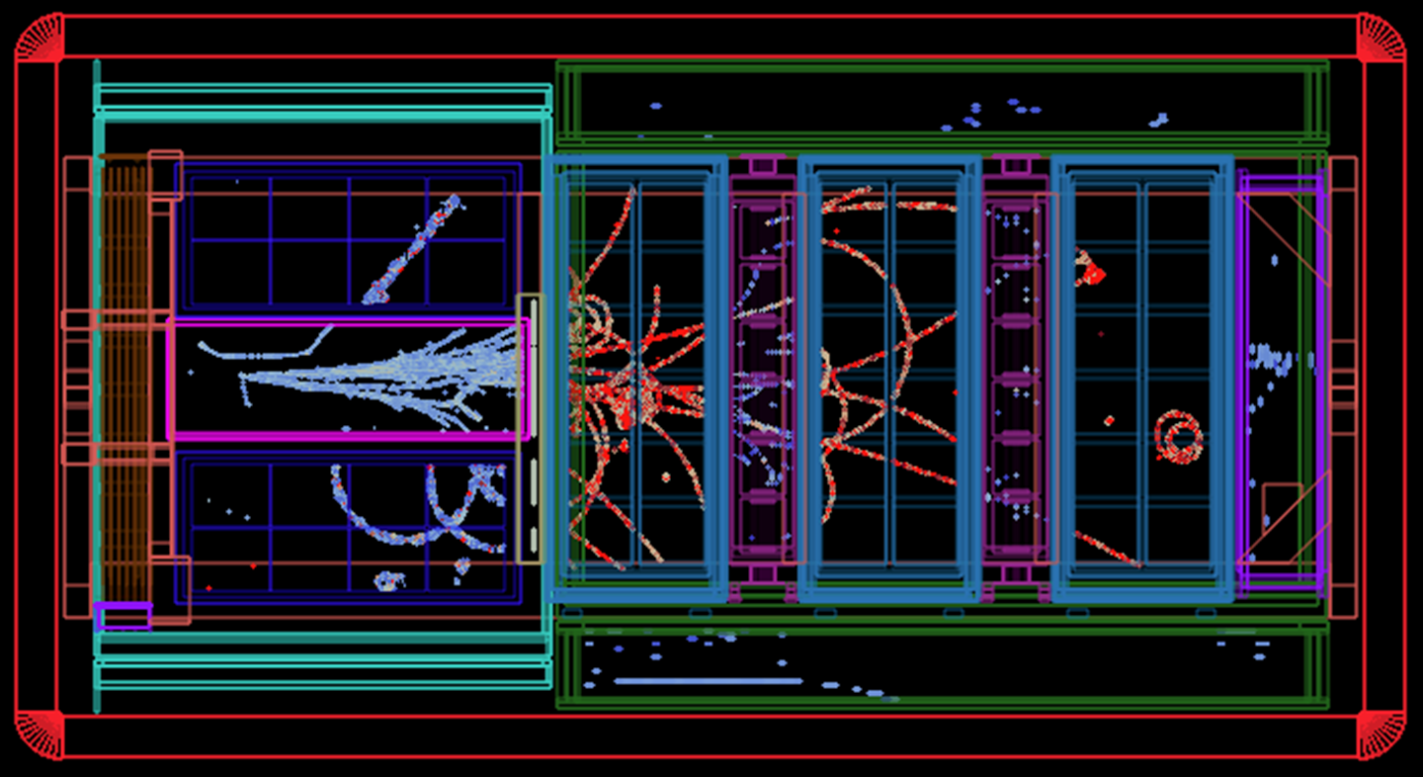
Upgraded ND280: Operation
Installation completed in May 2024
Old and new parts are working well together
Will continue data taking until start of HK

Slide 10
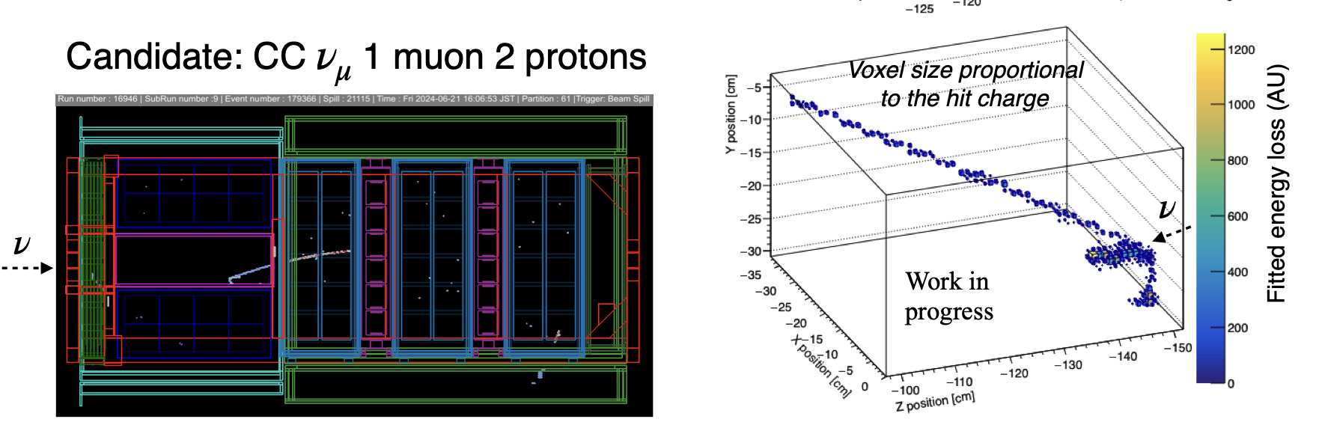
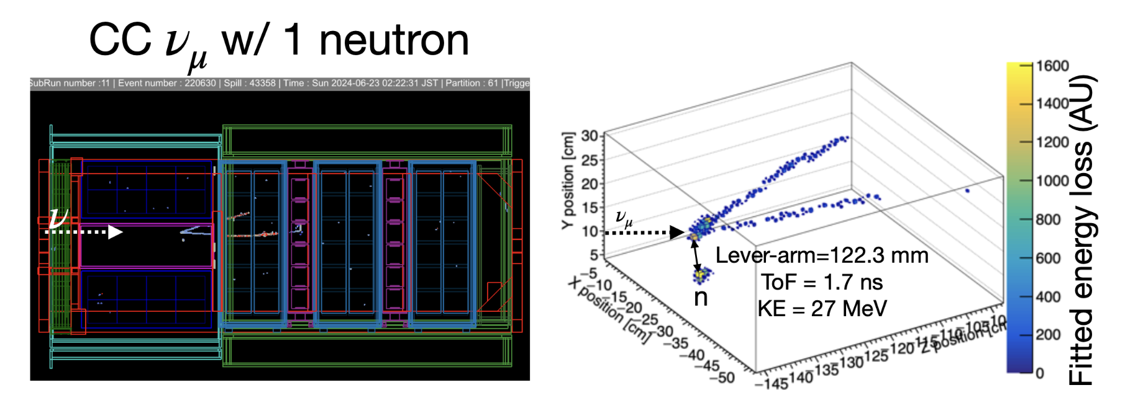
Upgraded ND280: Physics Events

Slide 11
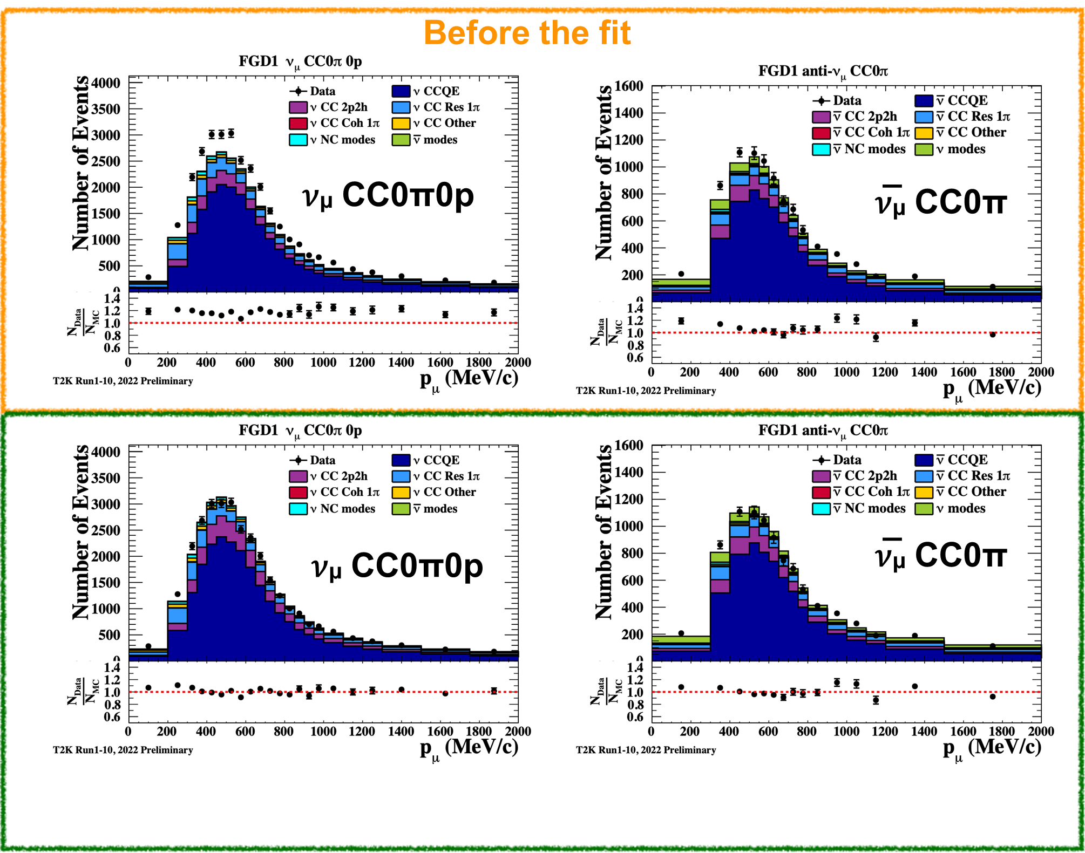
Upgraded ND280: Analysis
Select interactions on target: CH (FGD1/SFGD) and CH/Water (FGD2)
Precise measurement of Pμ and θμ with the TPCs
Distinguish 𝜈 from 𝜈̅ interactions thanks to the reconstruction of the charge of the lepton
Separate samples based on number of reconstructed pions (CC0π, CC1π, CCNπ), protons, photons, etc
22 samples for the original ND280
Work ongoing on upgrade selections in T2K
=> A lot of manpower required to apply these to HK ND280 data

Slide 12
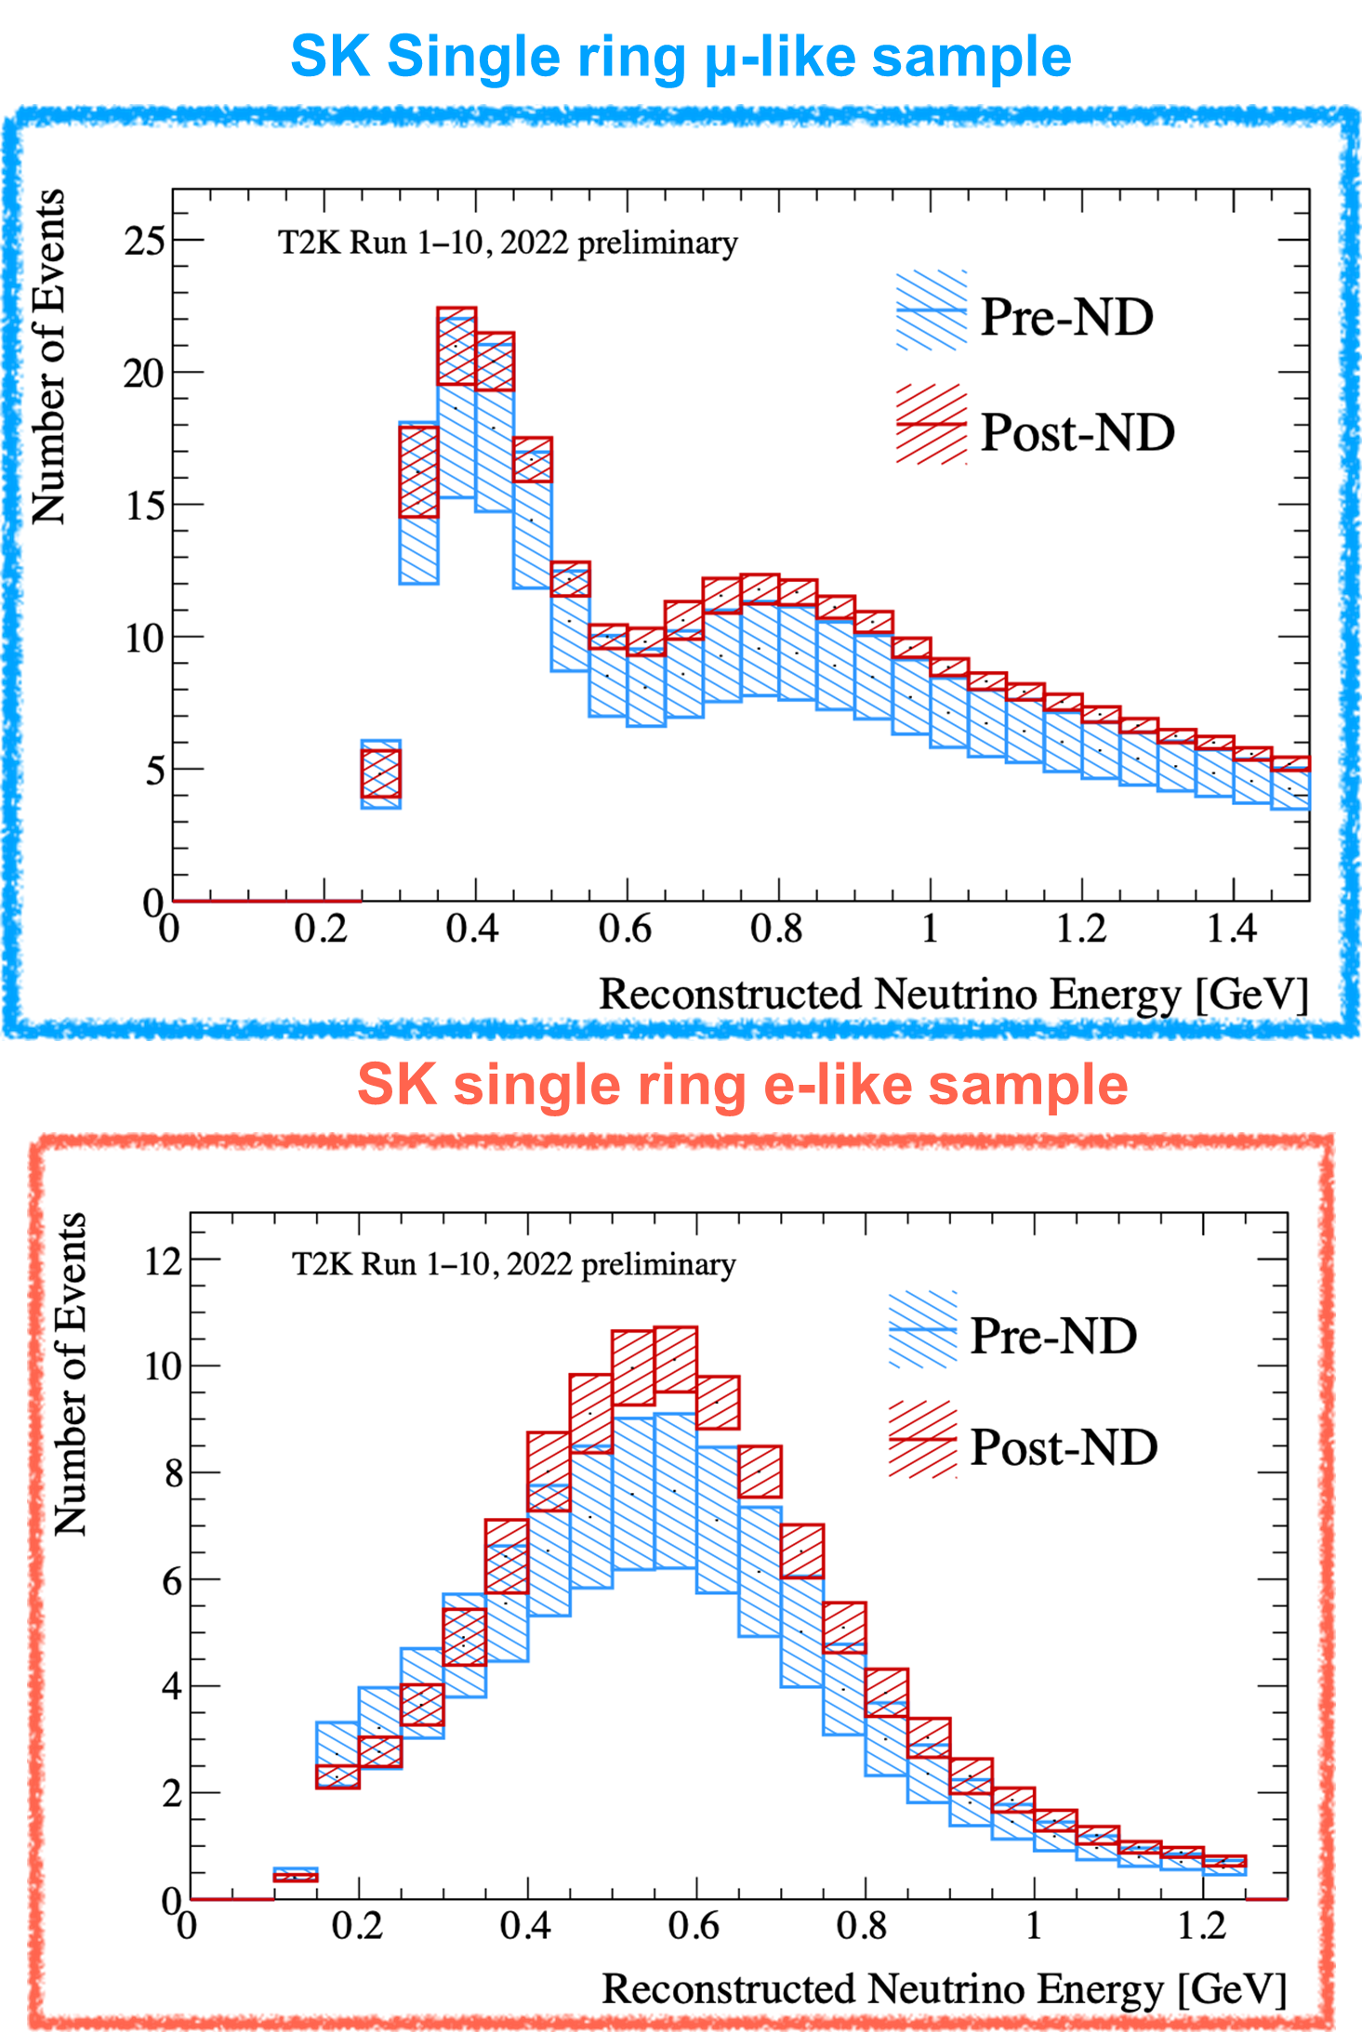
Systematic Uncertainties
Systematic uncertainties reduced from ~15% to ~5% with original ND280
When upgrade is included aim is to go down to ~4%
With IWCD aim is to go down to ~3%
Sample | Pre-ND fit | Post-ND fit
𝜈-mode 1Rμ | 16.7% | 3.4%
𝜈-mode 1Re | 17.3% | 5.2%
𝜈-mode MR | 12.5% | 4.9%
𝜈-mode 1Re+d.e. | 20.9% | 14.3%
𝜈̅-mode 1Rμ | 14.6% | 3.9%
𝜈̅-mode 1Re | 14.4% | 5.8%

Slide 13
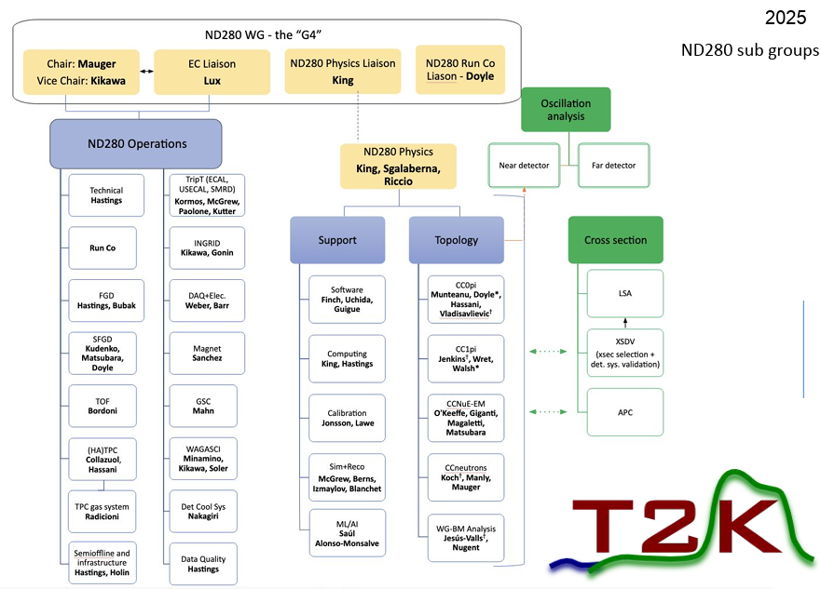
ND280 in T2K
T2K collaboration has about 550 members
About 330 authors
Fully established organization for workflow from data taking to OA input
3-4 months of beam per year
Normally, two data-taking periods per year
Many experts needed at J-PARC
6 persons per day for shifts
Continuous data quality and calibration to prepare data for analysis
=> Even in T2K, manpower is a concern

Slide 14
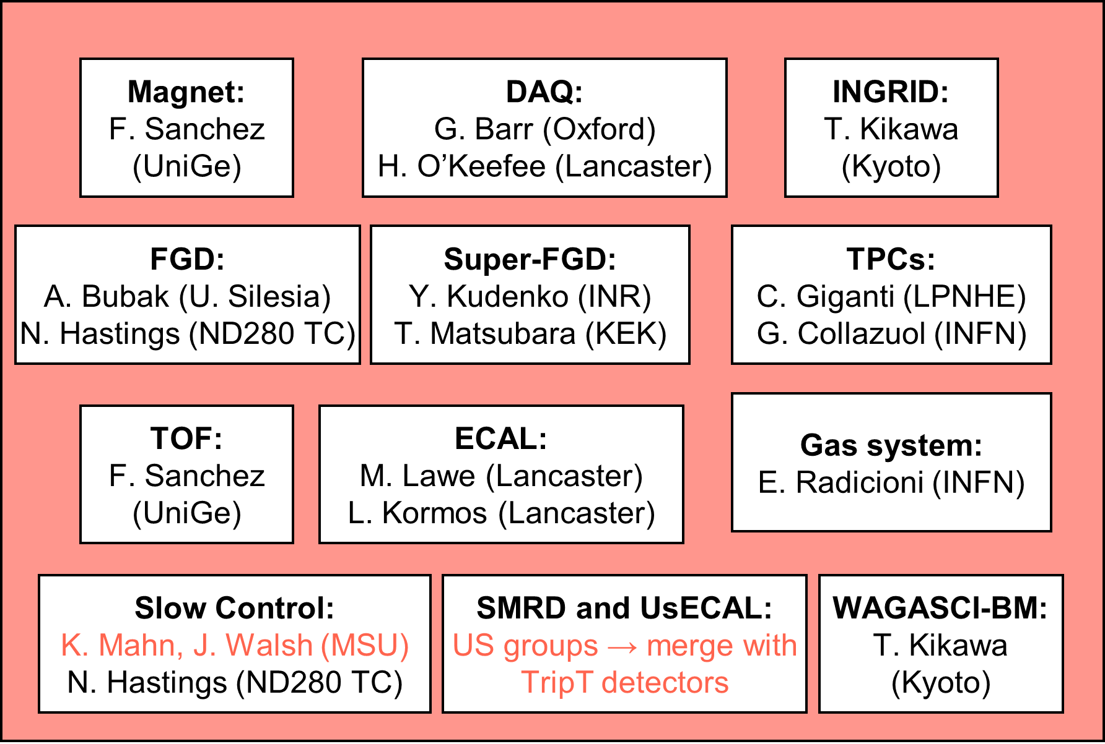
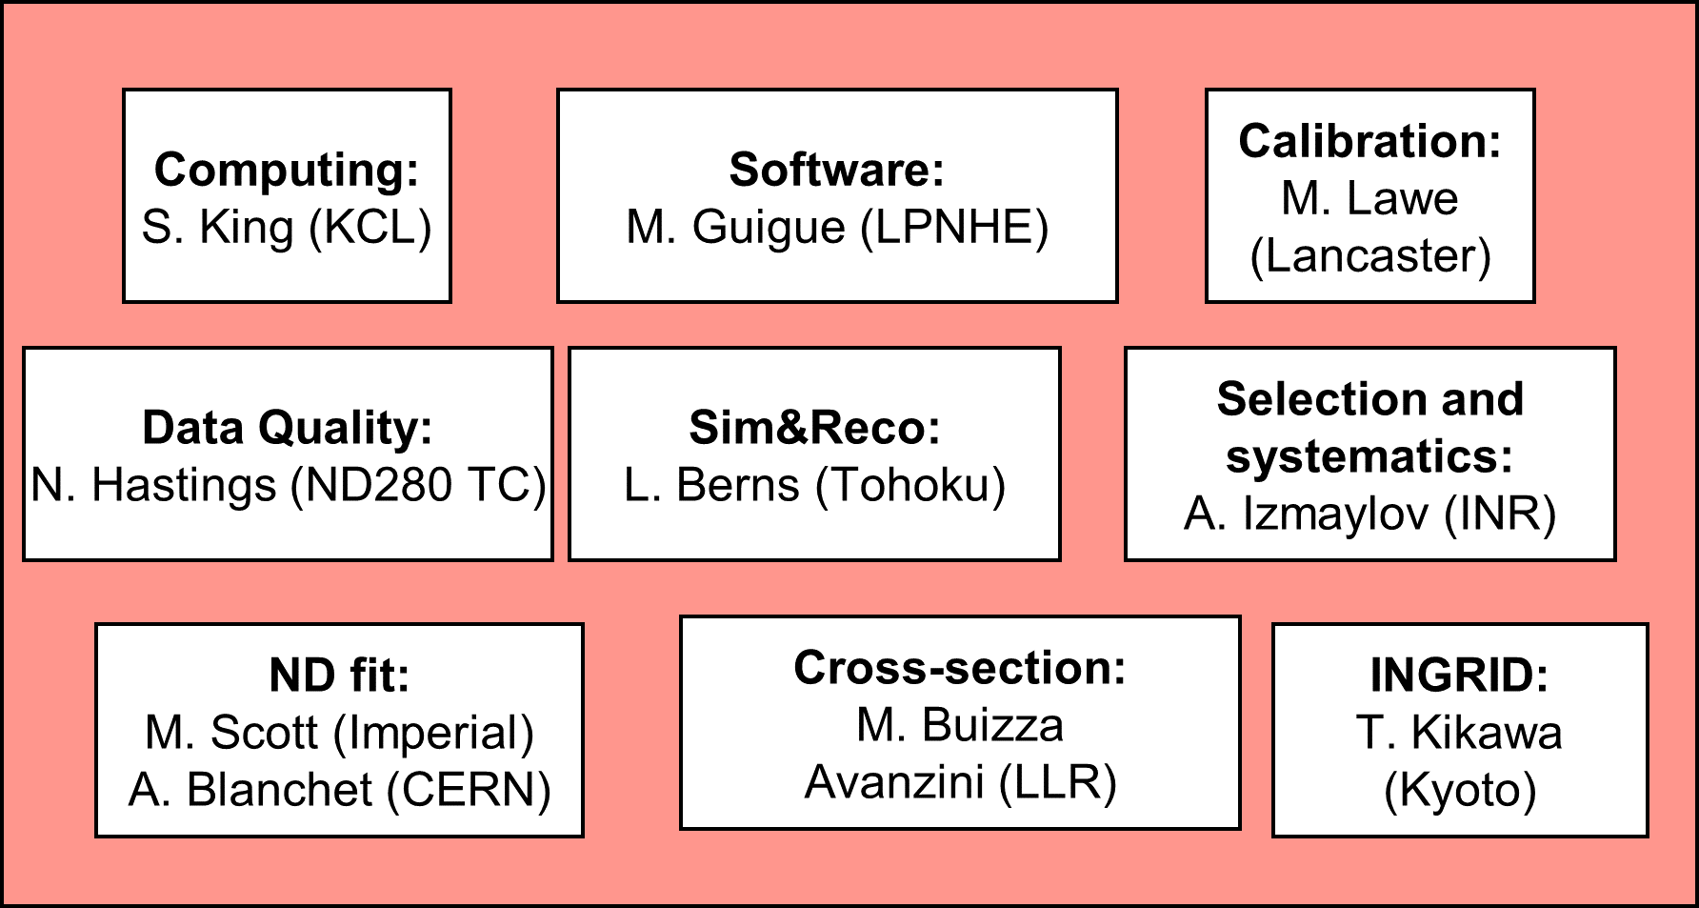
ND280 in HK
ND280 will be used in HK
Currently T2K-HK ND280 MOU for transfer being worked out
HK collaboration has about 600 members
But T2K is only ND while HK is FD, ND and IWCD
Construction phase makes it worse
Only fraction of T2K joins HK => many go to DUNE (e.g. all US groups, several from UK, …)
No organizational structure currently, only contact persons
=> Will be challenging/hell to be ready for data taking in May 2028!

Slide 15
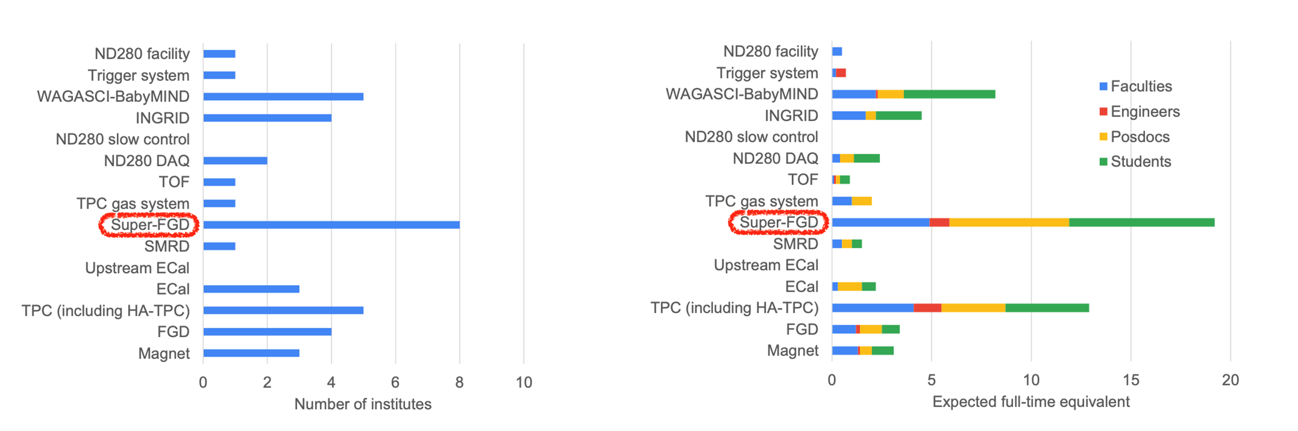
Estimated HK ND280 Manpower
20-25% of manpower in HK era compared to T2K
Some subdetectors have enough manpower but some have none
For software/analysis we still have no numbers

Slide 16
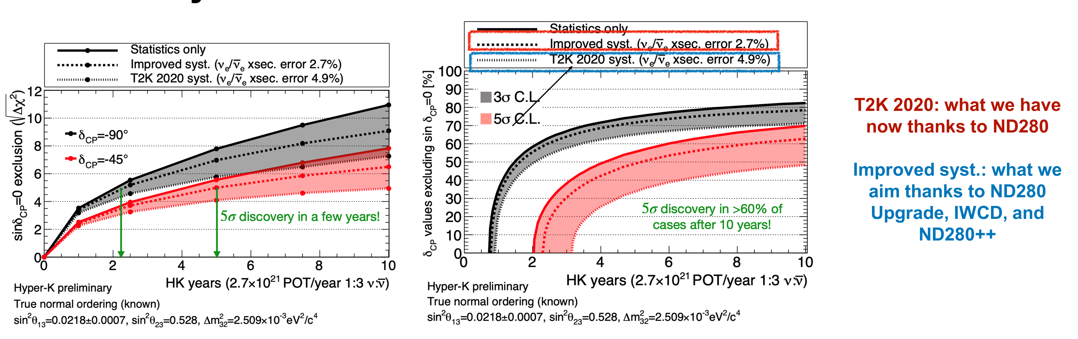
ND Importance for HK
The NDs are crucial for the success of the HK regarding deltaCP
Without INGRID we do not even take beam data

Slide 17
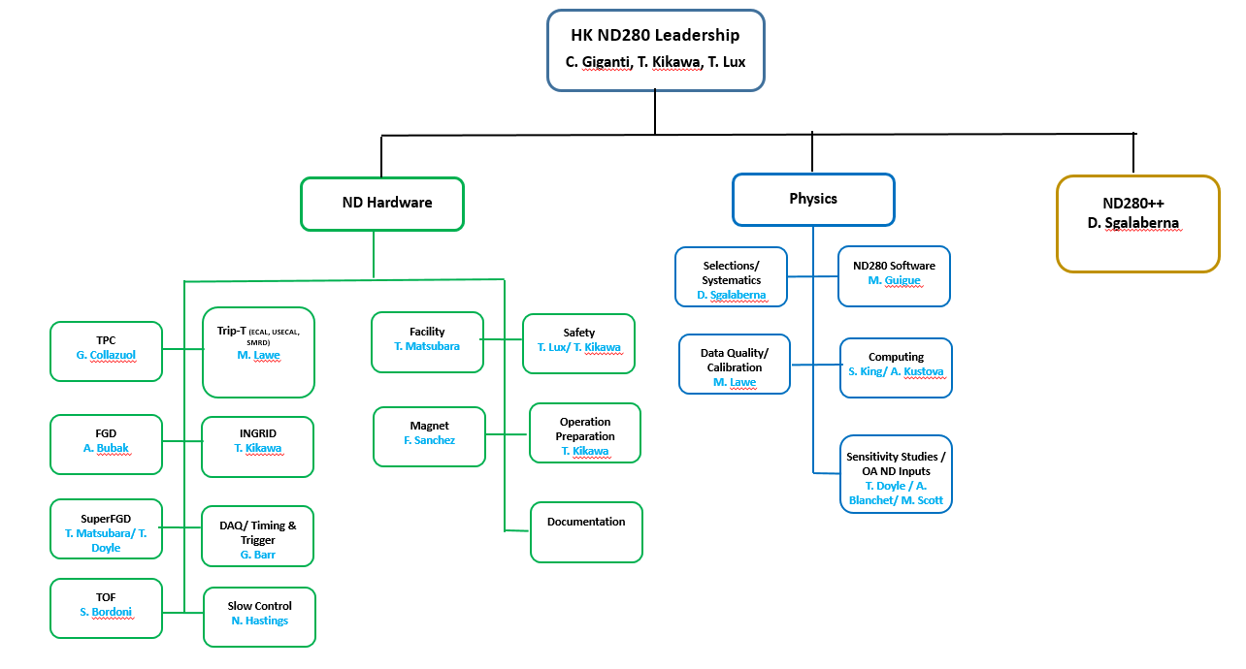
HK ND280 Organization
T2K-HK ND280 MOU being finalized soon
Defines the transfer of the detectors and expertise from T2K to HK
Must be done before HK starts since then DUNE colleagues will disappear
Organization necessary to absorb the expertise
I just become coordinator for this task
First step will be to find conveners and collect detailed information about needed manpower
Also sensitivity studies to define priorities are planned
Preliminary version
=> A lot of opportunities for (Spanish) groups to join!!!! (with limited resources needed)

Slide 18
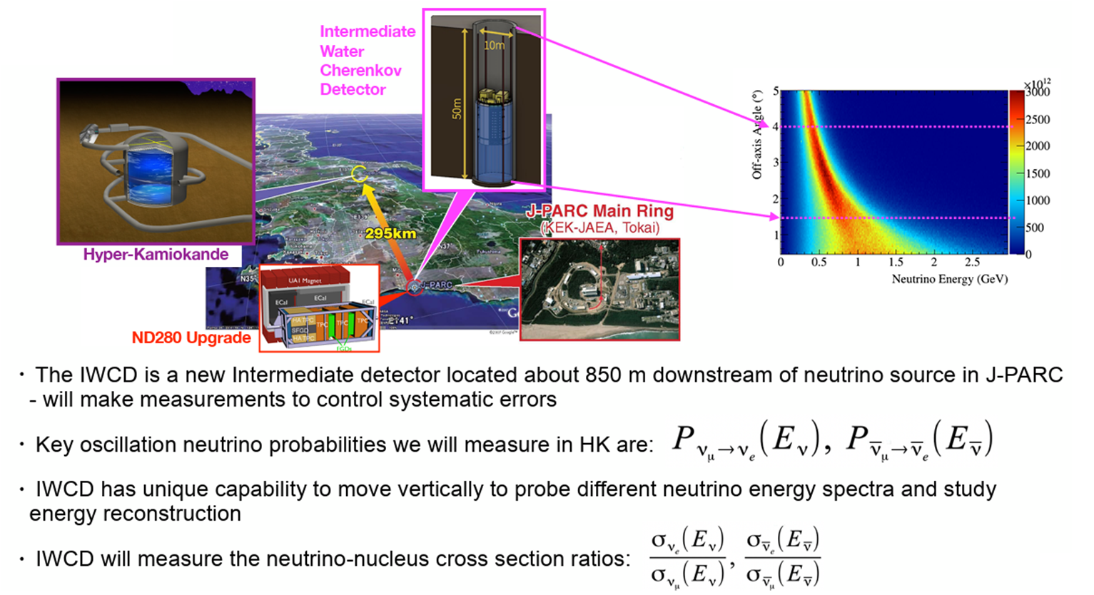
IWCD

Slide 19
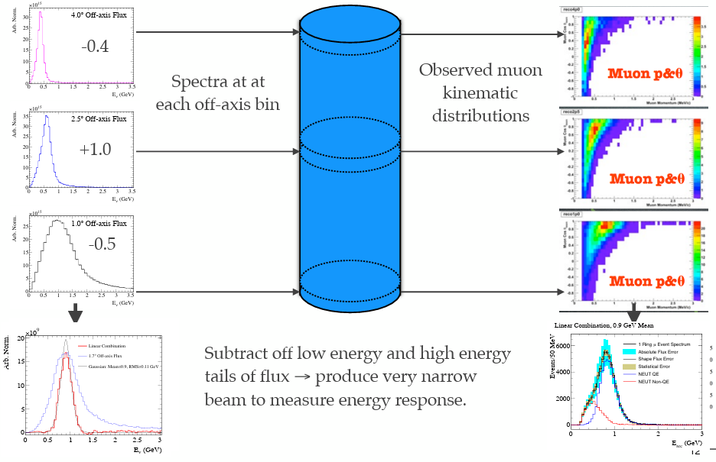
Prism Approach
Possibility to move the detector allows to measure at different fluxes
Linear combination allows to reduce systematic uncertainties
Price to pay is less statistics for per angle
Quite some engineering work

Slide 20
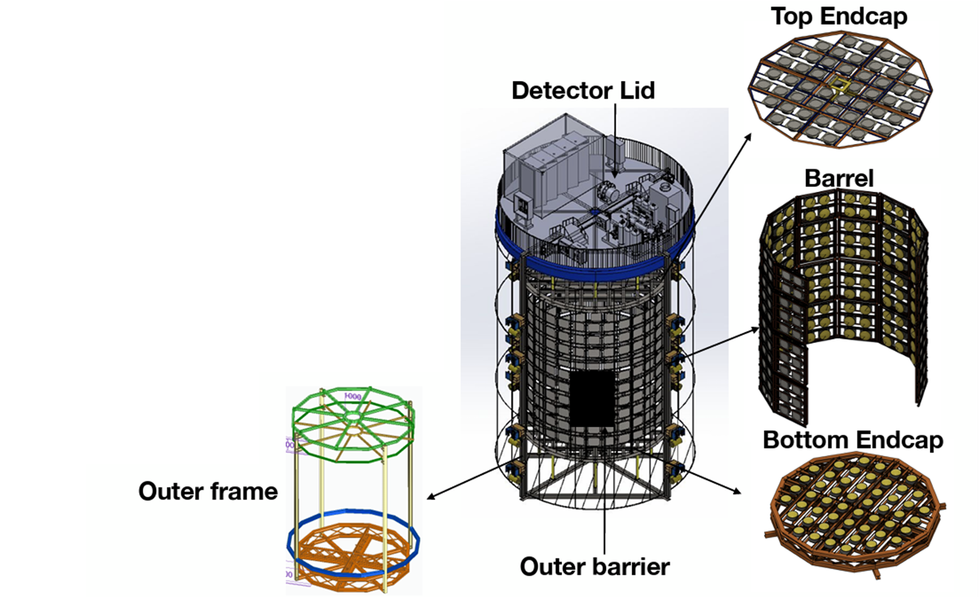
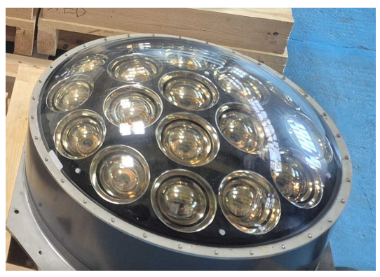
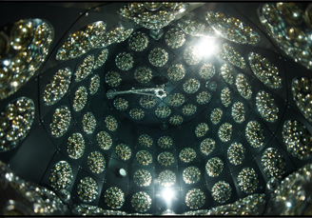
IWCD: Detector
Water Cherenkov detector of 100 t fiducial mass
Much larger mass than ND280 but also further away => roughly same event rate (at least with ND280++)
Size matters => not all detector systematics cancel out when compared with FD
No magnet => no wrong-sign measurement
mPMTs instead of 50 cm PMTs
Concept tested with WCTE => Helena’s talk

Slide 21
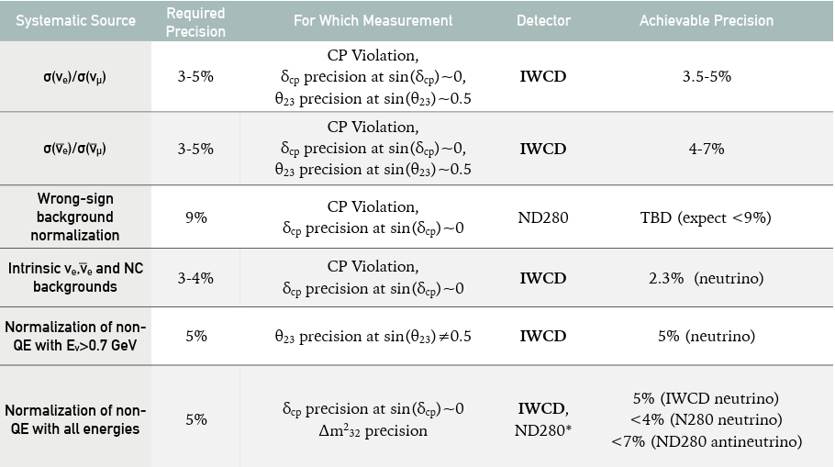
ND280/IWCD Complementarity

Slide 22
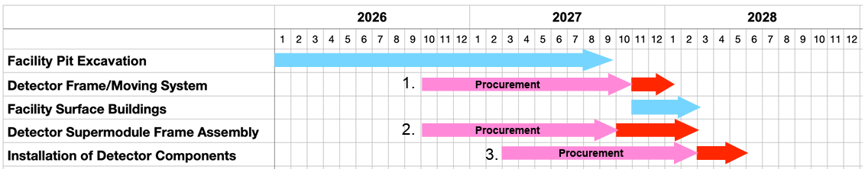
IWCD
Quite ambitious time schedule => aim is still to start data taking with IWCD when HK starts
Significant amount of funds not secured => about 20% of total costs (~ 9MEuro)
Spanish contributions so far:
  Calibration => Santiago de Compostela/DIPC
  Floating system => LSC (funding not secured)

Slide 23
IWCD: Missing Items
See Mark’s talk for details:
https://hkdbweb.in2p3.fr/doc/meetingfiles/A00215472/iwcd_introduction_20250702.pdf
Several key hardware components still not covered:
  Supermodule frames => essential component
  Water purification system => start with WCTE system but upgrade needed
  Outer detector => some components are not covered
  Lid => design is done but production not covered
  Trigger/clock => not covered currently, WCTE solution might be starting point
Possible software/analysis contributions:
  Event reconstruction: ML and classical
  Integrating IWCD into the oscillation analysis
=> A lot of opportunities for (Spanish) groups to join!!!! (but hardware would require significant funds)

Slide 24
ND280++
After the upgrade is before the upgrade
Large part of ND280 still original
After 20 years, detectors get old and hard to find spare parts
Idea is to replace VTPCs + FGDs by something new
Complementary to IWCD and existing upgrade:
  Lower detection thresholds
  Water target with magnetic field
  …
R&D phase => important to attract new groups

Slide 25
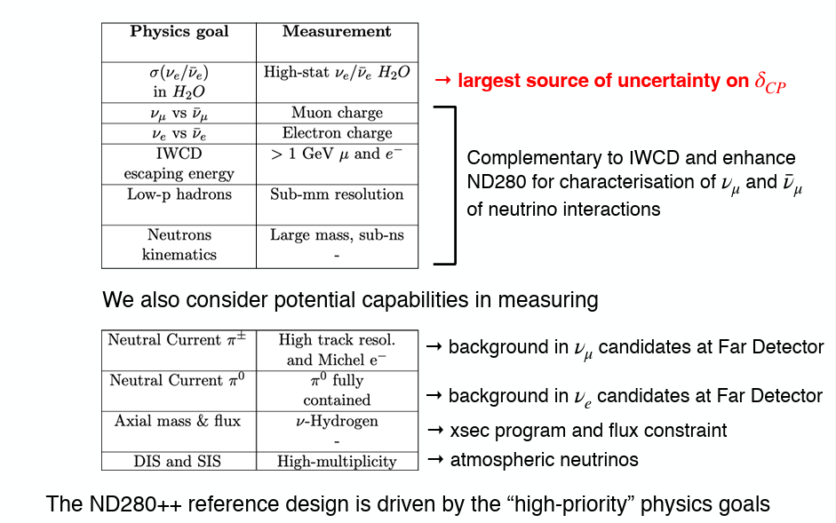
ND280++: Physics Goals
Differences to IWCD:
-) fixed angle over the lifetime of HK
-) magnetic field to measure contamination

Slide 26
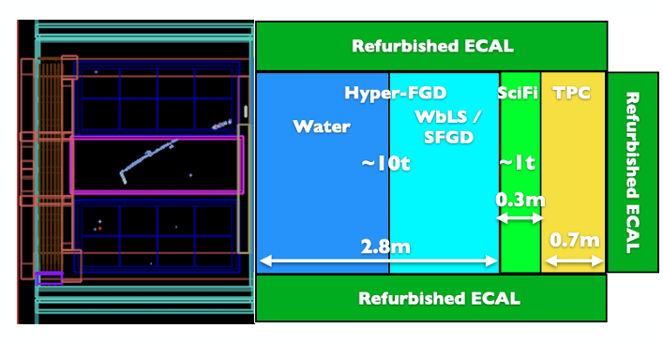

ND280: Baseline Design
Reminder:
Upgraded ND280: 4 (2 SFGD + 2 FGD) tons of CH target

Slide 27
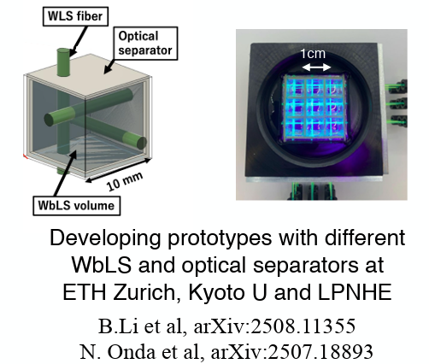
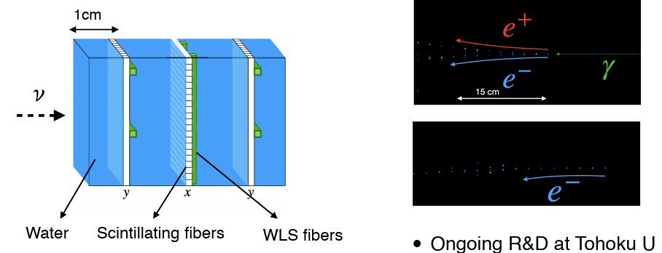
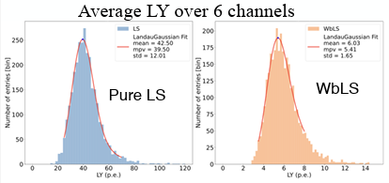
ND280++: HFGD Options
Various options studied to measure on water target
Active and inactive targets considered
Issue is that light yield with WbLS is low compared to existing SFGD
IFAE: Studying the possibility to use an opaque scintillator (LiquidO) => see Ewan’s talk

Slide 28
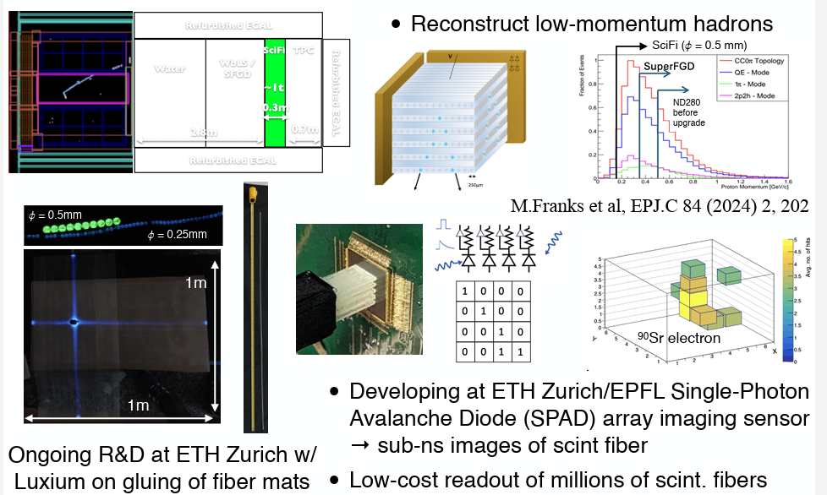
ND280++: SciFi Option

Slide 29
ND280++
Official date for ND280++ is 2030/2031
Probably not realistic and will be shifted by 2-3 years
And probably with less subdetectors as in the baseline design
Priority must be to keep existing ND280 running
Nice option for R&D project and certainly possible to join one of the existing efforts (hardware- or software-wise)
Strategy could be to learn with existing ND280 and prepare in parallel ND280++
=> A lot of opportunities for (Spanish) groups to join!!!! (with limited resources needed for the moment)

Slide 30
Conclusions
The near detectors will be crucial for the success of HK
Mainly deltaCP but cross-section measurements also relevant for atmospheric neutrino studies
HK physics will be largely done at ND site
The operation of INGRID and ND280 are essential for HK
Lack of manpower will be challenge for NDs
IWCD also facing the challenge of missing hardware contributions
ND280++ offers the possibility to do exciting R&D incl. testbeam => great for students and Postdocs
Consider to join these efforts (and not much is needed for many options)!

