Slide 1
Electron gun & collector for the new AD e-cooler
Numerical assessment
Teresa Guillen Hernandez
22/05/2025

Slide 2
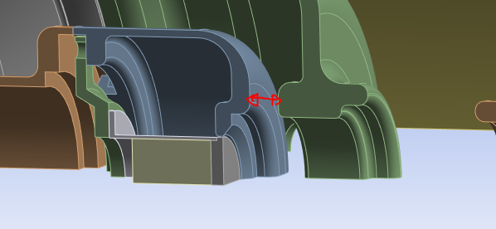
Objective
Operation
  Relative displacement due to plasticity
  New design of the part in contact with the cathode
    Inox
    Molybdenum
    Inconel
Bake out
  Review BC
  Relative displacement due to plasticity (as in operation)
Ceramics

Slide 3
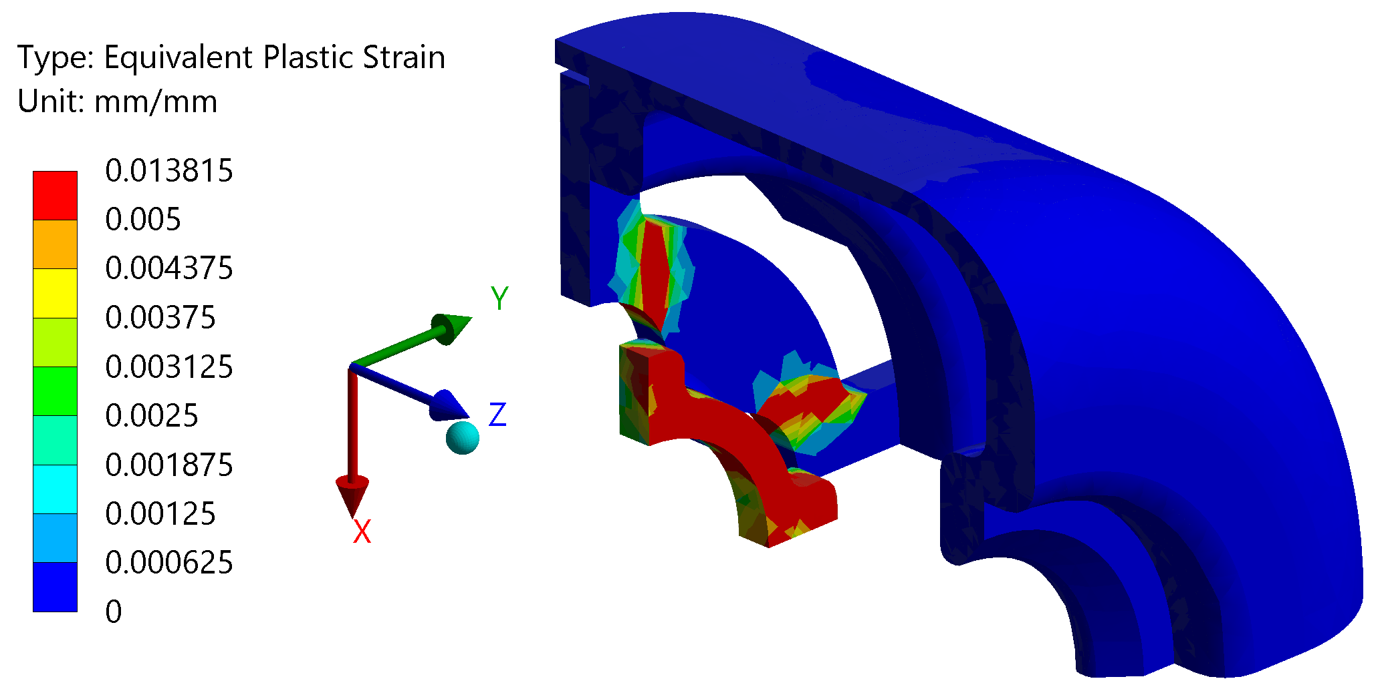
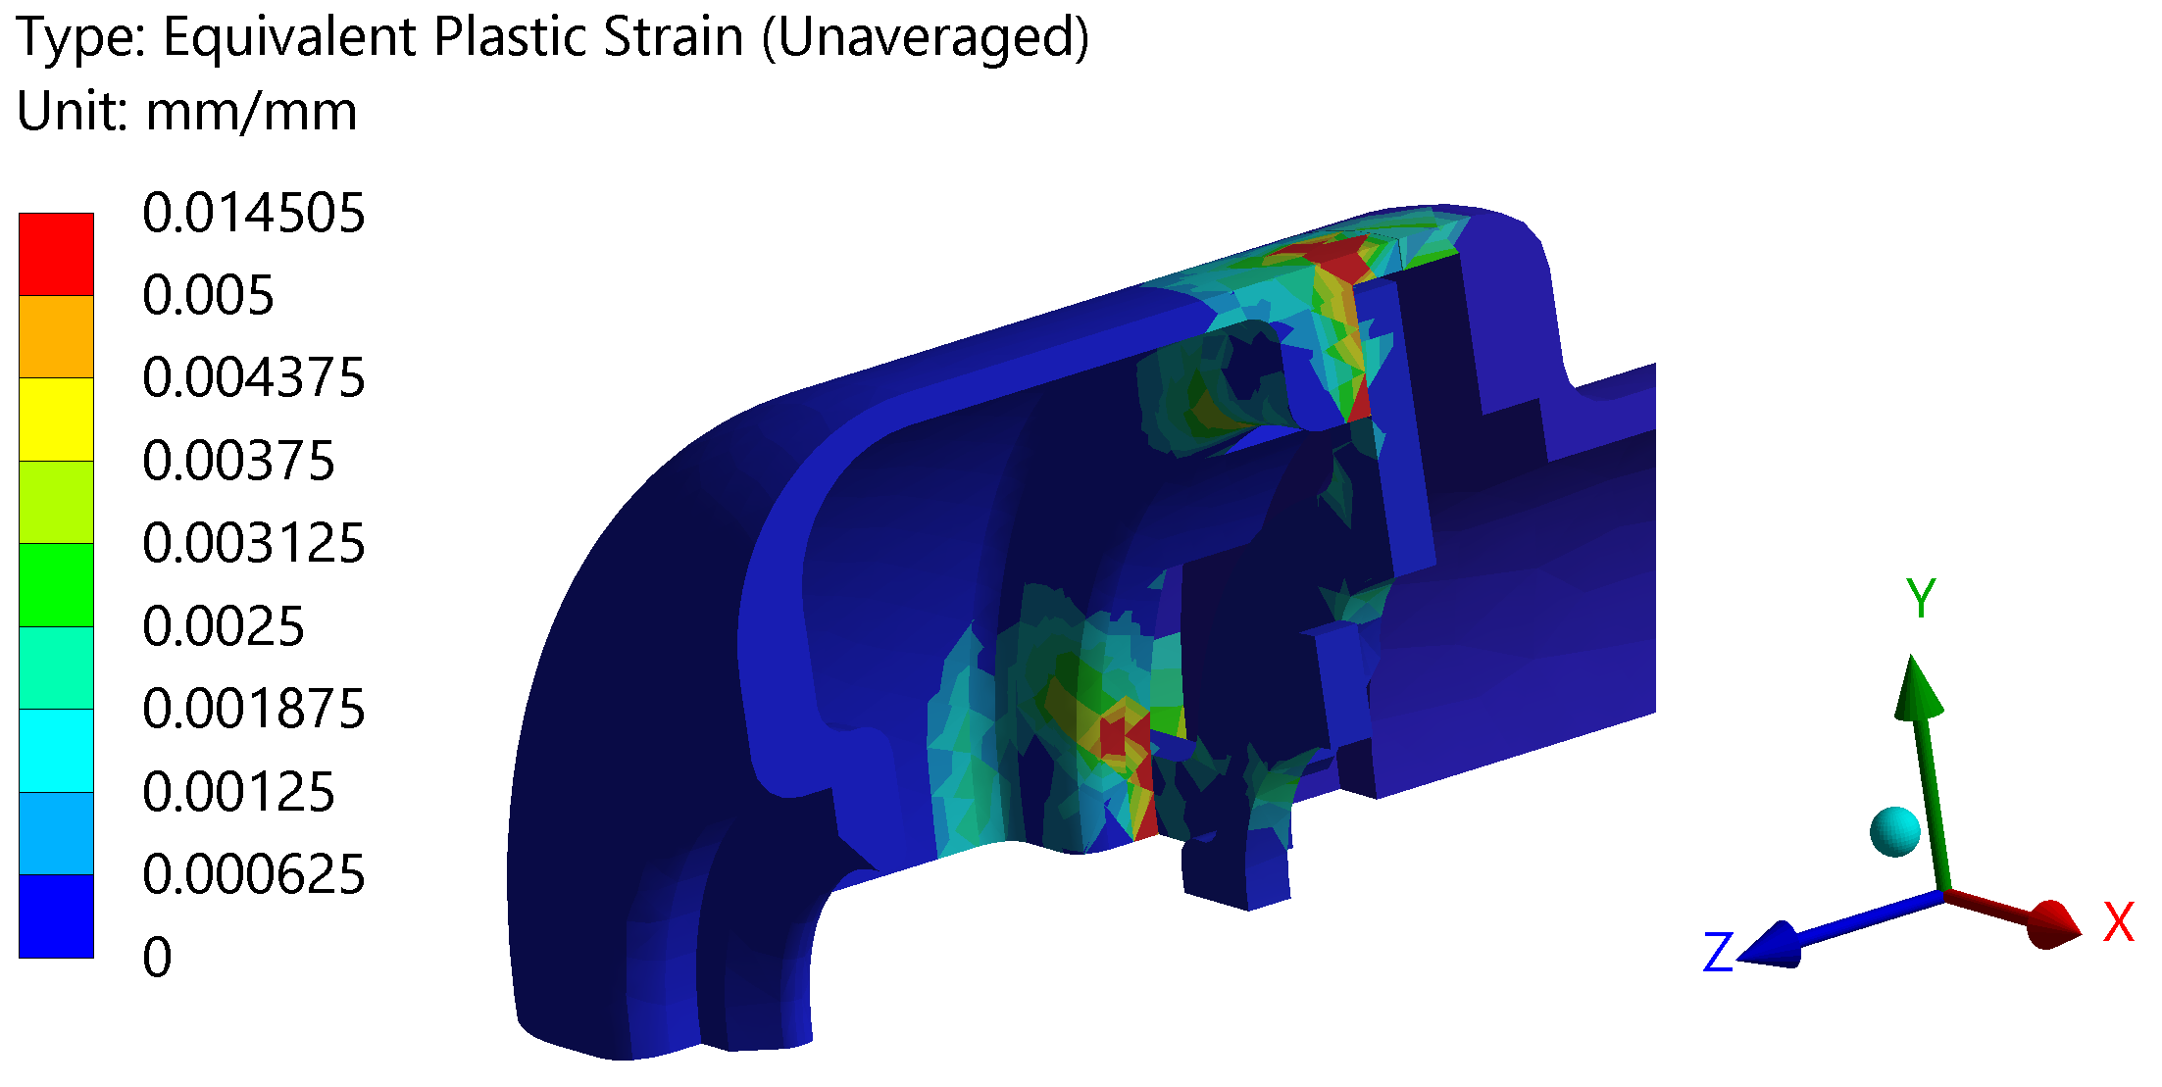
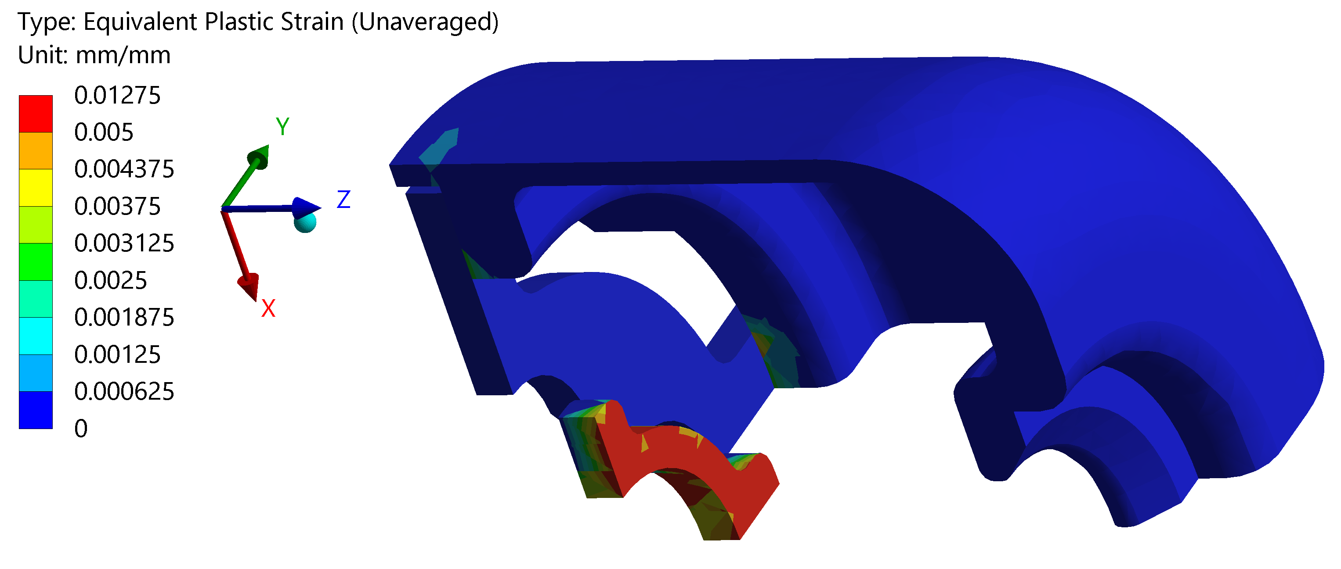
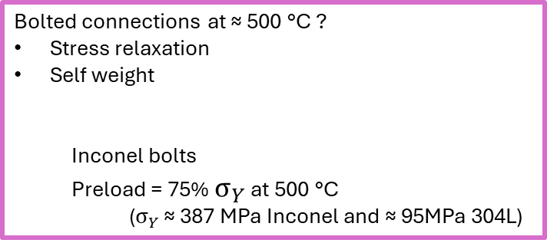
Operation new design – materials
St steel 304L
Molybdenum
Inconel
First cycle
operation 0.793 mm
shut down 0.0078 mm
First cycle
operation 0.9359 mm
shut down 0.01156 mm
First cycle
operation 0.793 mm
shut down 0.00096mm
Tolerance 0.8mm but only at room temp?
What happens in operation?
Bolted connections at ≈ 500 °C ?
Stress relaxation
Self weight
  Inconel bolts
  Preload = 75% $σ_{Y}$ at 500 °C
  ($σ_{Y}$ ≈ 387 MPa Inconel and ≈ 95MPa 304L)
Stabilization
3 % < 50 % Inconel elongation

Slide 4
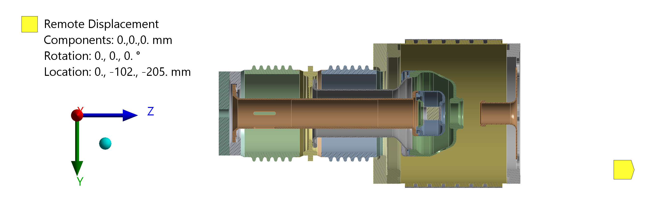
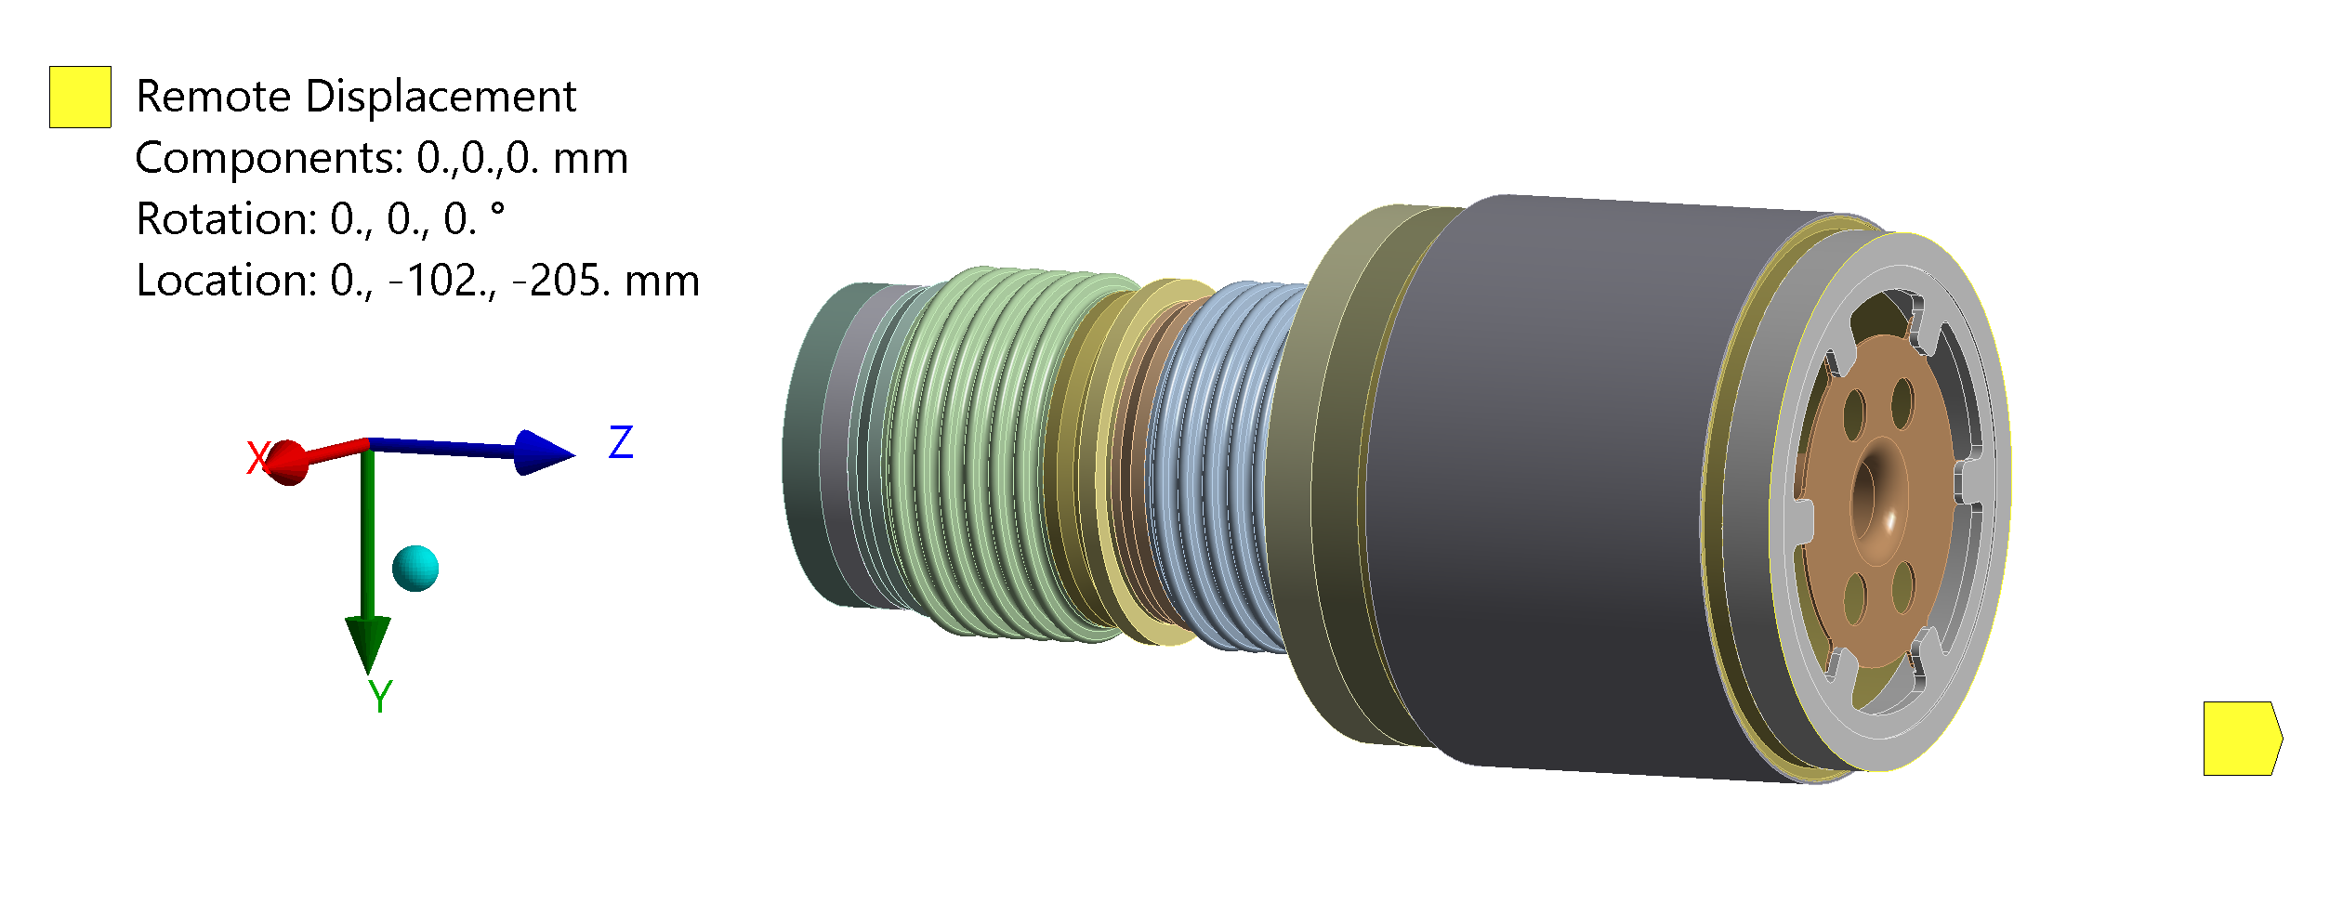
Bake out - 250 °C
Boundary conditions

Slide 5
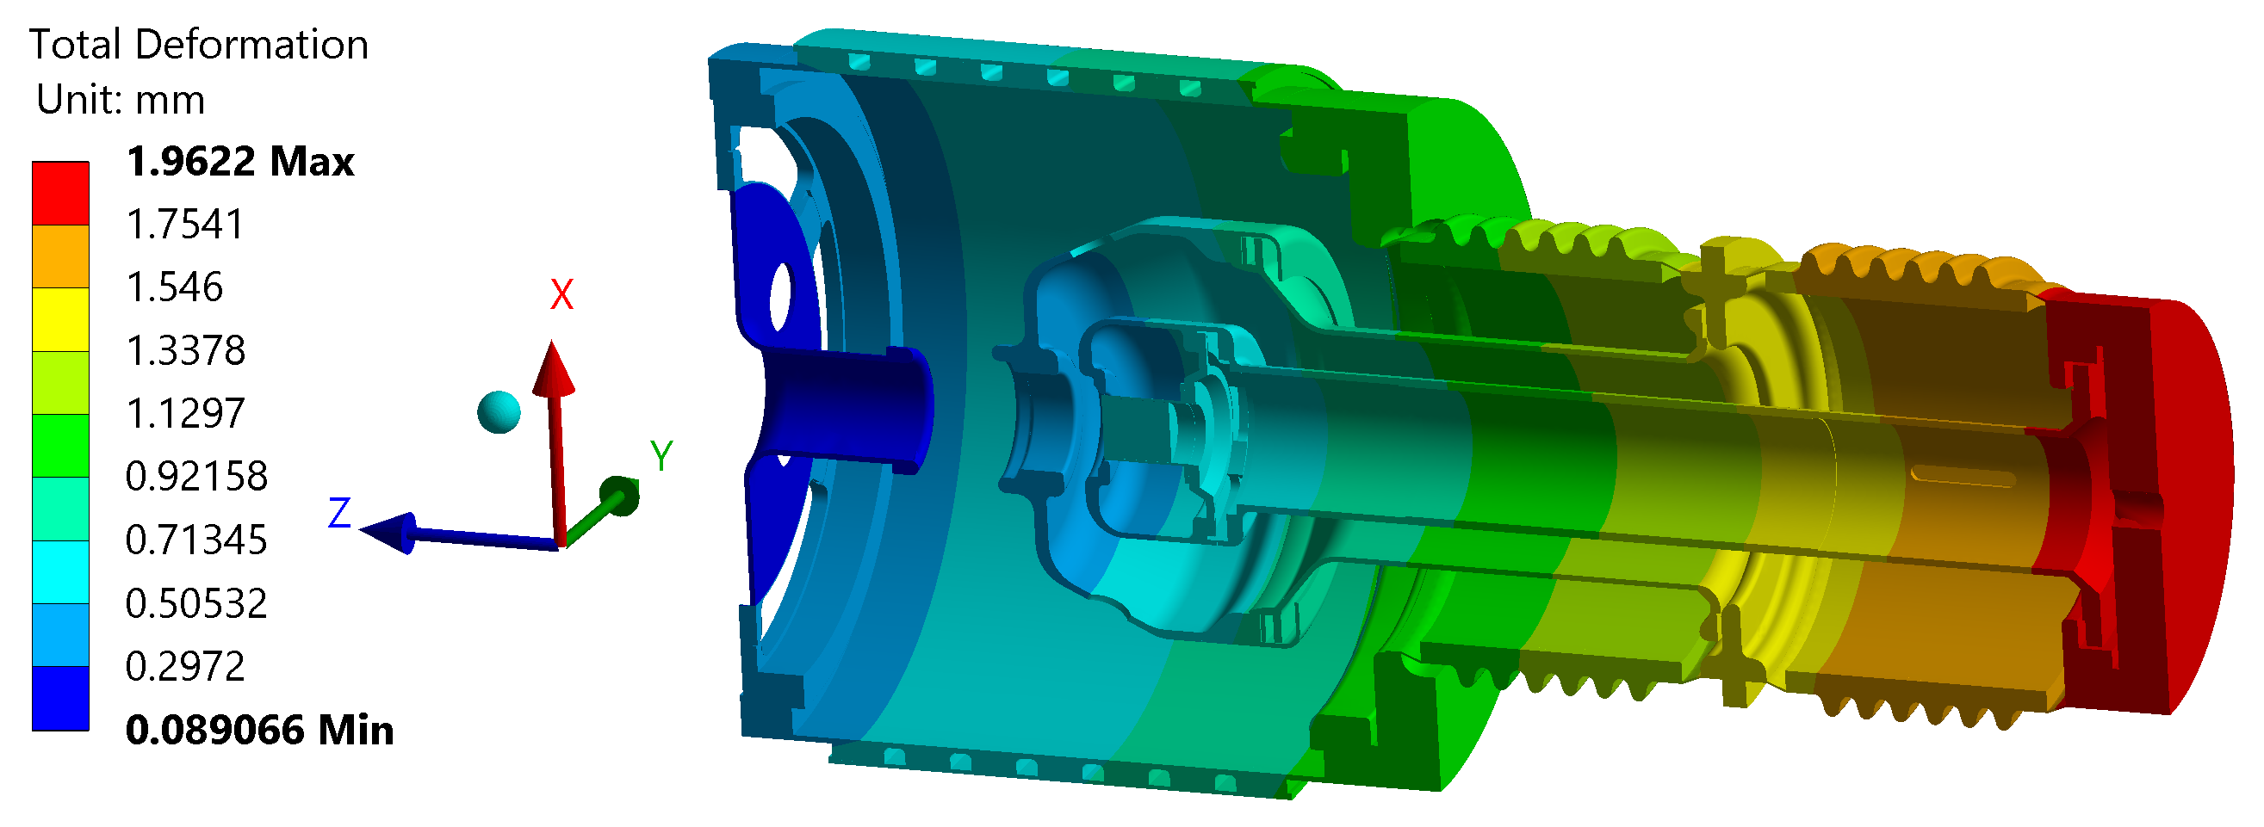
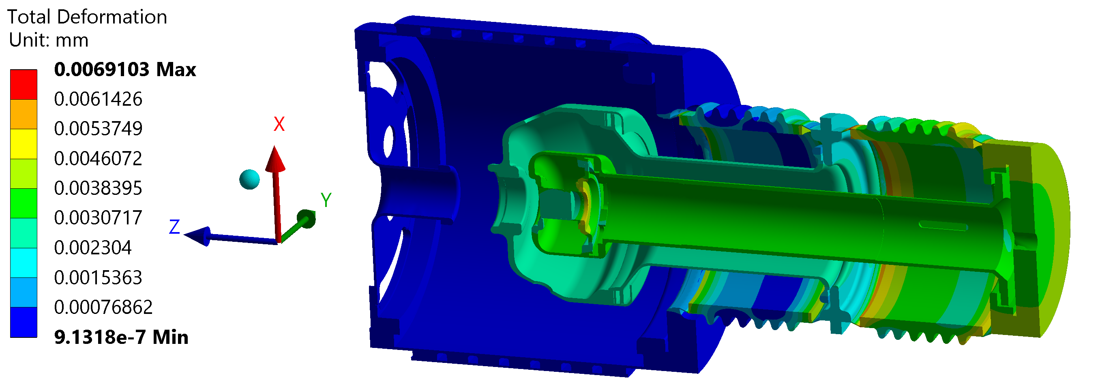
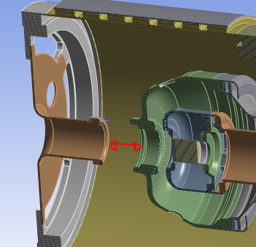
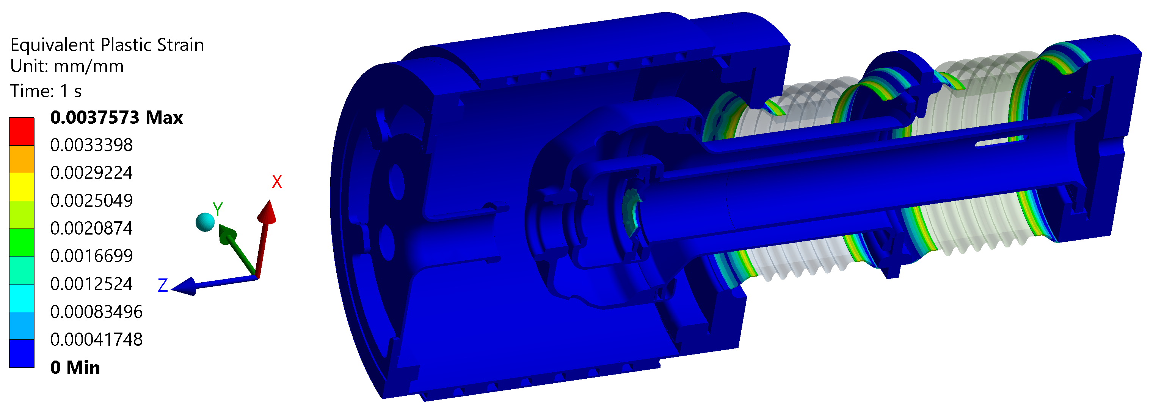
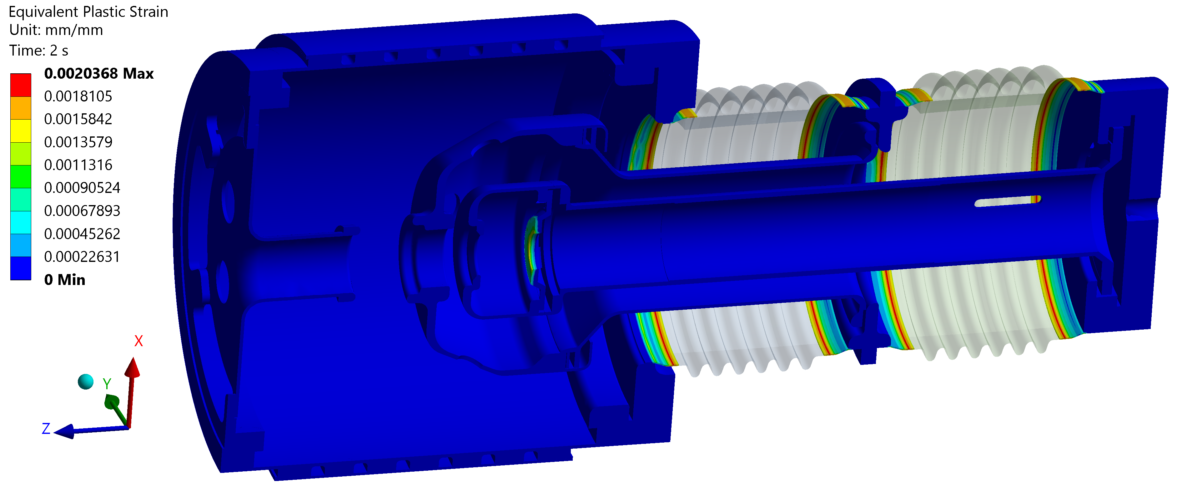
Bake out - 250 °C
250 °C
T room
Relative displacement Z
250 °C: 0.03213 mm
T room: 0.00018 mm
Relative displacement Z
250 °C: 0.04944 mm
T room: 0.00286 mm

Slide 6
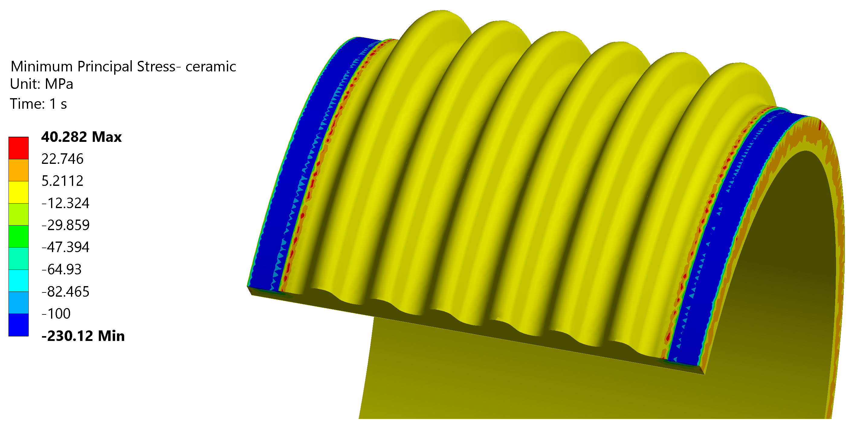
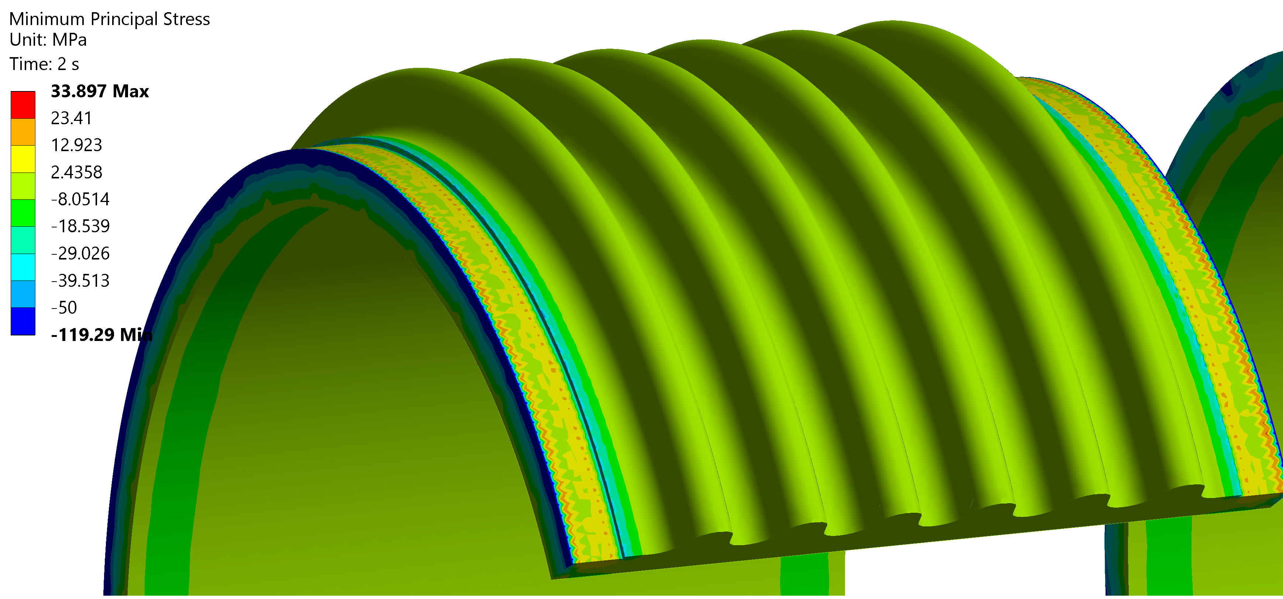
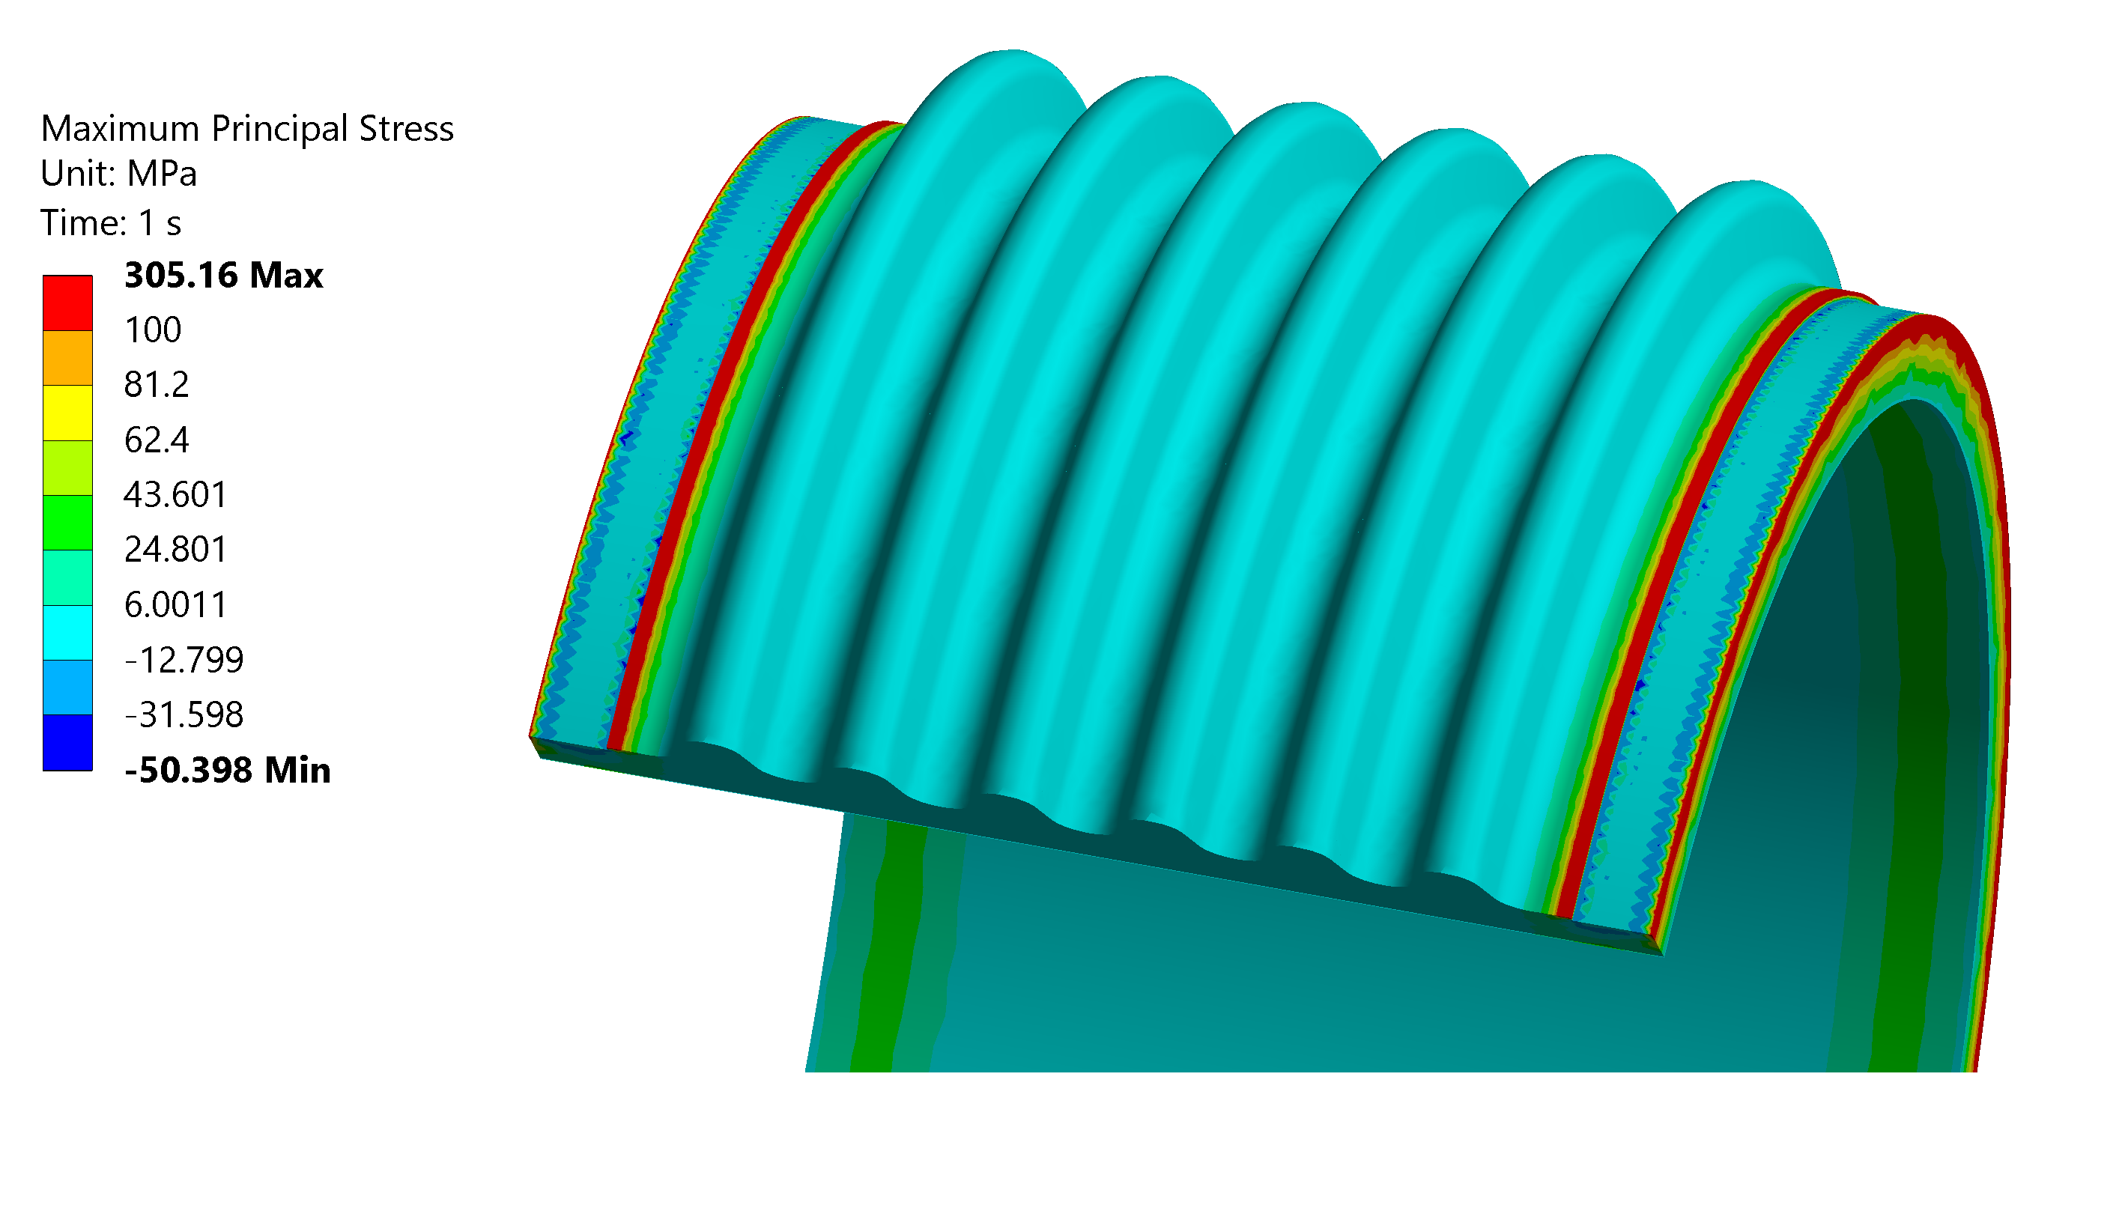
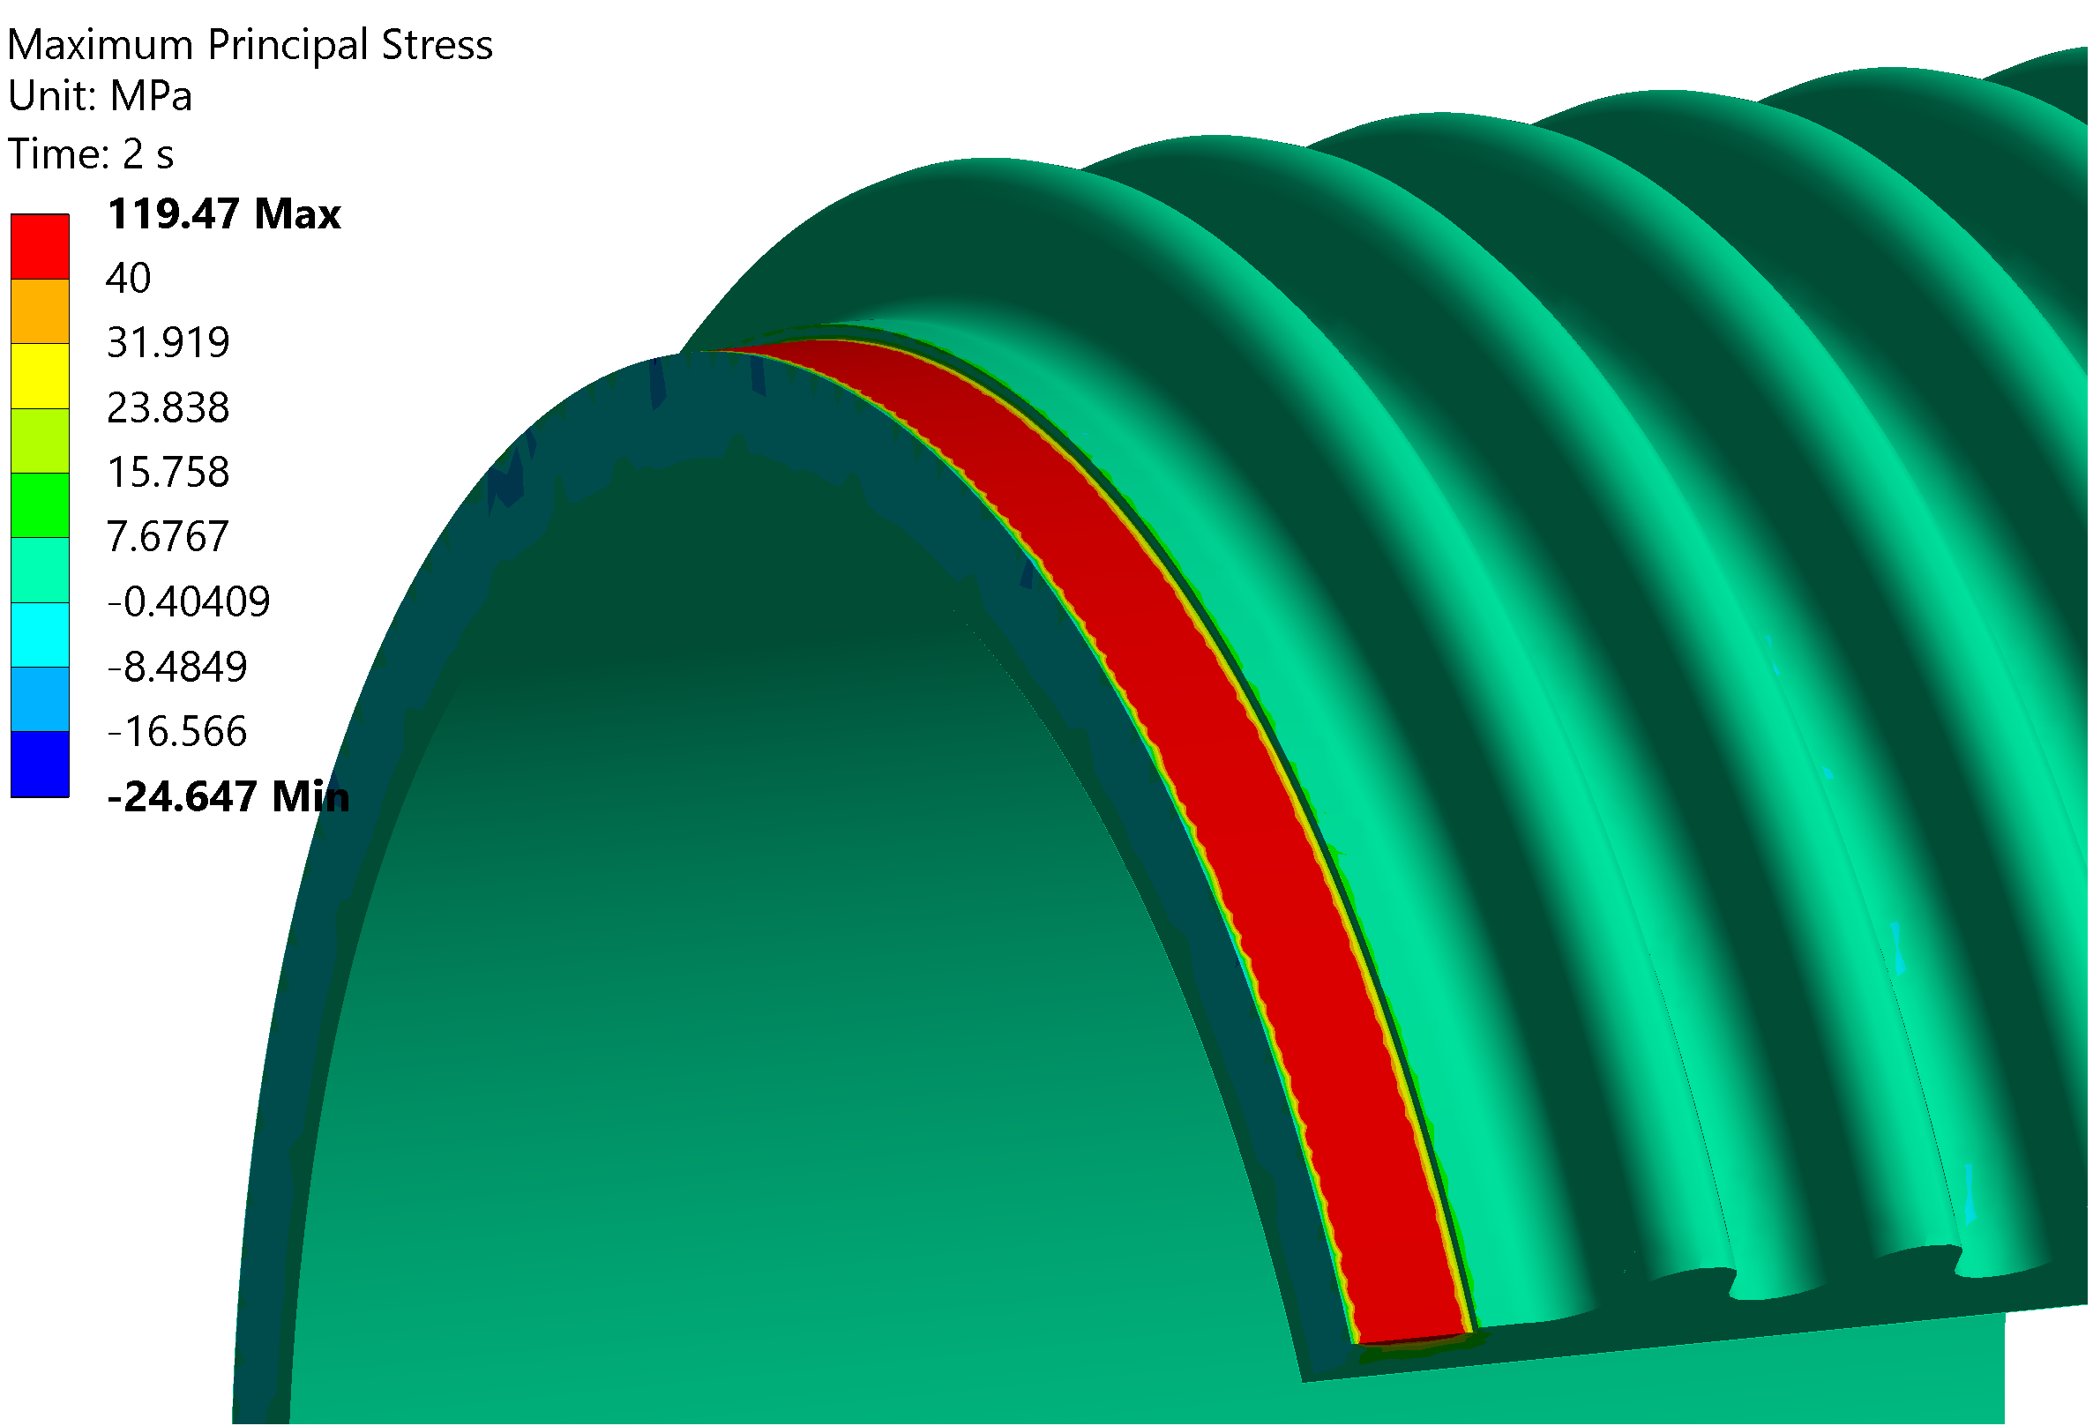
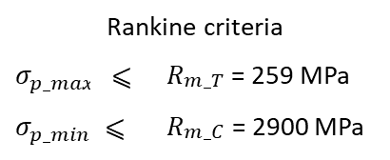
Bake out - 250 °C
Ceramics with invar collars
250 °C
T room
Rankine criteria
$$σ_{p_max}$$ | ⩽ | $R_{\begin{aligned}m_T \\ \end{aligned}}$ = 259 MPa
$$σ_{p_min}$$ | ⩽ | $R_{\begin{aligned}m_C \\ \end{aligned}}$ = 2900 MPa
Attention with sharp edges
Reduce the bake out temp

Slide 7
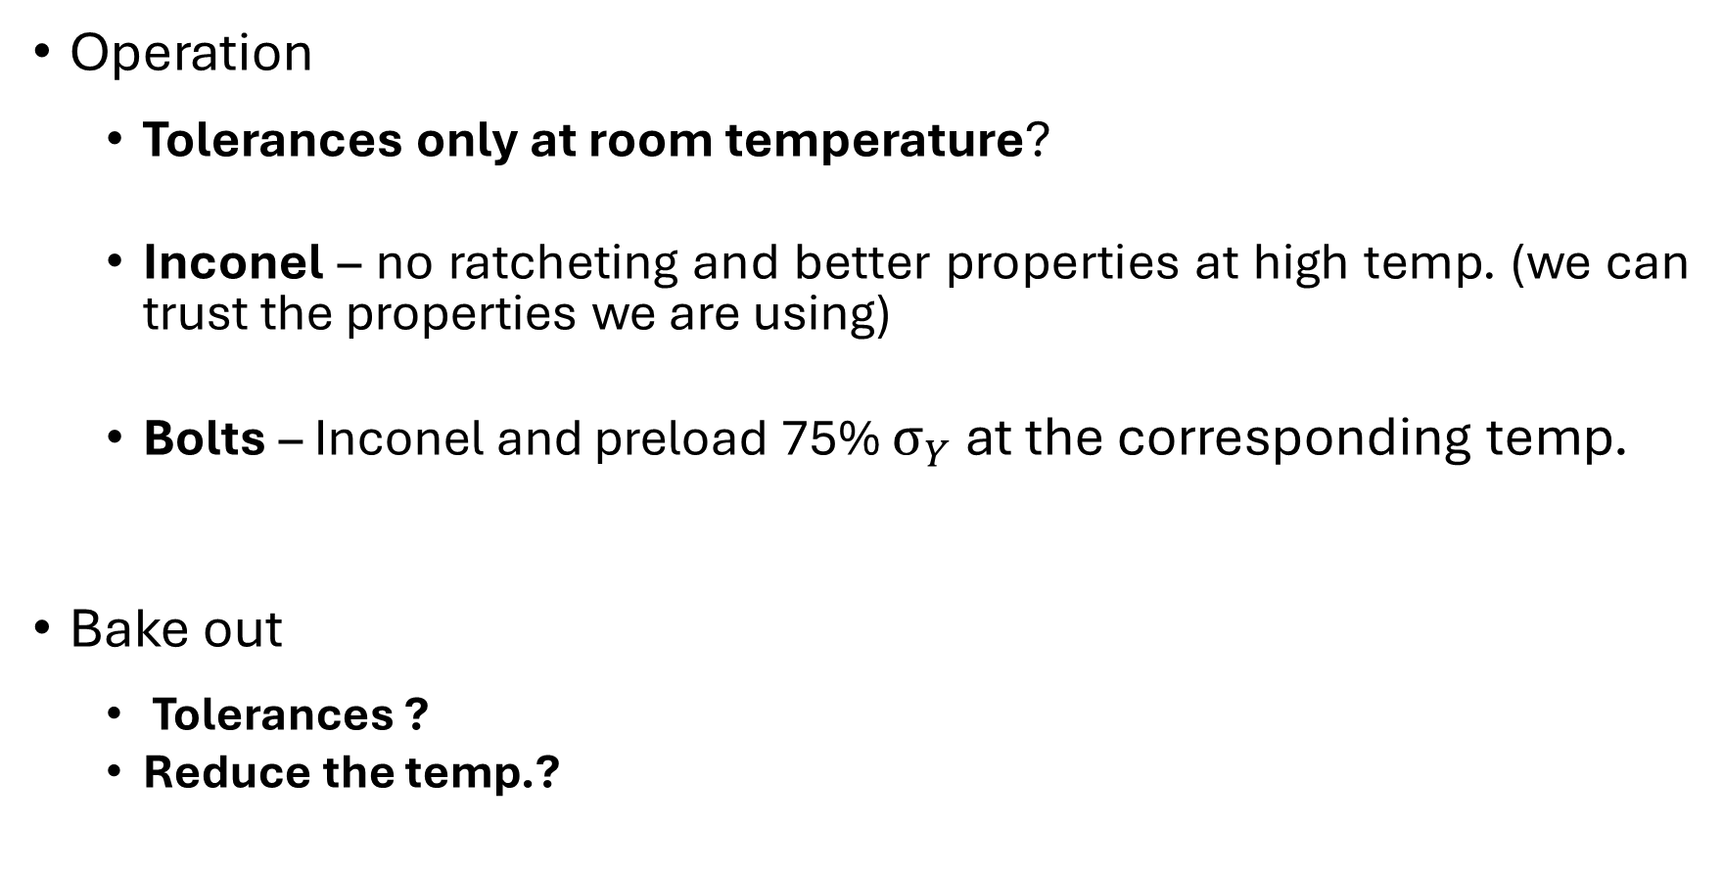
Conclusions
Operation
  Tolerances only at room temperature?
  Inconel – no ratcheting and better properties at high temp. (we can trust the properties we are using)
  Bolts – Inconel and preload 75% $σ_{Y}$ at the corresponding temp.
Bake out
  Tolerances ?
  Reduce the temp.?
First cycle with Inconel
operation 0.793 mm
shut down 0.001mm
Relative displacement Z
250 °C: 0.03213 mm
T room: 0.00018 mm
Relative displacement Z
250 °C: 0.04944 mm
T room: 0.00286 mm

