Slide 1
2025 TS1 planning meeting
A.Tauro

Slide 2
TS1: general information
TS1-2025: 5 days from Monday 23rd June at 6:00 (beam off) to Friday 27th June at 17:00
  LASS modification due to TED issue in TI8: no access between 6:00 AM and 8:00 AM
Ramp down both magnets Monday at 6:00 (ARC) – magnets will be restarted on Friday 12:00 PM.
Stop L3+dipole cooling on Monday → action EN-CV (restart on Friday 10:00)
RP & smear tests on Monday between 8:00 and 9:00 (Andre)
  Cooling sample collection (by HSE-RP) agreed with EN-CV
Access starts Mon at 9:00
Access condition: Restricted Automatic (access with key)

Slide 3
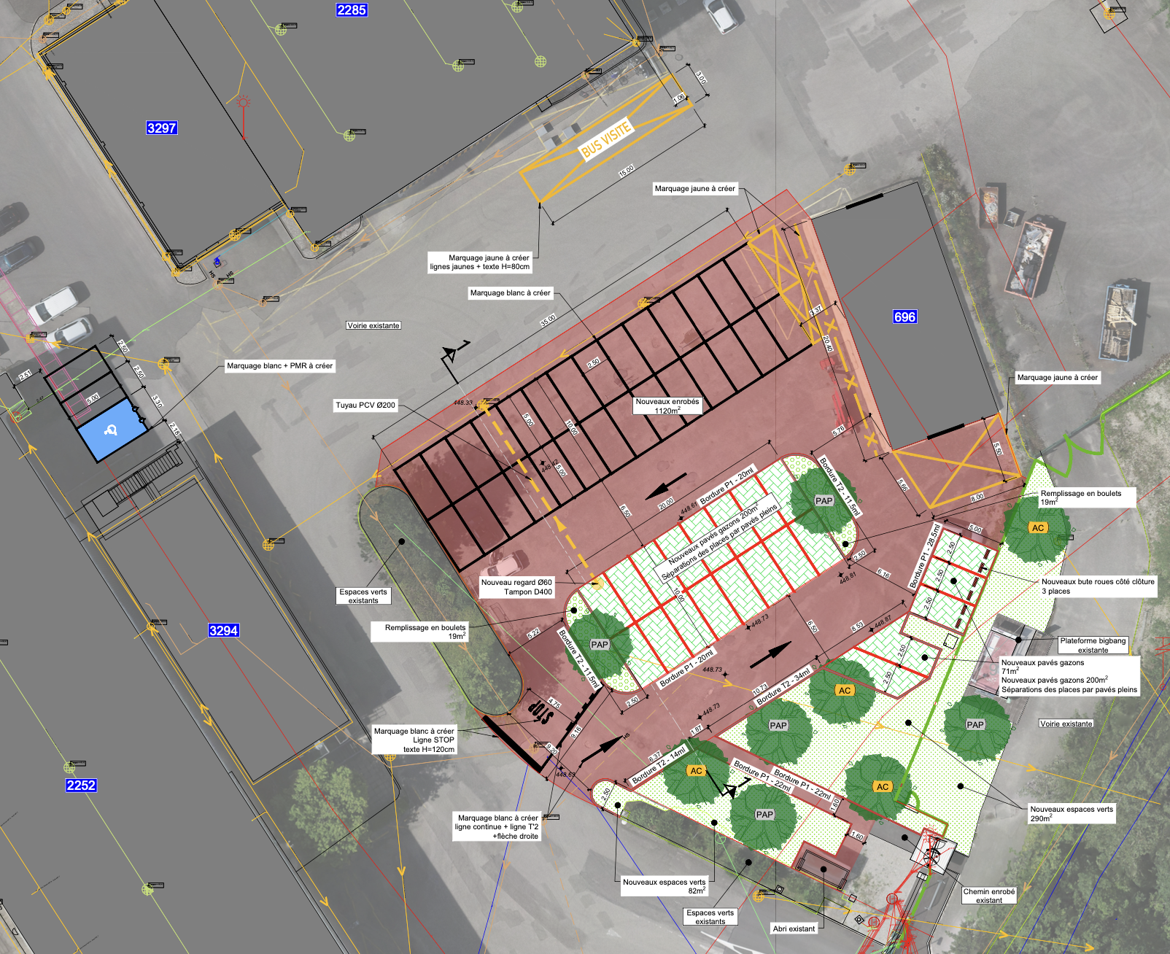
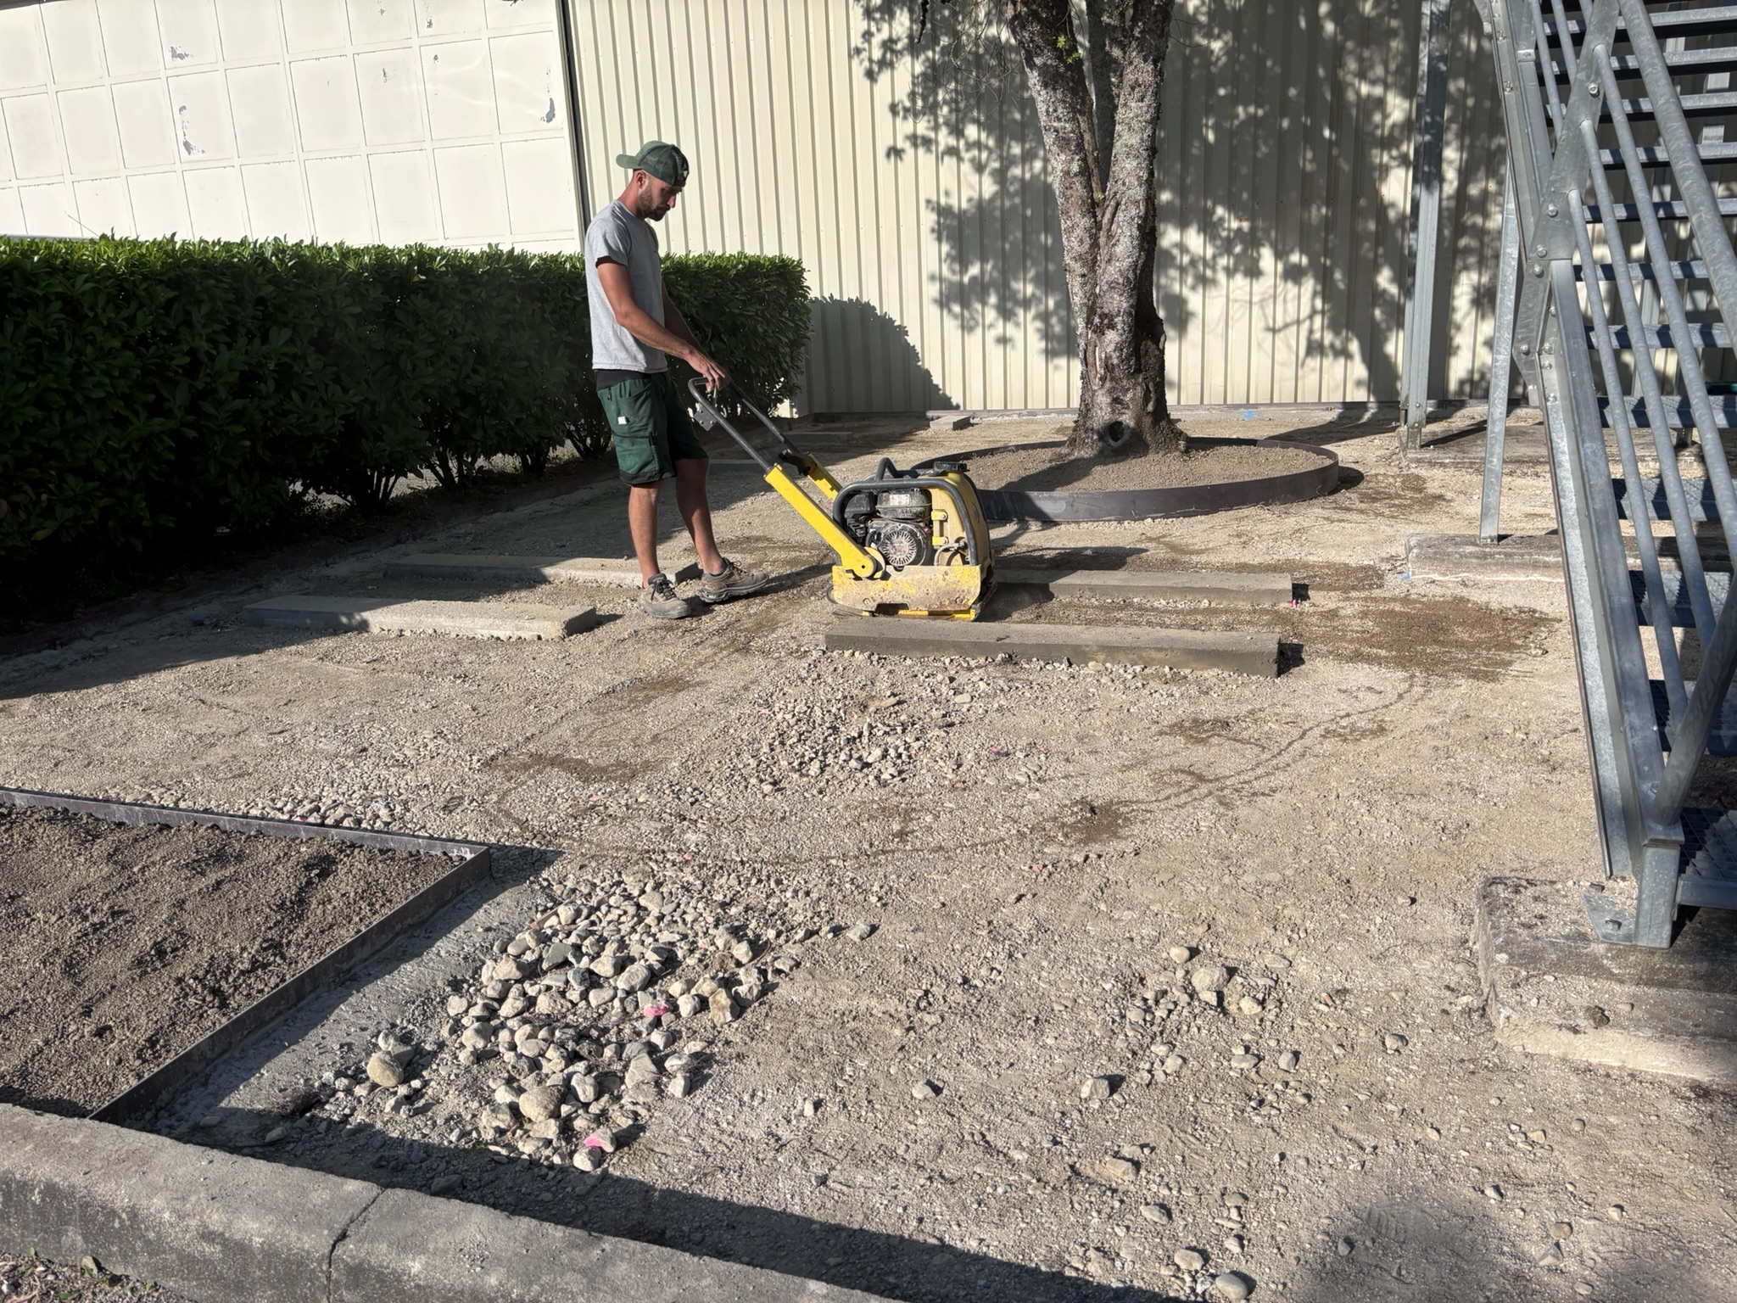
P2 parking renovation
Renovation P2 parking area:
  The large P2 parking area will be renovated during weeks 26, 27, and 28.
  Floor marking: September
  Green areas: end September/October
  During this period, shifters will need to park their cars in alternative locations. Please be also aware of the noise generated by these works.
  Parking already fenced off
The rest area behind b.3294 is being installed.

Slide 4
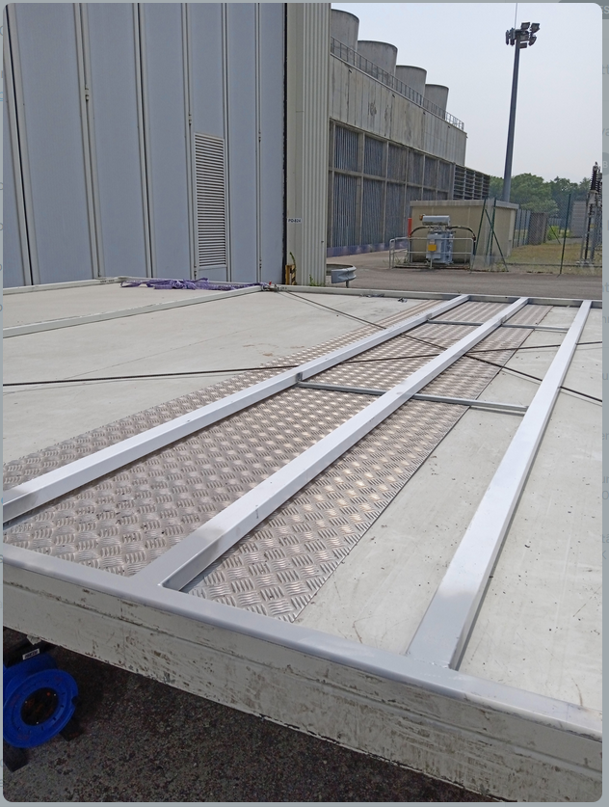
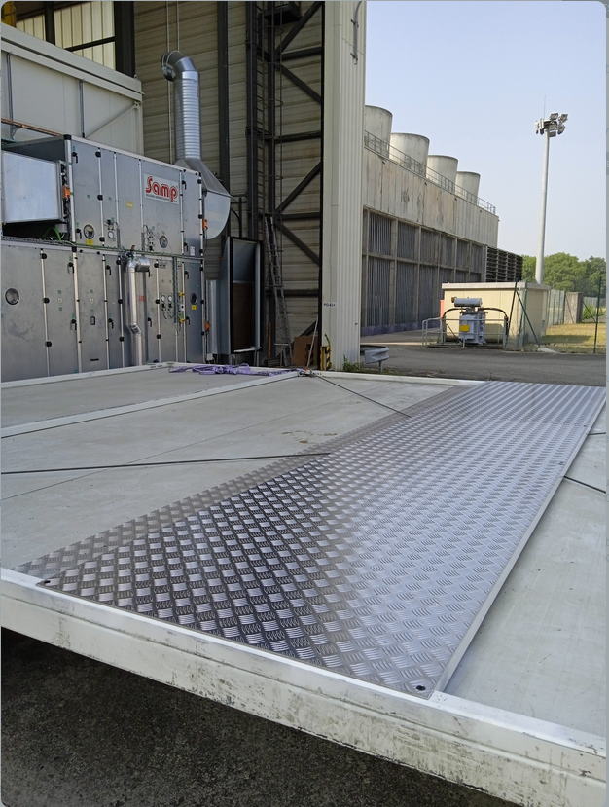
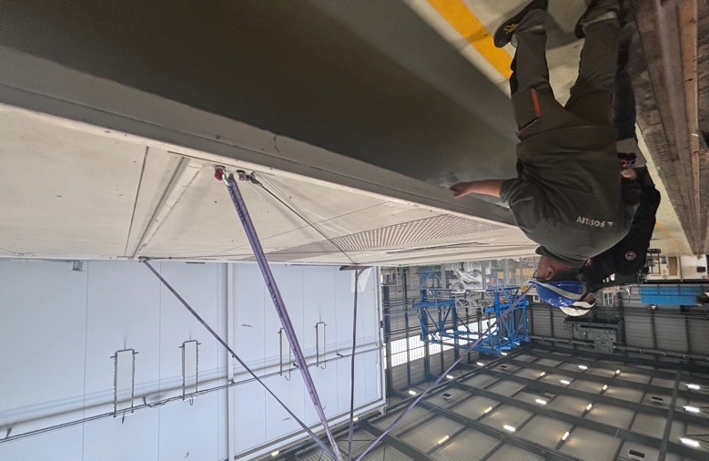
Cleanroom roof panels consolidation
Cleanroom roof consolidation
  → Done in w24

Slide 5
DCS
Usual backup of the DCS on Monday, starting at 9:00.
  DCS will be unavailable for approx. 2hrs
  Already agreed with RC
André

Slide 6
Detector’s activities
ITS: patch cord replacement and CAEN power module replacement
TPC: inspect the last resistors for the guard ring chains of the TPC field cage on the A and C sides. Maybe we will also open some sectors and check fibres.
TOF: maintenance activities: cooling, DRM2 to be changed
TRD: Wiener PSU inspection
FIT:
  FV0 PM clone tests
  Inspect one misbehaving FT0 HV channel and several FEE channels.
  Short miniframe access on Friday 8:30 – 9:00
FDD: inspection of the status of FDD A for documentation
MCH:
  Fix accessible readout issues in Station 1 and 2
  Fix faulty LVPS that tripped off the rack C09
  Cleanup a few fibers (unstable readout)
MID: replacement of ethernet hub
Muon nacelles will not be needed during TS1 → reinstallation of batteries not foreseen

Slide 7
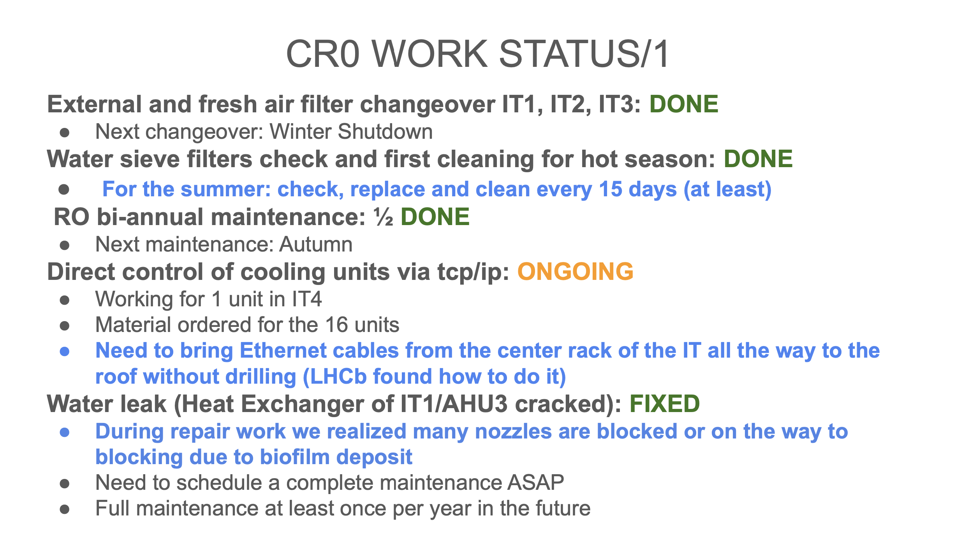
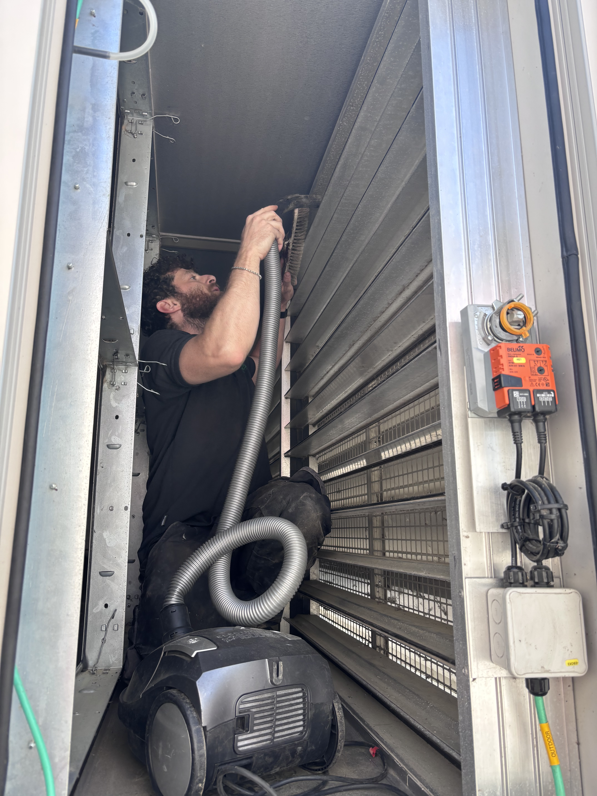
Federico

Slide 8
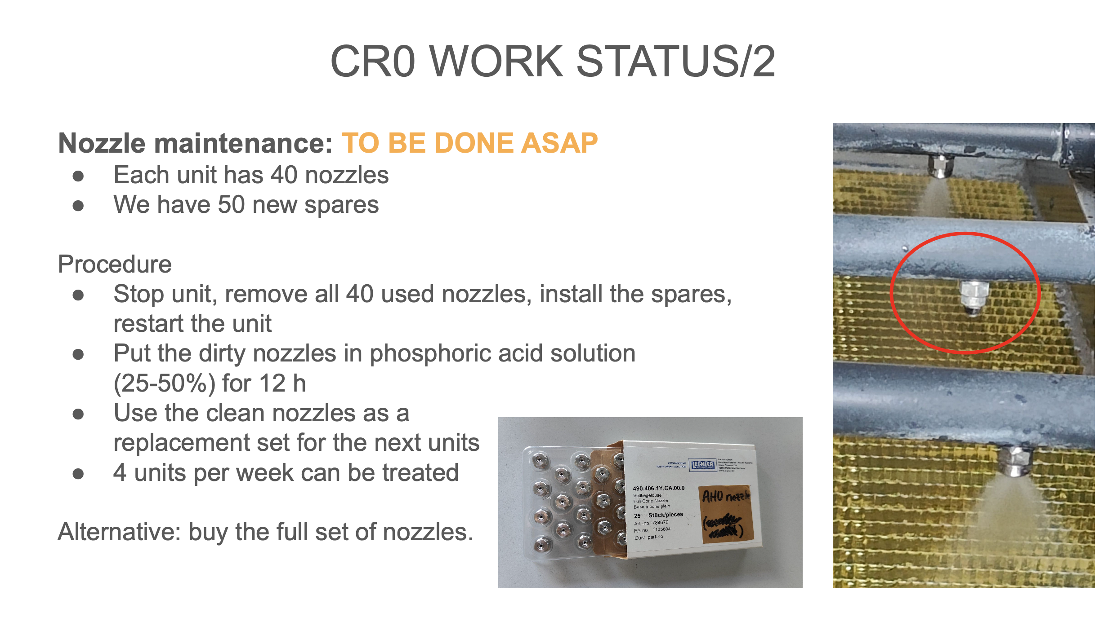
Federico

Slide 9
Other activities
EN-EL: investigation 48V isolation issue on SE2 – Monday afternoon
Blimp flight test with magnets ON, on Friday 13:00 – 16:30 (Elisa)
Robotdog camera test on the stairs (Elisa)
LHCif BCM: Verify CFC card calibration by current injection (Uli)
IT: visit replacement telecom cables (Tuesday 15:30 tbc)
IT-CS: Red phone lines survey
EN-AA: SNIFFER intervention (Réglage Dérives Détecteurs ODH)
HSE-FSR: ALICE Defibrillators' Maintenance

Slide 10
P2 technicians
Replace broken L3 lights (Philippe, Julien)

Slide 11
Gas (EP-DT)
MID:
Swap the running pump
Change the membrane in pump that is actually in run
Fill the humidifier → gas system stop about 10-15 minutes
Put thermal paste around the thermal sensor of the purifier
MCH:
Fill the humidifier (no need to stop)
Analysis Chain 3: put in permanent position the new H2O analyser
TRD: leak search and small operations around purifier
Louis-Philippe/Mattia

Slide 12
EN-CV activities
Data center:
  Connection to tap water (done w24-25)
  Replacement air filters (done w25)
  Cleaning water spraying system (w27)
Visit with contractor for LS3 projects
TOF: chemical analysis
FOCal: visit to finalise cooling pipes routing
Florent/Olivier

Slide 13
AOB
---

