Slide 2
FCC damping ring
circumference considerations
H. Damerau, H. Bartosik, I. Karpov
20/05/2025

Slide 3
FCC pre-injector complex
Sources and linacs → damping ring at 2.86 GeV → high energy linac: 2.86 GeV to 20 GeV → booster → FCC collider
Paolo Craievich, Chamonix 2025

Slide 4
Introduction
FCC requires flexible top-up filling schemes, e.g. to
mitigate e-cloud, see Hannes’ slides
Assumptions:
  Injection possible into any bunch position in booster/FCC
  Damping ring damps multiple batches (four bunches spaced by 25 ns) simultaneously
Cog-wheeling between damping ring and booster/FCC
Impact on choice of damping ring size?
Number of batches orbiting at the same time in damping ring?
Consequences for pulsing the linacs?

Slide 5
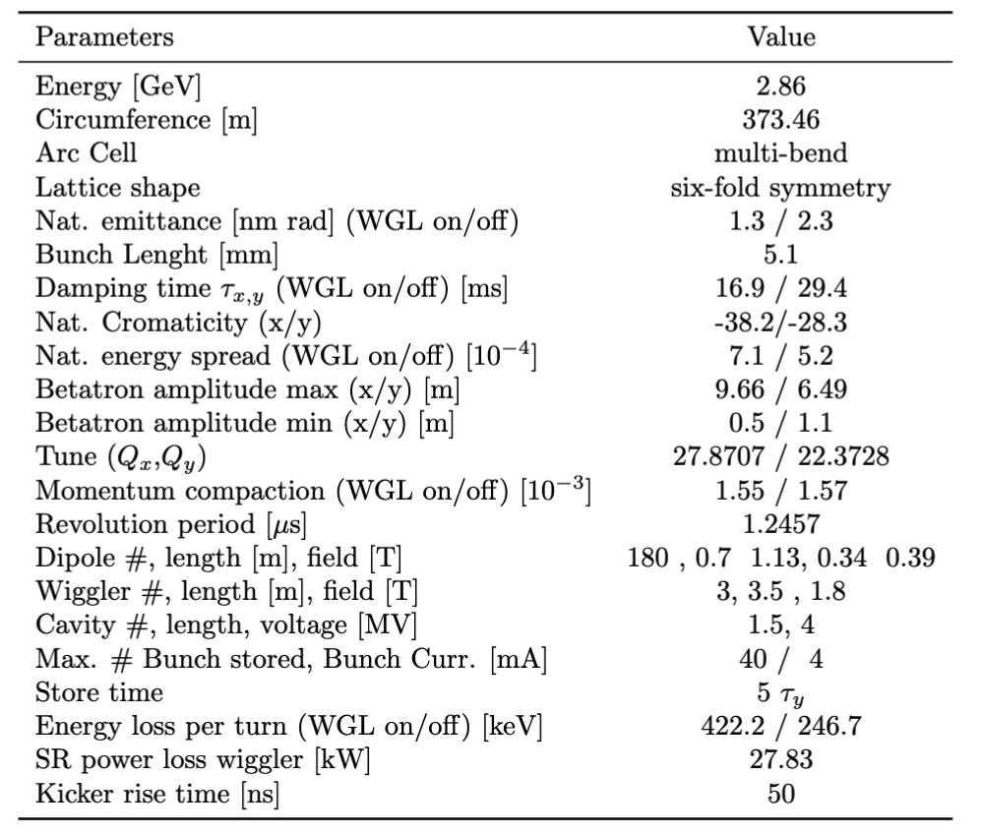
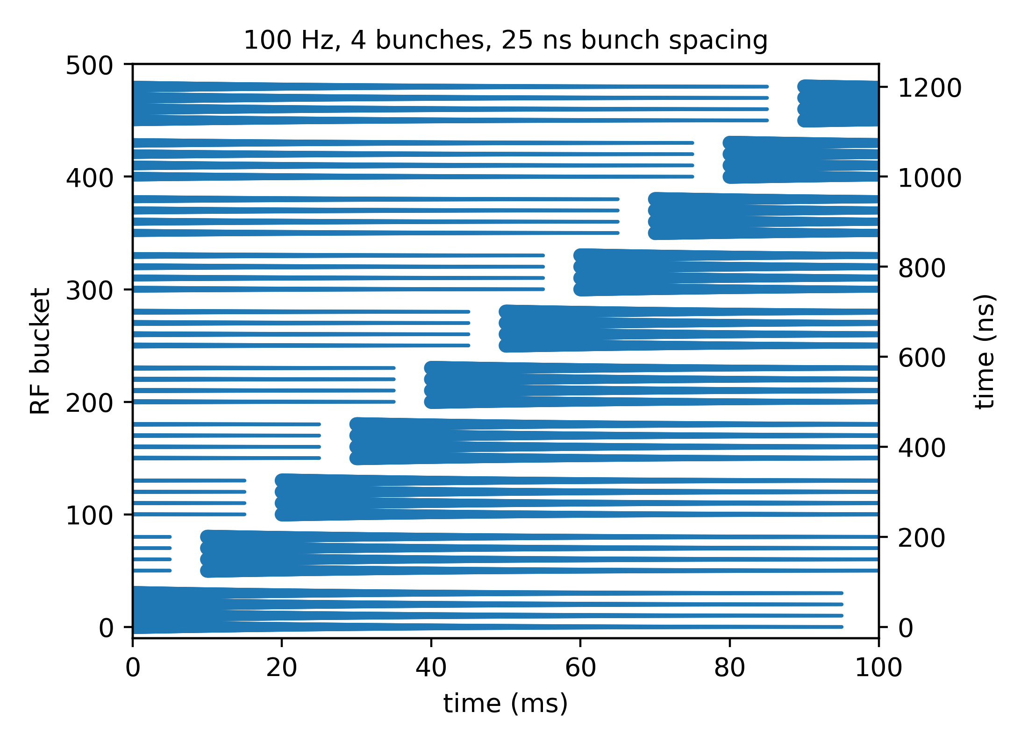
Damping ring operation
Multiple batches circulating simultaneously
Hannes Bartosik, FCC Week 2024
FIFO principle
storage time ~95 ms
Paolo Craievich, Chamonix 2025 and
Feasibility Study Report

Slide 6
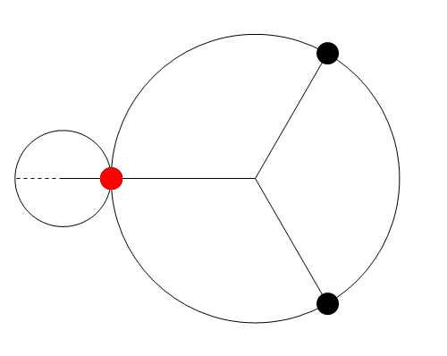
Integer ratio of circumferences
Integer ratio, r = C_{FCC}/C_{DR} of circumferences
  Only r azimuthal positions can be reached
  Transfer possible at each turn of the FCC booster
  Displacement or cogging/rephasing in the damping ring by up to ± 180°

Slide 7
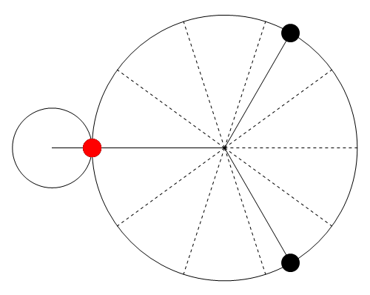
Rational ratio of circumferences
Rational ratio, r = C_{FCC}/C_{DR} = m/n of circumferences
  About n times more azimuthal positions can be reached
At expense of transferring only every n turns of booster
  ‘Jitter’ from zero to n turns → pulse linacs non-periodically
  Displacement in damping ring reduced to ~ ±180°/n

Slide 8
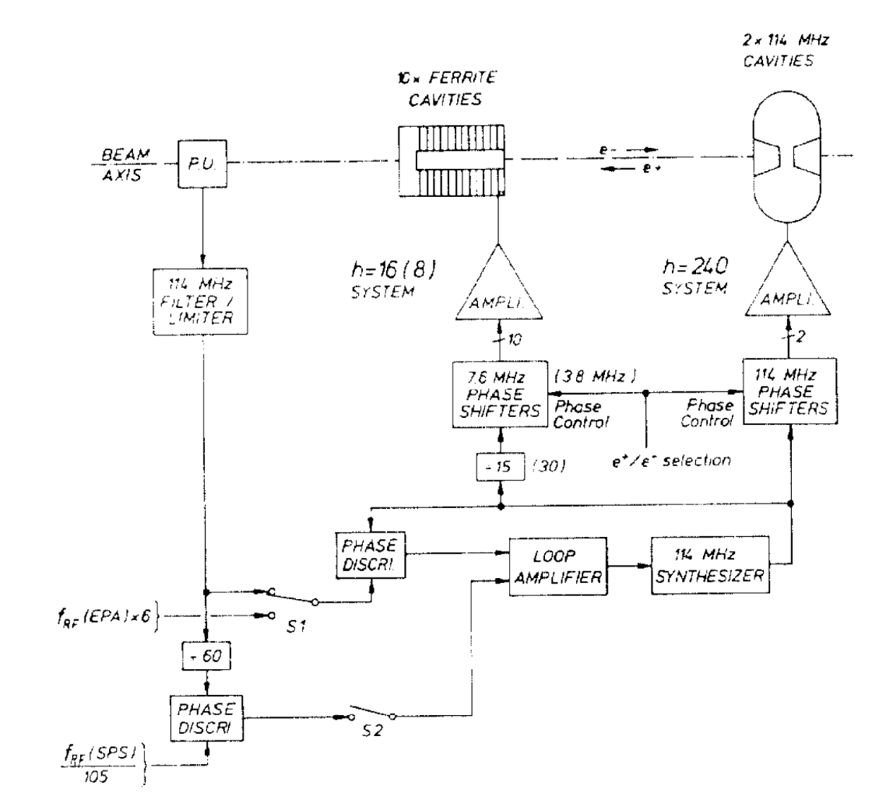
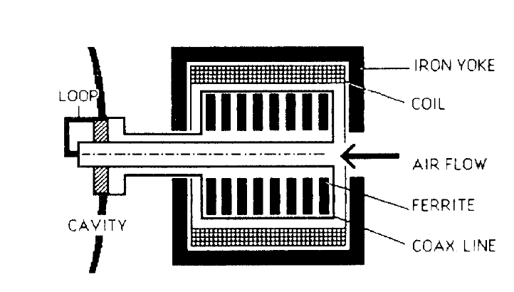
Cogging during LEP era
Cogging applied for transfer between PS and SPS as injectors for LEP
Transfer of two sets of bunches with re-phasing in-between
Orbit displacement due to RF frequency ‘modulation’
Not suitable for low-emittance damping ring
114 MHz cavity tuner
B. J. Evans, et al., PAC87, p. 1901
±10 KHz tuning range

Slide 9
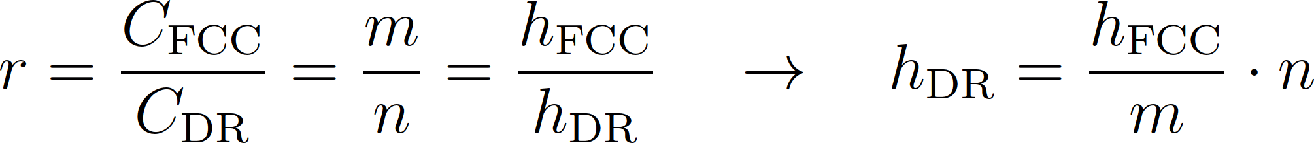
Fixed RF frequency schemes
Constant RF frequency in damping ring, booster and FCC
Coarse positioning of bunches by cog-wheeling
Fine positioning by displacing batches in damping ring
Clean solutions allow f_{RF,FCC} = f_{RF,DR} and 25 ns spacing
Assume h_{FCC} = 12120 → h_{RF} = 121200/10 → bunch position units
12120 = 2³∙3∙5∙101 must be dividable by numerator of C_{FCC}/C_{DR}

Slide 10
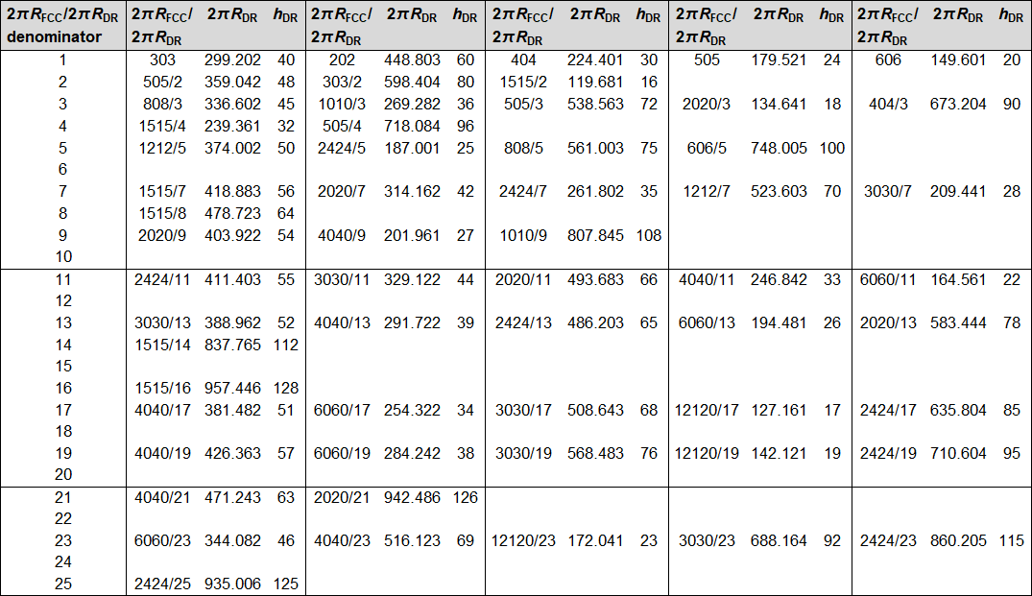
The closest circumference ratio options
Options close to present damping reference circumference: 373.46 m
Not many options in the relevant circumference range

Slide 11
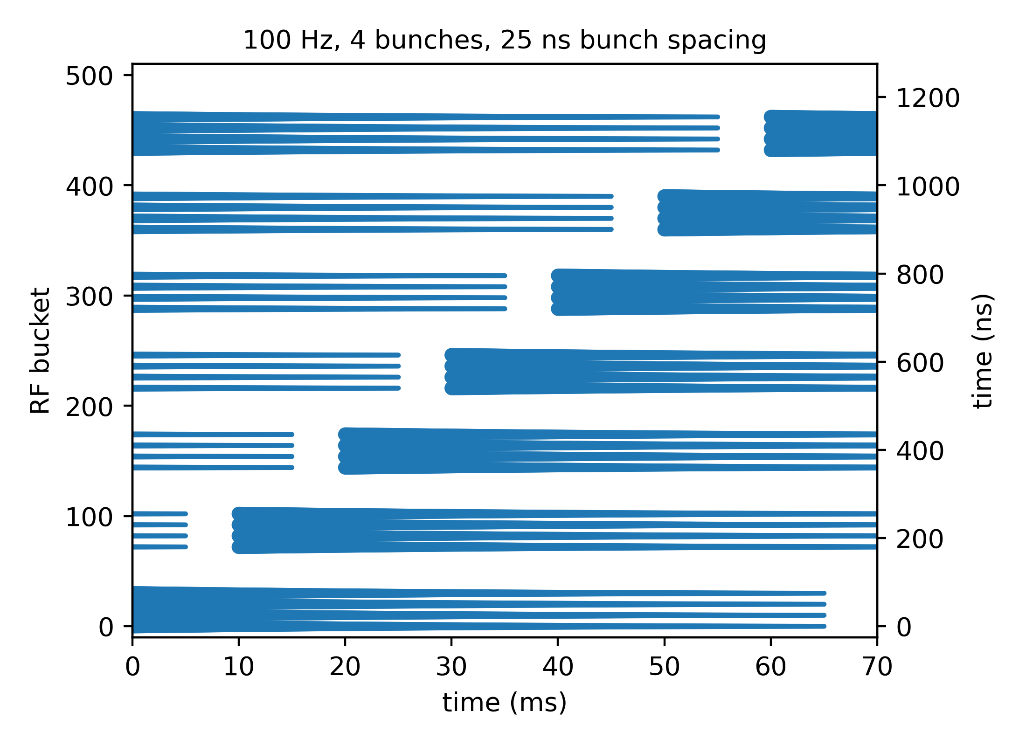
Flexibility of placing batches in damping ring
Inject each batch in the damping ring with pre-determined bunch position offset
Cog-wheeling then reaches
final bucket in booster/FCC
Cogwheeling can reach every h_{DR}/Denominator(C_{FCC}/C_{DR})^{th}
bucket position
  For example: C_{FCC}/C_{DR} = 4040/17 → h_{DR} = 51 → Every 3rd position reachable
Remainder must be set by displacing batches in damping ring
  Example sub-patterns: bbbbssk, sbbbbsk or ssbbbbk (k: kicker gap, 50 ns)

Slide 12
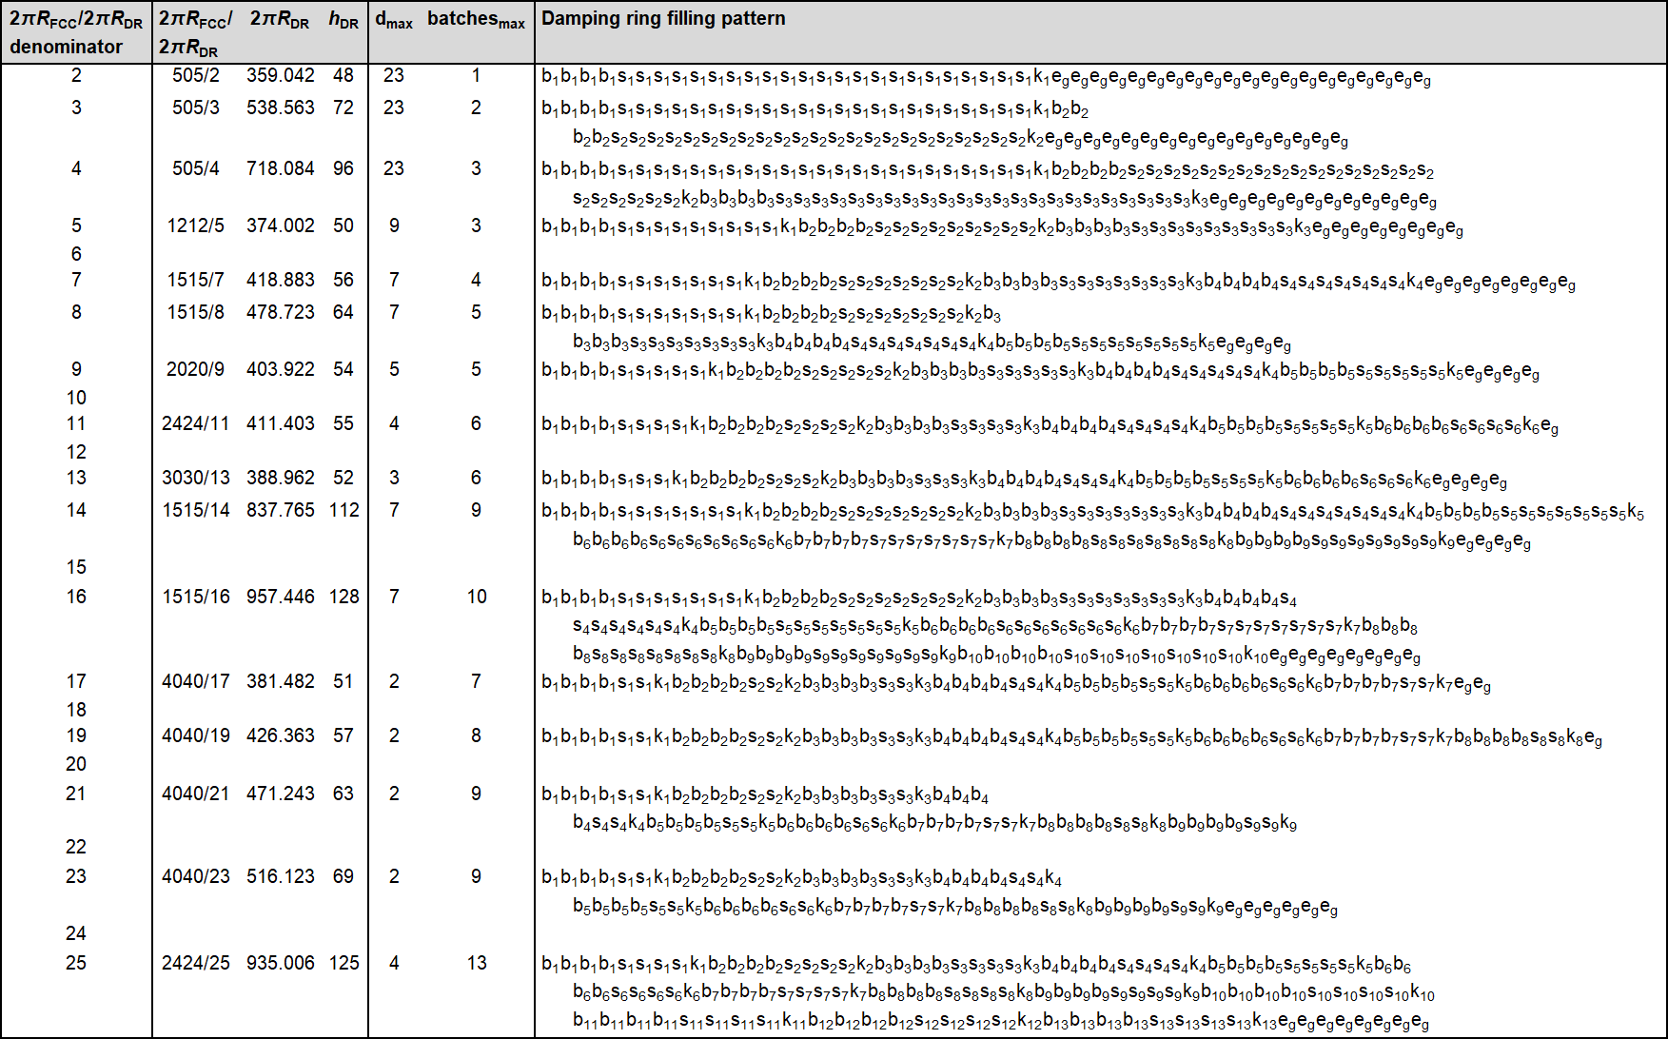
How many batches do fit into the damping ring?

Slide 13
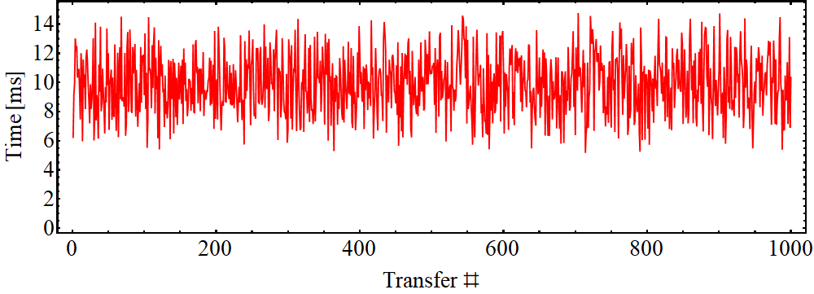
Consequences for linacs
Damping ring → booster transfer cannot take place every turn
Cog-wheeling in correct only every Denominator(C_{FCC}/C_{DR})^{th} turn
Although average repetition rate can be 100 Hz, linacs must pulse non-periodically
Simplified model for time between two transfers/linac pulses
Time
10 ms
n booster/FCC turns
Transfer
linac pulse
Example:
C_{FCC}/C_{DR}
= 4040/17
Preliminary
Random bucket positions

Slide 14
(Preliminary) conclusion and outlook
Circumference of damping ring in present scheme
  Very much constrained by synchronization scheme
  Not much freedom also for number of batches
Two-step process: Cog-wheeling and pre-positioning in damping ring
Constant RF frequency and orbit in damping ring
Flexible filling scheme pre-calculable from source (bucket counting)
Reduced number of maximum batches in damping ring
Non-periodic pulsing of linacs
Flexibility of damping ring circumference? Range?
Consequences for linac design?
Alternative options?

