Slide 1
NA CONS WP3.1 - Half-year status
3.1.1.3 General Cons BTV
3.1.1.10 BTV230925
S.Burger
2025_06_25

Slide 2
Status BTV230925 Consolidation Project
Work Unit 248567 – PRIMARY-CONS : BTV230925 upgrade
ECR draft was sent to Sonia (SPS) & Giulia (NA) few months ago
It now depends on the validation of the magnet replacement to have the latest differential views (Integration/F.Galleazzi). If this takes again more time, we will circulate the ECR without the latest vacuum interface, mentioning that it has no impact on our design/integration
Will soon be circulating (Frederic is finalizing the differential views)
Main parts:
BTV mechanical design → done (MME)
BTV optical line design → partially done (Vincent)
We are asked to spend money which could be done already from Feb or March, but I will not launch costly fabrication without the ~green light given by the ECR
(what is the status?)

Slide 3
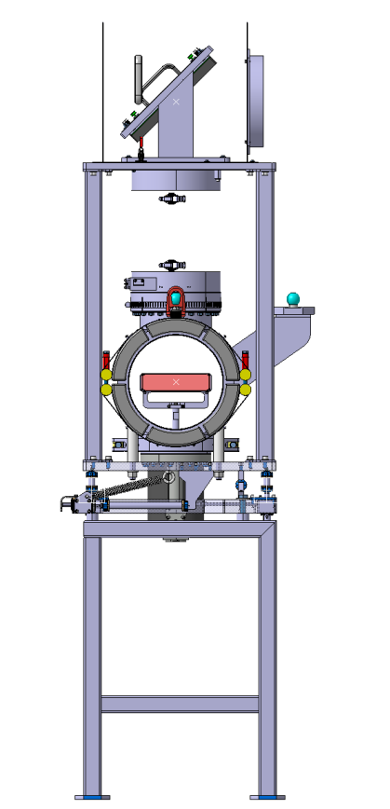
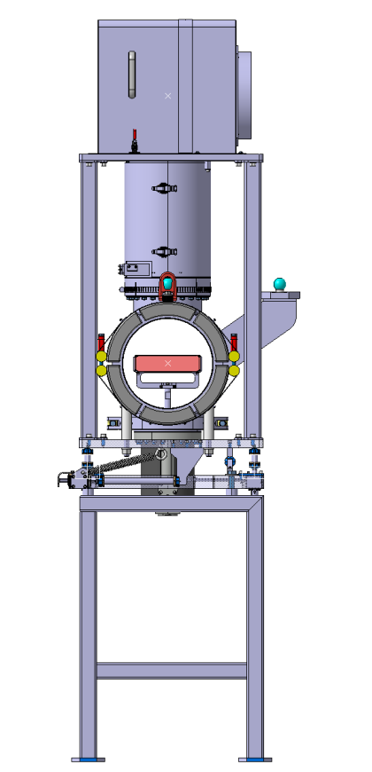
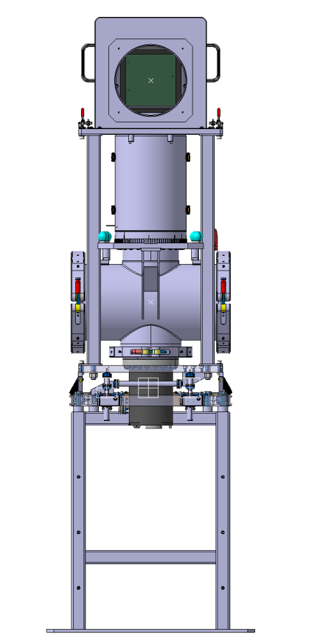
BTV mechanical design (1)
Main features:
  Screen size large enough to see the wobbling (H>180mm)
  High quality adjustable mirrors
  Covers (protect for dust and shocks)

Slide 4
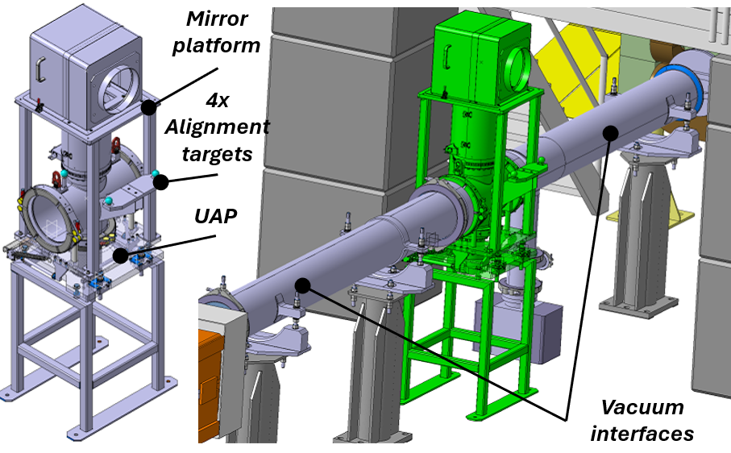
BTV mechanical design (2)
Main features:
  UAP table & targets defined with survey
  Vacuum interfaces to be finalized (seen with MME and VSC)

Slide 5
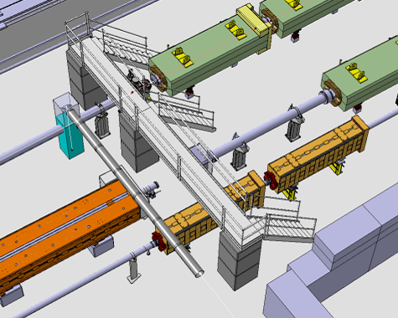
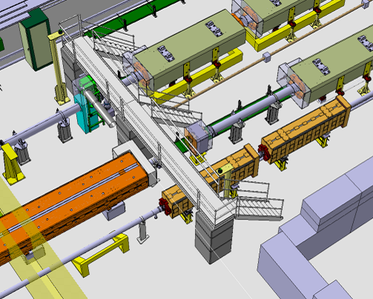
BTV Optical line design (1)
Actual integration + new BTV
Post LS3 integration
Location defined by the interaction of the optical line along TA801 crossing the SPS beam pipe.
Ref is in Vincent’s model (ST1863023)
Profit from the passerelle relocation to:
  Protect the optical elements
  Attach the first tubes

Slide 6
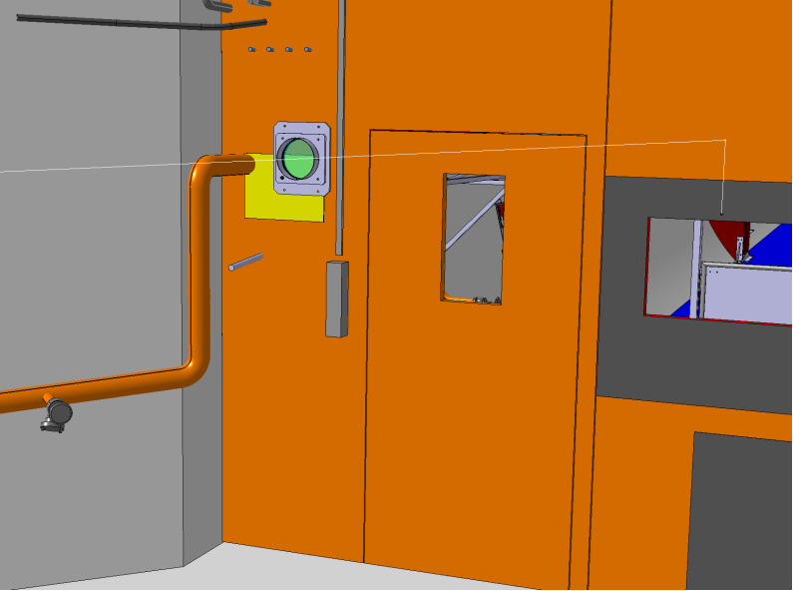
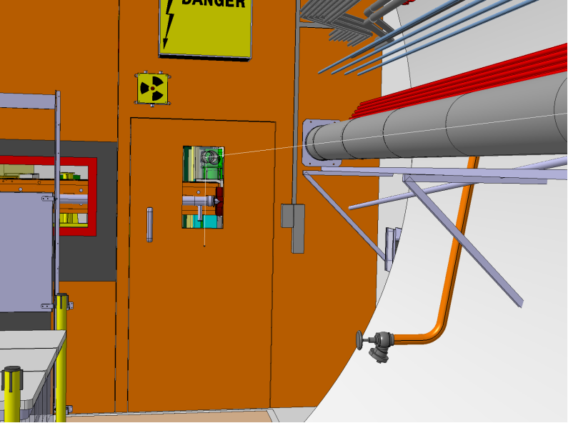
BTV Optical line design (2)
Need of a (high quality) window in the TA801/TCC2 door (volume separation/safety)
Pipes already rerouted
Door view from TCC2
Door view from TA801

Slide 7
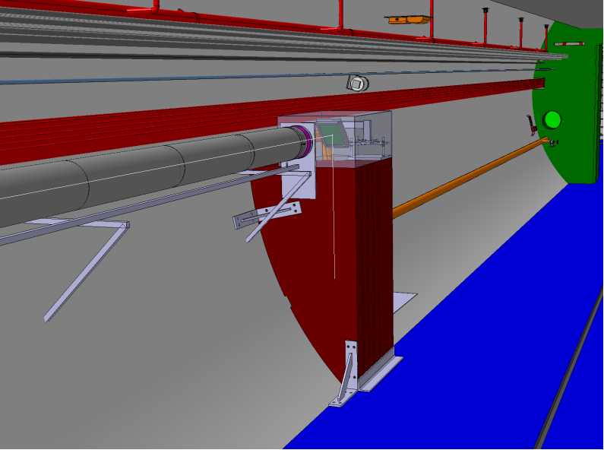
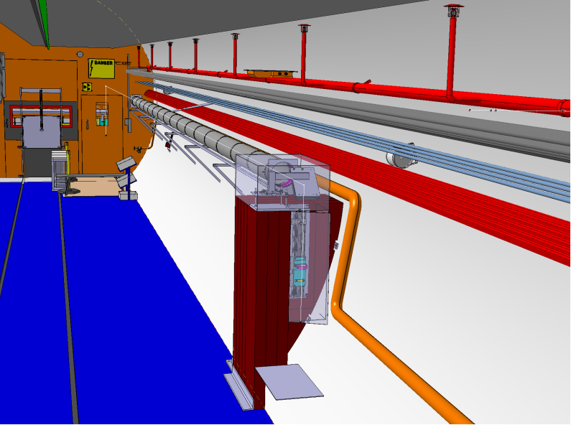
BTV Optical line design (2)
RP measurements and simulations showed the need for an iron shielding to ensure the availability of the camera over the runs.
Contact with CV to check whether their tube type can be used → benefit from existing ‘contract’ for procurement and installation
View of the camera shielding from TCC2 door.
View of the camera shielding from TA801 access.

Slide 8
Done so far
Mechanical design and integration of vac. chamber
Optical line integration
Screen is ordered
Next Steps
ECR to be circulated
Fabrication drawings of the shielding
Integration of covers/tubes on passerelle and along the wall (interface design)
Start fabrication/procurement this year
  BTV mechanics
  Shielding, optical covers/tubes, etc..), mirror supports
Order optics

Slide 9
EVM
https://apt.cern.ch/apt/gui/?u=https://apt.cern.ch/apt/ui/forms/ProgressReport.do?create_session=true&Id=248567#WU
Was update few weeks ago → still valid
No need for more money at this stage
Readiness
So far, the project is still on track
No issue encountered (but we need to have ECR validated to launch fabrication)
Only 1 new cable and 1 fibre requested (and quoted). No issue with cable/rack

Slide 10
Status General Cons. BTV
Work Unit 234920 – PRIMARY-CONS : General Cons BTV
TT20 and TDC2 BTVs (x9)
Screen replacement → engaged
New interface box → next year
New screen support → design will be done over summer (TS in ML)
New Cloche → same
New viewports → quoted, will be spent before end of 2025
(Maltese cross and filter wheel consolidation in LS4)

Slide 11
EVM
https://apt.cern.ch/apt/gui/?u=https://apt.cern.ch/apt/ui/forms/ProgressReport.do?create_session=true&Id=234920#WU
Was update few weeks ago → still valid
No need for more money at this stage
Readiness
So far, the project is still on track
No issue encountered
No new cables for this project
  Same cabling will be all new because to the cabling replacement
  New cables/fibres might be pulled in parallel but this is on the Analogue to Digital Camera Replacement project

