Slide 1
NACONS WP3.1
Long. BLM: project progress
E.Effinger, J.E.Felipe, M.King, B. Salvachua SY-BI-BL
Thanks to J.Kearney SY-BI-SW and S.Benitez SY-BI-PM for their contribution and help!

Slide 2
Progress on longitudinal BLM - Prototype
Update on the SPS Slow extraction LSS2 installation over YETS24-25:
  Replacement of 200um core fibre by 600um
  New photo-sensors, move from SiPM to PMTs with a modified input window that changes the acceptance wavelenght range.
  Study the need of shielding for the photo-sensor: testing impact of beam loss directly on the PMT
  Replacement of scope by picoscope and timing card. Configuration of FESA device.
Increase of signal
Increase of signal + reduce signal dependence with loss location
Improve read-out to make systematic data analysis of slow extraction.
Progress followed regularly at BLM Detector Studies Meeting: https://indico.cern.ch/category/12322/
B.Salvachua NACONS WP3.1 2025-06-25

Slide 3
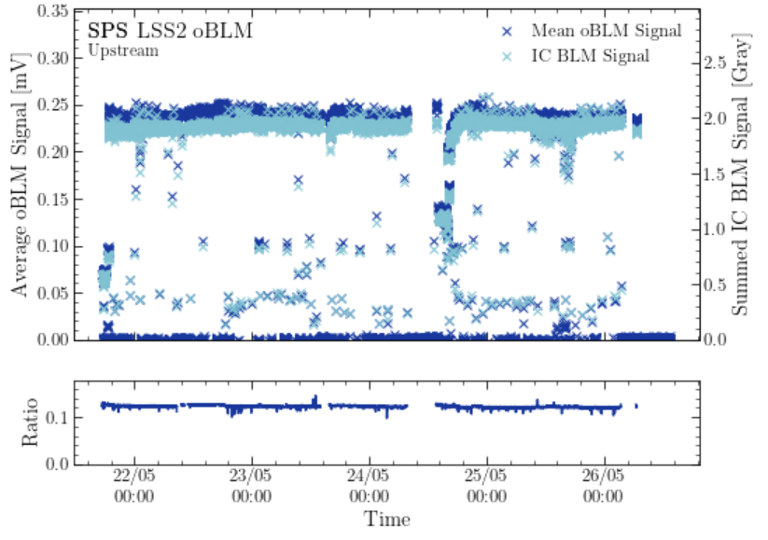
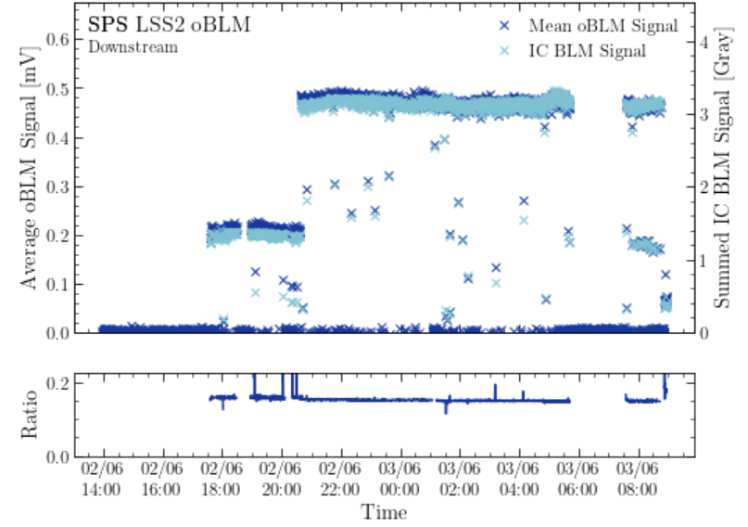
Measured signals in 2025
Comparison of the signal sum of ALL ionisation chambers along the slow extraction with the average optical BLM signal over the extraction. Each point represents one extraction
Figures by M.King
UPSTREAM
DOWN STREAM
Very good quantitative agreement between the measurement of the ionisation chambers and the optical BLM
B.Salvachua NACONS WP3.1 2025-06-25

Slide 4
Progress on longitudinal BLM – new installations
Cabling request done – no decabling needed – rack request done together with other BLM systems (one rack).
42 mm diameter duct request on-going. Concerned people are already in the loop (J.Blanc). We need to finalize the final start/end point of the device. These depends on the new location of the fire doors.
Integration of new devices in TT20 and TCC2, along the splitters. The device does not go to TDC2.
  F.Galliazzi as main contact for the integration, discussed already at ICL-SPS du 11/06/2025: https://edms.cern.ch/document/3310563/1 (several ad-hoc meetings to agree on the final start/end locations).
  S.Benitez as our main contact for integration.
Personnel:
  PhD student M.King (finishing end February) – finalising Prototype studies
  Origin to come (starting end of this year) – new installations and read-out
B.Salvachua NACONS WP3.1 2025-06-25

