Slide 1
BL: NA CONS WP3.1 - Half-year status
https://indico.cern.ch/event/1551737/

Slide 2
NA-CONS/HI-ECN3 Budget Committed
Reprofiling of the oBLM system needed (see Belen’s slides)
  Cabling costs estimated to 71 kCHF
  Duct and its installation not included yet

Slide 3
NA-CONS/HI-ECN3 BLM status
Large part of the electronics already available
  Some testing pending
Design status
  Robotic Solution for TDC2
    Design completed; Complete prototype under manufacturing
    Production to follow immediately for TDC2 and TCC2
  Distribution boxes (signal and HV)
    Design of two types completed; prototypes are being produced
Underspending & uncertainties:
  PLAN to make use of the P42 funds – system is already installed
  No price estimates from EN-EL - cable lists are changing; some positions still to be clarified

Slide 4
Detector Production
Majority of the order already completed
Plan to start charging from next year
BCR document to be produced
Detector production funds summary:

Slide 5
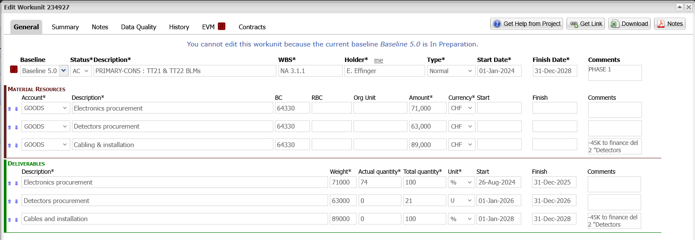
NA-CONS: TDC2
Production on-going
Two additional detectors added.
  Cabling request completed – to be uploaded next week

Slide 6
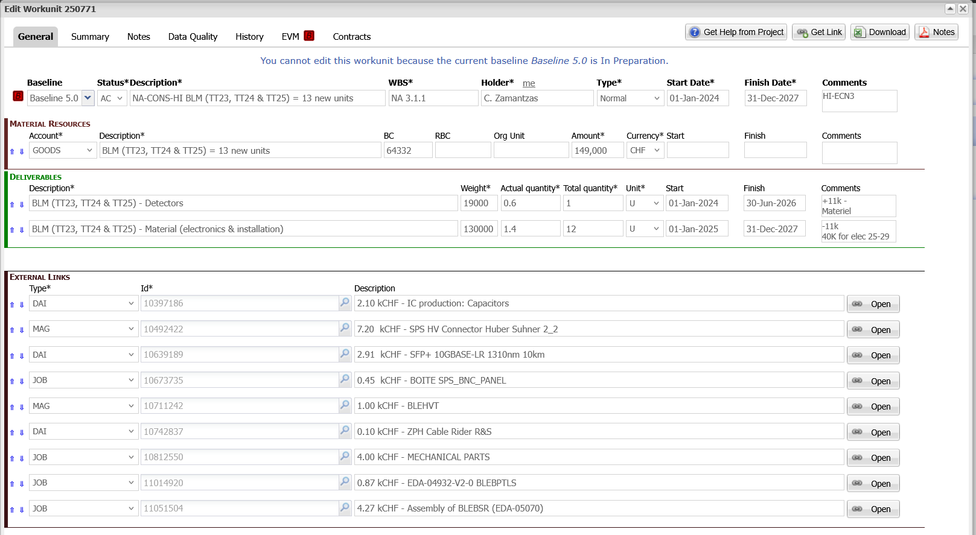
NA-CONS-HI: TCC2
Production on-going
Cabling request not-completed – 2-3 more detectors to be added around T4

Slide 7
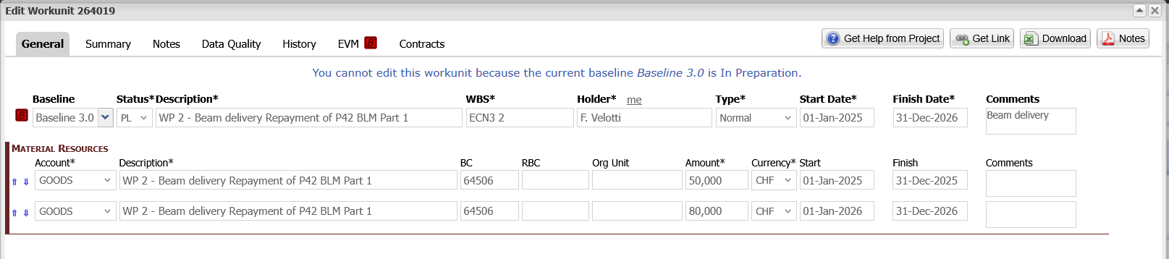
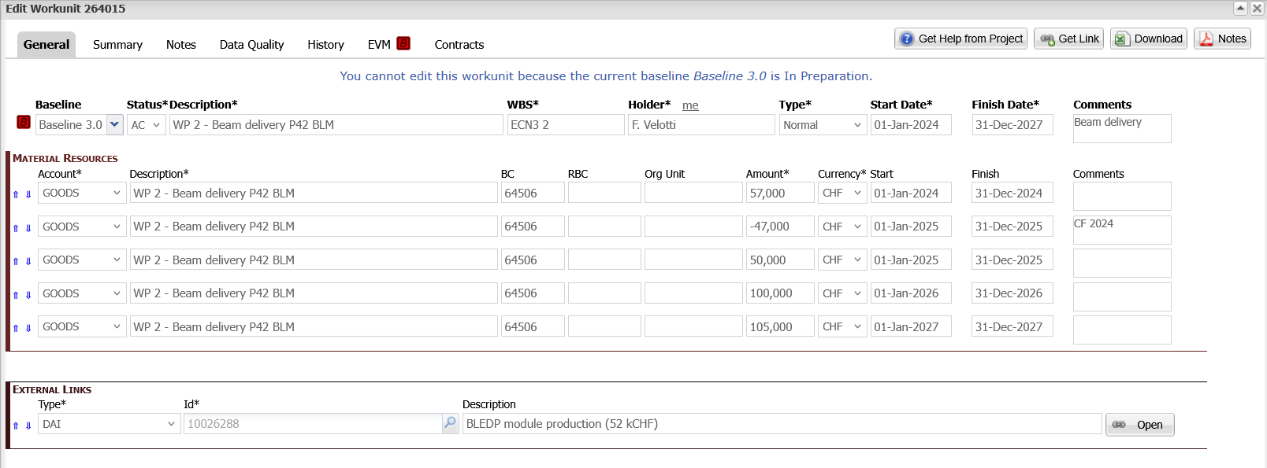
ECN3: WU
Restructure EVMs & move funds
Part 1 – completed:
Proposing to make a
TID of 40-50 kCHF for electronic production

