Slide 1
XCET Renovation and Upgrade
NA CONS WP3.1 - Half-year status
25 Jun 2025
Giulia Romagnoli

Slide 2
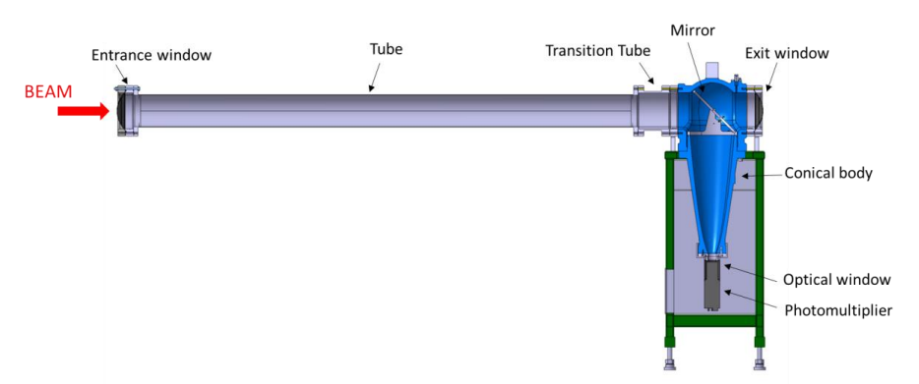
XCET Overview
The threshold Cherenkov Detectors (XCET) are used in the North and East Areas to count the number of particles in the beam
The XCET detector is composed of a horizontal tube filled with the required gas, thin entrance and exit windows traversed by the particle beam, a mirror at 45°, a body made of a spherical head and a conical part (in blue in the picture) leading to an optical window followed by a photomultiplier. The Cherenkov light is produced inside the tube by the interplay between the gas and the particles. At the end of the gas volume, a thin mirror is deflecting the light towards the optical glass window behind which the photomultiplier is located

Slide 3
XCET North Area Overview
7 XCET installed in the North Area beamlines (EHN1) → old installed since 1970
1 XCET on H2 installed during 2023 (mix of old and new components)
Already paid NACONS Phase1
 | Tube and Windows | GAS PANEL | BI gas control system | VACUUM system XCET | Gas Distribution + network | BODY | Mirror 45 degrees
7 XCET | Tubes : old vacuum chambres Windows: old Mylar on all | Old | Old | Old | Old | Old | Old
1 XCET on H2 | Tube new visse Windows: new Mylar | Old | Old | New vacuum pump | Old | Old | New
SPARES | / (no need) | 1 spare avaialble | No spares | No spares | / (no need) | 2 old available | 3 new available

Slide 4
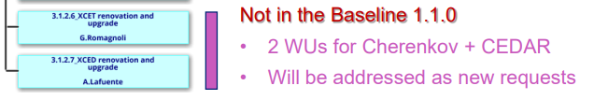
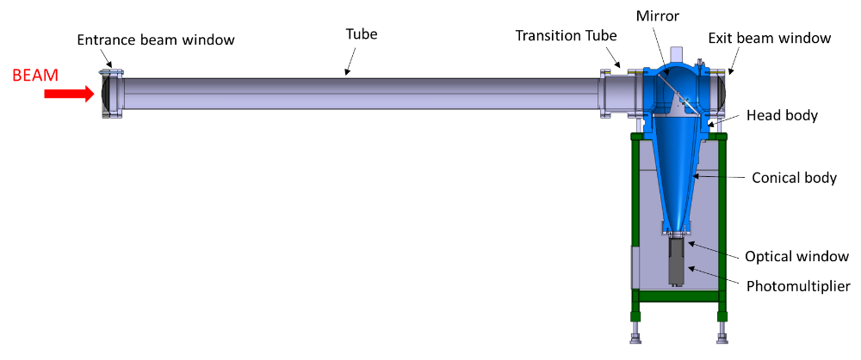
XCET Budget Change Requests
Phase 1 | 0 kCHF
Phase 2 | 670 kCHF
TOTAL XCET | 670 kCHF
Phase 1 | 1359 kCHF
Phase 2 | 0 kCHF
TOTAL XCET | 1359 kCHF
Phase 1 | 843 kCHF
Phase 2 | 245 kCHF
TOTAL XCET | 1088 kCHF
Phase 1 | 349 kCHF (95 kCHF already spent)
Phase 2 | 790 kCHF
TOTAL XCET | 1139 kCHF
→ Budget approved but WU missing
→ not approved (draft in EVM)
→ not approved (draft in EVM)
NACONS CSR25
NACONS Project Approval in 2021
NACONS CSSR23
NACONS CSR24
Memorandum BE-EA group (EDMS 2850754)
CHANGES in user requirement
XCET prototype production and test
Request from PL to save money in Phase 1
HSE derogations after experience with EAR
Increase of pressure needed after Phase2
Additional gas types after Phase2
NEW User requirements (EDMS 2114239)
HSE safety restrictions (EDMS 2744649)
New insights in detector working principle/fabrication
FTA completed and AFT data analyzed
Postpone control system consolidation and gas panels production thanks to procurement of spare pieces for old components
→ Ok from operation and safety!
Additional XCET units
Mechanical parts not compliant with HSE
Increase of pressure
Additional gas types
XCET CSR25 Request: Reprofile from Phase 2 to Phase 1 of 349 kCHF (95kCHF already committed!!!)

Slide 5
Planning & Spending Profile
Resources request | Units | Total Budget | Progress | 2023 | 2024 | 2025 | 2026 | 2027 | Phase 2
New mirrors 45° XCET | 10 | 12 |  |  | 4.6 | 7.4
New optical windows and flanges XCET | 15 | 0 | 10 Windows purchased with different BC |  | 0
Additional XCET on H2 beamline | 1 | 16.5 | Finished (with old body) | 16.5
New tubes and beam windows with flanges | 10 | 170 |  |  |  |  |  |  | 170
New XCET bodies | 10 | 80 |  |  |  |  |  |  | 80
Vacuum pumps | 10 | 15 |  |  |  |  | 15
New Gas panel | 10 | 170 |  |  |  |  |  |  | 180
New Gas Control Racks (hardware) | 2 | 60 |  |  |  |  | 60
New Gas Control Racks (control) | 2 | 60 |  |  |  |  |  |  | 60
Spare gas panels | 4 | 40 |  |  | 20 | 20
New supply lines for XCET | 1 | 75 |  |  |  |  |  | 75
New GHG gases lines | 1 | 75 |  |  |  |  |  |  | 75
N₂ Flushing | 1 | 50 |  |  |  |  |  |  | 50
Pressure sensors and units | 10 | 26.5 |  |  | 45.5
Ethernet cables DIC | 8 | 20 |  |  |  |  |  | 20
Photomultipliers and voltage dividers | 12 | 36 |  |  |  | 36
Control system (PLC) | 10 | 50 |  |  |  |  |  |  | 50
Decabling-Cabling | 1 | 100 |  |  |  |  |  |  | 100
Design NEW body | 1 | 25 |  |  | 25
FSU vacuum test and connection | 8 | 4 |  |  |  |  |  | 4
Assembly and testing new bodies | 1 | 12 |  |  |  |  |  |  | 15
Installation and Test (SY-BI) | 1 | 10 |  |  |  |  |  |  | 10
TOTAL |  |  |  | 16.4 | 95.1 | 63.4 | 75 | 99 | 790

Slide 6
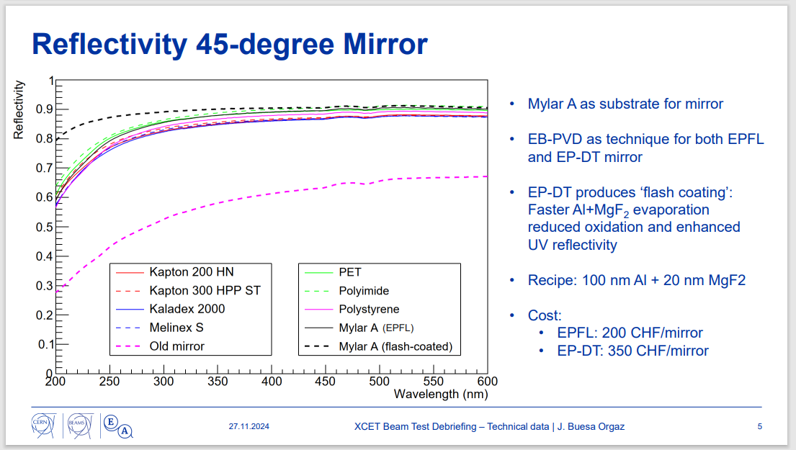
NEW 45° Mirrors
Reflectivity and production/fabrication studies performed for the XCET prototype

Slide 7
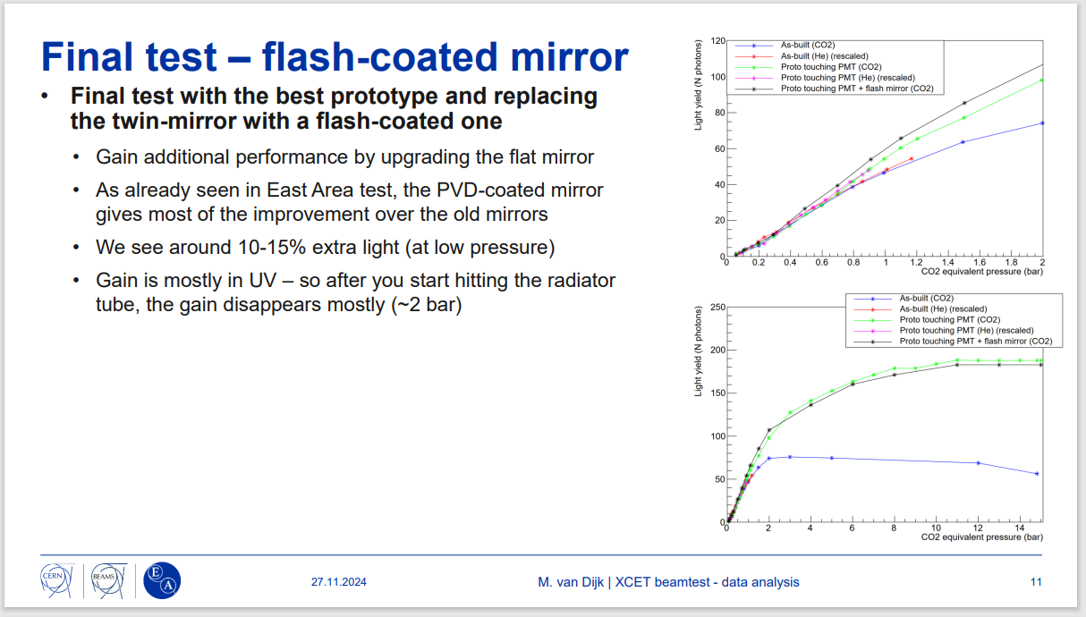
NEW 45° Mirrors
New mirros is really plying a difference!
8 new mirrors will be installed in the North Area

Slide 8
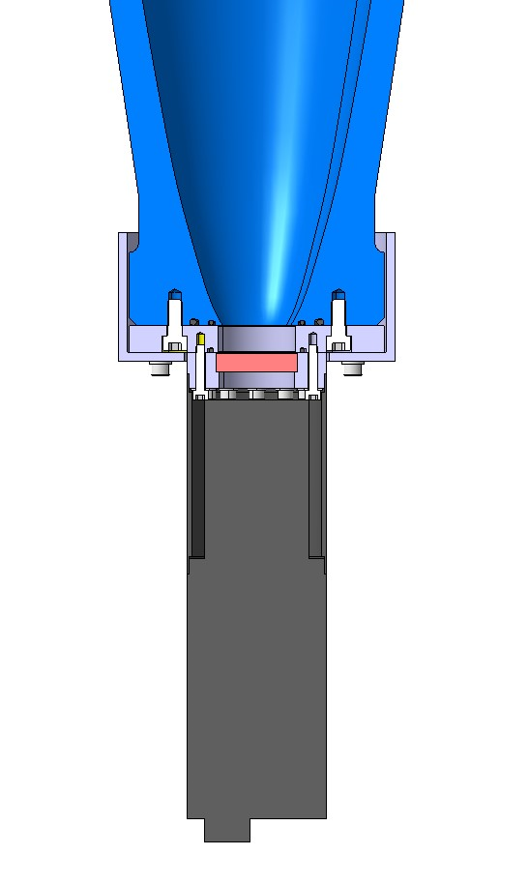
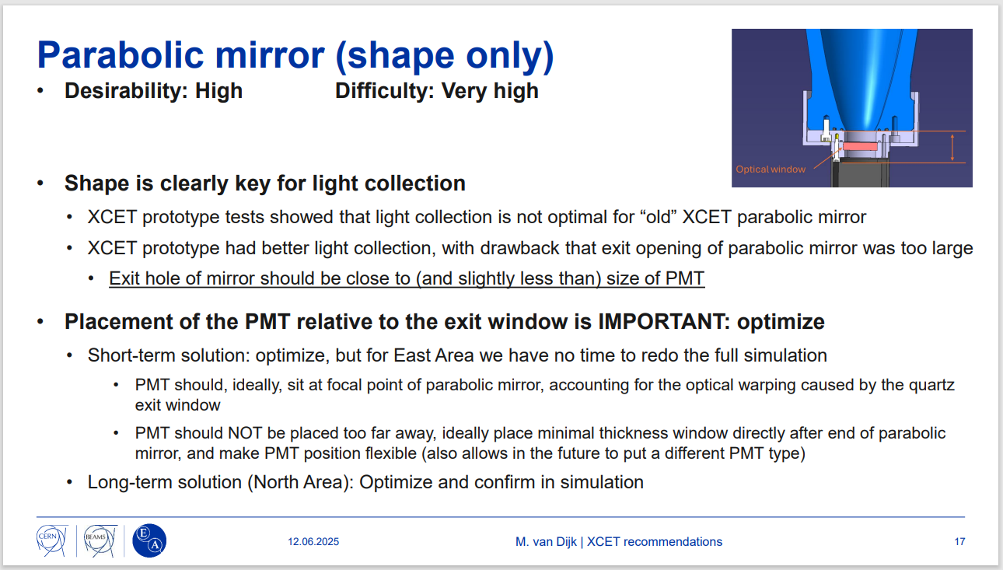
XCET Optical Windows
Key parameter in the light optical path.
We learned a lot from the prototype test in 2024!
A = distance between end of parabolic mirror and glass window
B = thickness of glass window
C = distance between glass window and top surface of PMT

Slide 9
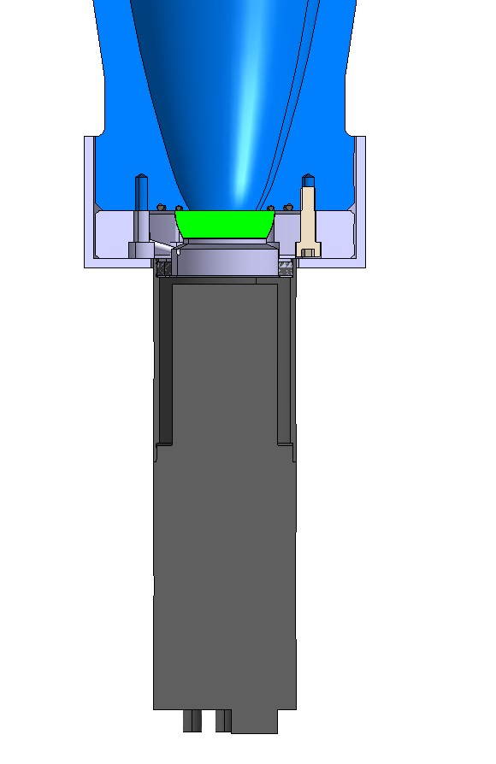
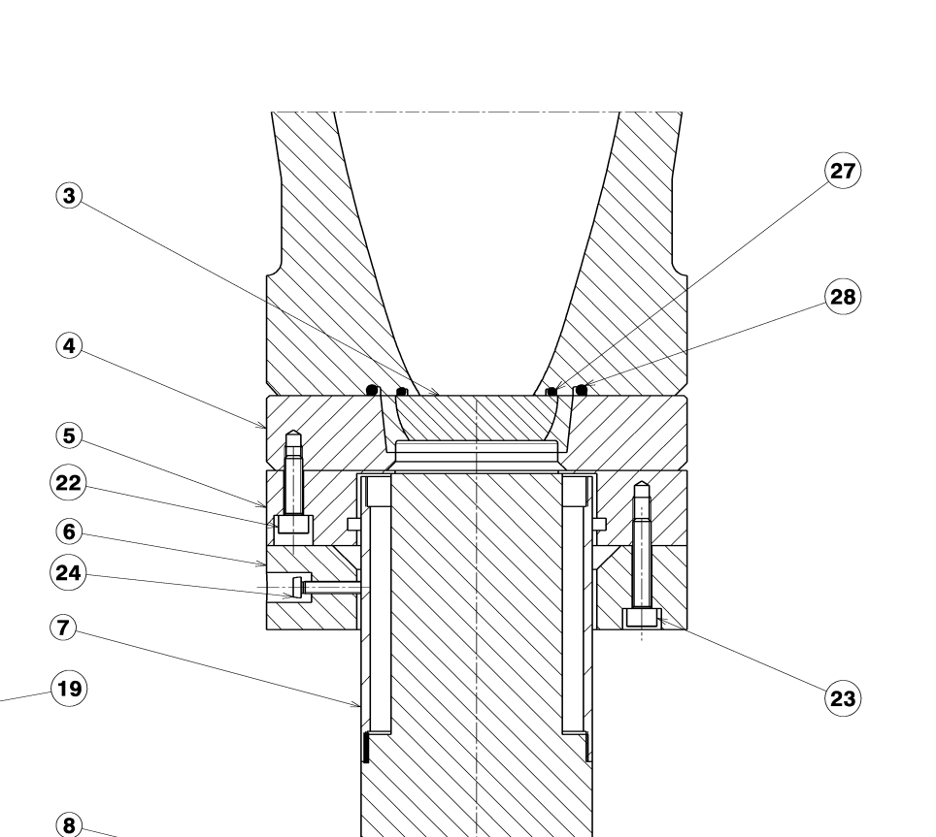
North Area Design
Material Certificate: ???
Pressure test (23 bar + rupture ): ????
Current East/North Area Assembly
Bottom mirror dia= 37.544 mm
Diameter: top 54mm / bottom 44.9 mm
Reference: ????
Material: glass
A = 0 mm
B = 15 mm
C = 25 mm
Total= 40 mm
https://edms.cern.ch/document/2738932/AA
SPSXCET_0020 v.AA
ST1205095_01_c.01

Slide 10
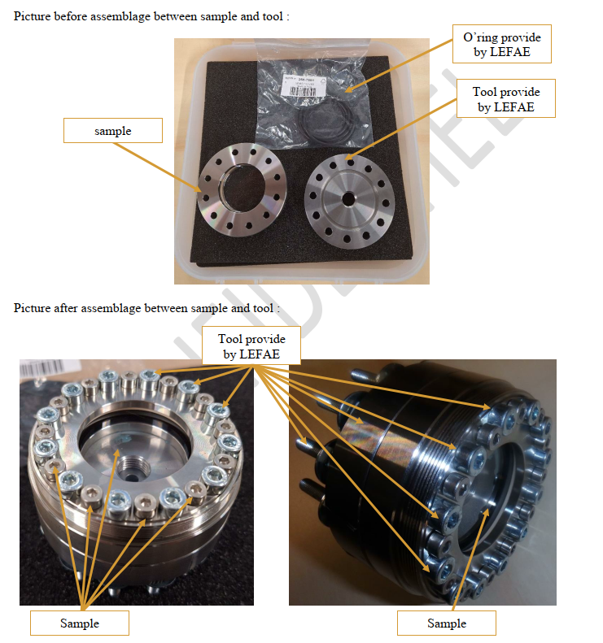
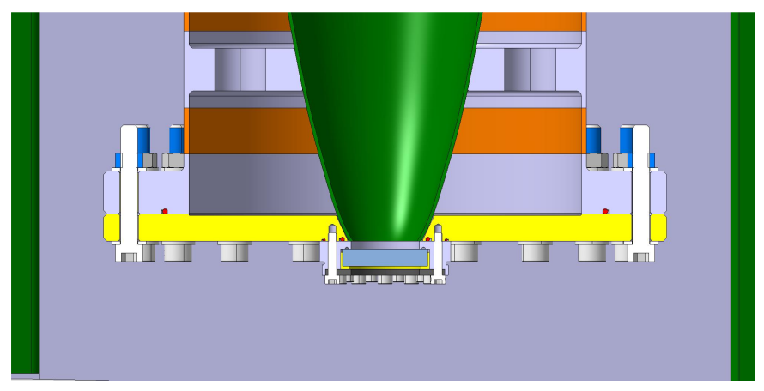
New supplier for Spares Windows
New supplier found
Pressure tested to 50 bar
Window design «CEDAR TYPE» with variation
10 pieces + 1 prototype with pressure test ordered

Slide 11
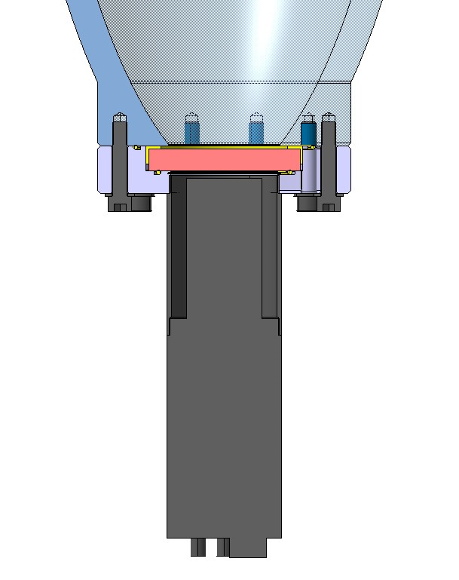
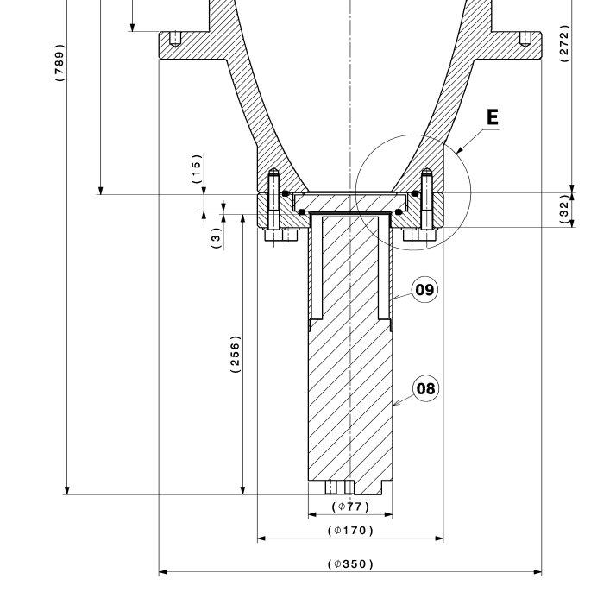
Prototype Window
This is the best choice for physicist!!
Material Certificate: EDMS 3312831
Pressure test (23 bar): EDMS 3161915
Purchase Requisition (DAI) 10513629
Prototype Assembly
Bottom mirror dia= 75 mm
A = 2 mm
B = 15 mm
C = 5 mm → in the test was reduced up to 1 mm
Total= 22 mm
Diameter: 101.6 mm
Reference: Eksma Optics 220-1825E /WHF10169-C
Material: UV Fused Silica
https://edms.cern.ch/document/3122624/AB
SPSXCET_0083 v.AB
ST1895193_01_c.00
The drawing number of optical window is SPSXCET_0074
The drawing number of the flange is SPSXCET_0073

Slide 12
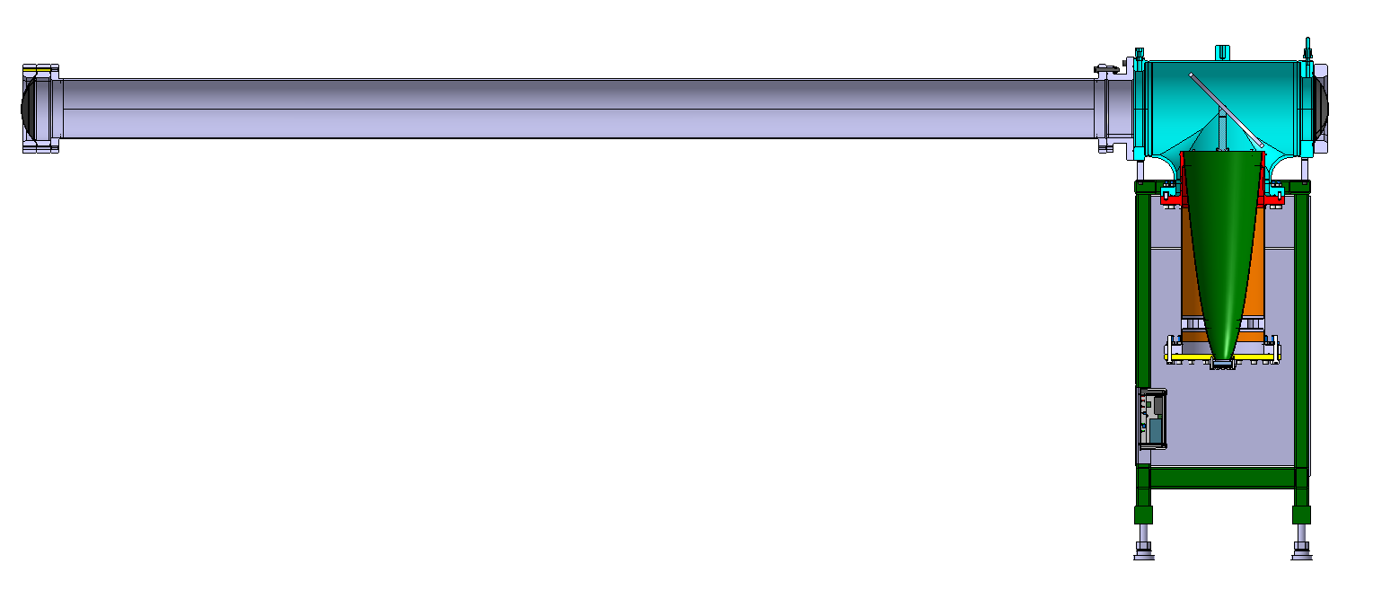
New Body
New body (using old optics) is being purchased for the East Area XCET
XCET Head
45 ° mirror
Downstream beam window
Upstream beam window
XCET Tube
Transition Part
XCET Body
Conical mirror
We will test them with beam and we will learn from this experience for doing the same in the North Area
HSE validation
Optical window choice
Optical window

Slide 13
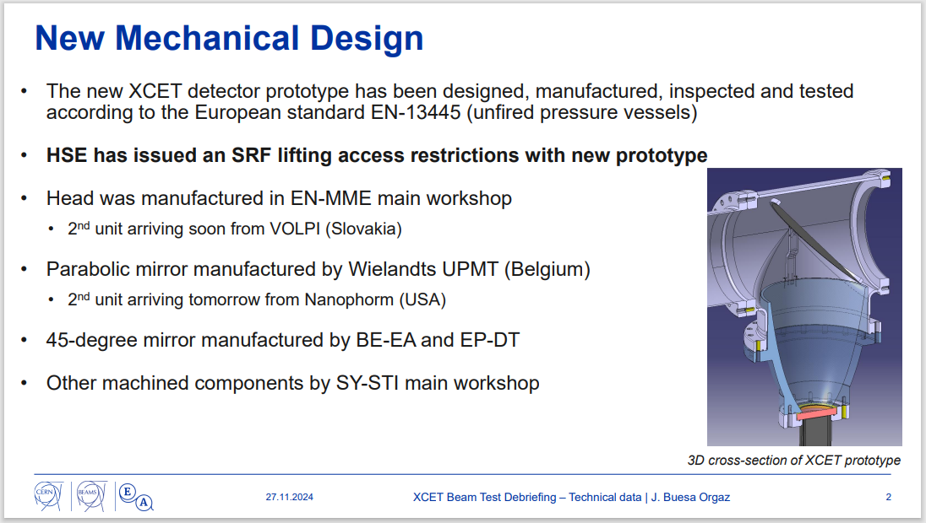
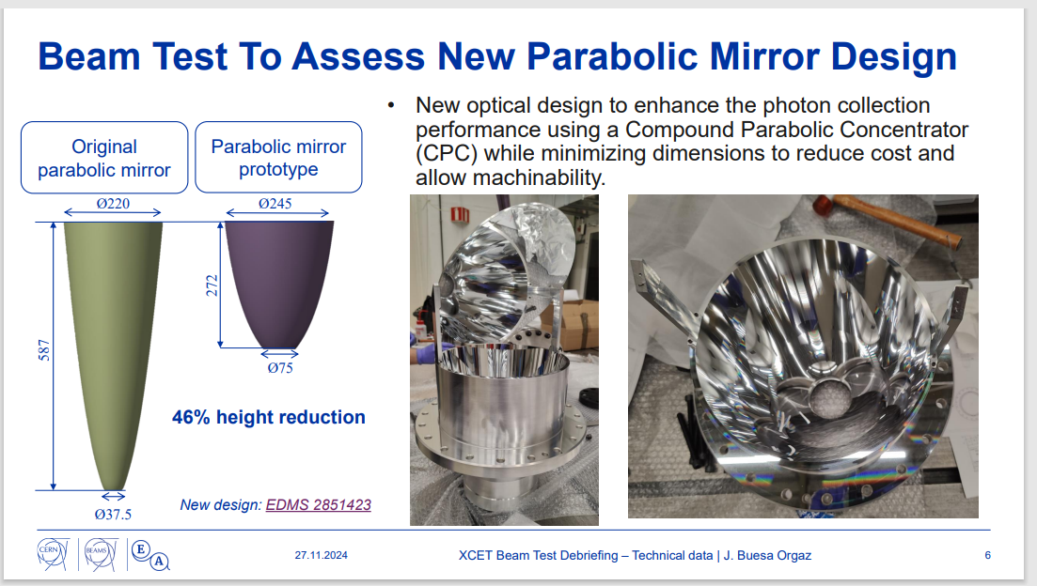
New Body Prototype
Test beam in Oct24 really successfull
The optical shape it is not fully optimized → mode study needed …PhD contract?

Slide 14
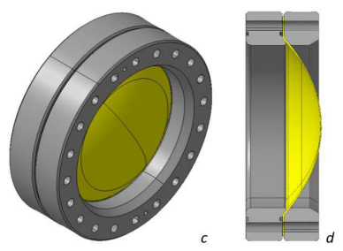
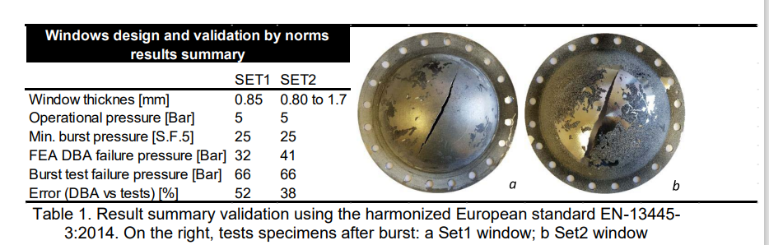
Optical Windows
Design and optimization of flages and aluminum windows for a high-presure Threshold Cherenkov Counter EDMS 2141807
Aluminum beam window design validated for the Neutrino Platform installation
Installed as well in the East Area
→ NOT OK for the NORTH AREA XCET → new design needed!!

Slide 15
EVM Work Units and Documents
EVM work units are still in DRAFT (budget for XCET approved in CSR25)
Works unit update on going → uploaded soon on EVM
WPD: Consolidation of XCET Cherenkov Detectors in NACONS Project (EDMS 2802361)
Updated and released
Work Package Analysis → not needed for this equipment

Slide 16
Summary and Conclusions
Gas supply and network half during LS3 and half phase 2
New chambers in phase 2
45° mirrors production and installation for LS3
New pressure sensors and PMT spares procured
Additional XCET oh H2 line installed
XCET body prototype done
New vacuum pumps installed in LS3
Open points for Phase 2:
New body design
Optical window design
PLC control
BEAM WINDOWS DESIGN → to be redesined for the North Area
Requests for NACONS CSR26:
Manpower PhD student for beginning phase 2
Resourses: TBD waiting for East Area new body

Slide 17
THANK YOU!!

Slide 18
project progress and achievements so far
issues encountered, which could potentially cause WUs not to be on track
EVM aspects of the WUs:
  already foreseen budget changes - savings/requests - for CSR26'
  resources: new requests for CSR26', currently missing manpower
  project management: lateness/underspending of your WUs explained
LS3 readiness and the respective deliverables
Work Package Analysis (here)
Cabling/decabling

