Slide 1


[NACONS] XCED WP3.2.1.7 REVIEW
BE-EA
25.06.2025

Slide 2
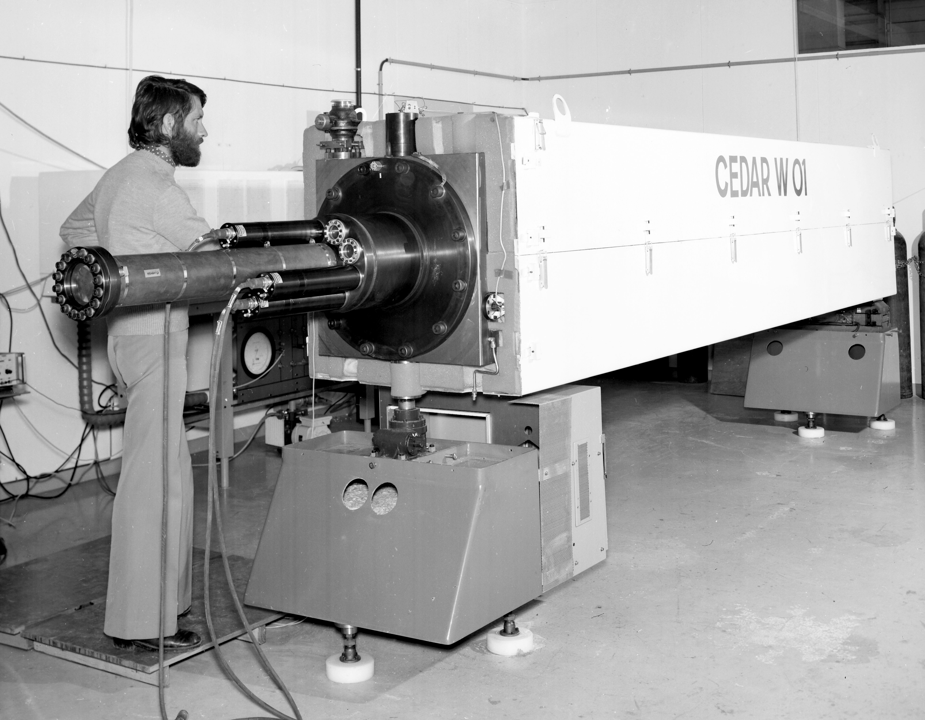
OVERVIEW
INTRODUCTION
ACHEVED MILESTONES
ON GOING ACTIVITIES SUMMARY
ISSUES
NACONS
  Baseline + Schedule
  New Requests
NEXT STEPS

Slide 3
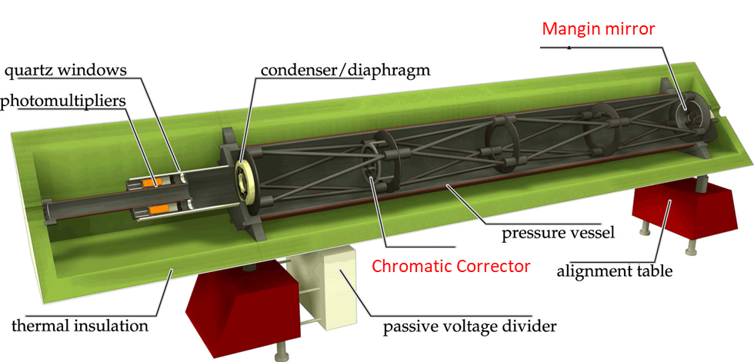
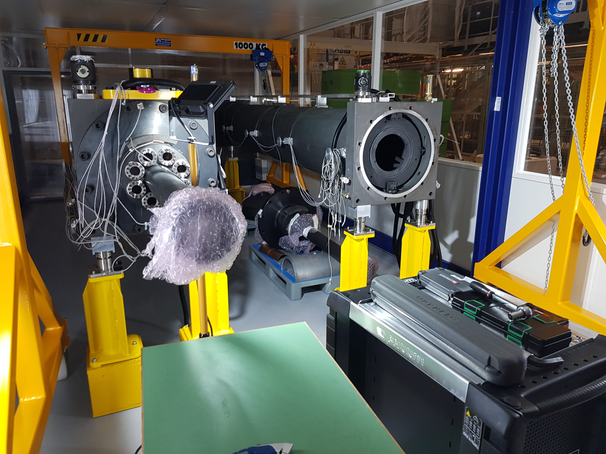
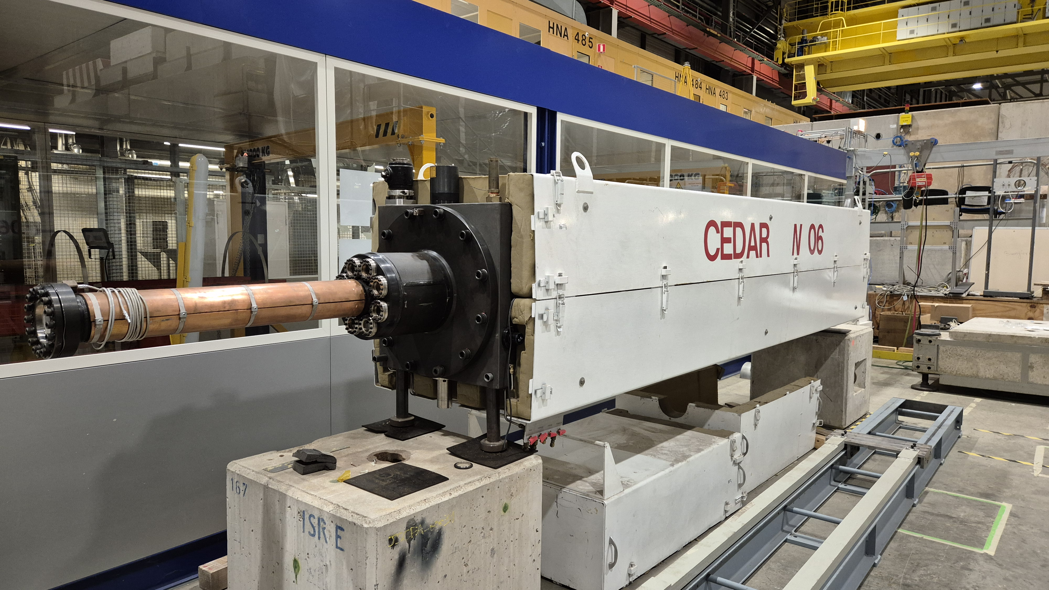
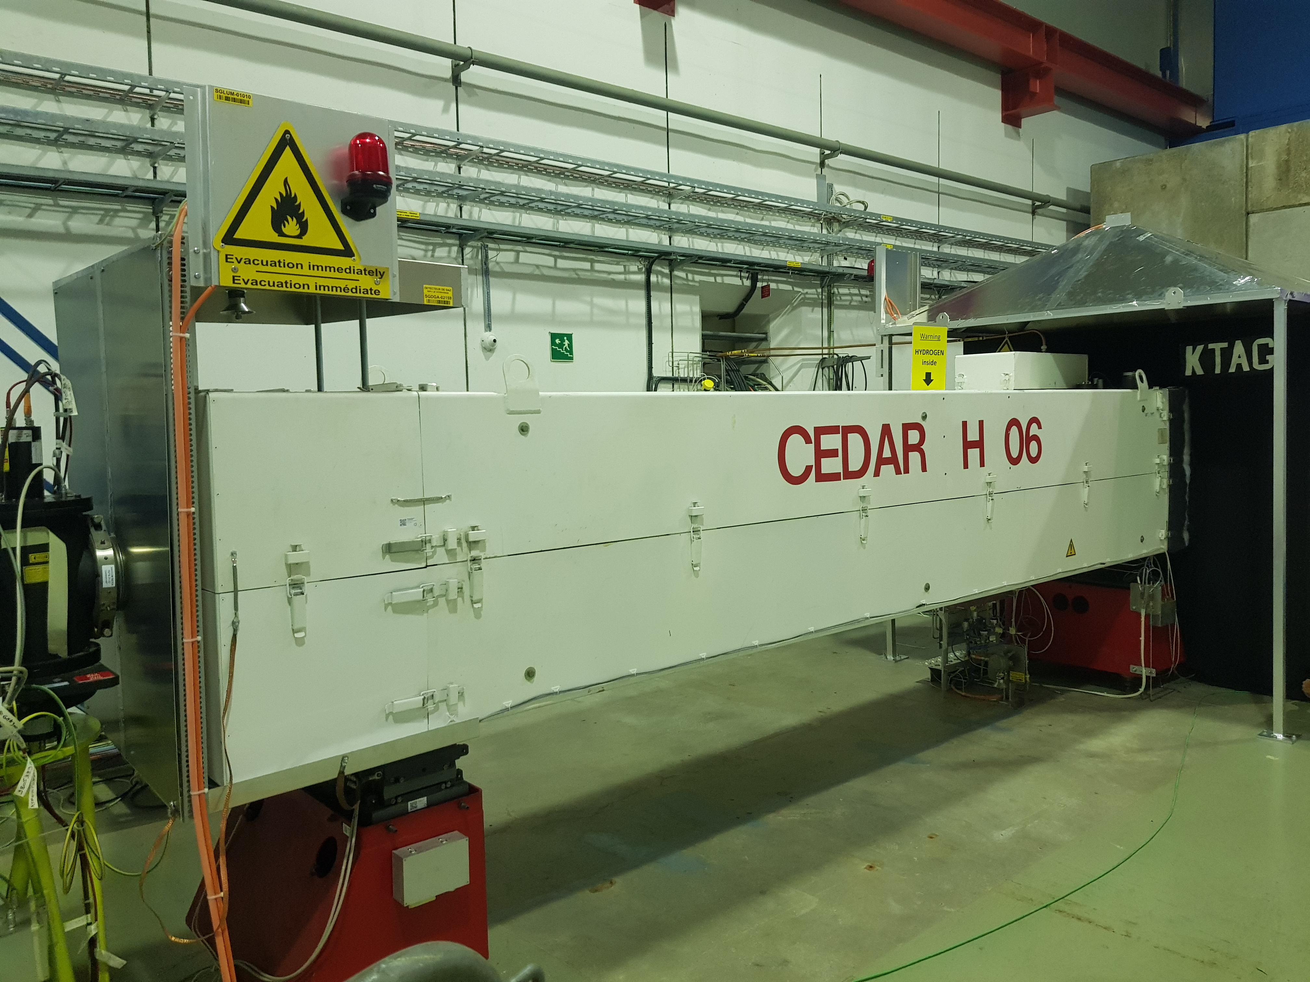
INTRODUCTION
CEDARs (Cerenkov Differential counter with Achromatic Ring Focus)
Designed at CERN between 1975 and 1980
Use pressurized gas and an optical system allowing the production and detection of the Cerenkov light
By tuning the pressure of the gas, we can then detect particles of a specific mass (and therefore of a specific type).
3 types of CEDAR’s are used:
  CEDAR N (North)
  CEDAR W (West),
  CEDAR H (Hydrogen)

Slide 4
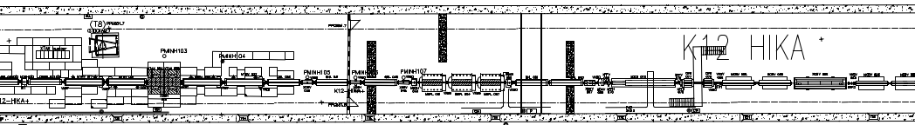
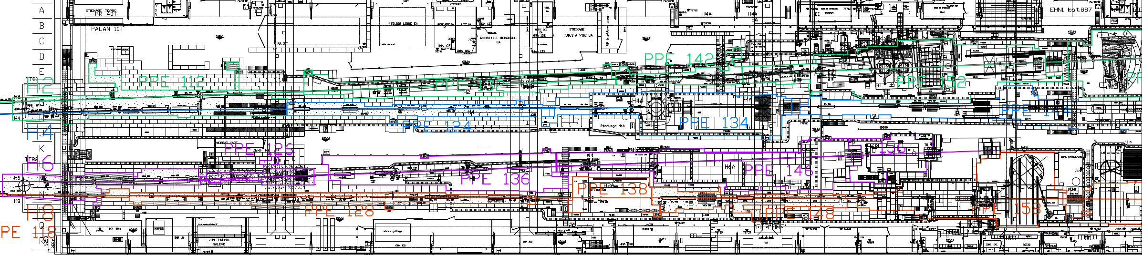
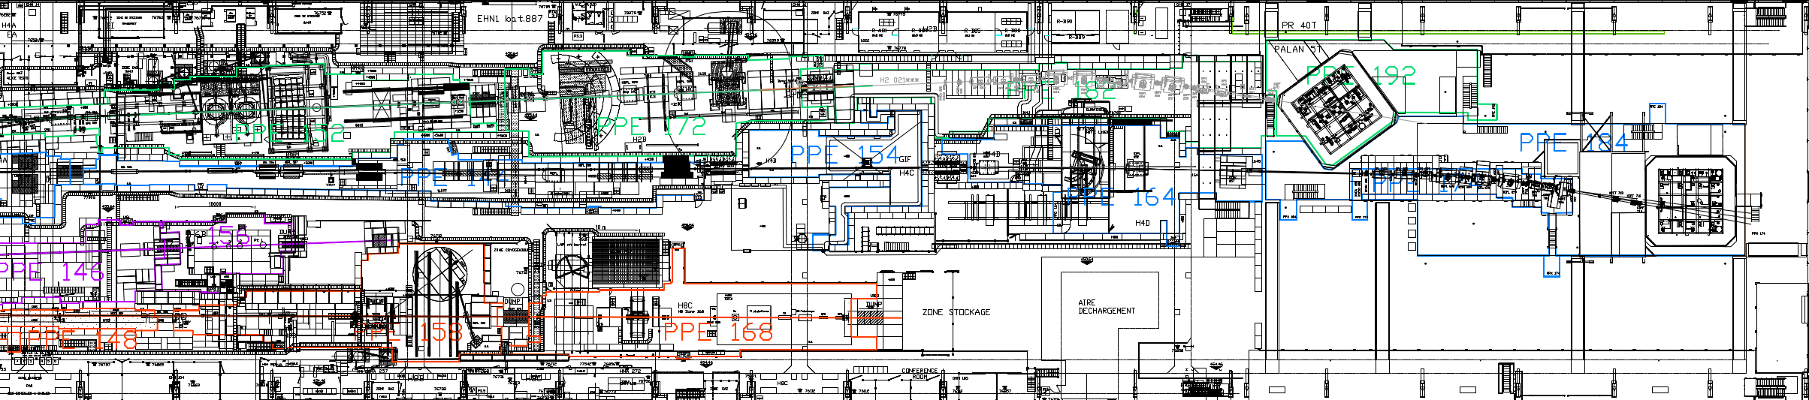
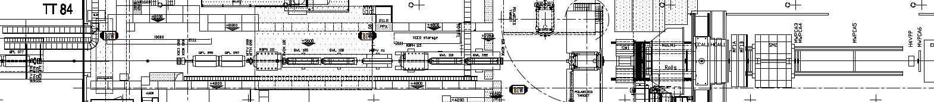
INTRODUCTION
XCED PARK
7 Operational XCEDs exist:
5 TYPE North:
  SPXCEDN001-CR000006
  SPXCEDN001-CR000007
  SPXCEDN001-CR000020
  SPXCEDN001-CR000002
  SPXCEDN001-CR000003
1 TYPE West:
  SPXCEDW001-CR000004
1 TYPE Hydrogen
  SPXCEDH001-CR000001
TCC8
XCED H
SPXCEDH001-CR000001
101.072
XCED N
SPXCEDN001-CR000003
XCED W
SPXCEDW001-CR000004
EHN1
021.463
041.440
041.449
XCED N
SPXCEDN001-CR000007
XCED N
SPXCEDN001-CR000006
EHN2
XCED N
SPXCEDN001-CR000020
XCED N
SPXCEDN001-CR000002
065.083
065.089

Slide 5
INTRODUCTION
XCED PARK TODAY
4 Installed XCEDs (29.04.2025):
3 TYPE North:
  SPXCEDN001-CR000003
  SPXCEDN001-CR000006
  SPXCEDN001-CR000007
1 TYPE Hydrogen
  SPXCEDH001-CR000001
TCC8
XCED H
SPXCEDH001-CR000001
101.072
XCED N
SPXCEDN001-CR000003
XCED W
SPXCEDW001-CR000004
EHN1
021.463
041.440
041.449
XCED N
SPXCEDN001-CR000007
XCED N
SPXCEDN001-CR000006
EHN2
XCED N
SPXCEDN001-CR000020
XCED N
SPXCEDN001-CR000002
065.083
065.089

Slide 6
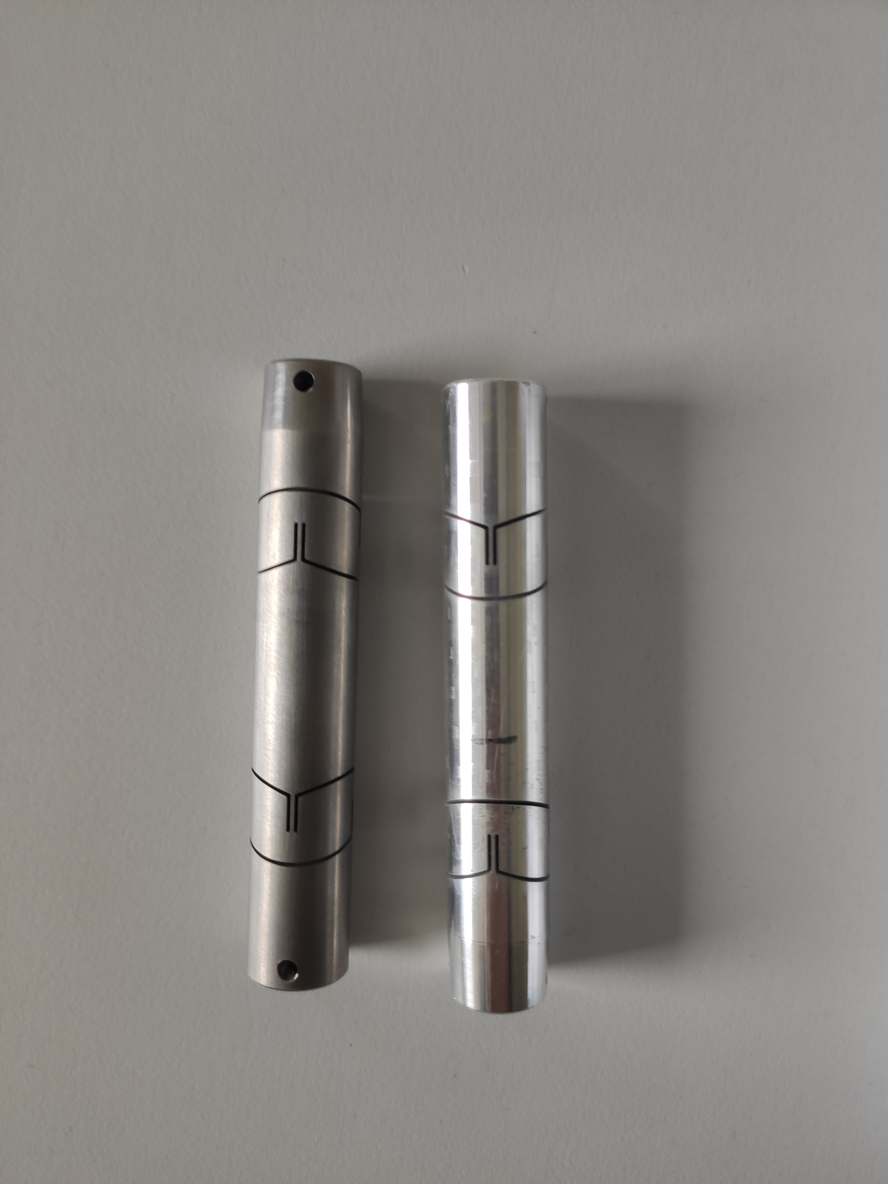
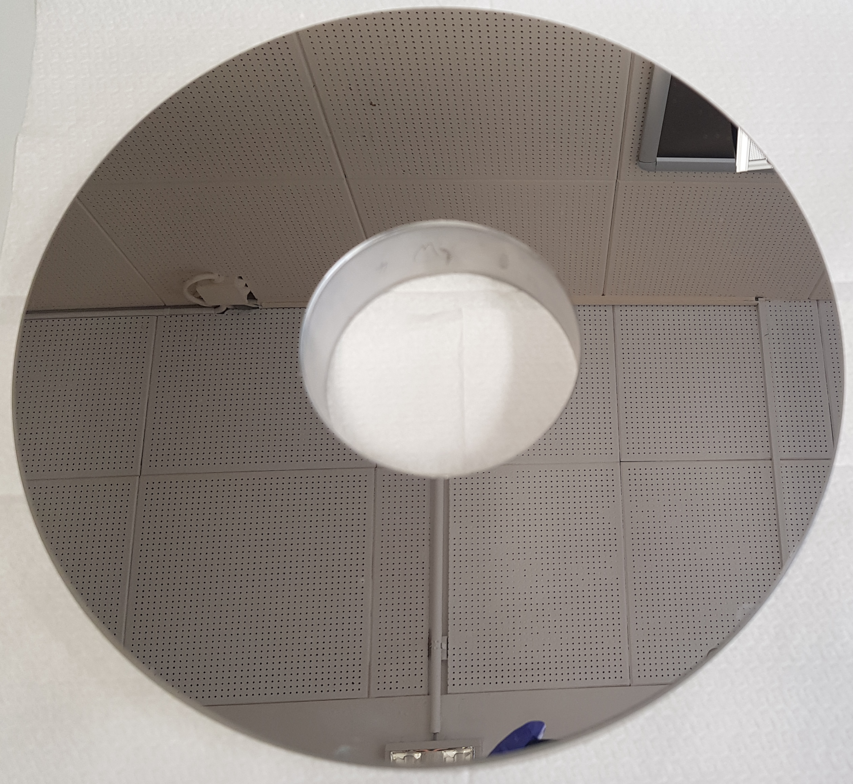
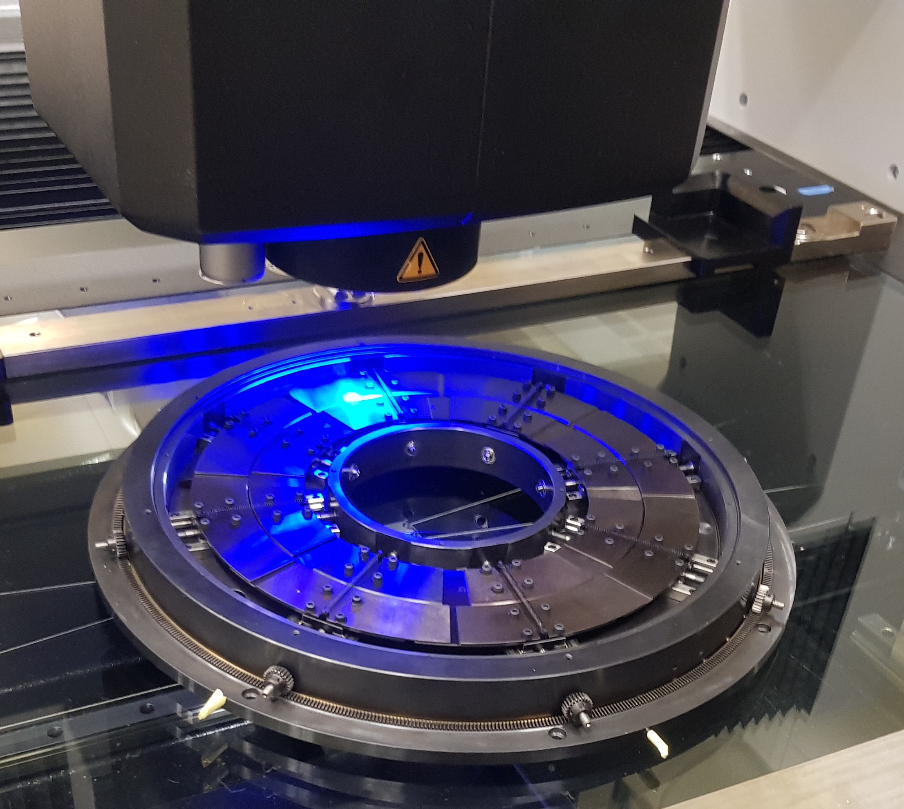
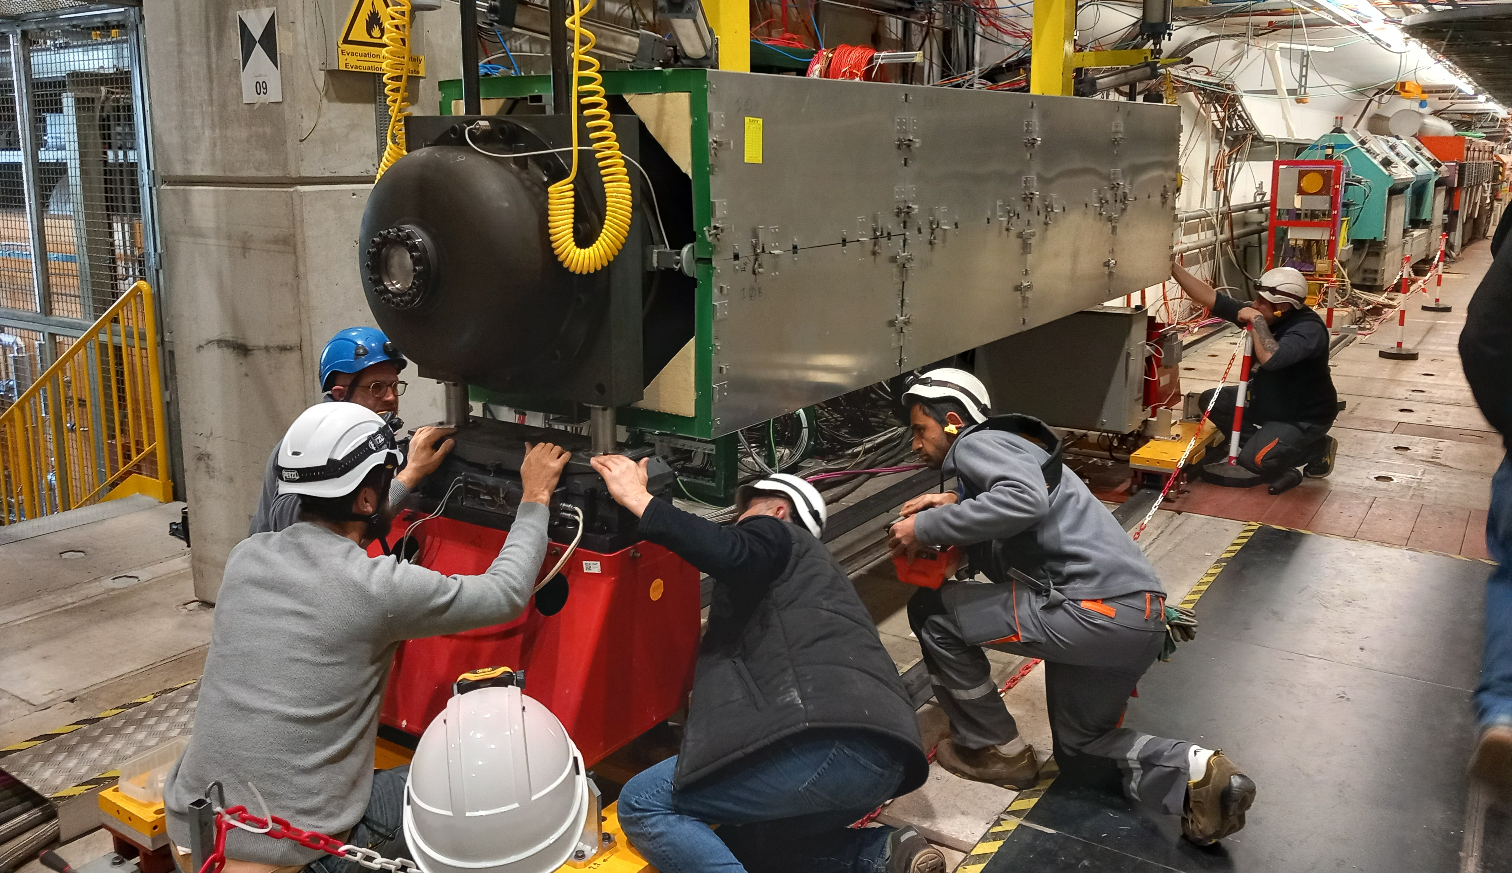
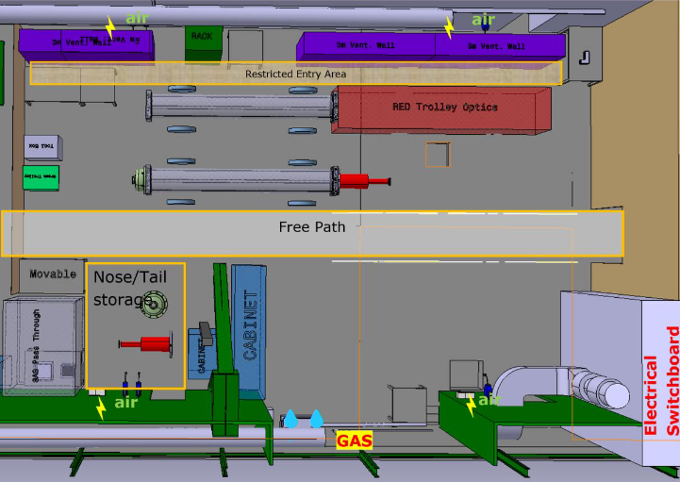
ACHIEVED MILESTONES
10 2023
New optics N Tests in H6
03 2025
04 2024
XCED WPD V0.3 Released
EDMS2742855
Thermal Hosing Functional Specification Approved
EDMS2957089
R&D New Coupling for Diaphragm
02 2024
XCED User requirements Approved
EDMS2813075
09 2024
01 2025
06 2025
XCED N06
New Spare Completed
XCED Spare components revised
10 New PMTs received
FORMAL APPROVAL
OF WP 3.1.2.7
PHASE I BUDGET
05 2025
03 2024
Clean Area Functional Specification Ready
EDMS3189466
XCED N02/20 REFURBISHMENT
12 2024
3D model for XCED Completed
ST1637677
Diaphragm baseline precision achieved
11 2023
XCED WPD V0.1 Released
EDMS2742855

Slide 7
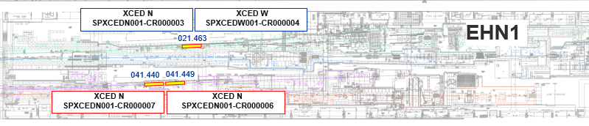
H6 XCEDS
DIAPHRAGM COUPLING
CLEAN ROOM
GAS SYSTEM
ONGOING ACTIVITIES SUMMARY
The H6 XCEDs are currently out of operation
  Missing PMTs
  Gas Leak
  Missing Cabling for XCED N06
XCED N07 will be fully operational after the 2025 TS – Commissioning predicted to start on the 07.07.2025:
10 new PMTs received on 06.2025
Gas Leak will be repaired during TS
XCED N06 will be fully operational until end of 08.2025
New cabling extension will be produced by BE-EA until 08.2025 – The XCED N06 will operate with the control of XCED N07 temporarily
A new request (RESCOPING FROM PHASE II TO PHASE I) was created and approved:
03.04.2025 - Budget Change Request - XCEDs - WP3.1.2 - 10 PMTs - Rescoping from PHASE II to PHASE I - EDMS3227498
14.04.2025 - DAI 10984078 - Acquisition of 10 new PMTs
A new request was created during 04.2025 to fully re-cable the XCED N06 :
PLAN activity : 14392 – XCED new cabling installation EHN1
DIC crated : RQF3137612 - Cable installation, number of cables: 46, length: 4600, SPS North Area, YETS 25-26
Discussed with and endorsed by Yacine – BCR needs to be placed for the MTP 2026 exercise if required
ECR – EDMS3286149

Slide 8
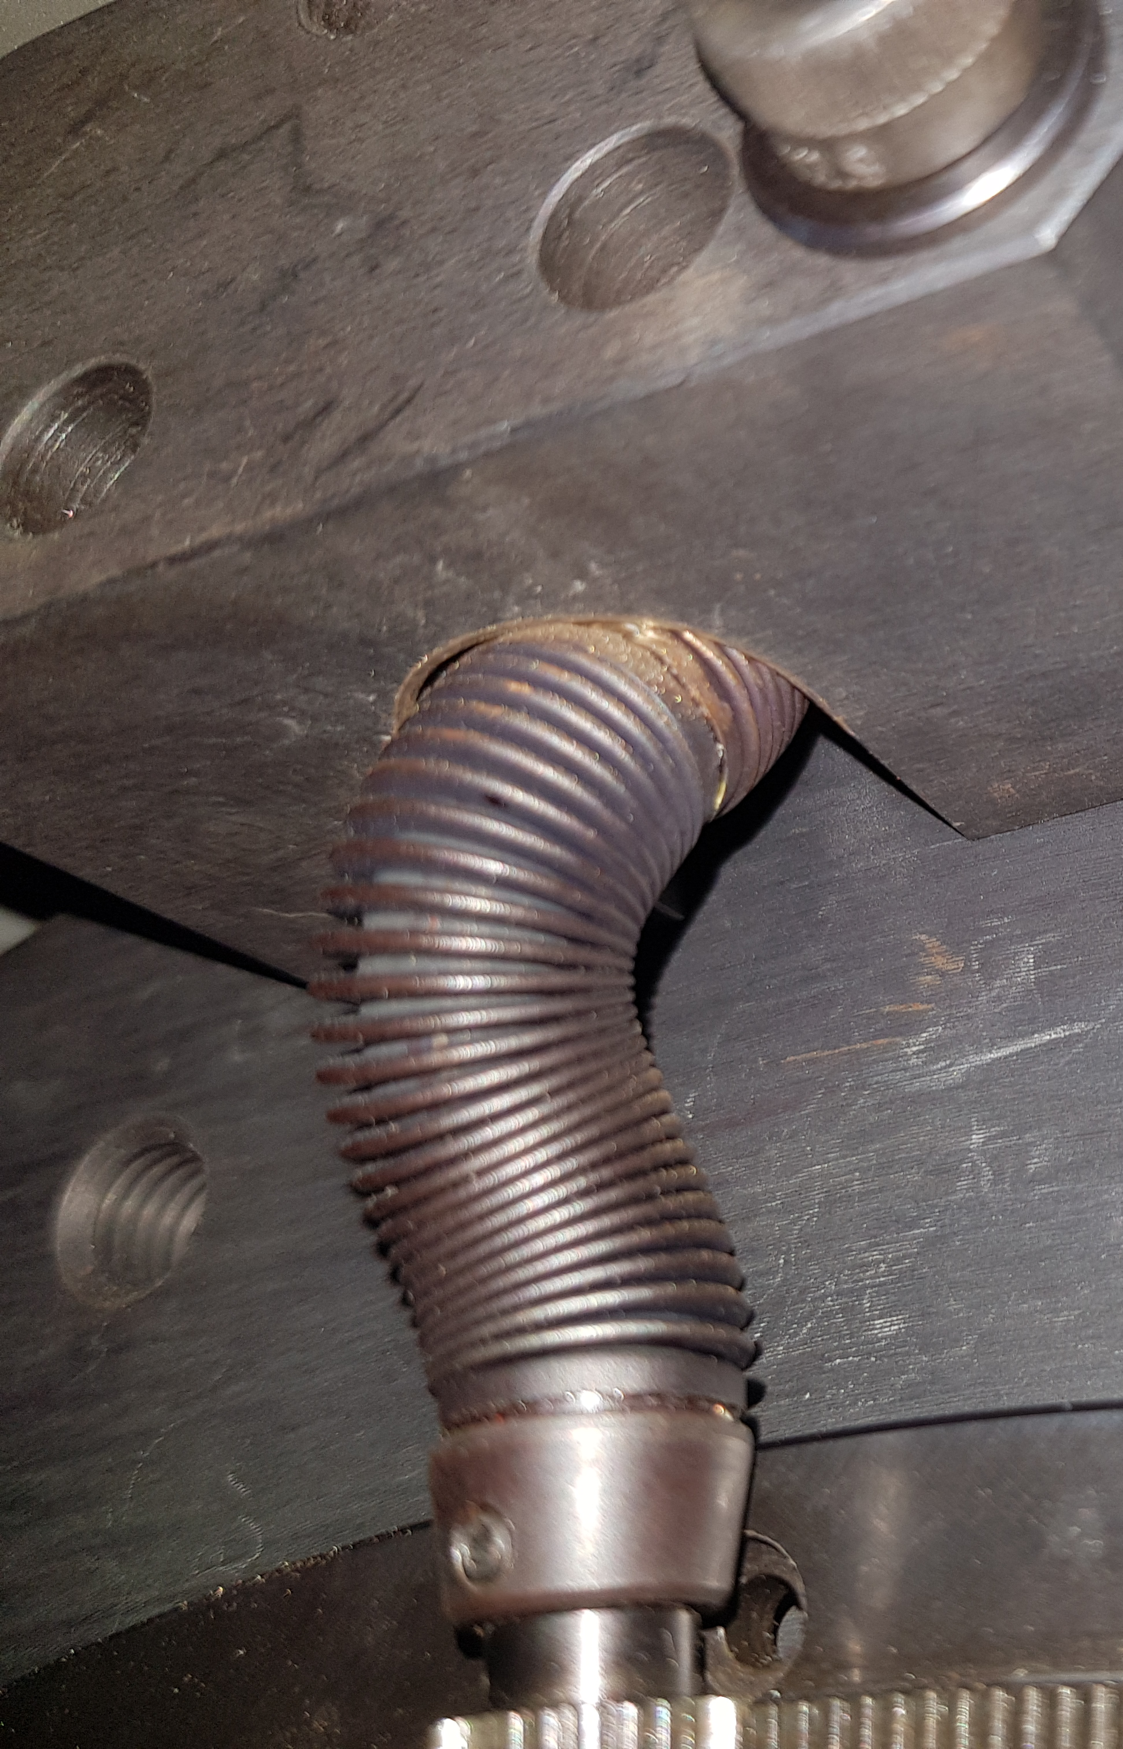
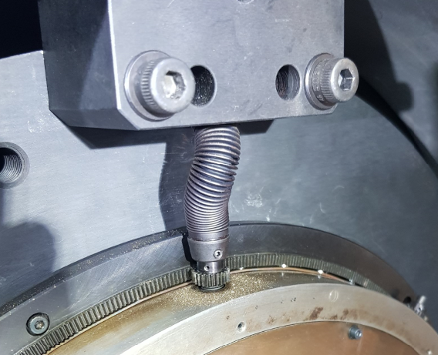
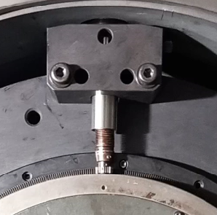
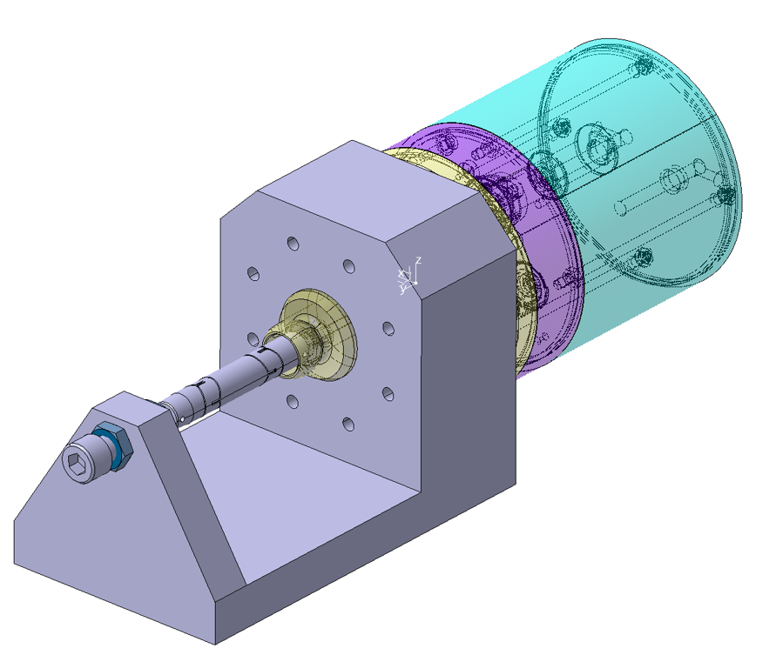
H6 XCEDS
DIAPHRAGM COUPLING
CLEAN ROOM
GAS SYSTEM
ONGOING ACTIVITIES SUMMARY
The diaphragm coupling issues are well known since 2022
Usually, paired with a poor adjustment and/or degradation of the motor clutch and diaphragm bearings leads to:
  Deformation of the coupling → AMBER 2022/2023
  Degradation and failure of the connections → XCEDH 2022/2023
  Diaphragm unusable for operation – Not possible to adjust it precisely or adjust it at all → AMBER 2022/2023
Mitigation measures science 2024 are being taken to ensure availability,
This mitigation has so far been implemented in:
  SPXCEDN001-CR000006
  SPXCEDN001-CR000020
  SPXCEDN001-CR000002
ANTI BUCKLING SLEEVE
A new solution is in R&D:
  Based on compliant mechanisms
  Rigid coupling with flexible joints small enough to be used in the XCED
FAILURE OF COUPLING IN AMBER XCED
Tests ongoing
COMPLIANT JOINTS COUPLING
TEST BENCH FOR RELIABILITY STUDY

Slide 9
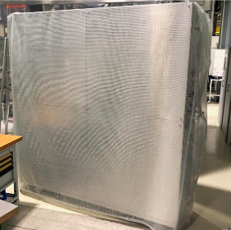
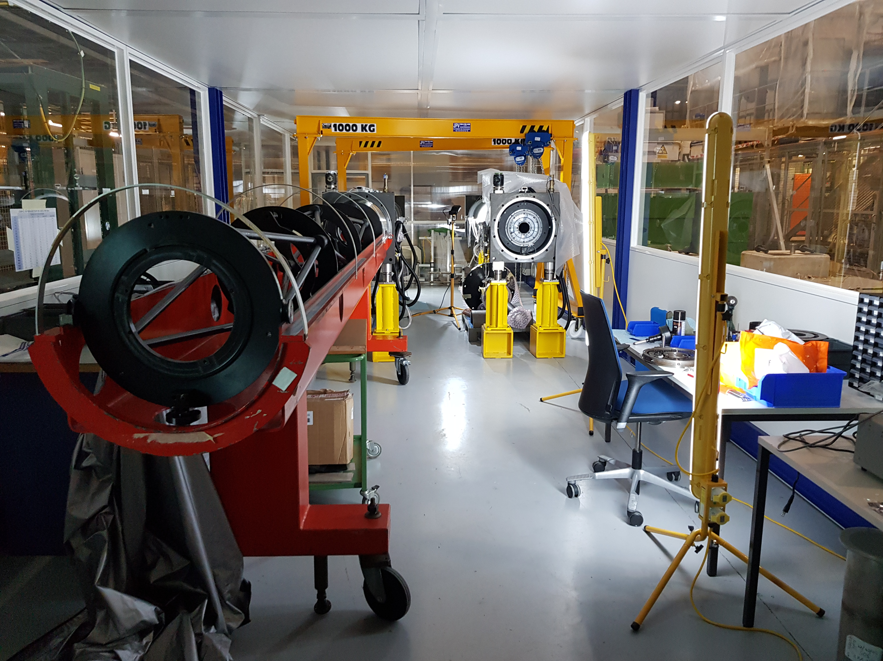
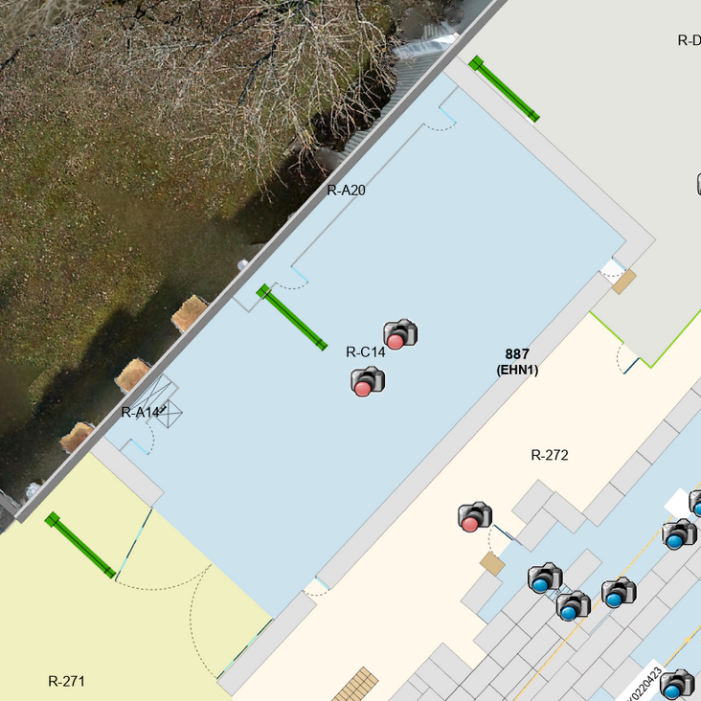

H6 XCEDS
DIAPHRAGM COUPLING
CLEAN ROOM
GAS SYSTEM
ONGOING ACTIVITIES SUMMARY
A new clean room/area for the XCED consolidation will be required.
The current clean room lack basic services such as lighting, water, gas and space
The future clean area will provide all amenities needed to ensure the safety and quality of all operation required to consolidate each XCED during PHASE II. → Functional Specifications EDMS3189466
The new clean area will be equipped with ventilation walls to guarantee cleanliness of the air surrounding the XCED – cleanliness level up to ISO CLASS 7 → Technical Specifications EDMS3293815
Procurement ongoing
Current Clean Room location 887/R-P89
New clean area location in 887/R-C14
Ventilation walls

Slide 10
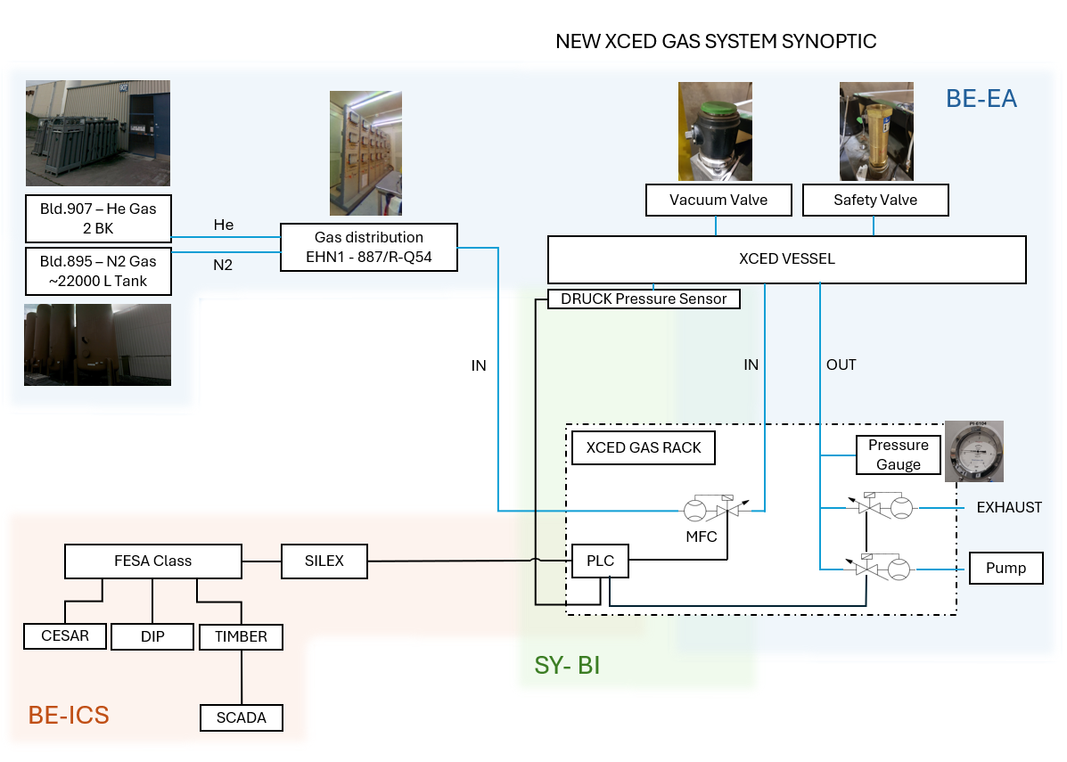
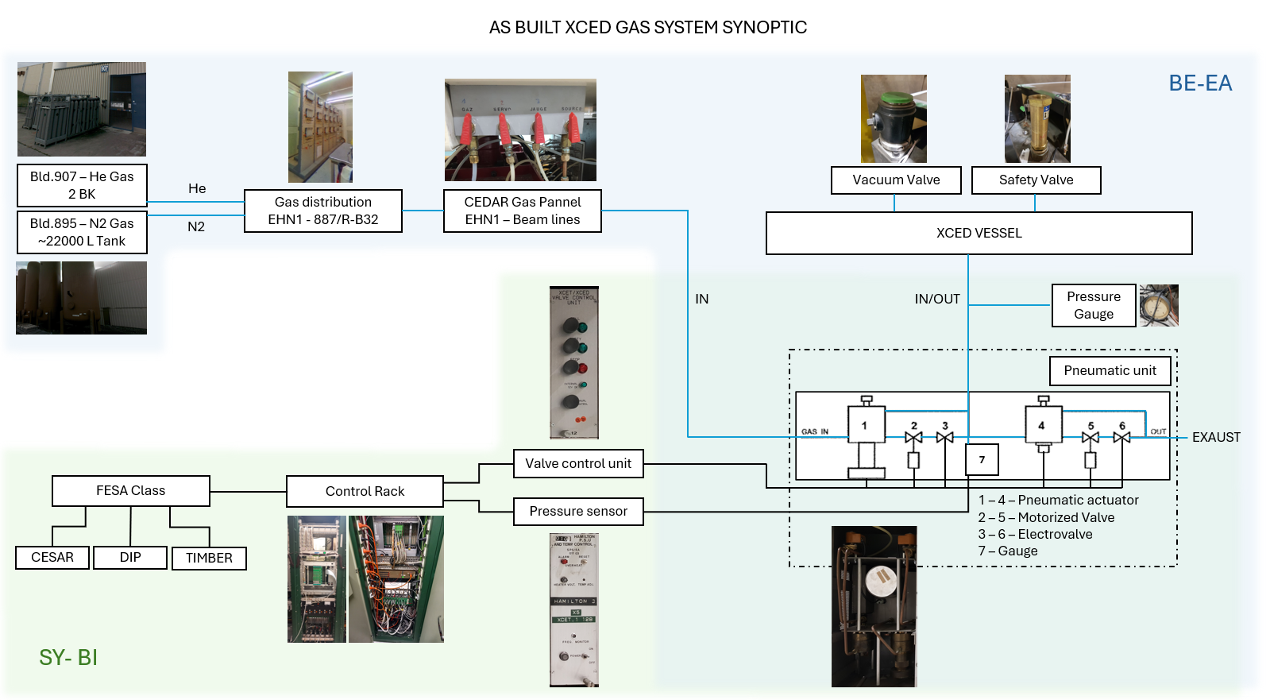
ONGOING ACTIVITIES SUMMARY
H6 XCEDS
DIAPHRAGM COUPLING
CLEAN ROOM
GAS SYSTEM
A new PLC Based Gas System is being design for the XCEDs replacing outdated current system. This Consolidation will see the improvement of the GAS System to align with the XCED user requirements: EDMS2813075
A collaboration between BE-EA / SY-Bi and BE-ICS is on going to produce the first prototype until Q1 2026
Functional Specification on going

Slide 11
ISSUES
Budget available in NACONS – 90 kCHF
TOTAL COST OF CLEAN AREA – 271 kCHF
Cost of the clean area: 230 kCHF
Cost of Infrastructure renovation 40 kCHF
1 - Clean area over cost:
181 kCHF not covered by the WP
The solution might pass by sharing the cost between:
NACONS (90kCHF) / HI-LUMI (30kCHF) and BE-EA (151kCHF)
Discussions on going
A new request was created during 04.2025 to fully re-cable the XCEDs in H6 :
PLAN activity : 14392 – XCED new cabling installation EHN1
DIC crated : RQF3137612 - Cable installation, number of cables: 46, length: 4600, SPS North Area, YETS 25-26
2 - New cabling request for H6*:
30kCHF not covered by the WP
Discussed with and endorsed by Yacine – BCR needs to be placed for the MTP 2026 exercise
*What about XCEDs in other beamlines (H2 and M2)?
PMTs covered by BI & EA (should) amount to 32 + 8 Spares = 40:
  8 x PMTs for SPXCEDN001-CR000006 – 0 Available
  8 x PMTs for SPXCEDN001-CR000007 – 10 New PMTs available
  8 x PMTs for SPXCEDN001-CR000003 – 8 old PMTs available
  8 x PMTs for SPXCEDW001-CR000004 – 8 old PMTs available
  8 x Spares - 0 Available
3 - Do we have enough PMTs to cover all operational XCEDs until LS3?
And for PHASE II ? → Budget available in PHASE II = 65kCHF
4 - Gas system will change for PLC based control meaning we will have to change also motorization to not have two different control logics.
Impact evaluation on going
5 – New optics validation → dependent on H6 availability and test results with impact for the procurement of new W type optics.
No major impact (spares) but possible postponing of this deliverable to 2026

Slide 12
NACONS BASELINE + SCHEDULE
Resources | PHASE I |  |  |  |  |  |  |  | PHASE II
 | 2021 | 2022 | 2023 | 2024 | 2025 | 2026 | 2027 | 2028 | 2029 | 2030 | 2031 | 2032 | 2033 | 2034
Design [kCHF] |  | 1 |  | 5 | 20
Material optics [kCHF] |  | 55 |  |  | 110 |  |  |  |  | 110
FSU optics tests [kCHF] |  | 3 | 2 |  |  | 5 |  |  |  |  | 5
Material pressure vessel and supports [kCHF] |  | 5 |  |  |  |  |  |  |  | 17 | 17 | 17
FSU pressure vessel and supports [kCHF] |  |  |  |  |  |  |  |  |  | 3 | 3 | 3
Material mechanics [kCHF] |  | 5 |  |  |  |  |  |  |  | 5 | 5 | 5
Material PMTs [kCHF] | 7 | 8 |  |  | 25 |  |  |  |  | 20 | 45
Material thermal housing [kCHF] |  |  |  |  | 35 |  |  |  |  | 70 | 70
Material gas system [kCHF] |  |  |  |  | 45 |  |  |  |  | 85 | 80 | 80
FSU gas system [kCHF] |  |  |  |  |  | 10
Clean room [kCHF] |  |  |  |  | 90
FSU Clean room [kCHF] |  |  |  |  | 5 |  |  |  |  | 2 | 2 | 1
XCED Spare |  |  |  | 10
TOTAL [kCHF] | 7 | 77 | 2 | 15 | 330 | 15 |  |  |  | 317 | 227 | 106
EDMS 2742855 REV3.0
PHASE I → Production of 1 x XCED spare including:
2023 - 2028
    Design work - completion of 3D model + Thermal housing + New gas system
    New set of optics W
    New PMTs – New request 2025
    New thermal housing
    New gas system
    New clean area
    XCED Spare – New request 2024
DONE
ON GOING
DONE
ON GOING
ON GOING
DONE
PHASE II → 6 x CEDAR consolidation 2028 - 2030
    2 x CEDAR H6
    2 x CEDAR H2
    2 x CEDAR M2
DG FUND
MAINLY FOR XCEDH
+ NEW OPTICS N
NACONS

Slide 13
NACONS NEW REQUESTS
Resources | PHASE I |  |  |  |  |  |  |  | PHASE II
 | 2021 | 2022 | 2023 | 2024 | 2025 | 2026 | 2027 | 2028 | 2029 | 2030 | 2031 | 2032 | 2033 | 2034
Design [kCHF] |  | 1 |  | 5 | 20
Material optics [kCHF] |  | 55 |  |  | 110 |  |  |  |  | 110
FSU optics tests [kCHF] |  | 3 | 2 |  |  | 5 |  |  |  |  | 5
Material pressure vessel and supports [kCHF] |  | 5 |  |  |  |  |  |  |  | 17 | 17 | 17
FSU pressure vessel and supports [kCHF] |  |  |  |  |  |  |  |  |  | 3 | 3 | 3
Material mechanics [kCHF] |  | 5 |  |  |  |  |  |  |  | 5 | 5 | 5
Material PMTs [kCHF] | 7 | 8 |  |  | 25 |  |  |  |  | 20 | 45
Material thermal housing [kCHF] |  |  |  |  | 35 |  |  |  |  | 70 | 70
Material gas system [kCHF] |  |  |  |  | 45 |  |  |  |  | 85 | 80 | 80
FSU gas system [kCHF] |  |  |  |  |  | 10
Clean room [kCHF] |  |  |  |  | 90
FSU Clean room [kCHF] |  |  |  |  | 5 |  |  |  |  | 2 | 2 | 1
XCED Spare |  |  |  | 10
TOTAL [kCHF] | 7 | 77 | 2 | 15 | 330 | 15 |  |  |  | 317 | 227 | 106
NEW REQUESTS FOR PHASE I → 2023 - 2028
    2024
      XCED Spare refurbishment (10kCHF) → APPROVED
    2025
      10 x New PMTs (25kCHF) → APPROVED
      Recabling H6 (30kCHF) → NOT FORMALLY APPROVED
      Others (Clean room, PMTs, Motorization) → ?
MTP 2025
MTP 2026
Pending Questions:
Do we need cabling for the other beamlines too?
Do we need more PMTs?
Extra costs for the clean room?
XCED Safety…. → being revised at the moment - impact?
XCED Pre-Commissioning tool - like beam tool ≠ sub systems test tools as used today in clean area → Cost hard to evaluate as there is not yet a concept or idea to do such instrument
DG FUND
MAINLY FOR XCEDH
+ NEW OPTICS N
NACONS

Slide 14
NEXT STEPS
2025
1 | 2 | 3 | 4 | 5 | 6 | 7 | 8 | 9 | 10 | 11 | 12
XCED N06 INSTALL
XCED N07 LEAK FIX + PMTs
H7 CABLING INSTALL
XCED N07 COMISSION
H6 LOCAL CABLING INSTALL
XCED N06 COMISSION
H6 CABLING INSTALL
N OPTICS TESTS
NEW OPTICS TYPE W PROCUREMENT
DIAPHRAGM FLEXOR R&D
DIAPHRAGM FLEXOR MANUFACTURING
DIAPHRAGM FLEXOR TESTS
NEW PMTs PROCURMENT
CLEAN AREA VENTILATION WALLS PROCUREMENTS + MANUFACTURING
NEW GAS SYSTEM FUNCTIONAL SPECS
NEW GAS SYSTEM DESIGN
NEW GAS SYSTEM MANUFACTURING
NEW THERMAL HOUSING R&D + FEA
NEW THERMAL HOUSING DESIGN
The XCEDs activities are independent from LS3 / TCC2 activities → NO WPA REQUIRED

Slide 15
Thank you very much for your attention!

Slide 16
INTRODUCTION
XCED PARK TODAY
3 Installed XCEDs (29.04.2025) → All 3 with issues
2 TYPE North:
  SPXCEDN001-CR000006
      Cabling missing for motorization
      Existing cabling needs renewal
      PMTs missing
      Control panels
  SPXCEDN001-CR000007
      Small but non negligible leak on the gas panel
      Cabling needs renewal
      PMTs partially missing
1 TYPE Hydrogen
  SPXCEDH001-CR000001
      Diaphragm coupling is broken – issue accepted by experiment, with no action to be considered as for the experiment is preferable to leave it as is until LS3
ECR – EDMS3286149

