Slide 1



Report 05-15
Dr. Oleg Kravcov
Vilnius

Slide 2

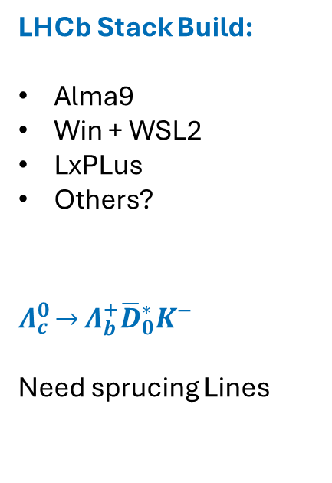
DPA?
LHCb Stack Build:
Alma9
Win + WSL2
LxPLus
Others?
$$Λ_{c}^{0}\underset{→}{}Λ_{b}^{+}{\overline{D}}_{0}^{∗}Κ^{−}$$
Need sprucing Lines
DPA
DPA

Slide 3
Code Analysis
DaVinci:
Mostly clear
2 instances of .c_Str()
Additional Libs needed:
pcre-devel
libgit2-devel
libuuid-devel
openssl-devel
bzip2-devel
libffi-devel
epel-release
Over all
Case statement if/ternary conditions repeat or always true/false
Compare i < 0, for unsigned int
Not used, or not initialized variables
Instance of 'std::lock_guard' object is destroyed immediately
Variable Shadowing

