Slide 1
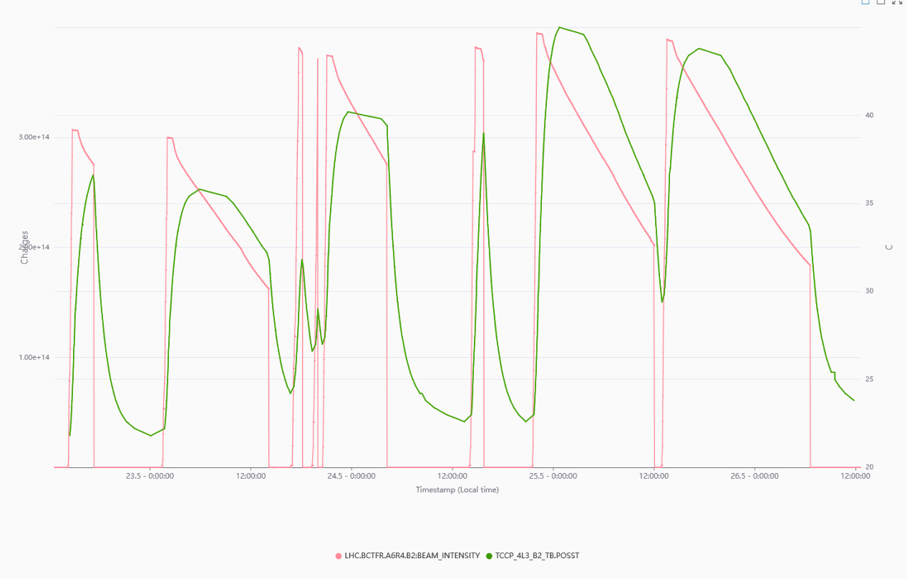
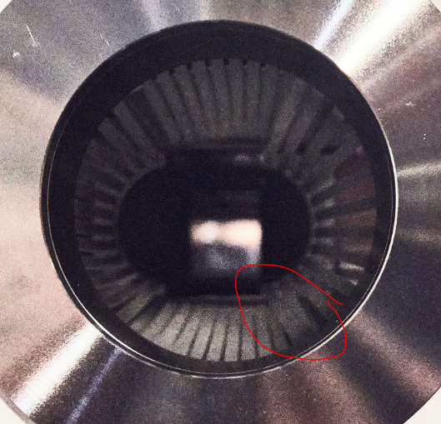
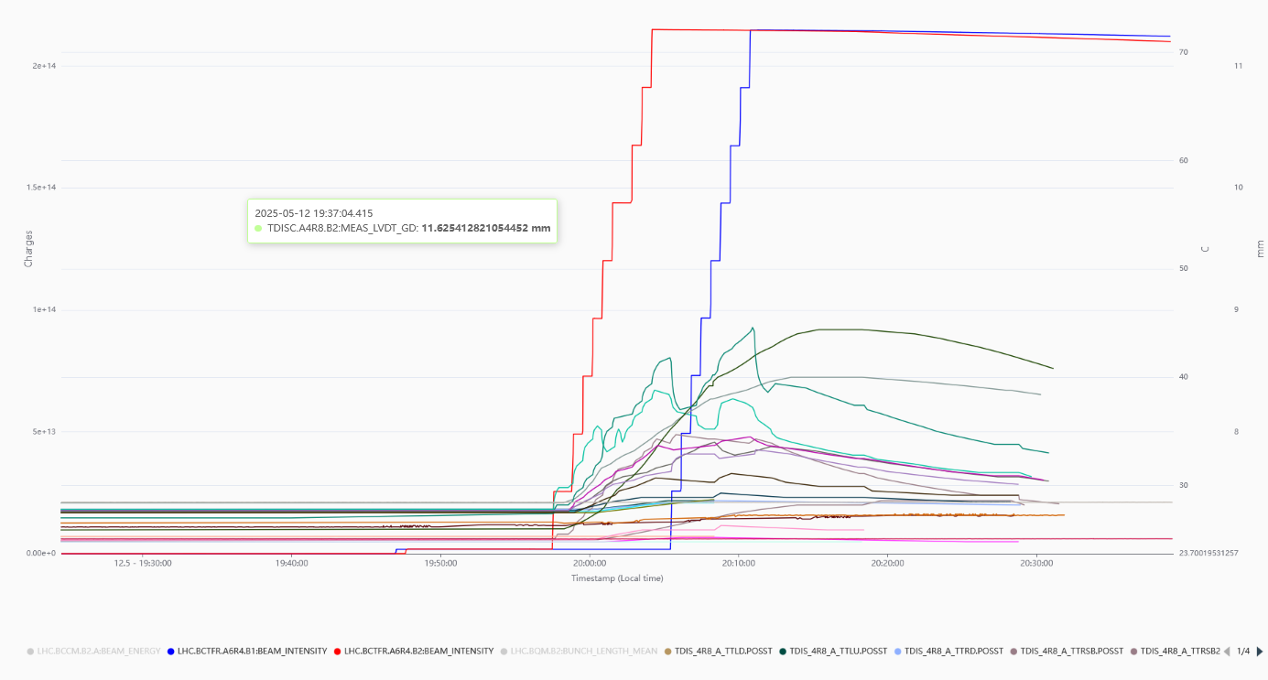
LHC matters to follow up
TCCP heating
TCLD spikes
TDIS heating
From 27 up to 42 degrees

Slide 2
Proposition to have a joint IWG ColUSM (WP5) on Friday June 13th to discuss some of these matters
  Observations of TCLD losses in 2025 operation (Natalia)
  Impedance considerations (if needed)
  Report on Xrays done in 2025 before beam operation (STI)
  Observations of IR3 crystals during proton operation (Maria? Benoit?)
  Consideration of TCCP crystal screens (Régis)

