Slide 1
Surface Resistance and Impedance Effects of LESS Processing for Q5 Magnets – AOB Follow Up
P. Krkotić on behalf of the LESS project team
M. Himmerlich, T. Madarasz, S. Calatroni
5/28/2025
100th IWG meeting

Slide 2
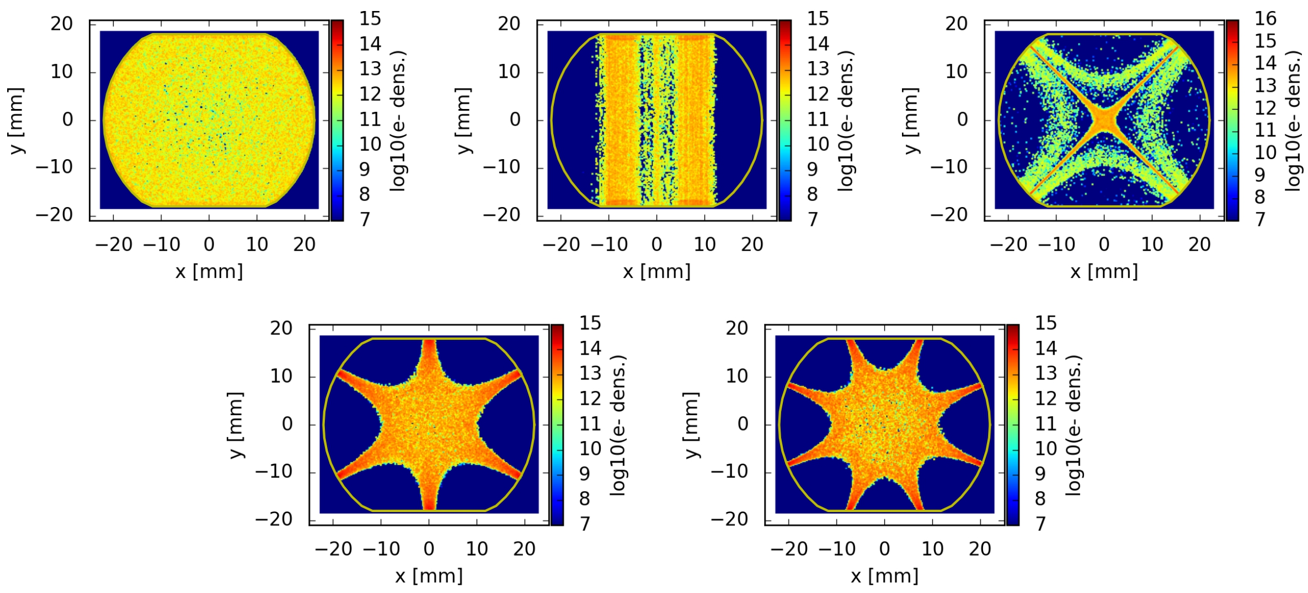
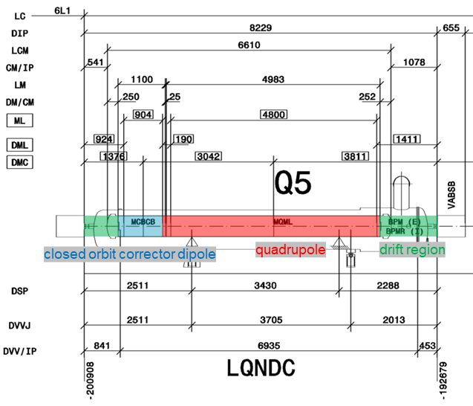
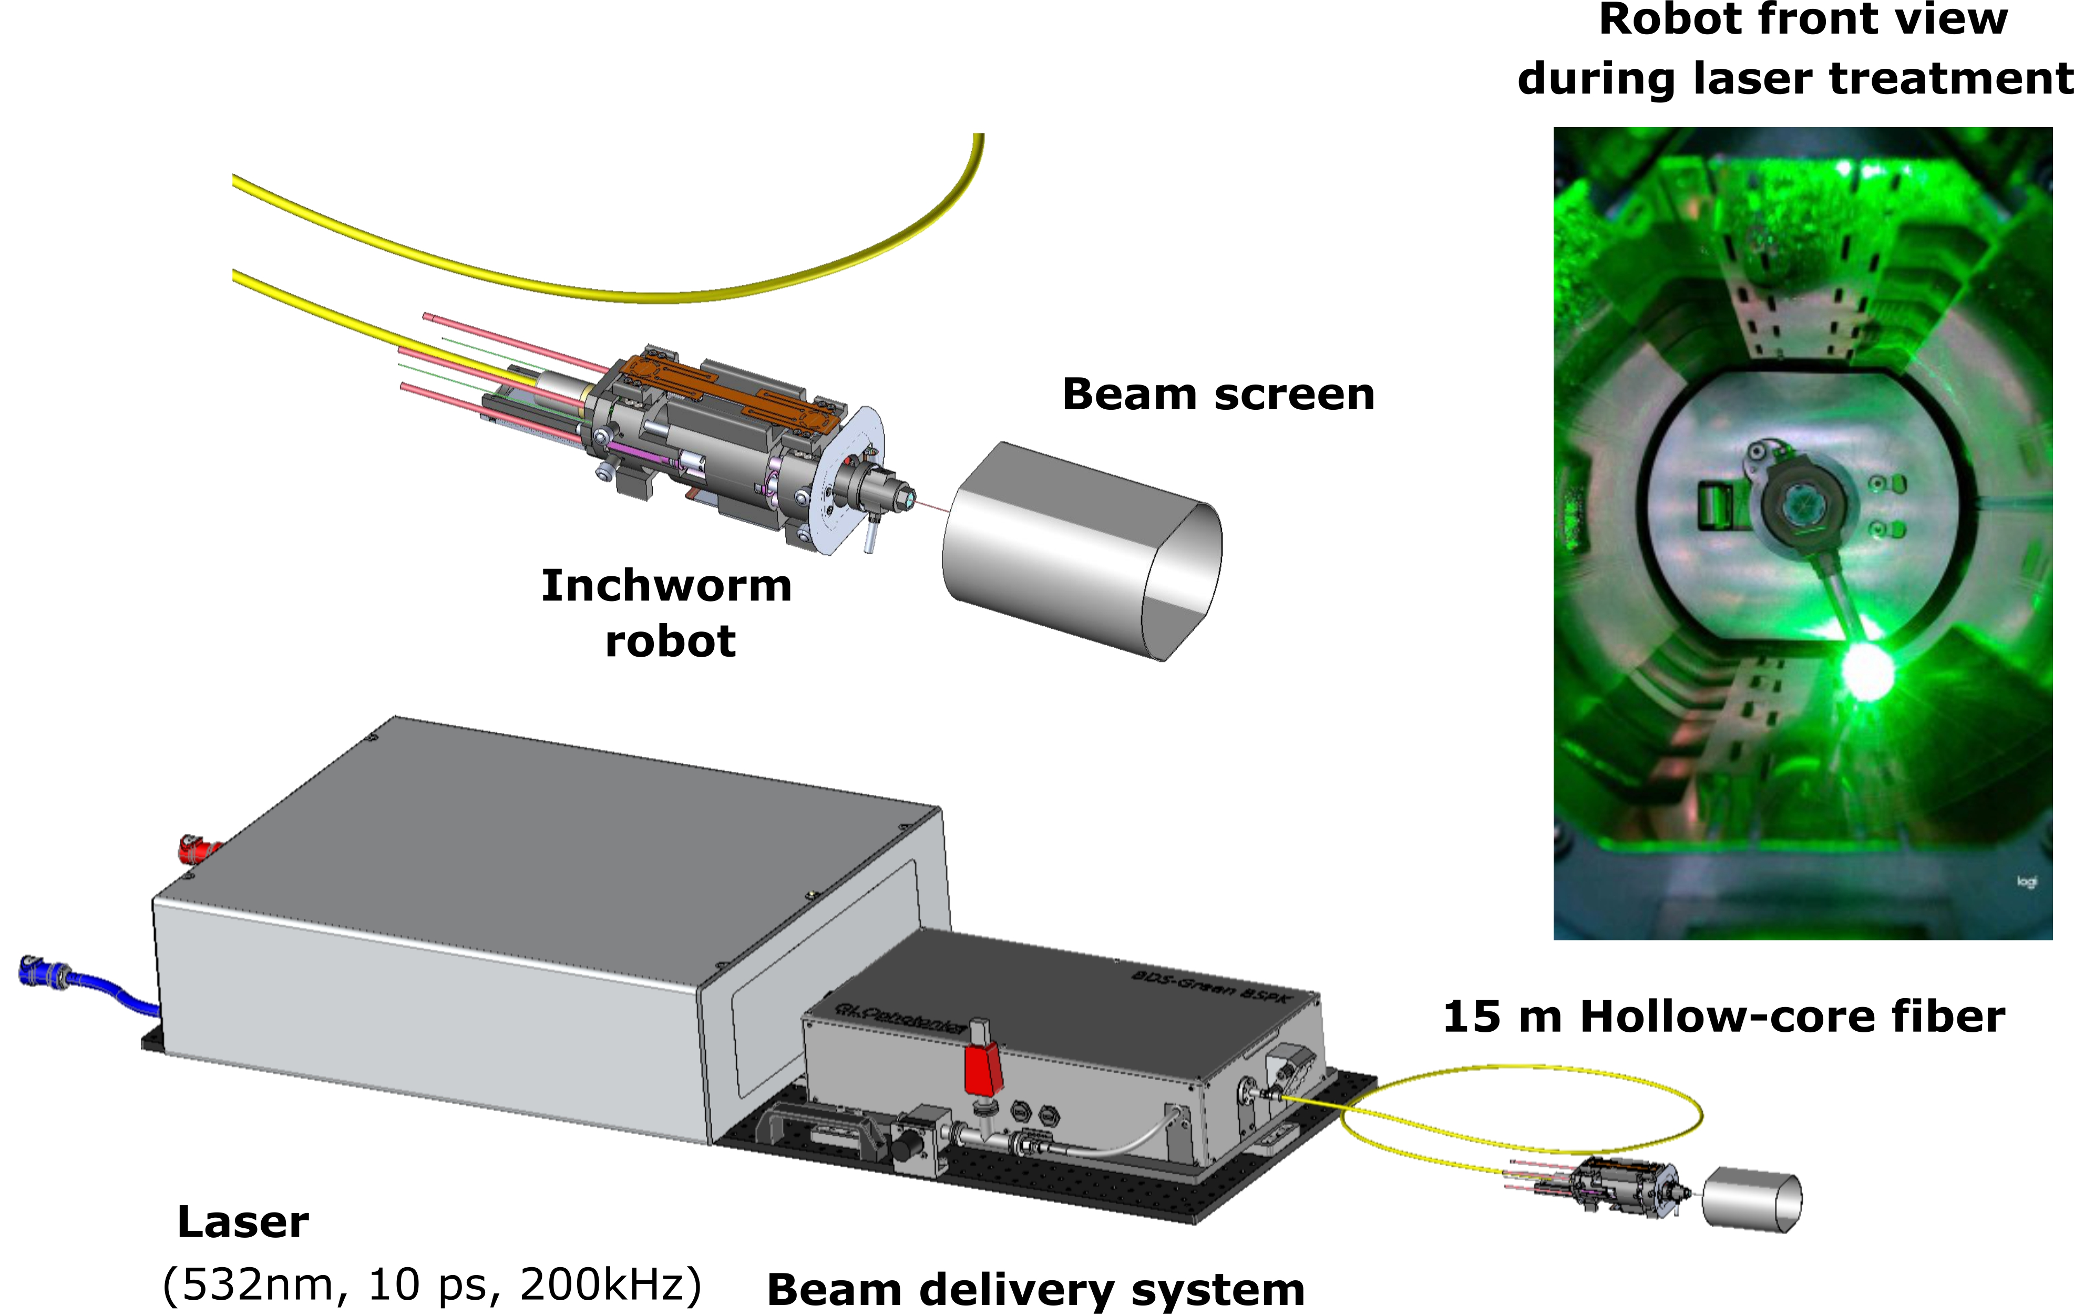
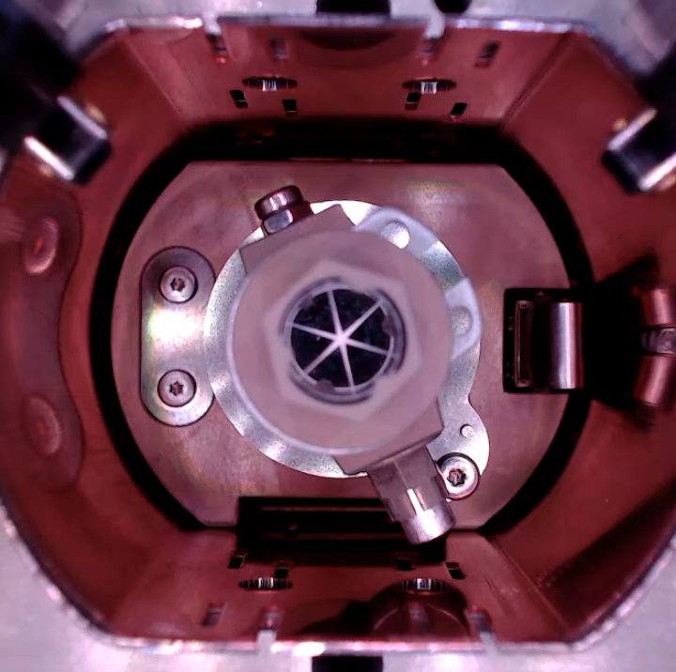
Recap
SEY reduction & e-cloud mitigation for improvement of beam quality for HL-LHC required
P. Dijkstal et al., Tech. Rep. CERN-ACC-NOTE-2017-0057, CERN, 2017.
M.Himmerlich at 97th IWG for comprehensive details

Slide 3
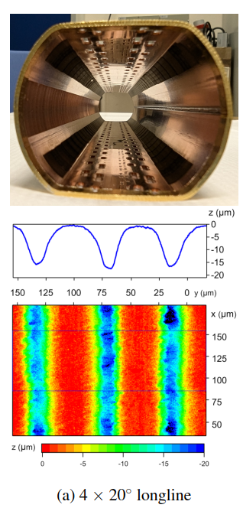
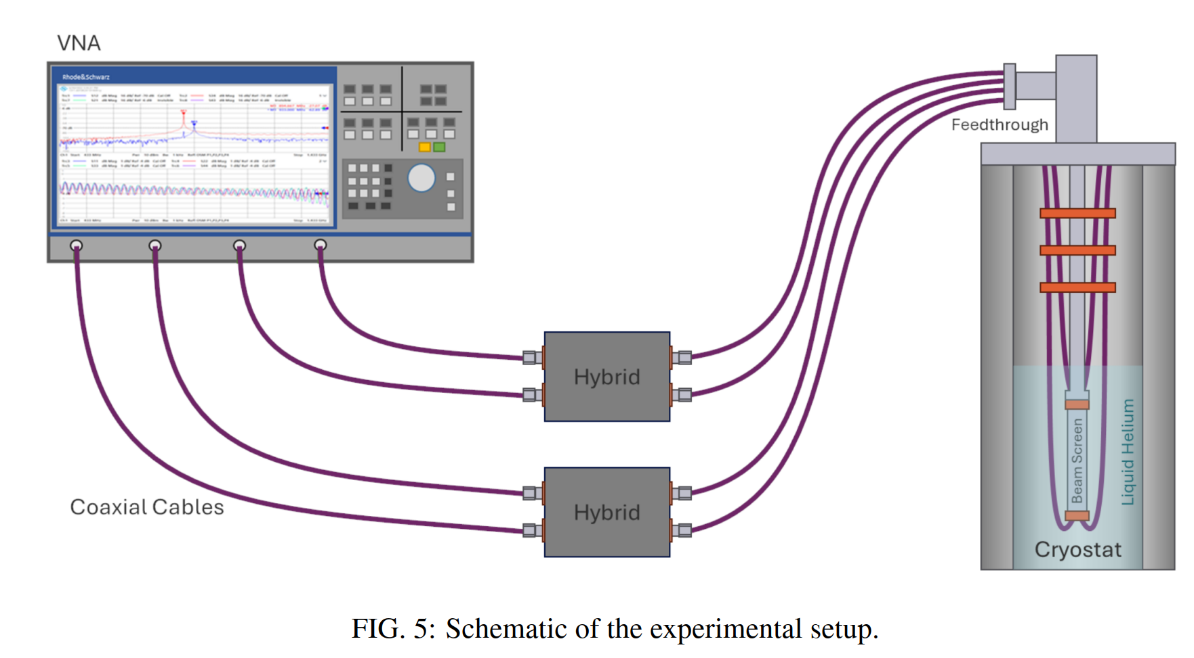
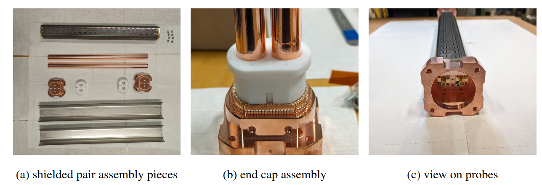

Recap
SEY reduction & e-cloud mitigation for improvement of beam quality for HL-LHC required
Surface resistance increase @ 4.2 K
$$R_{S}^{LESS}=1.41 R_{S}^{Cu}$$
M.Himmerlich at 97th IWG for comprehensive details

Slide 4
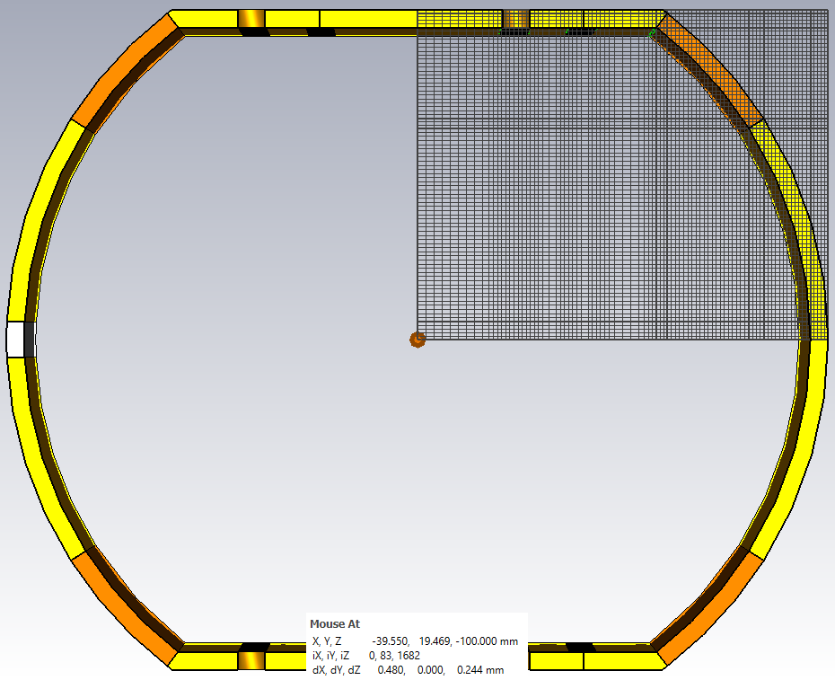
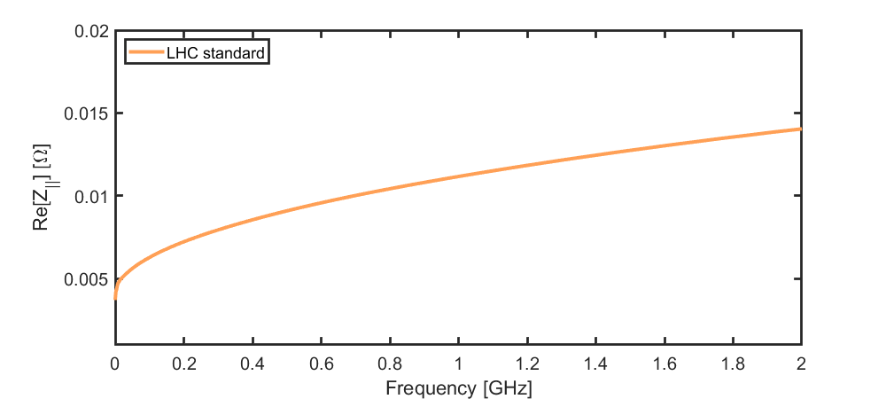
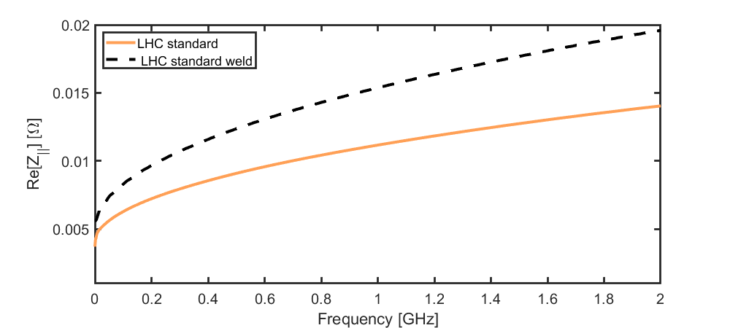
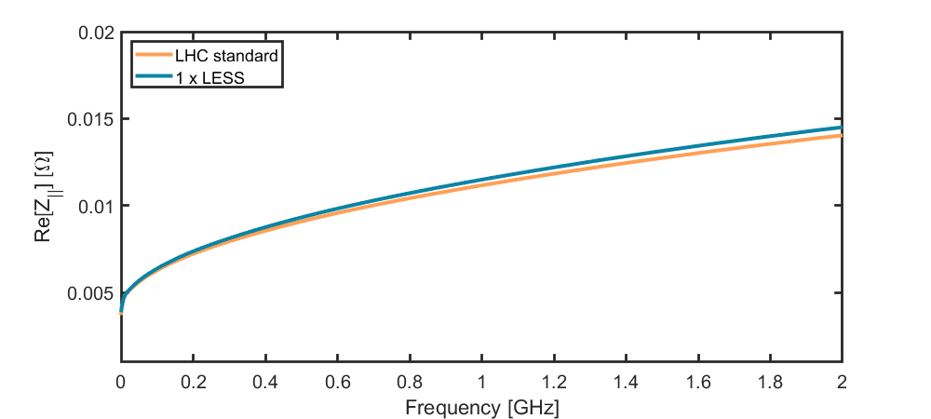
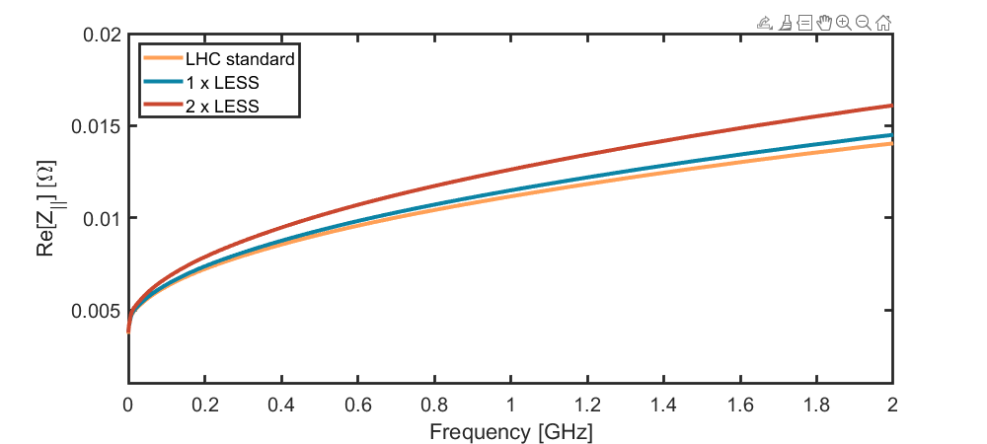
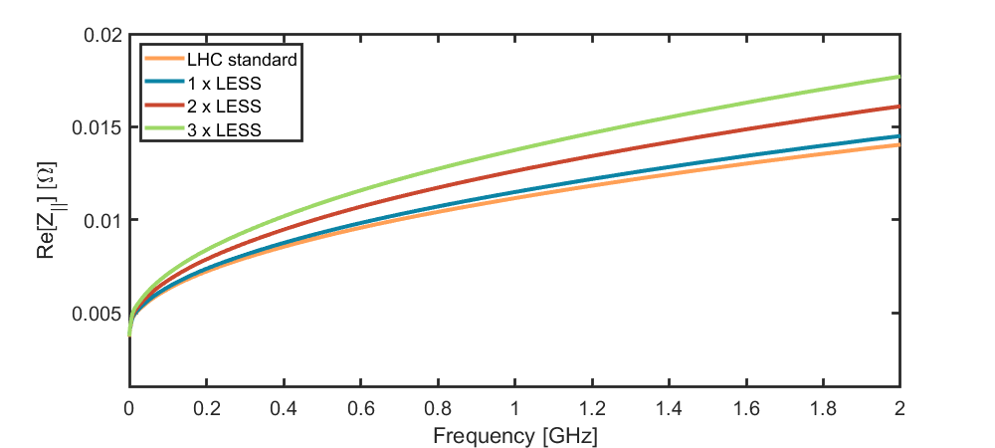
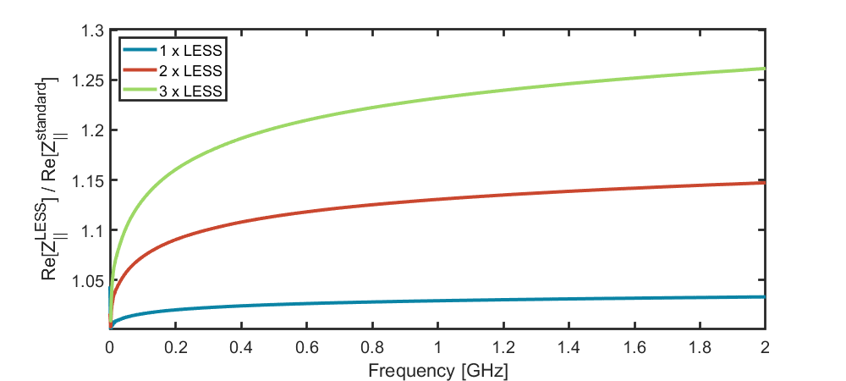
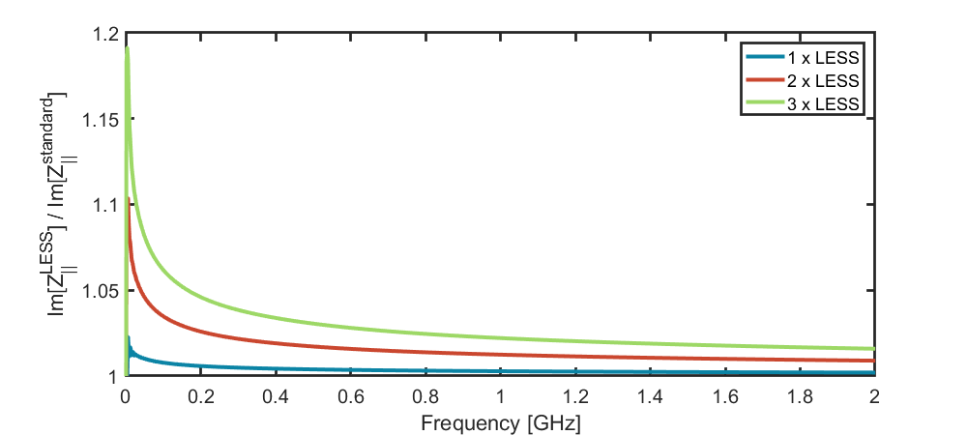
Longitudinal Impedance
  CST simulation configuration summary
Beam screen
1 m
Wakelength
100 m
# mesh cells
25 million
Bunch length
50 mm
Impact weld
excluded
RRR_{Cu} = 80
Surface resistance increase @ 4.2 K
$$R_{S}^{LESS}=1.41 R_{S}^{Cu}$$

Slide 5
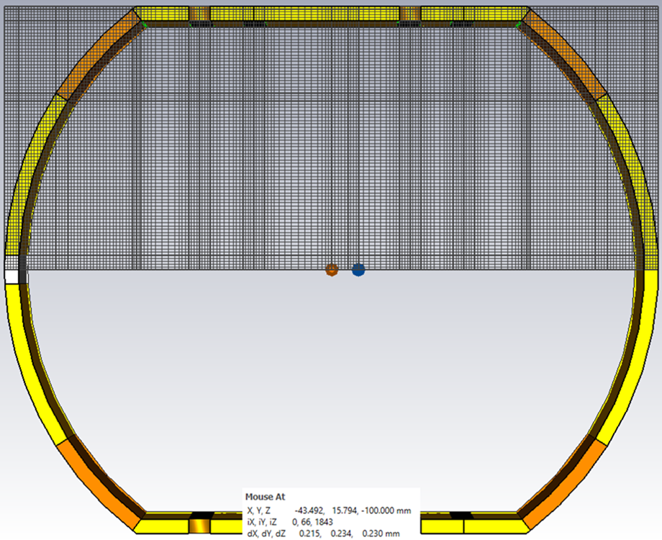
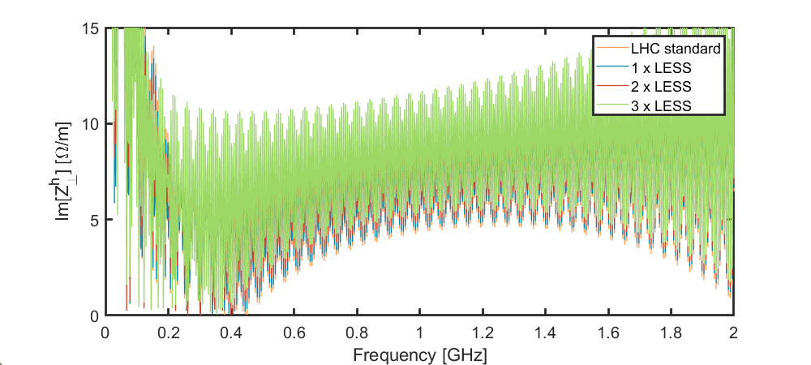
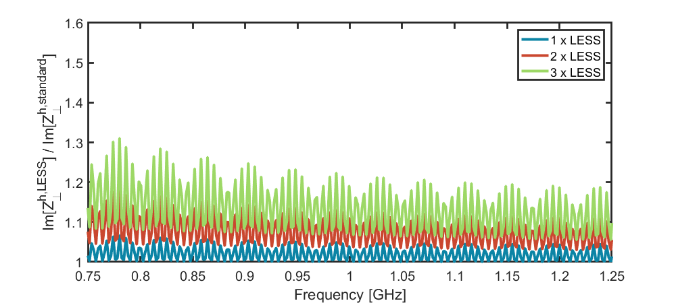
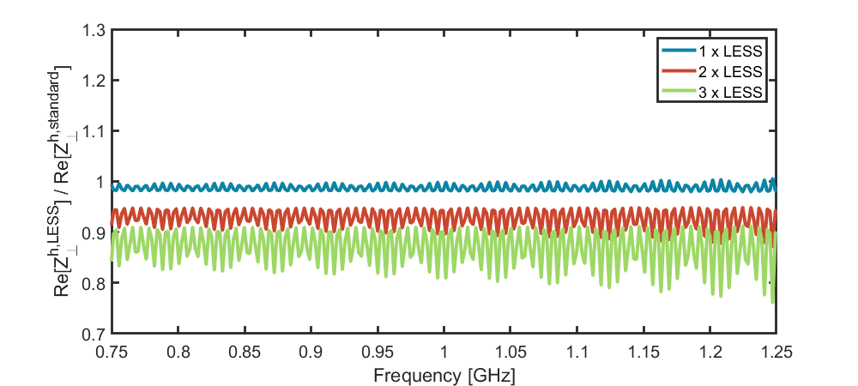
Transverse Horizontal Impedance
  CST simulation configuration summary
Beam screen
1 m
Wakelength
100 m
# mesh cells
60 million
Bunch length
50 mm
Impact weld
included
RRR_{Cu} = 80

Slide 6
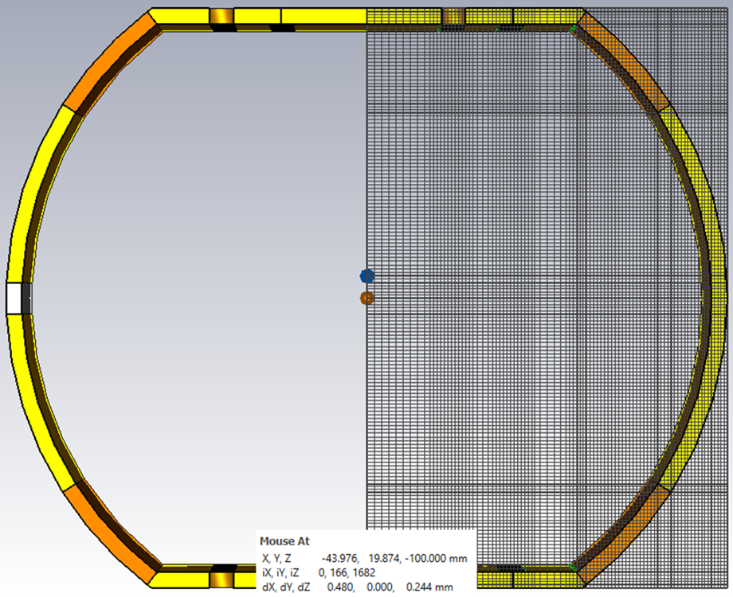
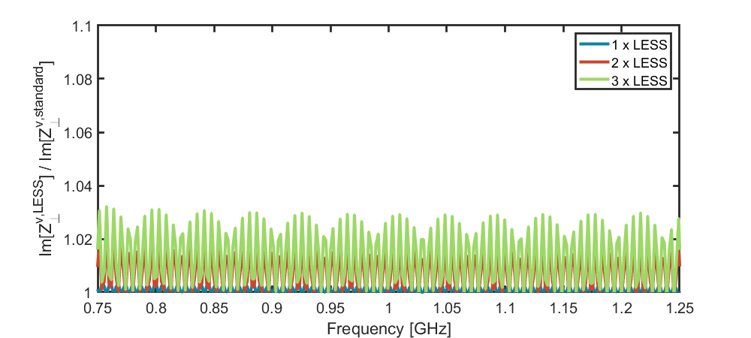
Transverse Vertical Impedance
  CST simulation configuration summary
Beam screen
1 m
Wakelength
100 m
# mesh cells
50 million
Bunch length
50 mm
Impact weld
excluded
RRR_{Cu} = 80

Slide 7
Summary
Laser processing leads to increment of copper surface impedance with anisotropy caused by the formed trenches
  Surface resistance measured
  Surface reactance unknown
Given the CST model
  No increase in the beam impedance results longitudinal and transverse, real and imaginary above a factor of 1.5 with a surface resistance approx. 5 times of copper
  The simulations are computationally intensive and may not be worth pursuing in greater detail, given the apparently low impact on the results
Does the Impedance Working Group rate the LESS treatment positive for a potential ECR to come for the Q5 magnet treatment ? -M.Himmerlich-

