Slide 1
AOB, 100th IWG meeting
C. Vollinger, C. Zannini

Slide 2
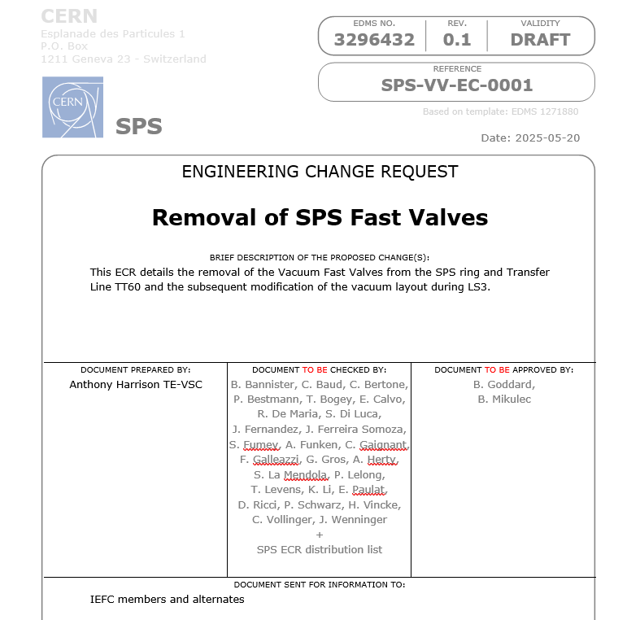
Removal of SPS Fast Valves – ECR 3296432
Fast valves were originally installed to protect delicate vacuum sectors from potential water leaks from septa cooling.
Today, these valves are considered unreliable for operation and have been blocked in open position since LS2.
For details, see ECR 3296432 directly.
Note that contrary to the many unshielded VVFAs (DN100), and VVFBs (DN150)*, these valves were not modeled for their impedance contribution in the SPS.
* Characterisation of Resonant Impedances of CERN-SPS Valves, 2017

Slide 3
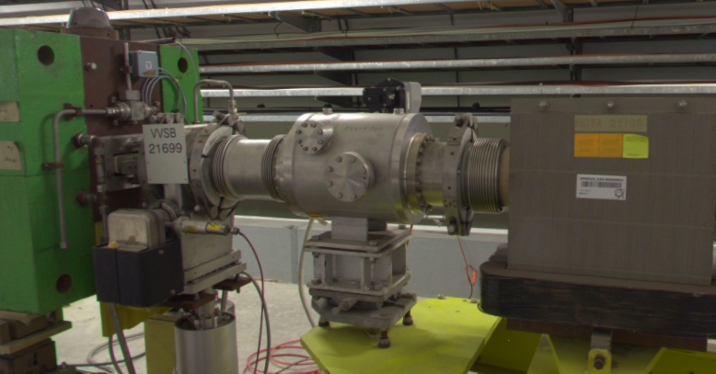
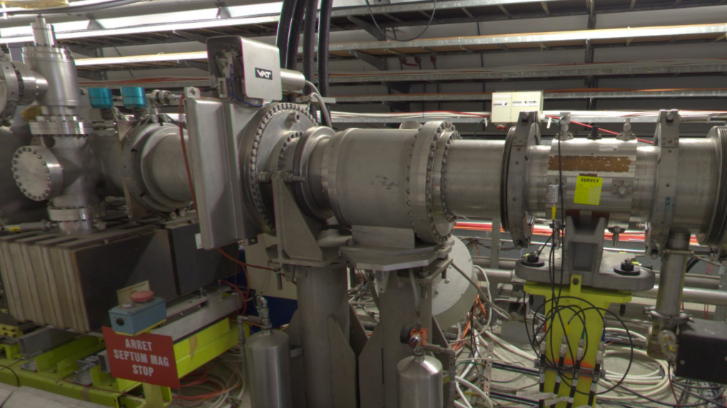
Removal of SPS Fast Valves – ECR 3296432
Proposed comment:
ACCEPTED - ECR was discussed in IWG meeting #100. IWG supports the removal of these unshielded valves as a welcome reduction of local contributions to beam coupling impedances.
Pictures taken from ECR.
Top = VVFA.21701; bottom = VVFB.21801

