Slide 1
Q4/Q5 BPM coating and
electron cloud in the orbit corrector
K. Paraschou, L. Mether

Slide 2
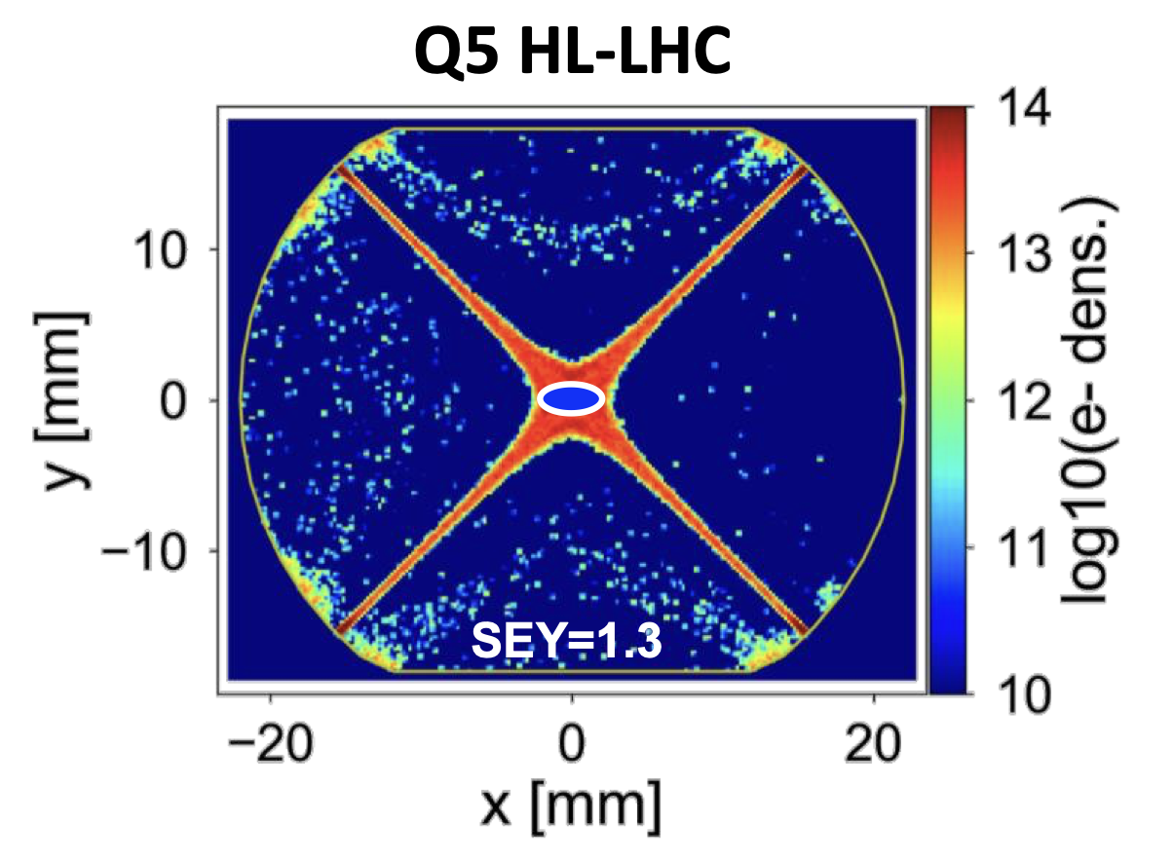
Introduction
In Run 2, proton beams in collision were found to suffer from strong incoherent electron cloud losses
  Source of losses traced to IR1/5, due to the large beta-functions
Coating with amorphous carbon adopted as baseline for full interaction region: Q5 → Q5
  G. Iadarola “Need for coating in Q4 and Q5 in IR1 and IR5”, 202nd HiLumi WP2 meeting
  G. Iadarola “Specification of SEY requirements for surface treatment of Q5 beam screens”,
  205th HiLumi WP2 meeting

Slide 3
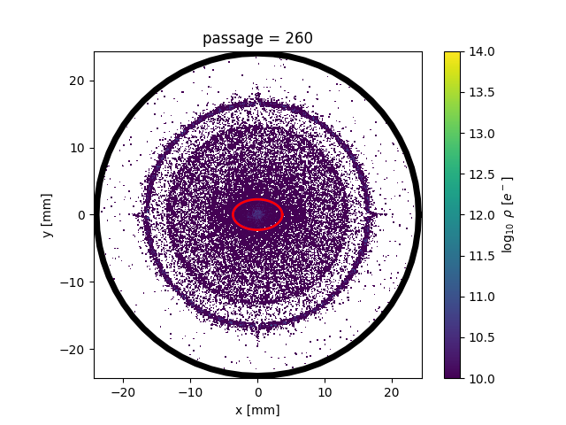
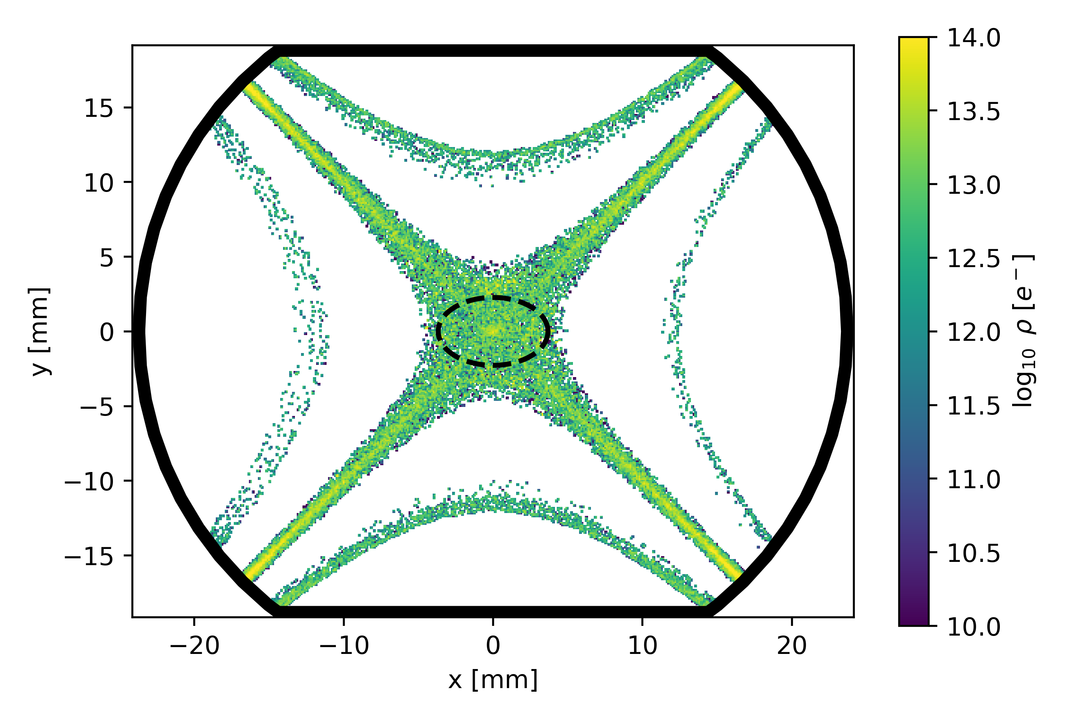
Introduction
Coating strategy for BPMs around Q4 and Q5 not explicitly considered by equipment groups
  Several technical challenges: radioactivity, limited spares → non-negligible additional cost
  M. Krupa “Coating of BPM for Q4/Q5 in IR1 and IR5”, 198th HL-LHC TCC
WP2 asked to assess impact of leaving BPMs uncoated
  K. Paraschou “Do we need amorphous carbon coating of BPMs in Q4 and Q5?”, 229th HiLumi WP2 Meeting
Q5 BPM
Q5 magnet
Decision to be taken after comparison of buildup in BPMs and dipole correctors (not currently foreseen to be coated)

Slide 4
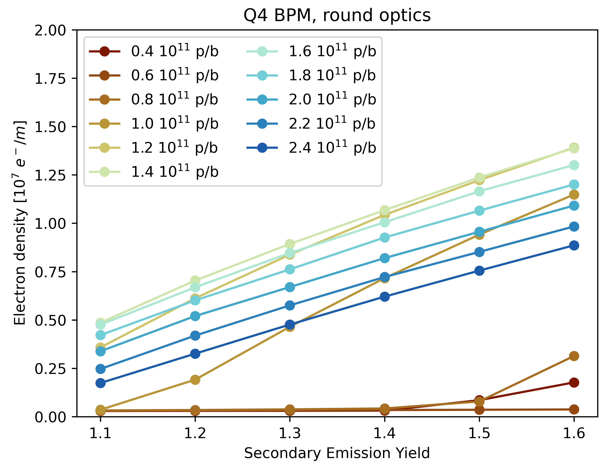
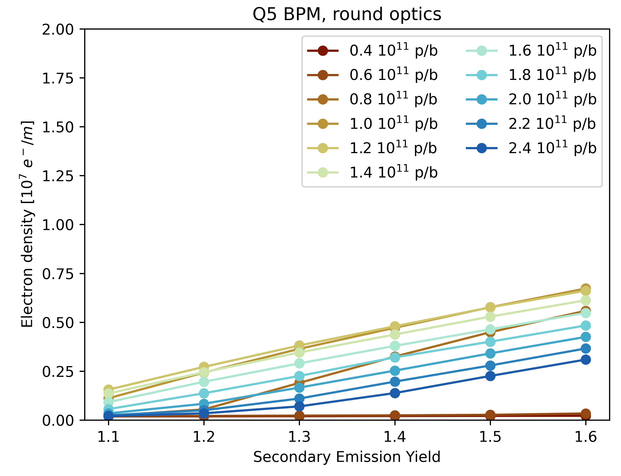
Buildup in BPMs – recap
Multipacting threshold is < 1.1 for the relevant intensities – buildup is basically unavoidable
Buildup in Q4 and Q5 BPMs is similar, with a factor ~2 difference in electron density

Slide 5
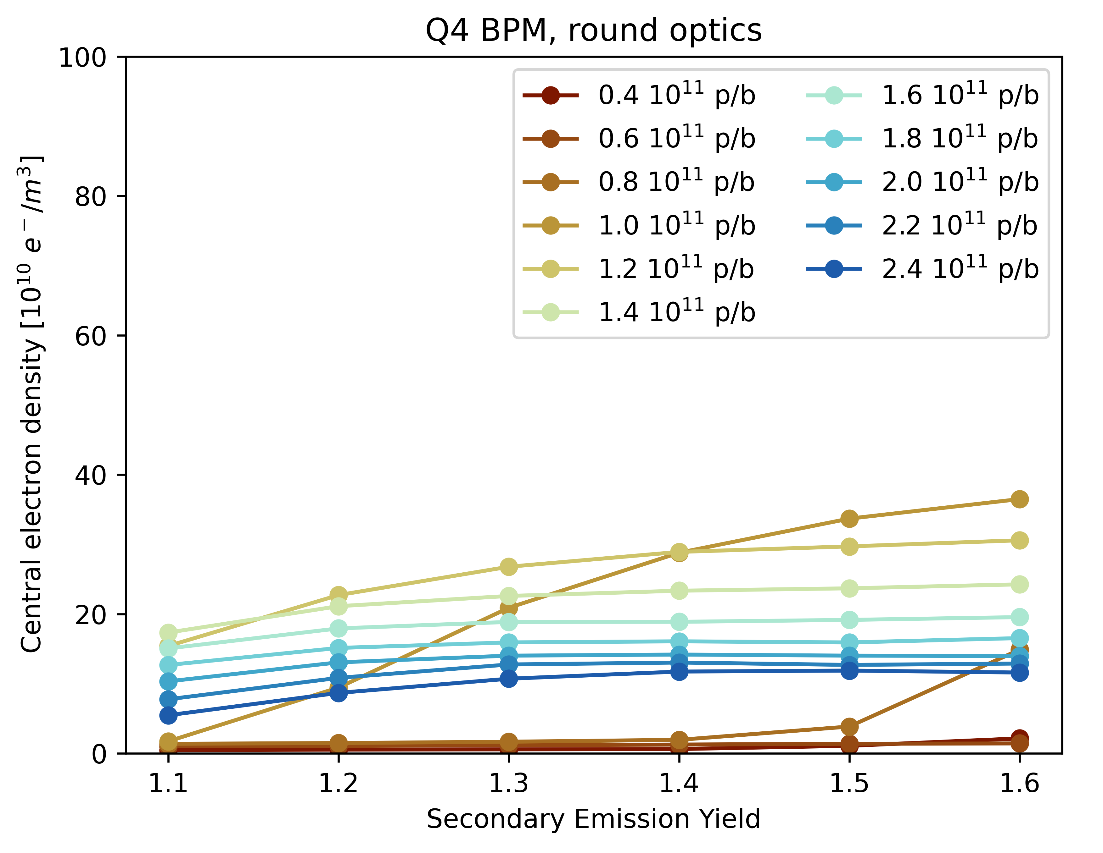
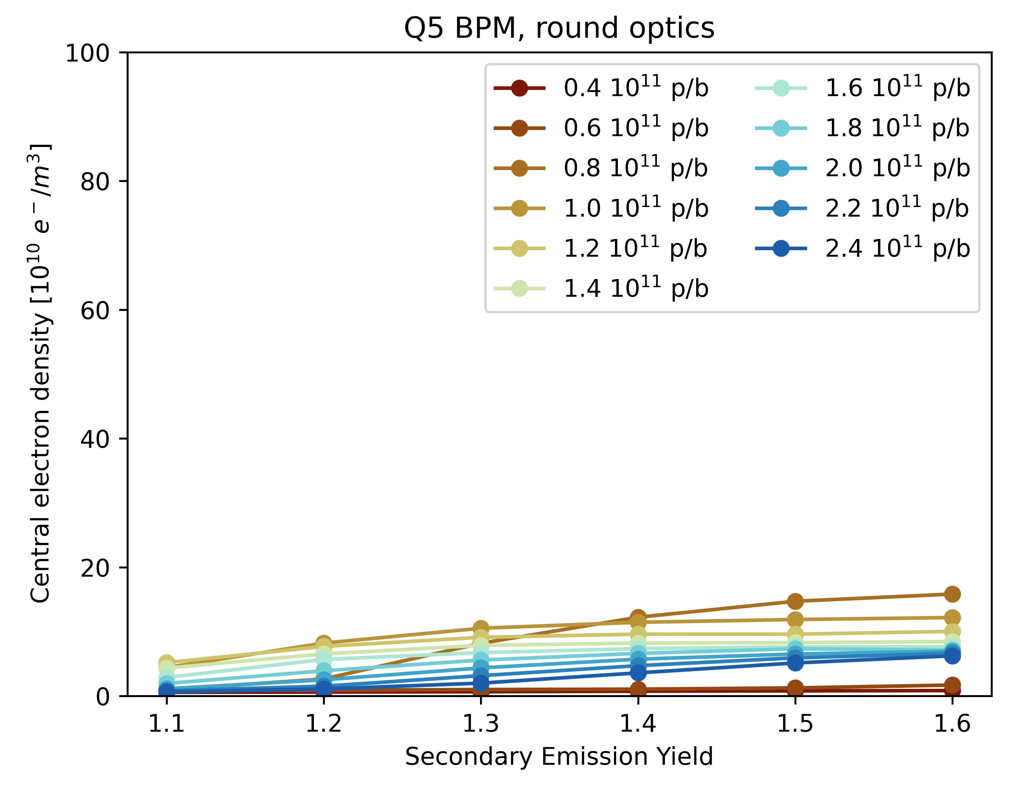
Buildup in BPMs – recap
Multipacting threshold is < 1.1 for the relevant intensities – buildup is basically unavoidable
Buildup in Q4 and Q5 BPMs is similar, with a factor ~2 difference in electron density
Central electron density goes up to 4 ∙ 10¹¹ e⁻/m³ in Q4 BPM, with Q5 BPM a factor ~2 lower
  3 orders of magnitude lower than in the Q5 quadrupole (4 . 10¹⁴ e⁻/m³)

Slide 6
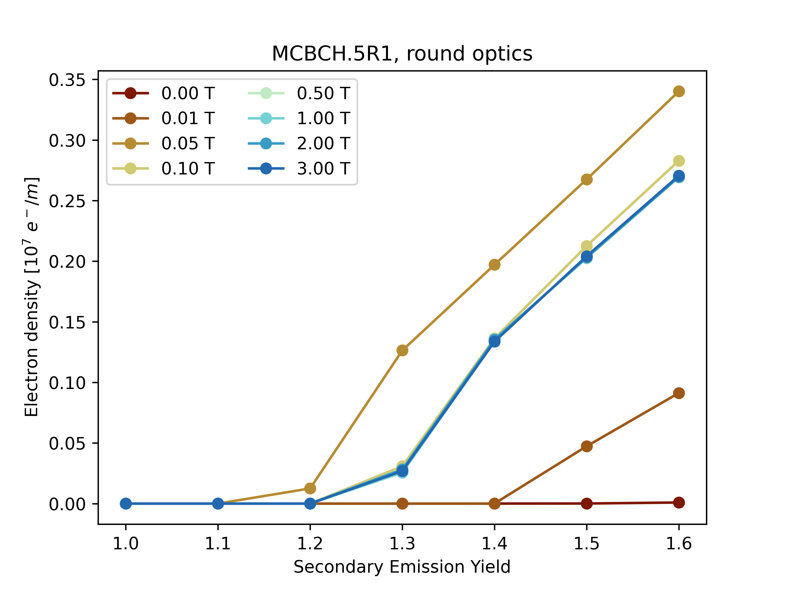
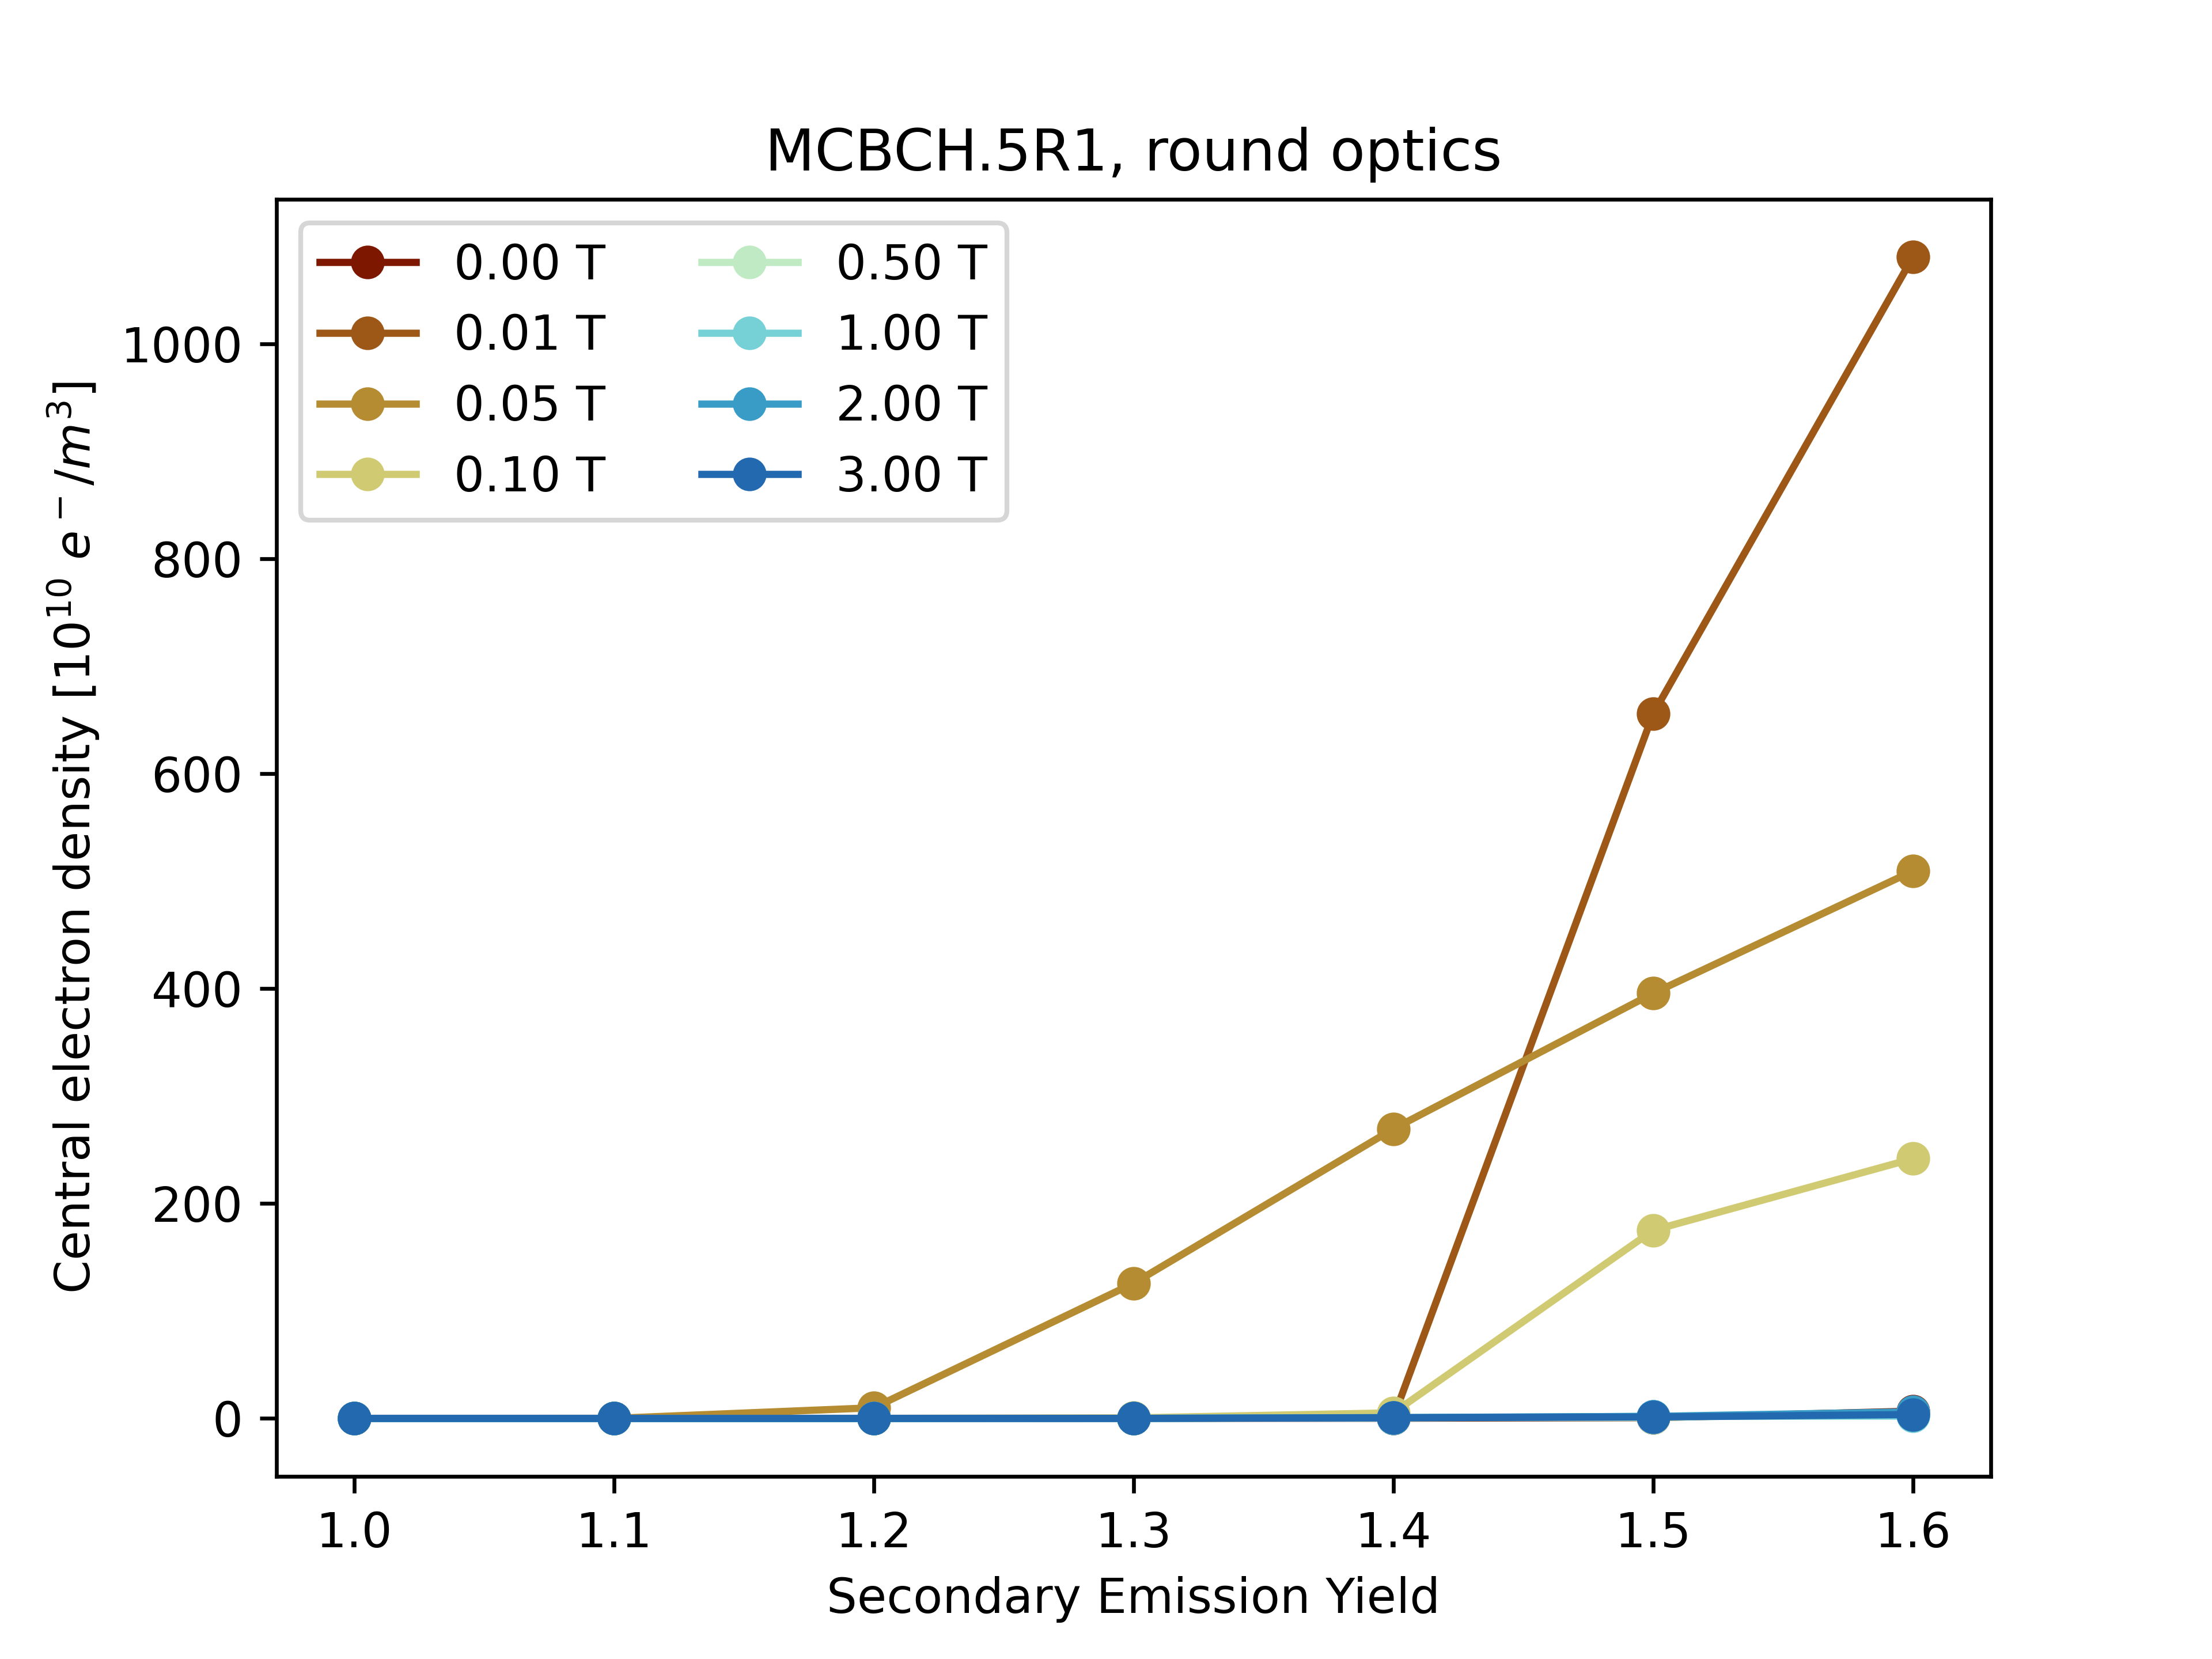
Buildup in MCBC
Buildup depends strongly on magnetic field
  Multipacting threshold is ≥ 1.2 (shown here for 1.8 ∙ 10¹¹ p/b)
Central electron density is significant only for non-zero, but low magnetic fields: 0 < B < 0.5 T
In the worst case, B ≈ 0.01 T and SEY ≥ 1.4, the central electron density goes up to 1 ∙ 10¹³ e⁻/m³
  1 order of magnitude below the Q5 magnet and 2 orders of magnitude above the BPMs

Slide 7
Summary
BPMs
Buildup occurs even for low SEY
Only mild variation of central electron density with SEY and bunch intensity
Central density 3 orders of magnitude below Q5
Low risk from leaving uncoated
MCBCs
Buildup only with SEY ≥ 1.2
Strong variation of central electron density with SEY and corrector field
Central density up to 1 order of magnitude below Q5
Low to moderate risk from leaving uncoated

Slide 9
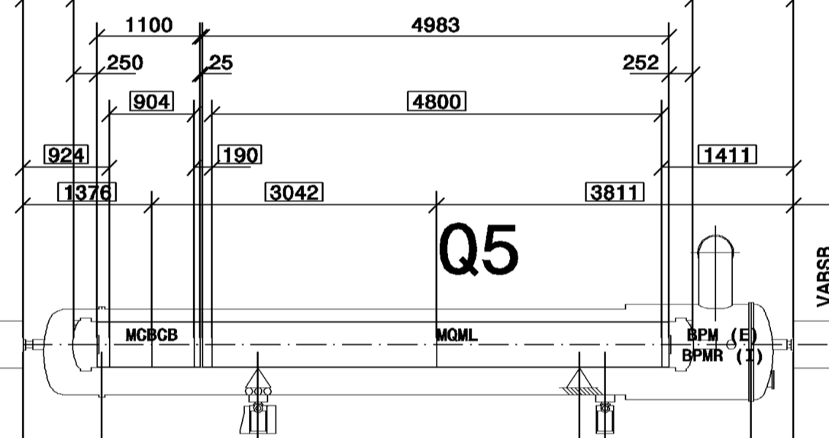
Layout

