Slide 1

UR15
As-built Tappings Compressed Air
F. Borralho / EN-CV
09.05.2025

Slide 2
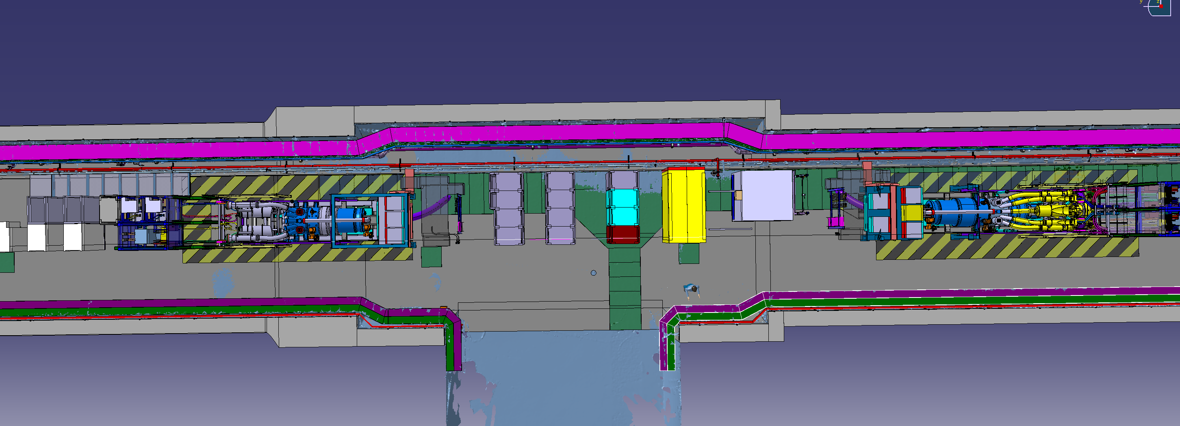
UR15 – 3D model+scan
3D model+scan
3D model+scan
UL17

Slide 3
UR15 – 3D model+scan
3D model+scan
3D model+scan
New tapping
UL17

Slide 4
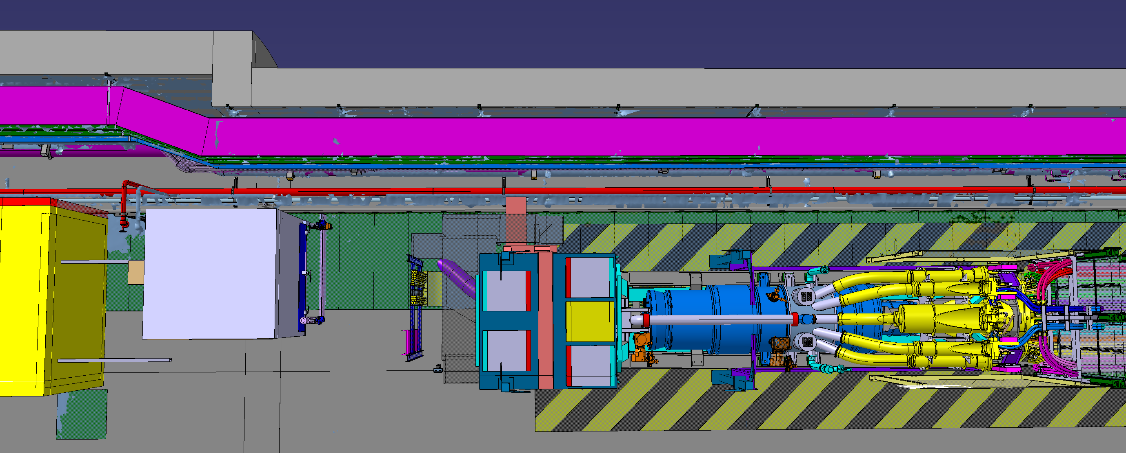
UR15 – 3D model+scan
From Firefighting
New tapping
8500mm

Slide 5
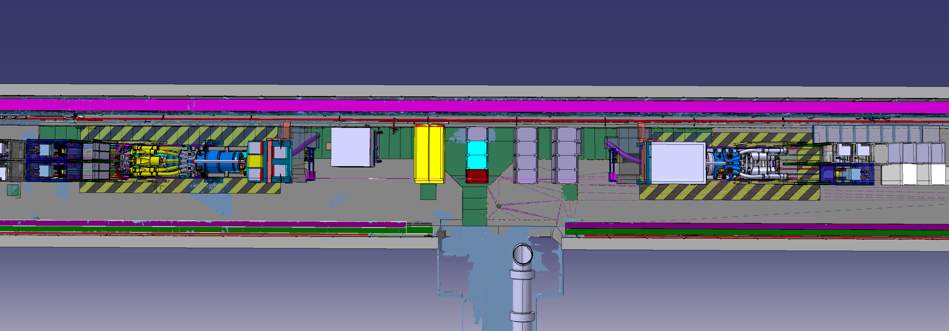
UR15 – 3D model+scan
3D model
3D model
New tapping
From Firefighting
11100mm
UL13

Slide 6
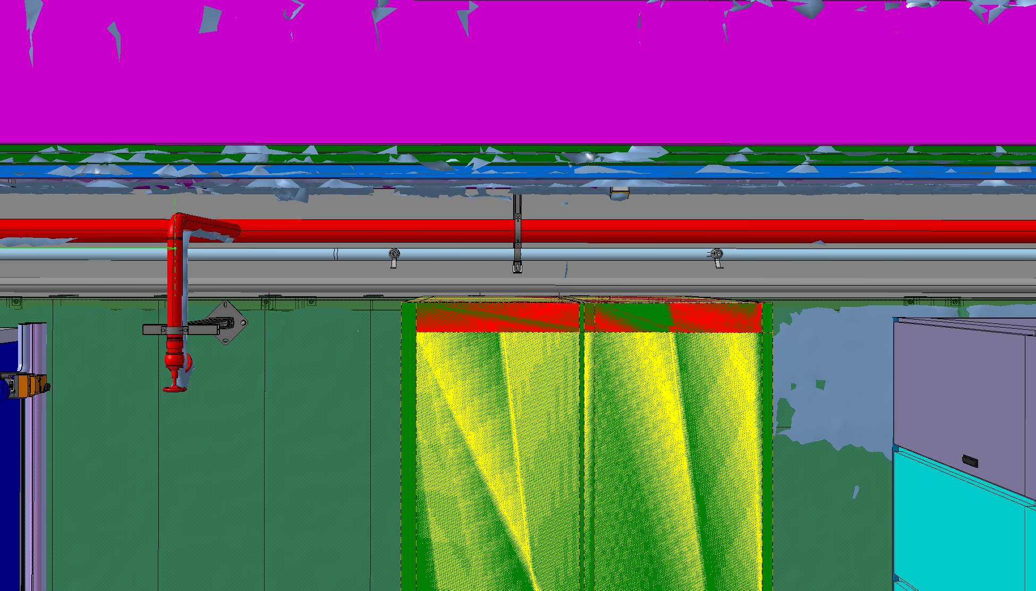
UR15 – 3D model+scan
3D model
1330mm
1550mm

Slide 7
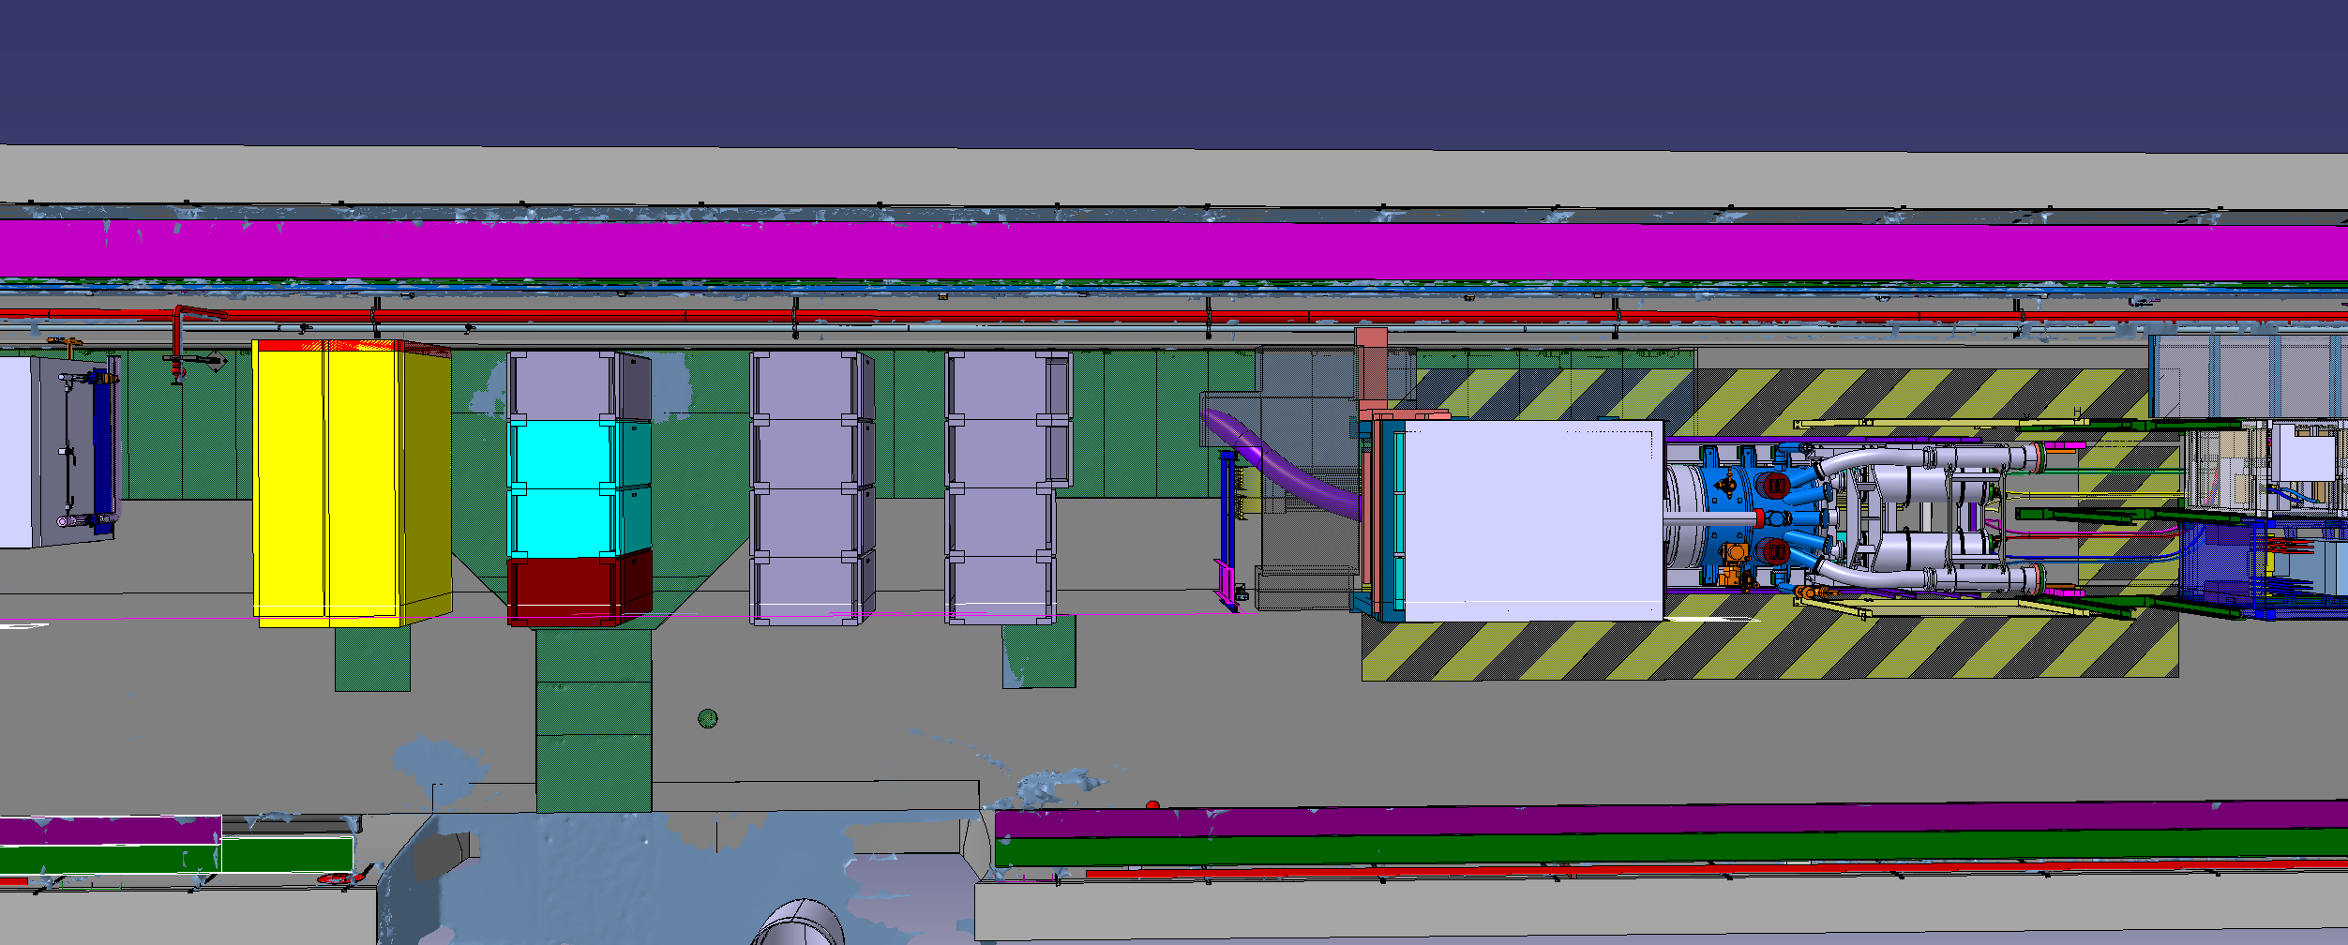
UR15 – 3D model+scan
New tapping
From Firefighting
14000mm
UL13

Slide 8
Thank you!

