Slide 1

UR55 As-built Tappings Compressed Air
F. Borralho / EN-CV
08.05.2025

Slide 2
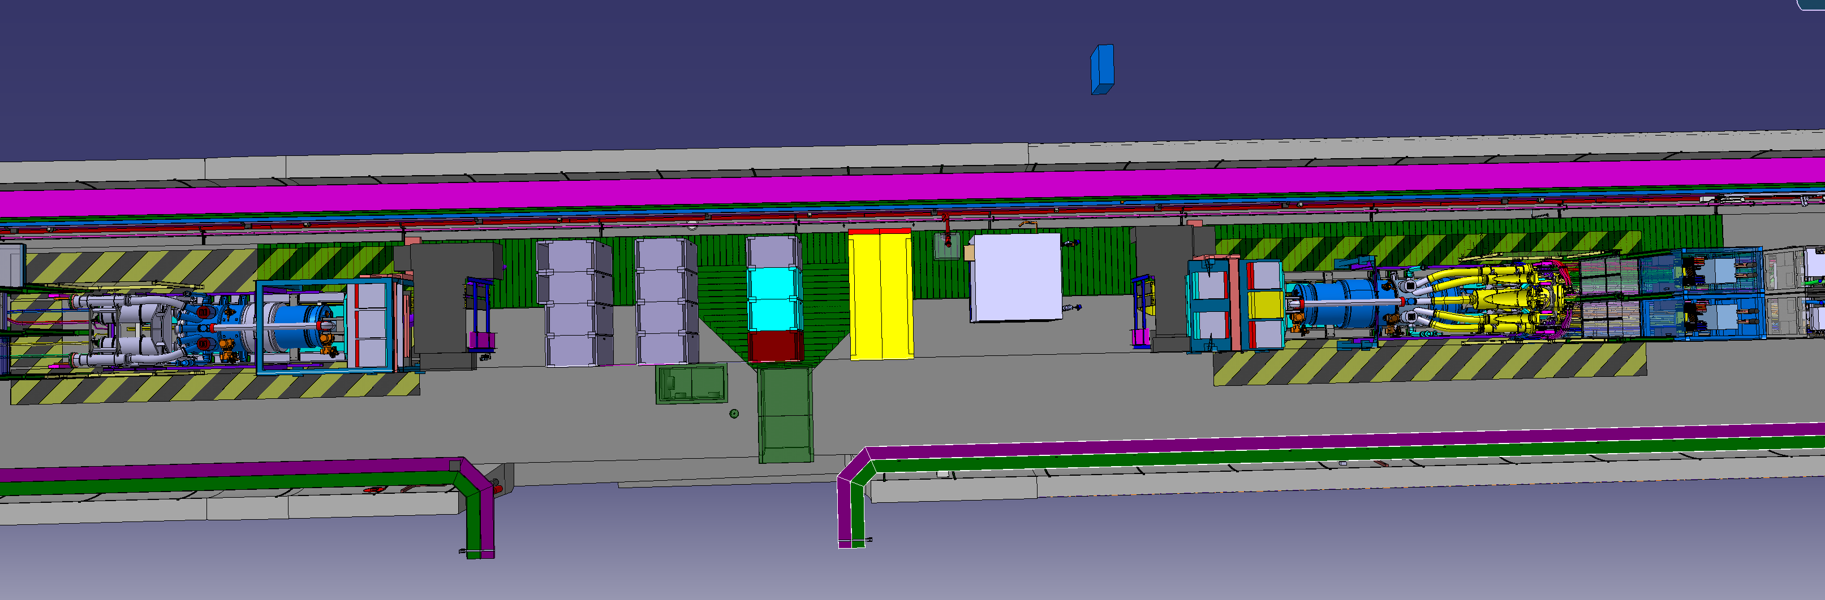
UR55 – 3D model
3D model
3D model
UL57

Slide 3
UR55 – As-built
As-built
As-built
9,6m
9,6m
UL57

Slide 4
UR55 – updated version
New tappings
Keep position
New tapping
Keep position
UL57

Slide 5
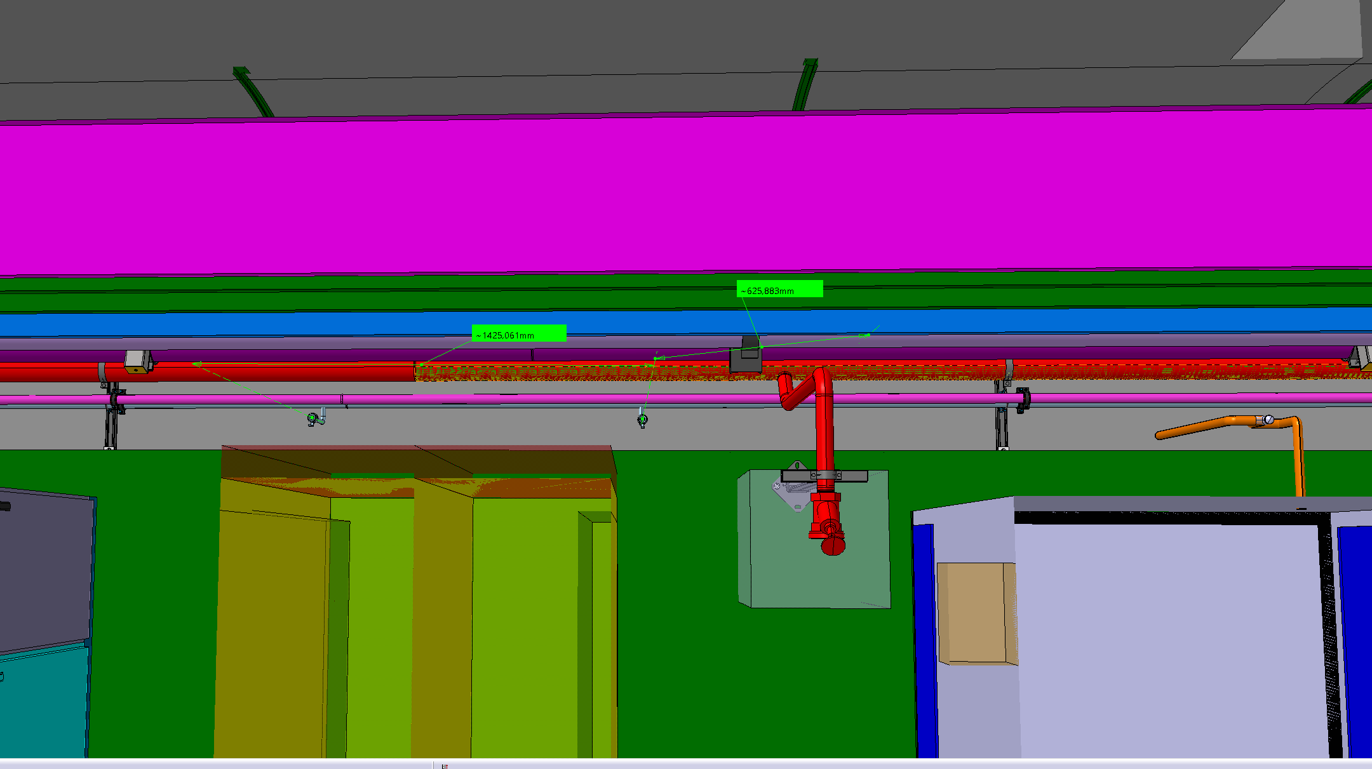
UR55 – updated version
Keep position
1425mm
625mm
UL57

Slide 6
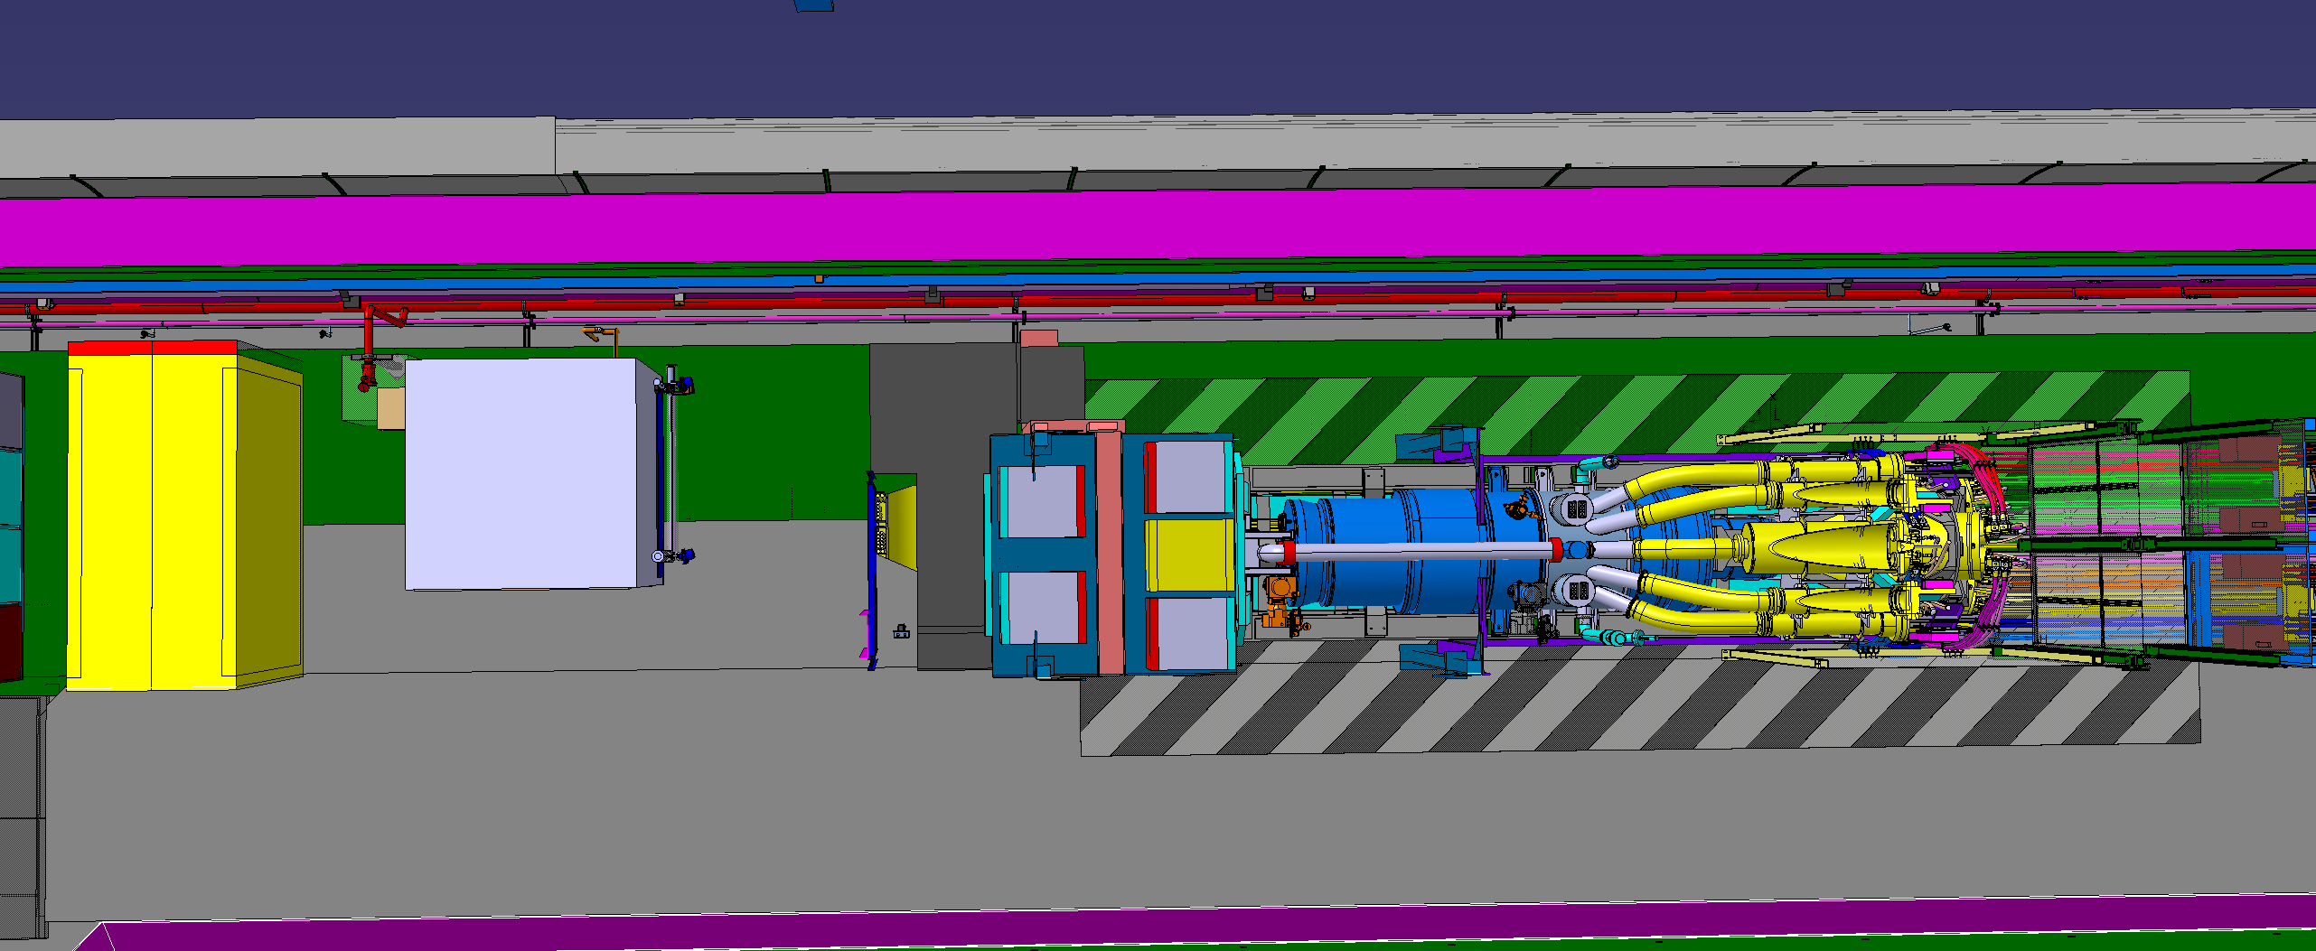
UR55 – updated version
Keep position
New tapping
8.6 m

Slide 7
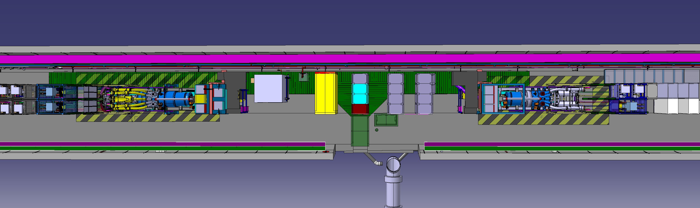
UR55 – 3D model
3D model
3D model
UL53

Slide 8
UR55 – As-built
As-built
As-built
9,6m
9,6m
UL53

Slide 9
UR55 – Updated version
As-built
As-built
New tappings
New tapping
UL53

Slide 10
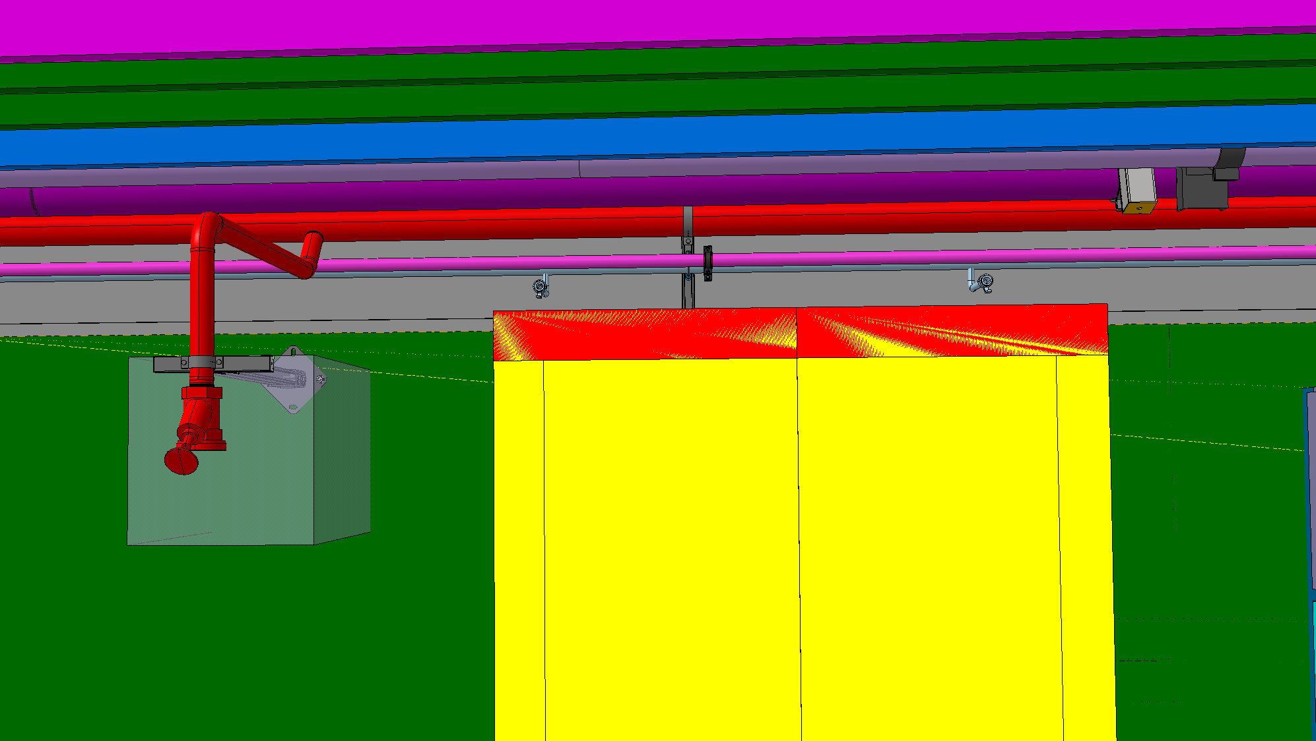
UR55 – As-built
As-built
As-built
New tappings
765mm
1400mm

Slide 11
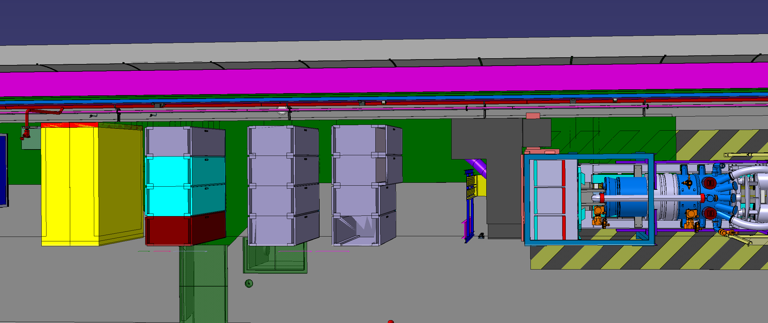
UR55 – Updated version
As-built
As-built
New tapping
13900mm

Slide 12
Thank you!

