Slide 1
GSM POINT 5
PICTURES EXTRACT FROM REFERENCE
ST1120275_01 | UR55_1503_INTEGRATION
ST1120269_01 | US57_1503_INTEGRATION
ST1120277_01 | UL53_1503_INTEGRATION
ST1120276_01 | UL57_1503_INTEGRATION
ST1120280_01 | UA57_1503_INTEGRATION
ST1120282_01 | UA53_1503_INTEGRATION
23/05/2025
Stephane Maridor

Slide 2
UA53

Slide 3
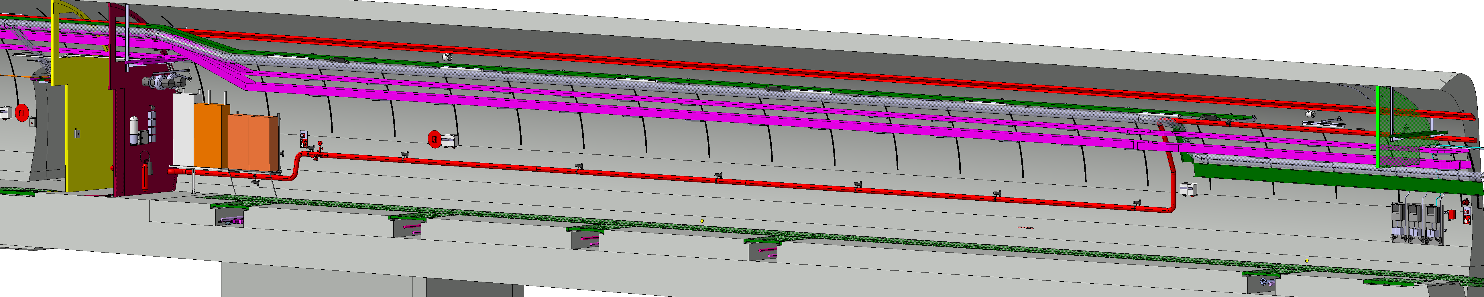

Slide 4
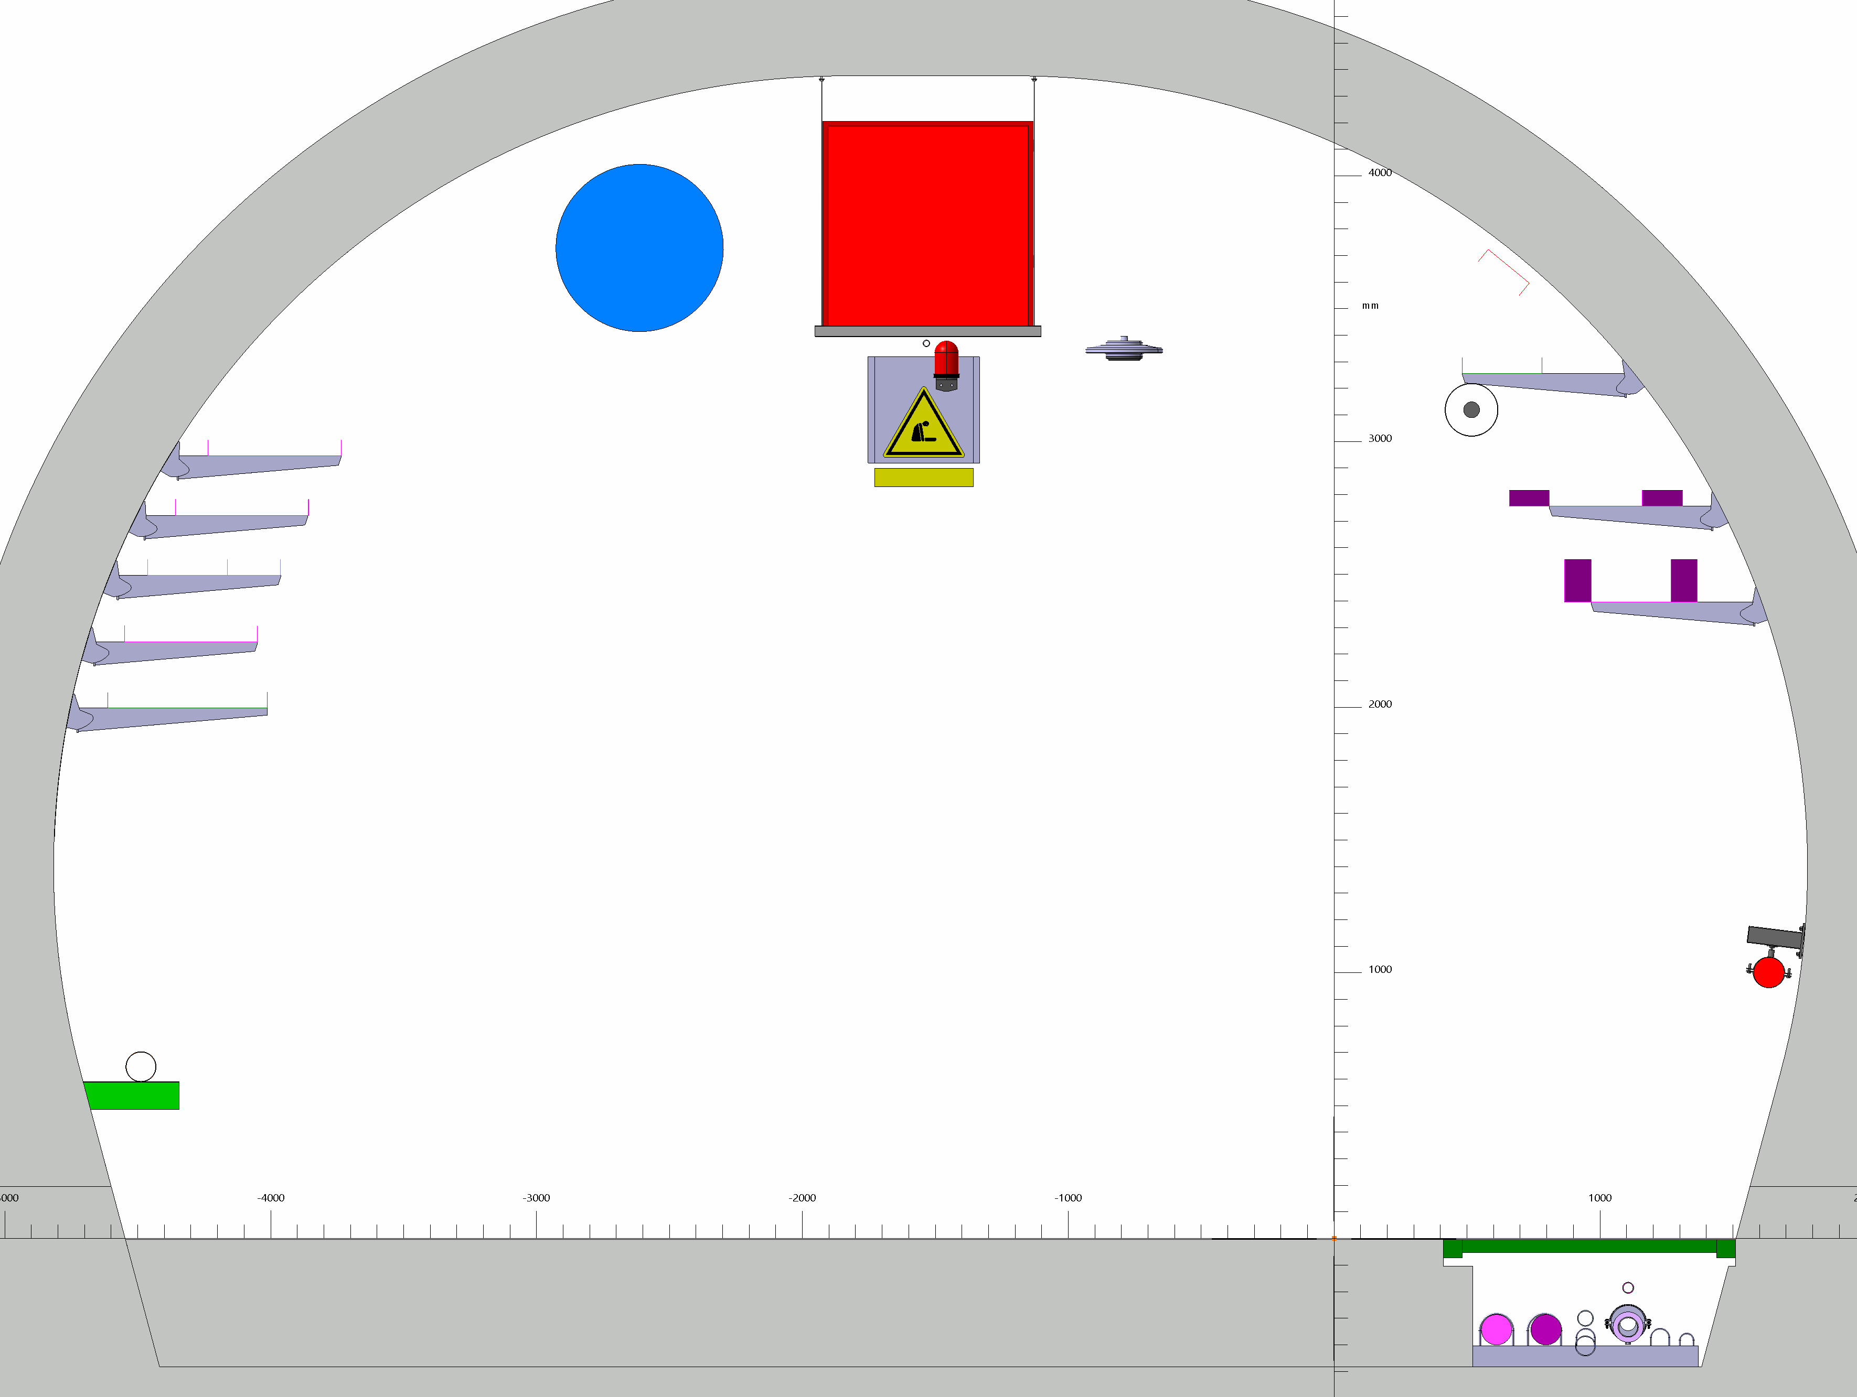

Slide 5
UA57

Slide 6
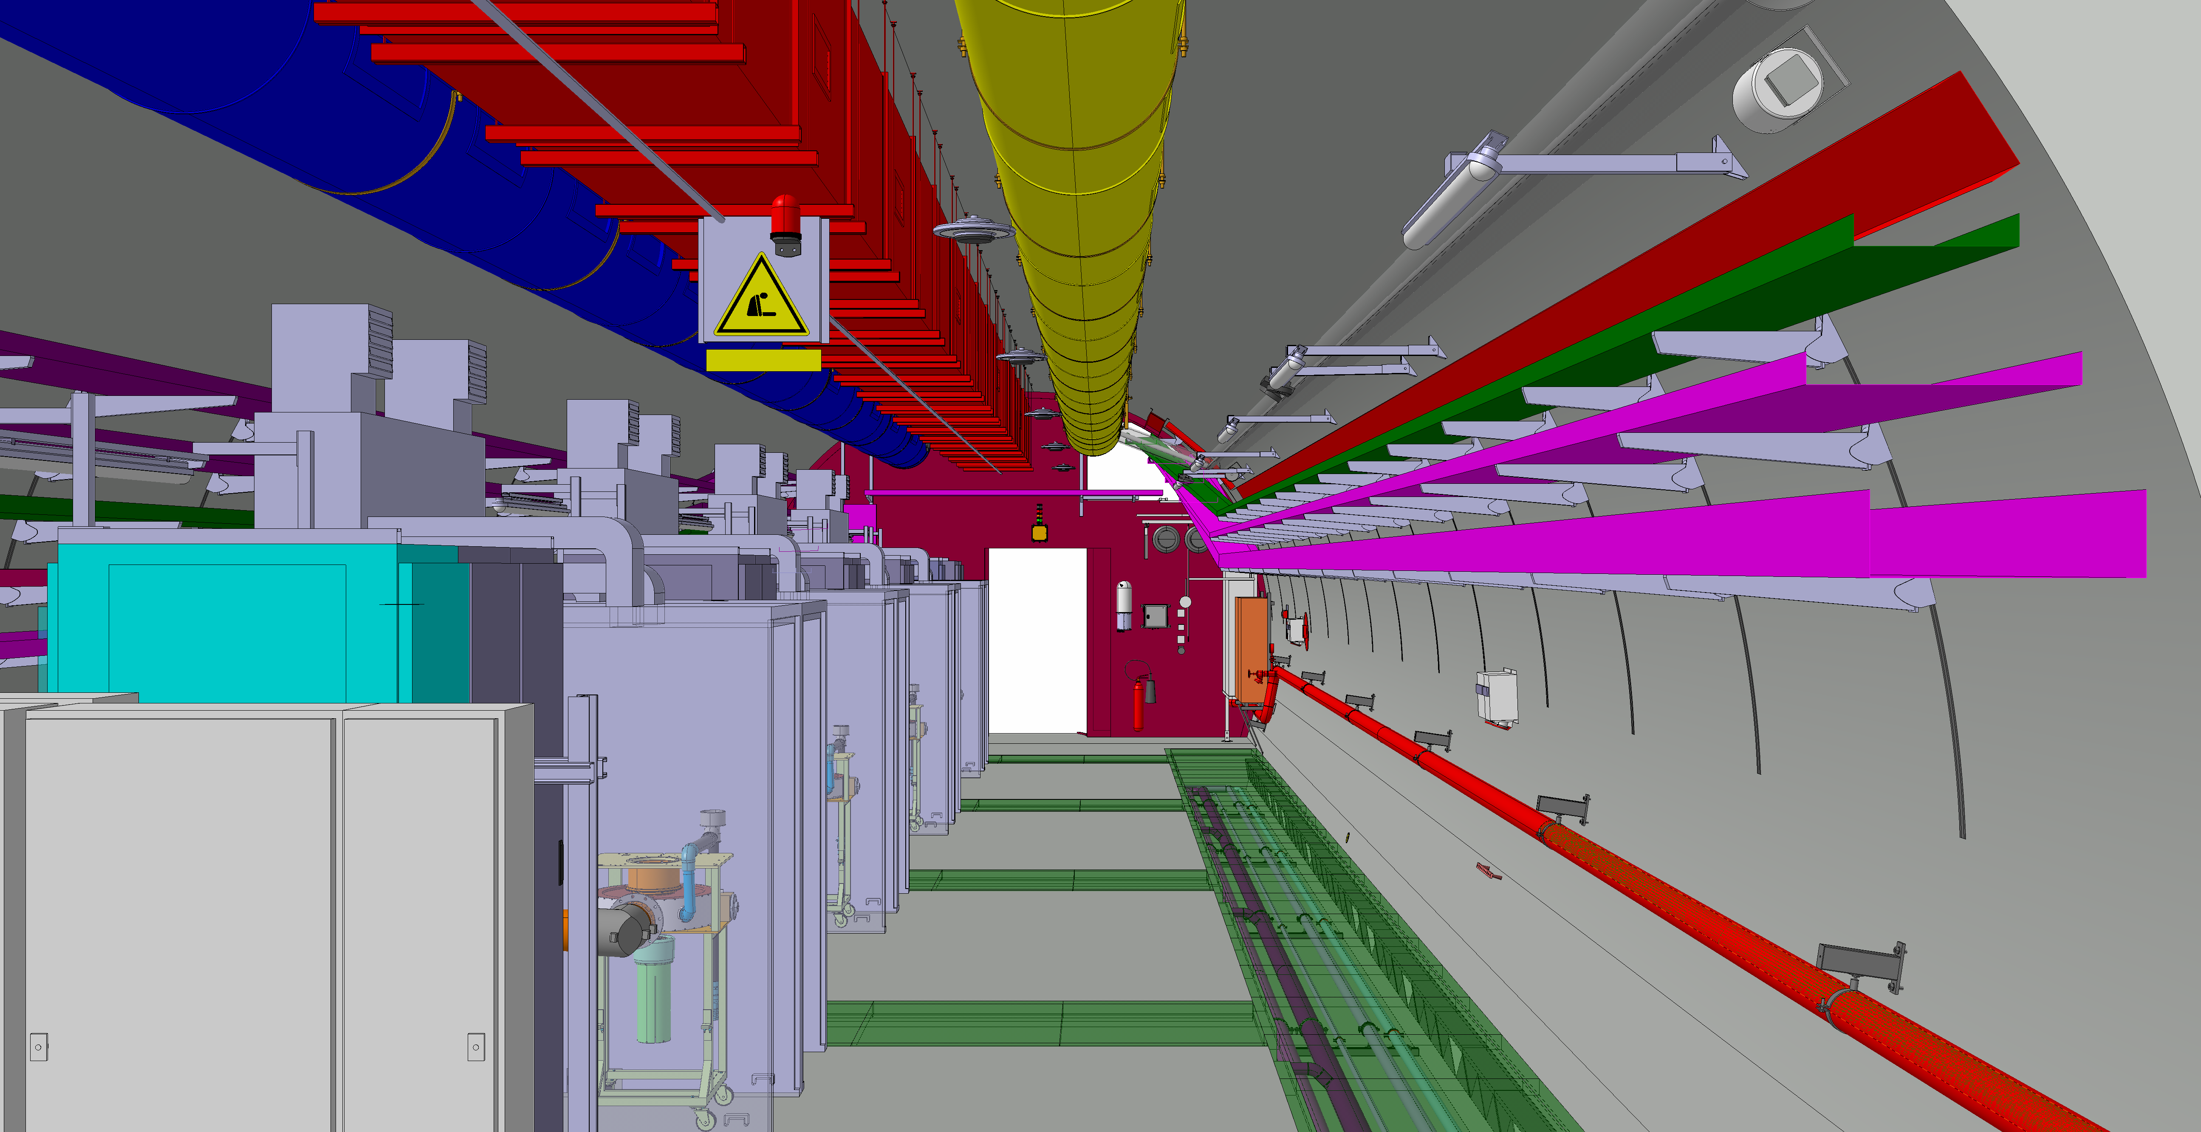

Slide 7
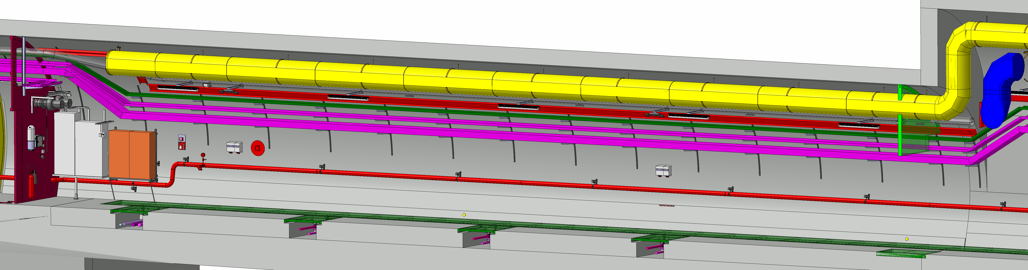

Slide 8
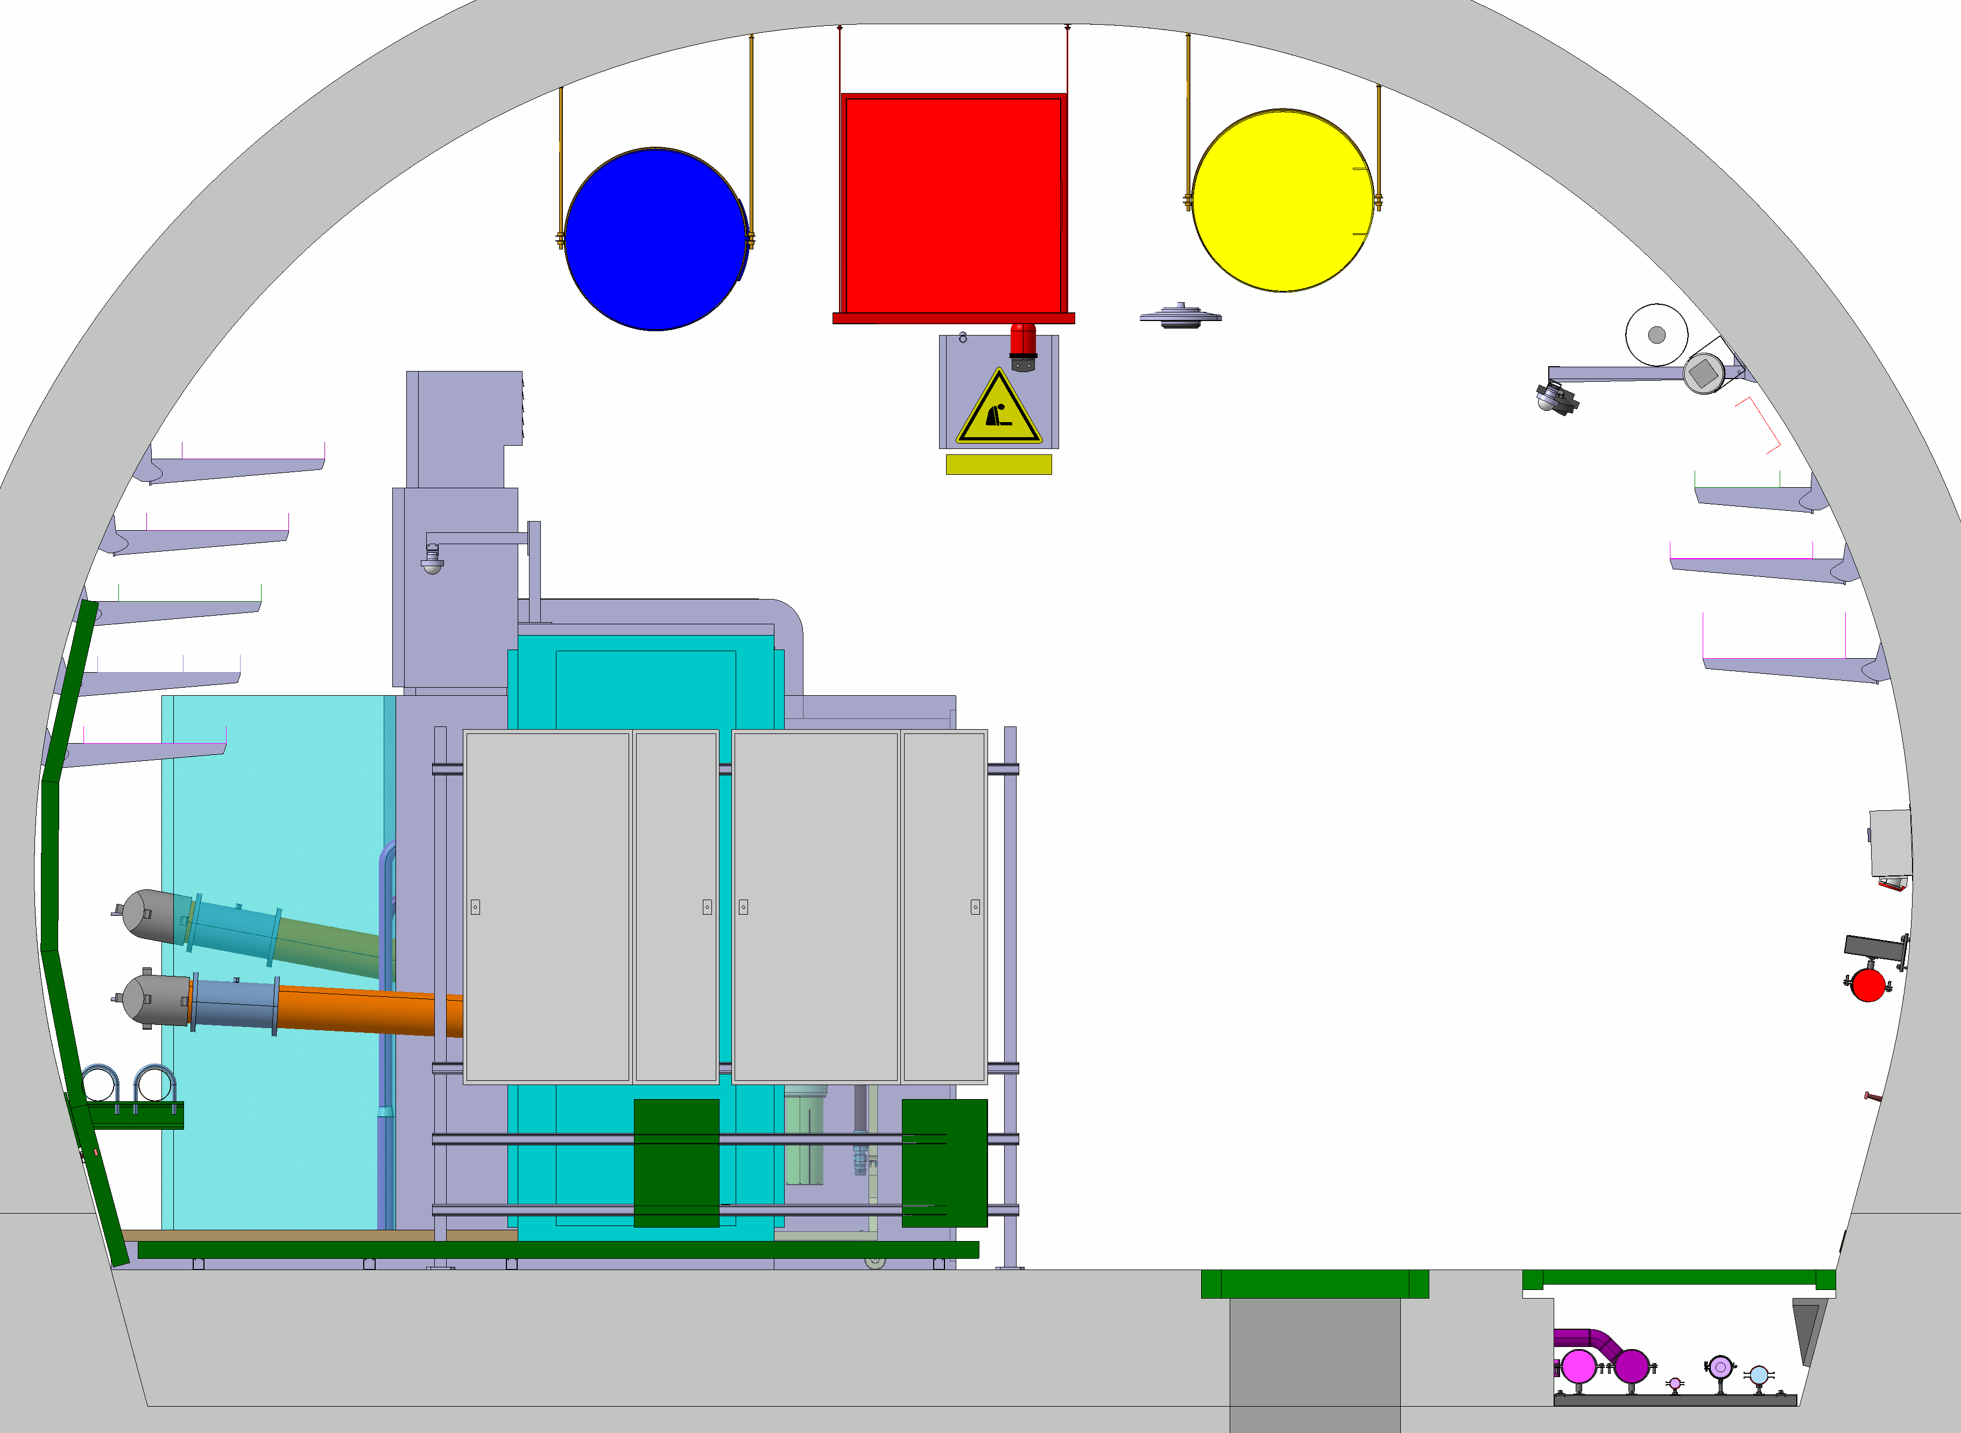

Slide 9
UL53

Slide 10
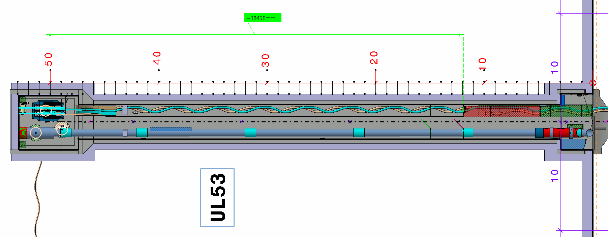

Slide 11
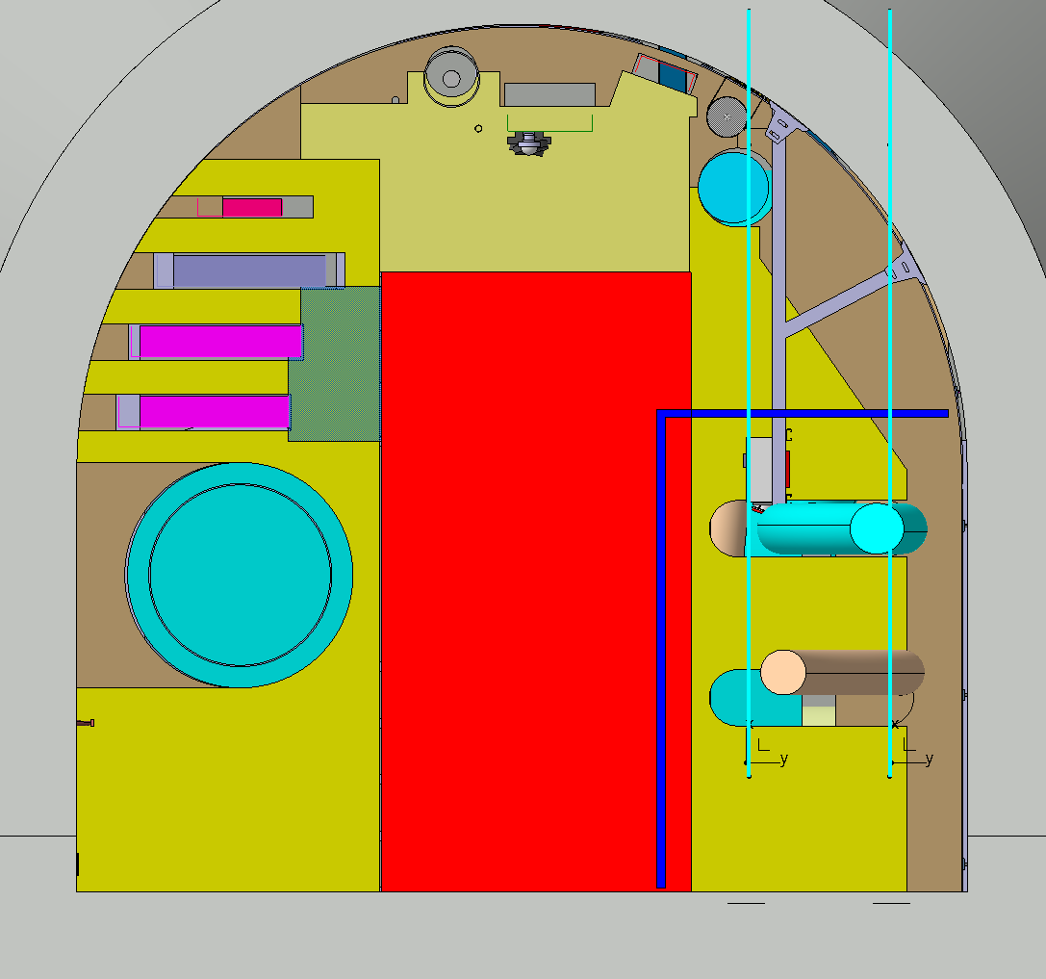

Slide 12
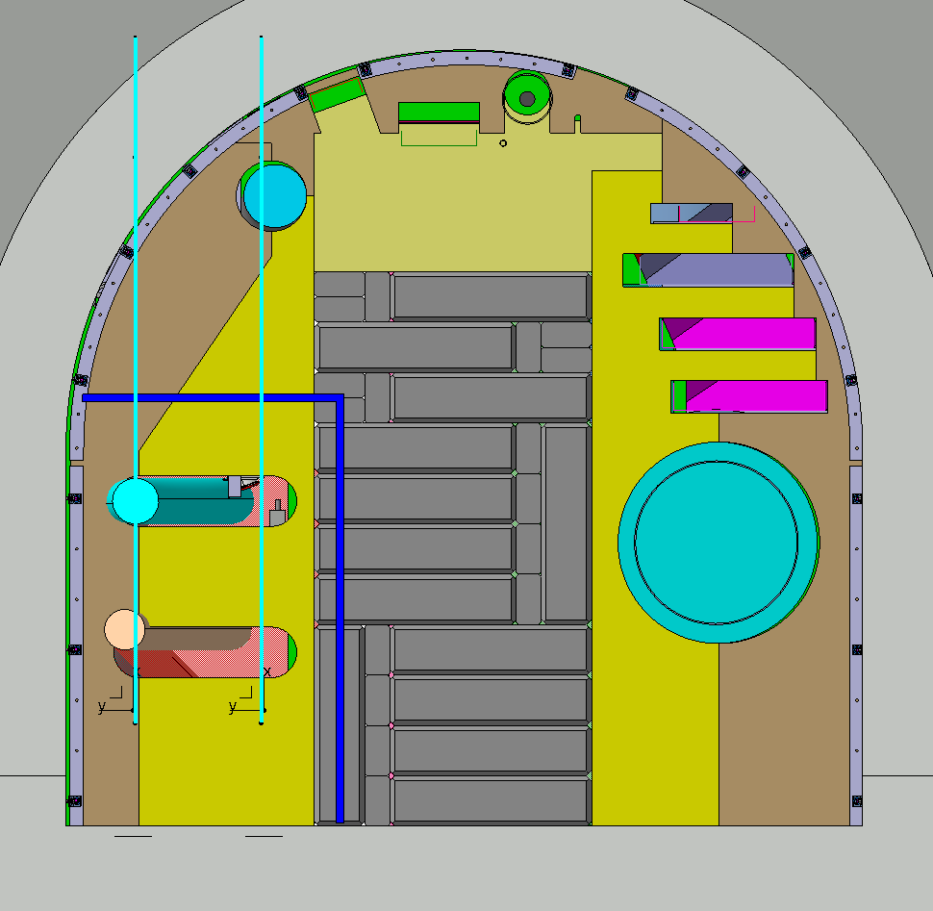

Slide 13
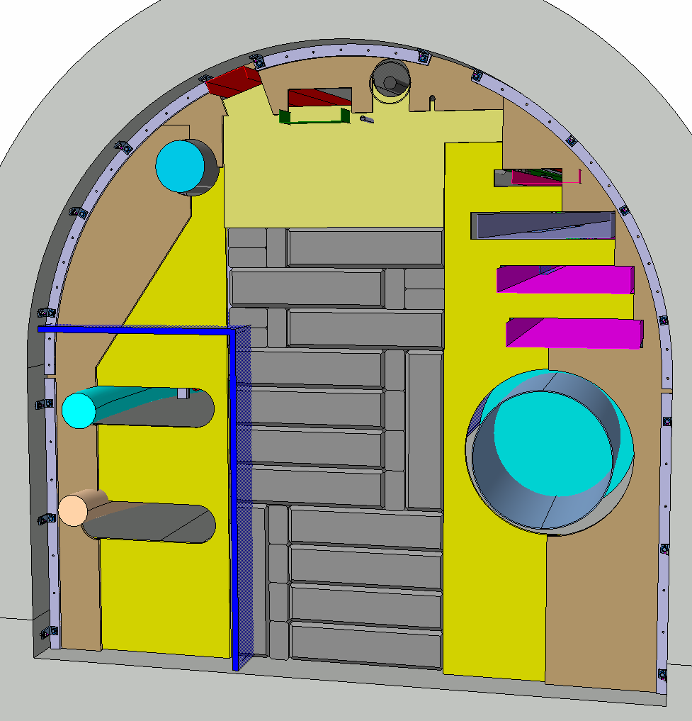

Slide 14
UL57

Slide 15
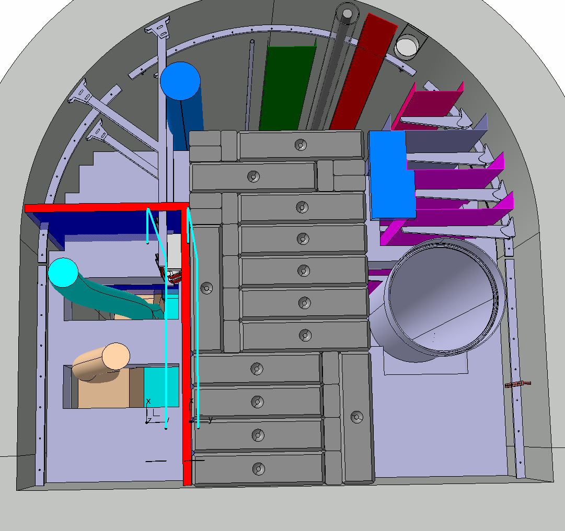

Slide 16
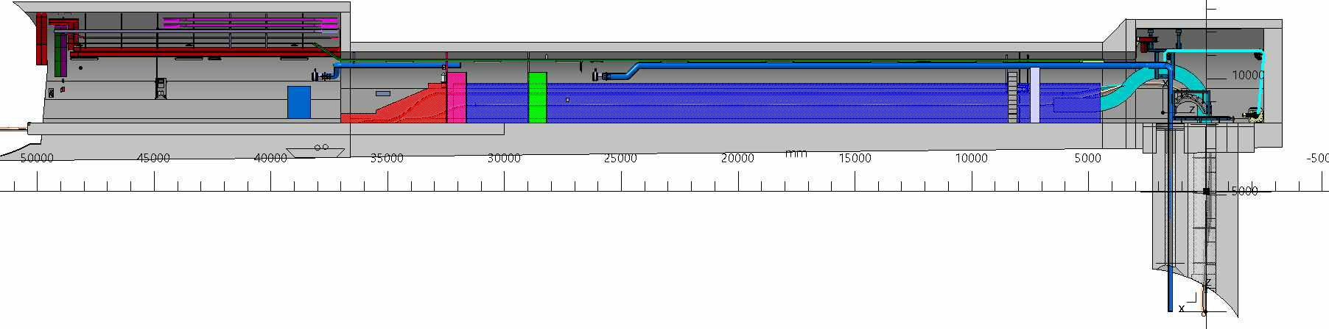

Slide 17
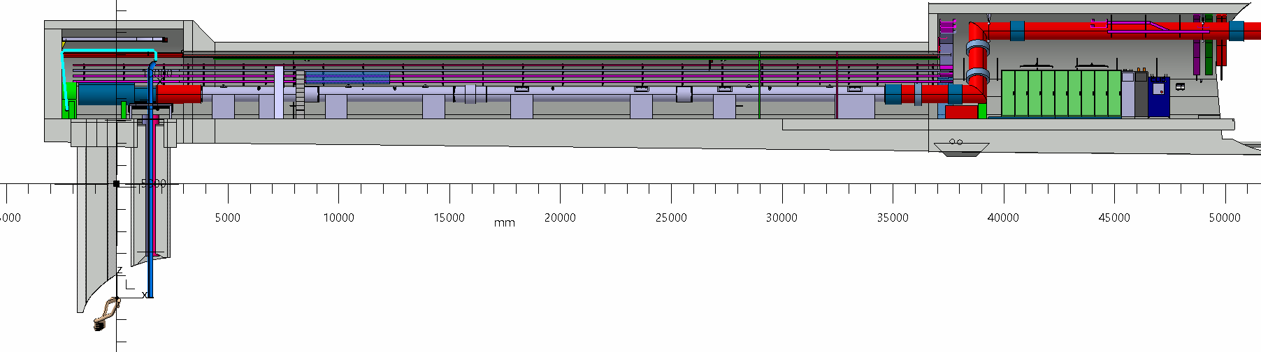

Slide 18
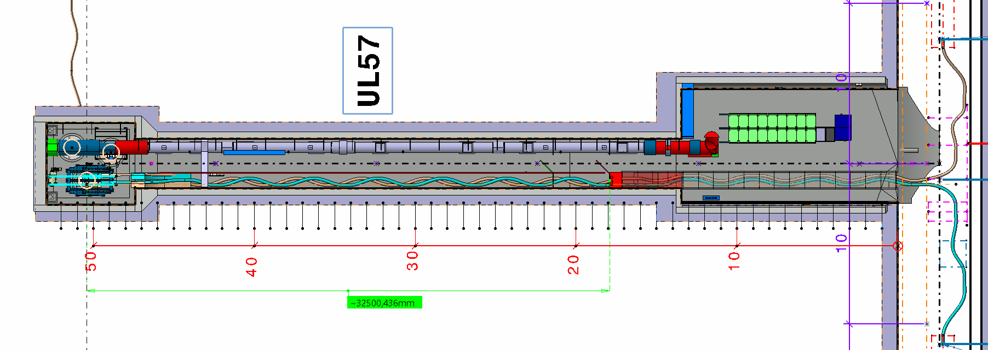

Slide 19
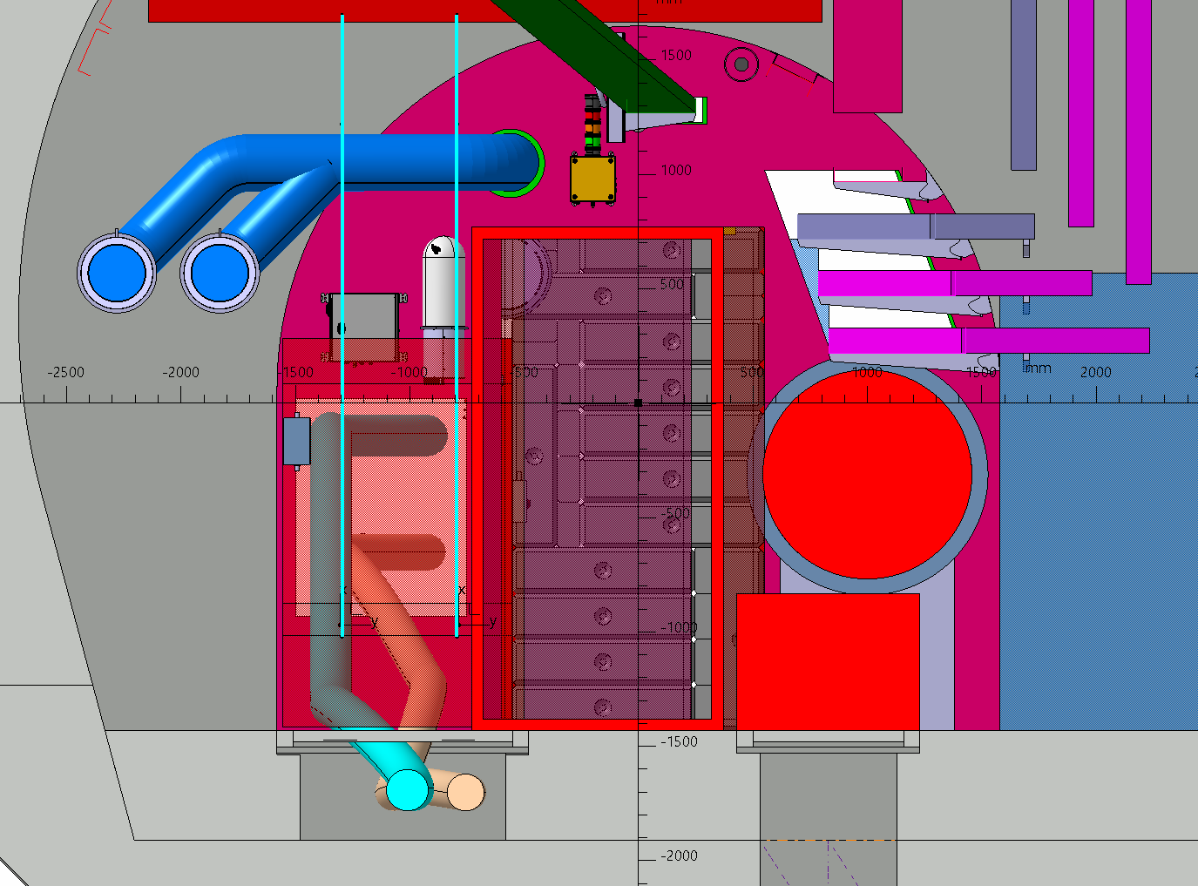

Slide 20
