Slide 1

DRD3 collaboration (R&D on Solid-state Detector Technologies )
Gregor Kramberger on behalf of the collaboration
Jožef Stefan Institute, Slovenia

Slide 2
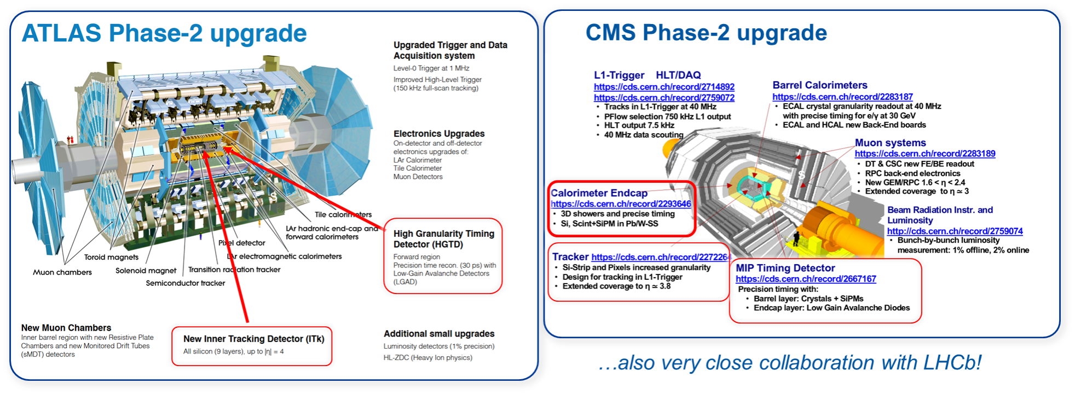
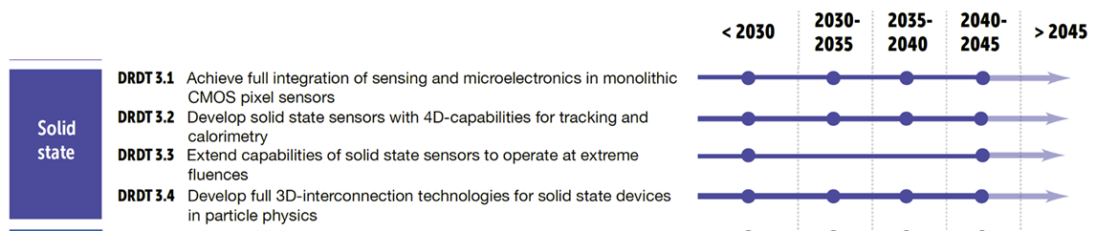
Semiconductor sensors
Semiconductor detectors are the cornerstone of all present and future experiments:
several R&D collaborations (RD39,RD42, RD48 and RD50) in the past with crucial contribution to the HL-LHC upgrades in all experiments
Improvements:
position resolution (CMS/ATLAS hybrid pixels on p silicon)
timing layers (ATLAS-HGTD, CMS-ETL)
large scale use in calorimeters (CMS HGCAL, p-type Si)
lightweight monolithic pixel detectors (ALICE ITS) with excellent position resolution
Coming after the accelerator upgrade in 2029
Diamond BCM
Diamond BCM
New Major Challenges for the future:
FCC-ee/CEPC/ILC: vertex detectors with low mass, high resolution (Target per layer spatial resolution of ≤ 3-5 µm and X/X₀≤ 0.05%),
FCC-hh/SppC: low power and high radiation hardness (up to 8·10 ¹⁷ n_{eq}cm⁻²). Resolving many pp hits in a bunch by ultra-fast timing in O(10-100ps)
Full integration with electronics, mechanics, services
Large area sensors at low cost for calorimetry
European Commission for Future Accelerators
Road map document on sensors
ECFA Detector R&D roadmap [CERN CDS]

Slide 3
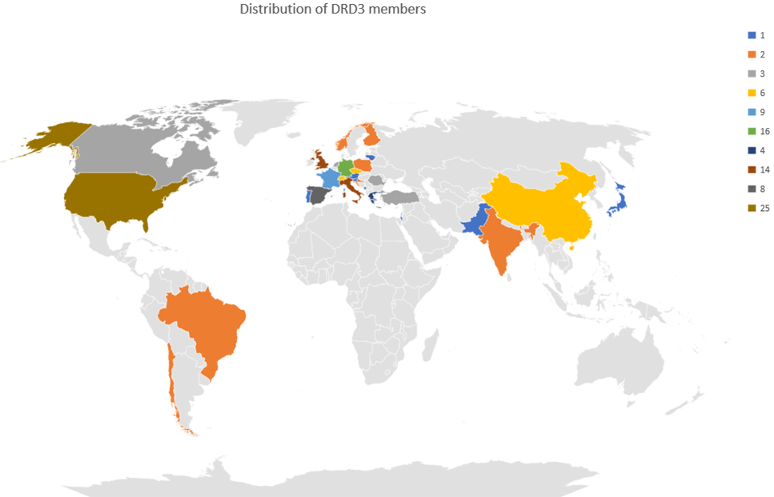
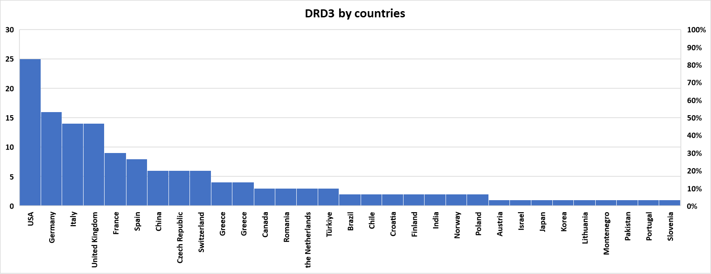
The DRD3 collaboration
A large collaboration on semiconductor has been formed at CERN to guide and steer the developments of semiconductor sensor developments in the next decades -148 Institutes currently involved with 700+ people
Large interests from the community:
Integration of most RD42 and RD50 groups
Interest from institutions from outside:
not in previous RD collaborations
Outside particle physics (nuclear, medicine, astro)
Collaboration is constantly growing
Different forms of collaboration
members
observers
industrial partners
Collaboration approved in June-2024 for 3 year with prospects of prolongations. It is in the last steps of formalizing the MoU. Collaboration is already fully functional and operational although many groups still involved in HL-LHC.
Europe – dominates as a continent
USA – the largest single country
Asia – the largest increase from previous RD
South America – joining

Slide 4
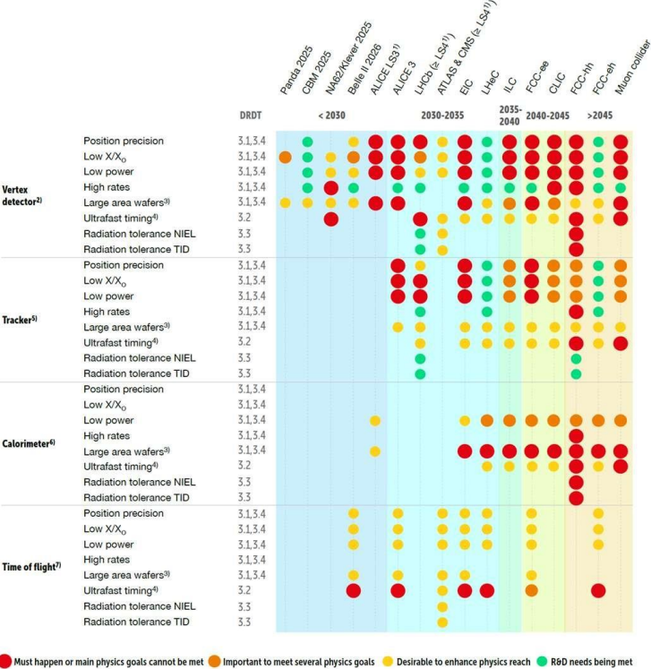
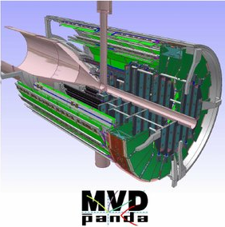
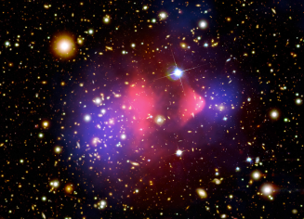
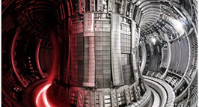
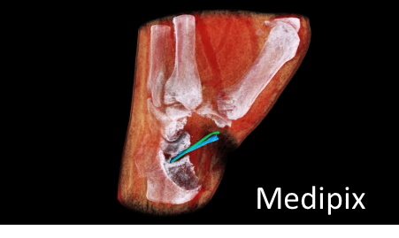
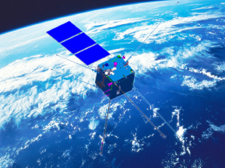
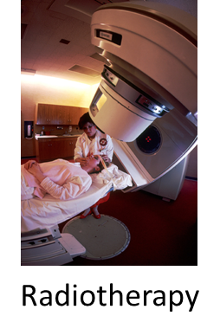
Objectives of the collaboration
The DRD3 collaboration has the dual purpose of pursuing the realization of the strategic developments outlined in the ECFA road map and promoting blue-sky R&D in the field of solid-state detectors including the synergies with other fields of science where charged particle detection is a key ingredient.
Particle Physics
(strategic R&D)
Nuclear Physics
Quantum sensing
R&D for future particle physics
Fusion
Space
Medical imaging

Slide 5
Objectives of the collaboration
The DRD3 collaboration has the dual purpose of pursuing the realization of the strategic developments outlined in the ECFA road map and promoting blue-sky R&D in the field of solid-state detectors including the synergies with other fields of science where charged particle detection is a key ingredient.
Particle Physics
(strategic R&D)
Nuclear Physics
Lots of goals to meet over several years and decades
Quantum sensing
R&D for future particle physics
Fusion
Space
Medical imaging

Slide 6
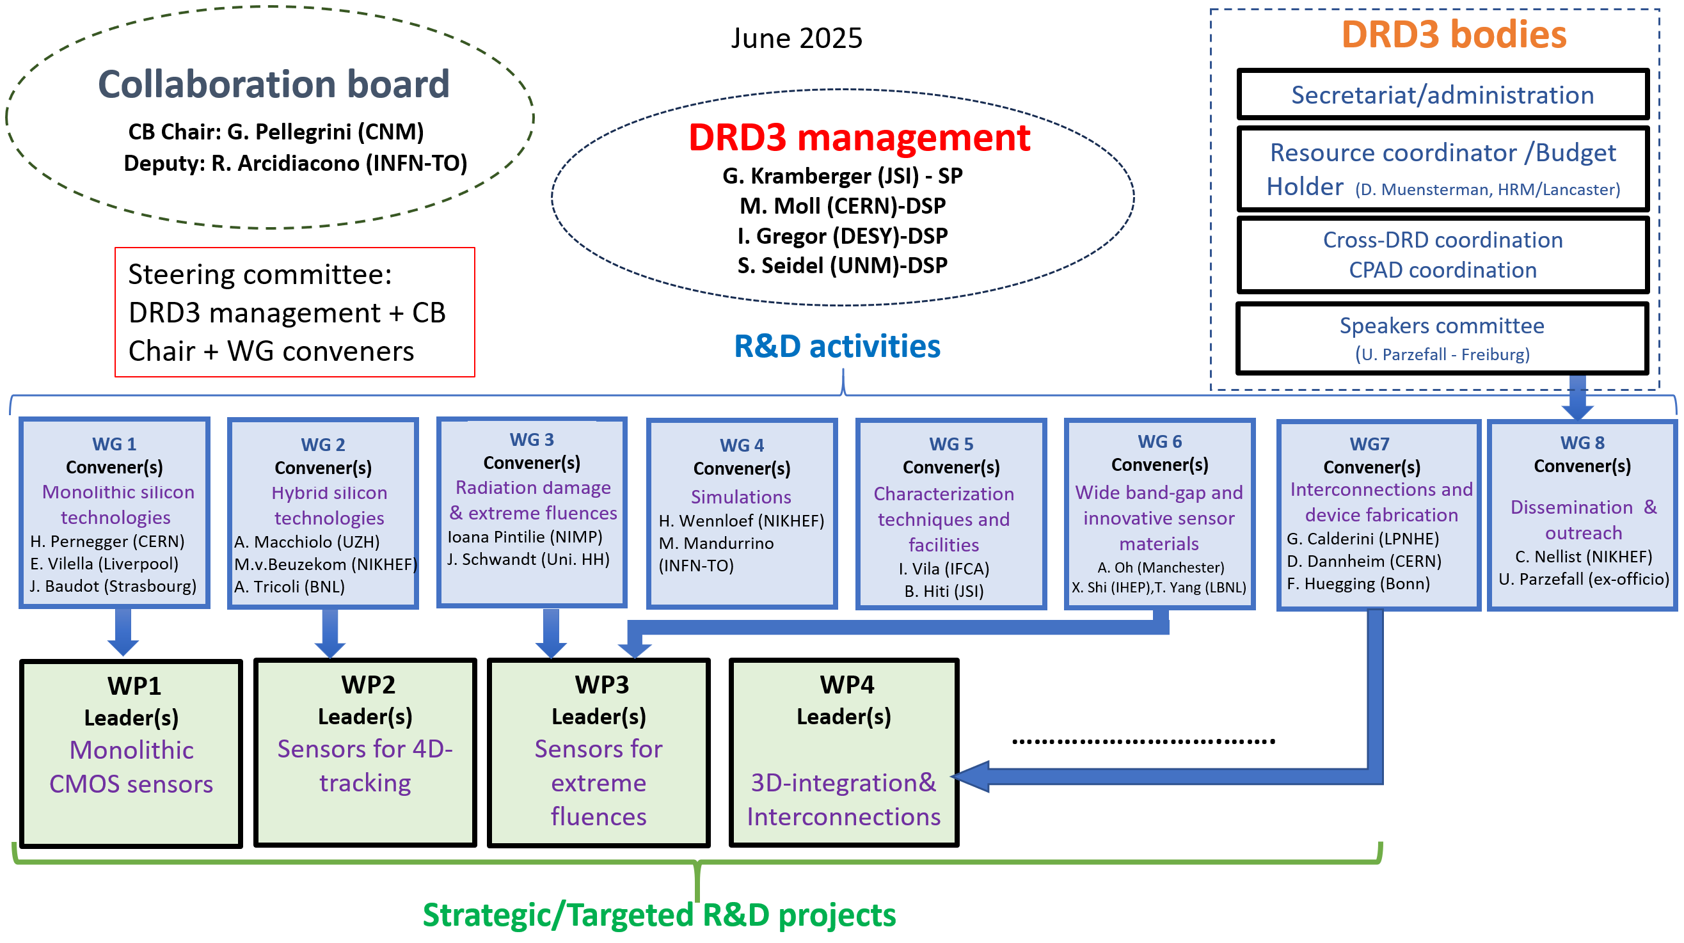
Organizational structure
12-2023 - provisional approval
01-2024 - formation of CB
03-2024 - election of SP
05-2024 - formation of WG-WPs
06-2024 - approval (scientific proposal)
06-2024 - first DRD3 week
07-2024 - start of scientific meetings
and preparation of
WP projects
10-2024 - approval of the DRD3 rules
12-2024 - second DRD3 week
01-2025 - finalization of WP projects
(adjustment to funding reality)
02-2025 - first DRDC review
06-2025 - third DRD3 week
approval of the first WP projects
11-2025 - fourth DRD3 week
- finalization of MoU
WG conveners serve also as leaders of the matching WPs.
Working Group (WG) = long term R&D activity (strategic or generic) linked to certain technology/purpose/application/method aiming to fulfil the research goals in scientific proposal
Work Package (WP) = strategic R&D activity and is linked to DRD Tasks. It should pursue the goals listed there.
Each work package consist of several WP projects - not yet fully resource loaded at the moment.

Slide 7
DRD3 organization of the work
Strategic R&D
(follow ECFA detector roadmap)
organized in four Work Packages
Supported by DRD3 Common Collaboration Fund
Supported by RD50 Common Collaboration Fund
Common activities
Test-beams, Irradiations…
Schools
Meetings
Awards
Mobility projects
DRD Common Collaboration Fund projects
small Blue-Sky projects
common hardware, software
consumables
RD50 Common Collaboration Fund projects
28 running projects with resources already allocated
The scheme was demonstrated to be very successful and was agreed by collaboration to be implemented also for DRD3.

Slide 8
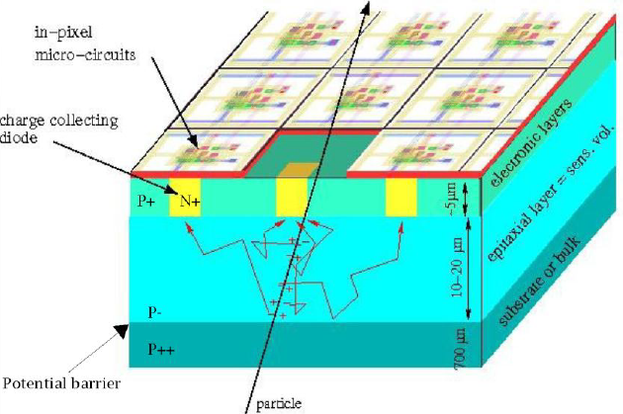
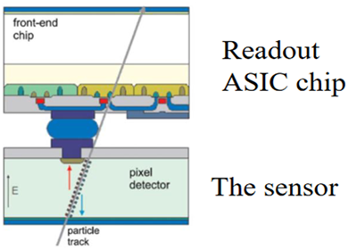
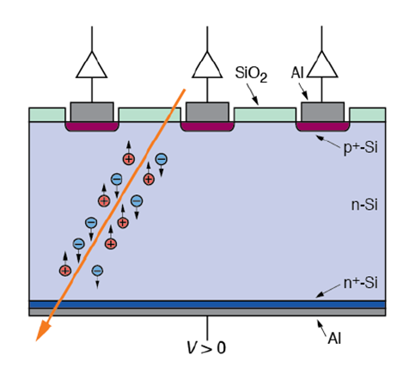
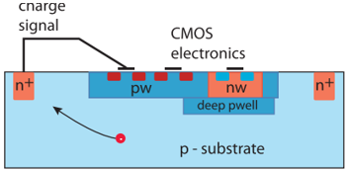
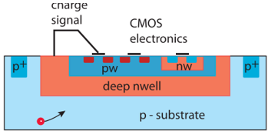
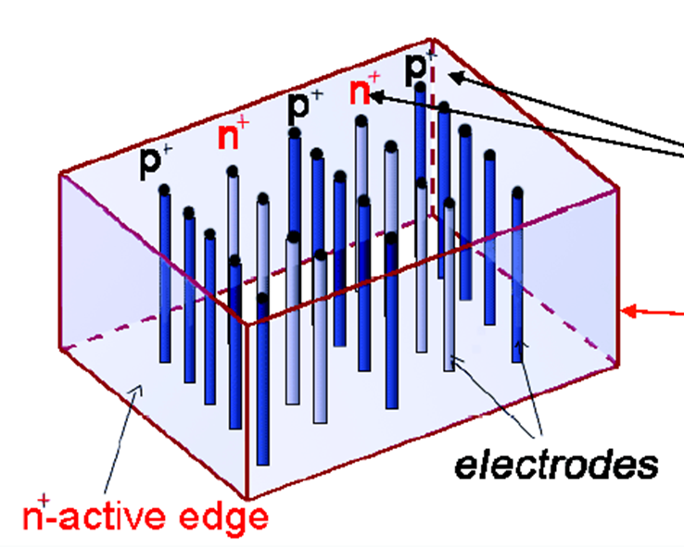
Paths of present silicon sensor R&D
Monolithic devices
( WG1/WP1-CMOS )
55-180 nm processes
Hybrid devices
(WG2/WP2-4D tracking)
Planar
3D devices
Small electrode device
Large electrode device
MAPS
Large area passive devices
(strips)
With Gain
(LGADs)
Trench
3D
Column 3D
with gain
DepletedMAPS
wo Gain
Depleted MAPS
wo Gain
with gain
proof of concept ongoing
With Gain
Optimized for rates/power/position resolution
Optimized for radiation hardness /timing
recent research (working prototype)
proven/demonstrated

Slide 9
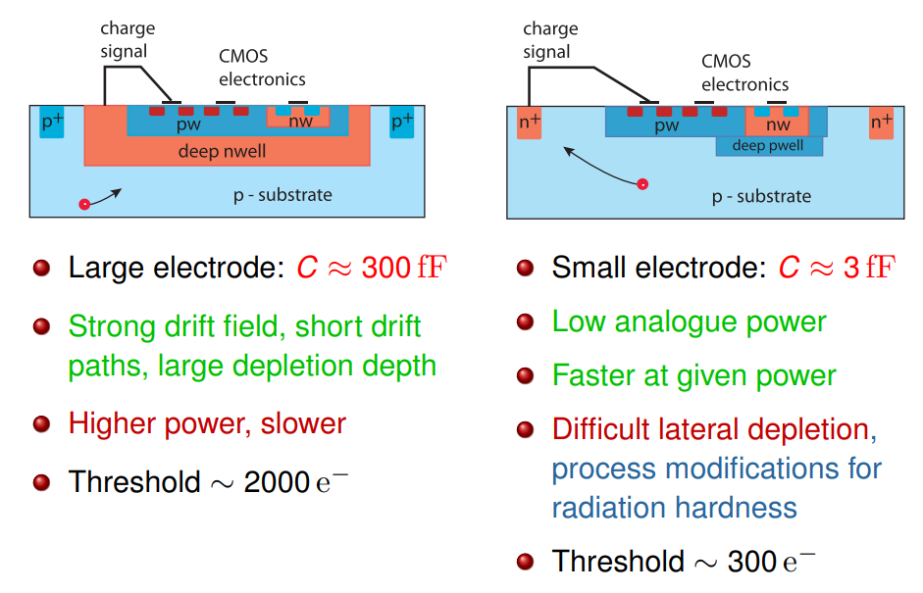
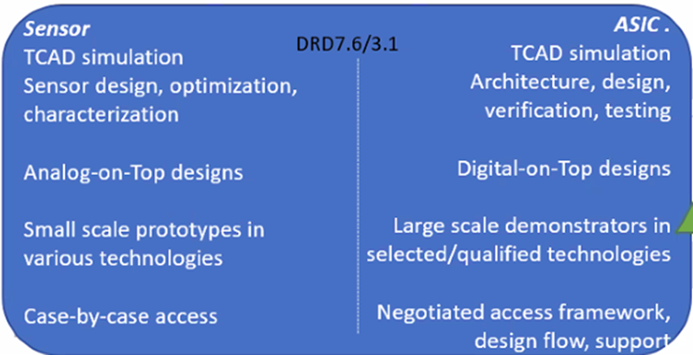
WG1/WP1 Monolithic silicon sensors
Aim is to advance the performance of monolithic CMOS, combining sensing and readout elements, for future tracking applications, tackling the challenges of:
very high spatial resolution (≤3 µm)
high data rate (~100 MHz/cm2)
high radiation tolerance (10¹⁶ n_{eq}/cm² NIEL and 500 Mrad)
low mass (~0.05% X₀)
Good timing (->20 ps/hit)
covering large areas
reducing power (few tens mW/cm²)
keeping an affordable cost
TWO approaches
LARGE ELECTRODE DESIGN
SMALL ELECTRODE DESIGN
taken from N. Wermes
Cactues
Program shared between DRD3/7

Slide 10
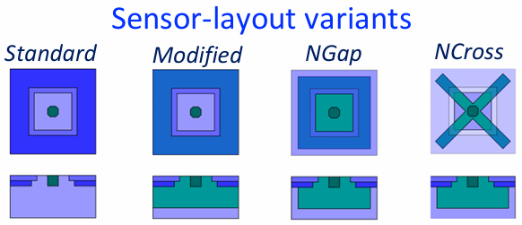

WG1/WP1 Monolithic silicon sensors
Projects running, proposal draft submitted (work ongoing), proposals in preparation (work ongoing):
55 nm SMIC
Development of HVCMOS sensors using 55nm process - COFFEE
65 nm TPSCo technology (in co. with DRD7.6a):
OCTOPUS - Optimized CMOS Technology for Precision in Ultra-thin Silicon
MANTA - Versatile MAPS
TPSCo 65nm MCMOS with high precision timing
150 nm LF technology
Towards large electrode CMOS sensors with intrinsic amplification for ultimate timing performance
Radiation hard HVCMOS detectors
Passive large area strip sensors
180 nm TJ technology
CMOS Active SenSor with Internal Amplification - “CASSIA”
Radiation hard read-out architectures
Main challenges (from DRD3 point):
availability of the active volume (60-80 e-h/μm)
epitaxial layer decreases with smaller node processes (350 nm->28 nm). Also, the lateral drift becomes even bigger problem for thin epitaxial layers.
few foundries are/will be open to use high resistivity substrate wafer
costs increase rapidly with the smaller node (MPW runs may not be available)
allocating the vendors that are open to our needs
minimum information about the process which allows for simulation of particle detection in the devices.
adaptation of the process
accessibility to the processes – licensing (access to process development kits - PDK)
requirements of additional processing (back side processing), back side metallization …
The work is ongoing in all of the projects:
Resources are at least partially secured
TPSCo 65 nm (organization together with DRD7/ESE in 2026/27)
LF15 run is coming in 2026 with resources secured (RD50 legacy)
TJ180 MPW runs

Slide 11

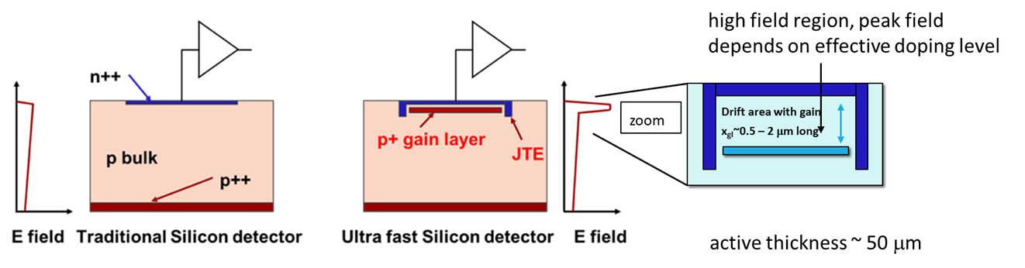
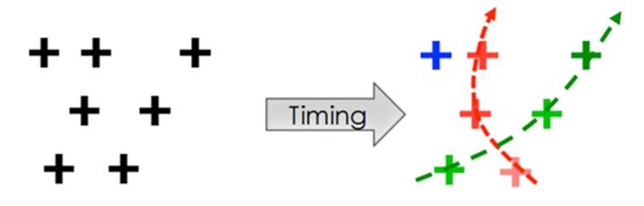
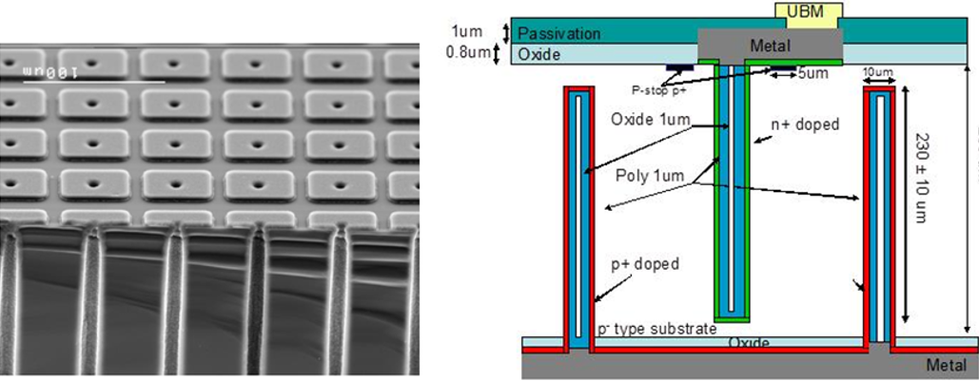
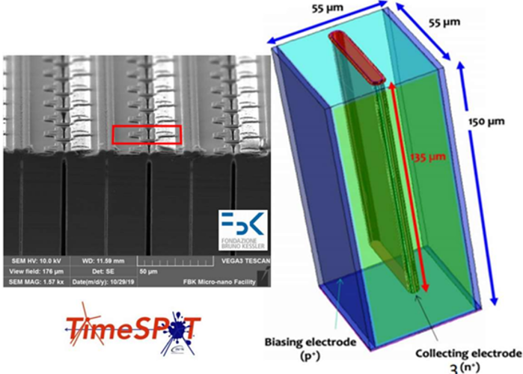
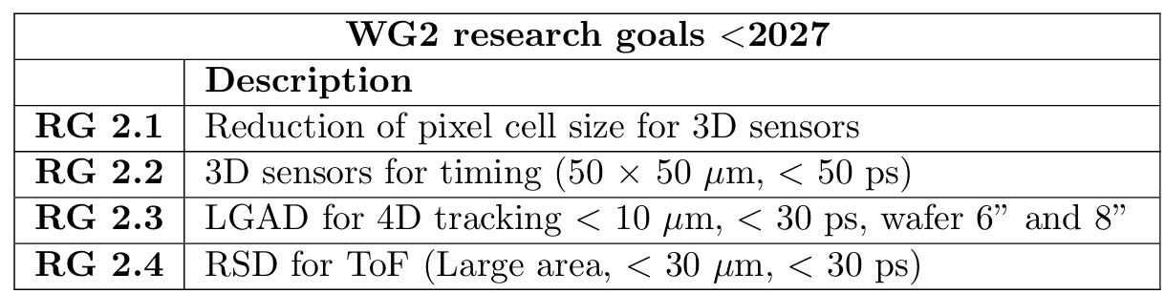
WG2/WP2: Hybrid silicon technologies and 4D tracking
HYBRID
By “4D tracking” we mean the process of assigning a space and a time coordinate to a hit - ~10-30 μm position and ~10-30 ps time resolution – simultaneously (many benefits in dense particle environment for tracking and PID)
The above goals can be achieved in planar technology with gain or 3D (requirement - high signal and short collection time)
4D tracking (not only track timing)
Column-3D detectors
Trench-3D detectors

Slide 12
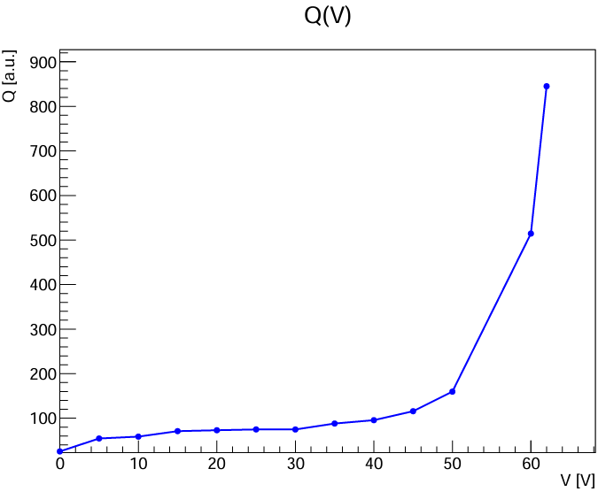
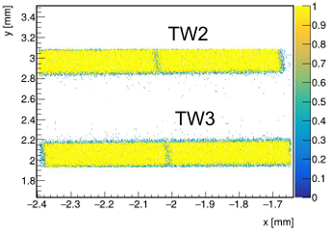
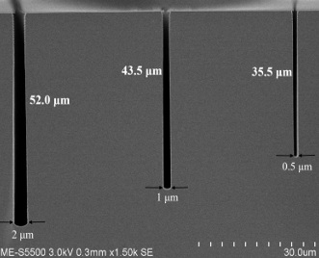
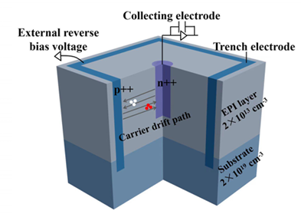
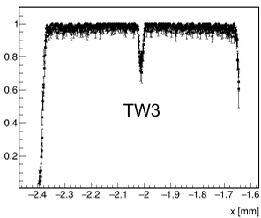
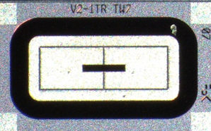
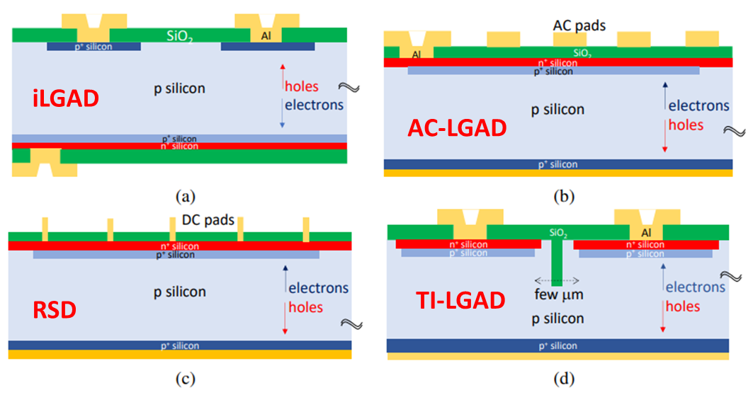
WG2/WP2: Hybrid silicon technologies and 4D tracking
Projects running, several in preparation
LGAD projects
LGAD based timing tracker development for future electron collider
Development of Ultra Fast-Time Low Mass Tracking Detectors
Development of TI-LGADs for 4D Tracking
3D projects
Development of very small pitch, ultra rad- hard 3D sensors for tracking & timing applications at FBK
Novel silicon 3D-trench pixel detectors based on 8-inch CMOS
Main challenges and developments:
3D detectors:
increase of column-width/depth->100 – narrower columns/trenches (~0.5-1 μm) that would allow for controlled multiplication/gain device (recently achieved within WP2 project)
Scalability to 8” wafers (ongoing)
Reduction of cell sizes to 25x25 μm² and thickness with gain leading to smaller capacitance (ongoing)
Optimization of geometry for best timing performance
LGADs:
Solution to fill factor problem – 100% surface efficiency. Addressed in several WP2 projects: TI-LGADs, RSD (AC/DC) LGADs
Addressing the radiation hardness – defect engineering
Co-implantation of impurities (Carbon) – addressed in WG3
Compensated LGADs – addressed in WG3
The work is ongoing in all of the projects:
Resources are at least partially secured (initial runs possible)
Several WP projects and also CCF in preparation

Slide 13
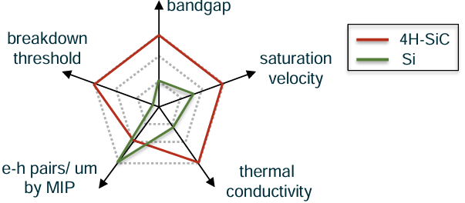
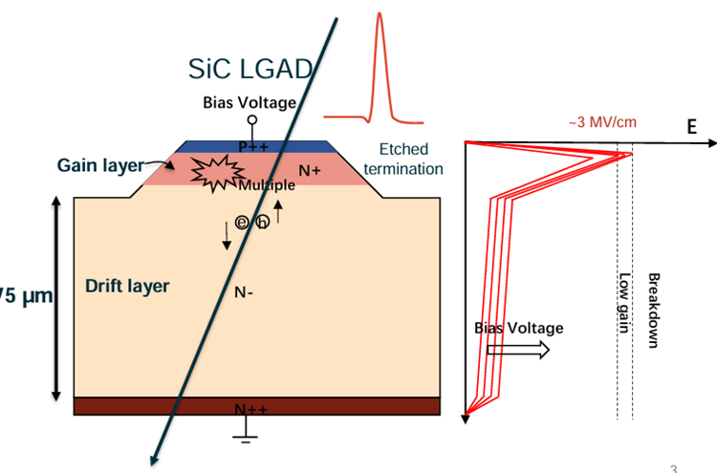
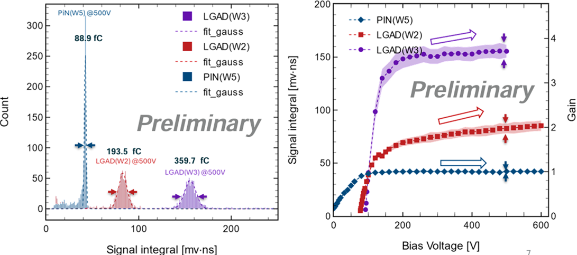
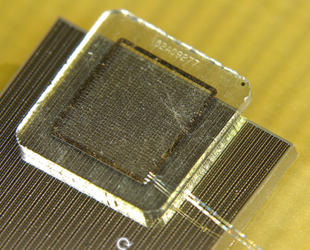
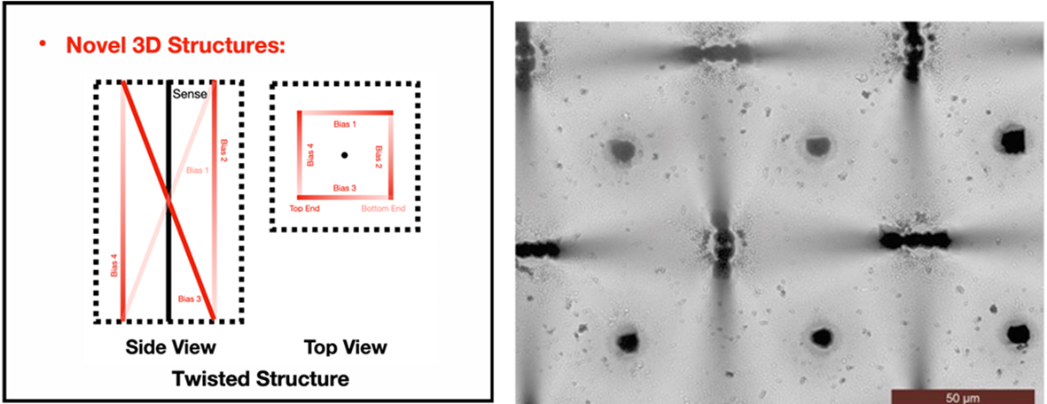
WG3,6/WP3 extreme fluence and WBS
Improve the radiation hardness of the semiconductor detectors and exploitation of the benefits of WGS for particle physics
Leakage current
Operation voltage
Projects running, proposal draft submitted (work ongoing), proposals in preparation (work ongoing):
Understanding silicon at extreme fluences (devices developed with in WP2)
Radiation damage in Si PiN and LGAD sensors
Many RD50 projects running on the radiation hardness
Wide-Bandgap-Semiconductors
SiC LGAD Detector (one running one in preparation)
Development of radiation-hard GaN devices for MIP detection
Radiation hardness of 25um 3D diamond detectors
Graphene/SiC Detector
diamond
signal
speed
Material budget
LBNL & NCSU
Main challenges and developments:
Silicon at extreme fluences:
understanding material properties (impact ionization, mobility, trapping…)
understanding the operation
SiC/GaN
understanding the material properties – defects formation
processing of large device SiC-LGADs
Diamond:
scalability of 3D column processing
availability of high quality large diameter wafers

Slide 14
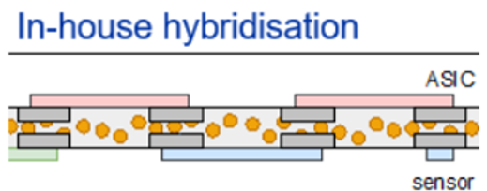
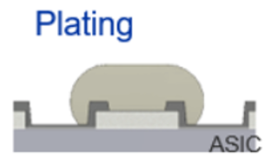
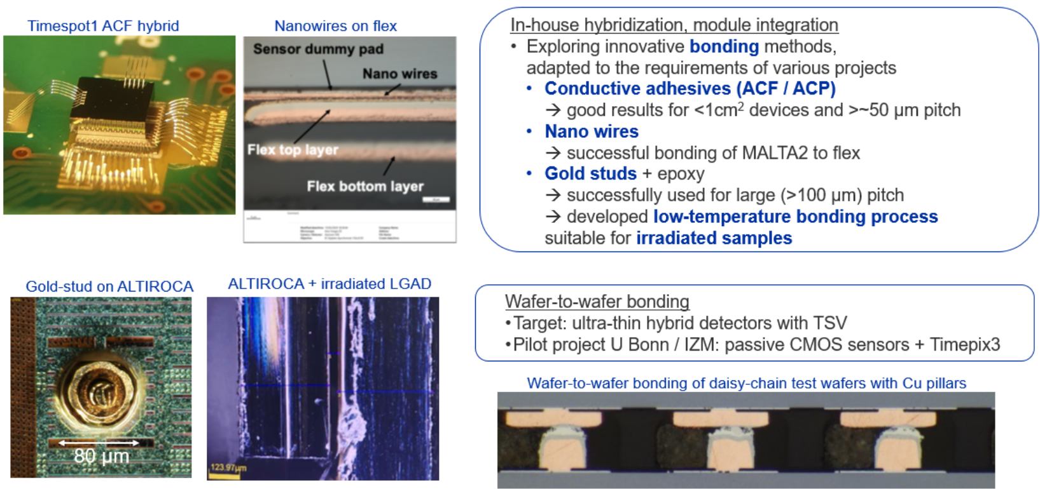
WP4: 3D-integration and interconnections
The goal of the DRD3 interconnection task is to organize the different technological readiness levels of interconnection solutions and the effort towards future advances in the field to match the requirements of future detectors in a coherent and coordinated way.
Projects running
In-house plating, hybridization and module-integration technologies for pixel detectors
CCF project:
CMOS Pixel Detector Demonstrator with Serial Powering and Innovative Interconnections

Slide 15
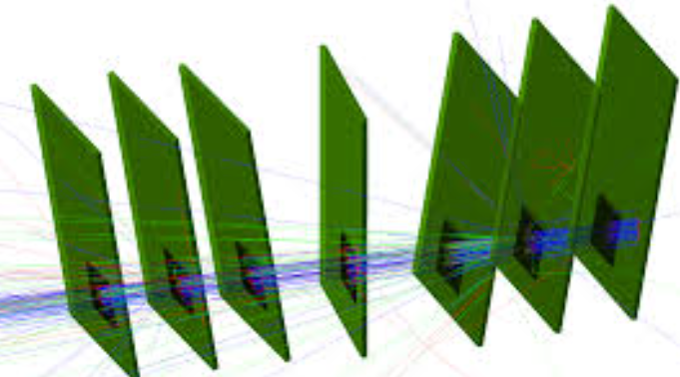
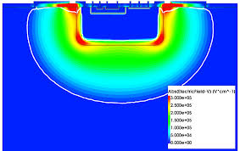
WG 4: Simulations
Simulations are essential for planning, understanding the performance and designing of devices. Aim to develop tools that could be (easily) implemented to simulate any specific detector or measurement.
“Monte Carlo”
(predicting the performance of complex detector assemblies)
GEANT4
TCAD
(understanding the sensors)
Synopsis, Silvaco …
AllPix2 / Garfield++ as the main tool
complement by other ones (also RASER, KDetSim…)
GOALS:
Developing and verification of damage models (effective and defect based)
Establish how to benchmark/evaluate the models against the measured properties (important milestone)
Improving the TCAD with new findings (WBS, extreme fluences)
Develop a flexible framework to simulate performance of different processes (CMOS)
GOALS:
Implementation of improved semiconductor models (e.g. mobility, impact ionization, trapping …)
Adaptation of WBS sensors
Adaptation of dynamic /adaptive E,E_{w}
Implementation of common electronics/digitization
E,E_{w}

Slide 16
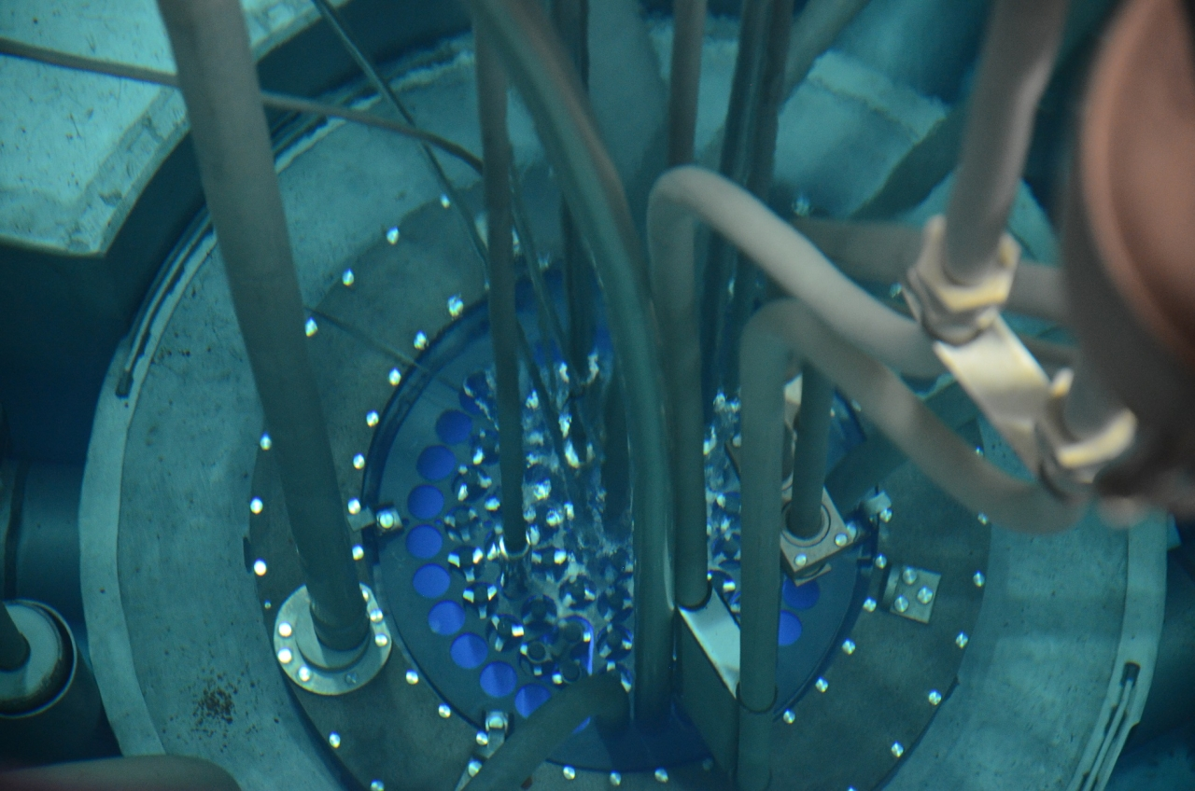
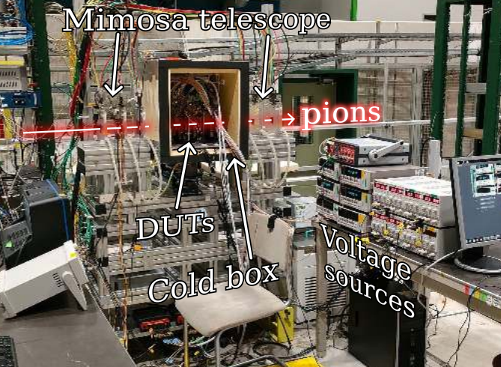
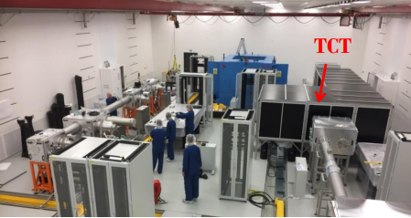
WG5: R&D on new techniques, common infrastructures, and characterization facilities
Lines of actions:
Development/improvement/diffusion of methods and techniques for characterizing sensors (those for defects spectroscopy DLTS,TSC, EPR…. as well those for characterization TCT, Beta-scope…)
Joint research activities for the delivery of common infrastructures for sensor testing (common sensor readers, jigs, test fixtures,…)
Promoting the use of unique irradiation and characterization facilities.
Activities in the last year:
Centrally organized irradiations to 10¹⁸ cm⁻² with reactor neutrons, now also PS and FNAL irradiations
Organization centrally organized TB campaign (many DRD3 groups benefited)
Setting up know-how and infrastructure at ELI-beams
Development new techniques e.g DB-TCT
…
Irradiation facilities (e.g. JSI reactor)
Test beam activities (CERN/DESY)
fs high intensity laser facilities (ELI Prague, SGIKER Bilbao…)

Slide 17
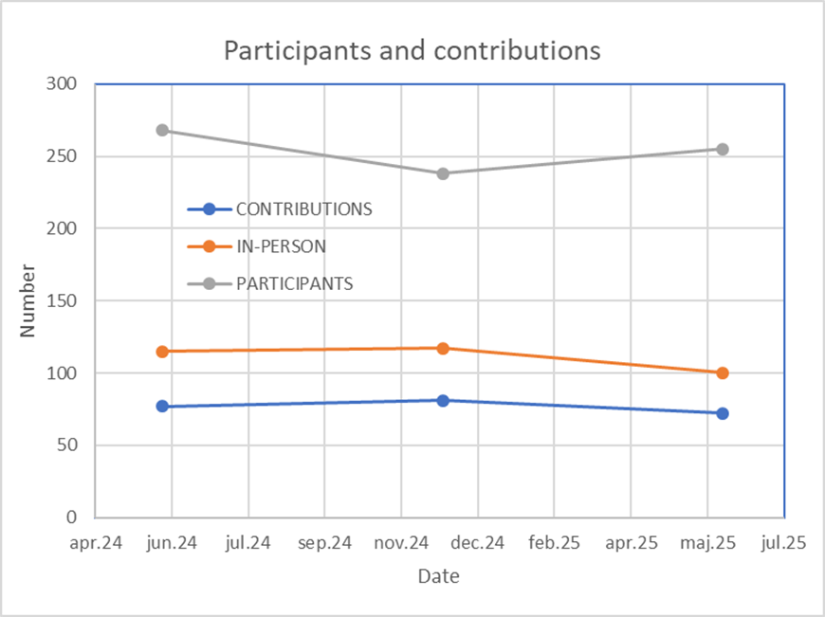
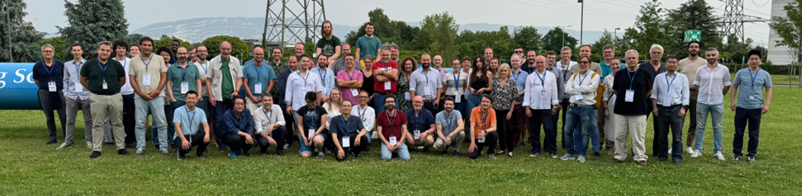
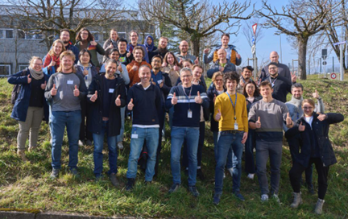
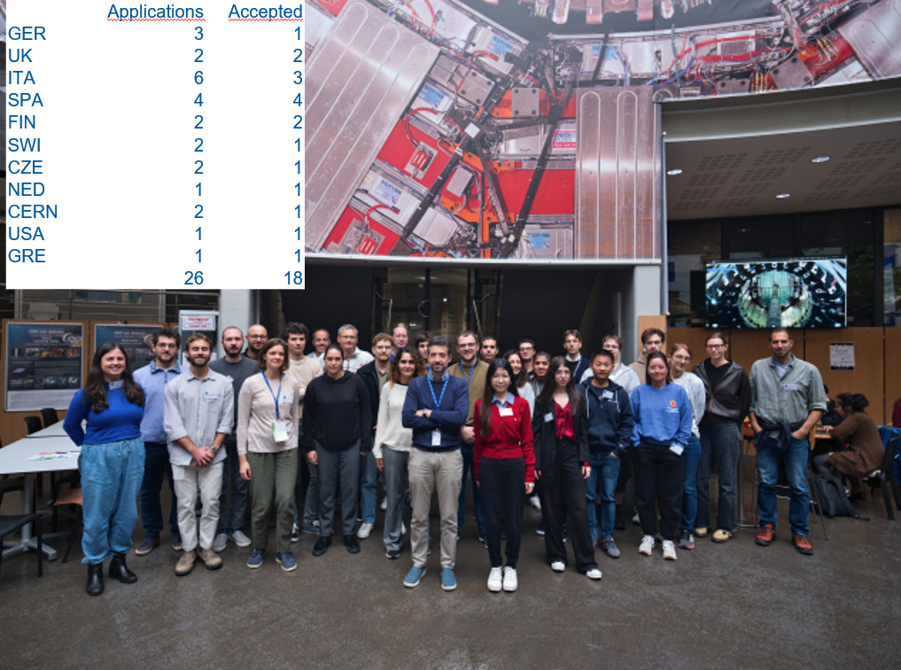


Outreach and visibility
We keep all he information in DRD3 www page (drd3.web.cern.ch):
announcements of interesting events schools/conferences/ workshops
open positions
repository of relevant literature and documents
links to CDS records of proposals and internal documents
Presentations:
at student lectures/schools
several overview presentations at various conferences/workshops
Schools organized within/by DRD3 in last year:
1st DRD3 TCT School (March 2025)
MAPS academy (July 2025)
2nd DRD3 TCT School (September 2025)
DRD3 weeks
our main events
open to everyone
1st DRD3 week
1st TCT school at CERN
2nd TCT school
CERN
MAPS academy
KEK

Slide 18
Conclusions & outlook
We are large fully functioning collaboration with MoU in the last phases of preparation.
We have very active R&D going on:
approved and running in total 12 WP projects with several in making (not all the projects have fully assured finances – most critical is financing of prototype runs)
small DRD3 CCF projects
small RD50 CCF running projects
More than 700 people are engaged with person-power of around 320 (full engagement) – we hope that at least this level of involvement in R&D will be kept or even increased after completion of HL-LHC.
CCF is as vital for promotion of new ideas, integration of smaller groups, facilitation of activities, and increase of mobility.
We would like to expand the sensors technologies developed in the DRD3 to the other fields of science for which adaptation we would need more resources.
“Far better it is to dare mighty things, to win glorious triumphs, even though checkered by failure, than to take rank with those poor spirits who neither enjoy much nor suffer much, because they live in a gray twilight that knows not victory nor defeat.”
-- Theodore Roosevelt, 1899
…. we dare mighty things …

