Slide 1



ATLAS RPC
FOAM TECHNIQUE STUDIES
Weekly Report
presenter: Ahmet Renklİoğlu
On behalf of atlas rpc FOAM team
26.05.2025

Slide 2
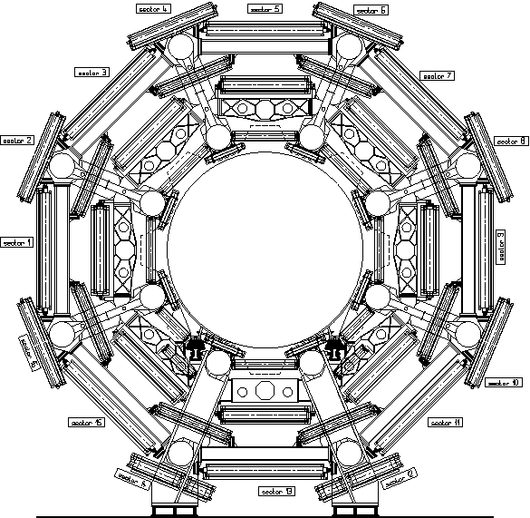
YETS 24/25
END OF YETS 23/24
Foam Technique has applied in YETS21/22, YETS 22/23, YETS23/24
Foam Technique has applied in YETS 24/25
Sectors where the current state of the technique can be applied
Sectors Requiring R&D

Slide 3
BEFORE
AFTER
Foam Technique has applied in YETS23/24
Foam Technique has applied in YETS21/22, YETS 22/23, YETS23/24
Foam Technique has applied in YETS21/22, YETS 22/23
Foam Technique has applied in YETS 24/25
Sectors where the current state of the technique can be applied
Sectors where the current state of the technique can be applied
Sectors Requiring R&D
Sectors Requiring R&D

Slide 4
NEXT YEAR?
Foam Technique has applied in YETS21/22, YETS 22/23, YETS23/24
Foam Technique has applied in YETS 24/25
Sectors where the current state of the technique can be applied
Secondary Sectors, the current state of the technique can be applied
Sectors Requiring R&D
From “Old” Sectors
Total Availvale Box
383 < x < 1069

Slide 5
Overview of R&D Activities
Tested in Cavern. Worked.
We have started to work on it
At the conceptual stage
We can categorize the issues in the ATLAS RPC Foam Repair Technique into two groups:
  The main challenge in this category has been the difficulty of accessing the corners of the relevant sectors. To address this, several alternative methods have been considered so far:
    Reaching the target corners with a robotic arm for sealing the edges and corners of the box and resin injection
    Using a proper single-component foam delivered through a pipe connected to a robotic arm to seal the box corners, instead of applying clay manually
    To access hard-to-reach sectors, one proposed solution is to install dedicated working platforms with the support of Technical Coordination, enabling manual injection and claying to be performed more easily and safely. CRITICAL.
  Improvements aimed at increasing the success rate of the technique by making its application safer and easier.
    Replacing manual mixing using a syringe and Dremel tools with an automated injection machine
    To avoid the need for a second injection, we aim to develop a method for injecting a higher-volume mixture in a single application.
    To avoid the need for a second injection, a single-component foam may be used to seal surface openings on the box.
26.05.2025

Slide 6
Proposed steps for ts1
Inspection of 3 suspicious chambers located in BO.06 using an endoscopic camera.
If platform installation requests are possible, identify the sectors where working platforms will be added for YETS 25/26 and define the platform dimensions.
  This will allow us to pre-plan the schedule by determining which sectors will be worked on during which weeks of YETS 25/26.
To avoid the need for a second injection, a single-component foam may be used to seal surface openings on the box.
  Re-testing the method to identify its deficiencies, allowing for further optimization after TS1.
26.05.2025

Slide 7
BACKUPS
ATLAS RPC Gas Repair Meeting
26.05.2025

Slide 8
GENERAL STATUS and technical Comments
YETS 21/22
YETS 22/23
YETS 23/24
YETS 24/25
Total Injection
100
277
224
409
1010
~32 person*week
~70 person*week
As shown above, our efficiency during YETS 24/25 appears to be lower than YETS 23/24. The reasons aree:
  Between February 3 and February 9, 2025, it was observed that the foam used was not expanding correctly. As a result, injection operations were paused for four days.
  Among the 19 sectors where injections were carried out this year:
    4 of them were sectors where repair attempts were made for the first time.
    The remaining 15 sectors were ones where we had already started repairs in previous years but still contained corners that were skipped due to either high leakages or the absence of boxes. This year, we also aimed to complete as many corners as possible.
This led to several challenges:
  Working across a large number of sectors simultaneously
  Applying the foam technique to boxes that were not initially in place
    As a result, needing to fill larger volumes, which in some cases required up to three injections per corner
  Cracking or breaking of some inlets during the claying step.
14.04.2025

Slide 9
BEFORE YETS 24/25 - Results
Status Cat. | Calculation with Parameters | With Values | Results
Still OK. | (Still Successful Layers/True Statistic)*100 | (136/149)*100 | 91.29%
Error of The Technique | ((Red Filled Rows)/True Statistic)*100 | (5/149)*100 | 3.35%
Requires 2nd Injection | (Need 2nd Injection/True Statistic)*100 | (5/149)*100 | 3.35%
Unknown Leak | (No Leak Found with Sniffer at the corners/True Statistic)*100 | (3/149)*100 | 2.01%
Results and Analysis of Gas Tests
Detailed Inspection Results: (16 Dec. – 19 Dec.)
Total No. Of
4 Corners Repaired Layers | 161
Application Failures (Excluded) | 12
Valid Layers for Statistics | 149
Still OK Layers | 136
New Big Leaks | 3
New Small Leaks | 10
The chambers that have New Big Leaks (3) and New Small Leaks (10) are examined in detail.
161
91.28%
Status of Small Leaks | 10
Fully Filled but the leak is still there | 2
Need 2nd Injection | 5
No Leak Found with Sniffer at the corners | 2
Bad Foam | 1
Status of Big Leaks | 3
Fully Filled but the leak is still there | 1
2nd Injection can be done. But high leak! | 1
No Leak Found with Sniffer at the corners | 1
13.01.2025

Slide 10
SUMMARY OF
STATUS before yets 24/25
3 Main Studies are completed in December:
The Detailed Gas Tests of 19 Sectors (16 Days)
Inspection of New Leaky Chambers
The General Analysis of first 2 Studies
Gas Tests
Losts:
Study:
We lost 6days for detailed inspection.
The first plan was aiming to spend 2 weeks for Gas Tests
In reality, we spent 20 days. (12(Gas Tests)+4 (Inspection of Susp. Chambers)
161
91.28%
19 Sectors are tested in detail—more detailed inspection than in earlier years.
Benefits:
The No. Of Available Boxes Before Tests: 240
The No. Of Available Boxes After Tests: 240+291 = 531
Risks:
~1 week lost due to gas tests. This may affect the total no. Of injectionn
Results and Analysis of Gas Tests
Detailed Inspection Results: (16 Dec. – 19 Dec.)
Total No. Of
4 Corners Repaired Layers | 161
Application Failures (Excluded) | 12
Valid Layers for Statistics | 149
Still OK Layers | 136
New Big Leaks | 3
New Small Leaks | 10
The chambers that have New Big Leaks (3) and New Small Leaks (10) are examined in detail.
Status of Small Leaks | 10
Fully Filled but the leak is still there | 2
Need 2nd Injection | 5
No leak found on corners | 2
Bad Foam | 1
Status of Big Leaks | 3
Fully Filled but the leak is still there | 1
2nd Injection can be done. But high leak! | 1
No Leak Found with Sniffer at the corners | 1
ERROR
2.68%
13.01.2025

Slide 11
YETS 24/25
Nof Fully Repaired Layers Before YETS 24/25
Nof Fully Repaired Layers Afyer YETS 24/25
Total CLAYING
Total INJECTION
451
409
-
149
337
3 teams, 6 days
3 teams, 5 days
3 teams,
3 days injection
27.01.2025-02.02.2025
03.02.2025-09.02.2025
03.02.2025-09.02.2025
10.02.2025-16.02.2025
17.02.2025-23.02.2025
24.02.2025-02.03.2025
03.03.2025-09.03.2025
10.03.2025-16.03.2025
17.03.2025-23.03.2025
27.01.2025-02.02.2025
03.02.2025-09.02.2025
03.02.2025-09.02.2025
17.02.2025-23.02.2025
24.02.2025-02.03.2025
03.03.2025-09.03.2025
10.02.2025-16.02.2025
10.03.2025-16.03.2025
17.03.2025-23.03.2025
14.04.2025

Slide 12
YETS 24/25
YETS 24/25’ten Önce Tamamen Onarılan Çember Sayısı
YETS 24/25’ten Sonra Tamamen Onarılan Çember Sayısı
Toplam Kil Sayısı
Toplam İnjeksiyon
451
409
-
149
337
27.01.2025-02.02.2025
03.02.2025-09.02.2025
03.02.2025-09.02.2025
10.02.2025-16.02.2025
17.02.2025-23.02.2025
24.02.2025-02.03.2025
03.03.2025-09.03.2025
10.03.2025-16.03.2025
17.03.2025-23.03.2025
27.01.2025-02.02.2025
03.02.2025-09.02.2025
03.02.2025-09.02.2025
17.02.2025-23.02.2025
24.02.2025-02.03.2025
03.03.2025-09.03.2025
10.02.2025-16.02.2025
10.03.2025-16.03.2025
17.03.2025-23.03.2025

Slide 13
WHEN WERE THE MEMBERS AT CERN?

