Slide 1

Double click to open table in Excel

Slide 2
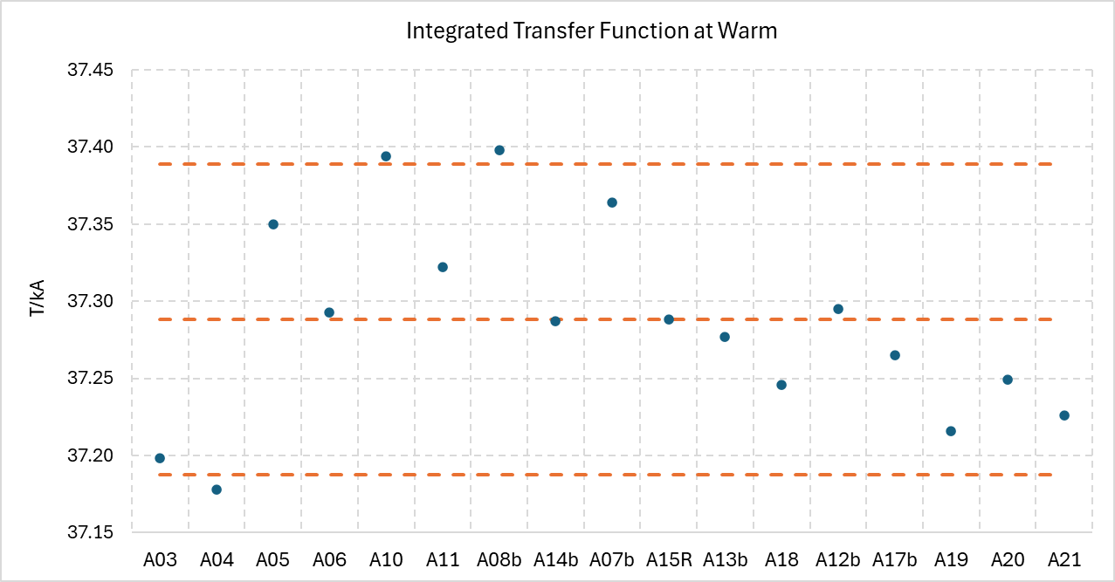
+0.27%
Mid-range
-0.27%
Accepted magnets plus A20, A21.
Mid-range is the average of the MAX and MIN value of the series.
Range ± 0.27% corresponds to the ±1.5T range at nominal

Slide 3
Integral Harmonics at the end of magnet assembly
Double click to open table in Excel

