Slide 1
Large Piwinski Angle MD
J. Abelleira, R. Assmann, P. Baudrenghien,
C. Bhat, T. Bohl, O. Brüning, R. Calaga,
R. De Maria, O. Dominguez, S. Fartoukh,
M. Giovannozzi, W. Herr, J.-P. Koutchouk,
A. Macpherson, M. Meddahi, E. Metral, K. Ohmi,
G. Papotti, T. Pieloni, S. Redaelli, L. Rossi,
E. Shaposhnikova, R. Tomas, F. Zimmermann
LSWG, 4 October 2011

Slide 2
MD plan
injection energy, collision tunes
two high-brightness bunches per beam, 2.5e11, ε~2 μm
long bunches (1.6 ns): blow up in SPS & low voltage in LHC (3.5 MV) [Philippe Baudrenghien]
collisions at injection in 3 IPs (TCT adjustments)
fill pattern: one bunch / beam colliding in IPs 1,5 and 8; the other in IP8 only
change IP8 spectrometer in 3 steps from nominal to zero (TCT adjustment, & orbit correction at eachstep) [nominal, ½, ¼, 0 strength]
monitor transient losses going into collision, beam lifetime and luminosity lifetime for large, intermediate, and zero Piwinski angle

Slide 3
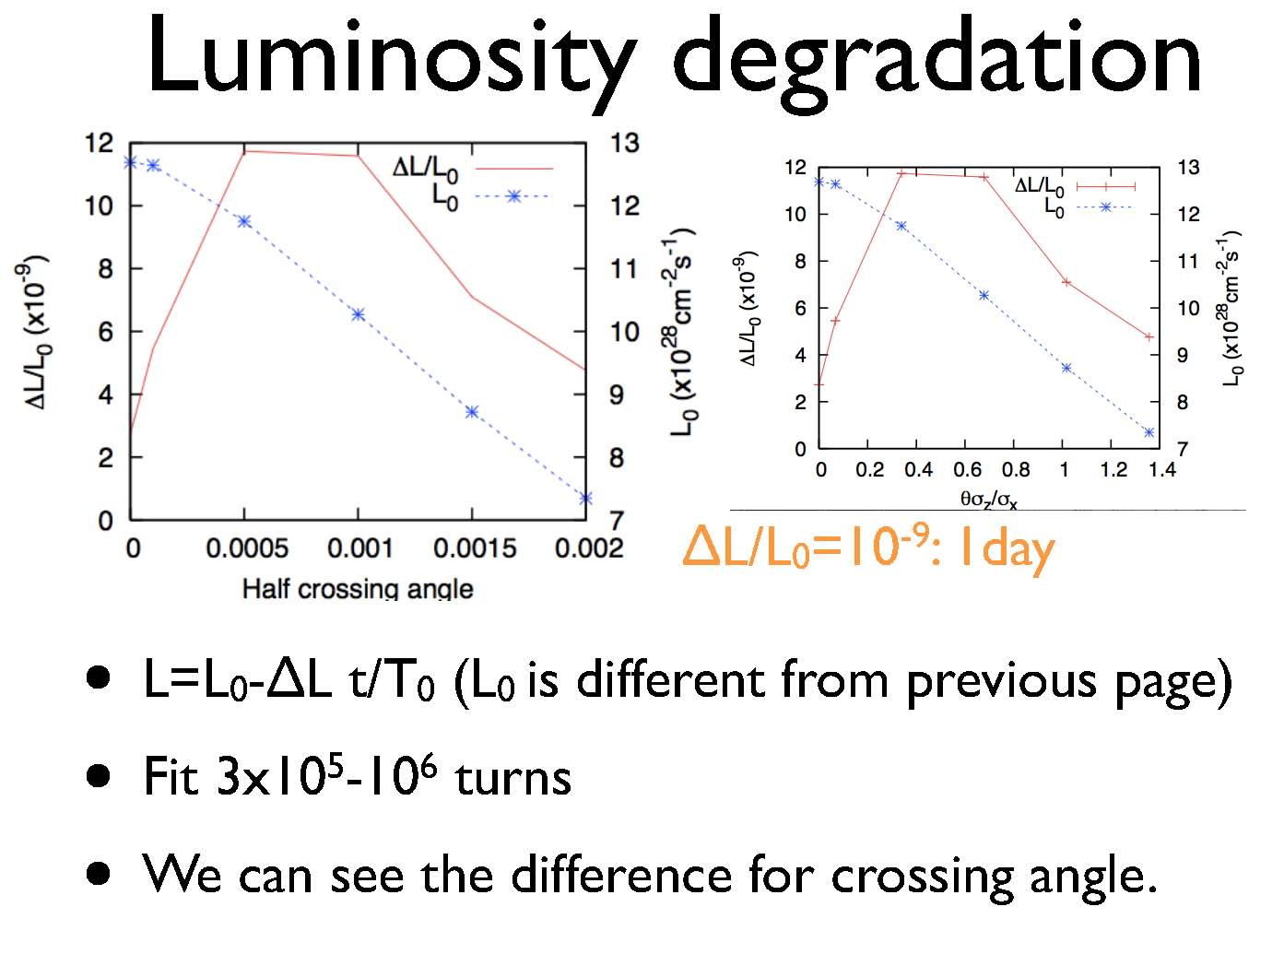
MD simulation by K. Ohmi

