Slide 1


Assistant EXSO Role and additional information
ISOLDE permanent experimental installations
EXSO: EXperimental Safety Officer

Slide 2
ISOLDE Safety Review
It recently took place a review of the past 10 years of ISOLDE from a safety perspective
This review was mandated by the Department Heads and Directors
Different recommendations were delivered from the working group:
  Transversal
  Technical
  Organisational

Slide 3
ISOLDE Safety Review
It recently took place a review of the past 10 years of ISOLDE from a safety perspective
This review was mandated by the Department Heads and Directors
Different recommendations were delivered from the working group:
  Transversal
  Technical
  Organisational

Slide 4
ISOLDE Safety Review
It recently took place a review of the past 10 years of ISOLDE from a safety perspective
This review was mandated by the Department Heads and Directors
Different recommendations were delivered from the working group:
  Transversal
  Technical
  Organisational
Nominate one AEXSO for each permanent experimental setup.
The appointed AEXSO should maintain direct communication and information exchange with the ISOLDE EXSO.

Slide 5
AEXSO Role
A specific mandate exist at CERN: GSI-SO-5
The EXSO training is provided by CERN/EP Safety Office (classroom, 1 ½ day training). A dedicated session for ISOLDE EXSO can be organised
Main tasks are:
  Keep informed regarding Safety aspects within the Experiment
  Make sure that risk assessments exist, and safety measures are implemented
  Oversee the development and update of Safety Files
  Support the Experiment in obtaining Safety clearance
  Collaboration/information with ISOLDE EXSO and EP DSO representatives

Slide 6
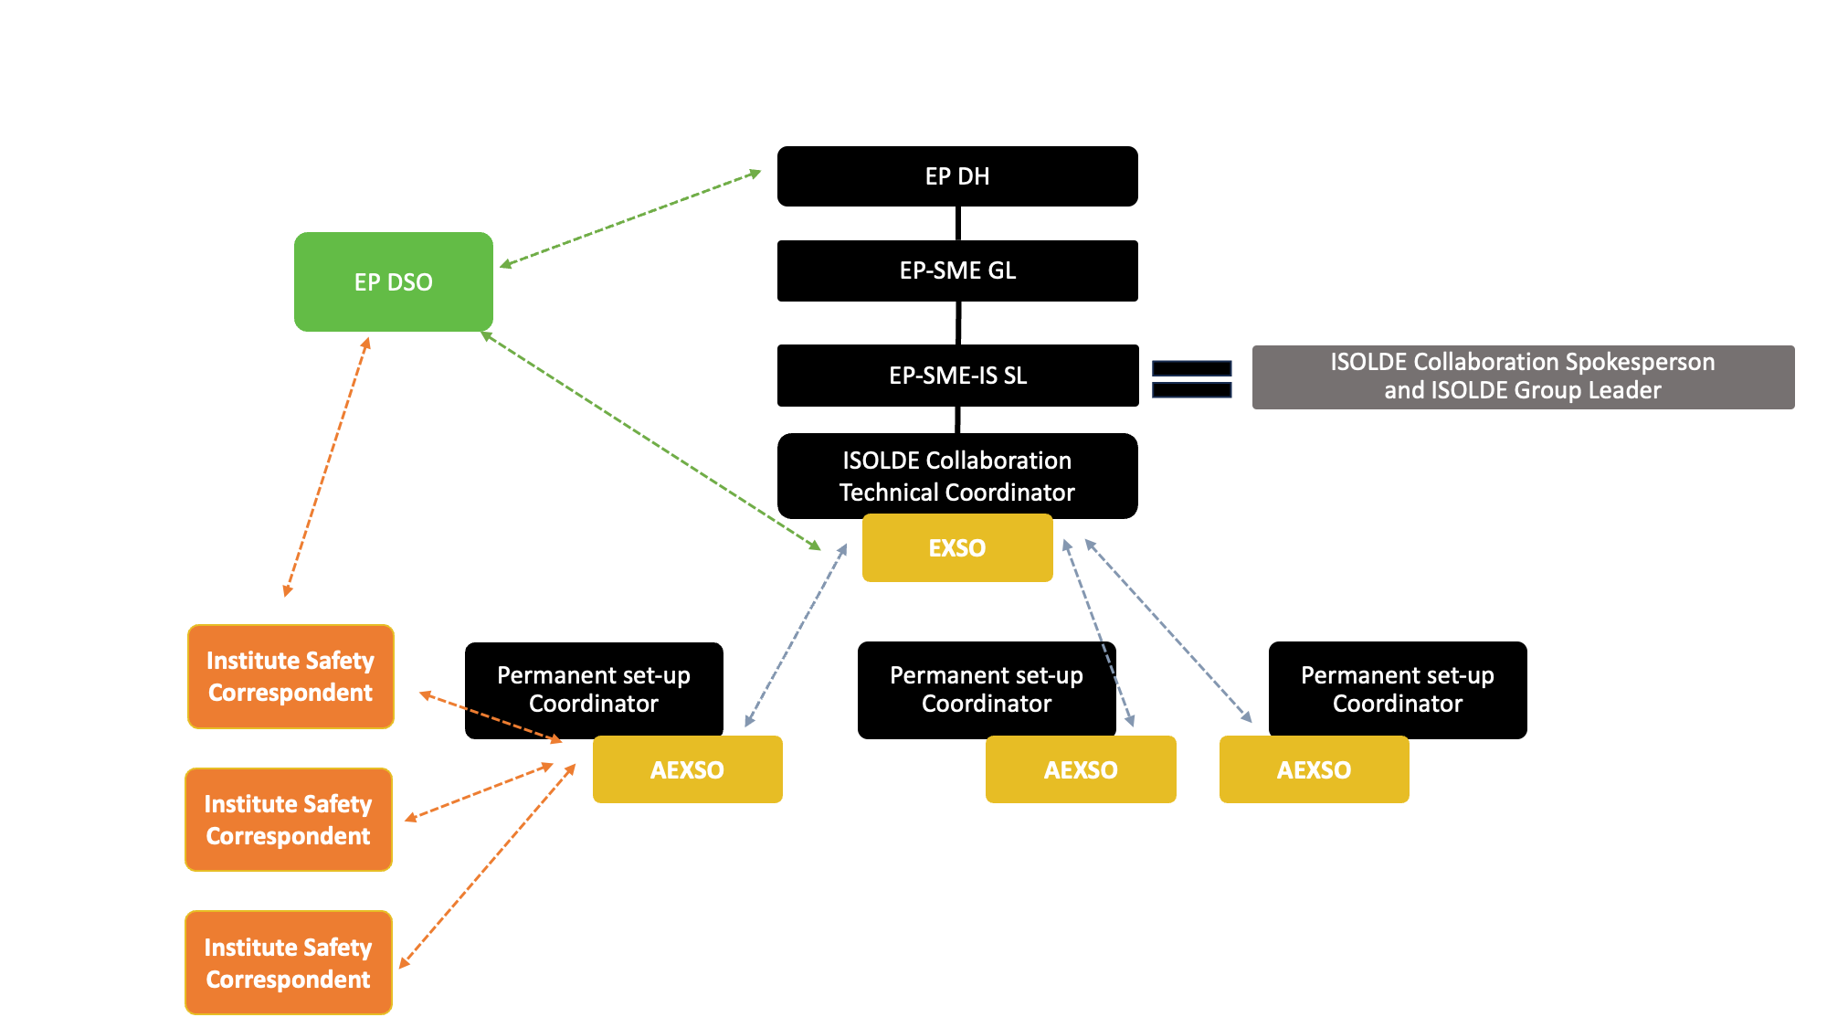

Slide 7
ISOLDE Training – General Safety
A new general safety training will be created, ~1h classroom
It will be part of the already existing day of trainings needed for ISOLDE users (Electrical Safety – Working in EP Experiments; ISOLDE – Radiation Protection)
Any inputs from you about the relevant topics to include are more than welcome!

Slide 8
DG-EP reserve budget for ISOLDE
Multiple safety improvement projects are done/on-going with this reserve budget. In particular:
  Upgrade of b.508 chemical lab
  Upgrade of radioactive source storage
  Chemical safety improvements
  Upgrade of flammable gas installation
  Connection GLM/GHM fume hood to outside
Any input about additional safety related projects are more than welcome!

