Slide 1
CERN Volleyball club AGM President’s report
26/05/2025

Slide 2
Situation with training gyms
For a couple of years now we have five time slots per week ( we use to have two, then three)

Slide 3
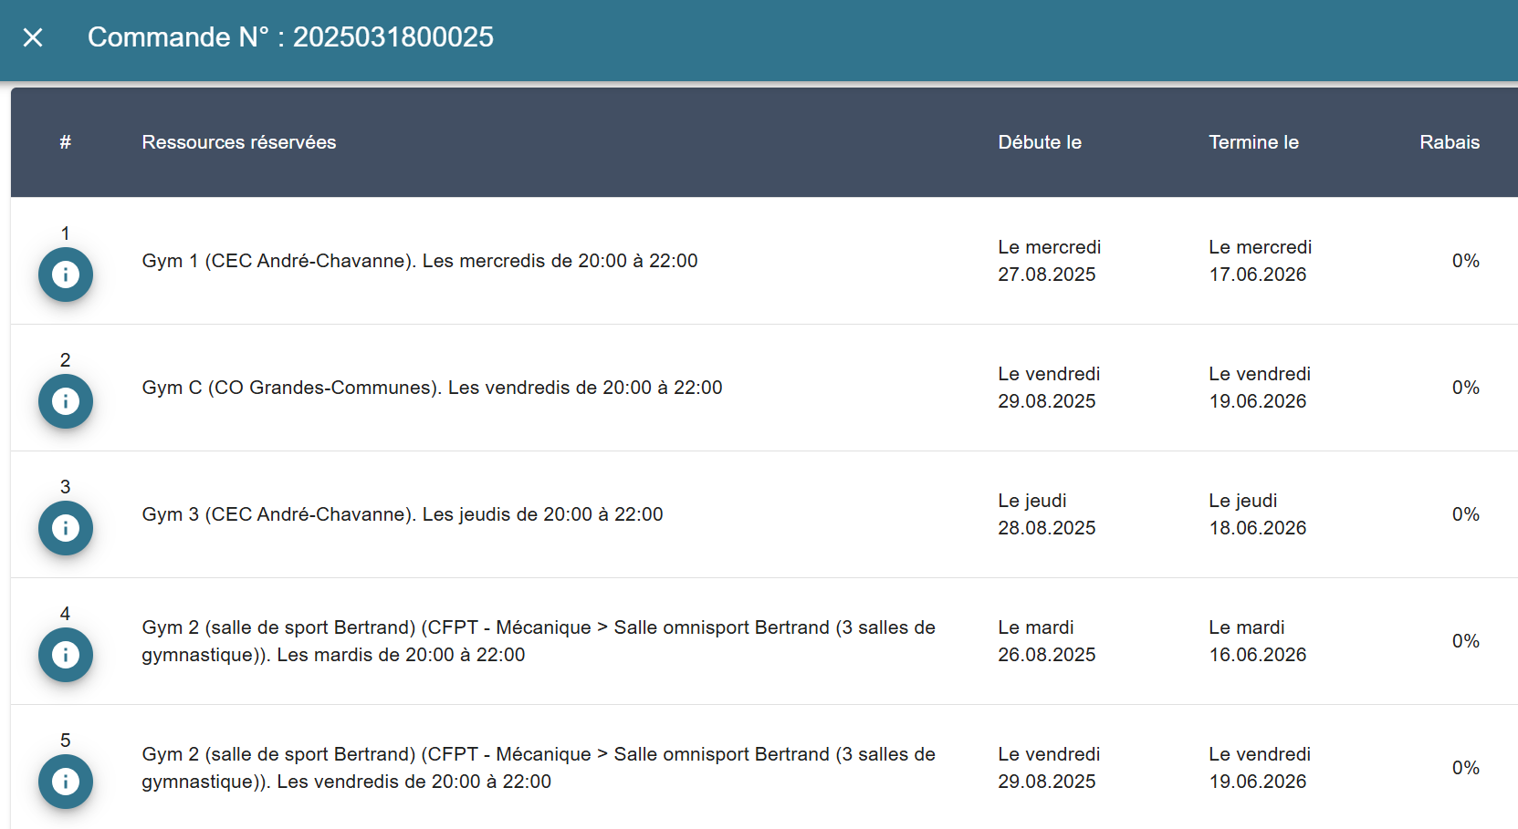
Team 1
Team 1
Team 3
Team 2
Team 2

Slide 4
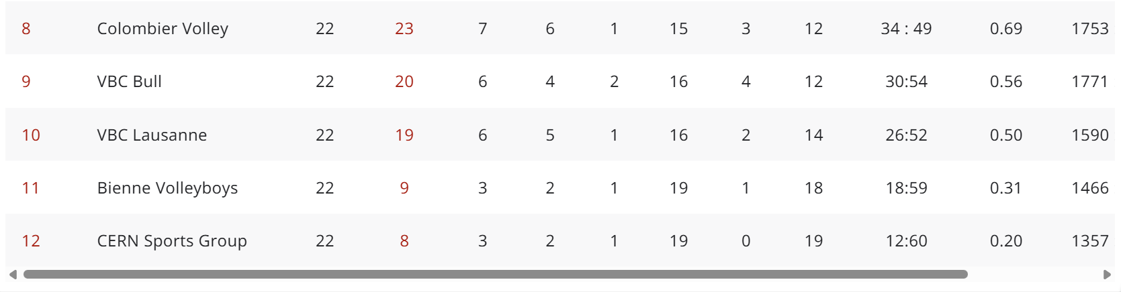
Reports of the teams – team1 (male team)
We finished the championship last with the worst performance in years. What went wrong?
We got relegated after 9 years in 1L

Slide 5
Team 1
Why did we get relegated?
Too many untimely injuries
Note enough commitment by the players
Players prefer to play matches rather than train
Players prefer to spend the weekend doing other things rather than play matches.
My take:
We are not professionals and people have other interests, this is normal. BUT this year the degree of non commitment was beyond acceptable.
The core of the team is the same as 10 years ago, but we are 10 years older…
Maybe it is a good thing to spend a year in an easier league and regroup…

Slide 6
Agreement with a junior team
Gilles Boyer, our external affairs officer, although not training with us this year, has continued helping in this:
The regulations of Swissvolley demand that each club has a junior team. Since we are not a club in the same sense as other local clubs, we have an arrangement with a Geneva club that does have a junior team, we provide some help to them, and they allow us to use their name to avoid a Swissvolley fine.
Cost to us: We provide them 8 new balls that they will keep
Probably not applicable next year

Slide 7
President’s “discretionary fund”
During this year I had to take a couple of decisions to support team 1 that involved spending money.
If the club does not agree with this spending, I will pay from my pocket, no big deal
Transport costs for our best player to come to a match: 180CHF
Physiotherapy treatment for member of the club for an injury incurred during play (210CHF)

Slide 8
Finances – season 24-25
See report of our treasurer, but I am happy to see that we have avoided financial ruin over the last couple of years.

Slide 9
Club fees
I propose to keep them as last year
For the male team, since the new season will be cheaper, we can reduce the fees a bit (currently 450CHF) by the amount of the license difference.

Slide 10
Use of gyms after the season
I find it really a pity that nobody is interested to play any volleyball after the season is over in March, although we PAY for the gyms until June
Why is this so? Can we not even fill up one or two training sessions per week (out of the five)?

Slide 11
Succession planning for the president
At some point a new president should be appointed for the club
To ease the transition, and as a token of respect for old presidents, I propose to introduce the title of “honorary president” for presidents that have served 10 years or more to the club
The position will be honorary and will not affect fees to be paid, for instance.

Slide 12
The job of the president
Support and defend the club at CERN and outside
Liaise with the CCC
Liaise with the Geneva renting authorities
Liaise with Swissvolley, junior team, referee pool
Ensure that the club has strategic goals and attracts the membership we want to attract

Slide 13
Club committee
Only requirement is that the treasurer should be a cern staff member
I would like to keep the position of team managers, I think it is important. Team managers can be members of the committee.

Slide 14
New committee
President:
Vice-president:
Treasurer: Stephan Hageboeck
Vice-treasurer:
Secretary:
Information contact:
Webmaster:
Team managers:
Male team:
Mixed team:
Beach volley:
Atomiade manager:

