Slide 1
PUMA
Status update
Mark Kirschbaum
PUMA | Institute for Nuclear Physics TU Darmstadt

Slide 2
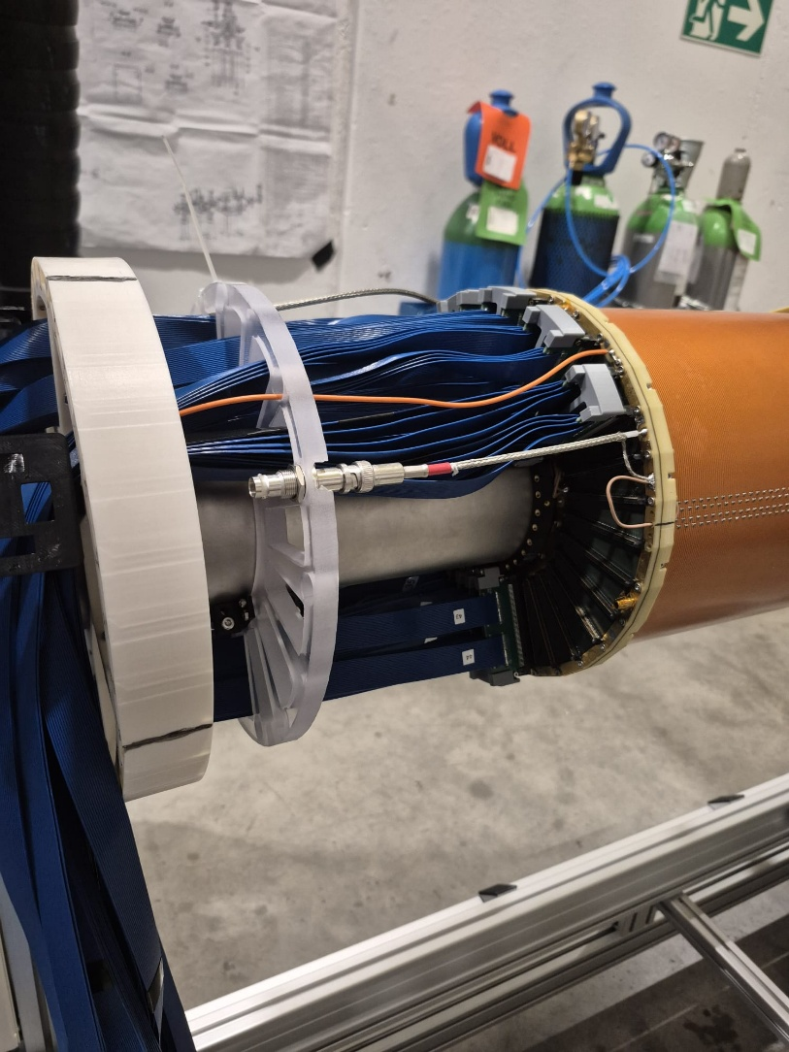
PUMA at the AD
Successfully tested different components (vacuum, TPC, trap electrodes)
Focus for the next weeks:
  Recommission of p-bar beamline
  Finish pion detector installation
  Cooling the magnet
  Start taking beam!

Slide 3
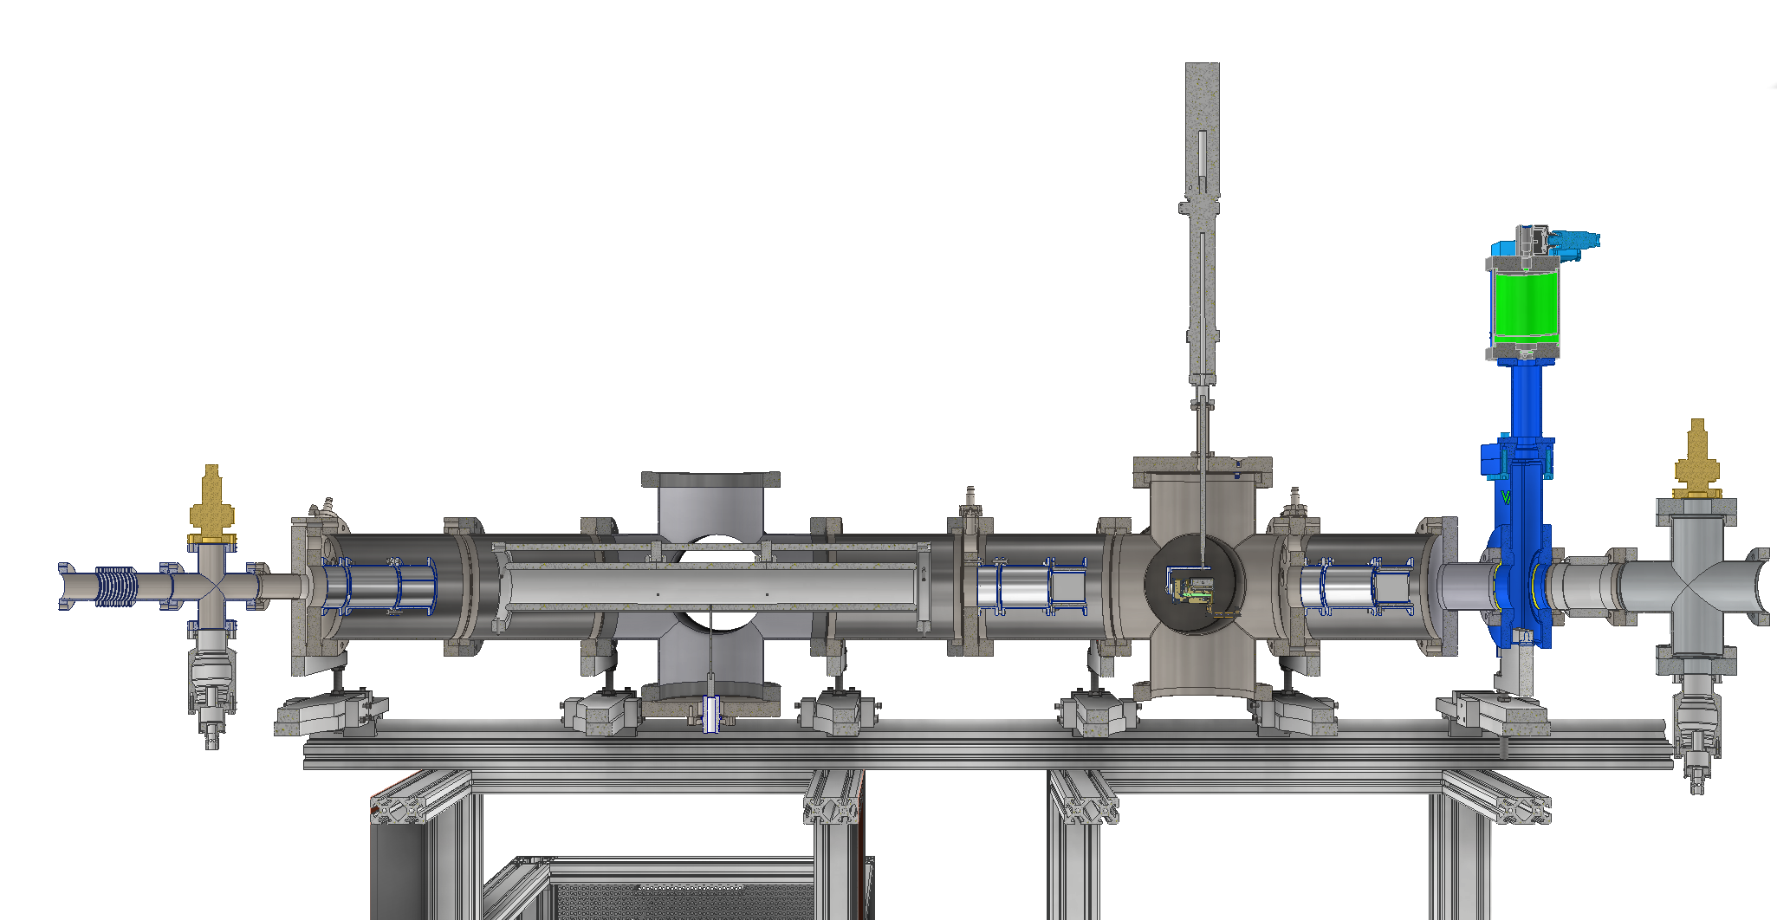

RC-7 Transfer line
26kV Pulsed Drift Tube
Valve
Handover point (CF-40)
Einzel
lens
Ion Optic
Ion Optic
Main Frame
RC-6
Support System compatible with the PUMA@AD system
Diagnostic Box

Slide 4
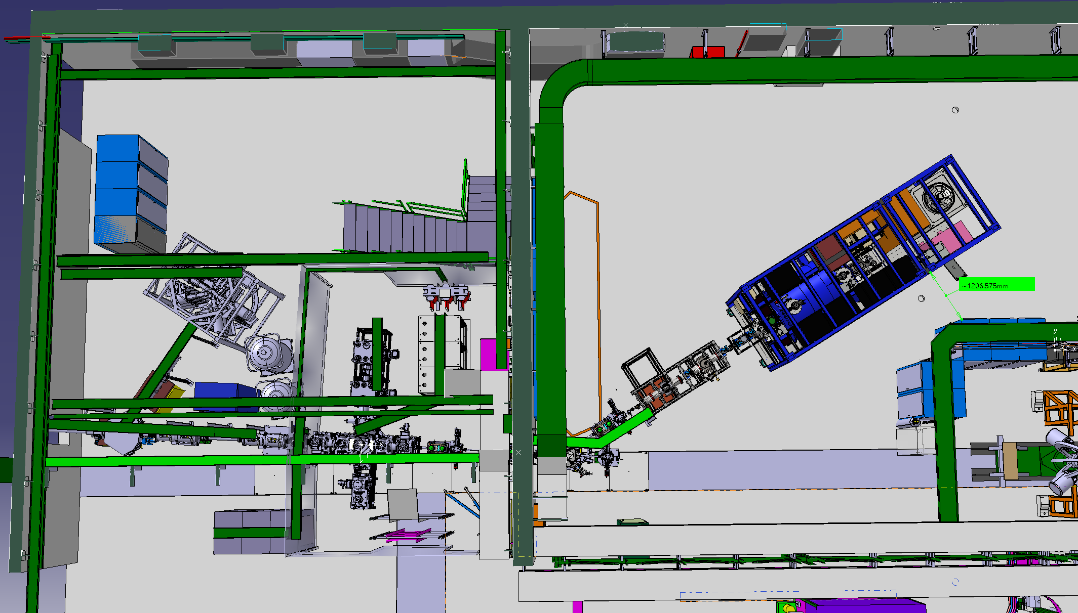
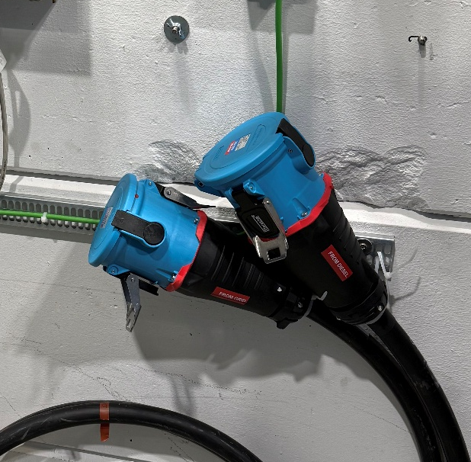
RC-7 Transfer line
Required services:
Power
Water
(Pressurized Air)

Slide 5
Timeline puma at isolde
Start taking beam in the AD [Summer’ 25 - p-bar beamline as soon as we have the beam permit; trap as soon as the magnet is cold and everything is operational]
Installation of the RC-7 transfer line [Summer’ 25 – Q4’ 25/Q1’ 26]
YETS for antiprotons [8 Dec 25 - ~May’ 26]
Commissioning RC-6 and RC-7 [Q1 / Q2’ 26]
Transport from AD (with/without antiprotons) [Q2 / Q3’ 26]

