Slide 1
Puma@Isolde
Survey
CMS BP new support 2 x AT401 AZ/AB
CMS BP new support 2 x AT401 AZ/AB
CMS BP new support 2 x AT401 AZ/AB
03.07.2025
Antje BEHRENS, Alexandre BEYNEL

Slide 2
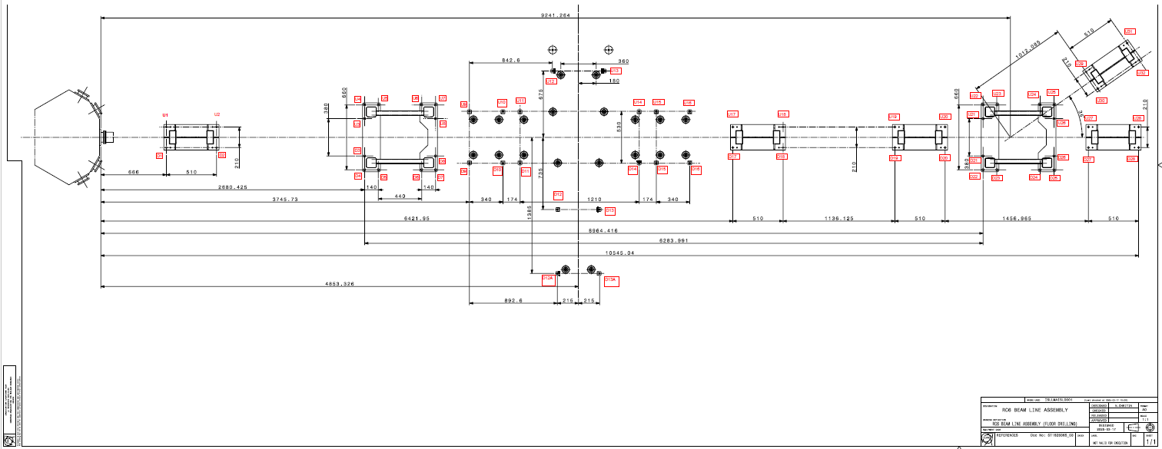
27.03.2025 RC6 tracing in local coordinate system

