Slide 1
Beam Instrumentation for PUMA@ISOLDE
M. Martin Nieto , P. Martins, J. Tassan-Viol
W. Andreazza, S. Bart Pedersen
C. Pasquino, F. Roncarolo
Puma@Isolde – 3 July 2025

Slide 2
Status and Plans of DBs
Mechanical Design, Integration and Procurement

Slide 3
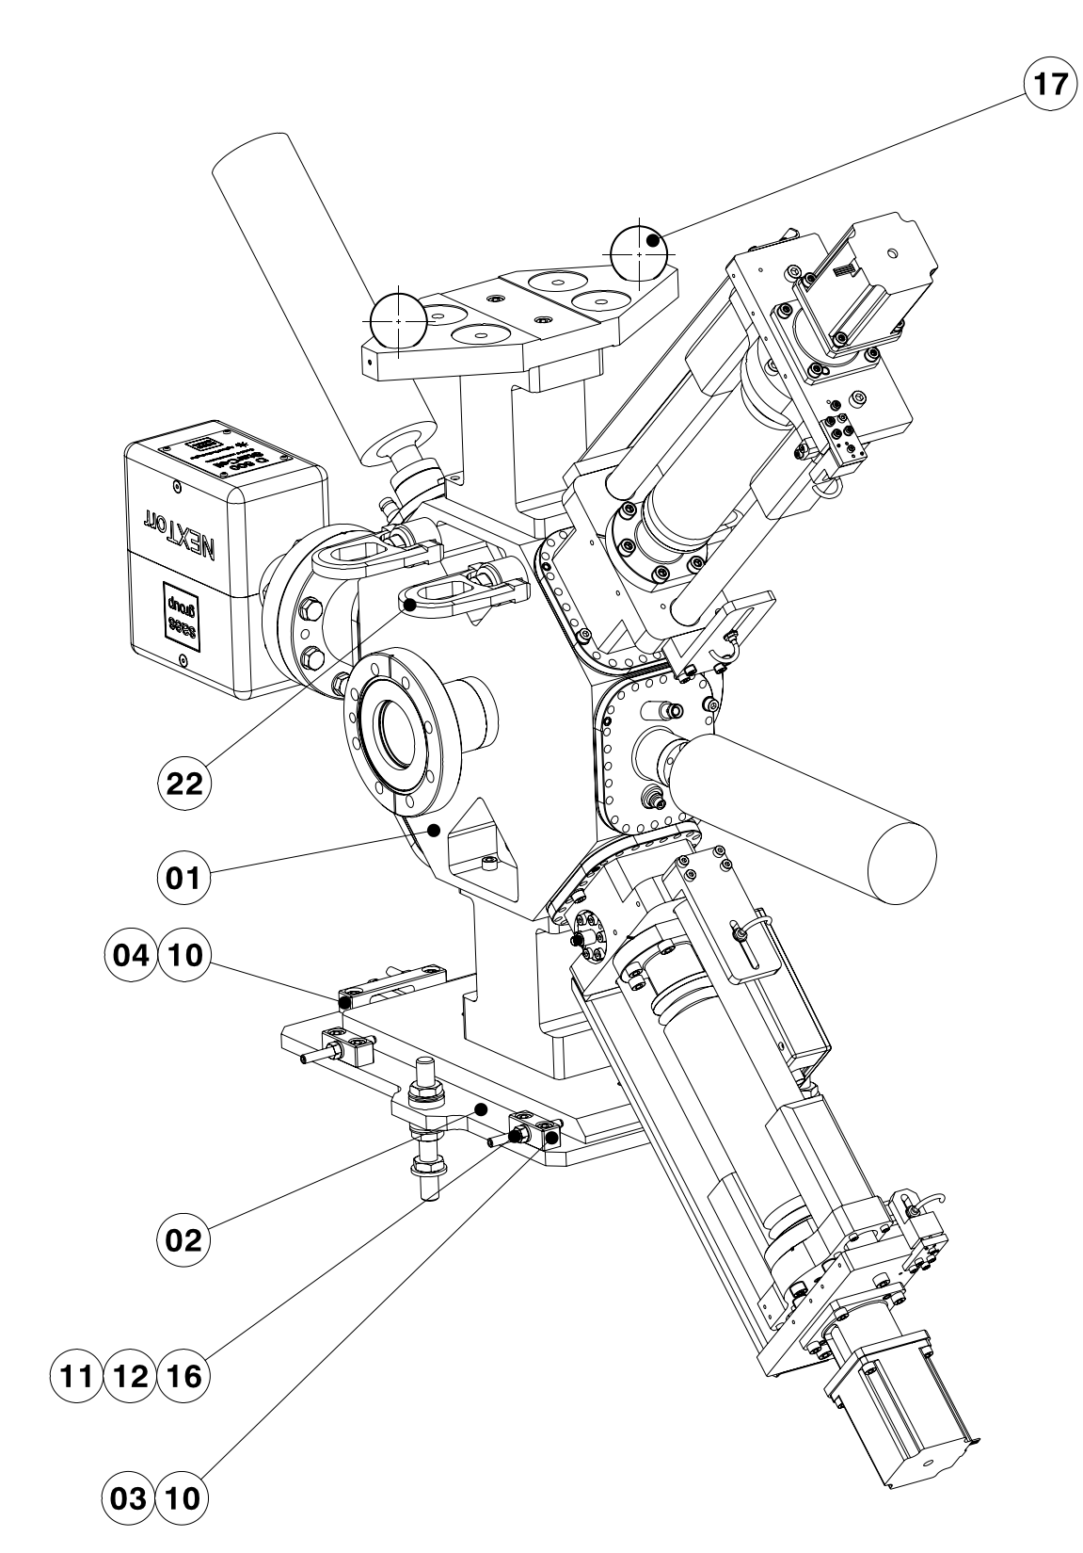
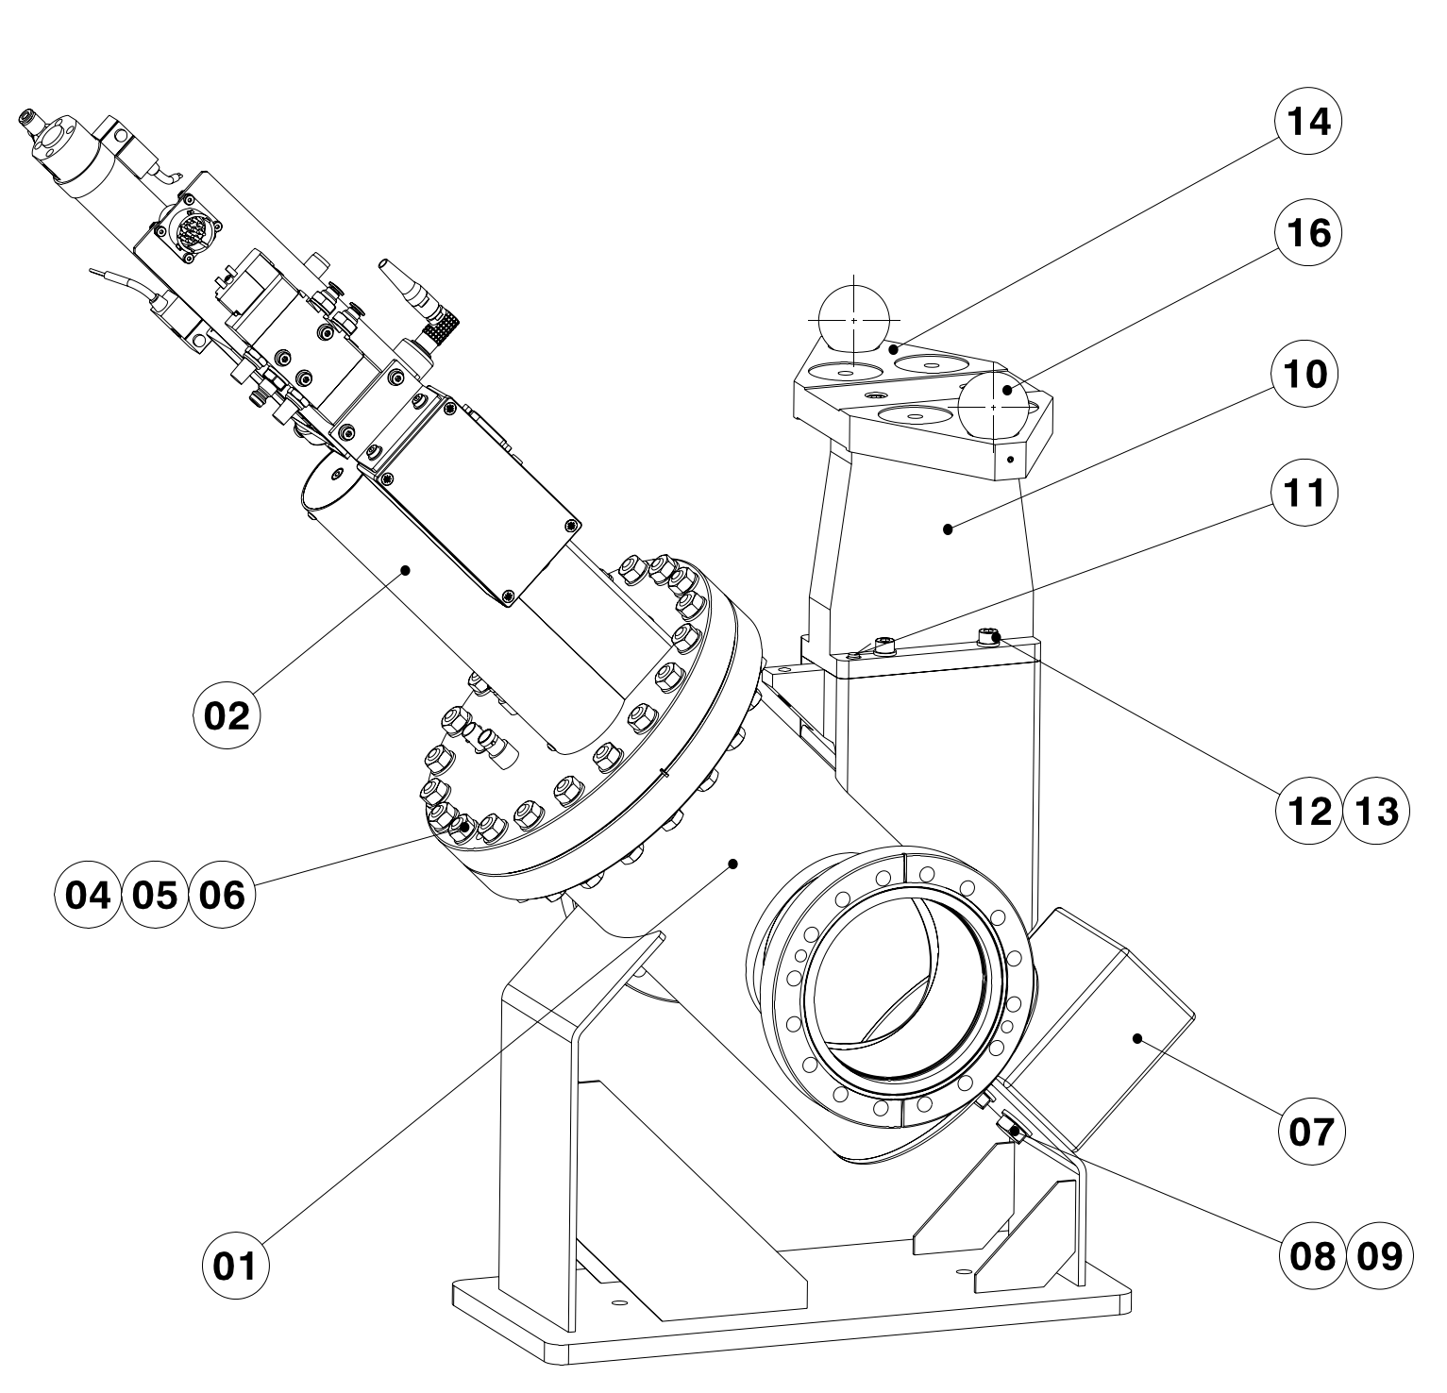
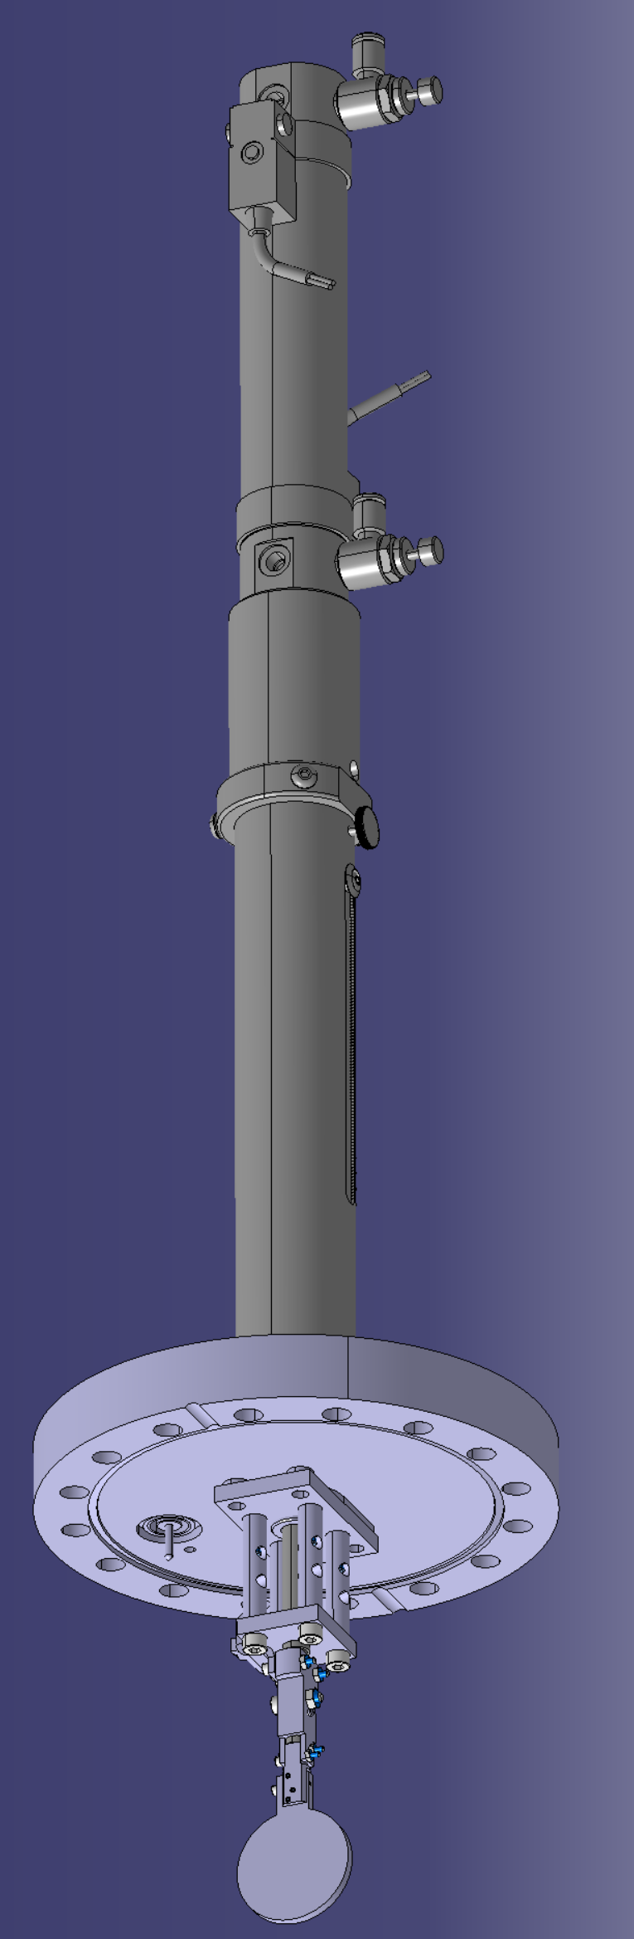
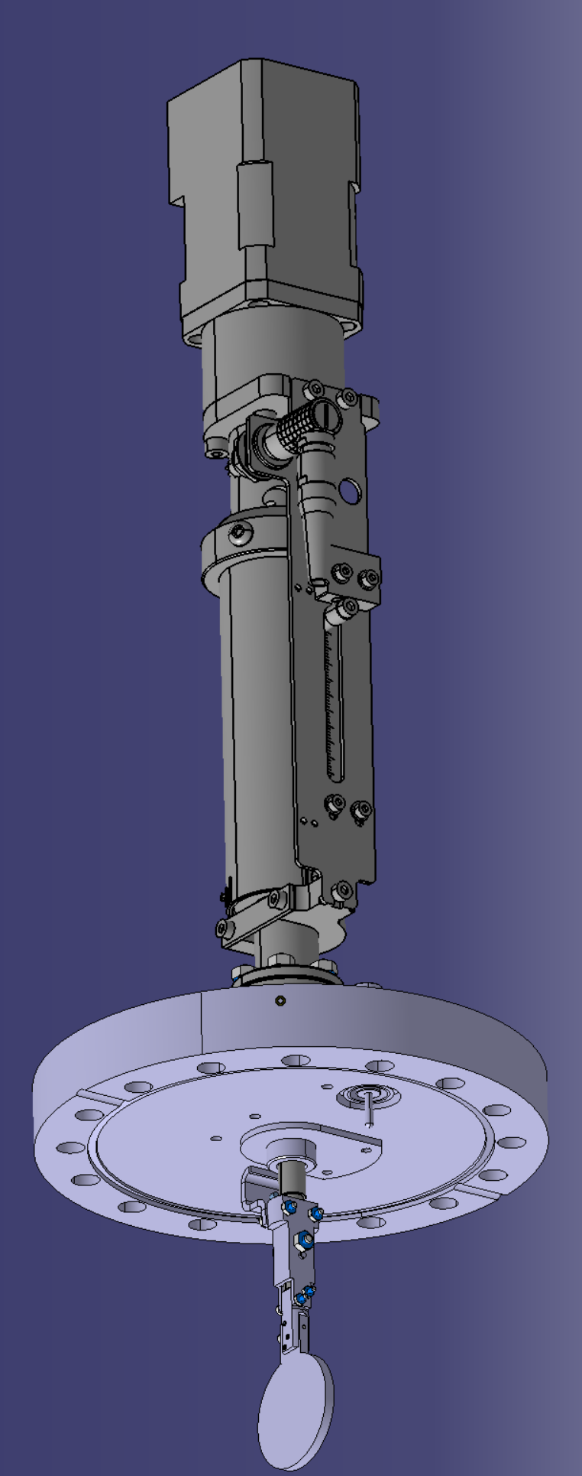
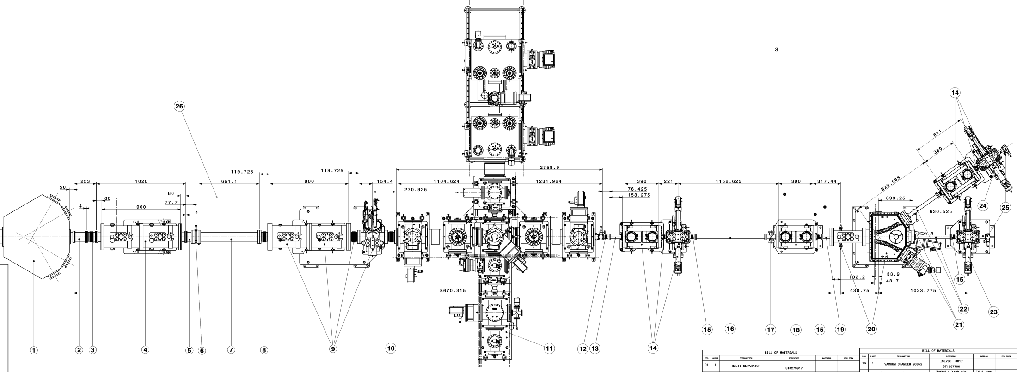
BI Diagnostic boxes
DB1
  Isolde type:
    Faraday Cup
    Scanner
DB2-4
  HIE-ISO type:
    Faraday Cup
    Scanner
    MagneToF
    Slit/collimator
  Collector plates

Slide 4
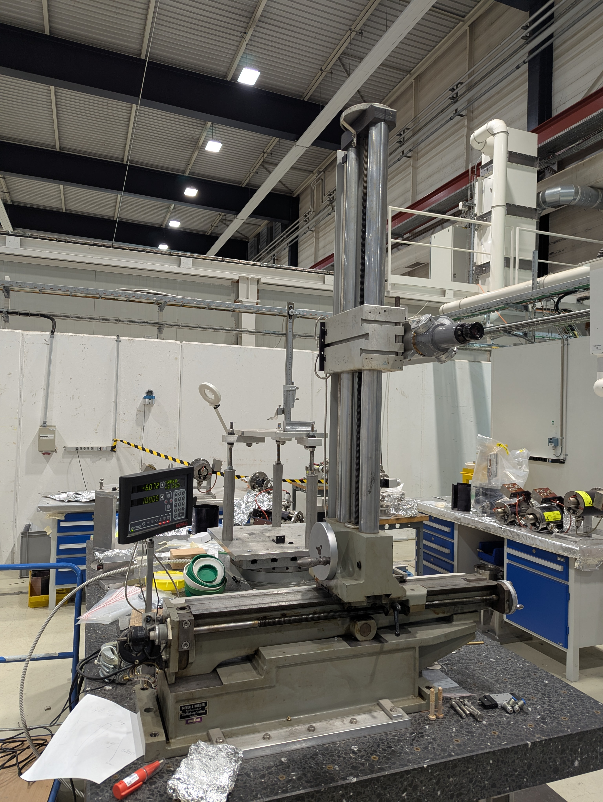
Manufacturing
Parts are being machined, components have been ordered.
  Delivery of machined parts for end of September.
  Procurement launched: only one order on hold due to single tender – closely followed.
  Assembly, calibration… will take ~1.5 months.
Calibration setup will be reused from HIE-ISO DBs.
  Two calibration stands: manual and motorised.
  Have spare parts to build a mock-up of the DBs.
  Tolerances have been discussed.

Slide 5
Electronics, Acquisition and Software

Slide 6
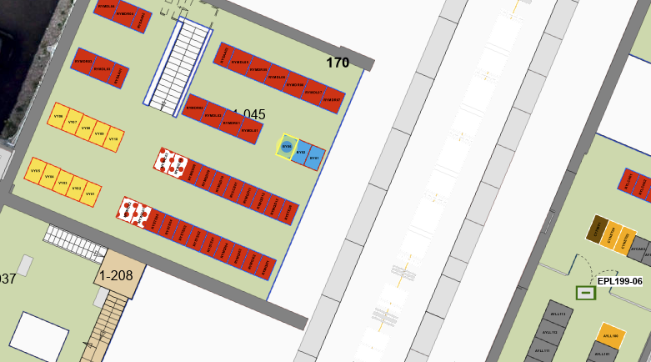
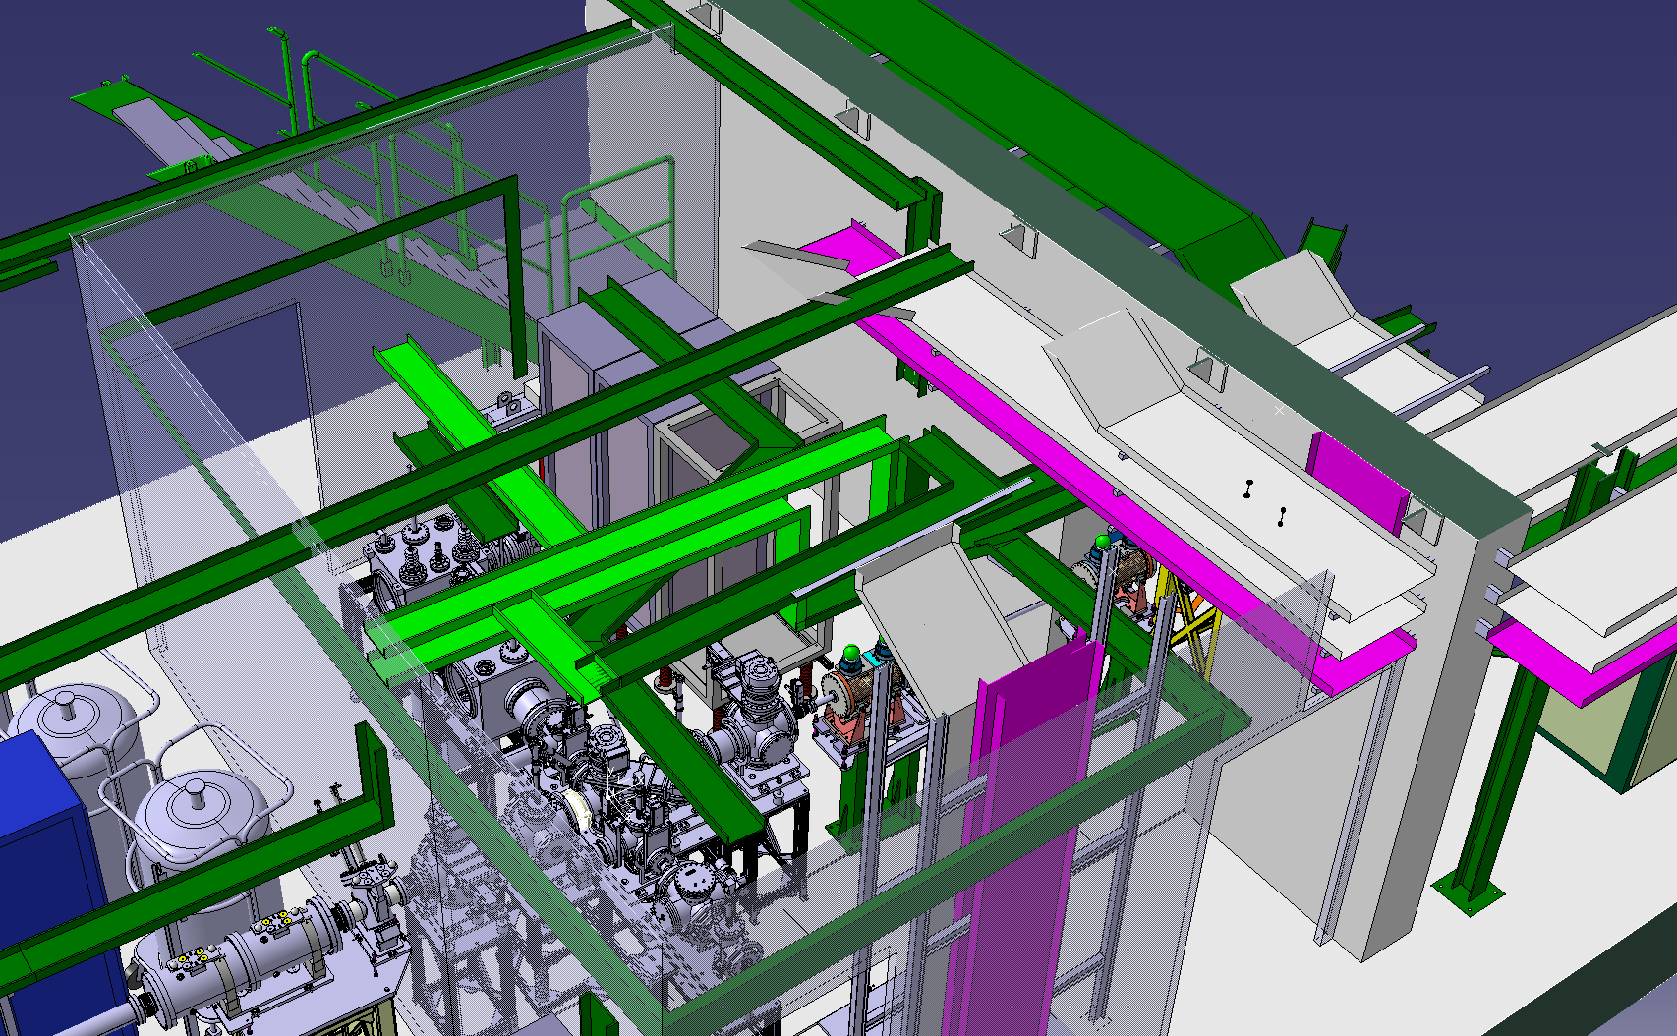
Rack and electronics
Rack is already installed: BY06=170.
Cabling will be pulled after the HV cage and cable trays are installed (EN-EL planning).
Electronics for FC, scanners and slits are in production or in stock.
TDC for MagneToFs:
  TDCs received.
  FEC installed.
  FESA class to be adapted from LHC BSRL.
New rack
installed

Slide 7
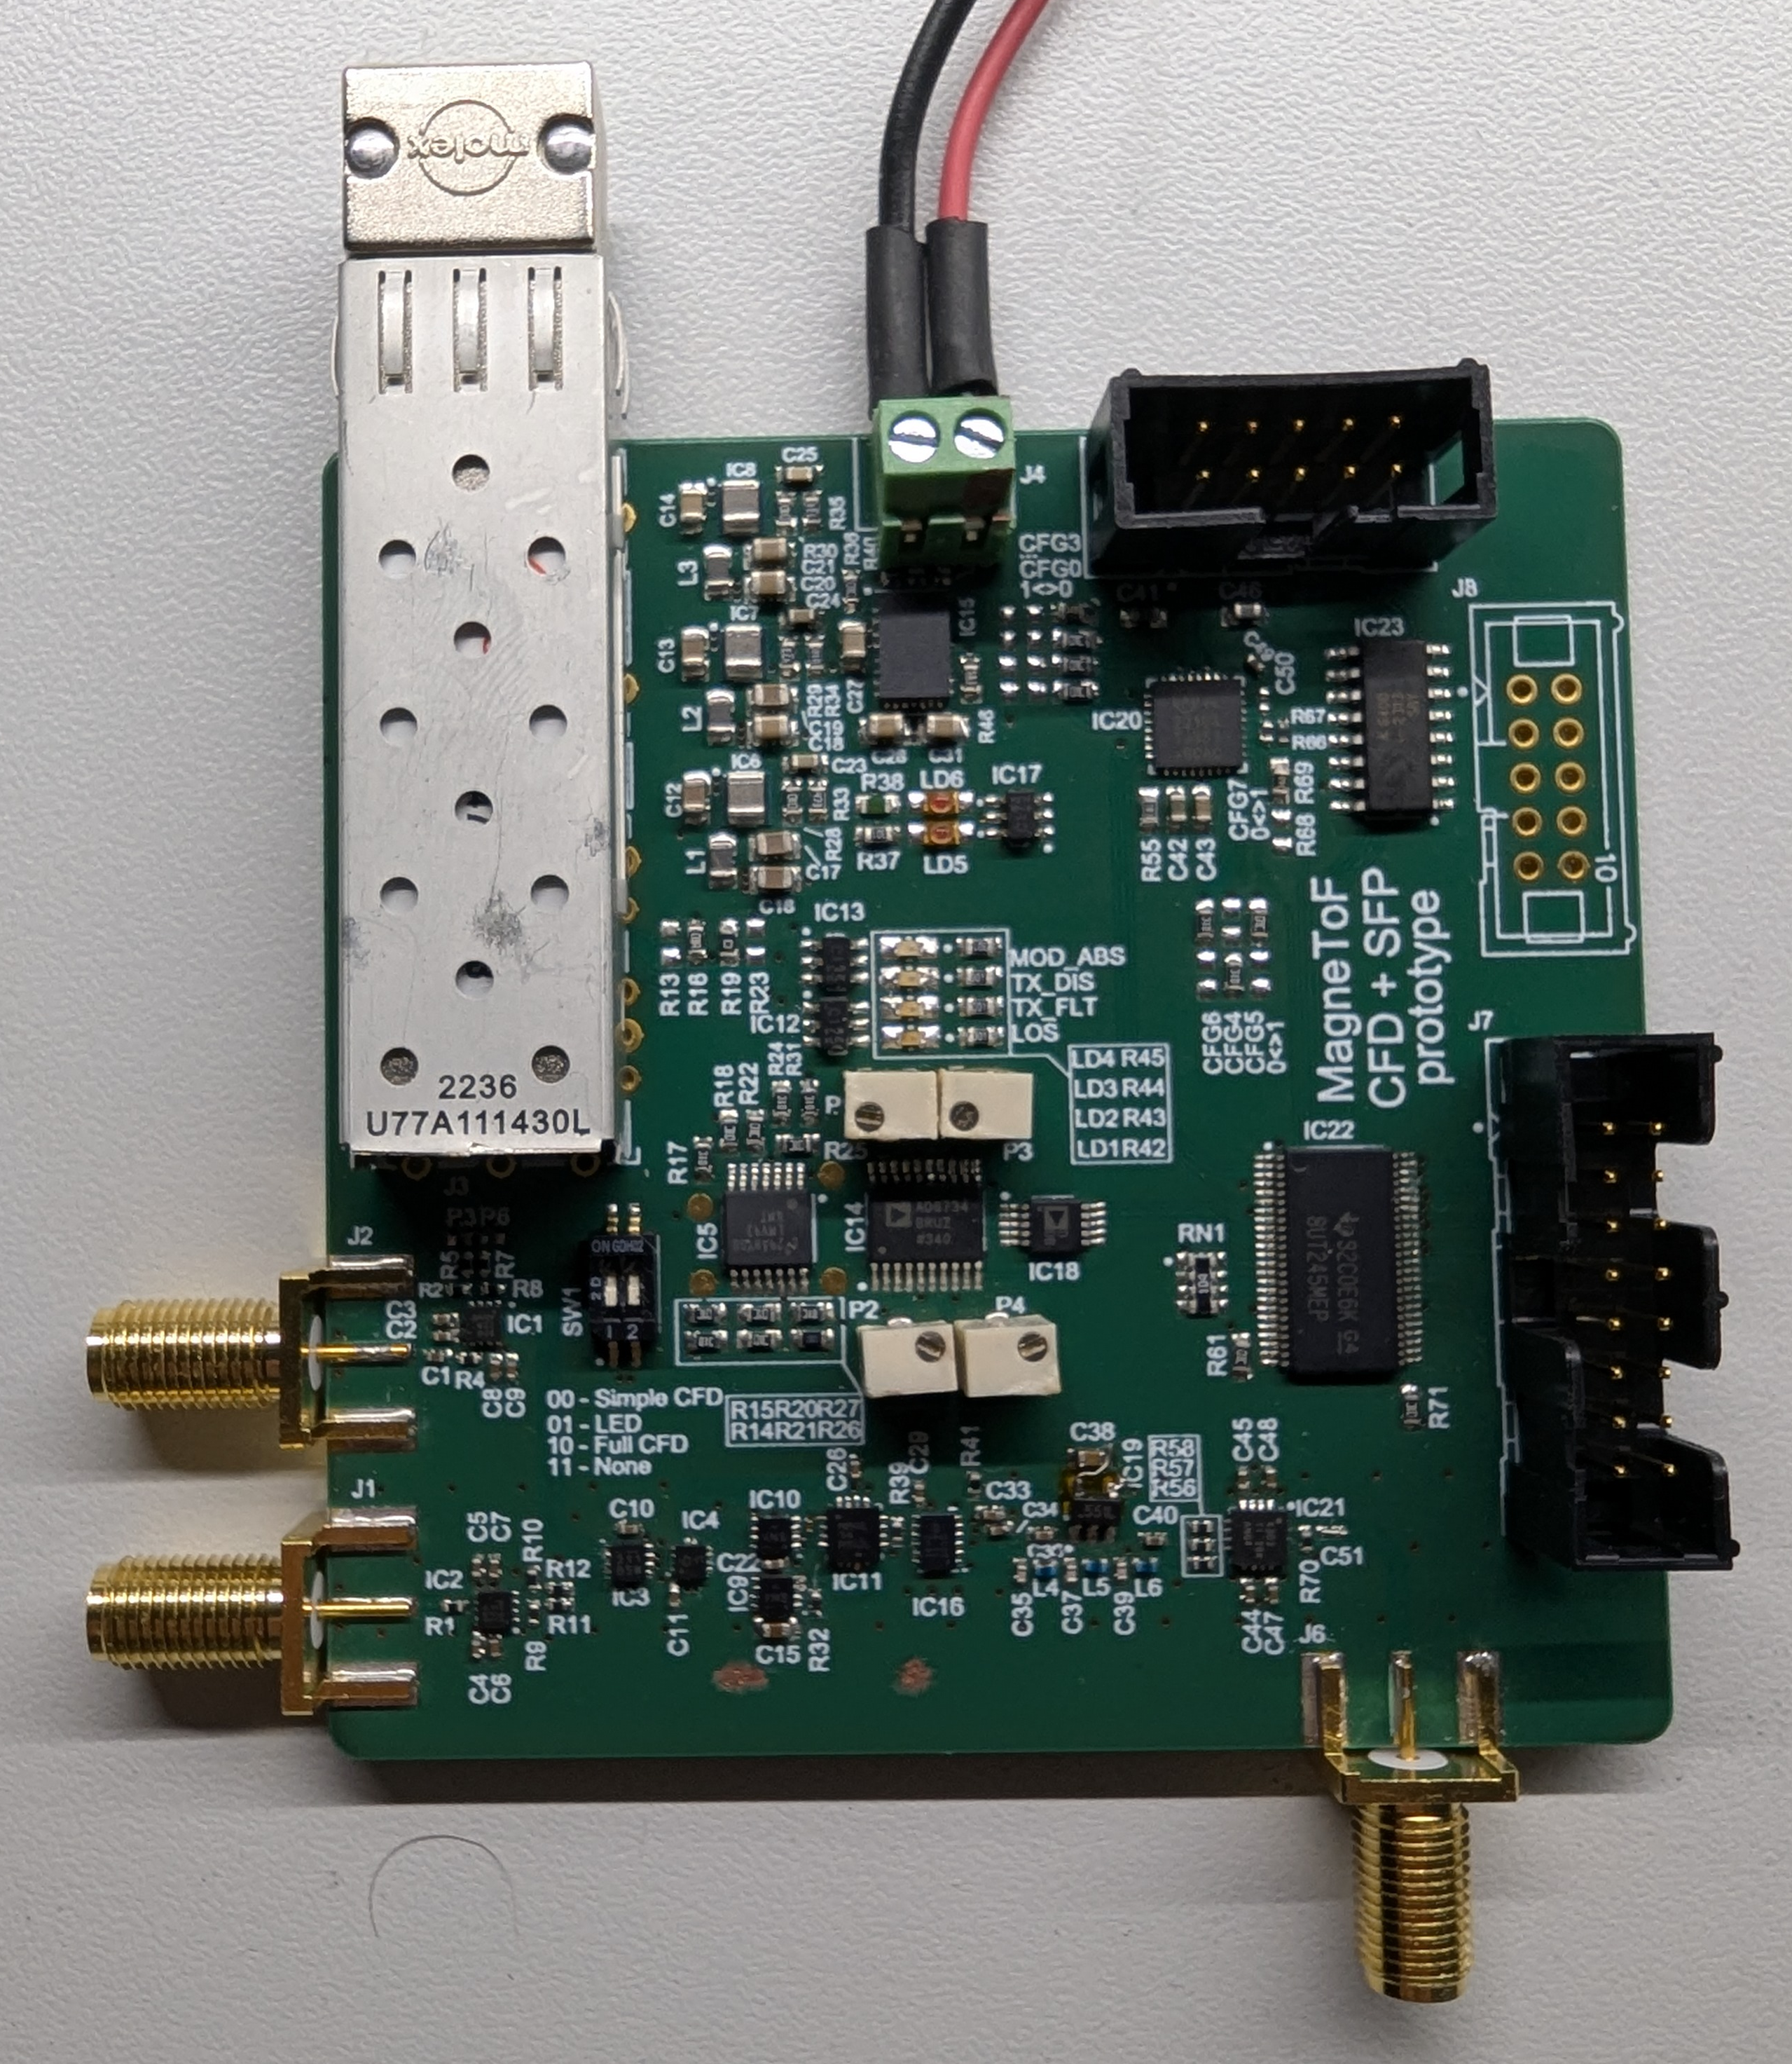
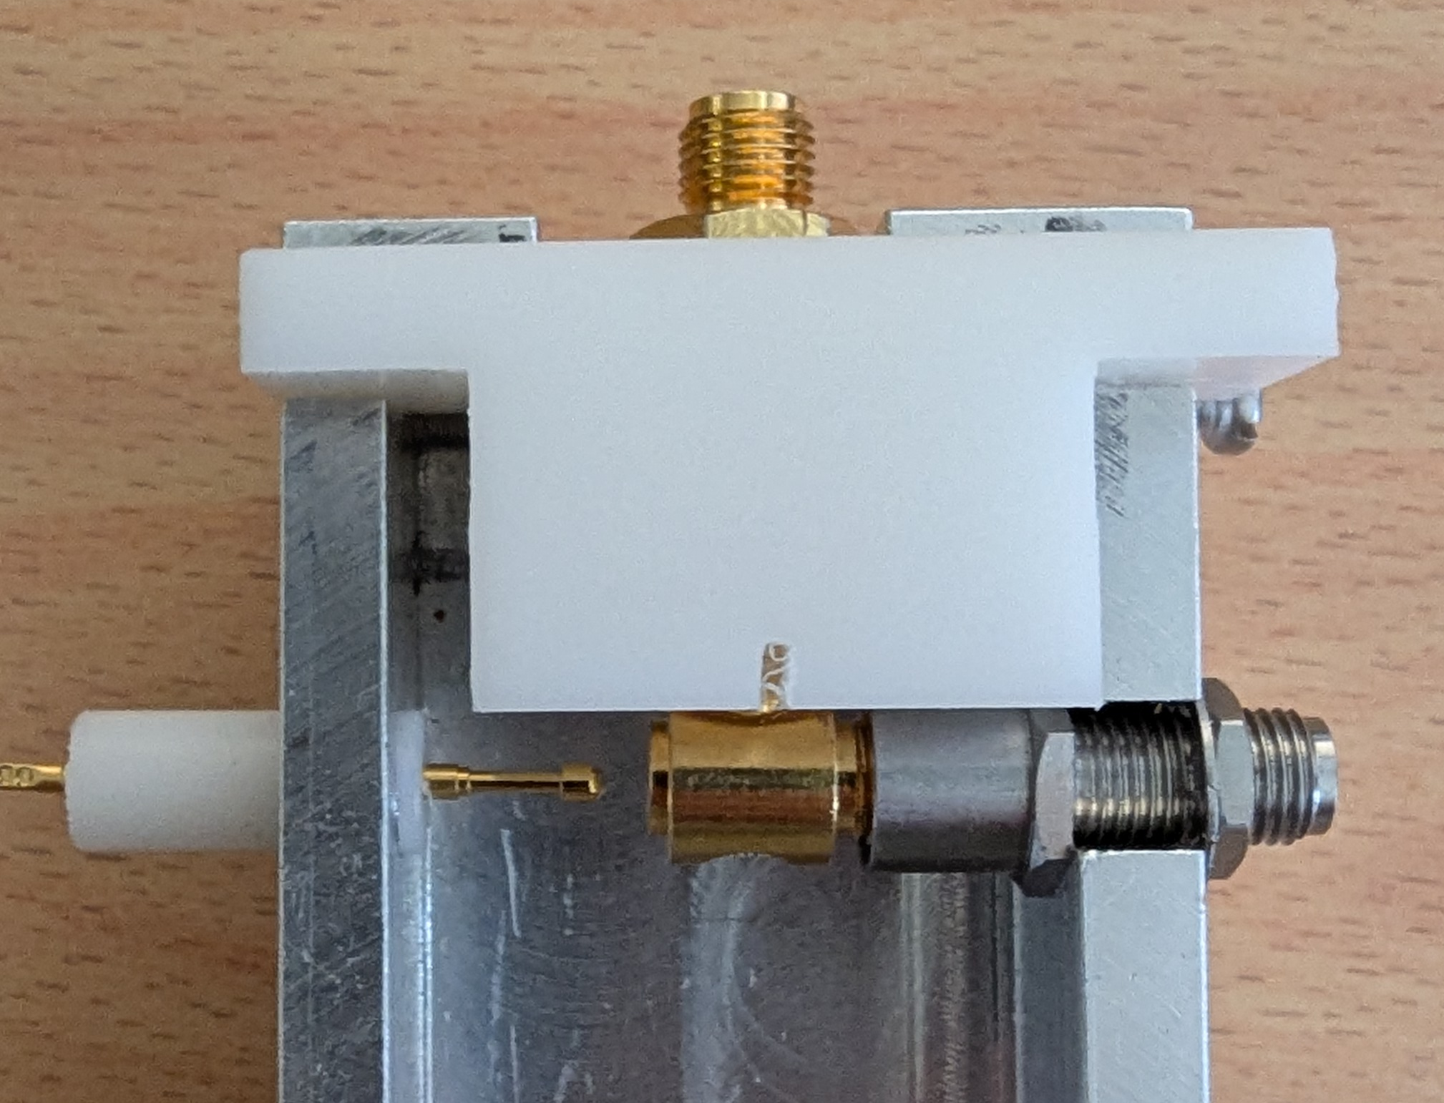
Hardware
Development of MagneToF electronics ongoing.
  Prototype for constant-fraction discriminator looks OK.
  Custom-built switch design ongoing.
    fA@DC and GHz are usually exclusive.
Integration with existing PAM infrastructure.
  FPGA in PAM to be modified for this application.
  Extra circuitry.
  PLC/SILECS/FESA code to be adapted.

Slide 8
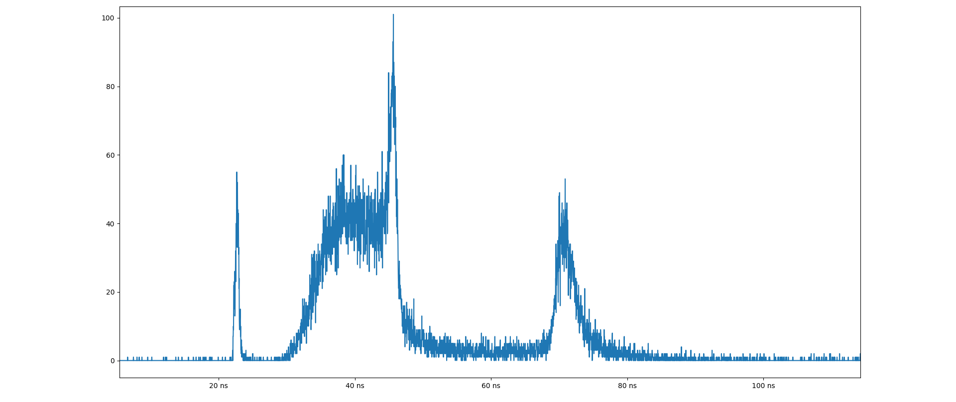
Software / FESA
Requirements discussed with users. Feasible.
Experience in using the TDC with the LHC BSRL.
FESA class will be adapted from the BSRL.
Raw data readout foreseen for some cases.

Slide 9
Outlook

Slide 10
Outlook
DBs in production queue:
  Delivery of components scheduled for end of September.
  Time needed for assembly, metrology, calibration, cleaning, vacuum acceptance, installation.
  Delivery for mid-November absolute best case. No change of delivery date.
  No change for collector plates.
Calibration:
  Calibration bench being readapted for the DBs.
Electronics and software:
  FESA class to be implemented considering input from users.
  MagneToF adaptation electronics being developed. Prototypes OK.
Budget:
  Mechanical: 350k (estimate) + 75k (collector plates).
    Components: 55k; machining: 107k.
    Some purchases and services to be added.
  Electronics: 65k (MT + electronics) + 20k (PAMs) + 18k (TDCs).

