Slide 1
WP6: Optics; AoBs
Lukas Nies (SY-STI-LP)
02 / 07 / 2025

Slide 2
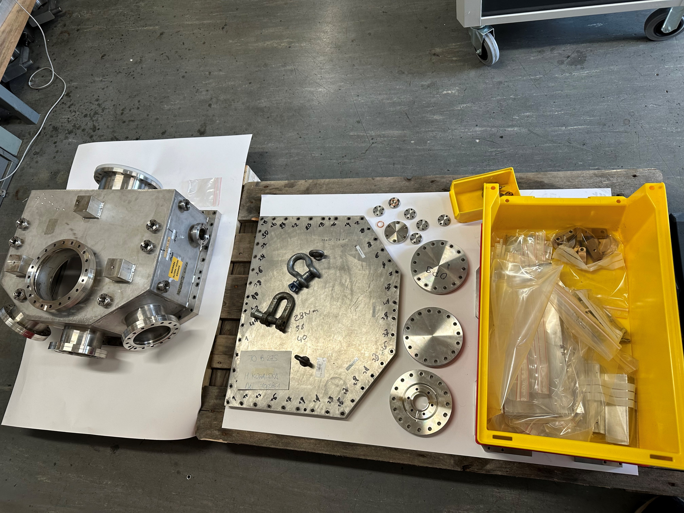
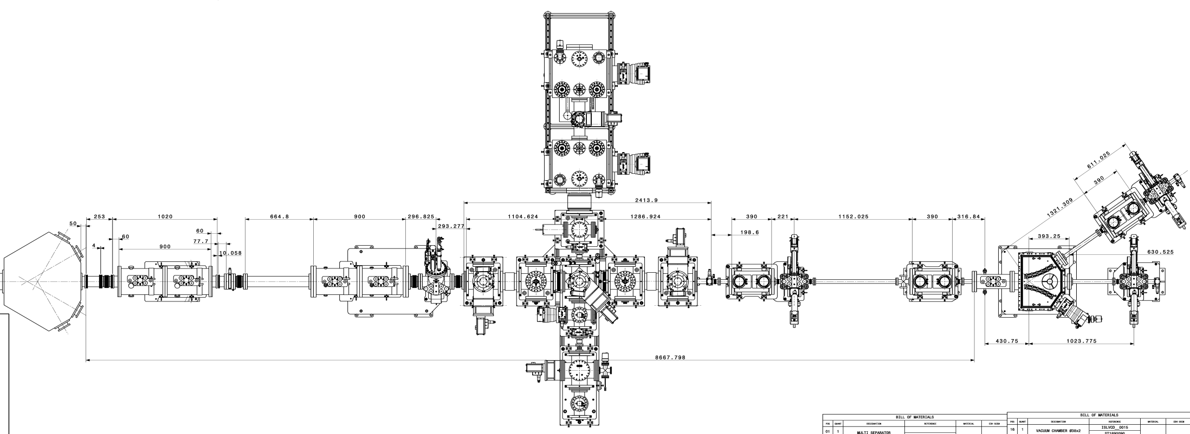
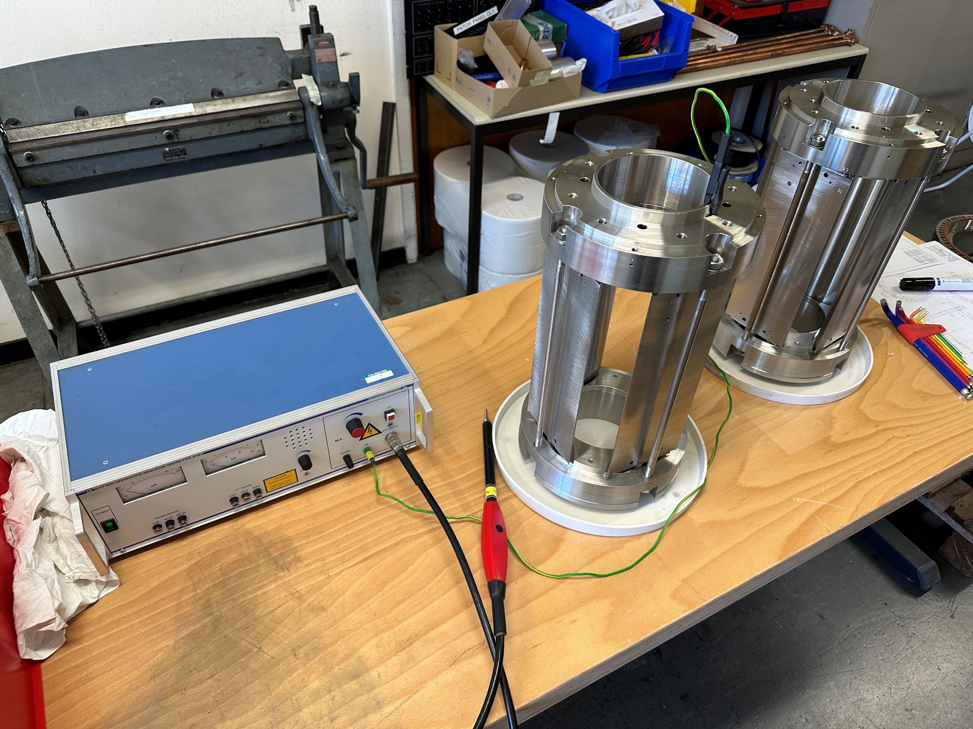
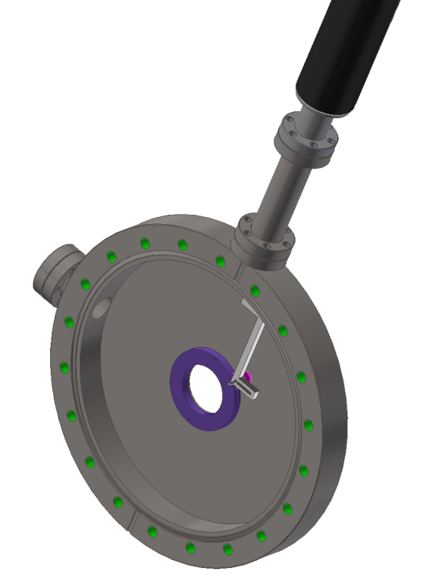
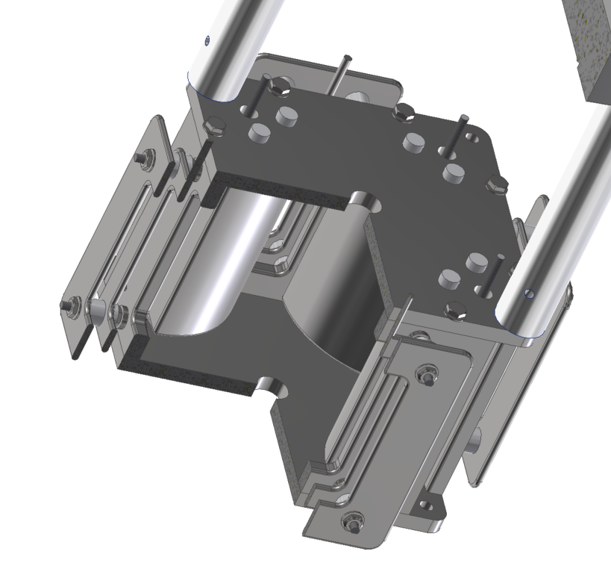
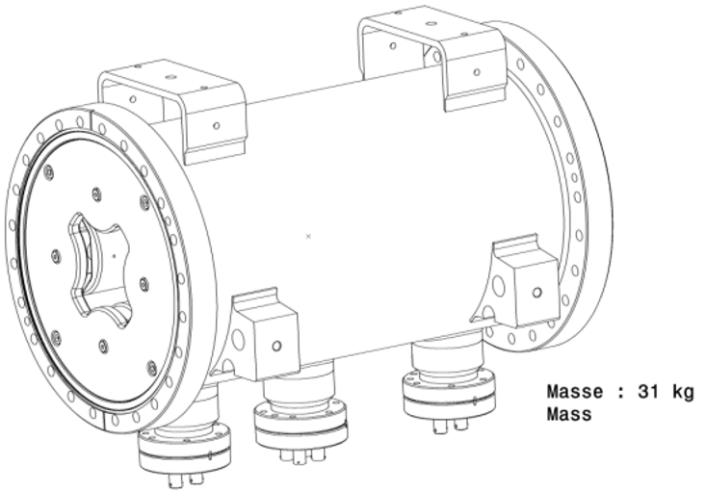
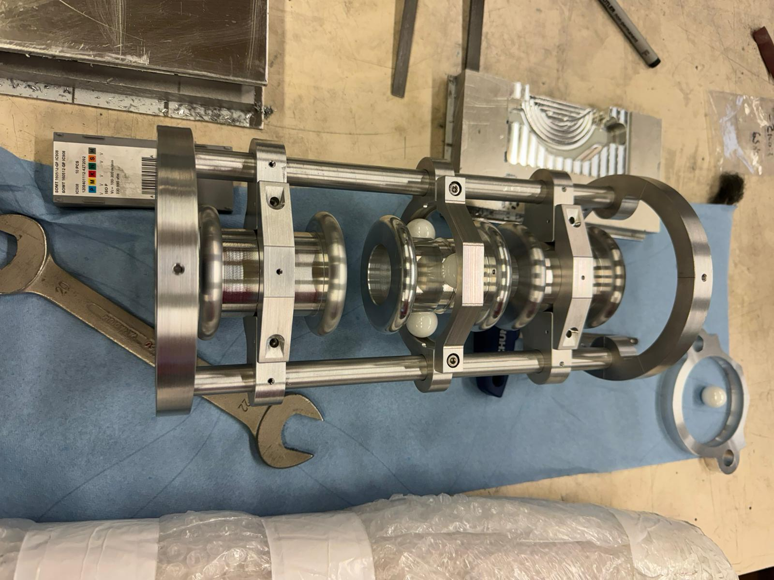
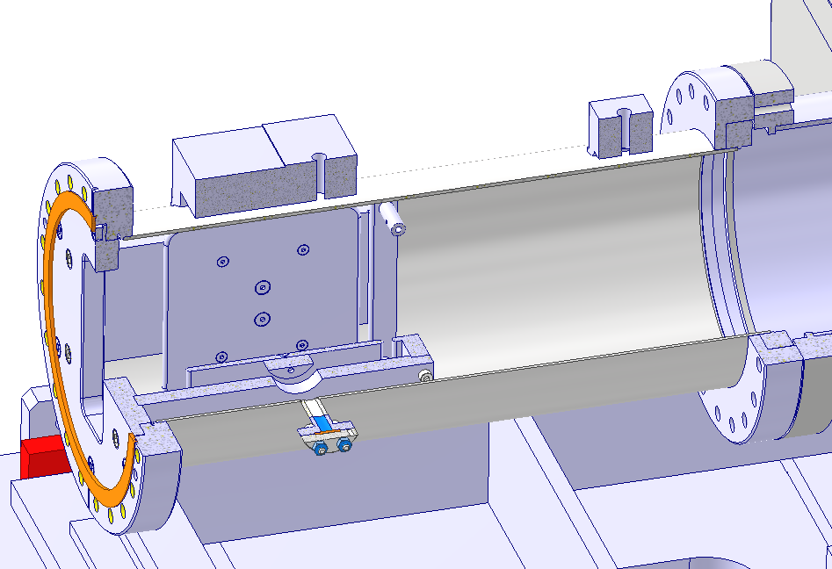
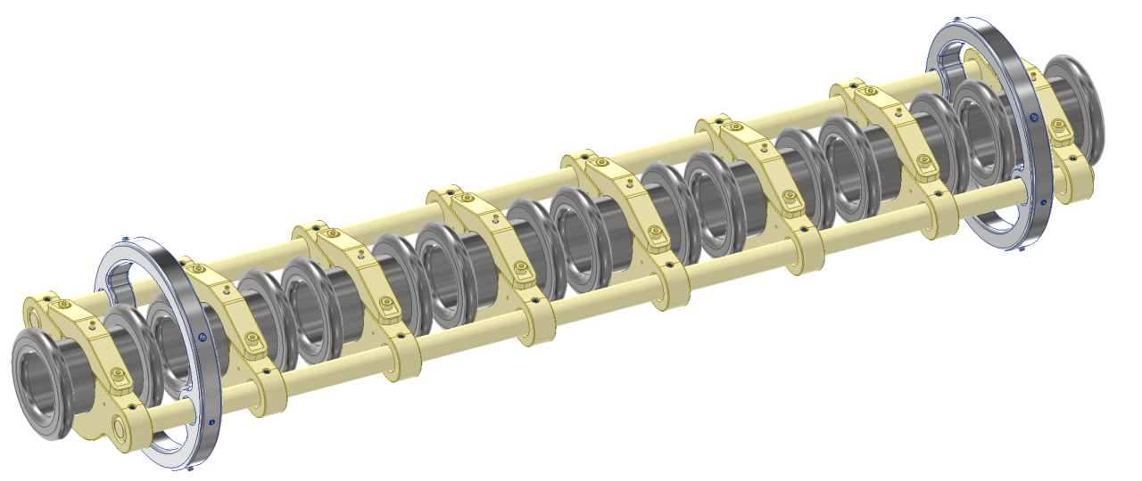
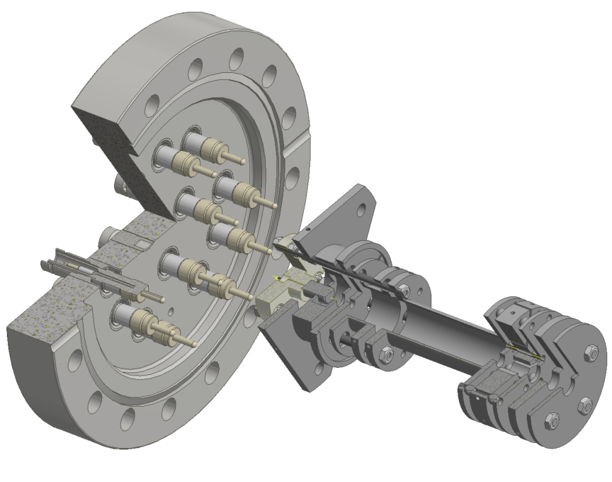
Final Layout – ISLLMAISL0001

Slide 3
Final Layout – ISLLMAISL0001
Installed!
Ready to be assembled
Ready for installation
Ready to be assembled
Ready to be assembled
Ready for installation
Prototype installed
To be delivered
Ready to be assembled

Slide 4
Final Layout – ISLLMAISL0001
Availability pending
Installed!
Ready to be assembled
Ready for installation
Ready to be assembled
Ready to be assembled
Ready for installation
Availability pending
Prototype installed
To be delivered
Ready to be assembled

Slide 5
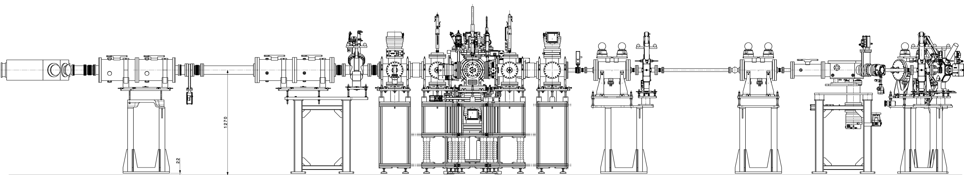
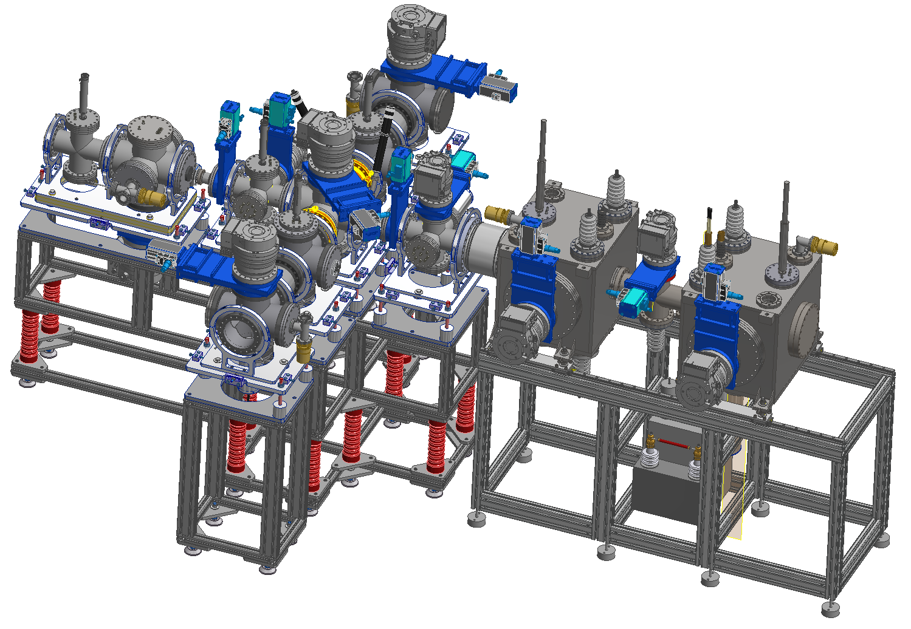
Supports – 100% installed! Thanks to TCD workshop!

Slide 6
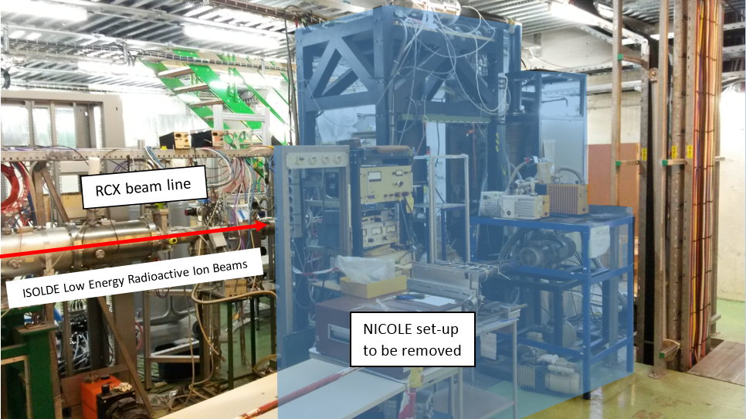
Installation Status
2021

Slide 7
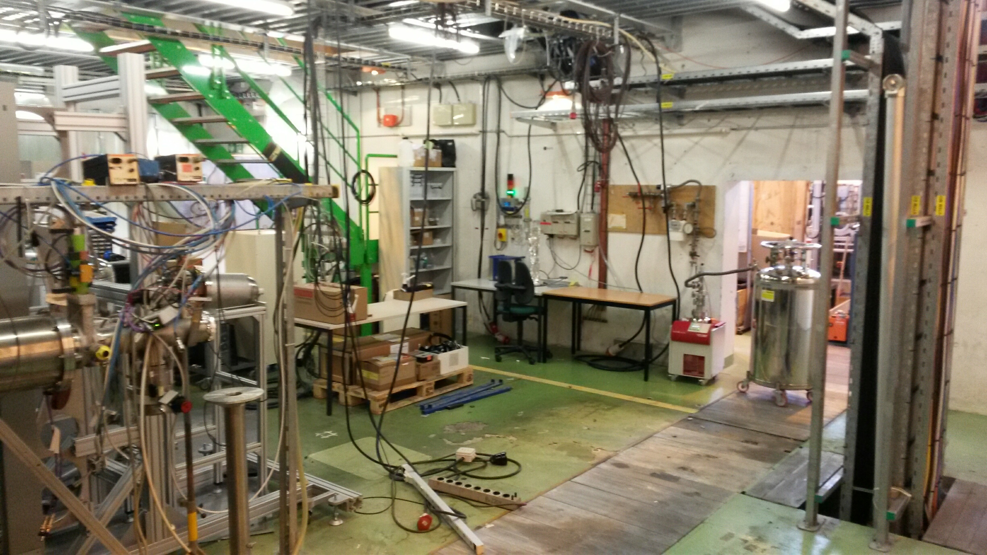
Installation Status
2021
2022

Slide 8
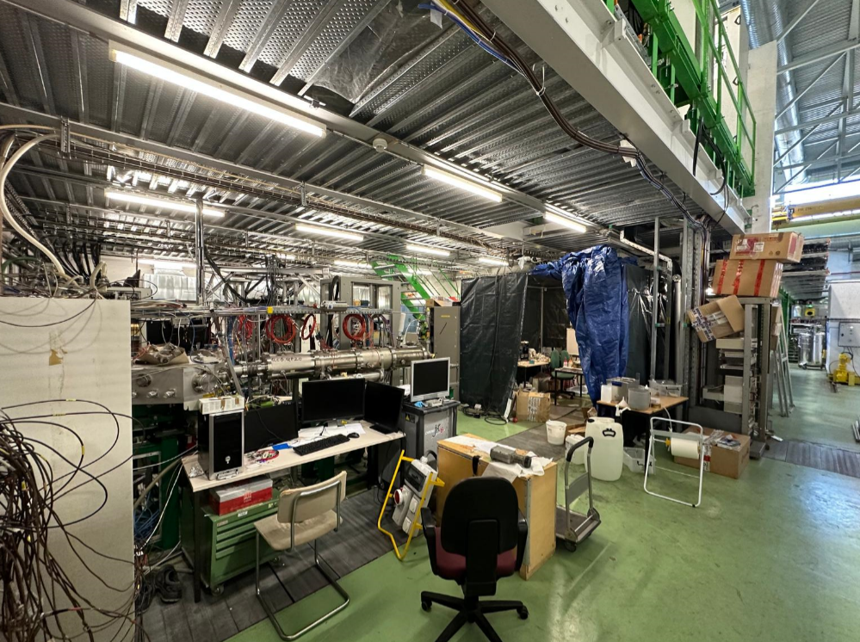
Installation Status
2021
2022
2023

Slide 9
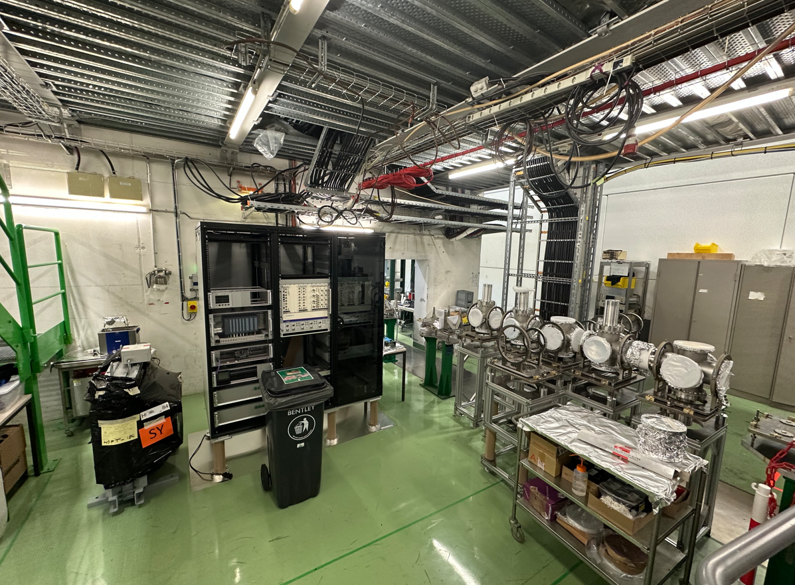
Installation Status
June 2025
2021
2022
2023

Slide 10
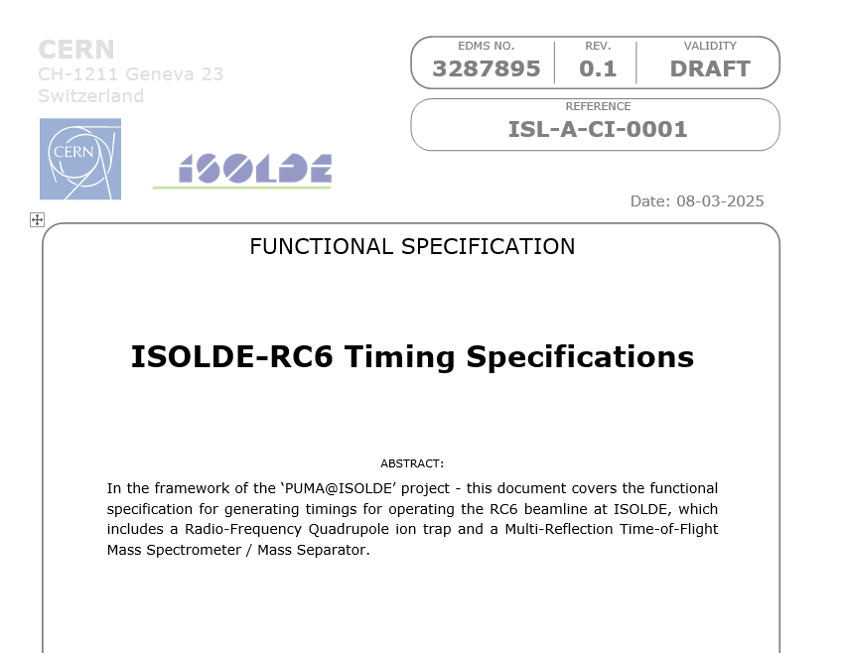
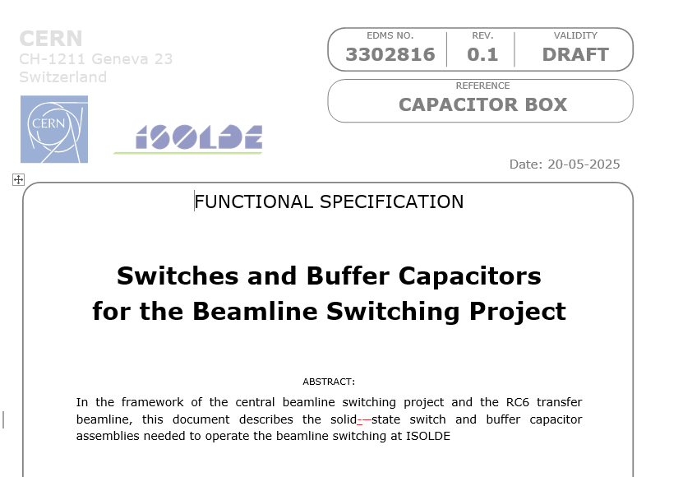
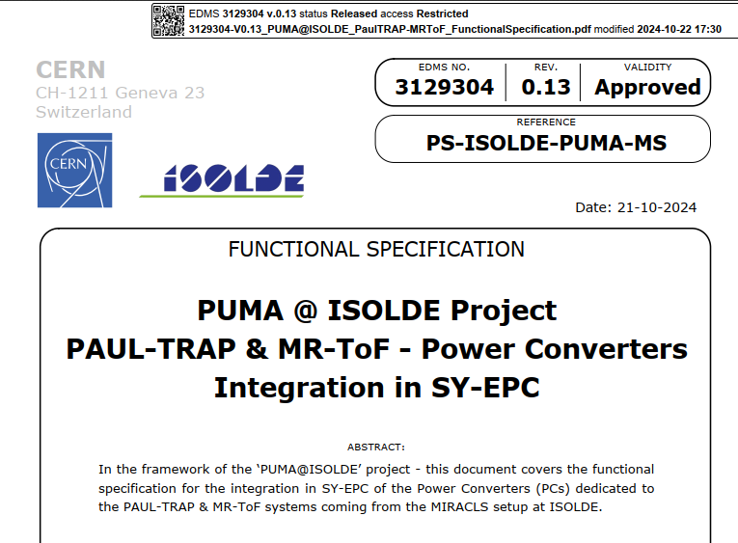
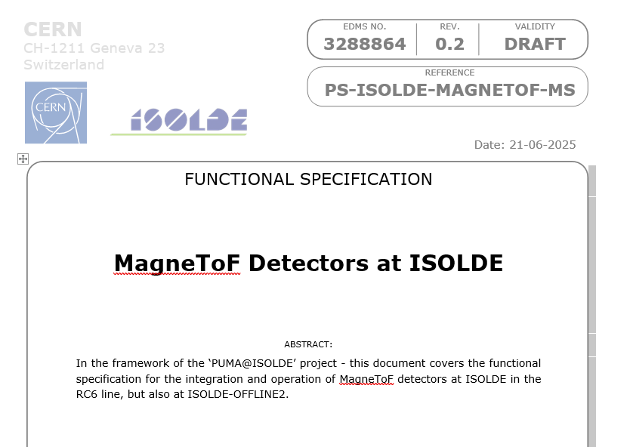
Documentation and specifications: work ongoing
Collected in folder:
https://edms.cern.ch/project/CERN-0000229206
Please upload any documentation or functional specifications document that you have available, or create a link to an already existing resource!

Slide 11
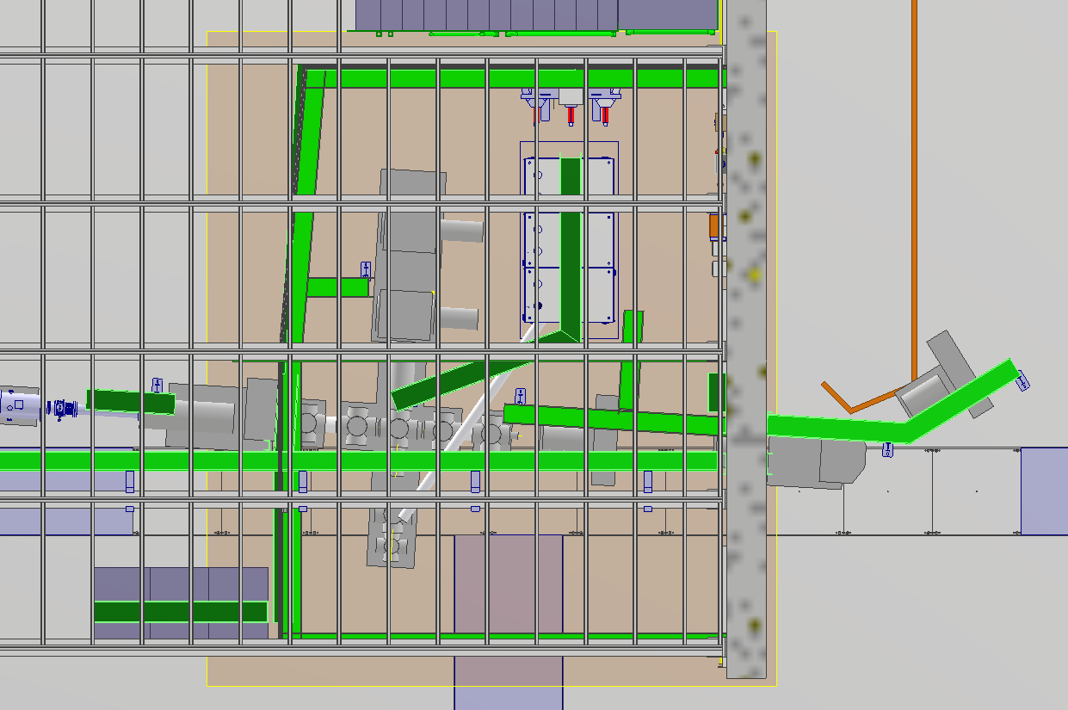
Cables: 5kV optics
From new ISOLDE PLC platform (coming 2026)
Pulled, but still need to be plugged
QPD1
QPD2
QPD5
QPD3
QPD4
Kicker/Bender
HT Cage draft 02/07/2025

Slide 12
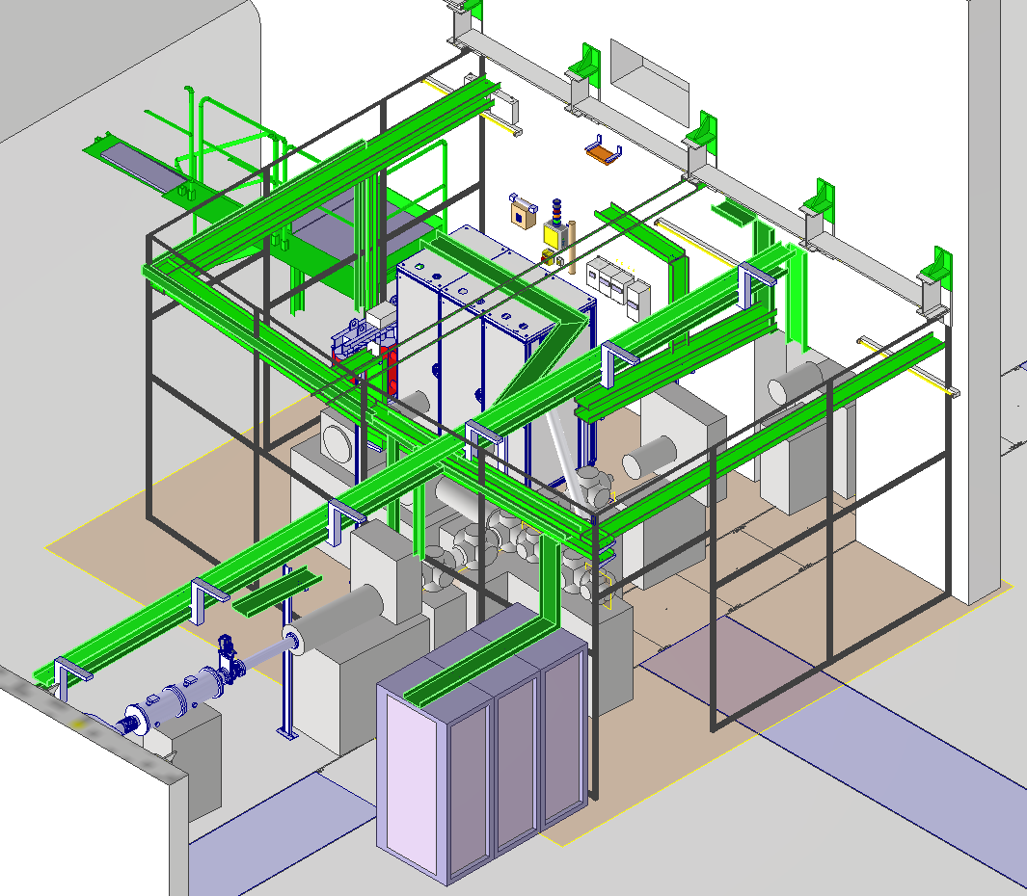
Cables: 5kV optics
From new ISOLDE PLC platform (coming 2026)
Pulled, but still need to be plugged
QPD3
QPD3
QPD2
QPD1
HT Cage draft 02/07/2025

Slide 13
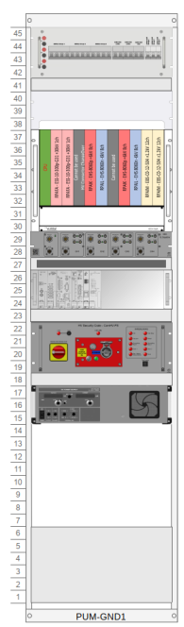
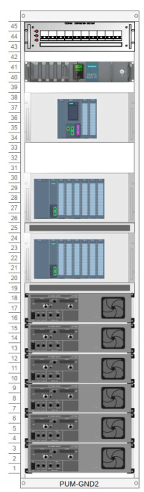
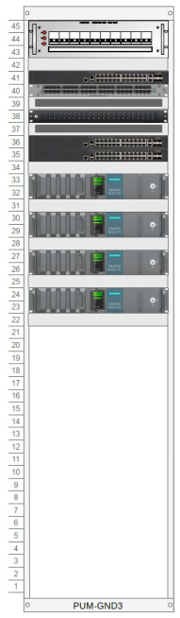
Cables: interlocks
Door 1
GND Racks
Cage interlocks
GND Racks
Door 2
HT Cage draft 02/07/2025

Slide 14
Cables: interlocks
GND Racks
Cage interlocks
Door 1
Door 2
GND Racks
HT Cage draft 02/07/2025

Slide 15
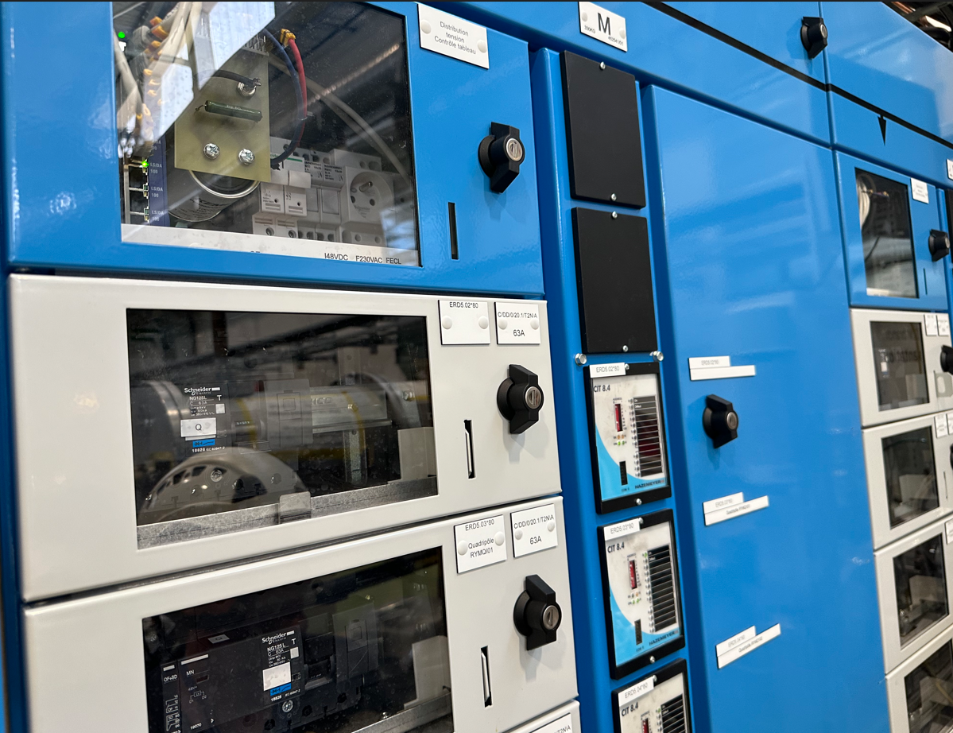
Cables: mains power
Trafo
GND Racks
Cage interlocks
Trafo and mains
GND Racks
HT Cage draft 02/07/2025

Slide 16
Cables: mains power
Trafo
GND Racks
Cage interlocks
Trafo and mains
GND Racks
HT Cage draft 02/07/2025

Slide 17
Cables: MR-ToF HV
GND Racks
Cage interlocks
Trafo protection & command
35 kV – 65kV PLCs
MRTOFMS
GND Racks
HT Cage draft 02/07/2025

Slide 18
Cables: MR-ToF HV
GND Racks
Cage interlocks
Trafo protection & command
35 kV – 65kV PLCs
MRTOFMS
GND Racks
HT Cage draft 02/07/2025

Slide 19
Cables: 20kV Lenses
GND Racks
Cage interlocks
Trafo protection & command
35 kV – 65kV PLCs
20 kV PLCs
MRTOFMS
GND Racks
HT Cage draft 02/07/2025

Slide 20
Cables: 20kV Lenses
GND Racks
Cage interlocks
Trafo protection & command
35 kV – 65kV PLCs
20 kV PLCs
Lens
Lens
GND Racks
HT Cage draft 02/07/2025

Slide 21
Cables: Beam DBs
From Mezzannine
DB3
DB1
DB2
DB4
HT Cage draft 02/07/2025

Slide 22
Cables: Beam DBs
From Mezzannine
HT Cage draft 02/07/2025

Slide 23
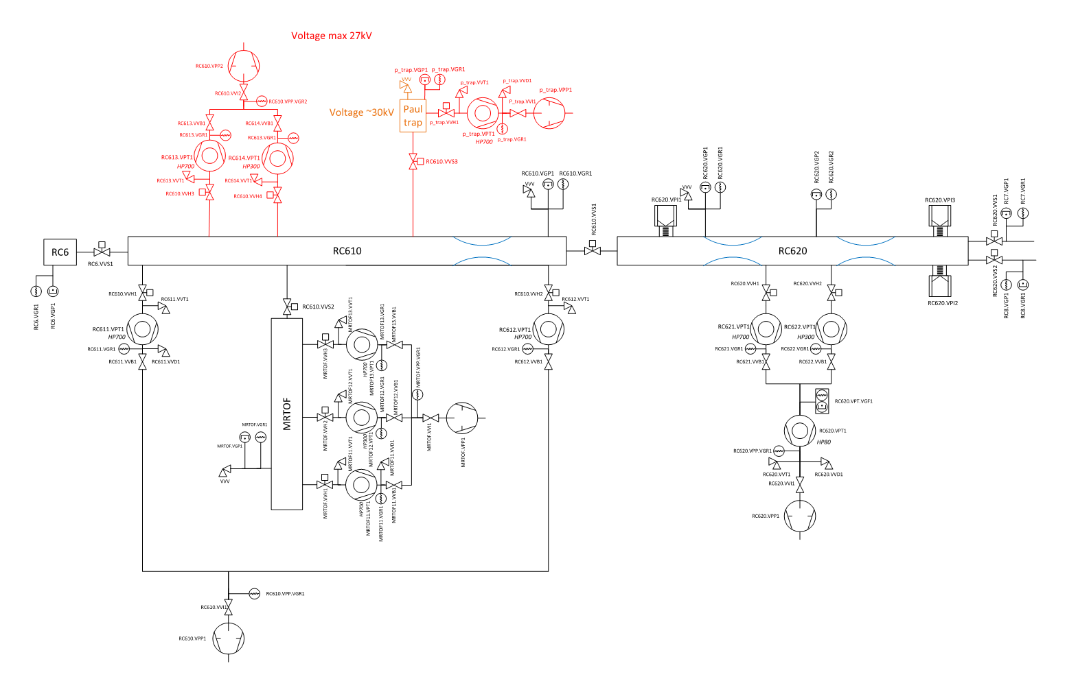
Cables: Vacuum
From Mezzannine?
RC613/614
RC611
VPI3
VPI1
RC612
RC621/622
VPI2
HT Cage draft 02/07/2025

Slide 24
Cables: Fibres for timing and communication?
HT Cage draft 02/07/2025

Slide 25
Cables: HV platform
Includes
Diagnostics
Vacuum
Data
Communication
Timing
5kV HV
And sub-platform
RF
5kV HV
Communication
Timing
Gas system
HV Platform
HT Cage draft 02/07/2025

