Slide 1
Masterclass Report Uta Bilow + Ken Cecire 30.10.2025, CERN

Slide 2
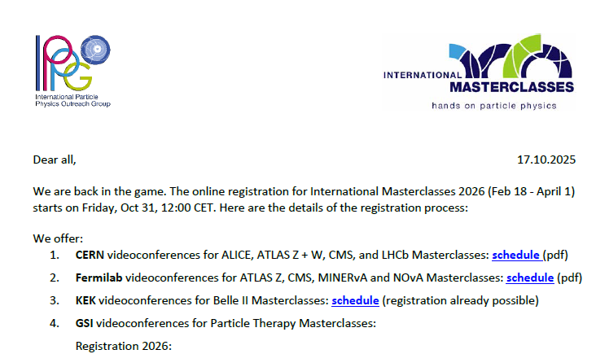
IMC 2026
9 Masterclass measurements
ATLAS, CMS, LHCb, ALICE, Belle II, Particle Therapy, Pierre Auger, MINERvA, NOvA
5 Videoconference centers
CERN, Fermilab, GSI, KEK, Malargüe (Pierre Auger)
Registration
For CERN + Fermilab + Auger VC start this Friday
PTMC + Belle II are already opened
Circulars for preparation
Bi-weekly in 2025, weekly in 2026
Archive

Slide 3
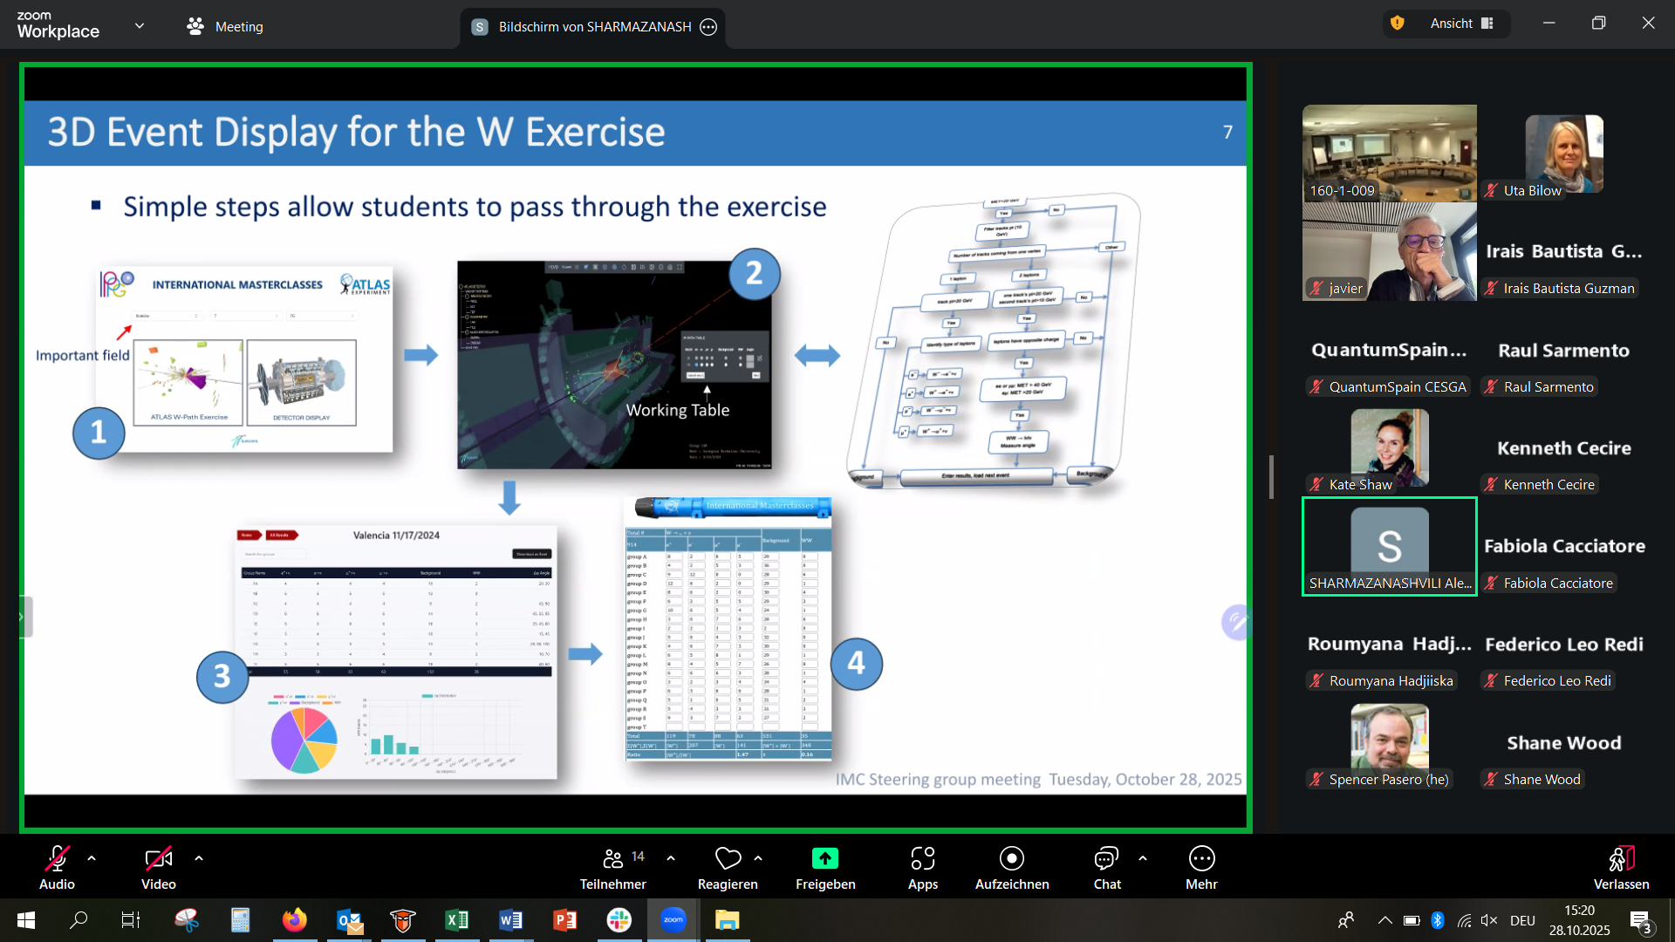
Results from IMC SG meeting
Tuesday, Oct 26, 15:00 – 17:00
https://indico.cern.ch/event/1593704/
~ 24 in attendance in presence and online

Slide 4
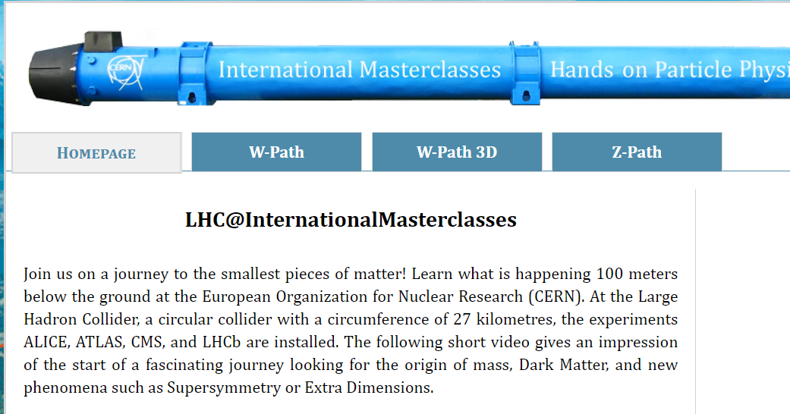
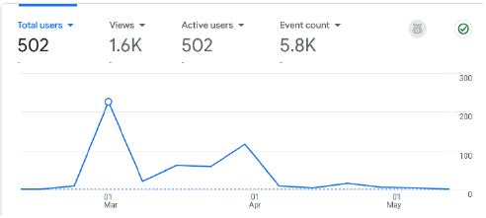
Tracer 3D event display
Developed by Lasha Sharmazanashvili et al.
https://ippog-masterclasses-website.web.cern.ch/en/wpath_3D.htm
Implemented for ATLAS W path in IMC 2025
Used on 4 days, by 9 institutes and 465 users (pairs of students)

Slide 5
Tracer 3D event display
Tracer v2.0
New engine development (app runs faster, loading time reduced, geometry loaded from cache)
New user interface development (table, geometry, emojis)
Future work/ideas:
Migrate to more stable platforms
Automatic transfer of data from Tracer output table to ATLAS Masterclass input table
Implement for ATLAS Z path

Slide 6
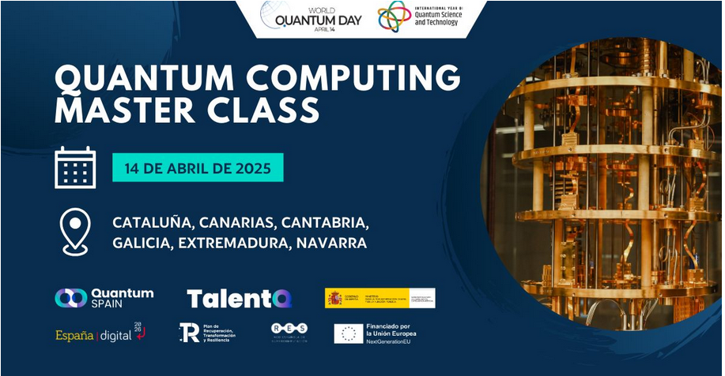
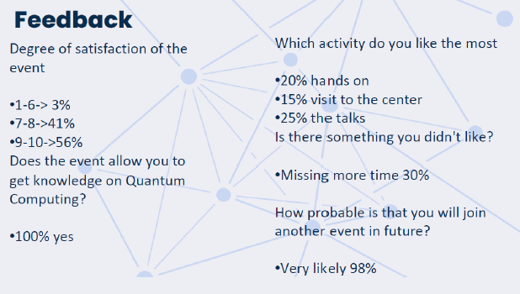
Quantum Computing Masterclass
Update from Irais Bautista and Javier Mas, after presenting in May 2023 at IMC SG meeting
https://www.talentq.es/es_es/masterclasses/
Running Quantum Computing Masterclasses in several places every year since 2023
Lectures, hands-on session (quantum computing practice), discussion of results, quiz + tour/visit
Audience: high school students, Bachelor students, general public, teachers)

Slide 7
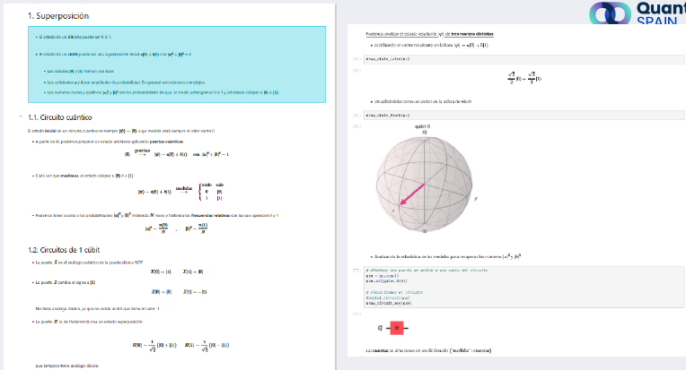
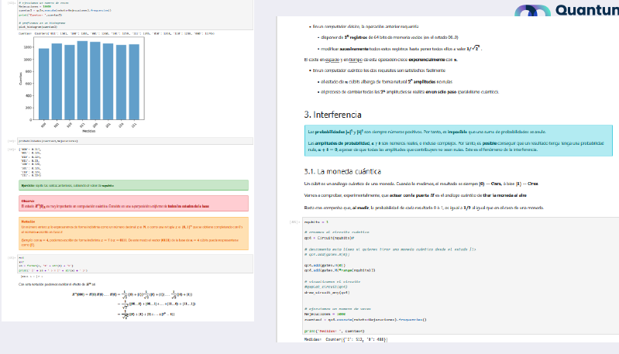
Quantum Computing Masterclass
Proposal by Irais and Javier:
make material available to IPPOG
Provide resources, incl. HPC-QPU resources
Provide virtual visits to QPU
Next steps:
Provide Masterclass resources to SG
Translate to English
Walk SG through Masterclass

Slide 8
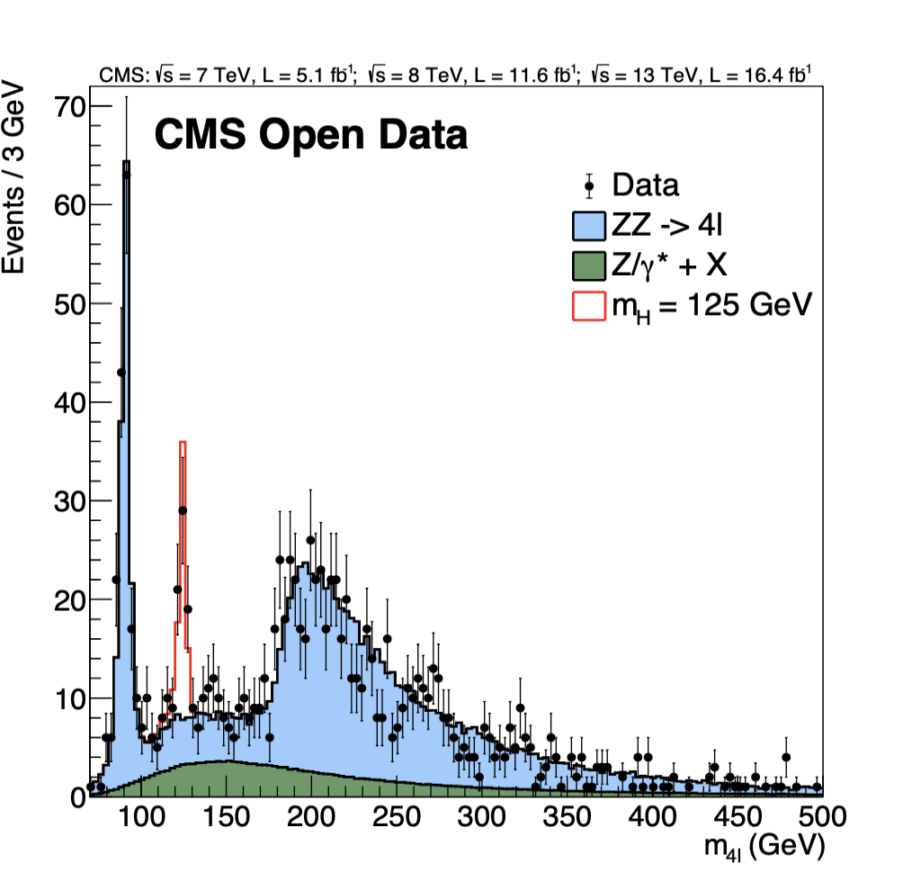
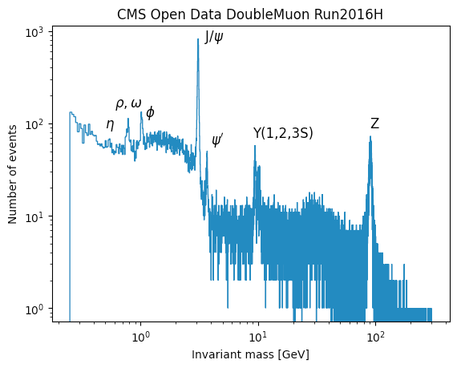
Updates on the CMS Masterclass
(Tom McCauley)
New for 2026
Run 1 data from 2010-2012 (7, 8 TeV) → Run 2 data from 2016 (13 TeV)
More four-lepton events for use
No longer need the different dataset groups (e.g. N10, N50, …)
CMS 2016 open data in both MiniAOD (necessary for event display files) and NanoAOD (reduced format). Event selection is easier and quicker e.g. in a Jupyter notebook with NanoAOD.
CIMA and iSpy hosting moves to CERN → CIMA no longer works in new OS at ND

Slide 9
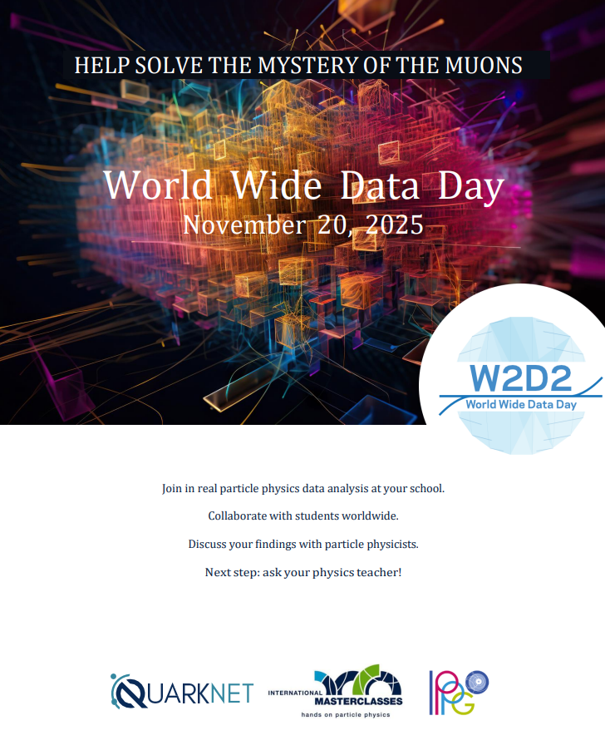
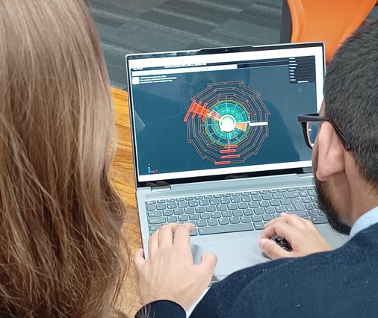
World Wide Data Day 2025
20 Nov 2025 → midnight-to-midnight, UTC
High school students and teachers make simple analyses of ATLAS and CMS Data anytime
Videoconferences (30 min) all on World Wide Data Day (W2D2)
Site: https://cern.ch/w2d2
Teacher/class registration: http://cern.ch/go/JlG6
Moderator registration: https://cern.ch/w2d2-mod25 (also linked on Indico)

Slide 10
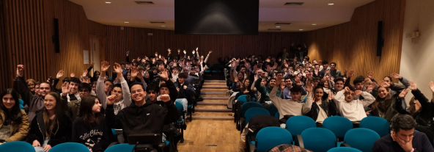
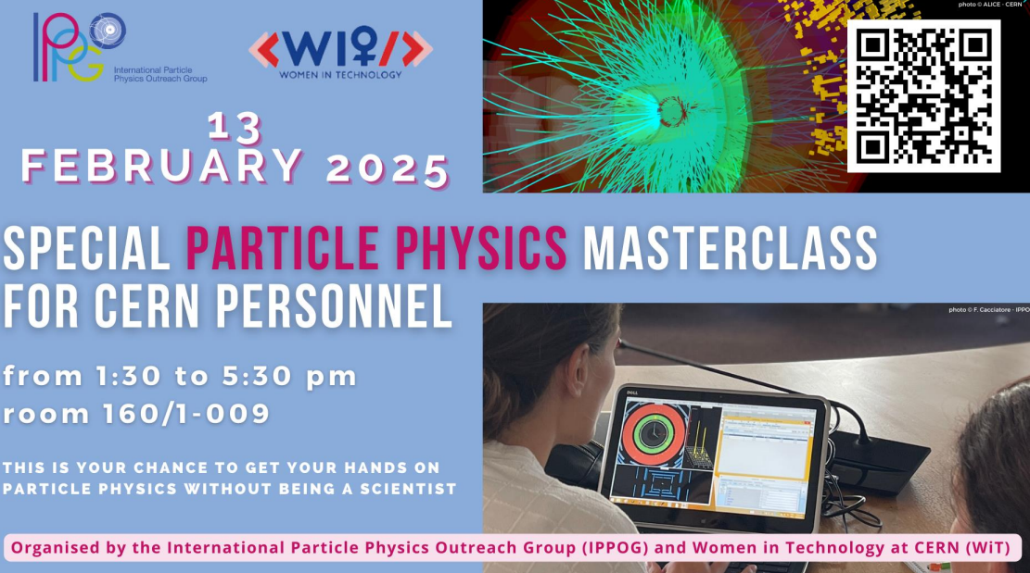
Results from MC2NC working group (14 Oct)
Despina facilitated ALICE masterclasses:
Dec 2024 in South Korea
Mar 2025 in Bhutan (online)
Feb 2025 for CERNois
Pedro noted good IMC 2025 participation from Cape Verde
Raul noted new Auger masterclass in Argentina
Vivek Patel, INFN Bari → outreach to India in Feb 2026
Uta notes IMC growth in Algeria
Name change? MC2NC → Outreach to New Countries?
Details: https://cern.ch/mc2nc-oct25

Slide 11
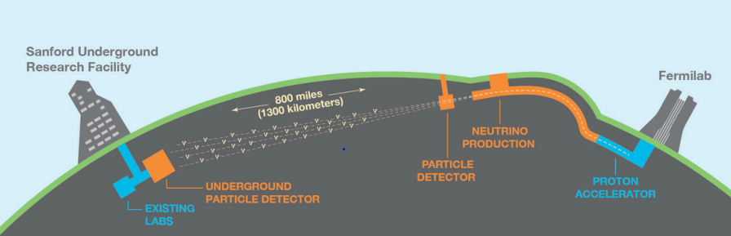
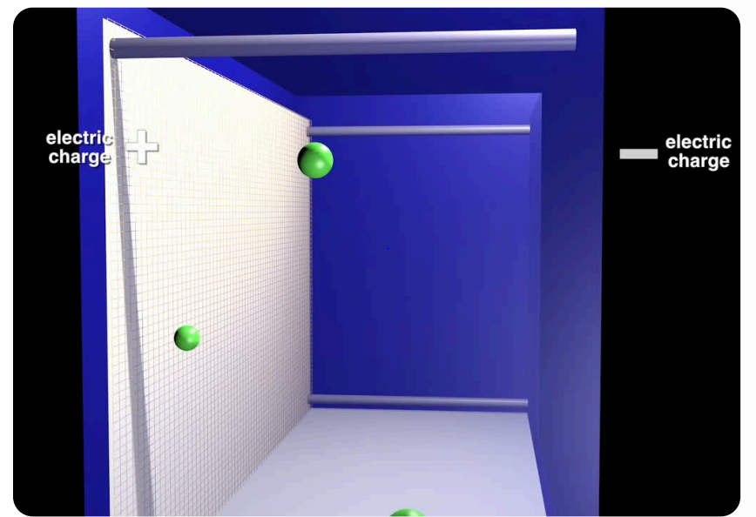
DUNE
(Kate Shaw)
DUNE will look to develop a masterclass:
Need to develop proper event display
Use simulated and real data from Far Detector LArTPC
Neutrino Oscillations: Calculate ratio for neutrino & anti-neutrino beams
Study and understand supernova neutrinos!
David DeMuth (GVSU) and David Martinez (SDSMT; ProtoDUNE) work on it
Work with QuarkNet

Slide 12
5-year Particle Therapy MasterClass Anniversary
PTMC 2025 events
12 June: PTMC integrated in week-long school in Hong-Kong plus broader China
20 June: PTMC for CERN personnel
28 June: PTMC for teachers at Oxford
10 sep, 7, 10 oct: PTMC for uni students
UNSA, SSST, at Sarajevo
Rector’s meeting
Beginning December: PTMC in Mexico
plus several conference presentations
and matRad users workshop
5-years PTMC : 31 March 2025 online
recap and continuation

Slide 13

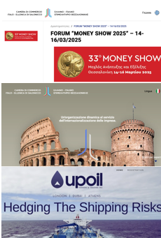
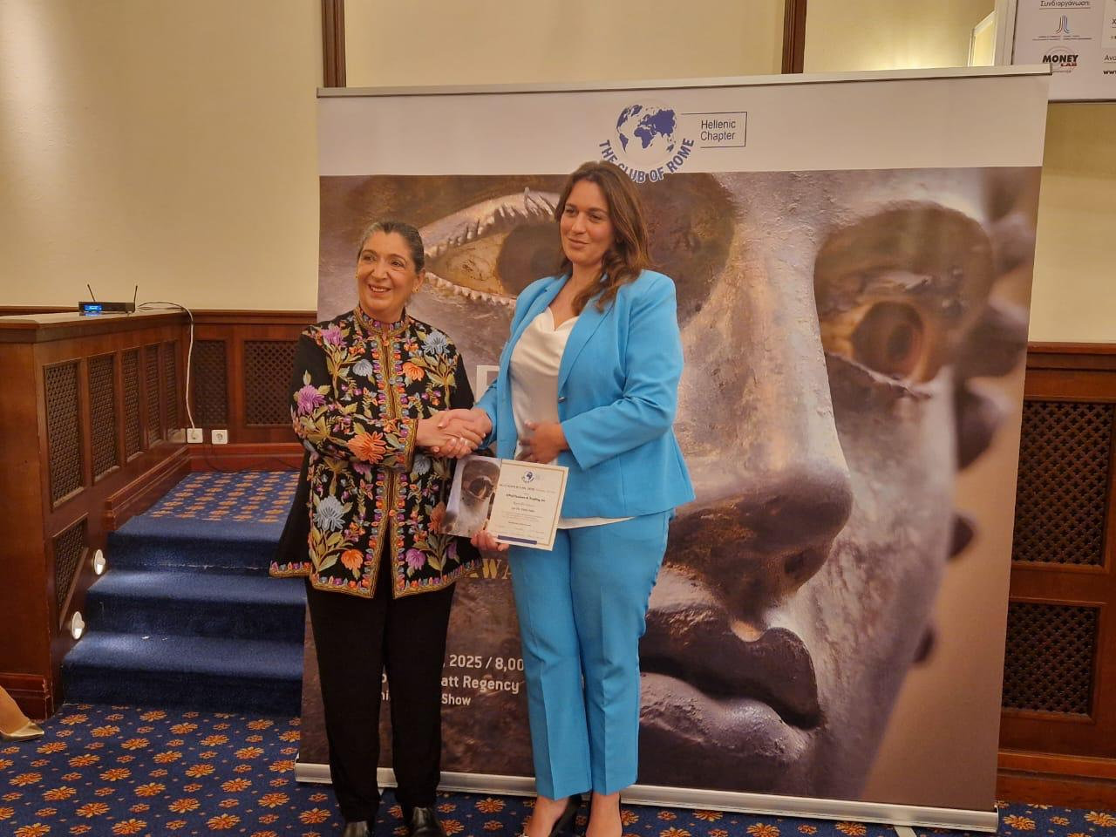
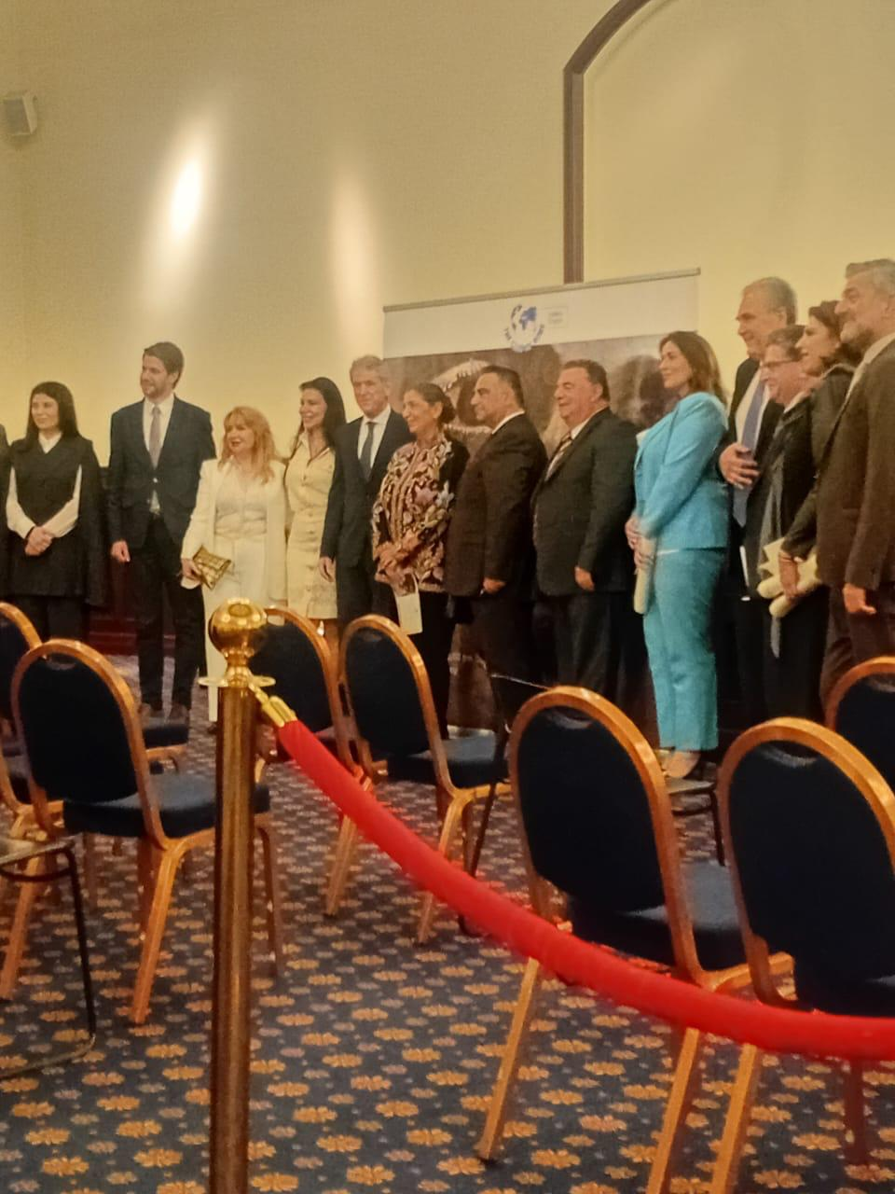
From Exhibitions to Award
“Money Show” 14-15-16 March in Thessaloniki
organised by italian-greek chamber of commerce
sessions organised by the UPoilTanker

