Slide 1
Summary of a Successful Pilot Season
Early Morning Coffee @ CERN
A Podcast created by Joni Pham (ATLAS), Chetna Krishna (CERN ECO), Steven Goldfarb (ATLAS)
IPPOG Success Story, 27 Oct 2025

Slide 2
What we set out to do
Video/Audio Podcast from Scientists at CERN
Start monthly, potentially increasing frequency
Roughly 30-45 minutes
Host with physicists around table with coffee
Potentially include interview on the scene with experimentalist
Cover a physics topic with fun, simple approach, humour
Add recent news, audience Q&A, CERN site visit, vocabulary
Goals
Engage broader audiences
Inform them of current activities
Build trust through informal chat

Slide 3
What we did
Video/Audio Podcast from Scientists at CERN
Start monthly, potentially increasing frequency (lacked approval procedure)
Roughly 30-45 minutes
Host with physicists around table with coffee
Potentially include interview on the scene with experimentalist (kept it simple)
Cover a physics topic with fun, simple approach, humour
Add recent news, audience Q&A, CERN site visit, vocabulary (kept it simple)
Goals
Engage broader audiences [diverse guests, engaging human conversation]
Inform them of current activities [recent measurements, updates, plans]
Build trust through informal chat [discussion of the scientific process, international collaboration, human challenges in research, applications]

Slide 4
The Team / Procedure
Current Team
Host, Script: Steve (with help from participants)
Episode planning: Steve (was with Chetna, Joni)
Permission to shoot: Matthew or Paola or Jacques (whoever is available)
Filming: Ron and/or Jacques (usually Ron)
Editing: Melanie (was Chetna)
Sound Engineering: Piotr
Visuals: Daniel (plus images from CDS or participants)
Social: Daniela & her team
Notes
Time & Effort from CERN ECO team optimised
Estimate contributions from experiments = contributions from ECO

Slide 5
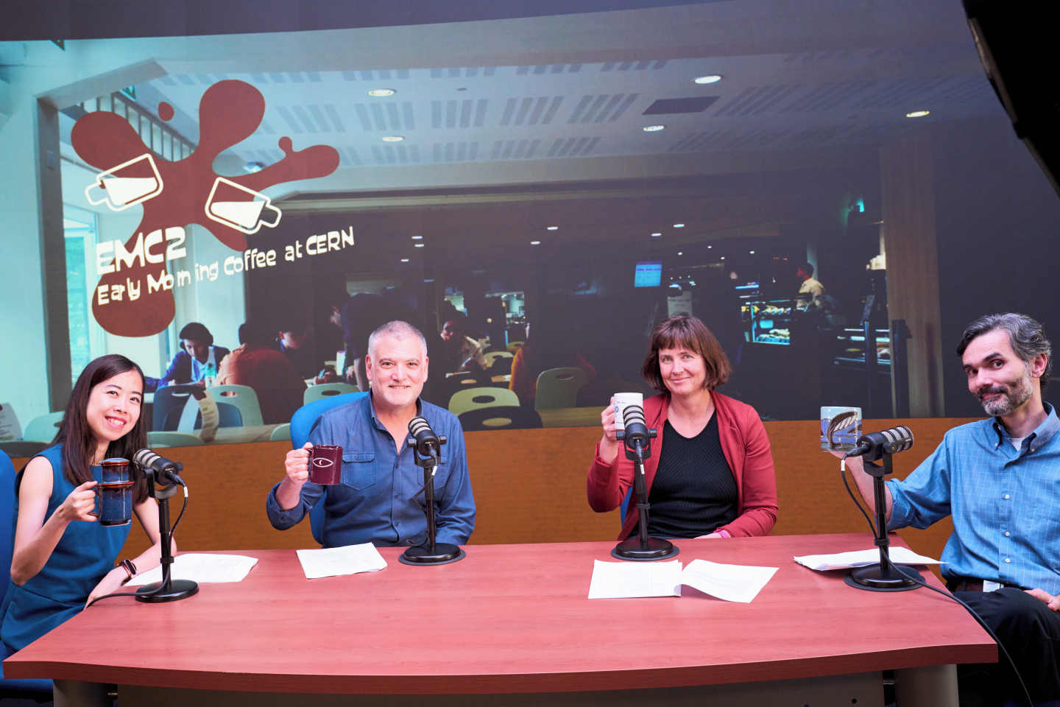
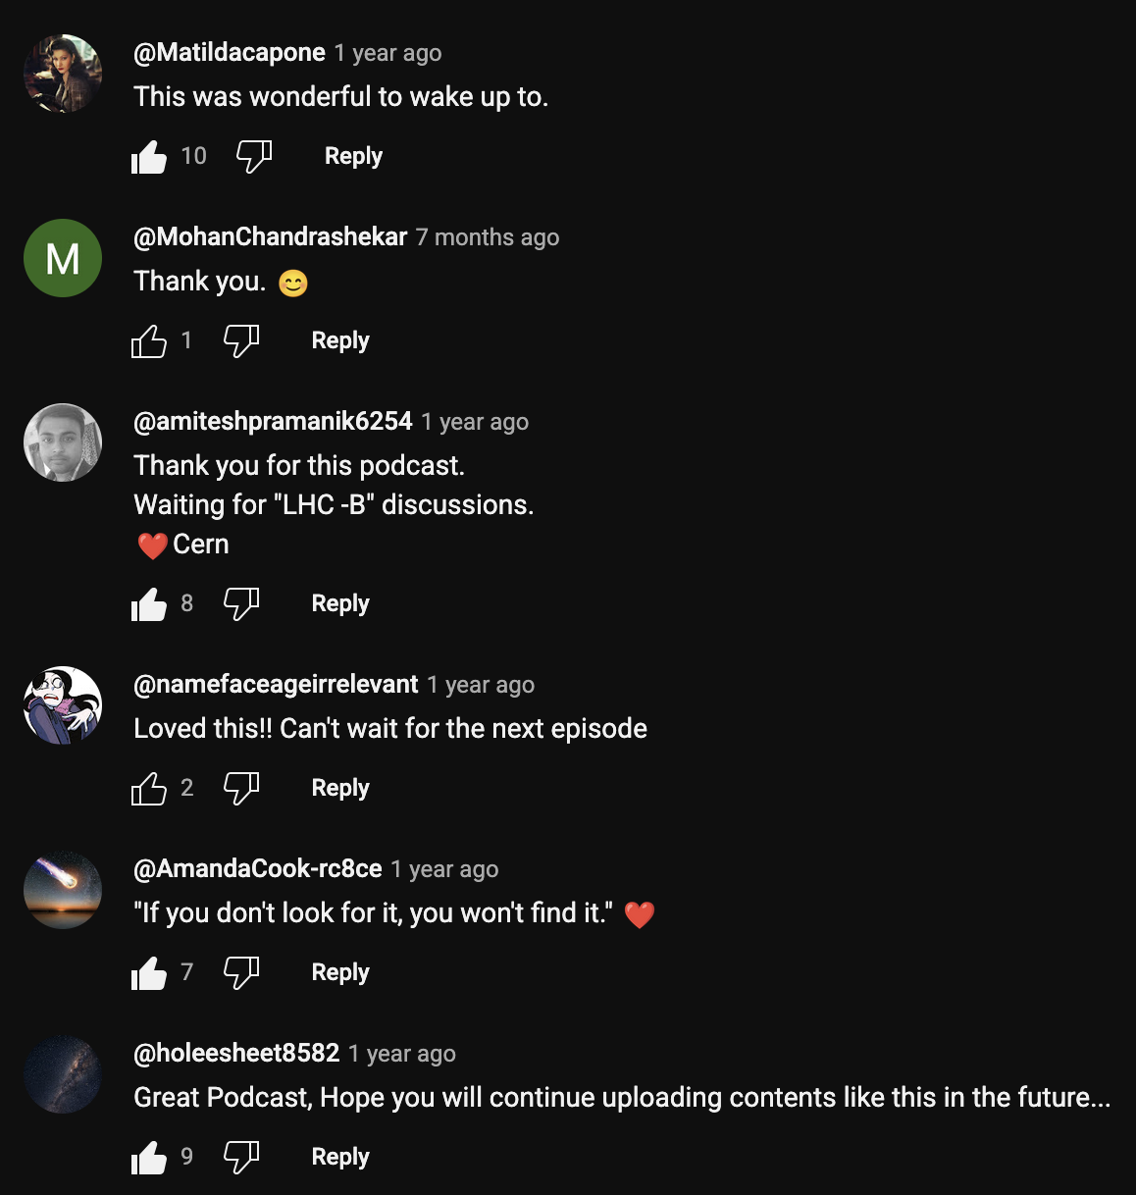
S1E1: The Higgs Boson Special
Heather Gray (ATLAS)
Andre David (CMS)
Published: 2 Jul 2024
8.0K YouTube Views

Slide 6
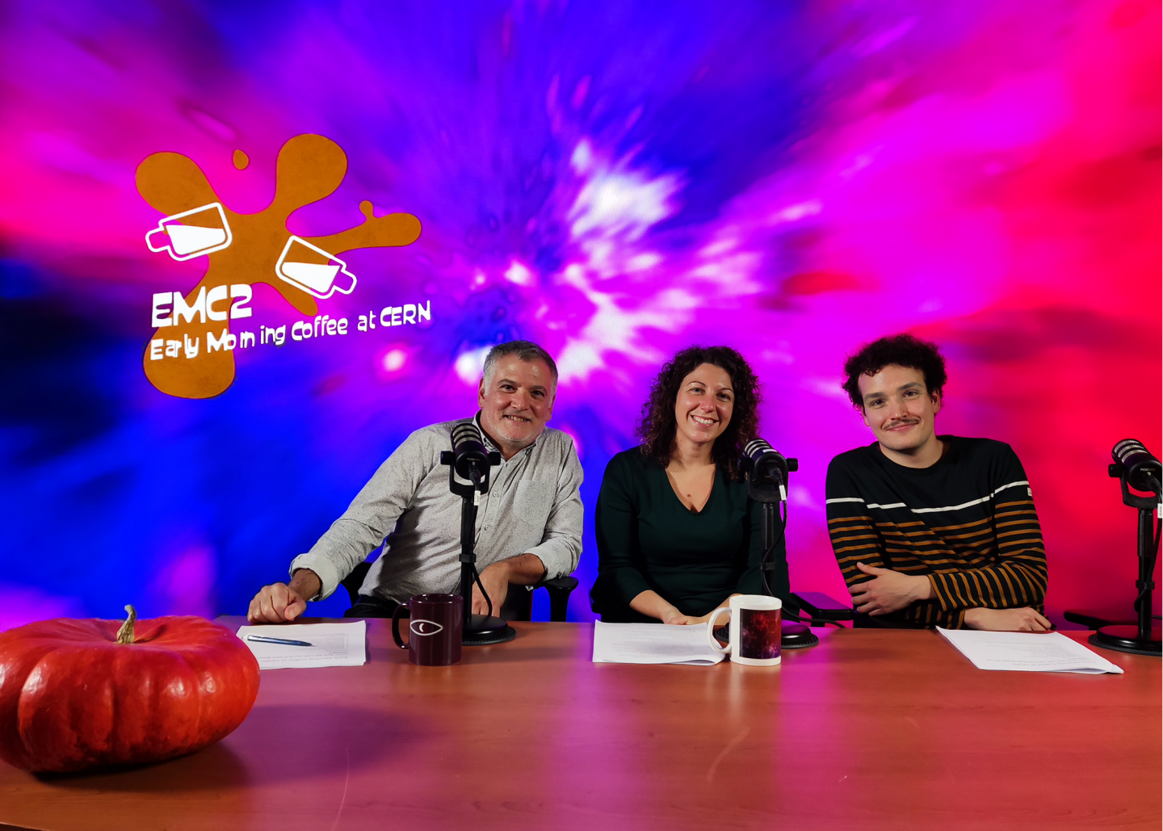
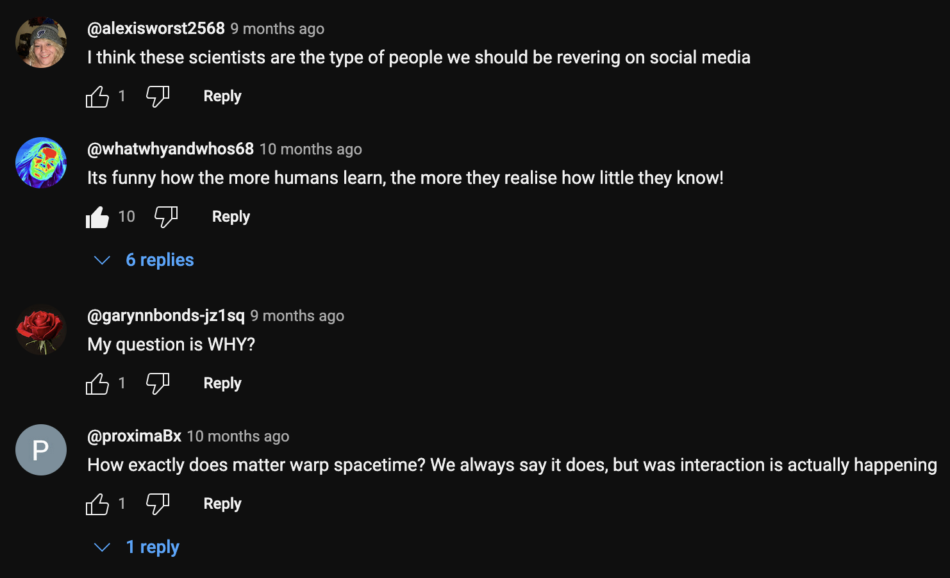
S1E2: Searching for Dark Matter at the LHC
Annapaola da Cosa (CMS)
Baptiste Ravina (ATLAS)
Published: 30 Oct 2024
5.6K YouTube Views

Slide 7
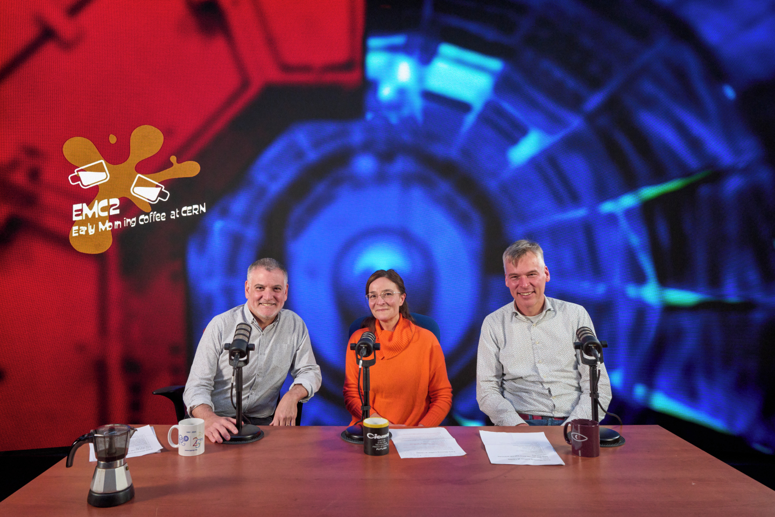
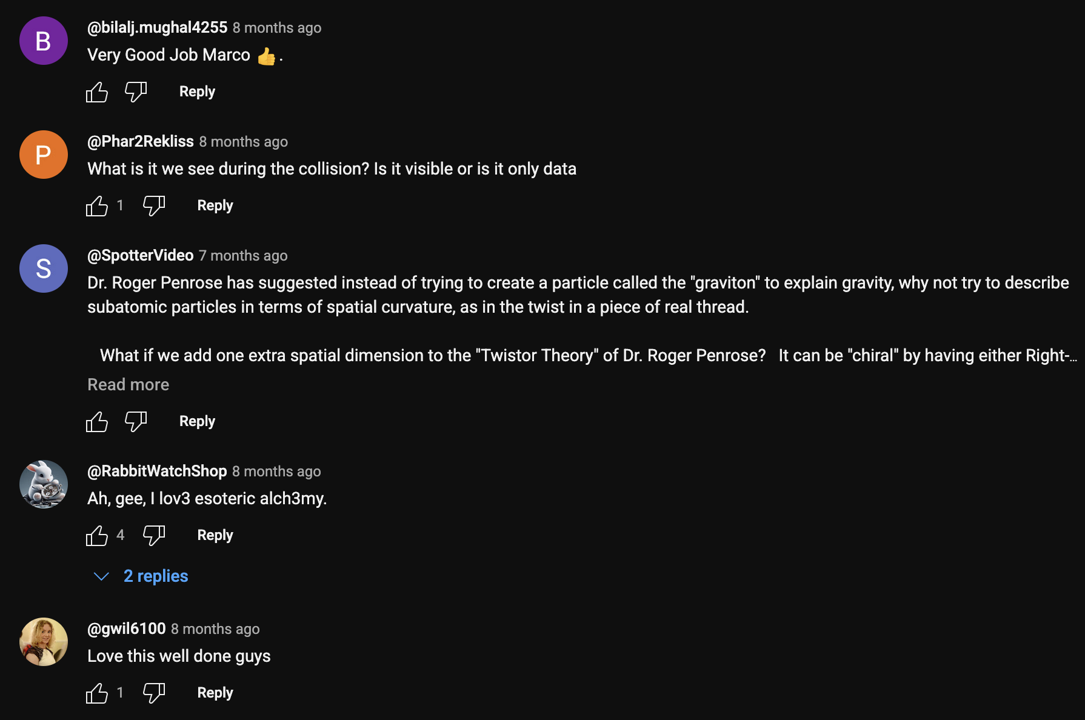
S1E3: Turning Lead into Primordial Soup
Reyes Alemany Fernandez (CERN Beams),
Marco Van Leeuwen (ALICE)
Published: 16 Dec 2024
3.7K YouTube Views

Slide 8
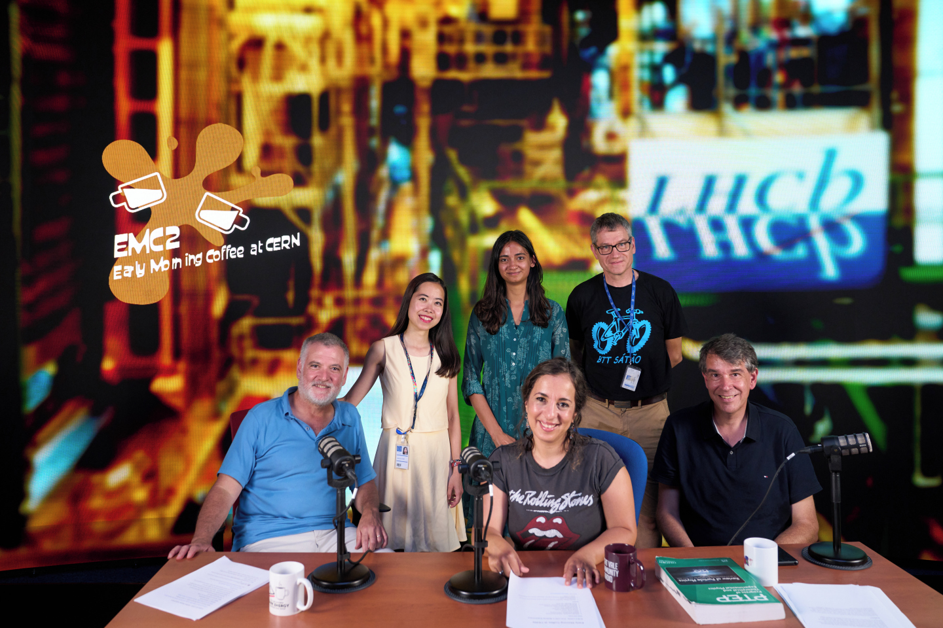
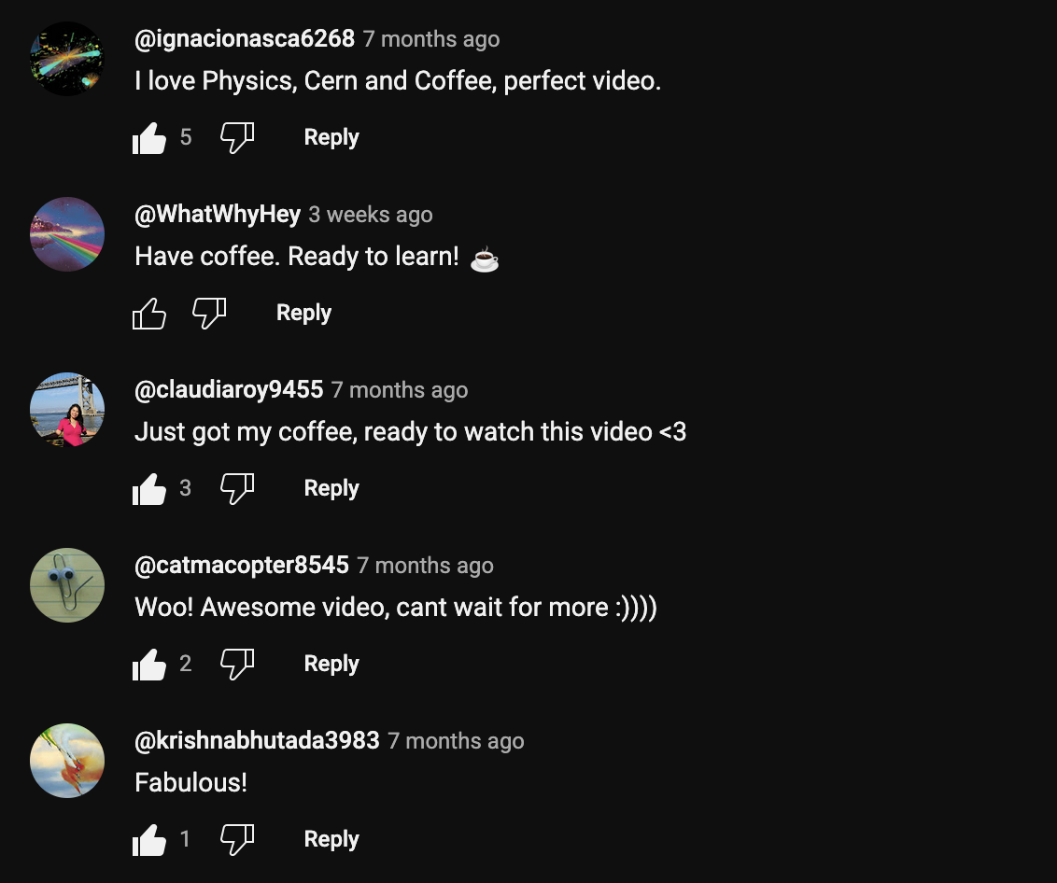
S1E4: Exploring the Matter-Antimatter Asymmetry
Yasmine Amhis (LHCb)
Patrick Koppenburg (LHCb)
Published: 4 Feb 2025
4.4K YouTube Views

Slide 9
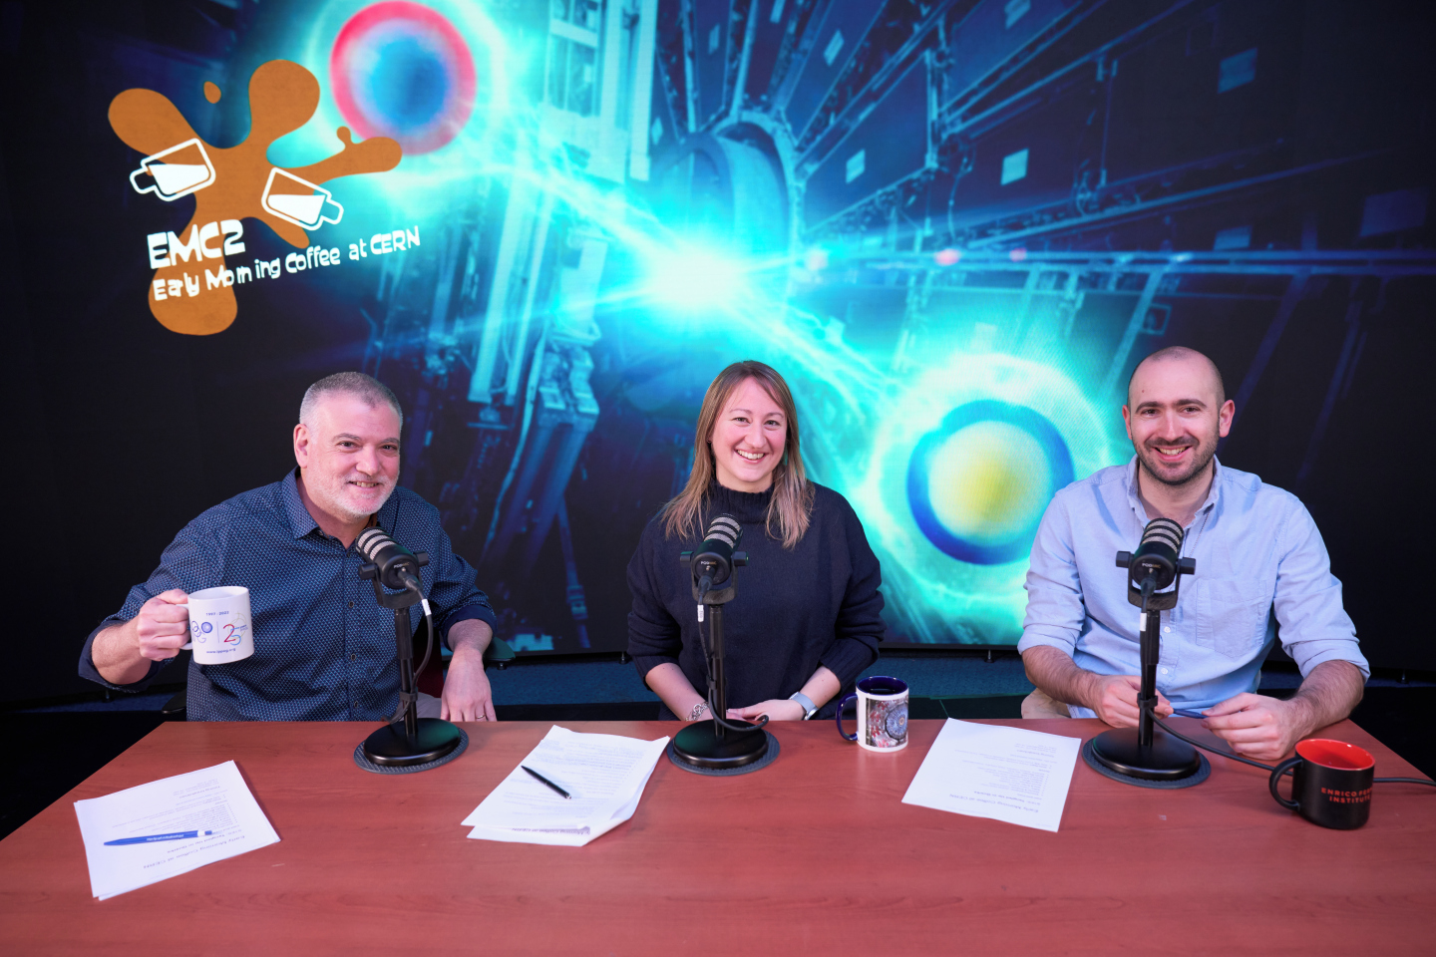
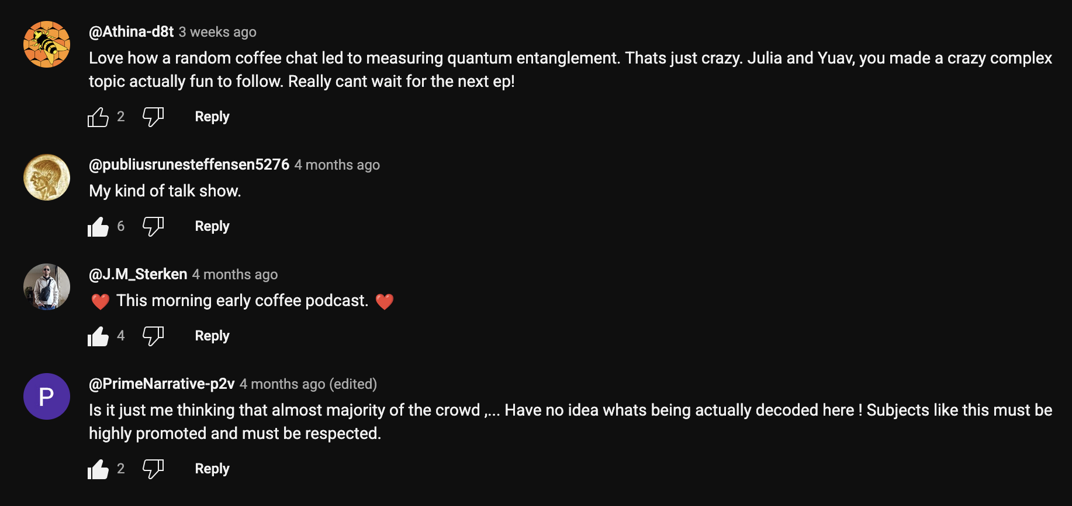
S1E5: Tangled Up in Quarks
Giulia Negro (CMS)
Yoav Afik (ATLAS)
Published: 14 Apr 2025
3.9K YouTube Views

Slide 10
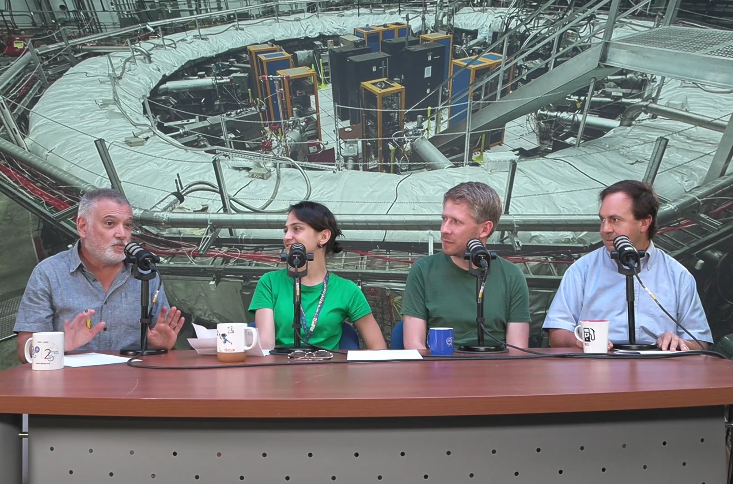
S1E6: A Final Moment for the Muon
Fred Gray (Muon g-2)
Claudia Cornella (CERN TH)
Simon Kuberski (CERN TH)
Shot: 26 Jun 2025
Final Edit: 1 Aug 2025
Awaiting Publication

Slide 11
YouTube Comments
Notes
Yes, we left the comments on.
We received no comments that warranted removal.
Some Jewels:
@Athina-d8t - Love how a random coffee chat led to measuring quantum entanglement. Thats just crazy. Julia and Yuav, you made a crazy complex topic actually fun to follow. Really can’t wait for the next ep!
@publiusrunesteffensen5276 - My kind of talk show.
@J.M_Sterken - ❤ This morning early coffee podcast. ❤
@Matildacapone - This was wonderful to wake up to.
@holeesheet8582 - Great Podcast, Hope you will continue uploading contents like this in the future...

Slide 12
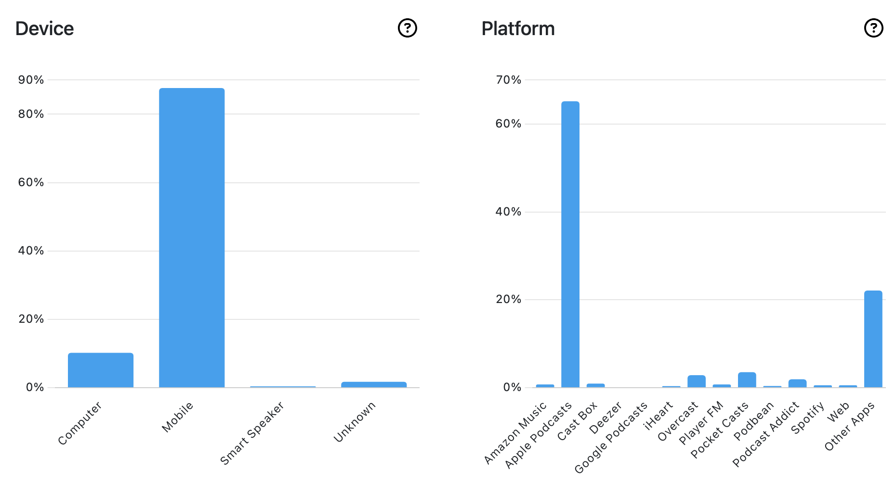
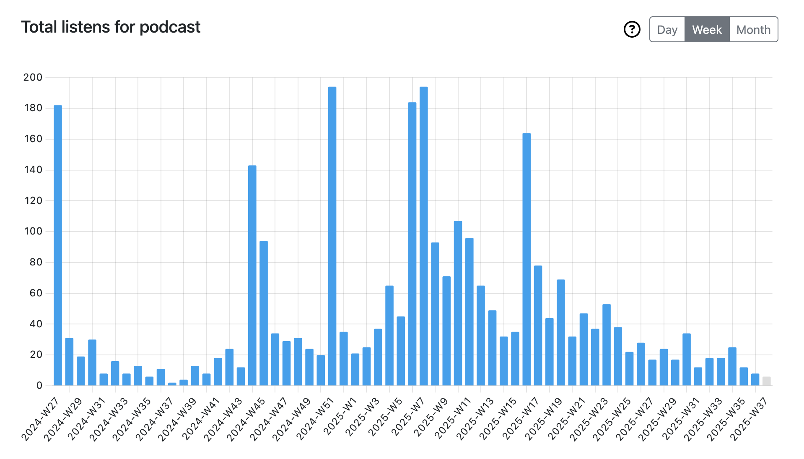
Audio Podcast
Platforms (audioboom)
Spotify, Apple Podcast, Castbox, Deezer, iHeart, JioSaavn, Listen Notes, Player FM, PodcastAddict
Audience
2.94k listens from 69 countries
Optimum frequency would be bi-weekly

Slide 13
What worked and what didn’t
What worked
Simple set up for audio/video (no external visits for now)
Selecting diverse guests with diverse topics
Meetings with guests ahead of time to prepare the show
Guests expressed gratitude at end of each podcast, want to do more!
Ron, Piotr, Jacques, Chetna, Melanie, Daniel, Daniela all did great work
Matthew gave us valuable feedback (but only a couple times)
Having a timer set to keep us to 30-35 minutes
Light-hearted conversation to gain audience trust
What didn’t
Audience will never grow without consistent periodic publication
We had no single point of contact for script approval or edit approval

Slide 14
Lessons Learned
Set Up
Single camera set-up with live switching works well
Microphones (with insulation pads) work well if placed correctly
No need to get fancy with graphics or audio
Our minimal set-up requires minimal effort (see Jacques)
Content
Remain topical and get episodes out in a timely manner
There is an infinite amount of interesting content at CERN
Experiments want this and appreciate being included
We know how to create a quality show that is appreciated by the public
This is one of the best tools in the world to gain audience trust

Slide 15
Where do we go from here?
Episodes
We need to publish muon g-2 ASAP
I have already apologised and given excuses to the guests (who were excellent)
Considering ISOLDE, AD, Oxygen Collisions, HL-LHC, Hyperkamiokande, etc.
Going Forward
We need to leave the CERN umbrella to set up a regular schedule
ECO has agreed to let us use the CERN equipment, provide training
This will also give more freedom on what we report
What do we need?
Technical volunteers: camera, sound, editing, production, approval
This is an excellent opportunity for training

