Slide 1

International Masterclasses in CROATIA
IPPOG Meeting, October 29 2025
Vuko Brigljević, Institut Ruđer Bošković, Zagreb
National contact point for International Masterclasses

Slide 2
The HEP Community in Croatia

Slide 3
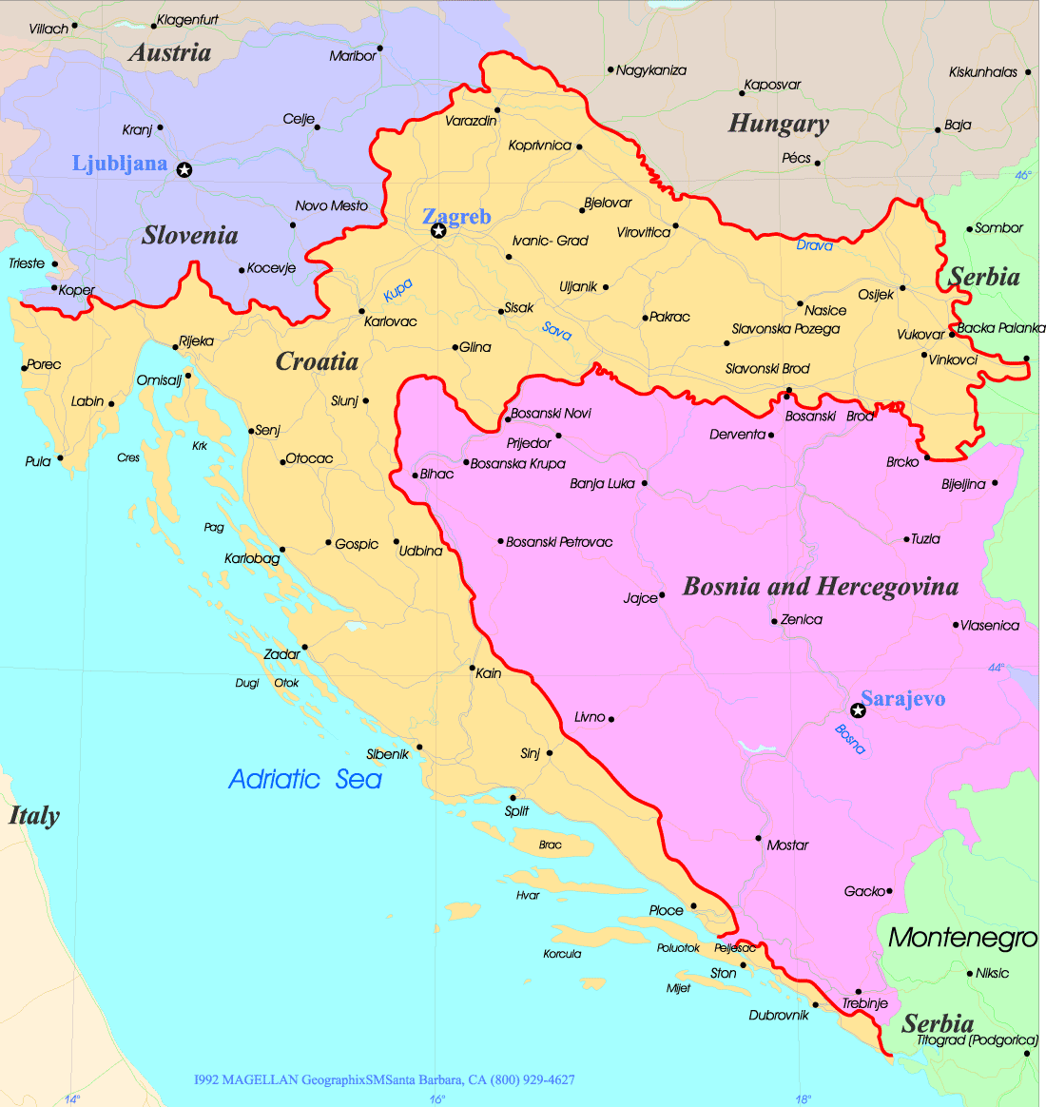
Croatian HEP Institutions
Ruđer Bošković Institute
Rijeka University
Split University
In Zagreb:
University of Zagreb
Ruđer Bošković Institute
Decades of activities in Particle & Nuclear Physics, and lately in Astroparticle Physics at CERN and many other labs
Zagreb University
Rijeka University
Split University

Slide 4
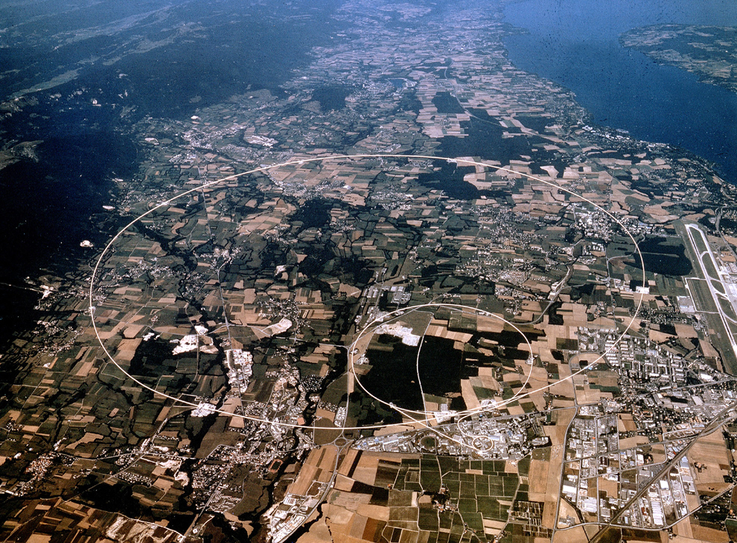



Croatia at CERN in the 21st century: Expts & Projects with Croatian Participation
R&D
projects
CMS Experiment
RBI + Split U.
OPERA
RBI
RD50
active
RD51
completed
RD53
NA49 / NA61 (SHINE)
RBI
future
DRD1
CAST
RBI.& Rijeka U.
DRD3
ALICE
RBI -> Zagreb U.
AIDA2020
AIDAINova
MUonE
Rijeka U.
ISOLDE
RBI + Zagreb U.
nTOF
Zagreb U.
EURO-LABS
4

Slide 5
Croatian Participation in the Masterclass program

Slide 6
Croatian Participation in International Masterclasses
Participation initiated by the CMS Group at RBI (Zagreb) in 2012, and followed in the same year by the CMS Group in Split
Since then these 2 groups have been organizing each year:
One to two Masterclass events at their home institution
Several events in other cities: Dubrovnik, Osijek, Varaždin, Virovitica, Požega, Čakovec, Karlovac, Mostar (Bosnia & Herc.)
2 young faculties at the U. Rijeka, former CMS members, have started 2017 organizing it in Rijeka and the Northern Adriatic region: Pazin, Pula
All these groups held CMS WZH Masterclass
ALICE group at Zagreb U. organized it one year (ALICE Masterclass) but discontinued

Slide 7
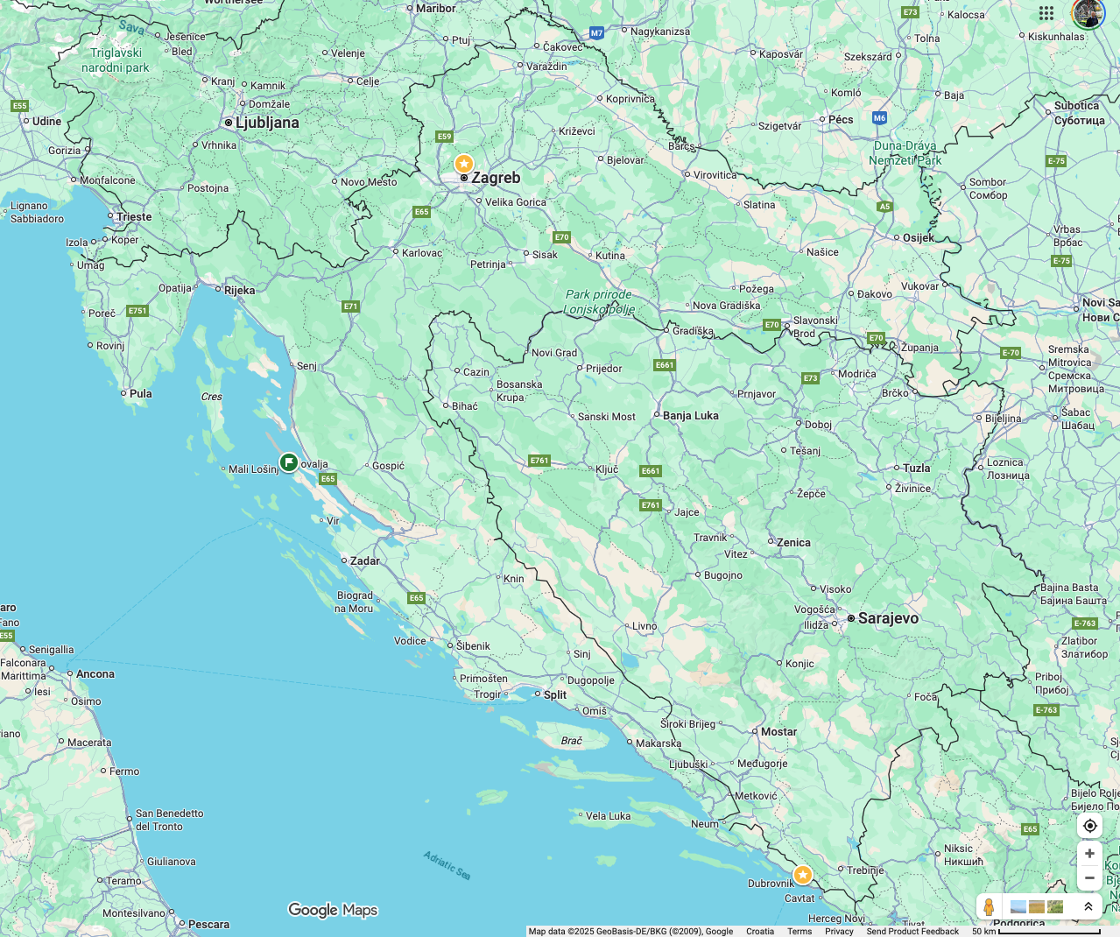
International Masterclasse in Croatia
Up to ~10 events / year
> 300 students / year
~4000 students since 2012
highschools students (14-18)
Focus on 3rd year high school
Almost all events using CMS WZH Path
Organizers
Remote events

Slide 8
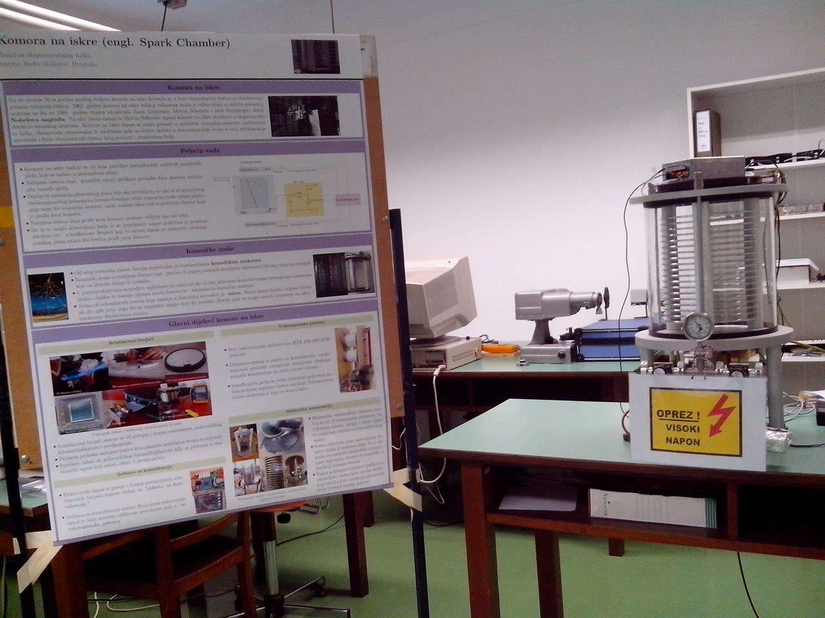
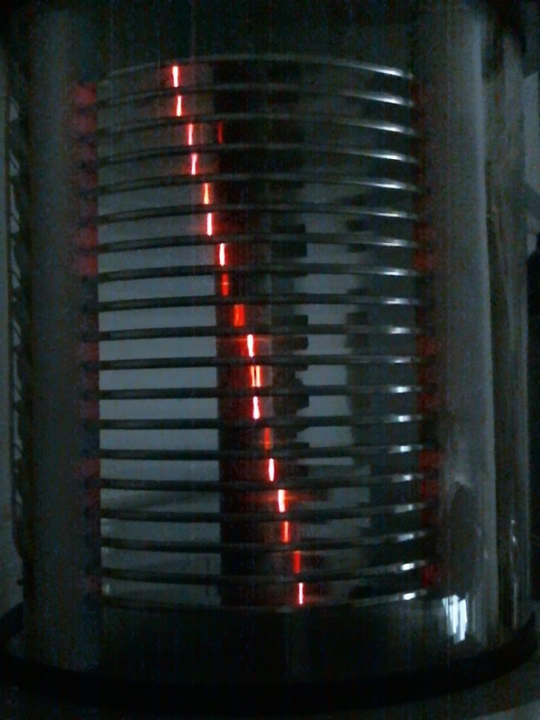
Our typical Masterclass Day
Venue: our universities / labs or in local schools
From 9:00 to 17:00
Morning: 2-3 lectures
Lab / Accelerator (@RBI) Visit if event at research institution
Lunch
Introduction to Analysis
Data Analysis
Discussion
Videoconference with Quiz
Involved staff:
2 to 6 people
(seniors to PhD students)
Some events not matched with official program:
No videoconference,
our own Quiz

Slide 9
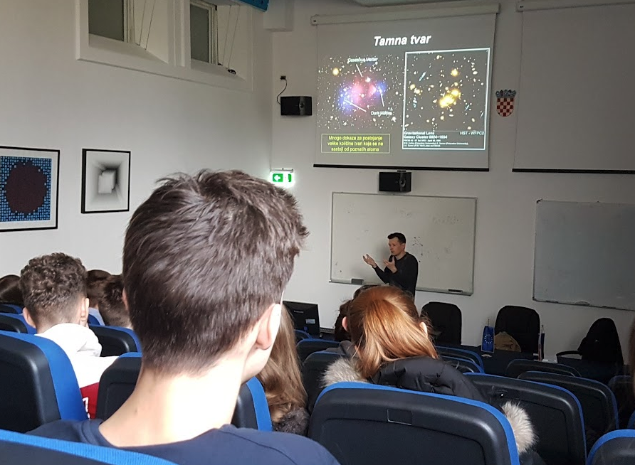
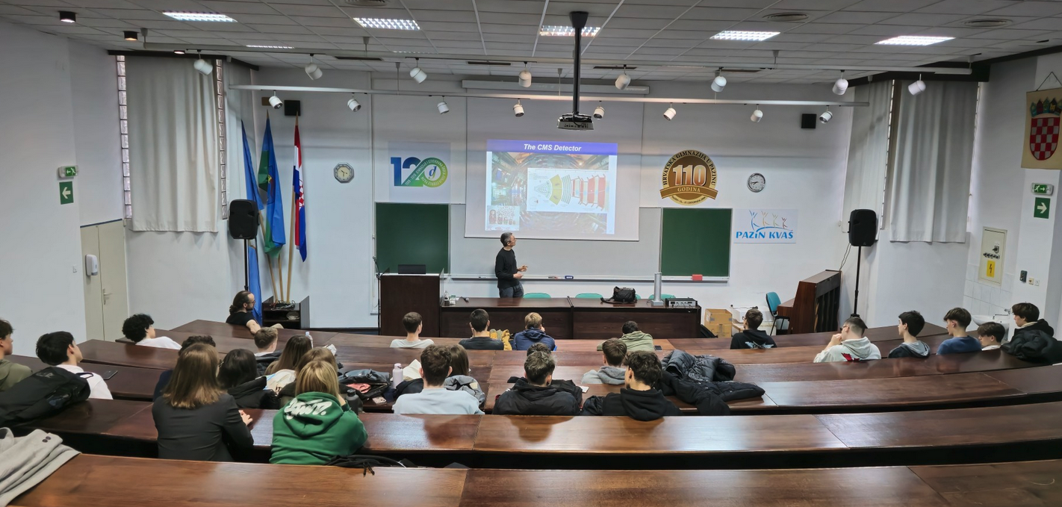
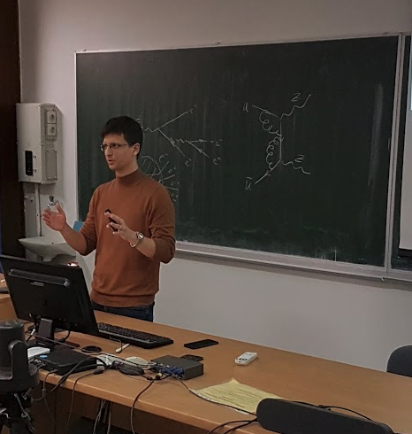
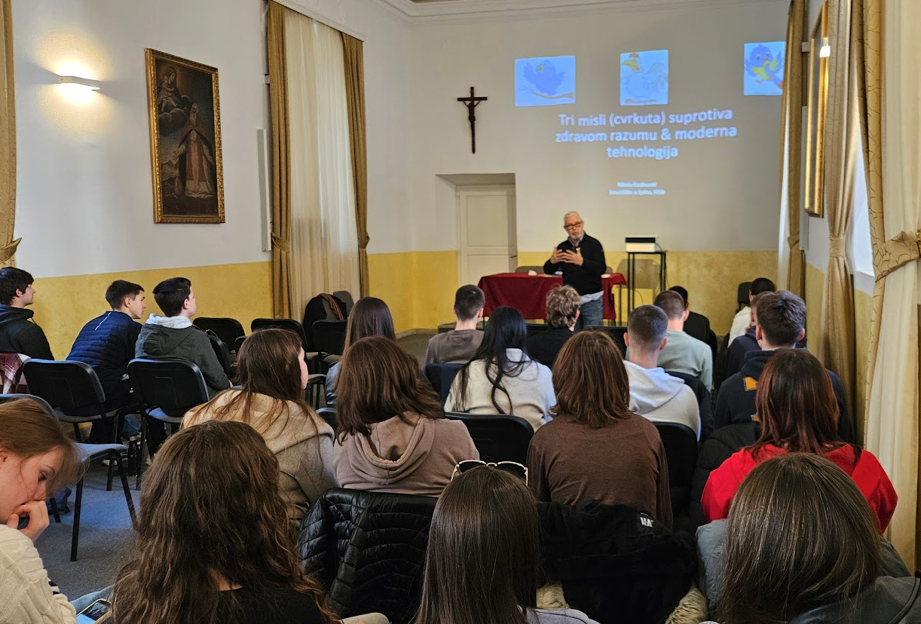
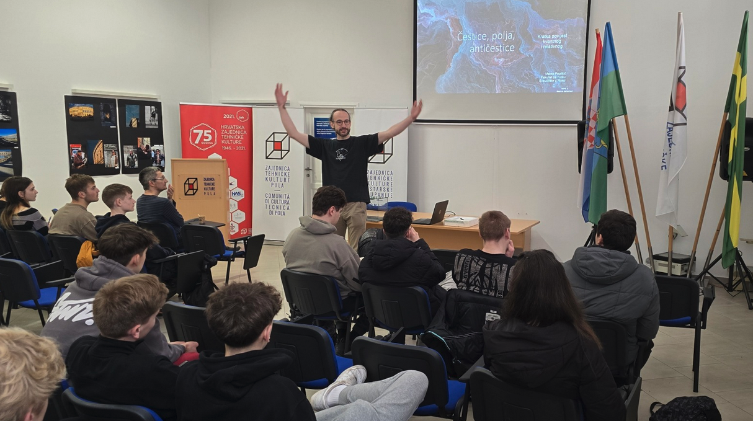
In pictures

Slide 10
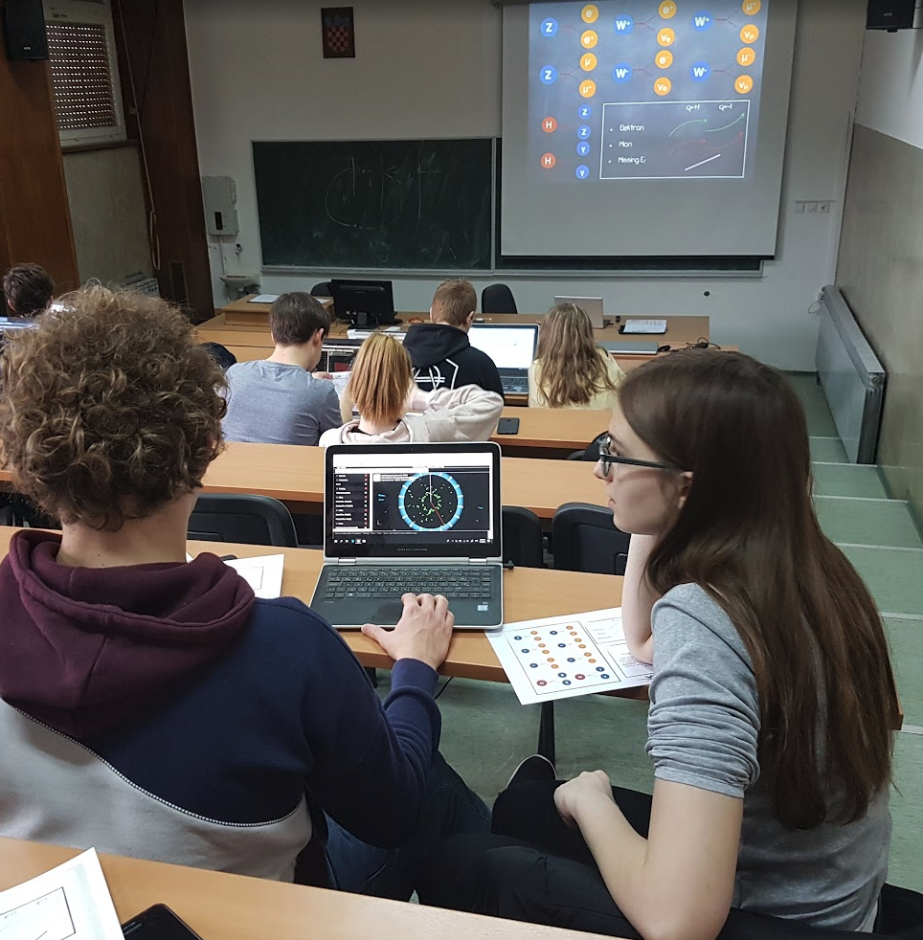
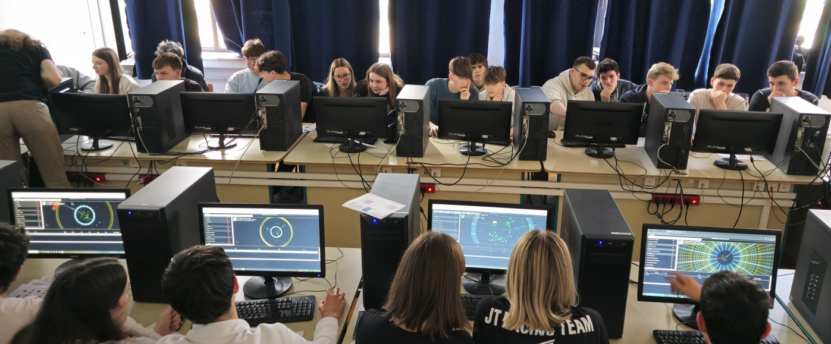
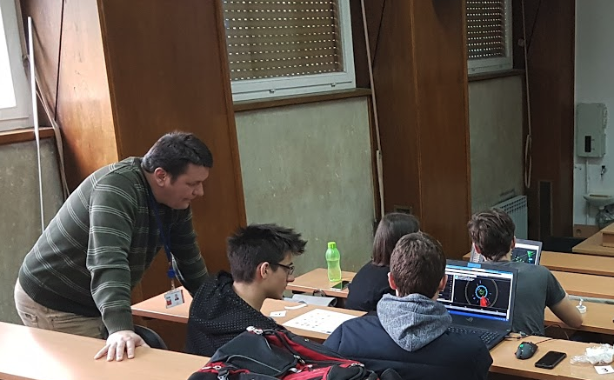
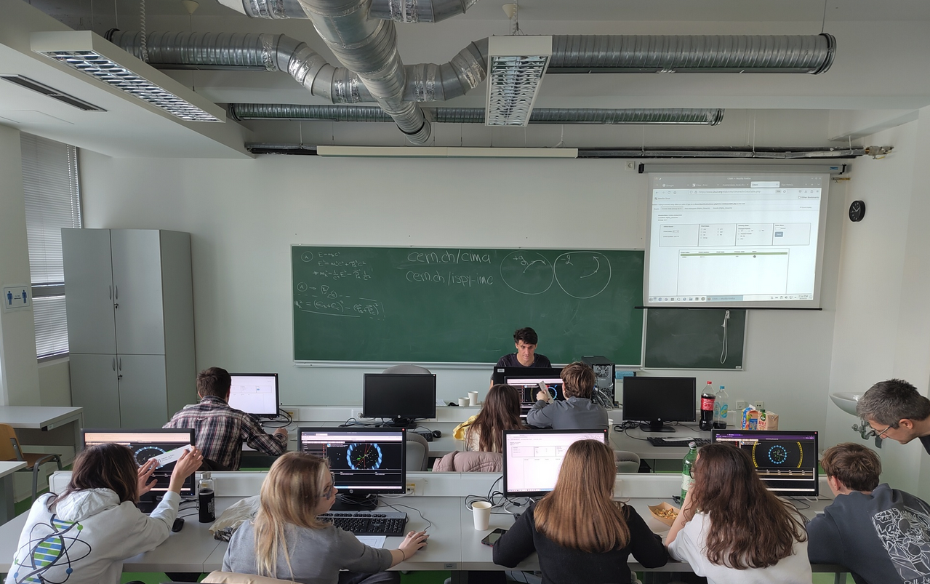
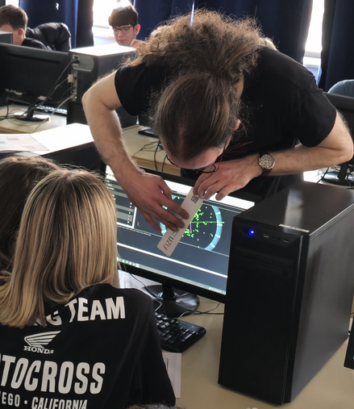
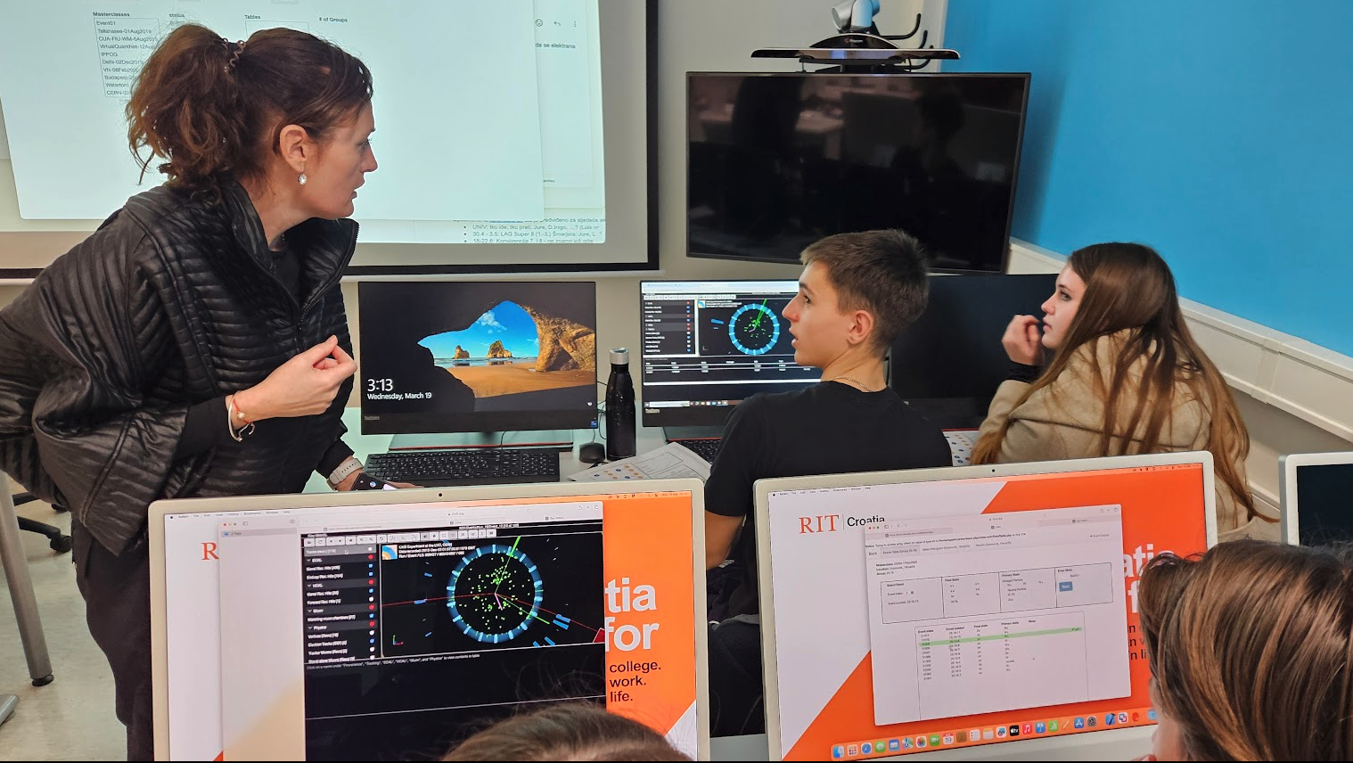
Analyzing Data

Slide 11
Some special Masterclasses
Masterclasses for Physics Teachers
In the Croatian Teachers Program at CERN
As special event at RBI in Zagreb (on Teachers request)
In Sarajevo School for High Energy Physics
Target audience: Master students
For the first time in January 2026: for Physics 1st year students at the U. of Zagreb (the students requested it!)

Slide 12
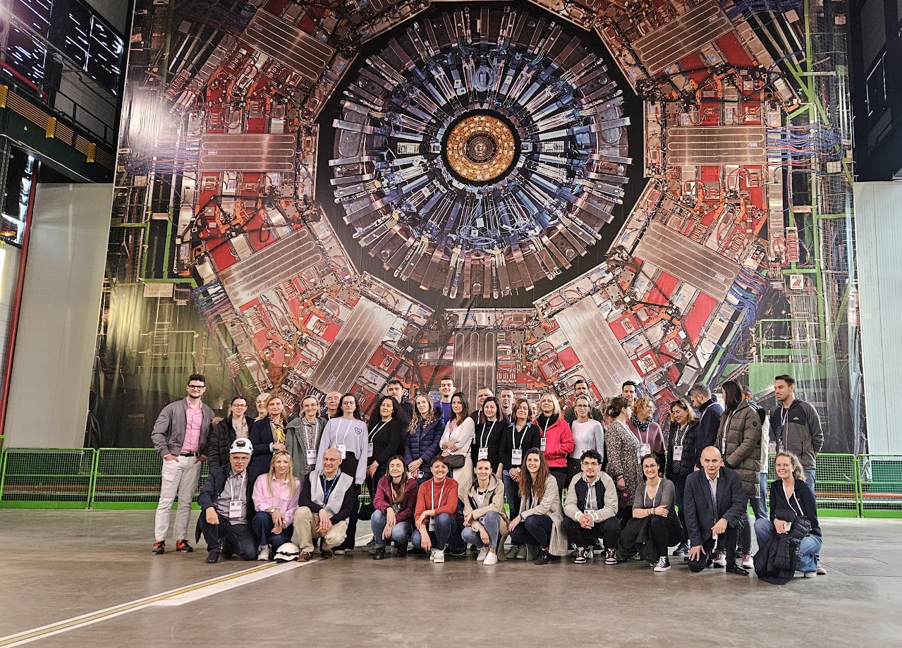
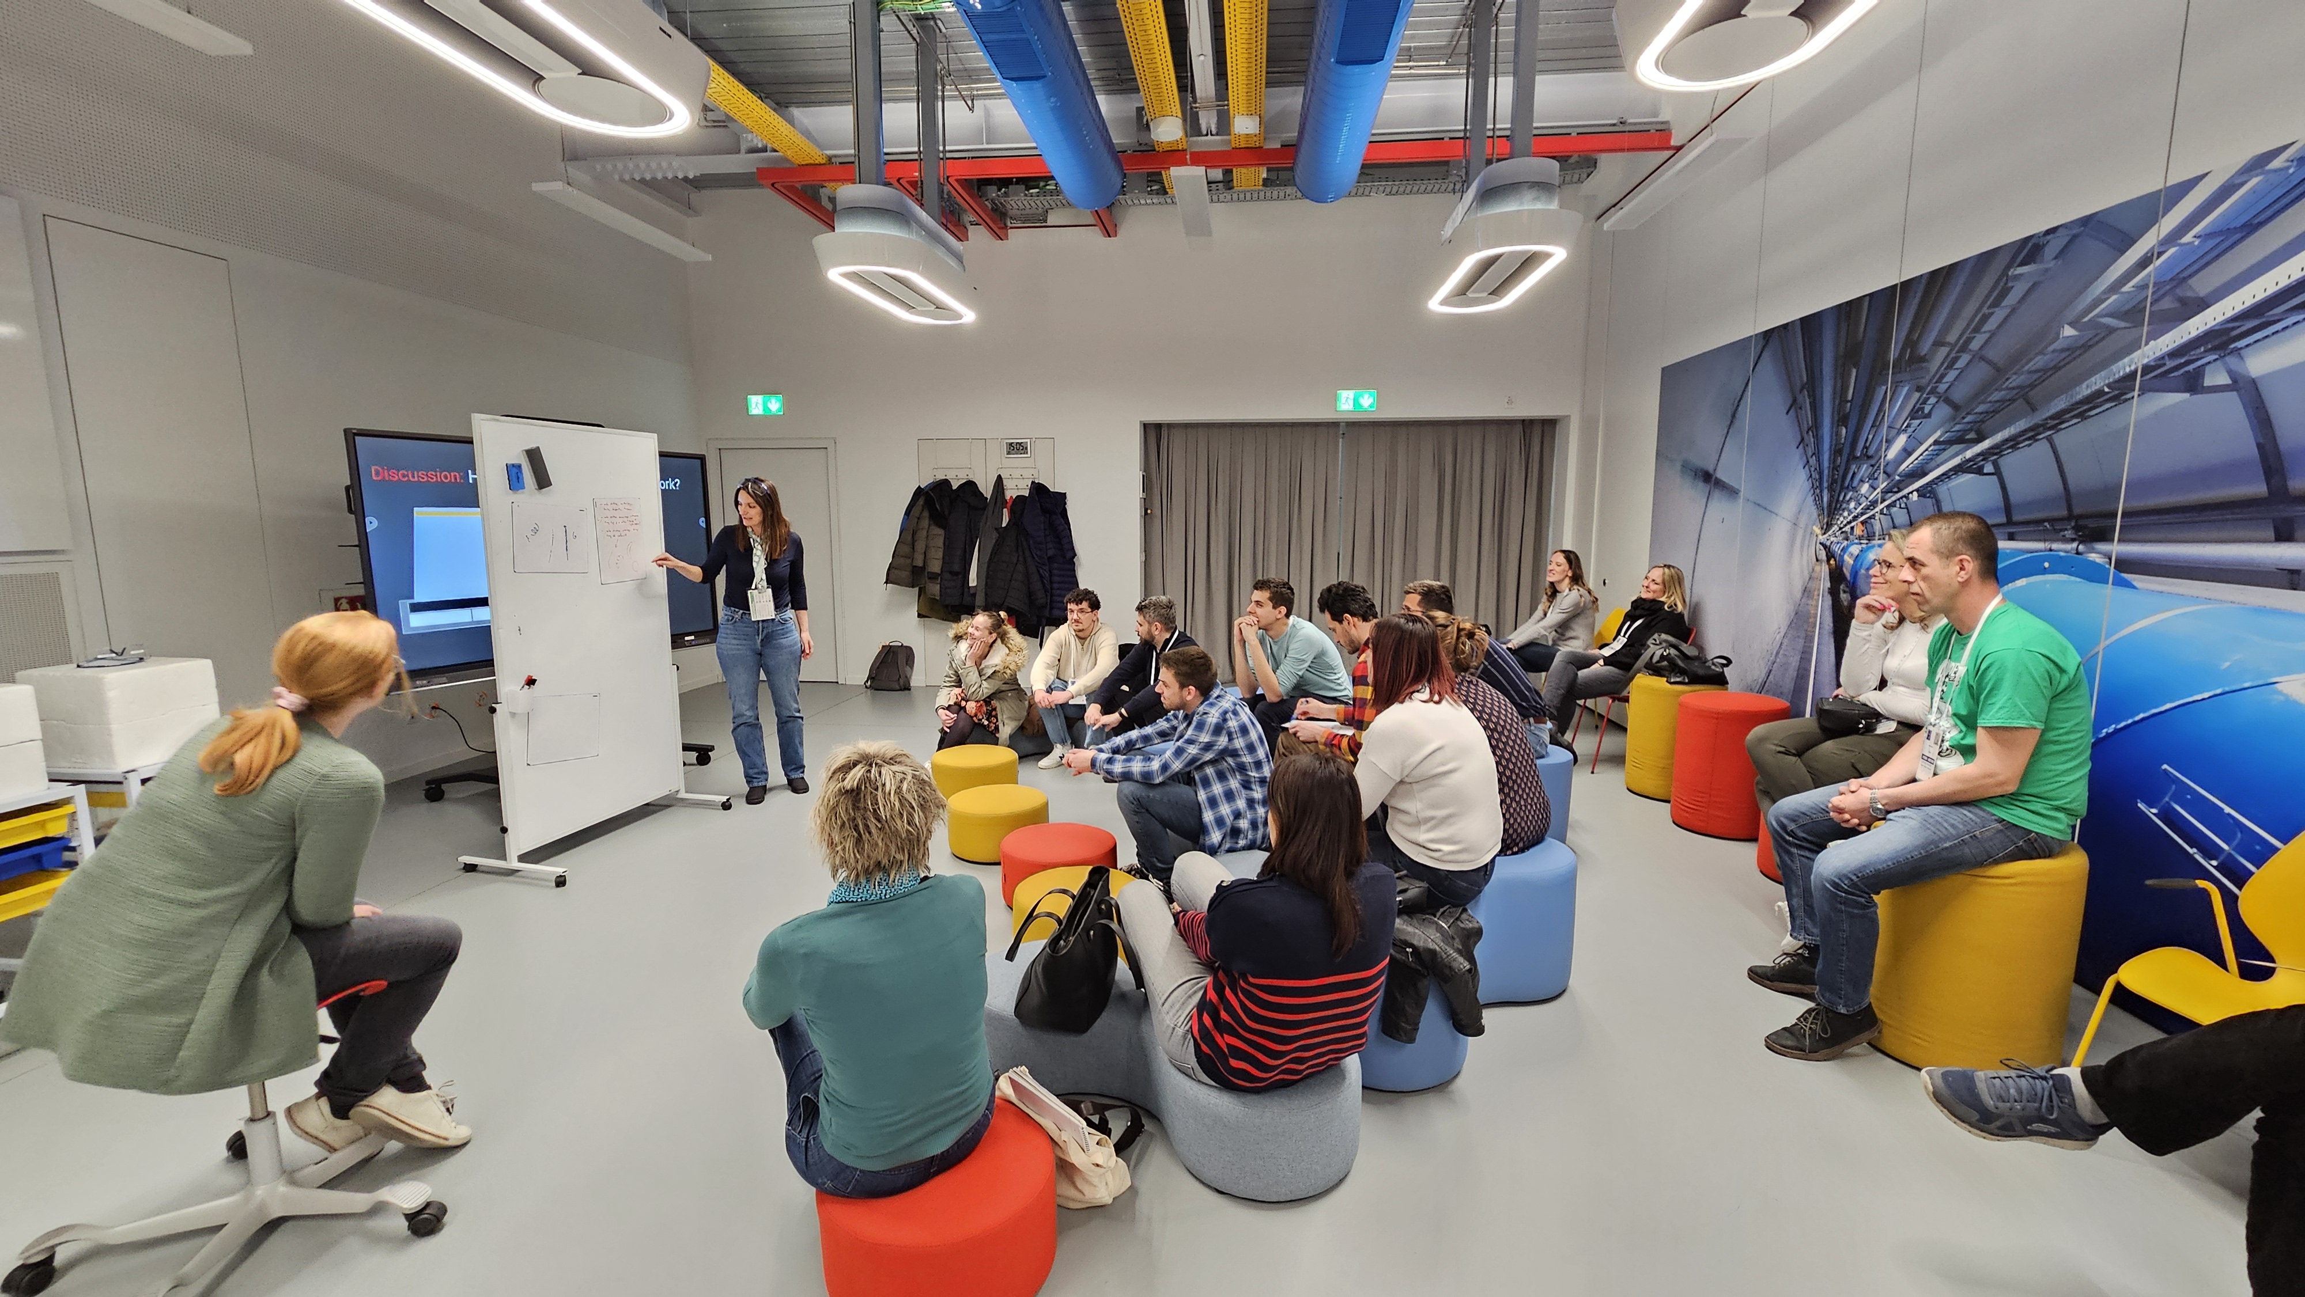
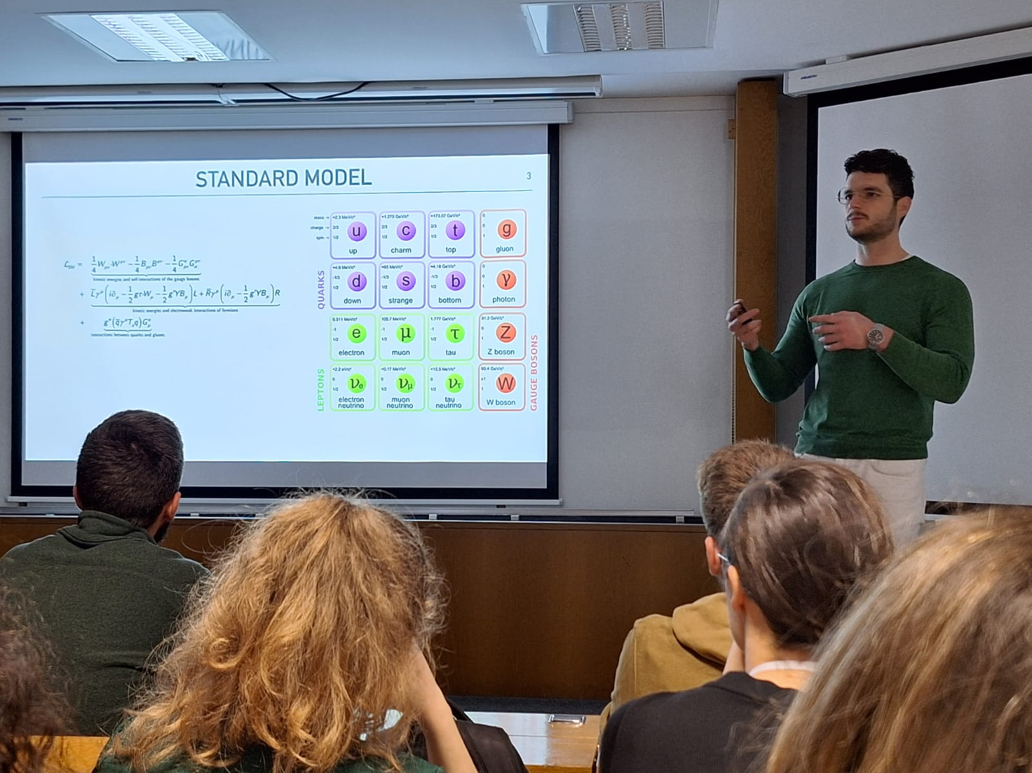
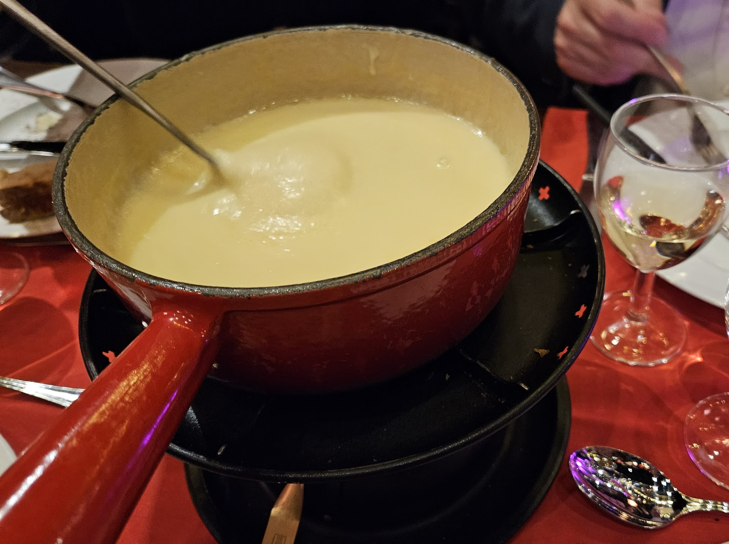
Croatian CERN Teachers Program
3 days at CERN-u: lectures, visits, workshops
~250 Croatian physics teachers attended the program since 2015
Teachers love it, all of it, from the physics to the cheese Fondue!

Slide 13
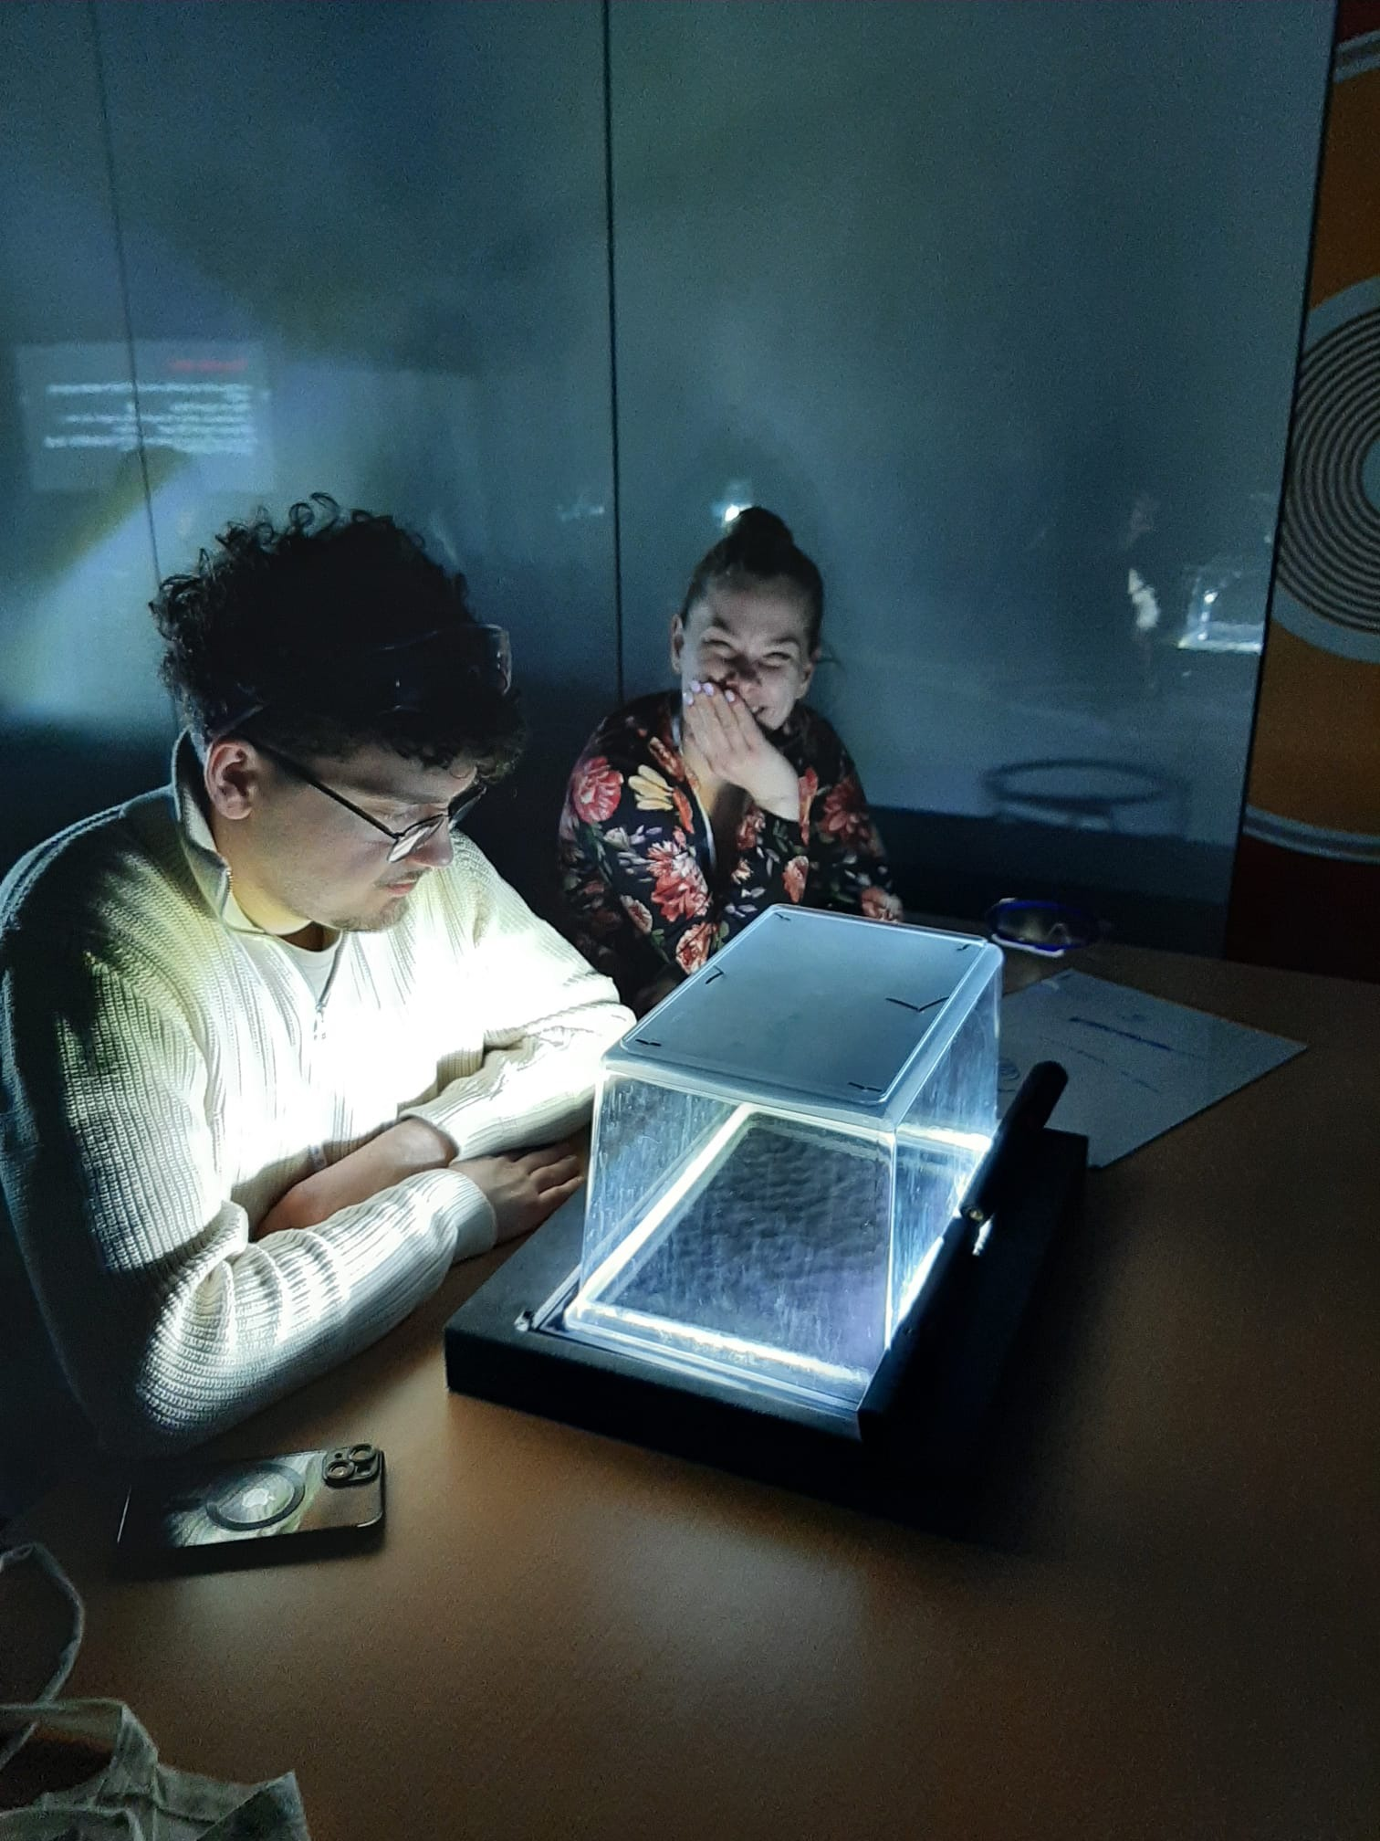
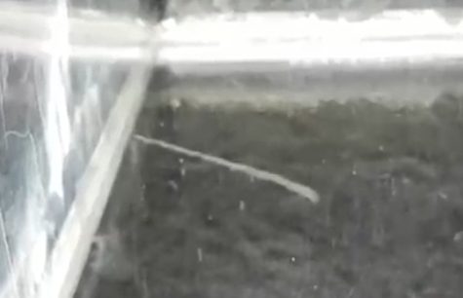
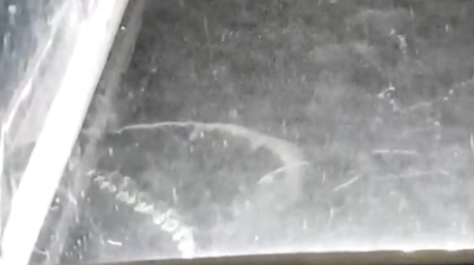
Teachers Program: detectors for schools
… tracks of α,β,γ particles appeared in the chambers we just put together

Slide 14
Masterclass: the feedback we receive
Program highly appreciated by students and their teachers
We cannot accept all students who would like to come
More schools are inviting us than we can handle
Only limit: our time
Positive echo in the media
Heard more than one from physics students:
“This is the day I decided to study physics”

Slide 15
This would not be possible without…
We benefit from the infrastructure and support put together by Uta, Ken, and the whole team
We always got great support when requesting help with additional samples, additional dates, questions about the tools (CIMA, Event display)
We provided some feedback on things that we think could be slightly improved (Analysis, Event display, videoconference)
Thank you to all who started the fantastic Masterclass and continue to make it possible!!!

Slide 16
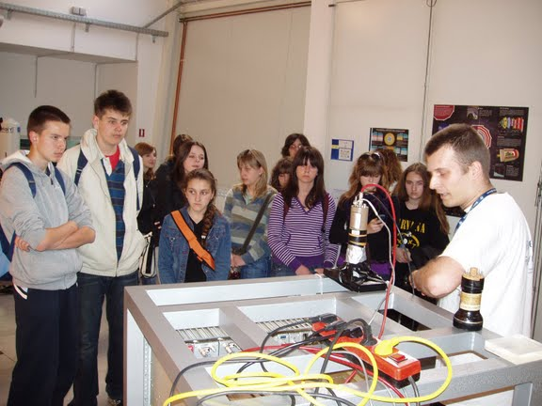
Other HEP Outreach Activities
Croatian HEP Community involved in many other Outreach Activities over the years
Public talks for all kinds of audiences
Participation in Science festivals, Institute and Faculty Open days
Talks
Experiments
Media presence:
Interviews with individual researchers
TV visits to labs and universities
All of this: very much bottom-up, grassroots
little or no infrastructure
But very good and collegial relation between active groups
Demonstrating cosmic rays
At RBI Open Days

Slide 17
THANK YOU FOR YOUR ATTENTION!

