Slide 1
MuCol Cooling Cell
Outcome of the 1st Integration Review
MuCol-WP8 Zoom meeting #27, 3 June 2025
Laurent Tavian, on behalf of the Review Panel

Slide 2
Introduction
The first review of the conceptual design of the cooling cell integration held on 6 May 2025 at CERN.
Review Panel:
  Francesco Bertinelli (CERN, contributing retiree)
  Teddy Capelli (CERN, EN/MME)
  Vittorio Parma (CERN, SYS/RF)
  Laurent Tavian (CERN, contributing retiree)
The review agenda and the presentations are available on Indico (Review of the 1st cooling cell integration (May 6, 2025) · Indico)
The Panel thanks the participants for their clear and complete presentations.

Slide 3

Agenda of the review meeting
Review of the 1st cooling cell integration (May 6, 2025) · Indico

Slide 4
Charges to the review panel
The review panel is asked to assess the work done, taking into account that the work is at a very preliminary stage. It is recommended to address the following questions:
  Q1: Is the proposed concept for cooling cell integration suitable to the scope?
  Q2: Is the assembly procedure viable and effective given the constraints?
  Q3: Is the force support structure and support/anchoring system adequate?
  Q4: Are there other more promising solutions worth exploring?

Slide 5
Findings and recommendations
Q1: Is the proposed concept for cooling cell integration suitable to the scope?
In the experience of the Panel, this application is probably the most severely complex because of the number of systems to be developed (HTS, aluminium RF foil, absorber material, vacuum couplers, …) and integrated in a very tight volume and reproduced in hundreds/thousands of units.
The lithium absorbers will bring specific hazards (explosion, flammability, corrosion, toxicity) with respect to other materials less performant but less reactive (e.g. Al or plastic) and maybe still acceptable for the demonstrator.
The present scope approach aiming to satisfy all constraints in a beam working demonstrator seems excessively ambitious. A more conservative pre-demonstrator combining HTS magnet and RF aspects with a more conventional absorber material (e.g. plastics or Al) and vacuum connection will already present challenges and learning opportunities to ensure progress.
Recommendation 1: Assess the impact on the performance of the demonstrator equipped with more conventional material.

Slide 6
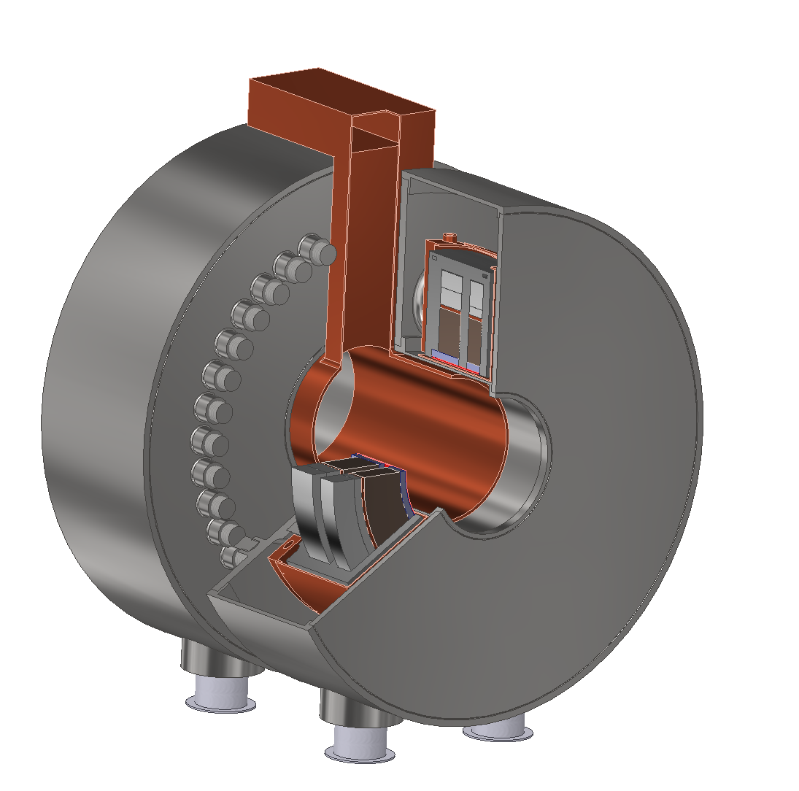
Findings and recommendations
Q1: Is the proposed concept for cooling cell integration suitable to the scope?
The new concept introducing the inter-cell cryostats seems better than the old concept. In steady-state operation, the magnetic forces are self-contained inside the inter-cell cold masses. However, during transient (quenches…), unbalance in magnet currents can create axial forces. The present design is based on 10 % of current unbalance.
+
-
+
-
+
-
+
-
-
+
-
+
-
+
-
+
Old
(cell
cryostat)
New
(inter-cell
cryostat)
Recommendation 2: Confirm this maximum unbalanced value of 10 % as this input has a large impact on the inter-cell thermo-mechanical design.

Slide 7
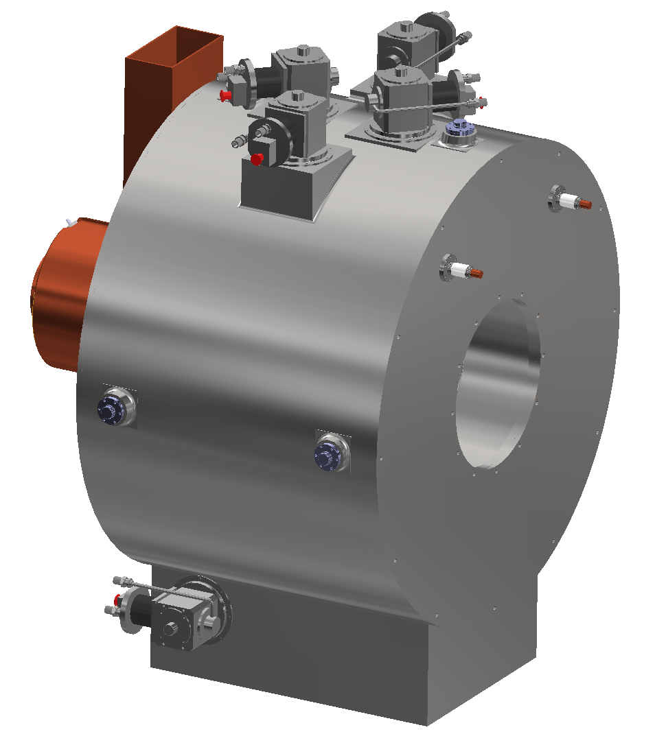
Findings and recommendations
Q1: Is the proposed concept for cooling cell integration suitable to the scope?
Cryocoolers
The proposed concept is based on cooling with cryocoolers (5 cryocoolers per inter-cell cryostat of ~ 1-m length). Appling this concept to the 2 times 1-km of inter-cooling cells, ~10’000 cryocoolers will be needed. This concept is not technically and economically acceptable for the final configuration which will require a cooling using a central refrigerator (~80 kW @ 20 K + ~660 kW @ 70 K) and a cryogenic distribution system. Therefore, it is proposed to study later the adaptation of the cryocooler cooling concept to the refrigerator cooling concept which could not be fully optimized without introducing painful modifications or bricolage.
Recommendation 3: Base the cooling concept already with the final configuration and adapt this concept to cryocoolers if some initial tests of prototypes do not require large refrigeration capacities.

Slide 8
Findings and recommendations
Q1: Is the proposed concept for cooling cell integration suitable to the scope?
The vacuum layout and sectorization are not completely defined. From what the Panel understands, the absorber needs to be actively pumped. However, if it is decoupled from the cavity vacuum, a dedicated vacuum sector is introduced, this would require the integration of additional equipment (e.g., pumps, gauges, etc.), which should be considered in the design.
Recommendation 4: Define the vacuum layout and sectorization and integrate the additional equipment.

Slide 9
Findings and recommendations
Q2: Is the assembly procedure viable and effective given the constraints?
The assembly procedure seems feasible. However, the use of remote “smart” couplings needs special developments and risk analysis. Two “smart” couplings are under investigation: the Shape Memory Alloy (SMA) couplers and the Pillow-seal couplers.
The present state of the art of SMA couplers is limited to an ID ring of 130 mm and must be extended to larger ID. The tightening of the coupling is made by active heating of the ring above 100 °C and the decoupling by active cooling down to -40 °C. Nevertheless, a passive cooling down below this temperature could appear in case of an accidental loss of the insulation vacuum (with air or He) of the inter-cell cryostat and could create an accidental loss of the beam/cavity/absorber vacuum.
Heat exchange by convection in air
Cold-mass
(~3 t @ 20 K)
Air
Thermal shield
(with or w/o MLI?)
Vacuum vessel
SMA ring (T ?)
(in a confined space which will ease its cooling-down)
Air
Air
Recommendation 5: As a loss of the insulation vacuum of an inter-cell cryostat cannot be excluded, investigate and study the impact of this accidental case on the temperature of the beam vacuum equipment to confirm the safe use of SMA couplers.

Slide 10
Findings and recommendations
Q2: Is the assembly procedure viable and effective given the constraints?
The Pillow-seal couplers require permanent pressurization during operation. Once pressurized, the required leak-rate of the seal must be below 0.1 mbar.l/s, which seems feasible. However, in case of failure the pressurisation system (e.g. power-cut), the tightening of the seal could not be guarantee. In addition, during shut down for maintenance, all the couplers (~2000 units) will be depressurized. What is the risk of having couplers not recovering their tightness after re-pressurization? What could be the repair procedure (change of the cooling module…)?
Recommendation 6: Assess the risk of using Pillow-seal couplers and the corresponding impact on the collider availability.

Slide 11
Findings and recommendations
Q3: Is the force support structure and support/anchoring system adequate?
The new concept of the inter-cell cryostat is based on a single support post which has presently (see recommendation 1) to withstand an axial force of 1.1 MN. The design of the support post is based on composite material having a maximum acceptable stress of 350 MPa. Furthermore, the stress analysis of the support appears to be done assuming an isotropic material and taking safety margins which are typical for isotropic materials. GFRE must be designed according to the layup of the fibre material and mechanical resistance making use of composite material specific failure criteria like Tsai Wu.
Recommendation 7: Review the support post design considering anisotropic material properties.

Slide 12
Findings and recommendations
Q3: Is the force support structure and support/anchoring system adequate?
In the proposed design, the large axial force imposes to have massive support post with large thickness (> 60 mm). As a comparison, the three support posts of a LHC dipole (30 t) have a thickness of 4 mm.
The addition of axial stoppers could relax the stresses applied to the support post. In nominal operation without unbalanced force the axial stoppers could not be in contact with the cold mass (i.e., no additional thermal loads).
Axial stopper
Main forces
Recommendation 8: Integrate axial stoppers and assess the corresponding impact on the support post design.

Slide 13
Findings and recommendations
Q3: Is the force support structure and support/anchoring system adequate?
The RF windows are very vulnerable to pressure forces. A maximum RF field pressure below 1000 Pa seems acceptable. However, the pressure forces which will be applied during transient operations and accidental scenarios (pump down, accidental loss of vacuum pressure…) are not investigated.
Recommendation 9: Assess the pressure forces for transient operations and accidental scenarios to confirm the feasibility/robustness of the proposed RF window design.

Slide 14
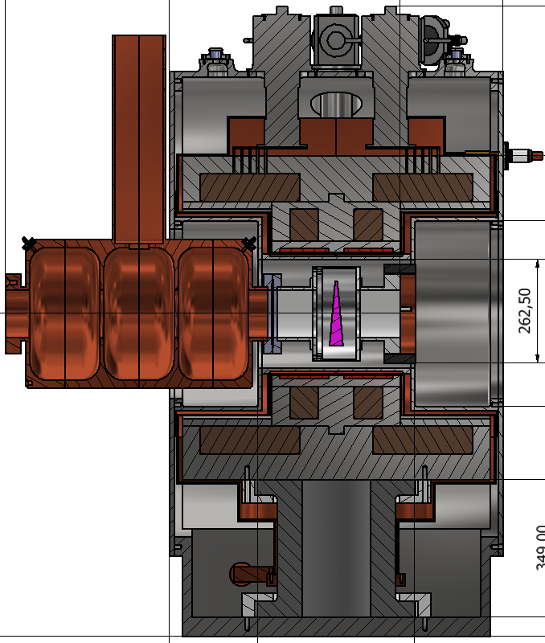
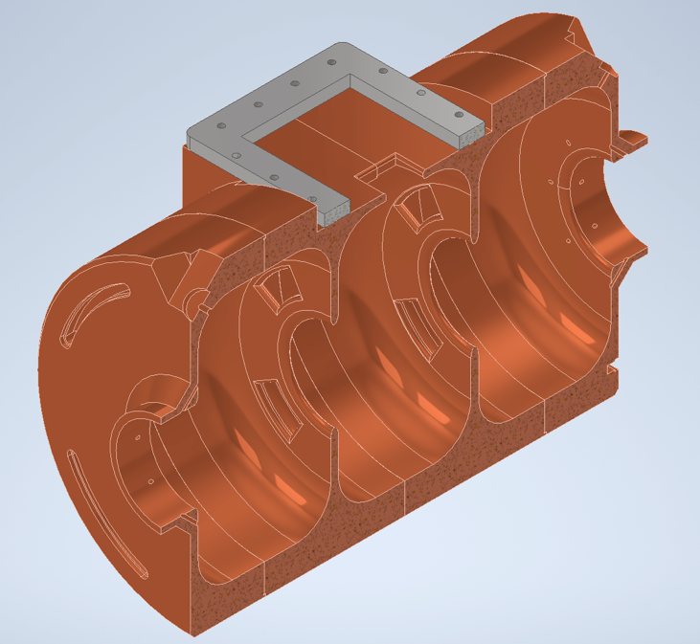
Findings and recommendations
Q4: Are there other more promising solutions worth exploring?
Conflict 2
In the proposed design, it is not possible to laterally insert an inter-cell cryostat around a warm bore constituted of cavities and adsorbers preassembled and to use standard vacuum coupling system. It is mainly due to two conflicts:
  The internal diameter of the cryostat is few centimetres smaller than the external cavity diameter. What will be the impact on the performance if we remove this conflict (smaller cavity external diameter and/or larger SC coil diameter)?
  The waveguides of the cavity are blocking the lateral insertion. In the preliminary mechanical design of the cavity (see slide #23 of the RF design presentation), the waveguide seems bolted on the cavity. Can we assemble the waveguide after the cryostat insertion?
Removing these two conflicts will:
  Ease the assembly of a cooling cell.
  Ease the de-assembly of a cooling cell if we must exchange/repair a cavity or an absorber.
  Decouple the inter-cell cryostat assembly with respect to the availability of RF cavities and absorbers.
  Allow the use of standard vacuum couplings on the warm bore (cavity/absorber line).
Conflict 1
~4 cm

Slide 15
Findings and recommendations
Q4: Are there other more promising solutions worth exploring?
The Girder concept:
  The presented concept would not allow the disassembly (e.g. for repairs) of a single 1-metre unit in the 1-km line. Hence a full girder (probably limited to 25 tonnes, so 5-6 metres long) would need to be replaced, with disassembly then done outside the beam line.
  For this reason, we recommend to focus the design on a complete girder, and from there to identify what a 1-metre demonstrator would look like.
  This girder concept could allow to optimise the warm RF/beam line much better, i.e. to include absorber, RF waveguides and any vacuum connections in a single position and to exploit the longitudinal space more for RF field. A 5-6 metres warm line could even be fully welded.
  This girder concept will impose the assembly of the solenoid cryostat in two half shells (while of course using full solenoids) with full RF/magnet integration.

Slide 16
Thank you!

