Slide 1
EESD2
Instrumentation inventory

Slide 2
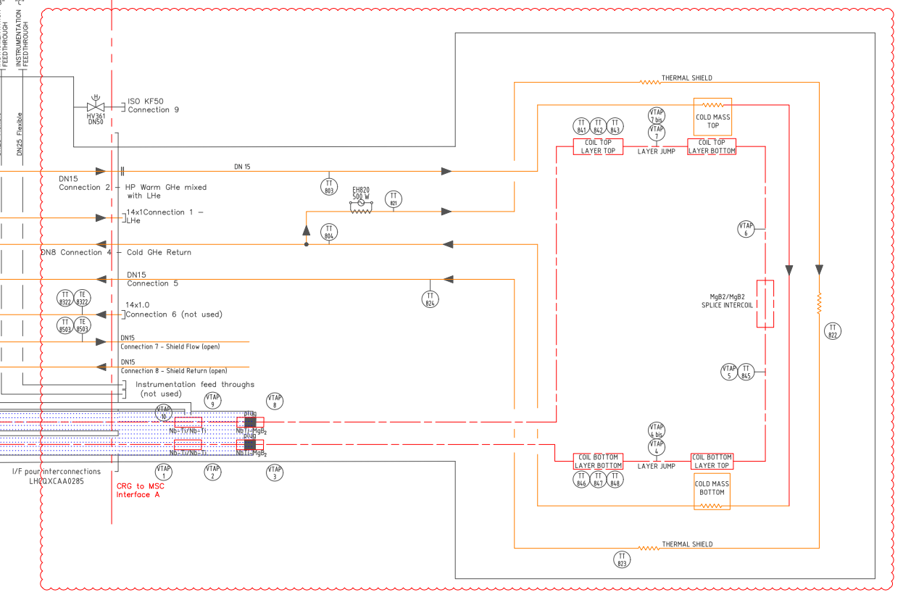
Reminder : CRNLSQLJ0006

Slide 3
Instrumentation list :
Vtaps :
Finger thermometer :
Long thermometer :
Cryo heater :
Co-winded voltage tap :

Slide 4
Vtaps
4 Vtaps around NbTi splices in LHe vessel.
4 wires to guide through the feedbox

Slide 5
Vtaps
2 Vtaps distant of 470mm from NbTi/MgB2 splices

Slide 6
Vtaps
2 Vtaps around coil layer jump
(~200mm from mid-splice ends)

Slide 7
Vtaps
2 Vtaps around each coil’s layer jump

Slide 8
Thermal sensor
1x CX-1050-AA-1.4L clamped to mid splice

Slide 9
Thermal sensor
2x3x CX-1050-AA-1.4L clamped to exterior formers

Slide 10
Thermal sensor
4x CERNOX SUPPORT “LT-PIPE”
Support to be manufactured ?
(pipe Ø10)

Slide 11
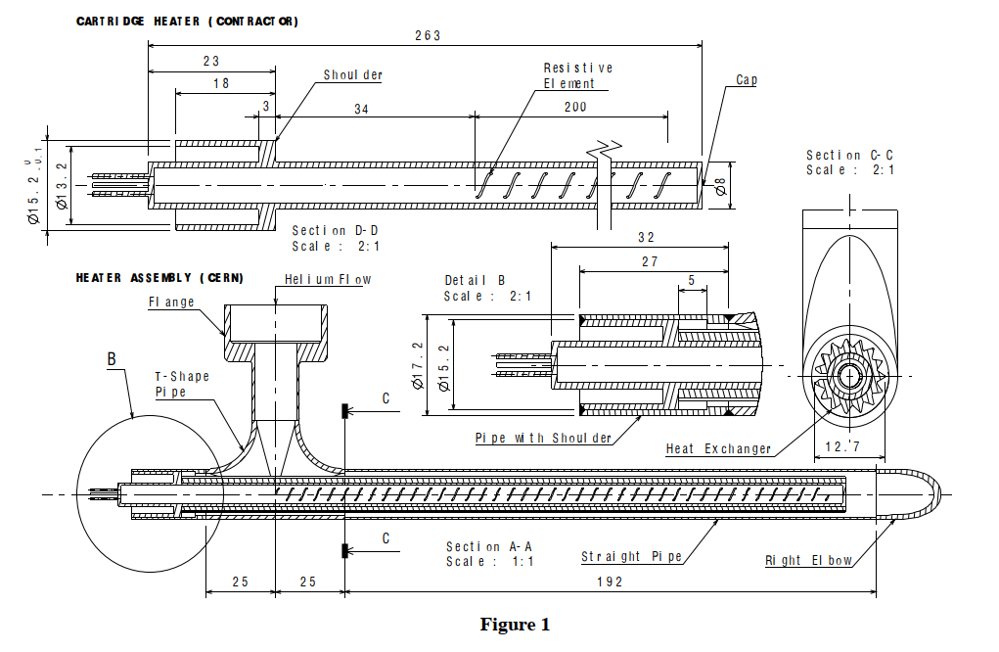
Cryo heater
Today feedthrough limit:
500V / 5A / pin
https://edms.cern.ch/document/431306/1

Slide 12
Co-winded voltage tap
Thin and insulated braid copper wire (Ø1.5mm maxi) co-winded

