Slide 1
Design of FFA magnet for LhARA
18/09/25
Ta-Jen Kuo
Supervisor: Jaroslaw Pasternak, Jean-Baptiste Lagrange
Imperial College London, STFC

Slide 2
Content
What is LhARA
Target field
Magnet and coil geometry
Optimisating of current
Adjusting fringe field
Final tune result

Slide 3
What is LhARA

Slide 4
LhARA
Laser-hybrid Accelerator for Radiobiological Applications, dedicated to radiobiology research
Laser target: Up to 15 MeV proton beam at 10Hz
FFA: Variable extraction energy 15-127 MeV

Slide 5
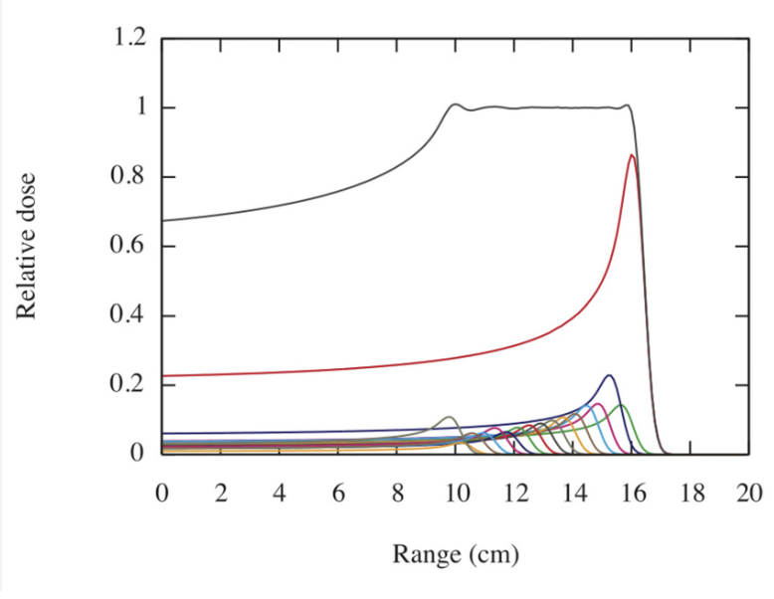
Variable extraction energy
Combine beams of different energy to
create a spread out Bragg peak
Injection energy and total B field
varied for different extraction energy
Verify behavior at 2 different extraction
energies 127 Mev and 57 MeV.

Slide 6
2.Target field

Slide 7
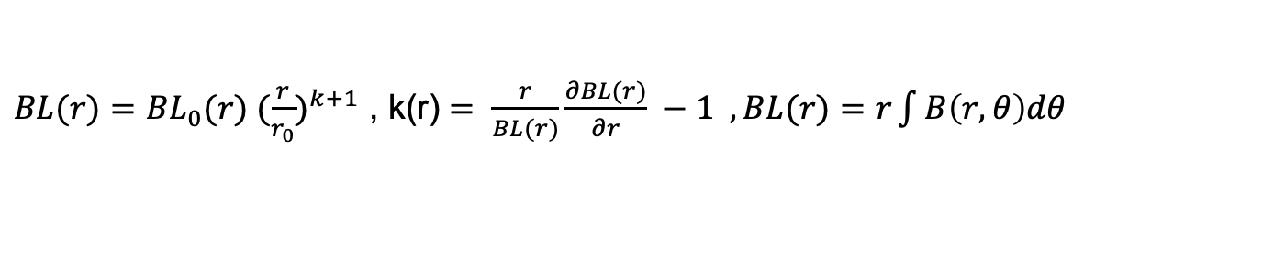
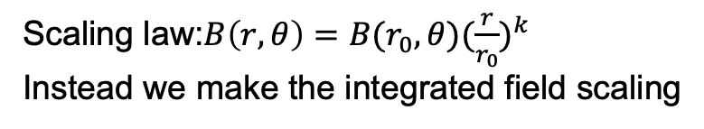
Integrated scaling law
Scaling law:$B\left(r,θ\right)=B(r_{0},{θ)(\frac{r}{r_{0}})}^{k}$
Instead we make the integrated field scaling
$BL(r)={BL}_{0}(r) {(\frac{r}{r_{0}})}^{k+1}$ , k(r) $= \frac{r}{BL(r)}\frac{∂BL(r)}{∂r} −1 ,BL(r)=r\int{B\left(r,θ\right)dθ }$
This is the same as making the average B field scaling if it’s a singlet.
Slightly different for doublet (FETS-FFA magnet talk tomorrow)
To first order the horizontal tune roughly constant
Vertical tune variation will need to be investigated later on

Slide 8
3.Geometry of magnet and coils

Slide 9
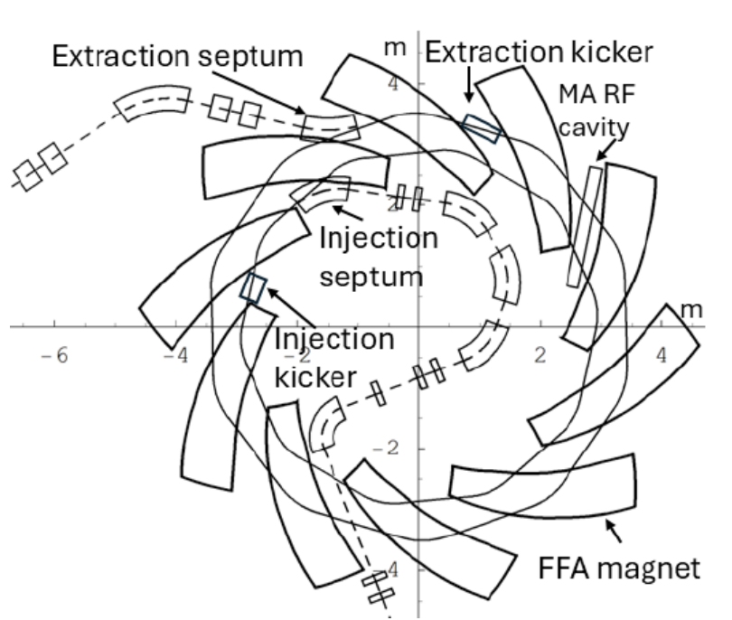
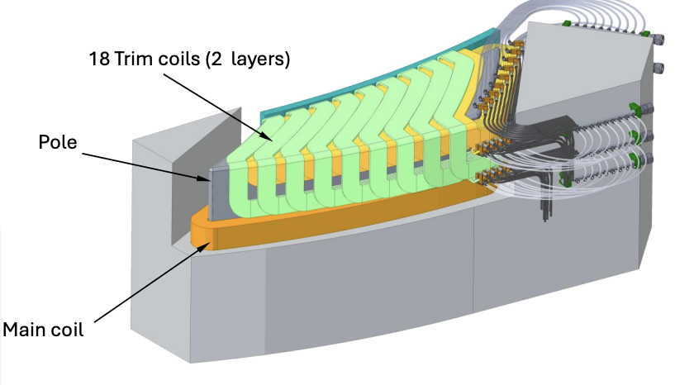
Geometry of the magnet
Spiral angle 53.9 degrees
10 fold symmetry
Full gap of iron 96 mm
Field gradient generated by radially dependent trim coils, each with a different current setting
Clive Hill, Daresbury lab

Slide 10
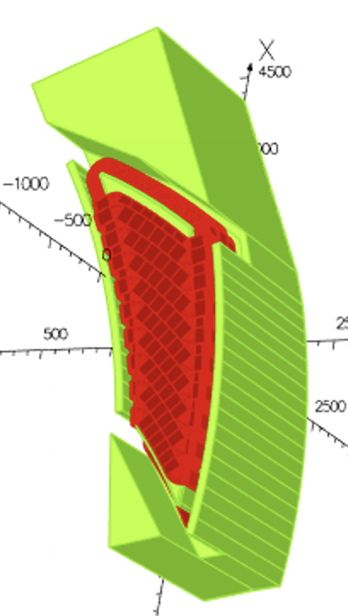
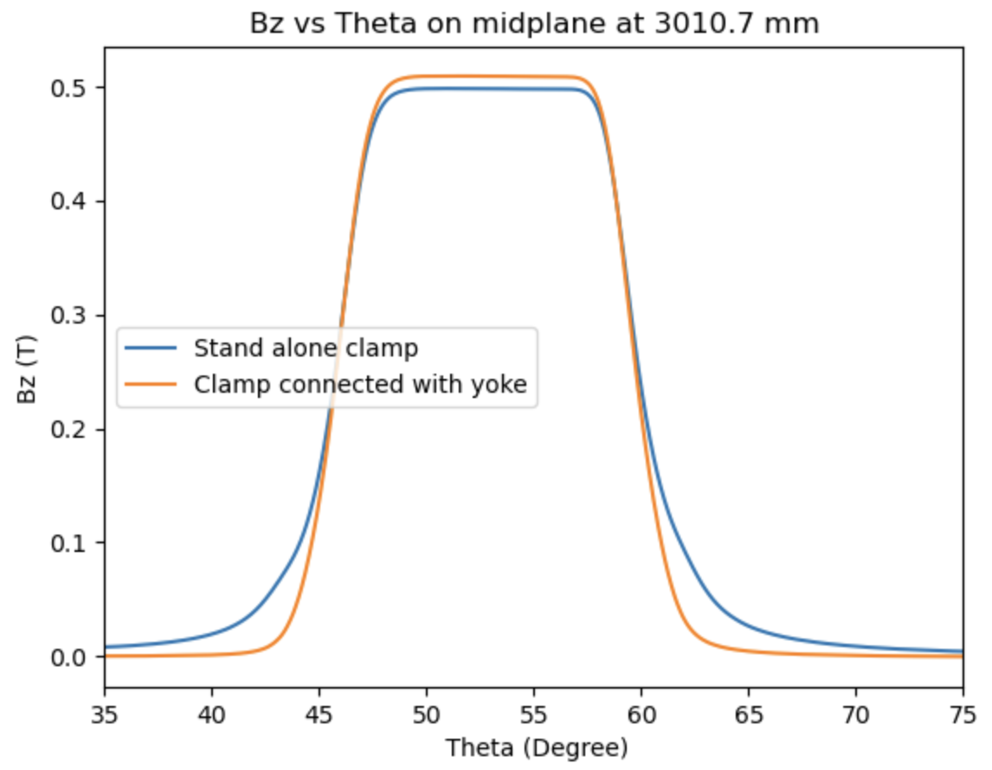
Geometry of the clamps
Clamps placed at constant angle away from the pole
Connected magnetically with the pole improves efficiency

Slide 11
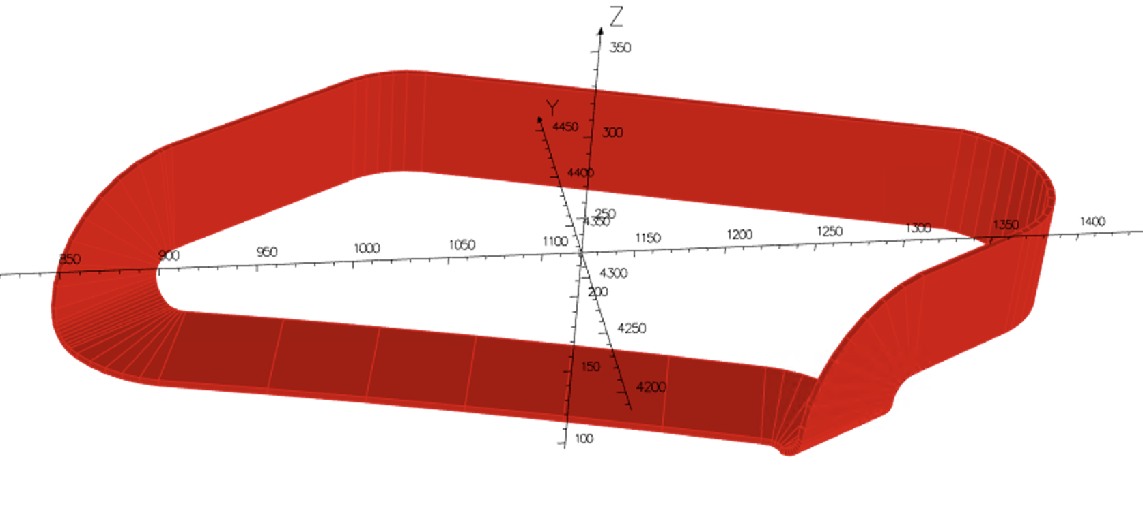
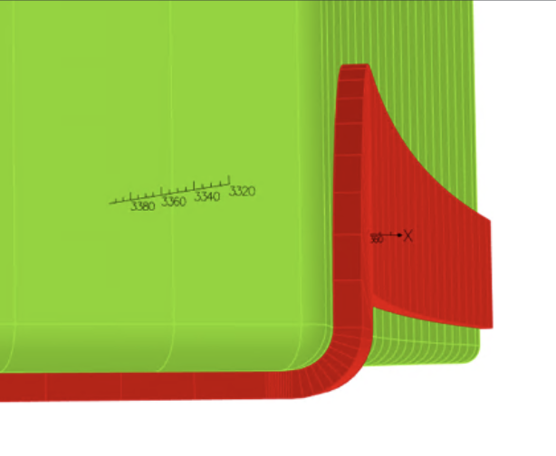
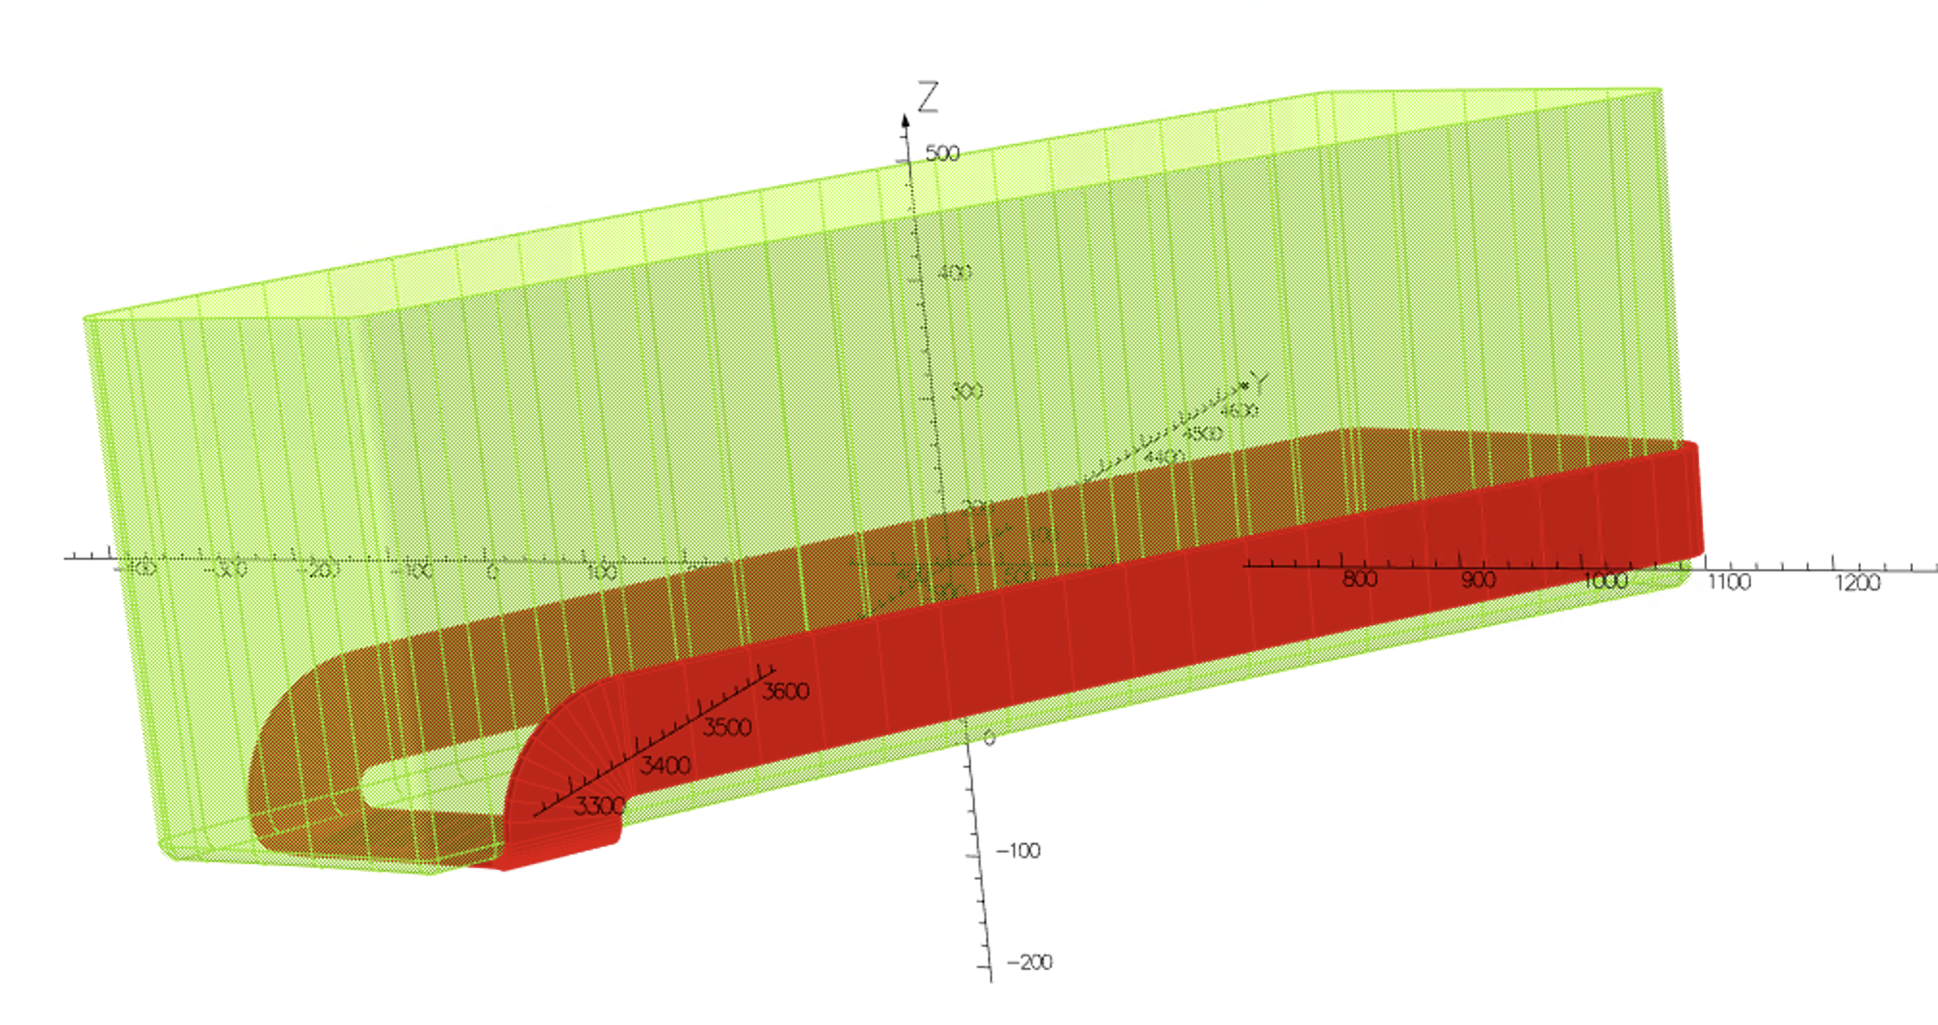
Geometry of a trim coil
The match the scaling law, the constant radius area should be as large as possible
The return part shaped accordingly to the pole to minimize space taken up
Modelled in Opera 3D via Metaopera¹
1 (T. Planchet, H.W.Koay, J-B Lagrange and T.J.Kuo)

Slide 12
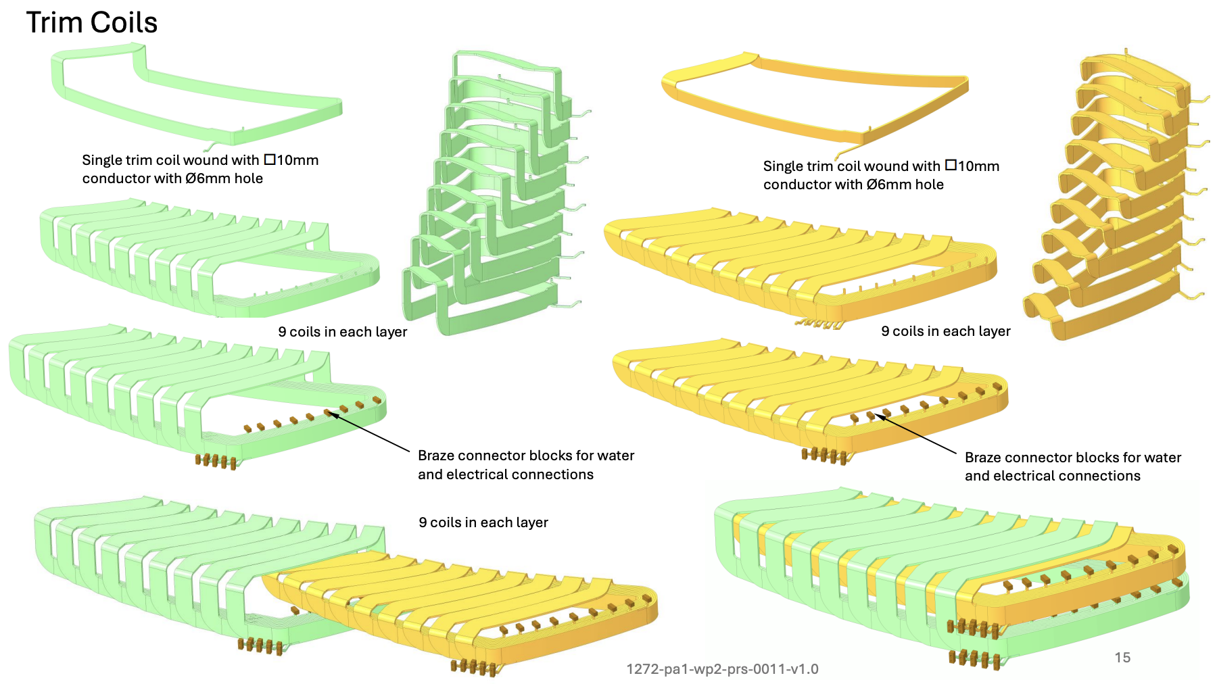
Geometry of trim coils stacked together
Cross the pole face at different radius, returns stack longitudinally
Two vertical layers slot into each other
Clive Hill, Daresbury lab

Slide 13
4.Optimisation of currents

Slide 14
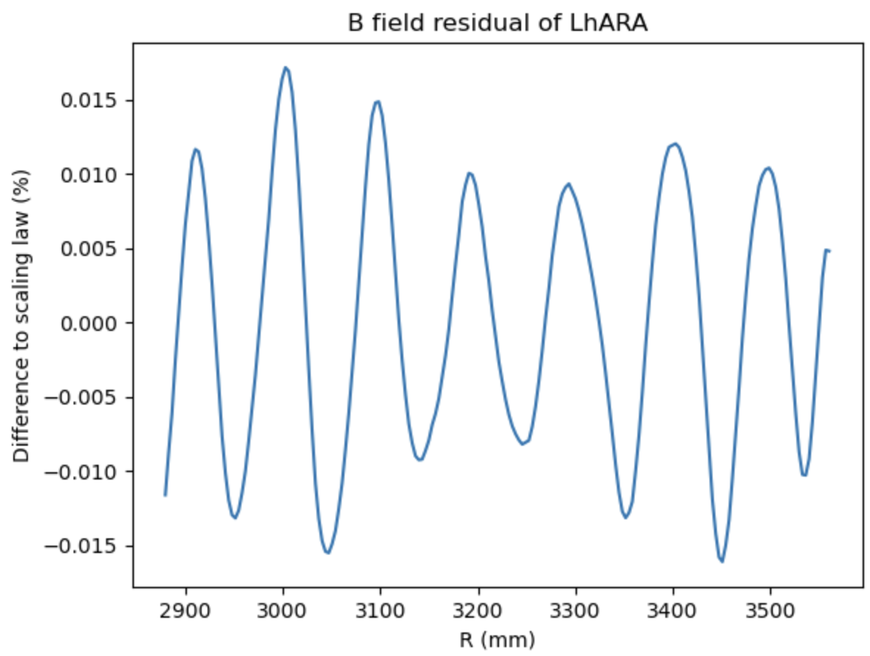
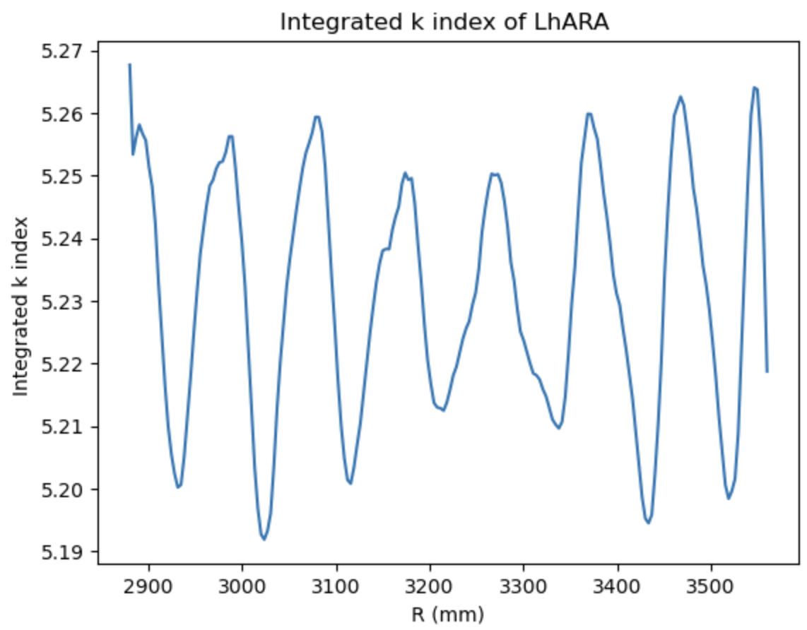

Field error, 127 MeV extraction energy
$$BL={BL}_{0} {(\frac{r}{r_{0}})}^{k+1}$$
127 MeV extraction energy: BL₀ : 1.44 Tm , r₀ :3.477m, k : 5.23
Oscillation in residuals due to the discretization of trim coils

Slide 15
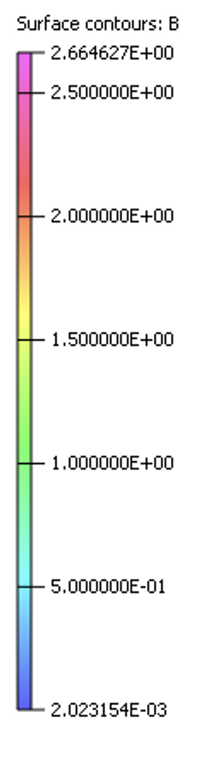
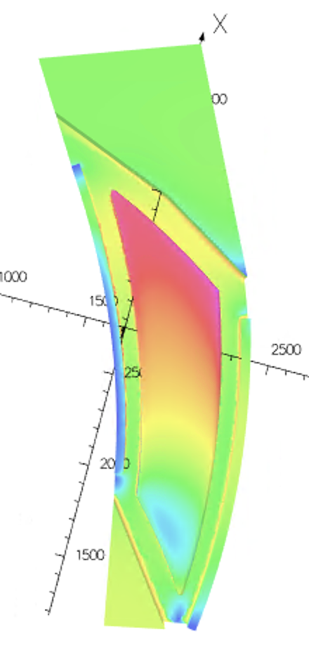
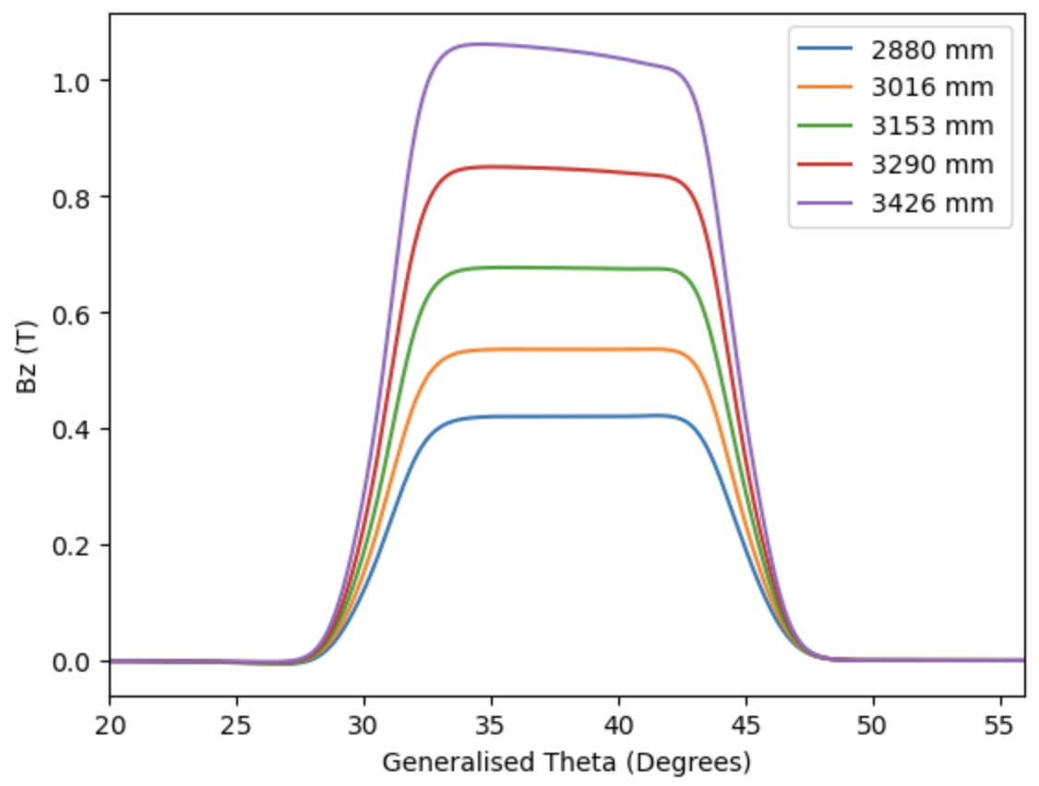
Saturation level
Part of the pole reaching 2.66T
Flat top of field distorted at higher radii due to
saturation and will have an impact on the tune
(Plotted in a coordinate that undoes the spiral angle)

Slide 16
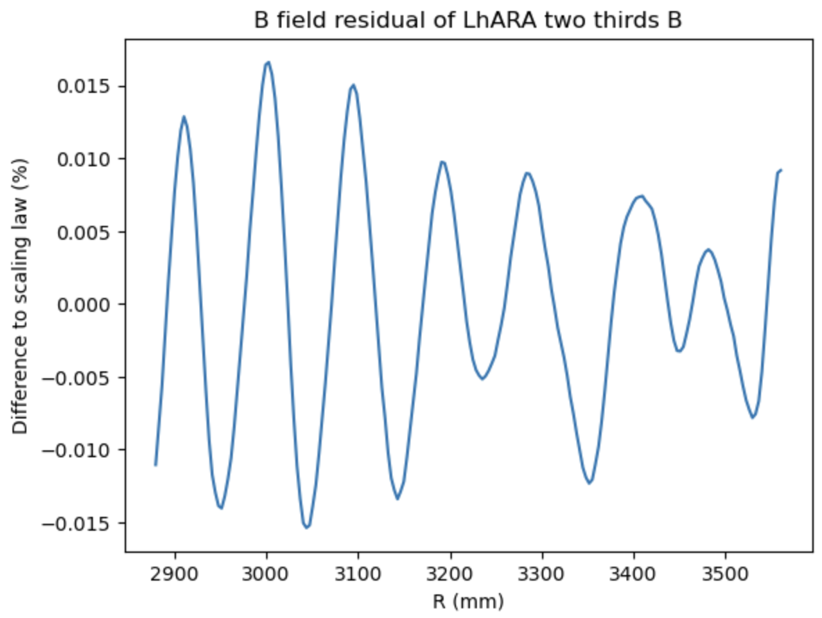
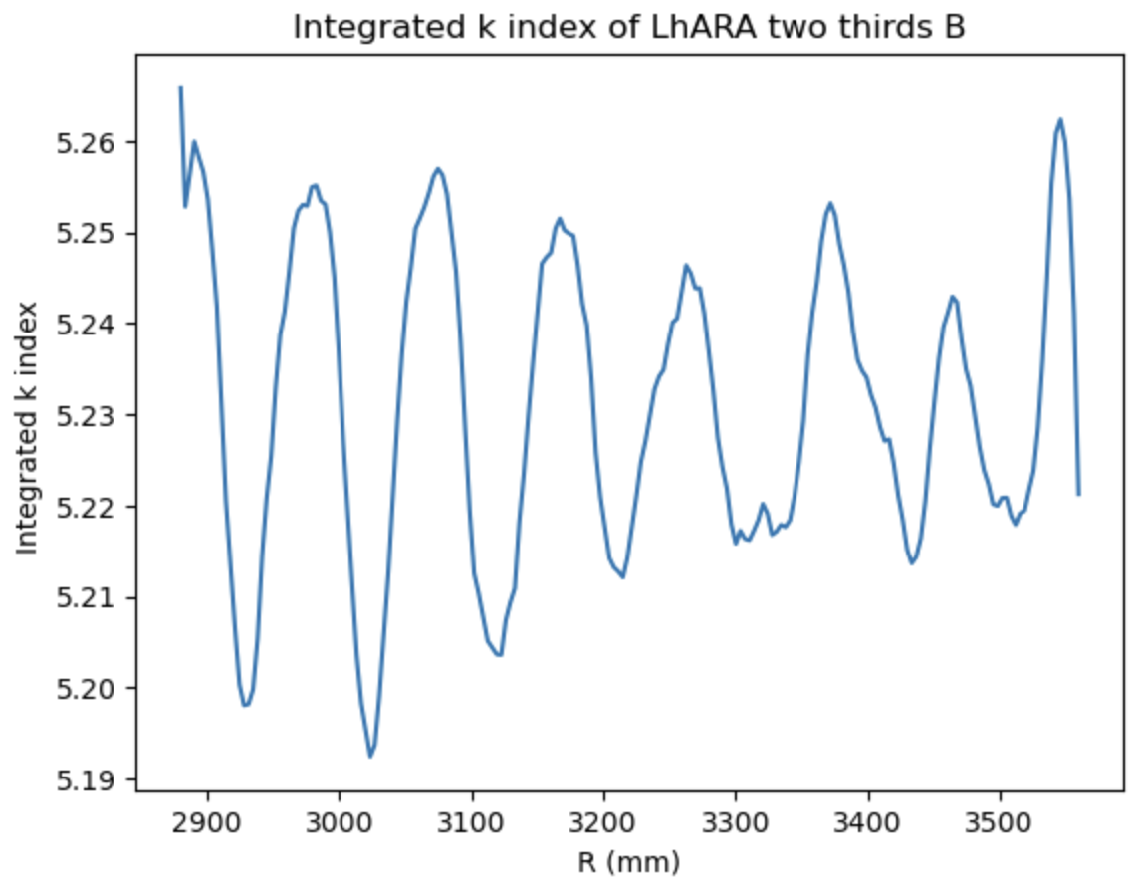
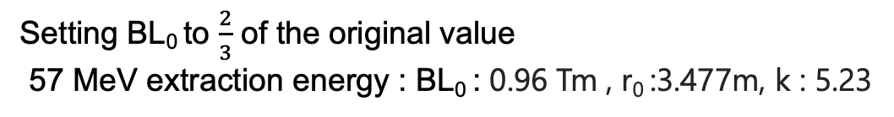

Field error, 57 MeV extraction energy
Setting BL₀ to $\frac{2}{3}$ of the original value
57 MeV extraction energy : BL₀ : 0.96 Tm , r₀ :3.477m, k : 5.23
$$BL={BL}_{0} {(\frac{r}{r_{0}})}^{k+1}$$

Slide 17
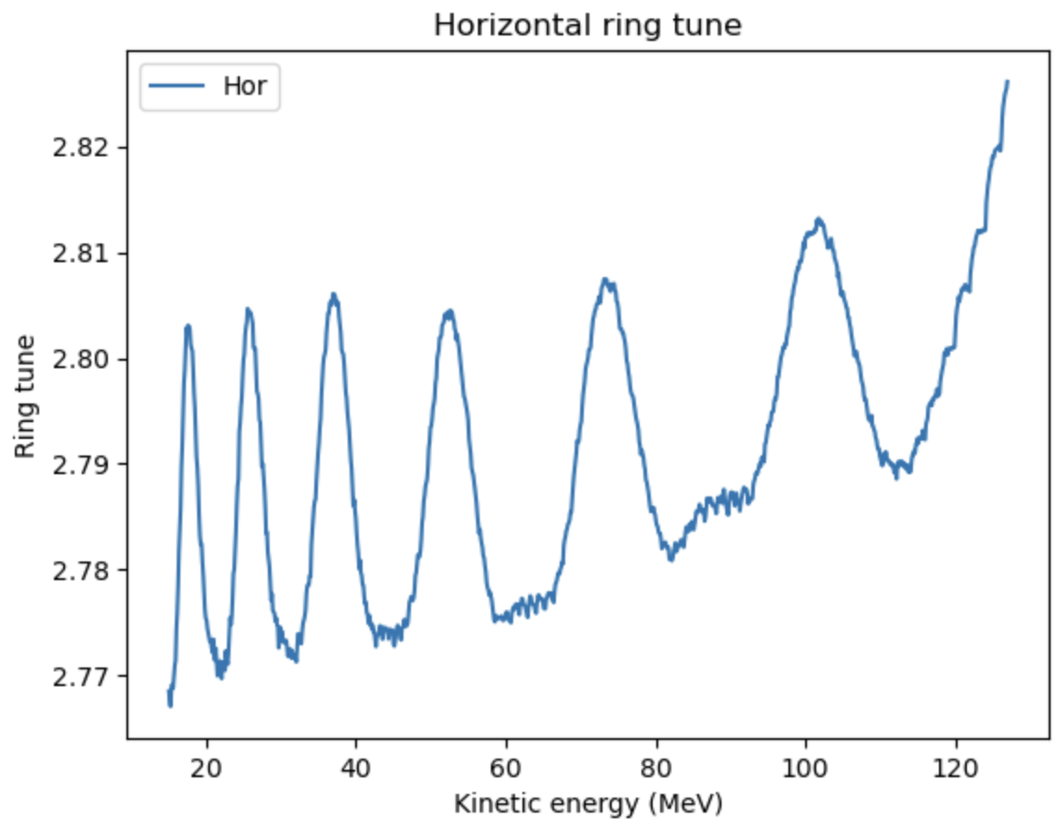
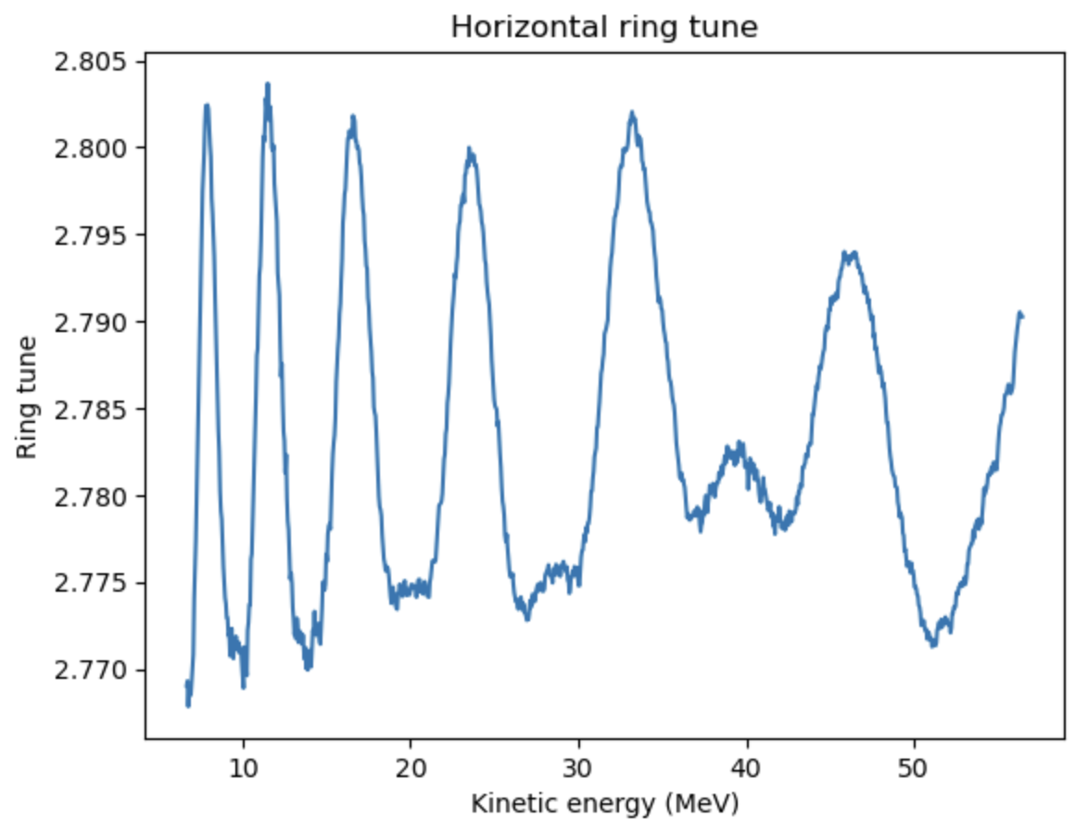
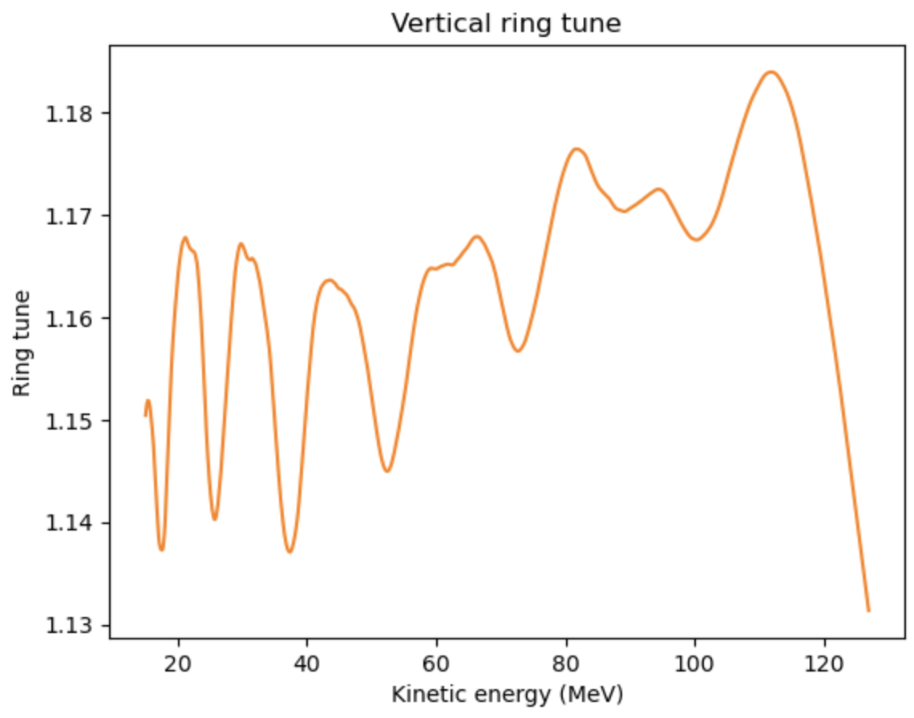
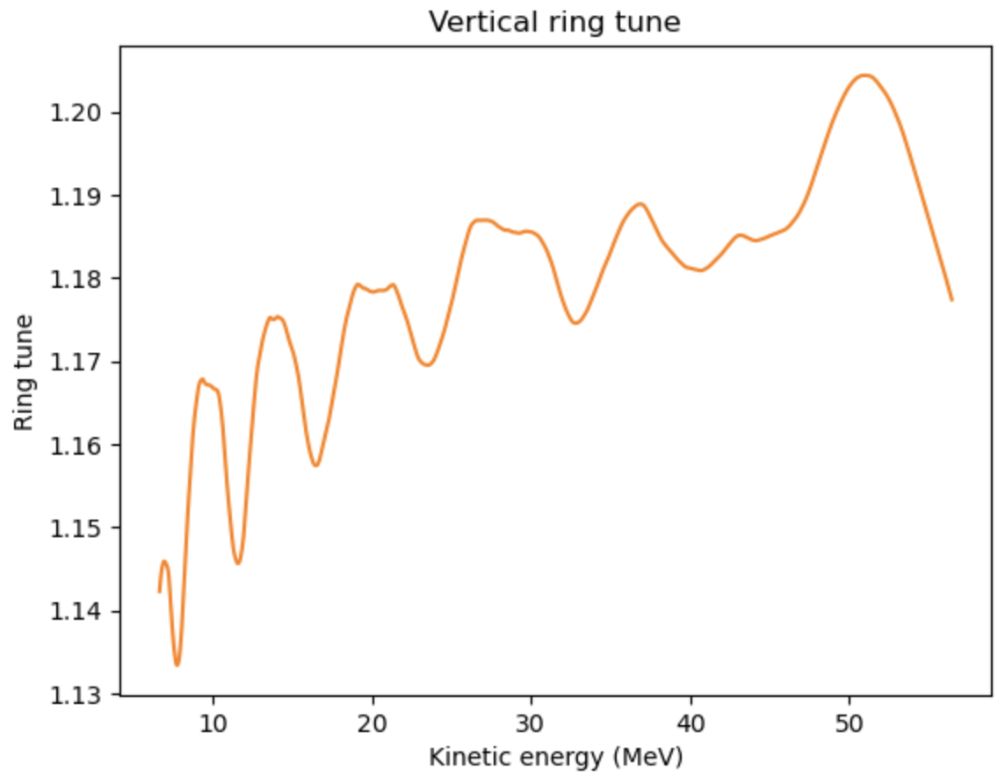
Ring tune
127 MeV extraction energy
57 MeV extraction energy
Some variation of horizontal
tune at 127 MeV
Vertical tune variation to be
minimized by shaping the field
clamps

Slide 18
5. Adjusting fringe field

Slide 19
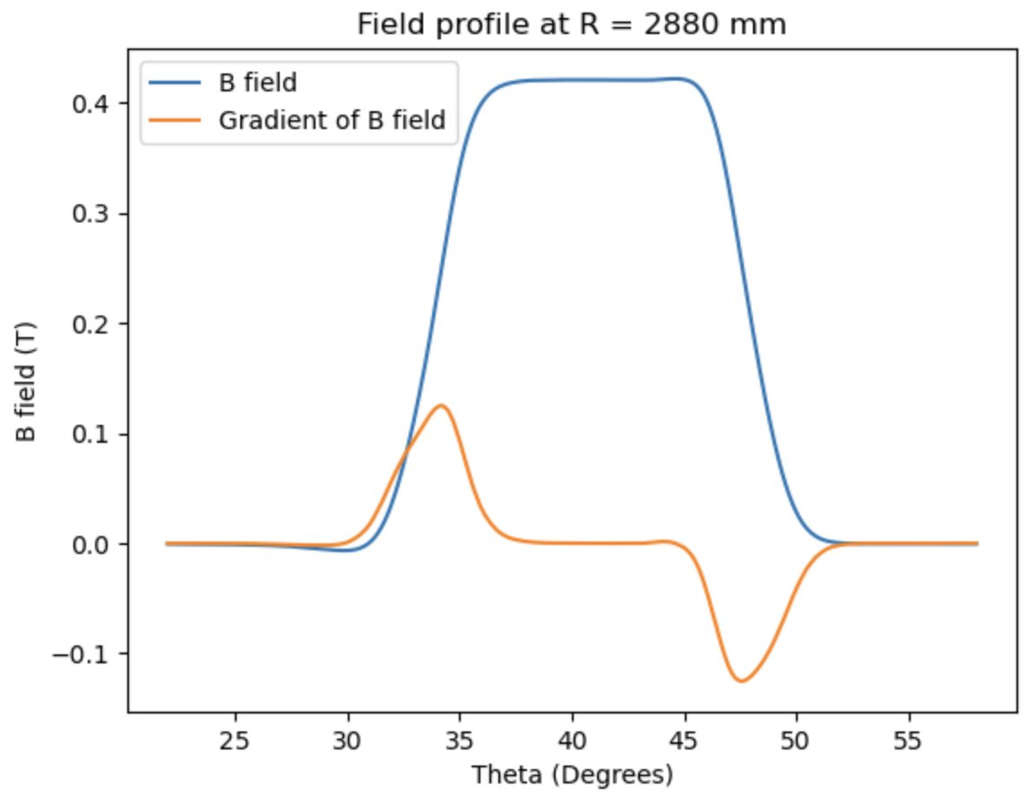
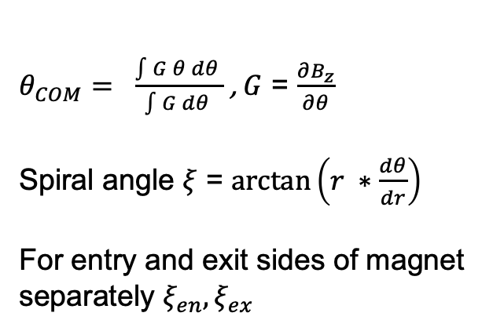
Spiral angles
Spiral angle of the magnet may not be the same as the spiral angle of the B field.
Calculate the integrated average gradient of the field to define magnetic field boundary
$θ_{COM}= \frac{\int{G θ dθ }}{\int{G dθ }}$ , $G$ = $\frac{∂B_{z}}{∂θ}$
Spiral angle $ξ$ = $\arctan\left(r ∗\frac{dθ}{dr}\right)$
For entry and exit sides of magnet separately $ξ_{en},ξ_{ex}$

Slide 20
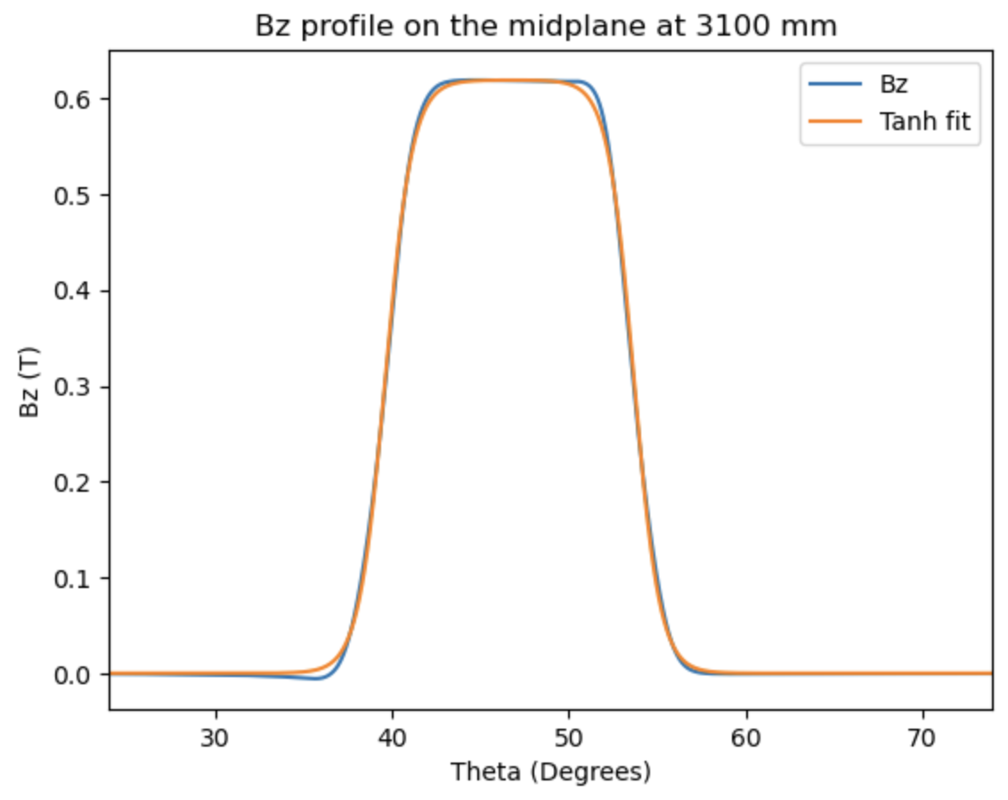
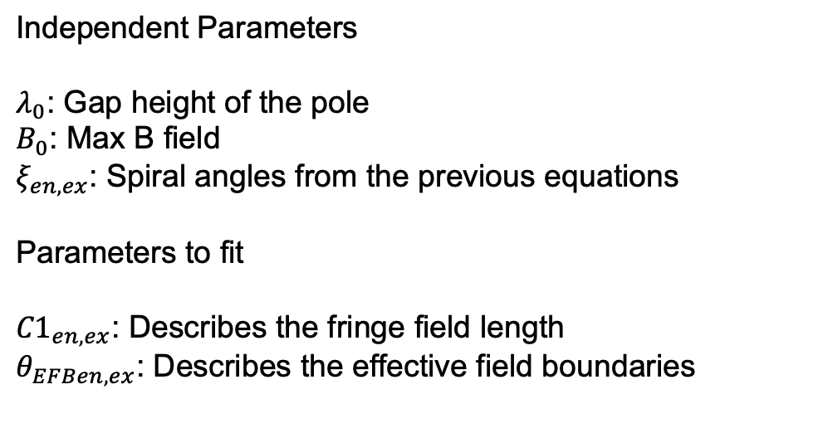
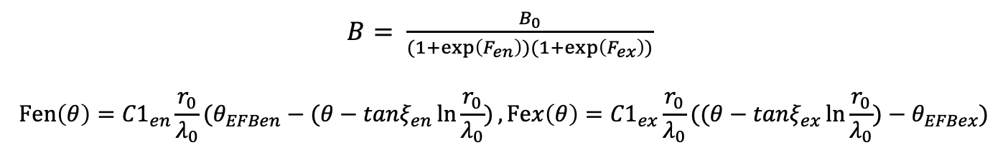
Tanh model of fringe field
This describes the fringe field length of the magnet at the entrance and exit separately.
The larger C1 is the shorter the fringe field
$B= \frac{B_{0}}{(1+\exp\left(F_{en}\right))(1+\exp\left(F_{ex}\right))}$
$$Fen\left(θ\right)={C1}_{en}\frac{r_{0}}{λ_{0}}(θ_{EFBen}−(θ−tanξ_{en}\ln{\frac{r_{0}}{λ_{0}})},Fex\left(θ\right)={C1}_{ex}\frac{r_{0}}{λ_{0}}{((θ−tanξ_{ex}\ln{\frac{r_{0}}{λ_{0}})}−θ}_{EFBex})$$
$$\text{Independent} \text{Parameters}$$
$λ_{0}$: Gap height of the pole
$B_{0}$: Max B field
$ξ_{en,ex}$: Spiral angles from the previous equations
$\text{Parameters}$ to fit
${C1}_{en,ex}$: Describes the fringe field length
$θ_{EFBen,ex}$: Describes the effective field boundaries

Slide 21
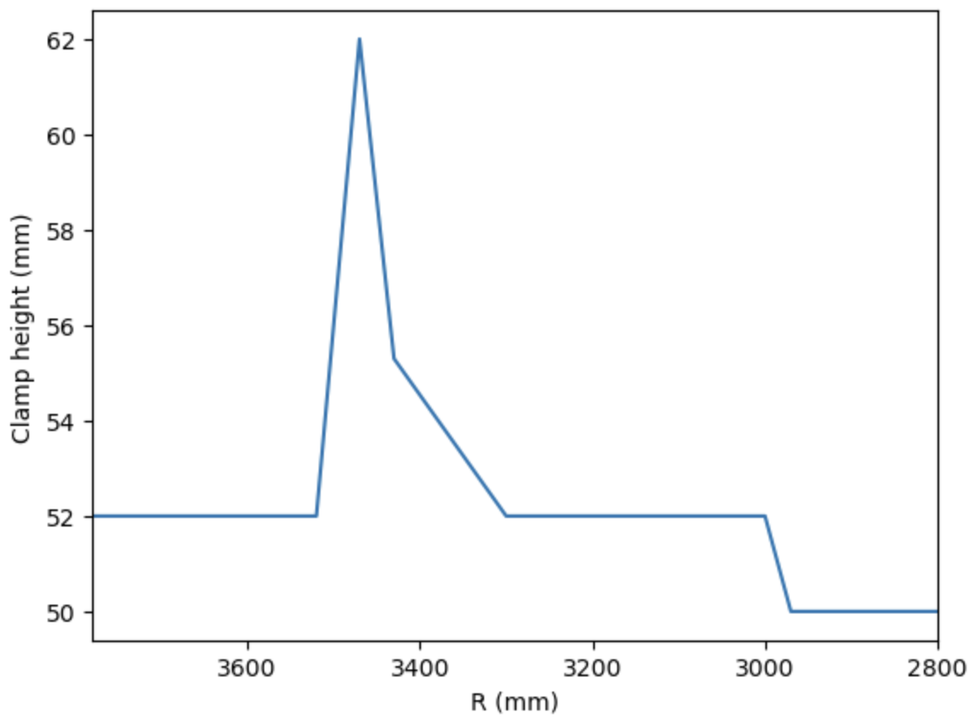
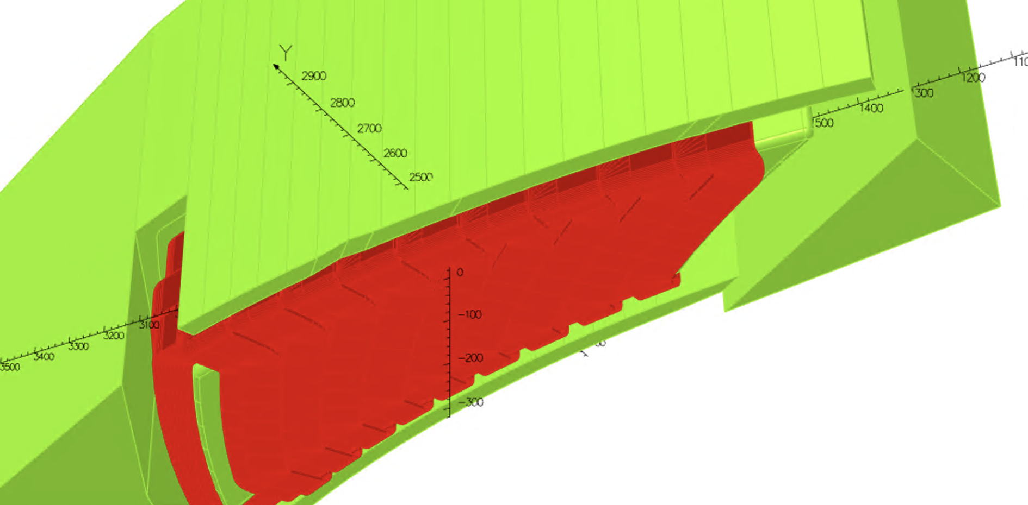
Clamp height optimisation
Vary the clamp height to achieve better tune spread. Iterations were done with tune
spread as the target.

Slide 22
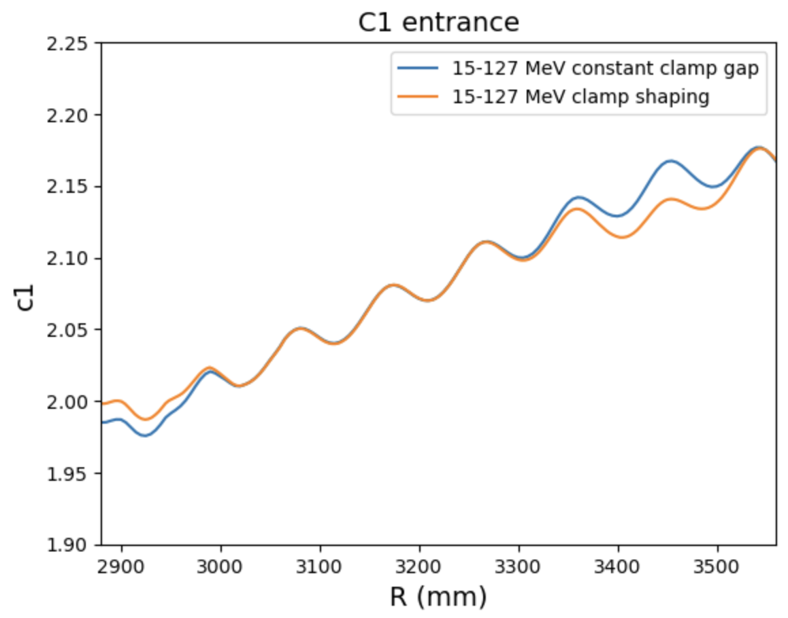
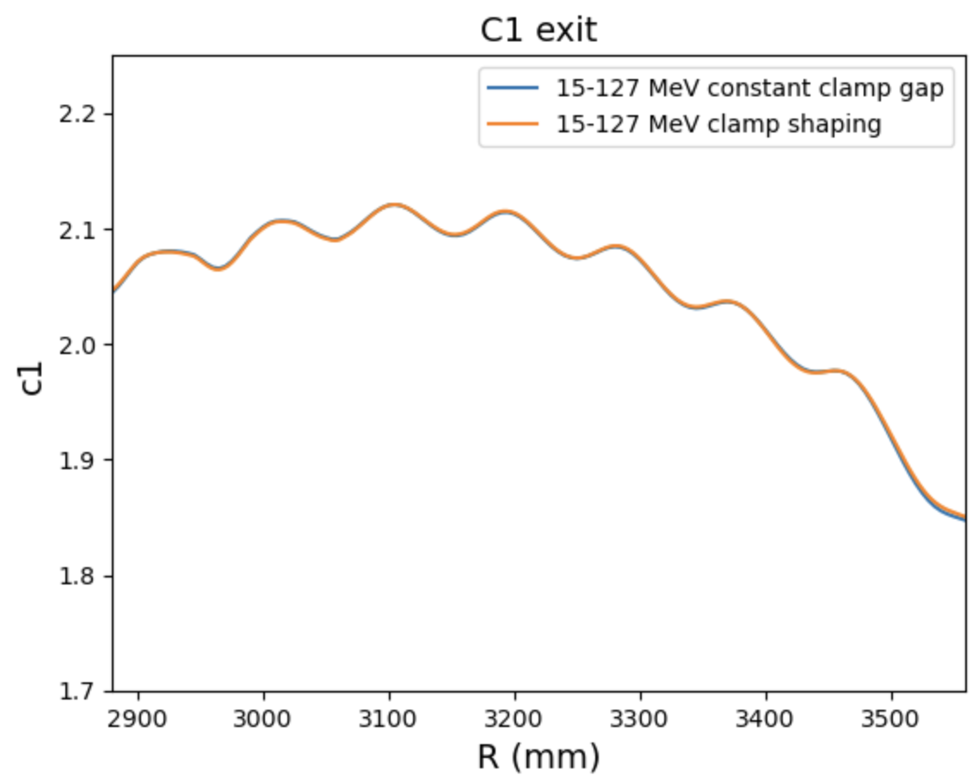
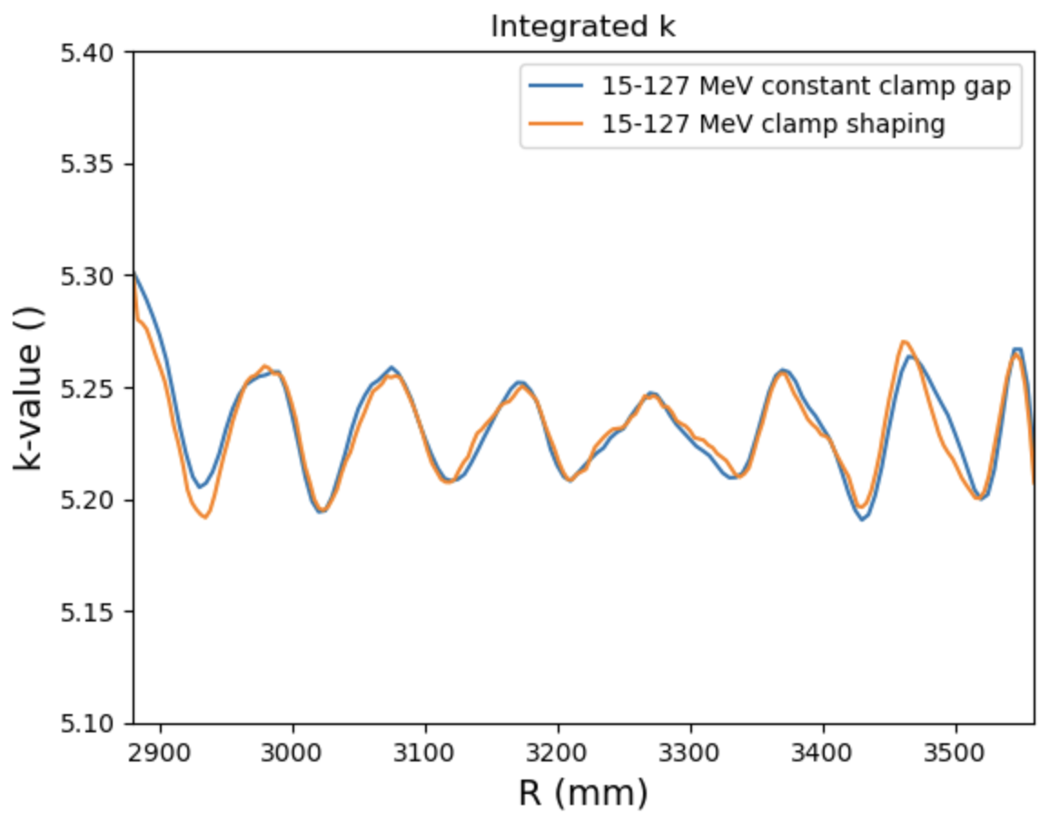
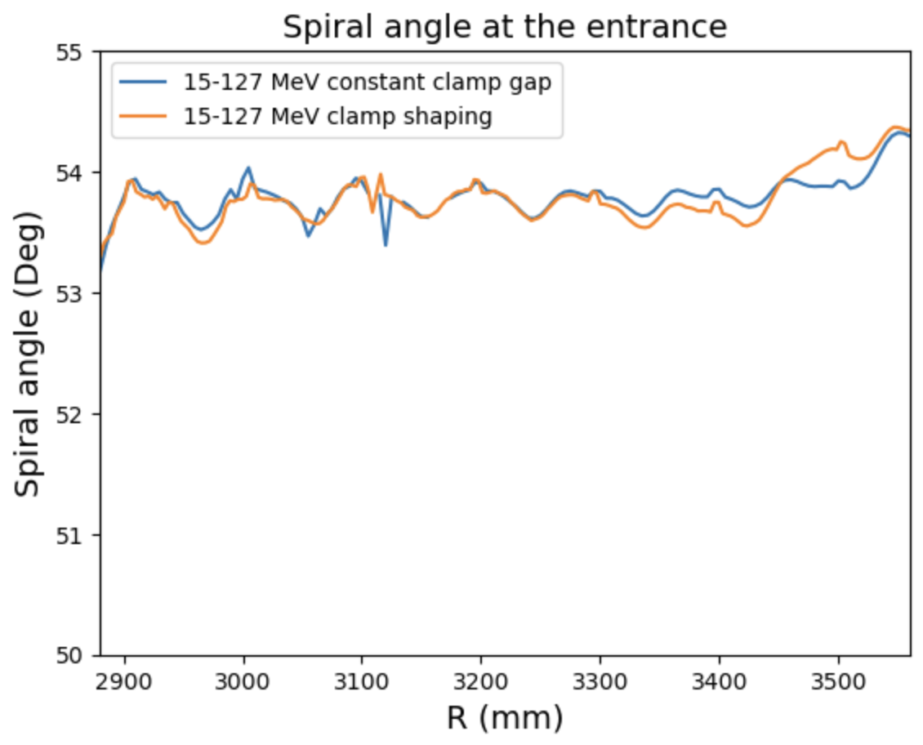
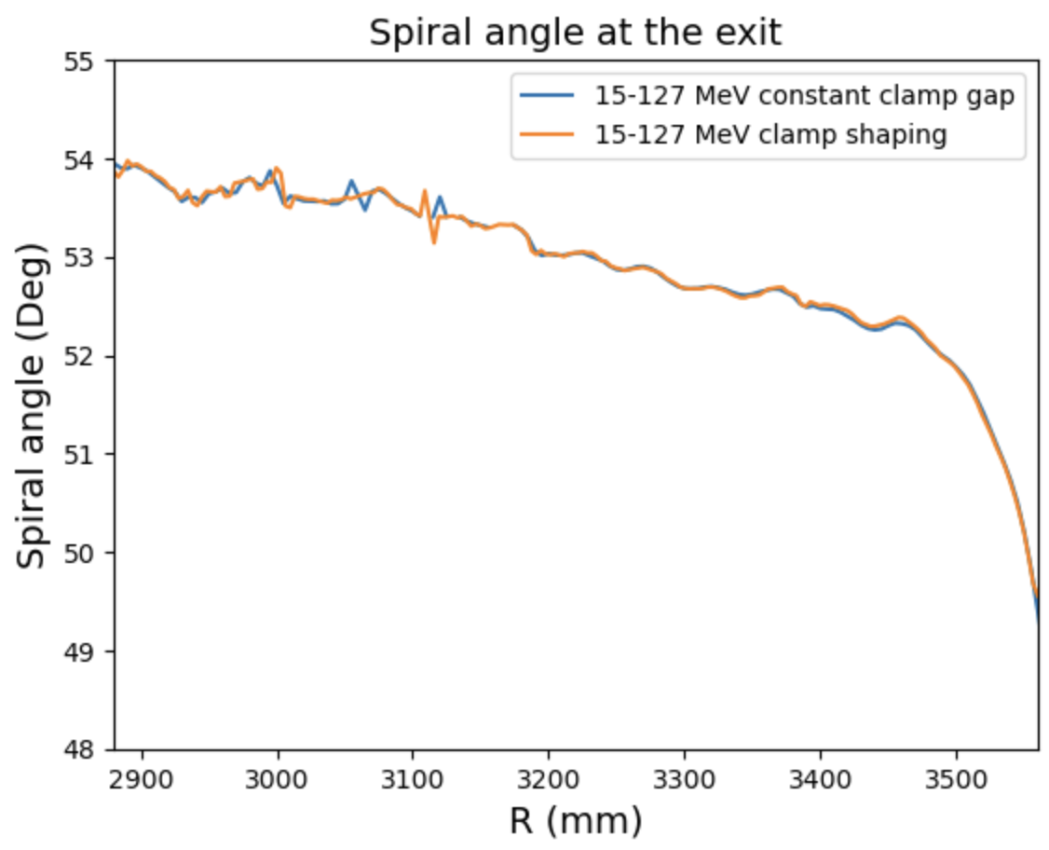
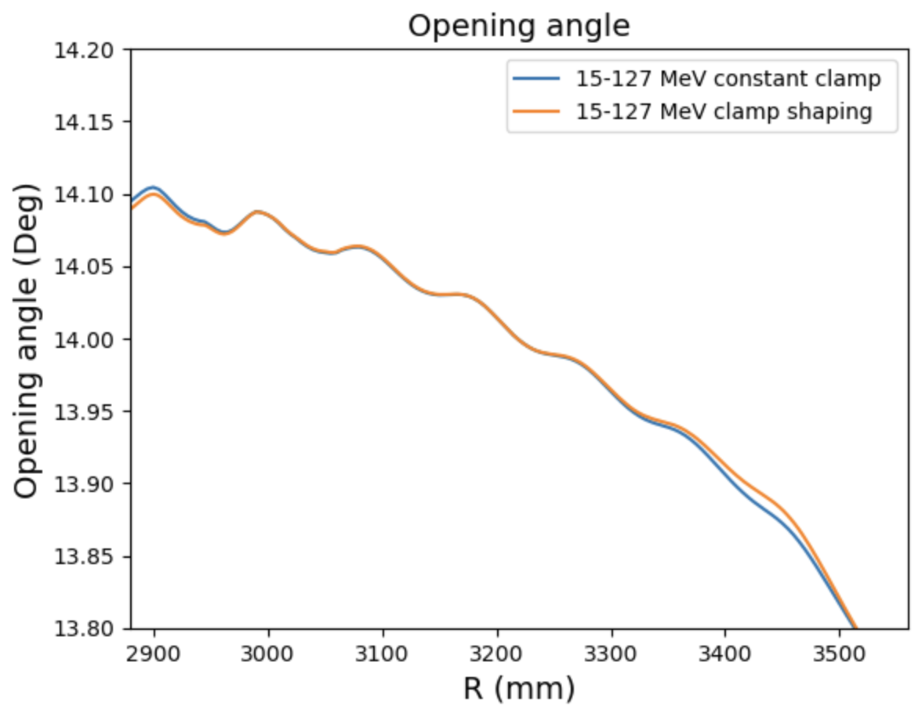
Fringe field parameters, 127 MeV extraction energy
Clamp shaped with tune as target
Fringe field parameters calculated for sanity check
Comparing the coefficients before and after clamp shaping

Slide 23
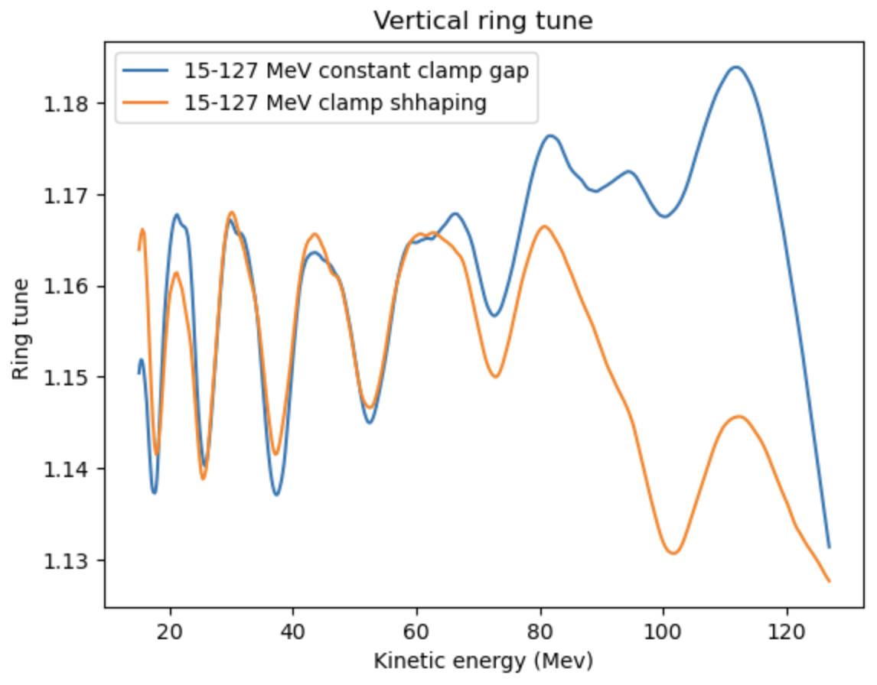
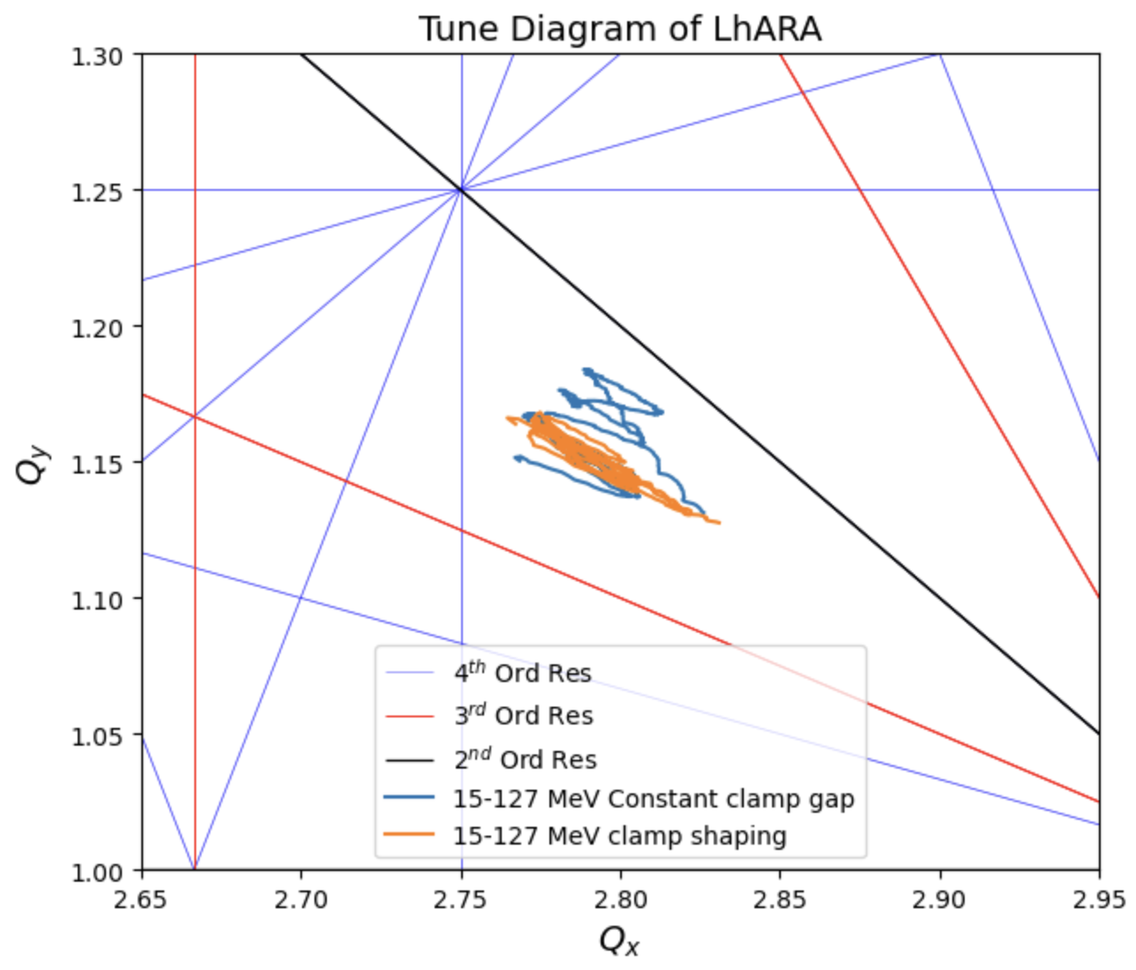
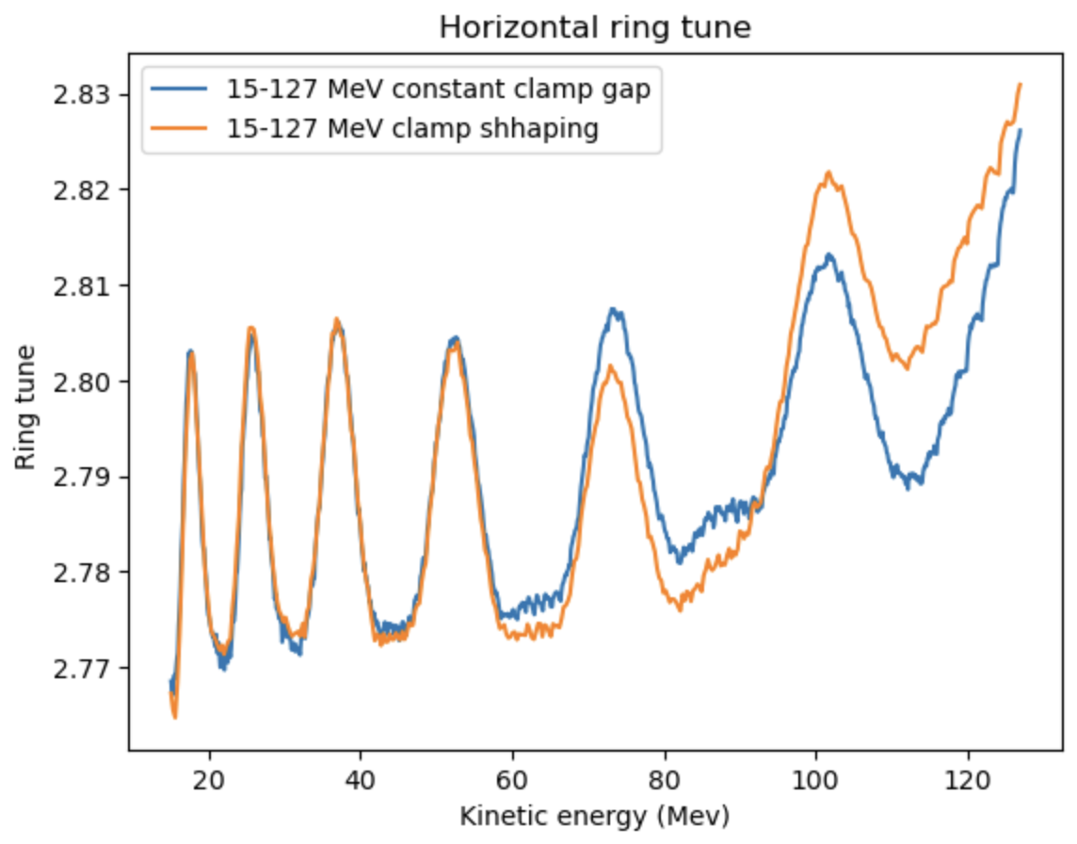
Ring tune, 127 MeV extraction energy
(Not all the resonances plotted are systematic)

Slide 24
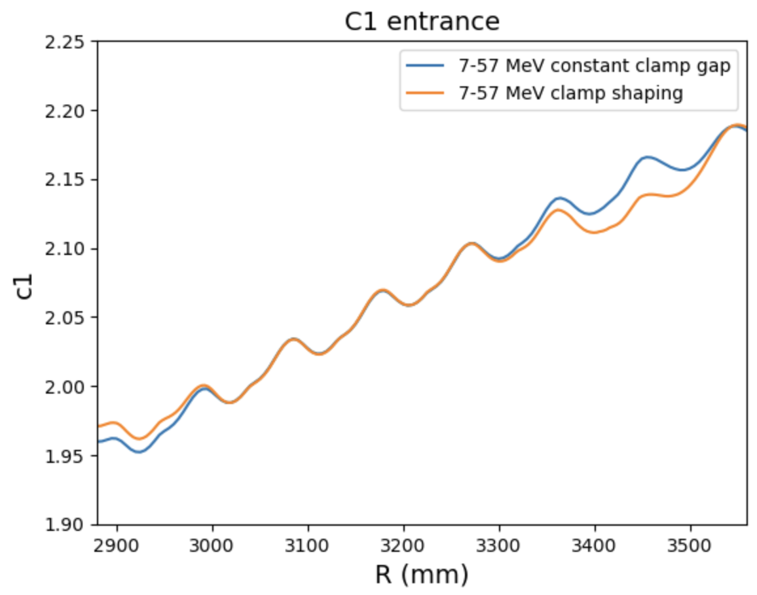
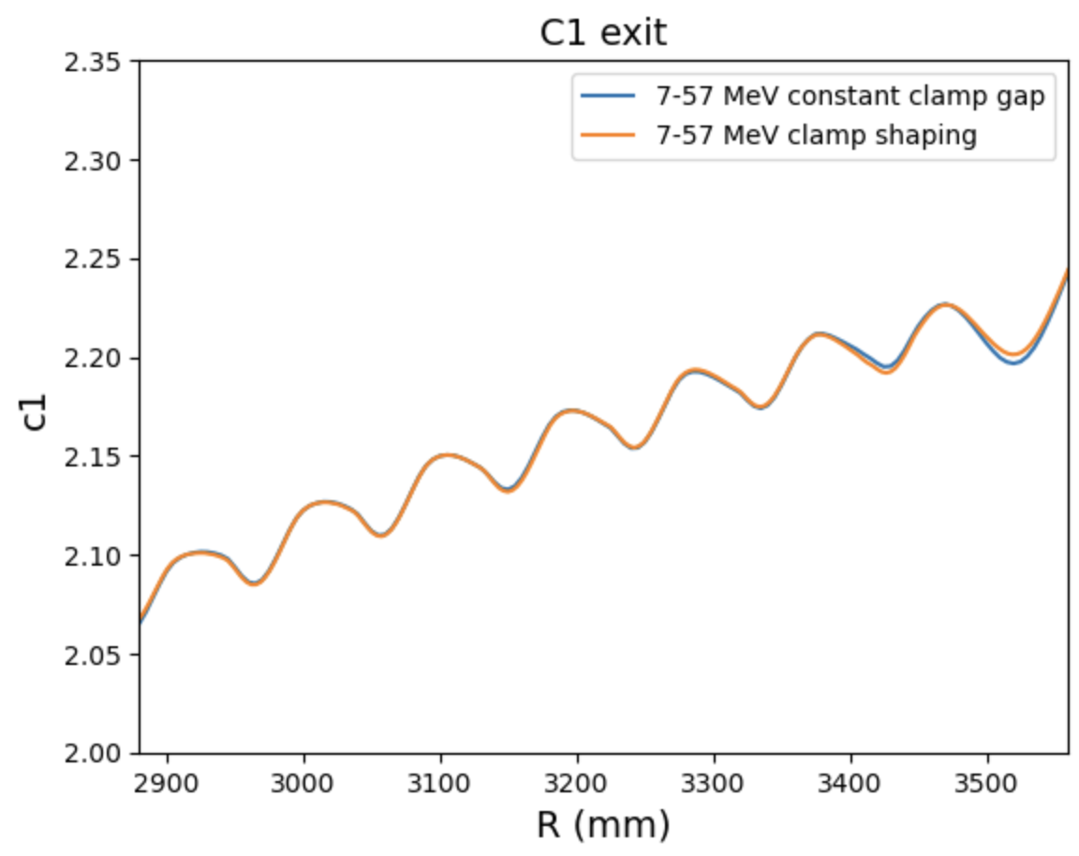
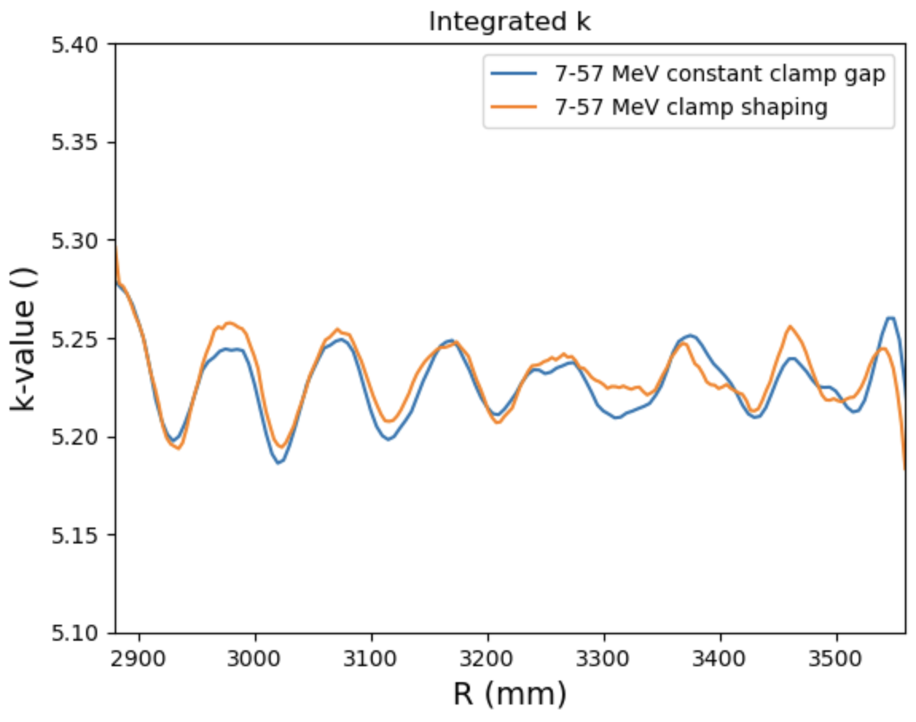
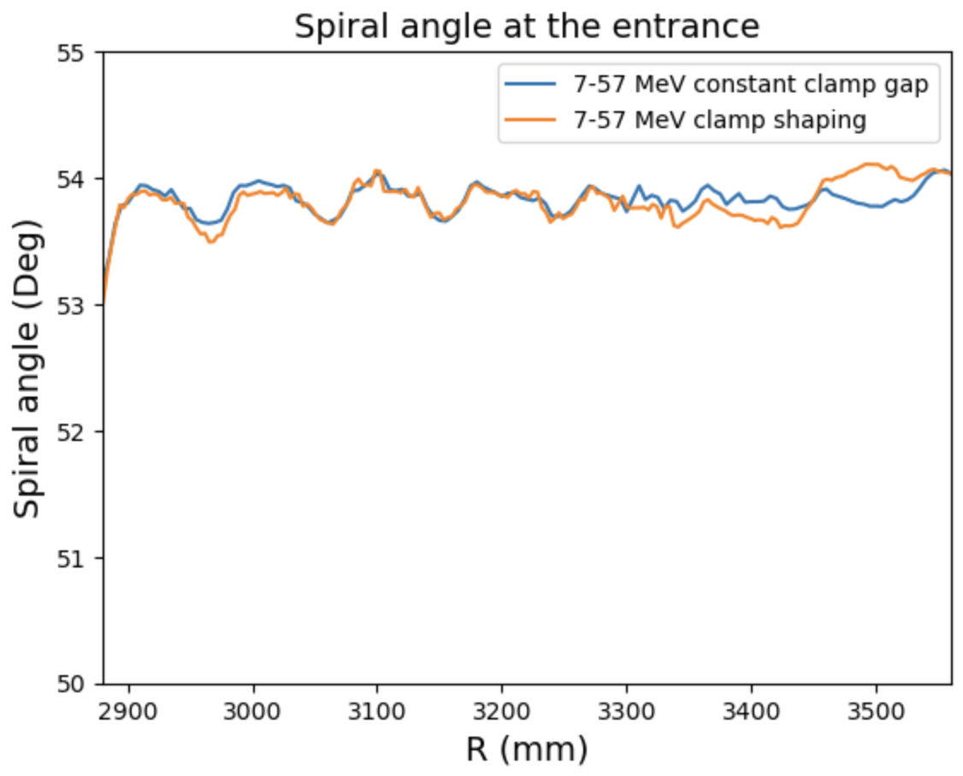
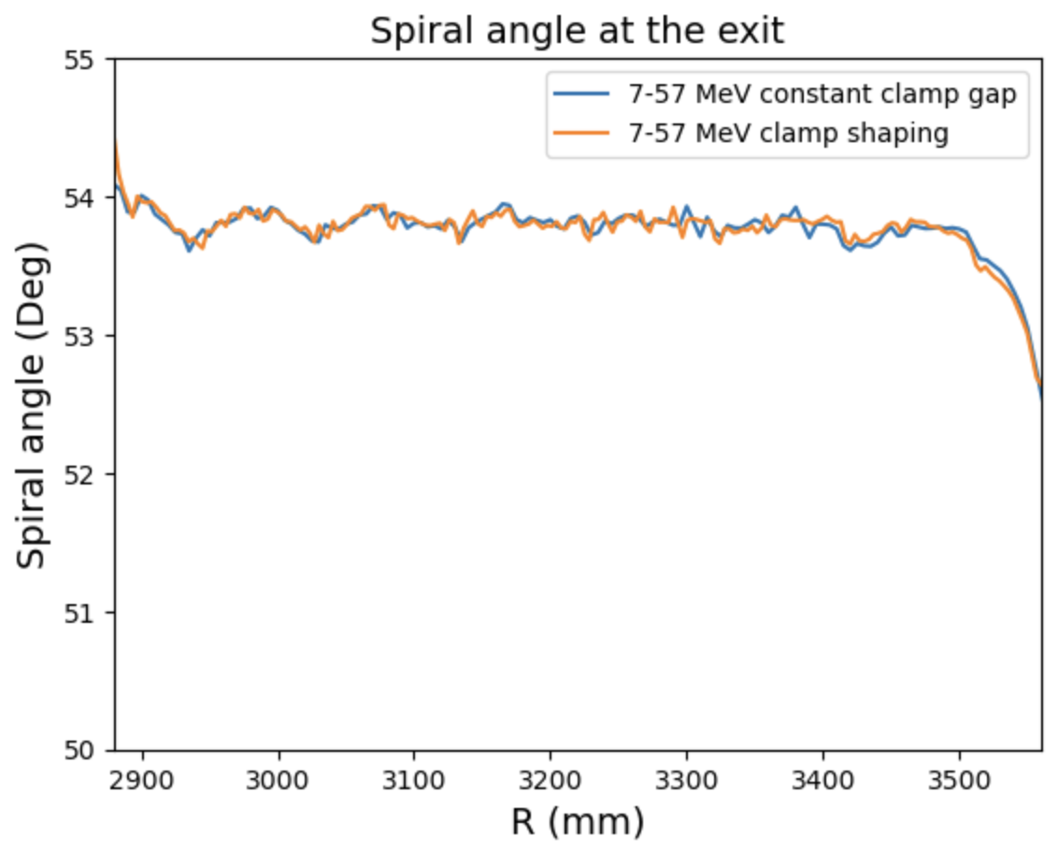
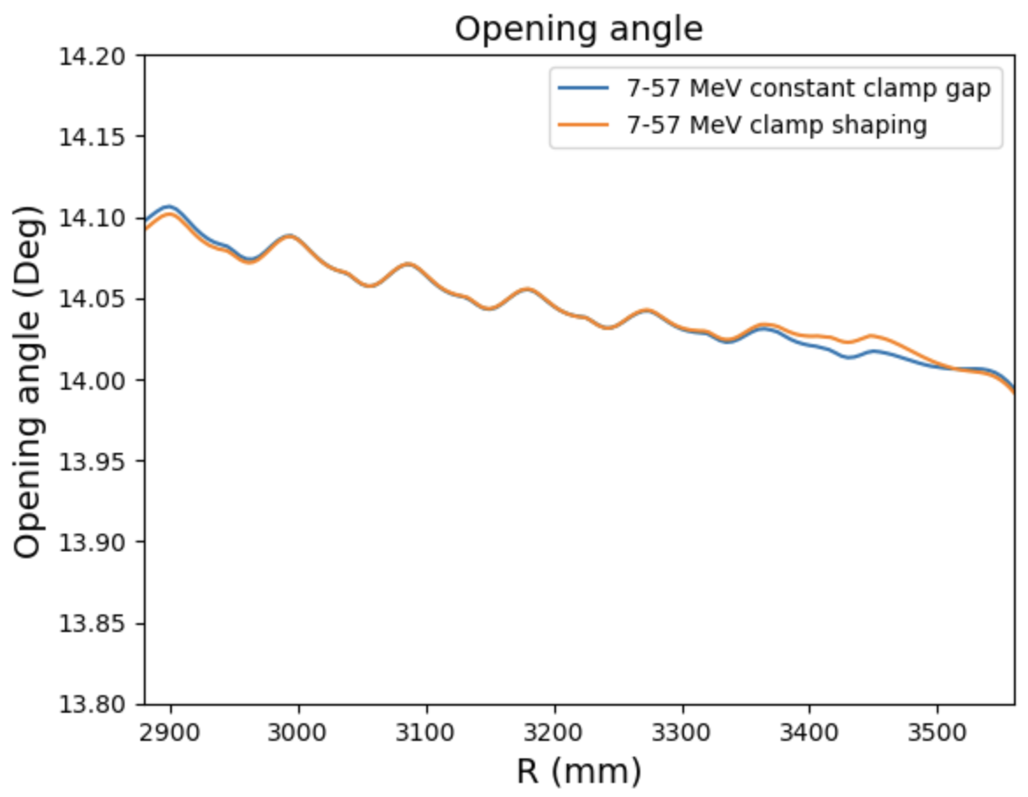
Fringe field parameters, 57 MeV extraction energy

Slide 25
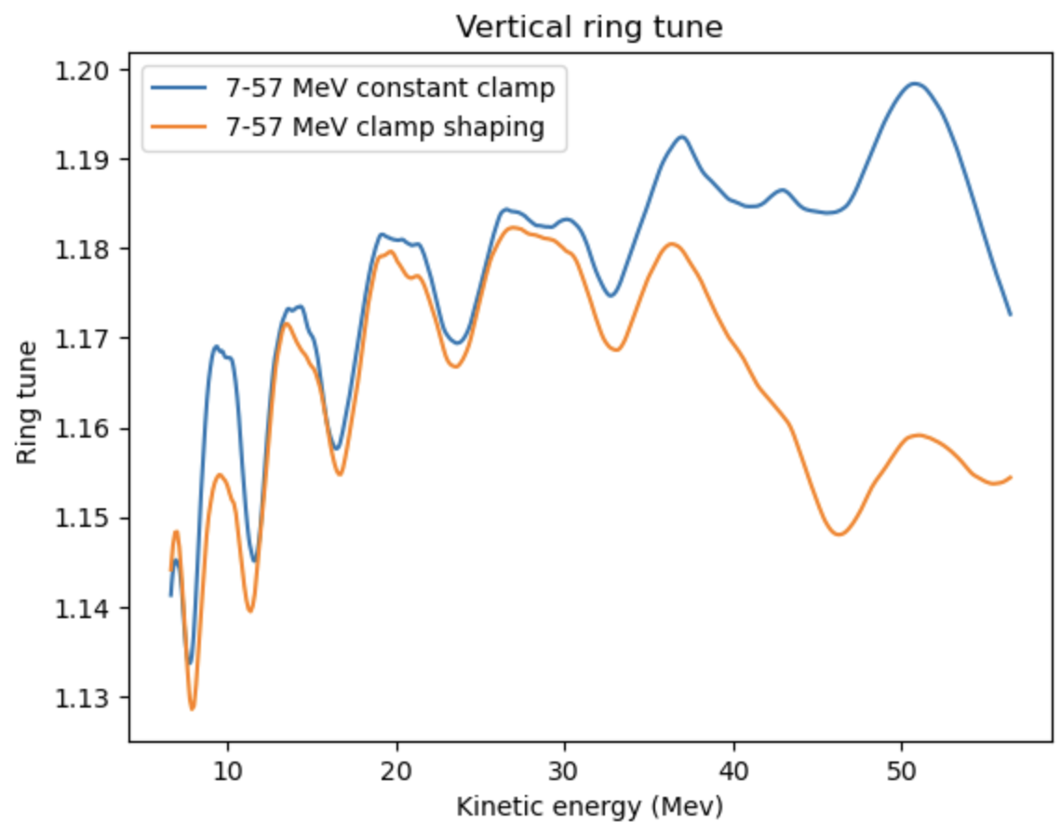
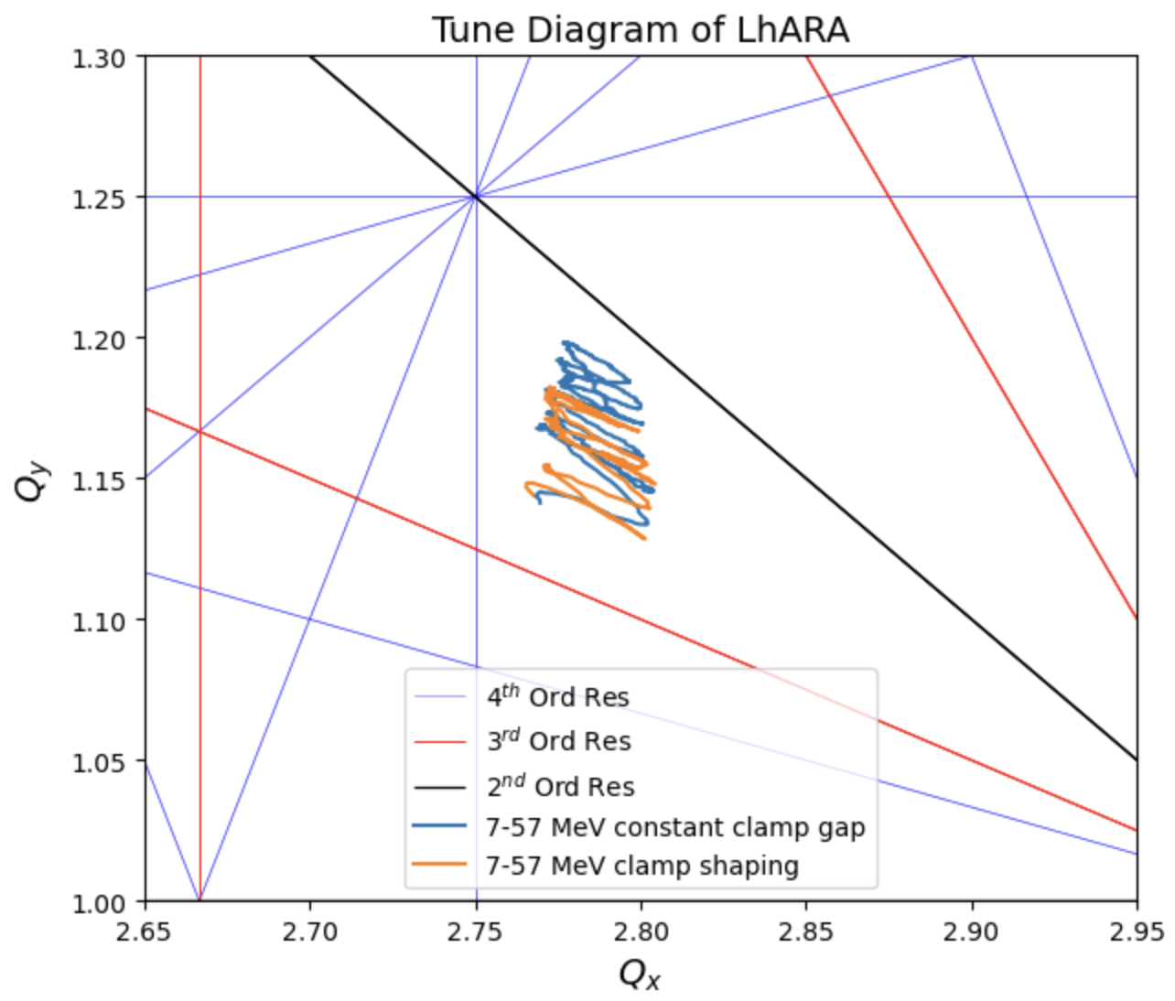
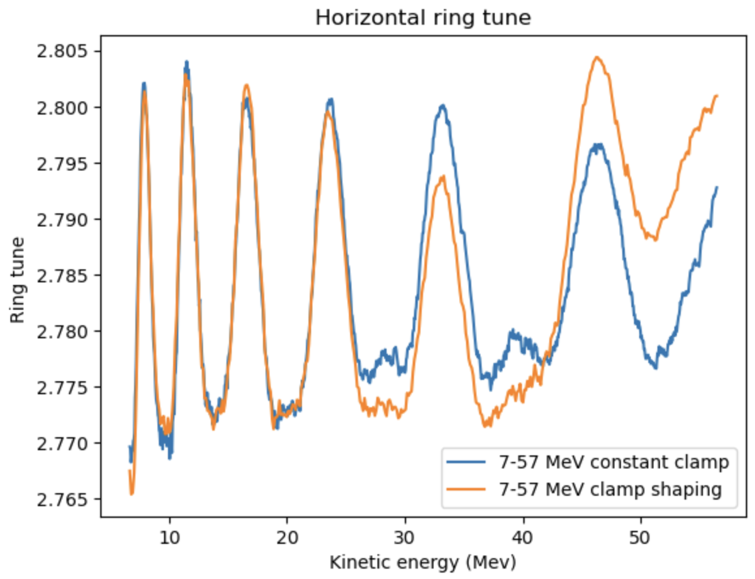
Ring tune, 57 MeV extraction energy

Slide 26
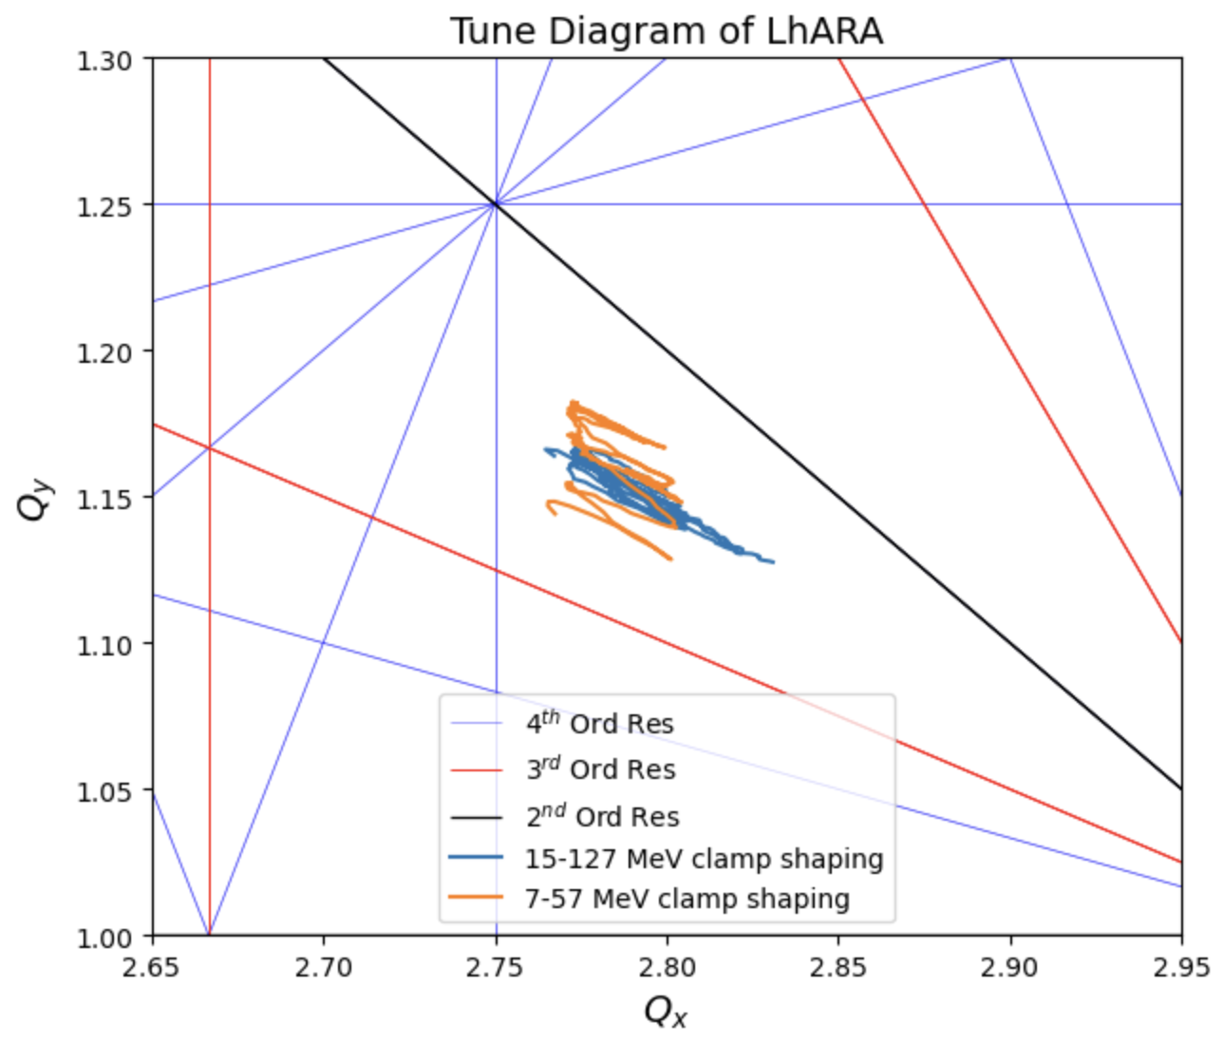
Final results

Slide 27
Conclusion
+/- 0.035 variation in k achieved with the trim coils set up
Clamp shape optimized to reduce vertical tune variation at 127 MeV extraction energy
Working tune for two different extraction energies (57, 127 MeV) stay at the same point
Tune spread in both cases are small enough to avoid any resonance up to fourth order

