Slide 1
Faraday cup on the FETS-FFA
-Sushanta Sapkota
B.Sc. (Hons) Physics, UOP,
Industrial Placement student, ISIS-RAL

Slide 2
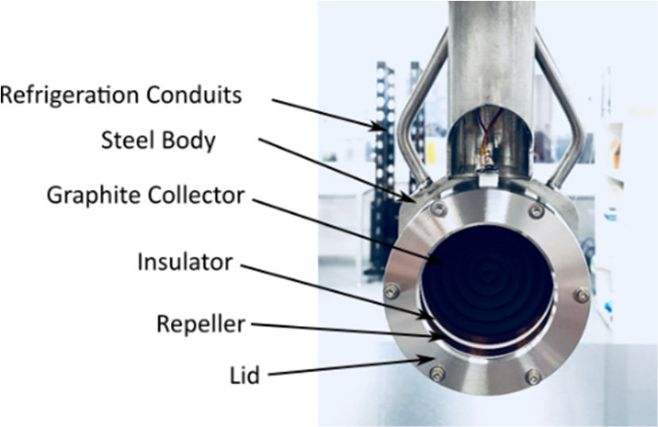
FETS-FFA Faraday Cup
Faraday cup is a shielded insulated cup thick enough to catch the charged beam and measure the resulting current from it.
For FETS-FFA, it is to be installed on the FETS beam line to identify the injection profile of H- beam (max intensity of 3E11 ppp).
A. R. Páramo et al, Design of the ESS MEBT Faraday Cup, IBIC 2019, Sweden, Sep 2019.

Slide 3
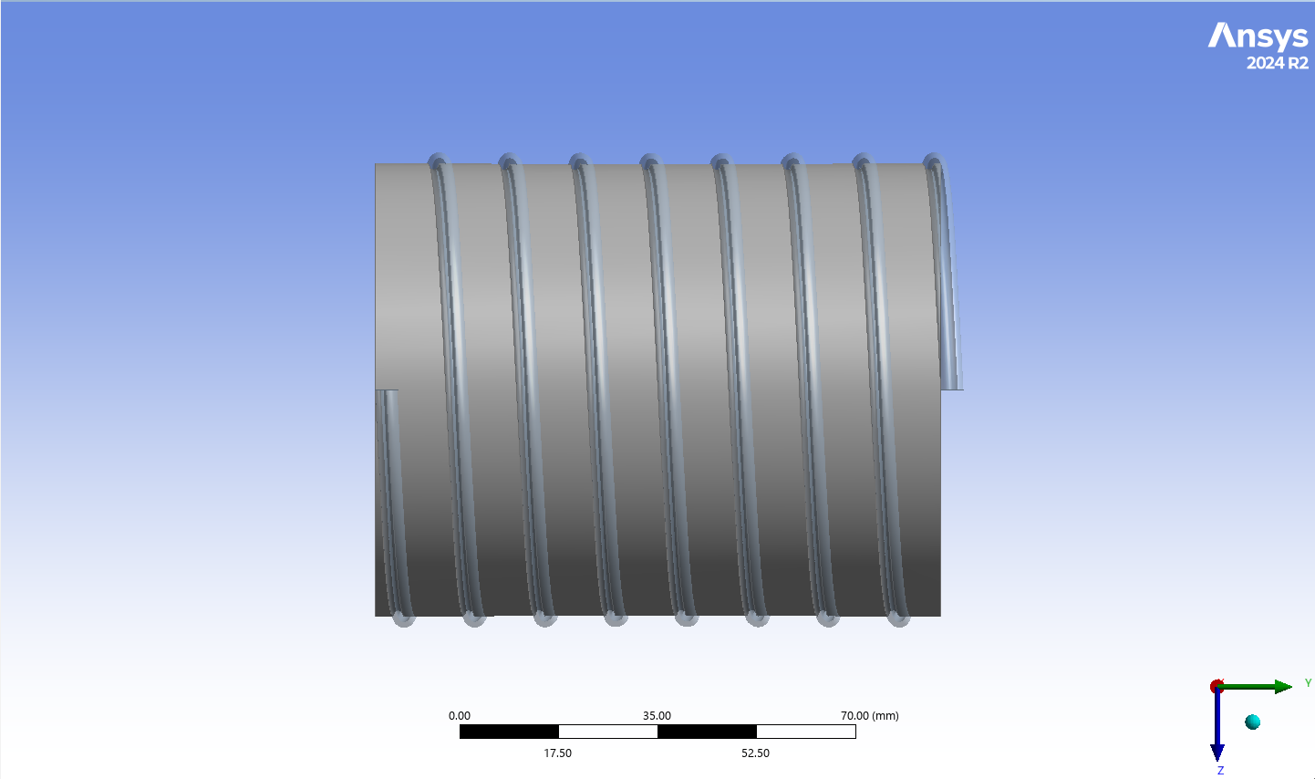
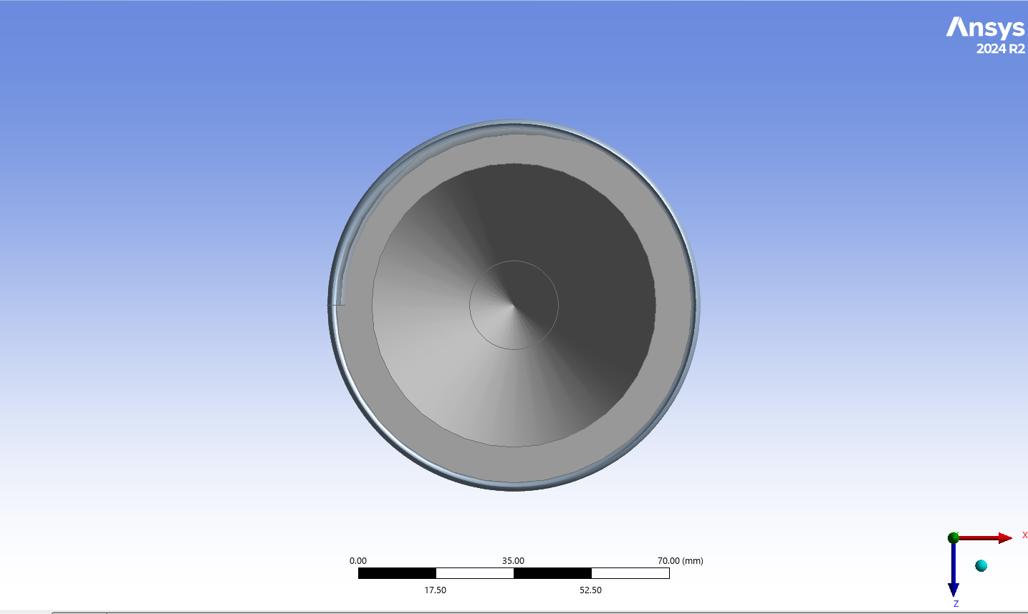
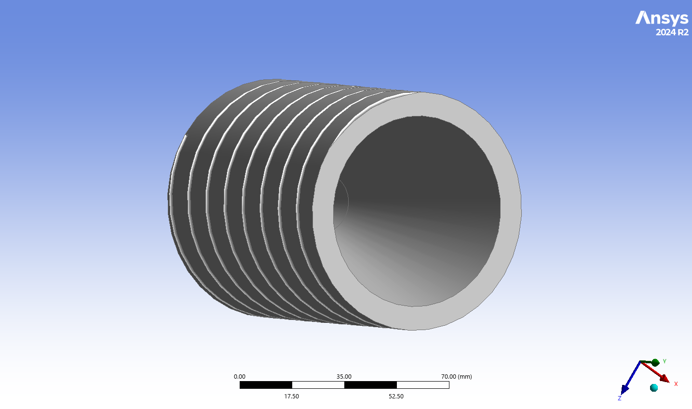
Design of the Faraday cup

Slide 4
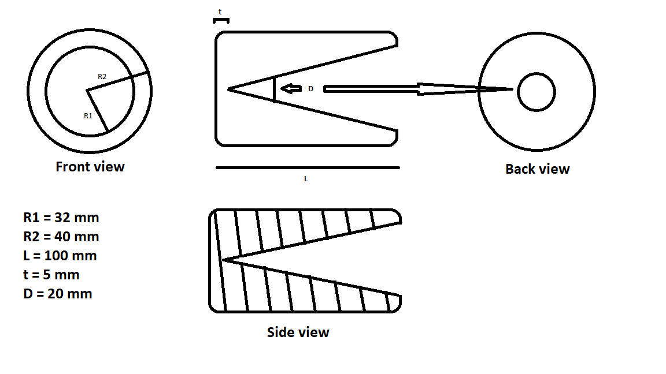
Dimensions of the Faraday cup
Also,
Bending radius of the pipe = 40 mm
Inner radius of the pipe = 2 mm

Slide 5
Thermal Calculation

Slide 6
Instantaneous Temperature Calculation

Slide 7
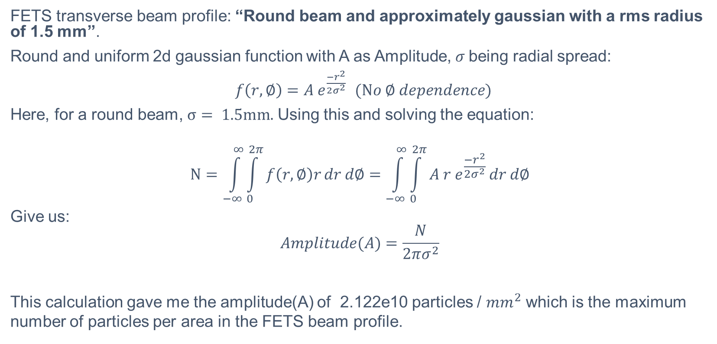
FETS approximate beam profile
FETS transverse beam profile: “Round beam and approximately gaussian with a rms radius of 1.5 mm”.
Round and uniform 2d gaussian function with A as Amplitude, $σ$being radial spread:
$f\left(r,∅\right)=A e^{\frac{{−r}^{2}}{2σ^{2}}}$ $(No ∅ dependence)$
Here, for a round beam, $σ= 1.5mm.$ Using this and solving the equation:
$$N=\int_{−∞}^{∞}{\int_{0}^{2π}{f\left(r,∅\right)r}}dr d∅=\int_{−∞}^{∞}{\int_{0}^{2π}{A r e^{\frac{{−r}^{2}}{2σ^{2}}}}}dr d∅$$
Give us:
$$Amplitude(A)=\frac{N}{2πσ^{2}}$$
This calculation gave me the amplitude(A) of 2.122e10 particles / ${mm}^{2}$ which is the maximum number of particles per area in the FETS beam profile.

Slide 8
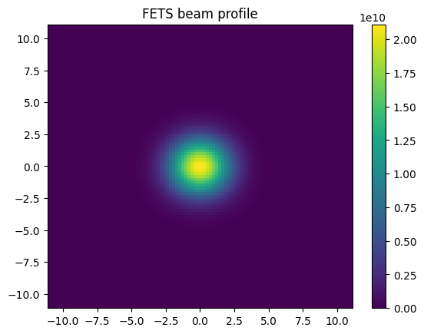
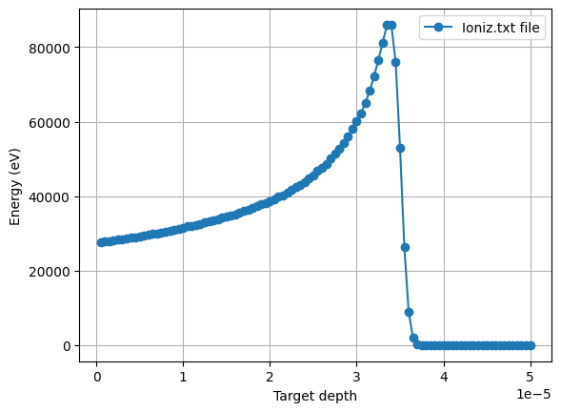
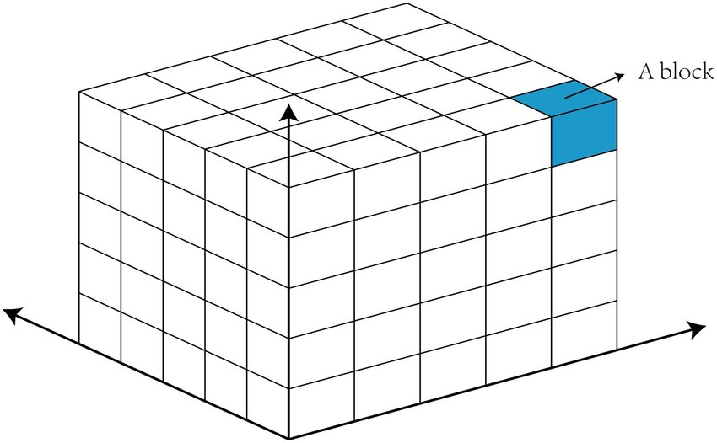
FETS max energy deposited calculation

Slide 9
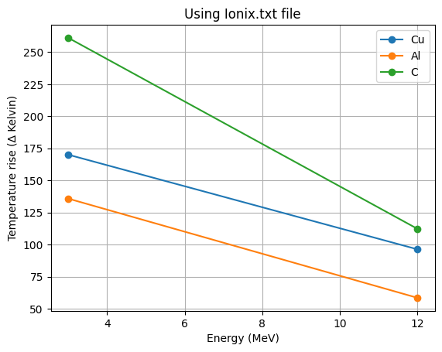
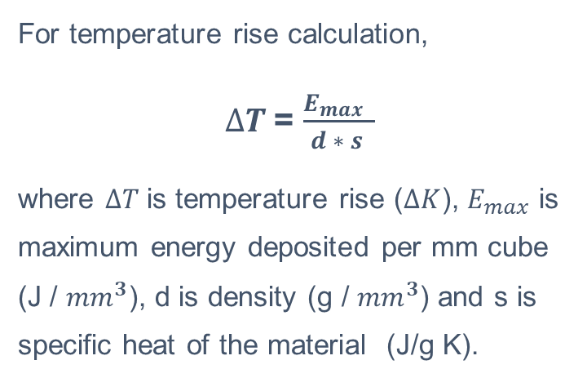
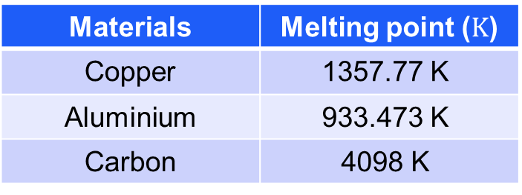
FETS Temperature rise calculation
For temperature rise calculation,
$∆T$= $\frac{E_{max} }{d ∗ s }$
where $∆T$is temperature rise ($∆K$), $E_{max}$ is maximum energy deposited per mm cube (J / ${mm}^{3}$), d is density (g / ${mm}^{3}$) and s is specific heat of the material (J/g K).
Materials | Melting point ($K$)
Copper | 1357.77 K
Aluminium | 933.473 K
Carbon | 4098 K
(Royal Society of Chemistry)

Slide 10
Steady State Simulations:
The design is fixed as conical Faraday Cup (FC) with helical water-cooling wrapped around it. And material is fixed to be Copper (Cu).

Slide 11
Heat Load Calculation:
Using the FETS transverse beam distribution with the longitudinal structure of FETS-FFA to create the worst possible thermal case.

Slide 12
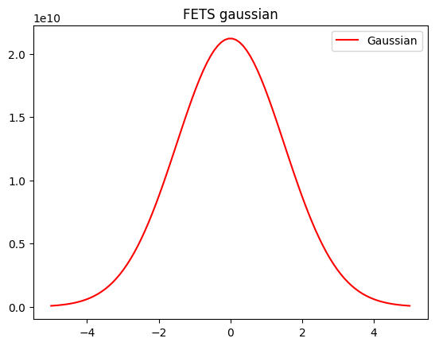
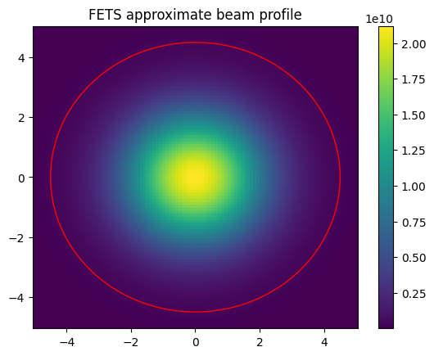
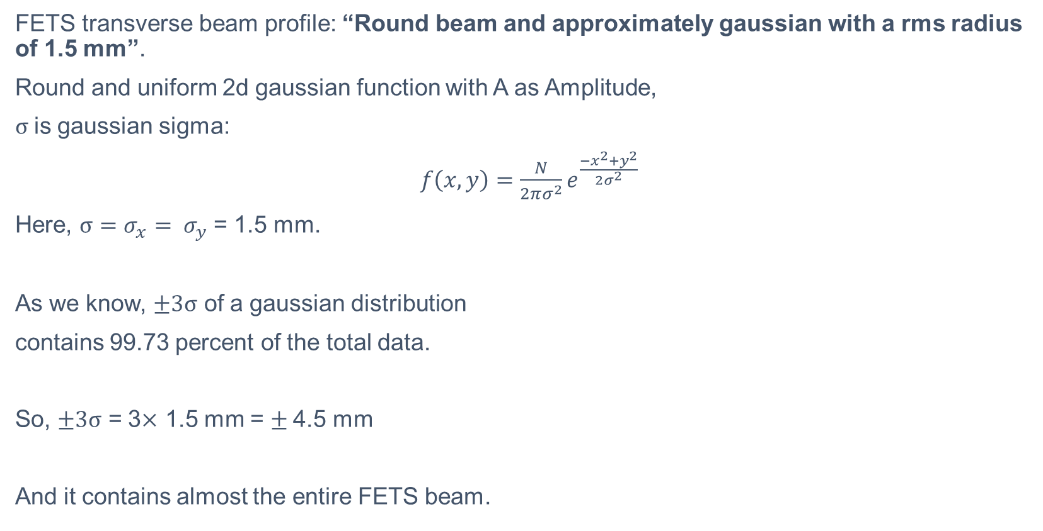
FETS beam profile
FETS transverse beam profile: “Round beam and approximately gaussian with a rms radius of 1.5 mm”.
Round and uniform 2d gaussian function with A as Amplitude,
$σ$is gaussian sigma:
$f\left(x,y\right)=\frac{N}{2πσ^{2}}e^{\frac{{−x}^{2}+y^{2}}{2σ^{2}}}$
Here, $σ=σ_{x}= σ_{y}$= 1.5 mm.
As we know, $±3σ$ of a gaussian distribution
contains 99.73 percent of the total data.
So, $±3σ$ = 3$×$ 1.5 mm = $±$4.5 mm
And it contains almost the entire FETS beam.

Slide 13
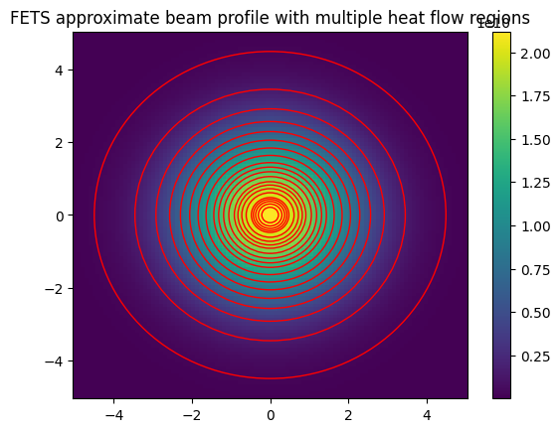
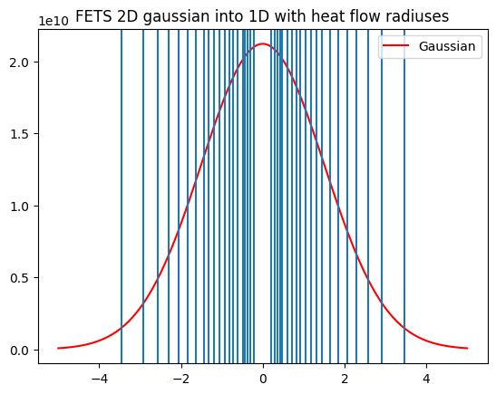
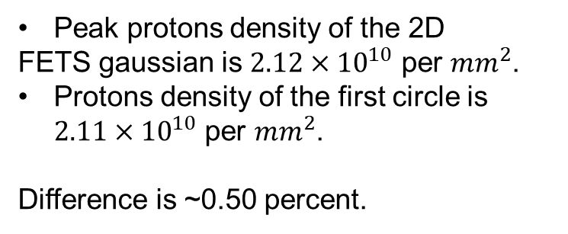
FETS Heat flow region
Peak protons density of the 2D
FETS gaussian is $2.12×{10}^{10}$ per ${mm}^{2}$.
Protons density of the first circle is $2.11×{10}^{10}$ per ${mm}^{2}$.
Difference is ~0.50 percent.

Slide 14
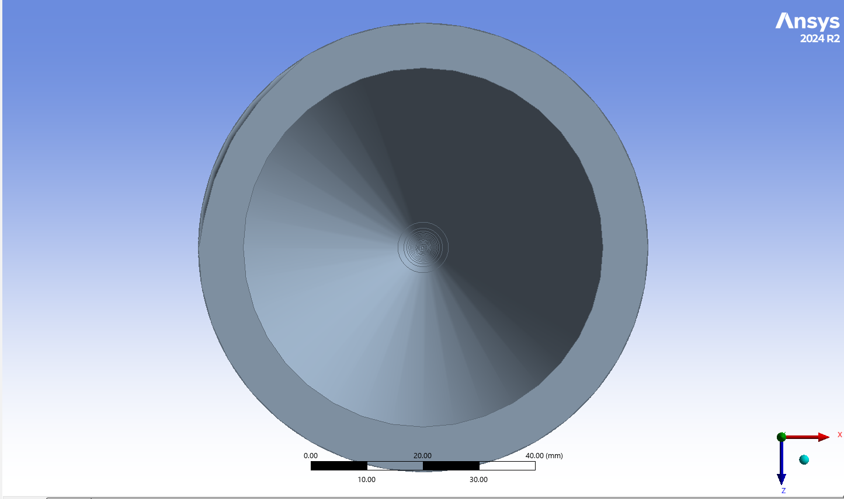
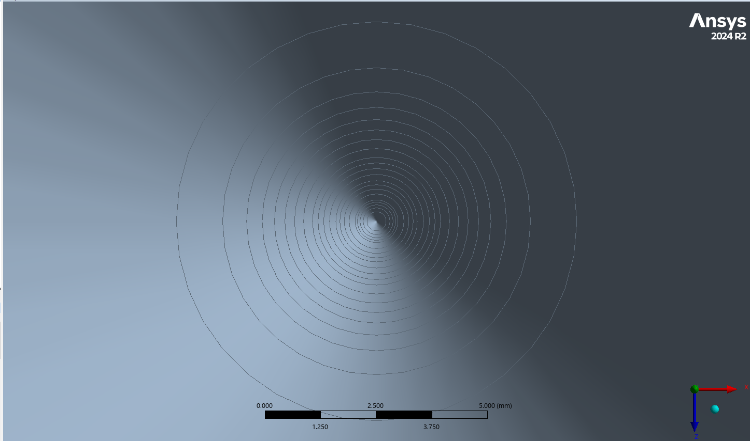
Transverse heat flow distribution

Slide 15
Heat Sink Calculation

Slide 16

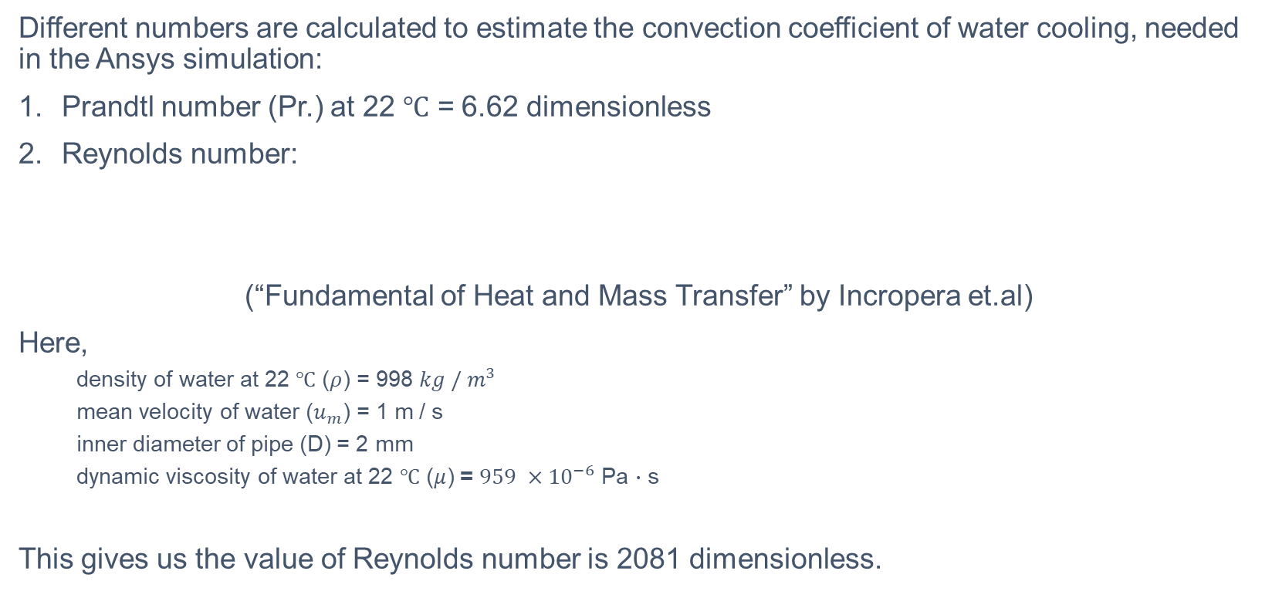
Reynolds Number calculation
Different numbers are calculated to estimate the convection coefficient of water cooling, needed in the Ansys simulation:
Prandtl number (Pr.) at 22 $℃$ = 6.62 dimensionless
Reynolds number:
(“Fundamental of Heat and Mass Transfer” by Incropera et.al)
Here,
  density of water at 22 $℃$ ($ρ$) = 998 $kg / m^{3}$
  mean velocity of water ($u_{m}$) = 1 m / s
  inner diameter of pipe (D) = 2 mm
  dynamic viscosity of water at 22 $℃$ ($μ$) = $959 ×{10}^{−6}$ Pa $∙$ s
This gives us the value of Reynolds number is 2081 dimensionless.

Slide 17
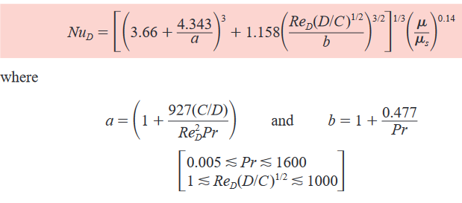


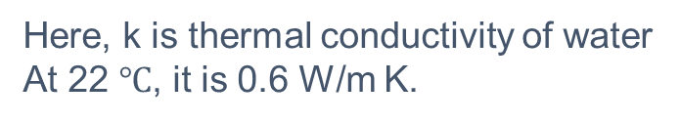
Convection Coefficient Calculation
To calculate the Convection Coefficient of water, the Nusselt number is also needed. In the book, the formula for the Nusselt number is given as:
Here, I have made one assumption that $μ≈μ_{s}$ (Viscosity of water in the middle is the same as at the surface of the pipe).
Here, k is thermal conductivity of water
At 22 $℃$, it is 0.6 W/m K.

Slide 18
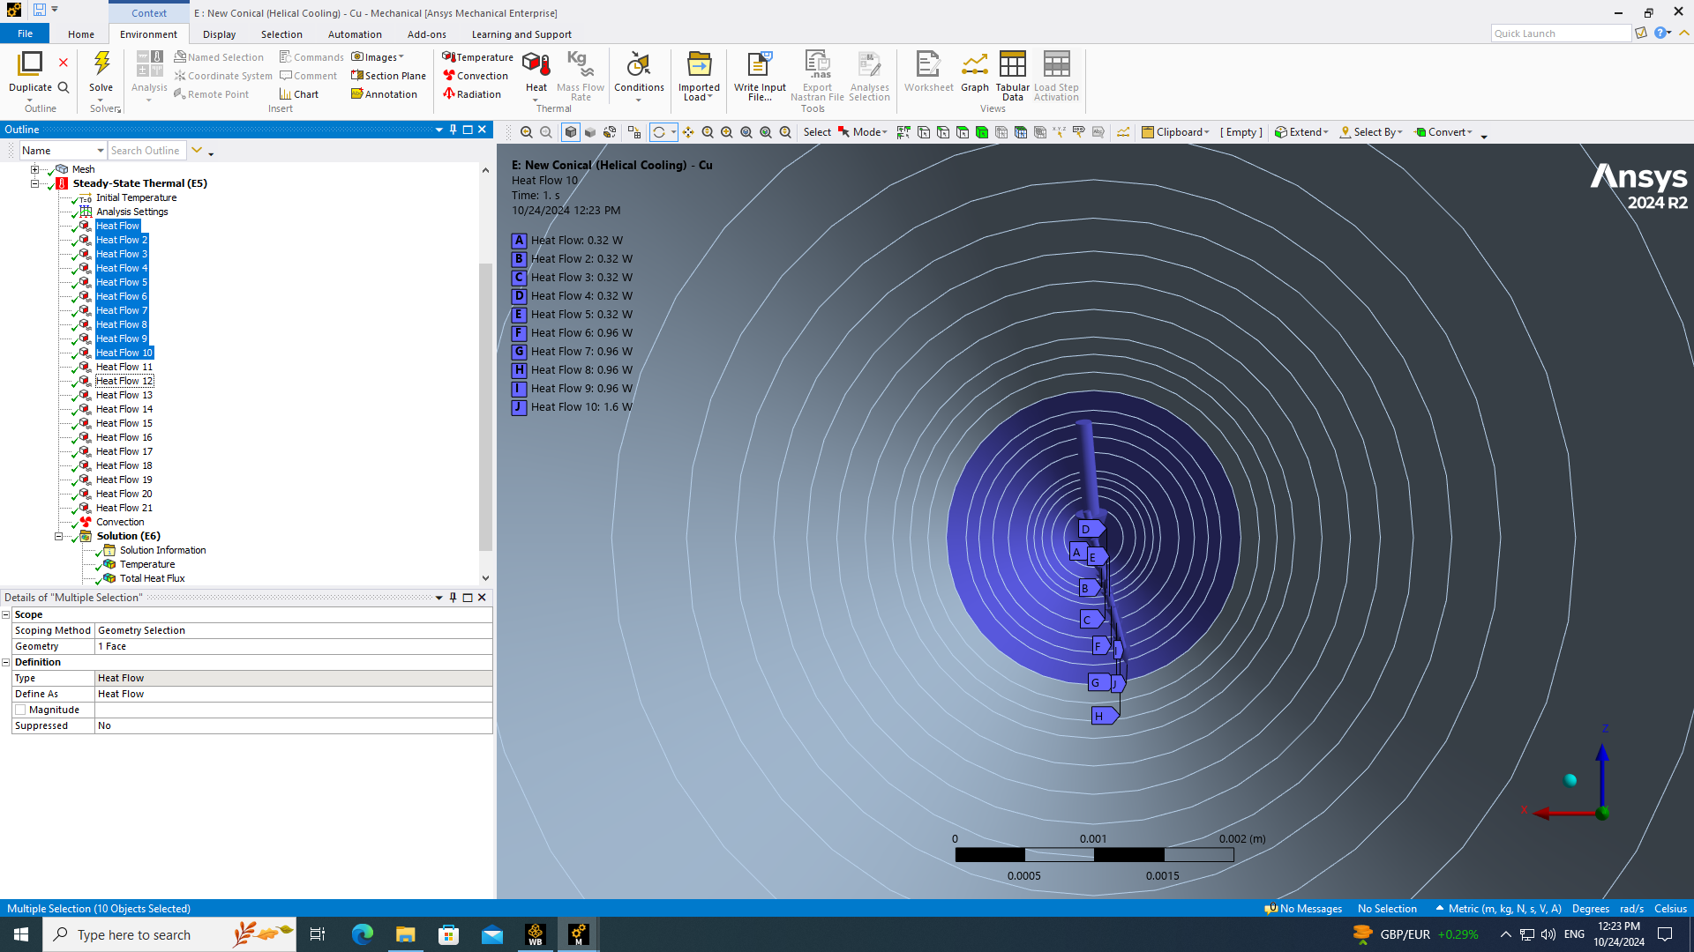
Steady state simulation

Slide 19
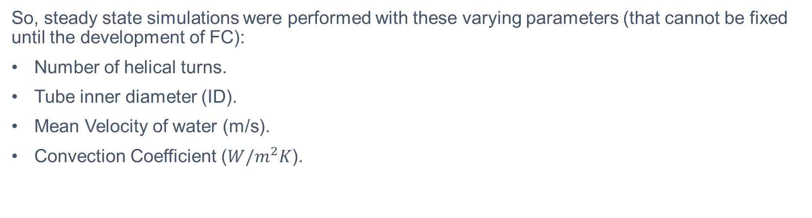
Steady state simulations
So, steady state simulations were performed with these varying parameters (that cannot be fixed until the development of FC):
Number of helical turns.
Tube inner diameter (ID).
Mean Velocity of water (m/s).
Convection Coefficient (${W/m}^{2}K$).

Slide 20
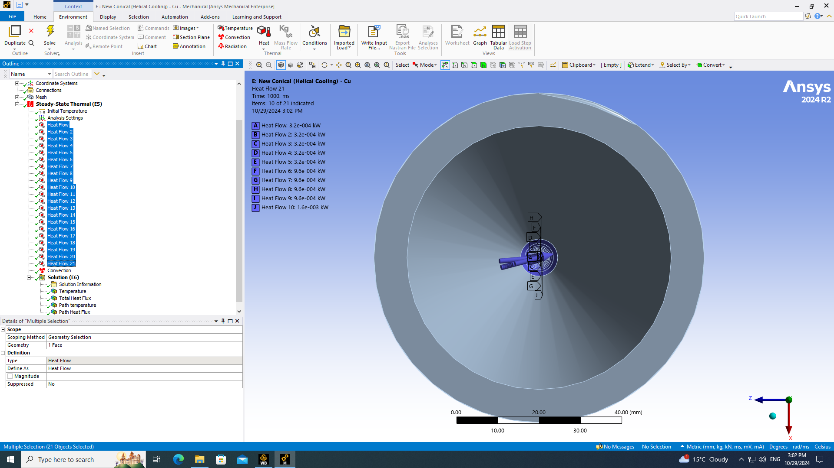
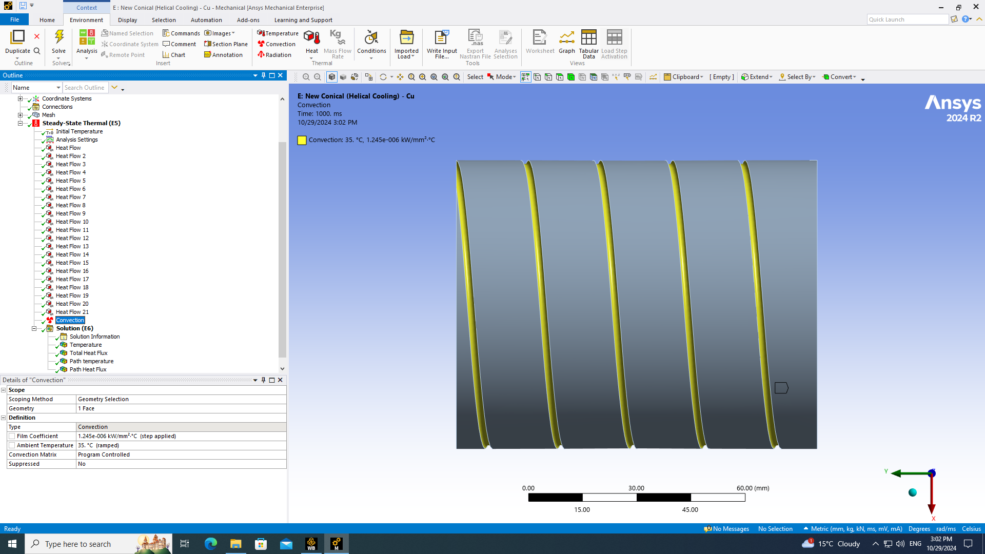
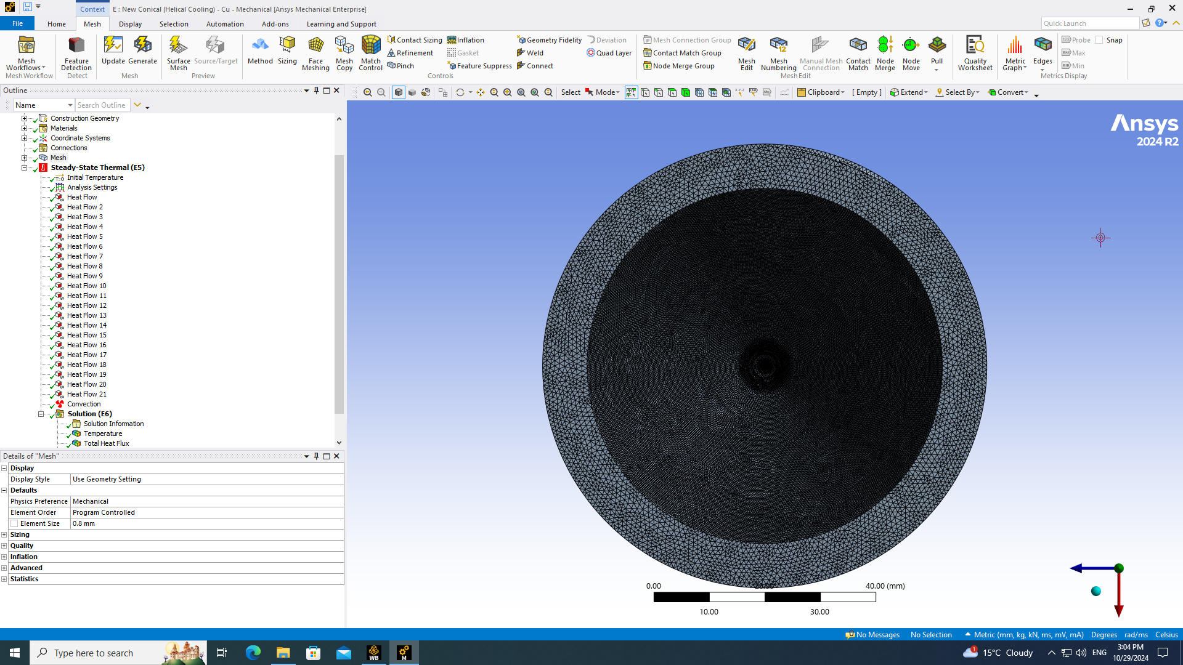
Steady state simulations
While there are parameters varied over the simulation, there also are some of the things not changed in any of all the simulations performed.
They include:
Design and geometry (Conical shape).
Material (Copper).
Convection region.
Heat flow region.
Mesh and element size (0.8 mm on average overall).
Transverse heat flow distribution (Gaussian as estimated).

Slide 21
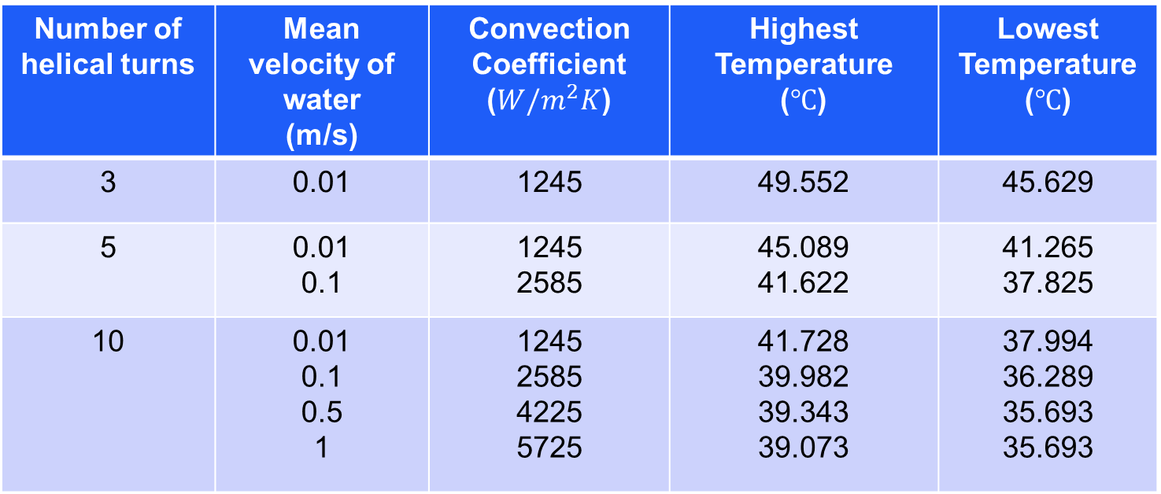
Steady state simulations
So, results from steady state simulations:
Fixed tube Inner diameter (ID) at 2 mm:
Each tube is 50 percent immersed inside the FC.
Number of helical turns | Mean velocity of water (m/s) | Convection Coefficient (${W/m}^{2}K$) | Highest Temperature ($℃$) | Lowest Temperature ($℃$)
3 | 0.01 | 1245 | 49.552 | 45.629
5 | 0.01 0.1 | 1245 2585 | 45.089 41.622 | 41.265 37.825
10 | 0.01 0.1 0.5 1 | 1245 2585 4225 5725 | 41.728 39.982 39.343 39.073 | 37.994 36.289 35.693 35.693

Slide 22
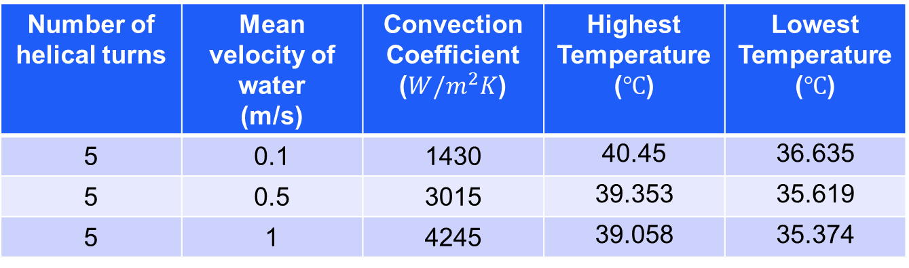
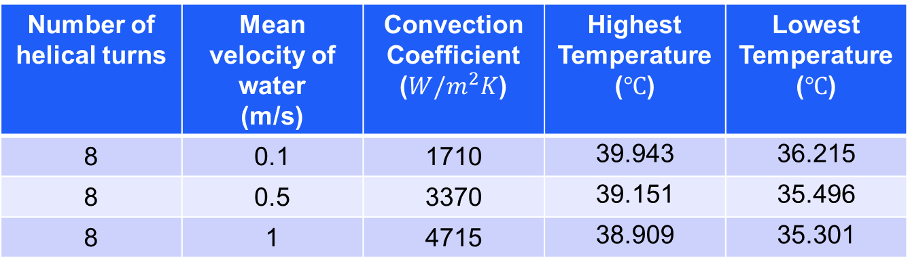
Steady state simulations
Fixed tube Inner diameter (ID) at 4 mm:
Fixed Inner diameter (ID) at 6 mm:
Number of helical turns | Mean velocity of water (m/s) | Convection Coefficient (${W/m}^{2}K$) | Highest Temperature ($℃$) | Lowest Temperature ($℃$)
8 | 0.1 | 1710 | 39.943 | 36.215
8 | 0.5 | 3370 | 39.151 | 35.496
8 | 1 | 4715 | 38.909 | 35.301
Number of helical turns | Mean velocity of water (m/s) | Convection Coefficient (${W/m}^{2}K$) | Highest Temperature ($℃$) | Lowest Temperature ($℃$)
5 | 0.1 | 1430 | 40.45 | 36.635
5 | 0.5 | 3015 | 39.353 | 35.619
5 | 1 | 4245 | 39.058 | 35.374

Slide 23
Conclusions:
Water cooling is surely needed for the Faraday Cup (especially helical cooling for better contact and heat transfer).
Tube inner diameter and mean velocity of water can be changed depending on availability, but the water mass flow rate should be kept constant as calculated, presumably ~10 g/s. However, if possible, maximising the water flow rate is only advantageous.
Thermal contact between tube and FC cylinder should be maximised with the number of helical turns of the water-cooling tube.
Even though the instantaneous temperature rise is seen to be very high, average temperature could be kept significantly down with the water cooling.
Only temperature rise is taken into consideration excluding the thermal stress on the target material.

Slide 24
Secondary Electrons Suppression

Slide 25
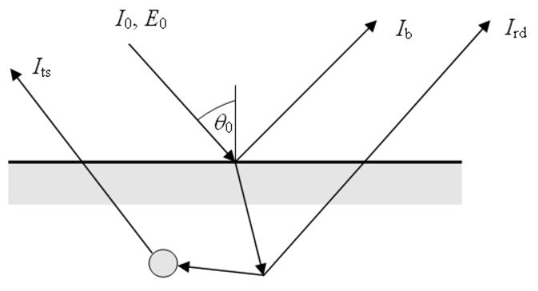

Secondary Electrons (SEs)
$I_{0}$ = Incident electrons or ions.
Types of Secondary Electrons:
$I_{b}$ = Backscattered electrons (electron-induced only)
An incident ion undergoes an elastic collision at the surface of a material, and it is reflected.
$I_{rd}$ = Rediffused Electrons (electron-induced only)
An incident electron moves into a material, but it is scattered back out of the material.
$I_{ts}$ =True electrons
An incident electron moves into a
material and due to collisions,
electrons other than the incident
one are scattered out of the material.

Slide 26
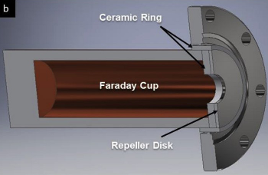
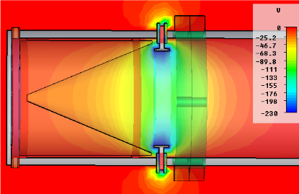
FC Electron Suppressor

Slide 27
CST Particle Tracking Simulation

Slide 28
SEE on CST:
While SE source is used for SE suppression mostly, there is also another way of simulating SEs on CST studio suite: to induce the SEs from proton bombardment.
CST has in-built model for Secondary Electron Emission (SEE) covering both types of emission: Electron-induced SE and ion-induced SEs.
For electron-induced SE: Either Furman or Vaughan model can be used, or one can also import the data themselves.
For ion-induced SE: SE yield data is imported, and the most probable energy of SEs (temperature value) is also needed.

Slide 29
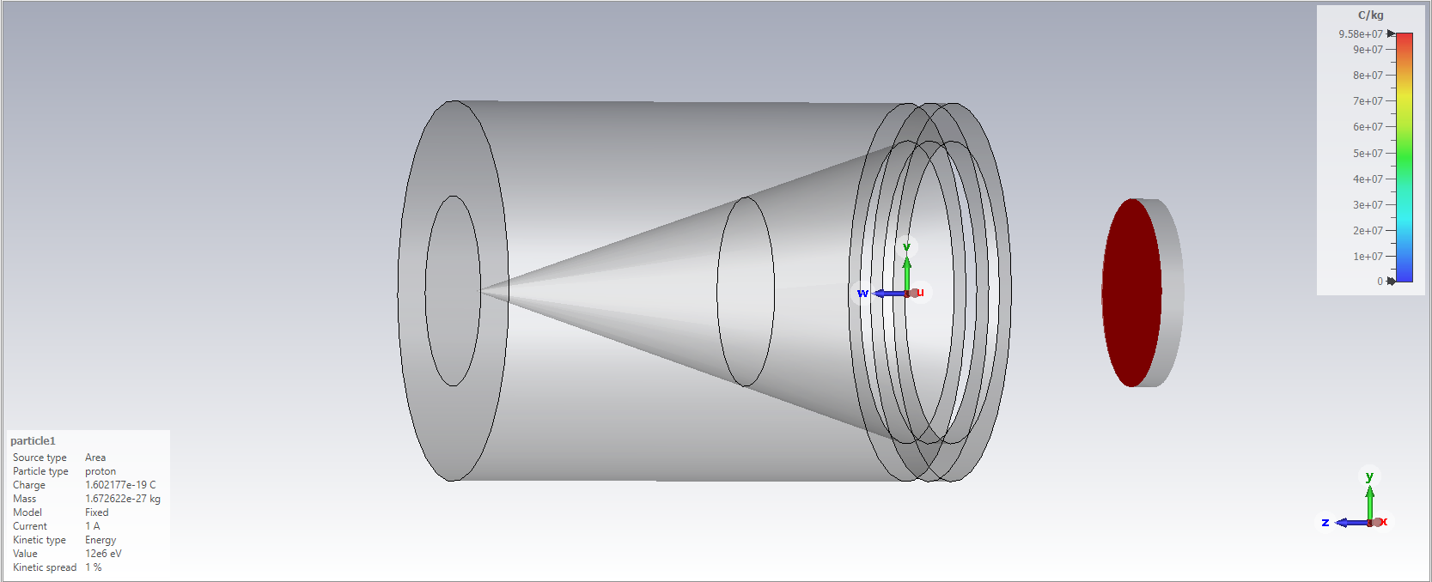
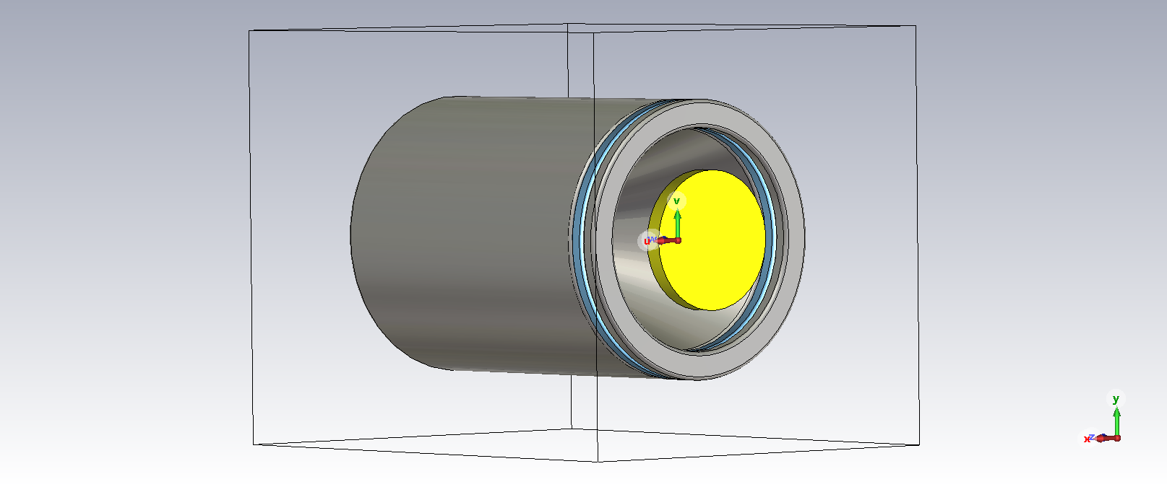
Proton-induced SE emission:

Slide 30
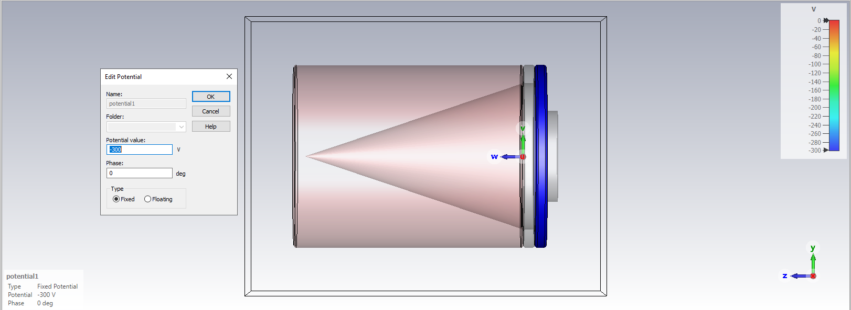
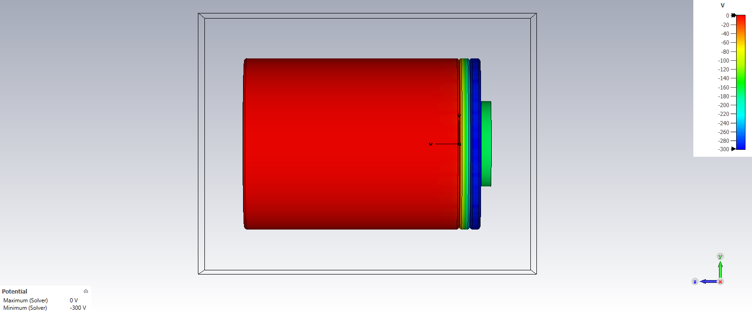
Electric Potential:
.

Slide 31
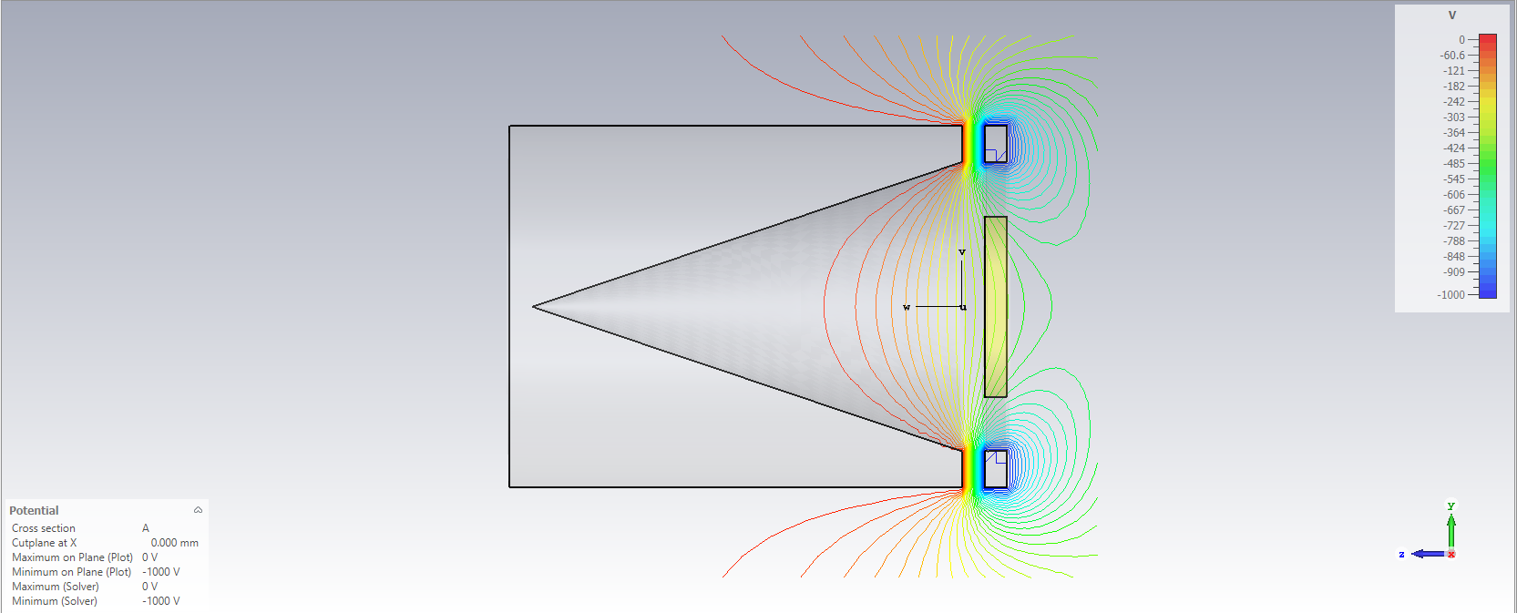
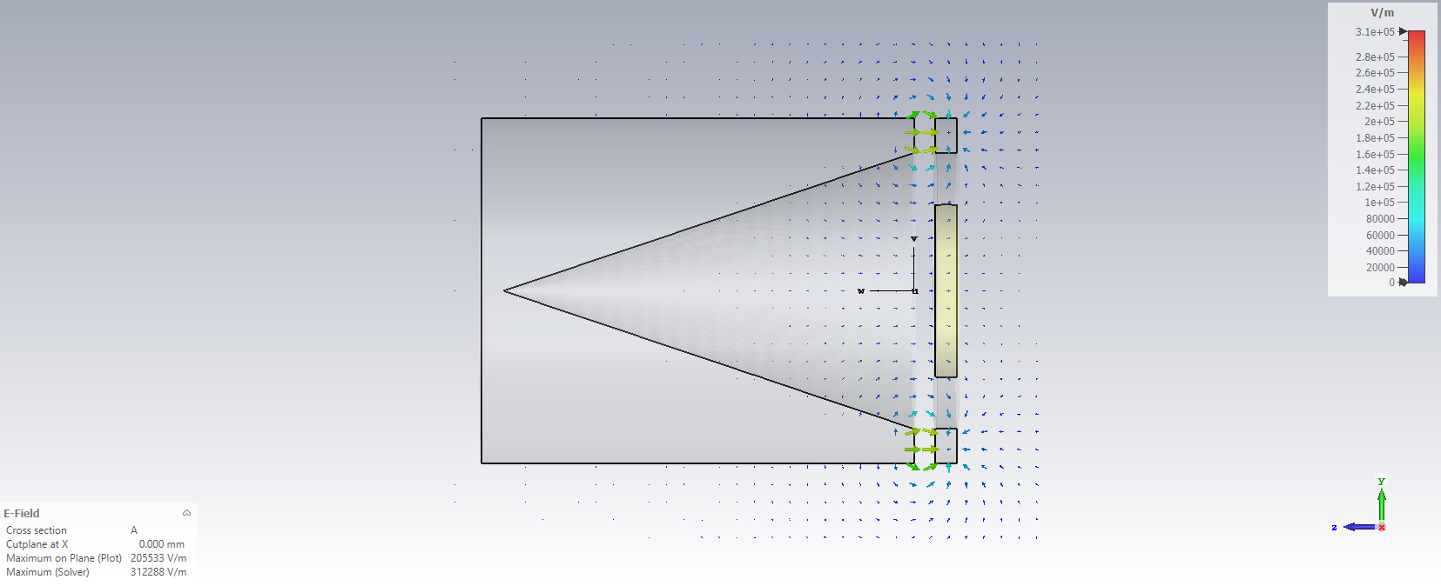
SE-Suppression Field

Slide 32
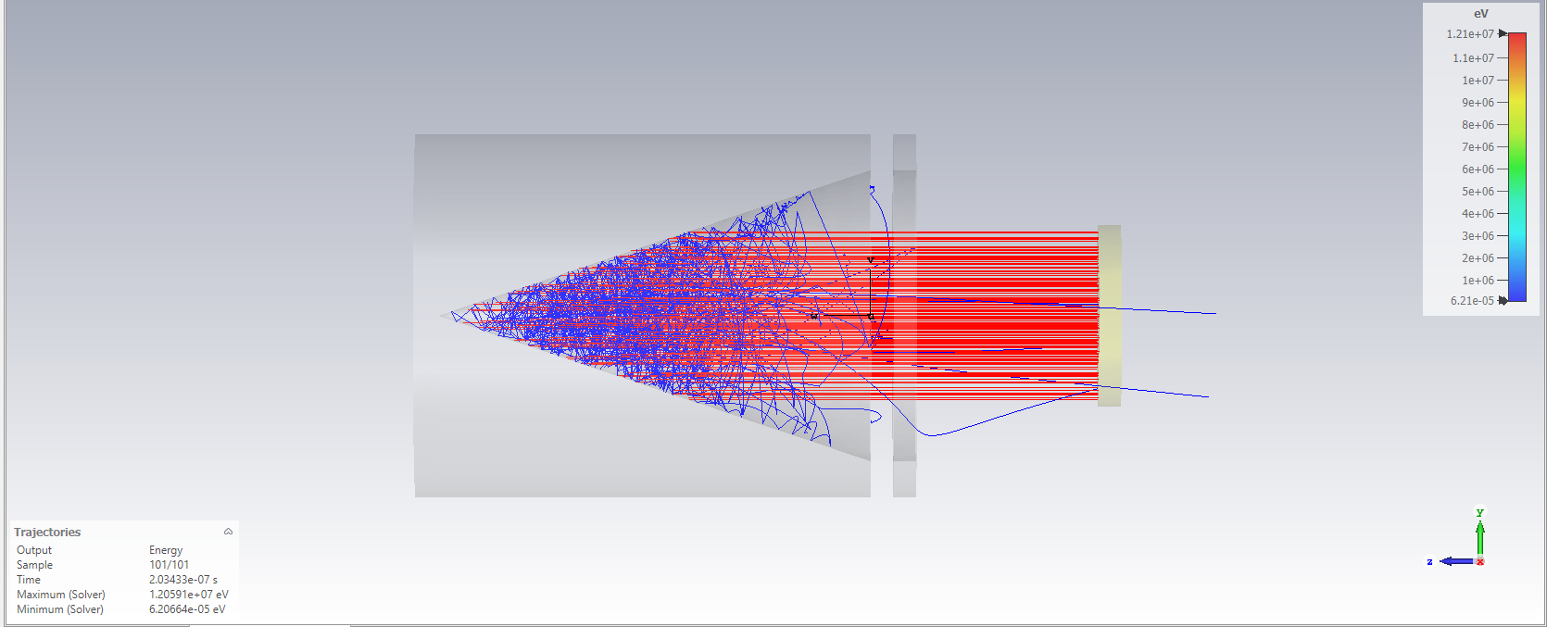
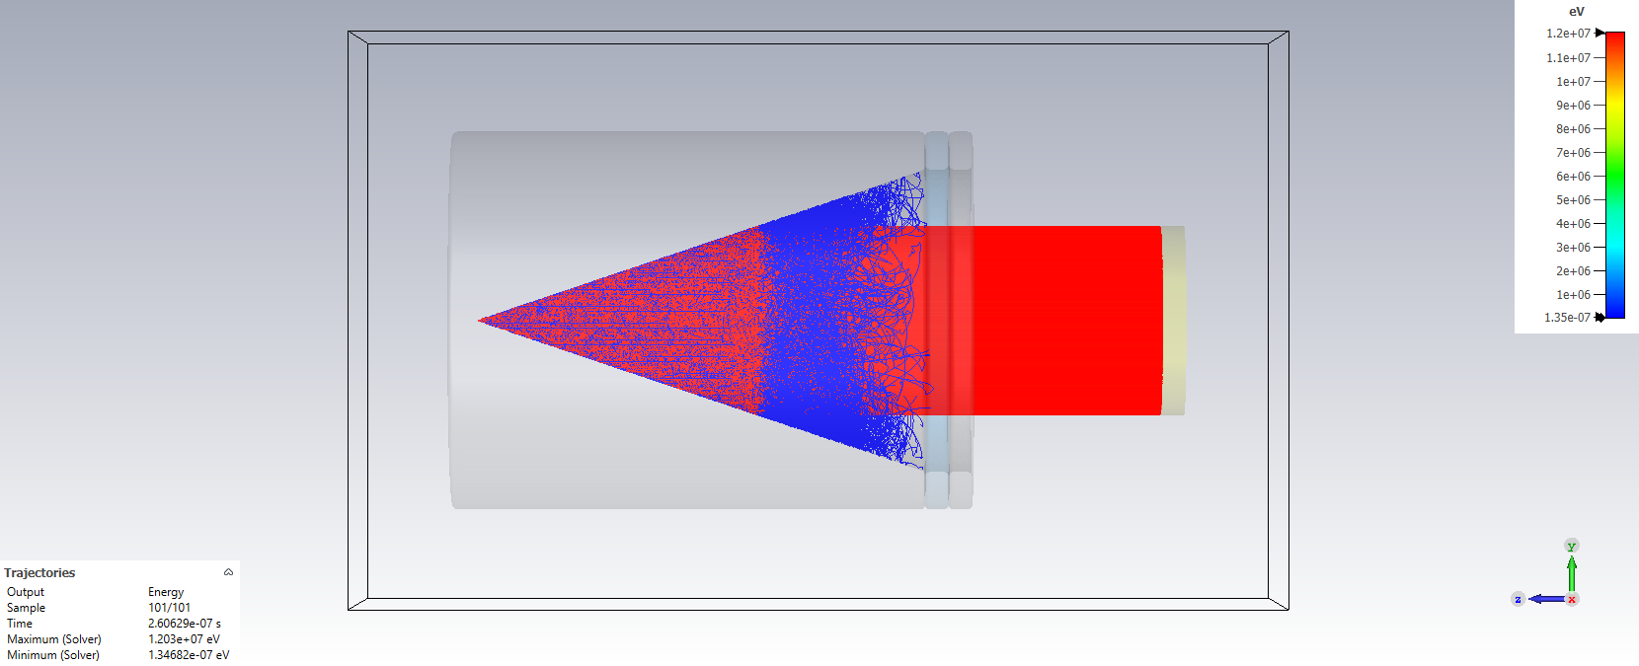
Proton-induced SE emission:

Slide 33
Running Simulation:
A Python code was developed, which determine the number of SEs leaving the FC using their last position from the trajectories file exported from the simulation. Energy of the SE was also calculated.
Particle tracking simulations were performed with changing parameters:
Number of protons: ~10000 to ~100000.
Absolute current: 1.6 mA or 80 mA.
Voltage: 0 V to -1000 V.

Slide 34
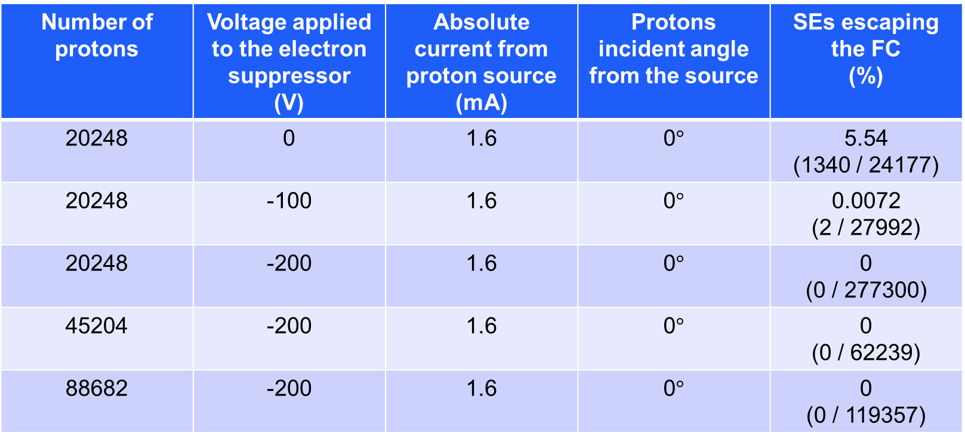
Simulation Results
The proton source 50 mm away from the front of the FC:
Number of protons | Voltage applied to the electron suppressor (V) | Absolute current from proton source (mA) | Protons incident angle from the source | SEs escaping the FC (%)
20248 | 0 | 1.6 | 0$°$ | 5.54 (1340 / 24177)
20248 | -100 | 1.6 | 0$°$ | 0.0072 (2 / 27992)
20248 | -200 | 1.6 | 0$°$ | 0 (0 / 277300)
45204 | -200 | 1.6 | 0$°$ | 0 (0 / 62239)
88682 | -200 | 1.6 | 0$°$ | 0 (0 / 119357)

Slide 35
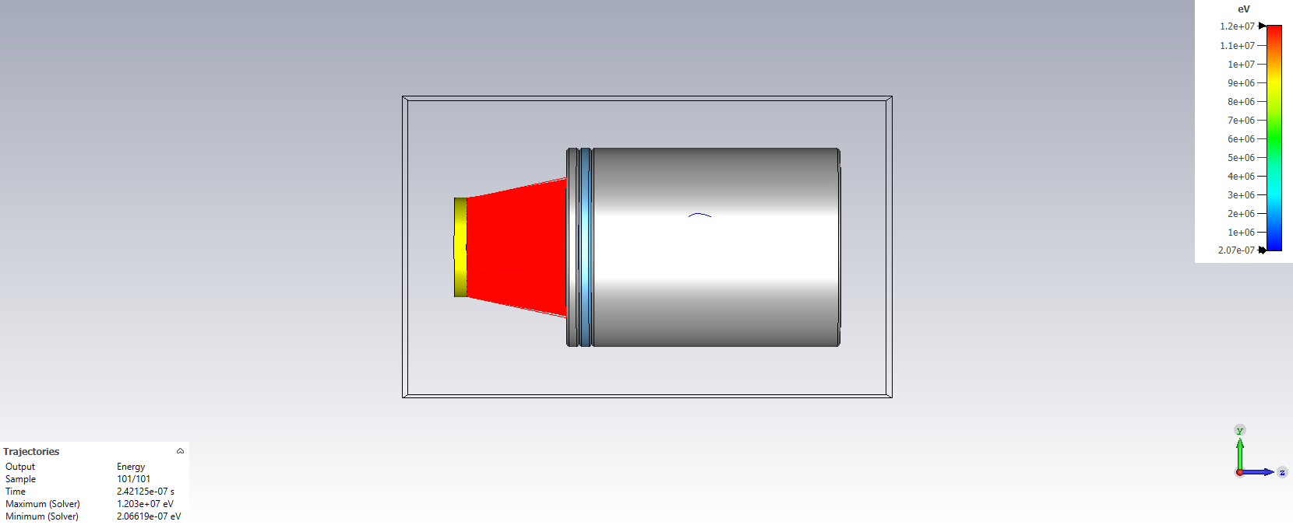
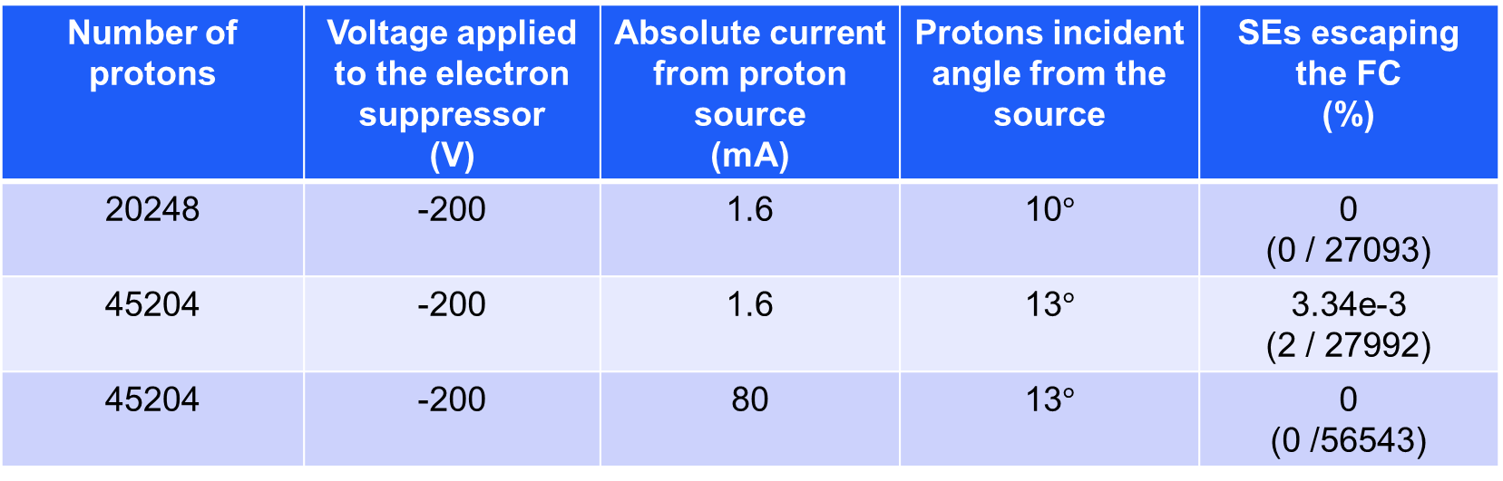
Simulation Results
The proton source 50 mm away from the front of the FC:
Number of protons | Voltage applied to the electron suppressor (V) | Absolute current from proton source (mA) | Protons incident angle from the source | SEs escaping the FC (%)
20248 | -200 | 1.6 | 10$°$ | 0 (0 / 27093)
45204 | -200 | 1.6 | 13$°$ | 3.34e-3 (2 / 27992)
45204 | -200 | 80 | 13$°$ | 0 (0 /56543)

Slide 36
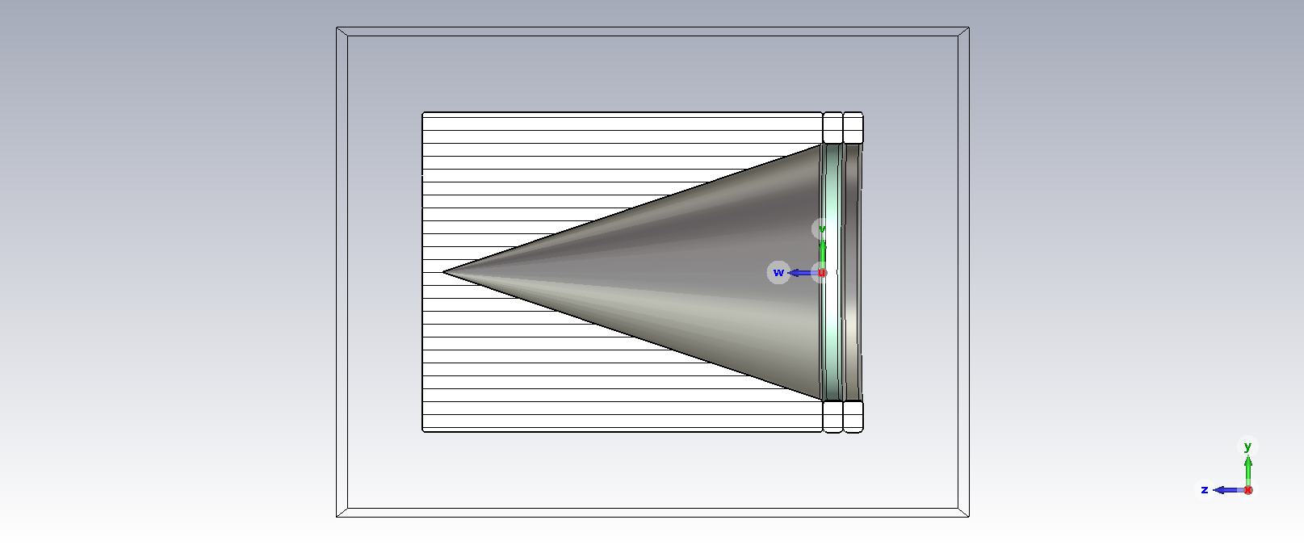
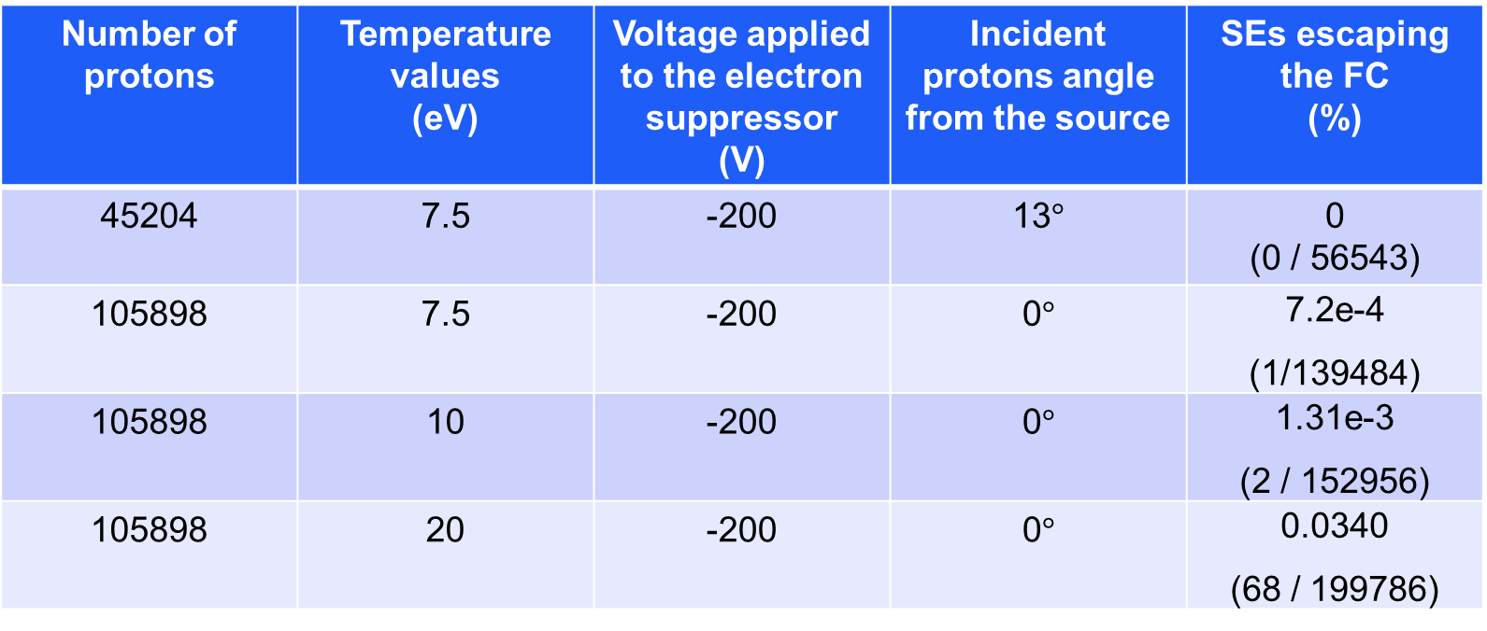
Simulation Results
Incident proton current
Is 80 mA.
Number of protons | Temperature values (eV) | Voltage applied to the electron suppressor (V) | Incident protons angle from the source | SEs escaping the FC (%)
45204 | 7.5 | -200 | 13$°$ | 0 (0 / 56543)
105898 | 7.5 | -200 | 0$°$ | 7.2e-4 (1/139484)
105898 | 10 | -200 | 0$°$ | 1.31e-3 (2 / 152956)
105898 | 20 | -200 | 0$°$ | 0.0340 (68 / 199786)

Slide 37
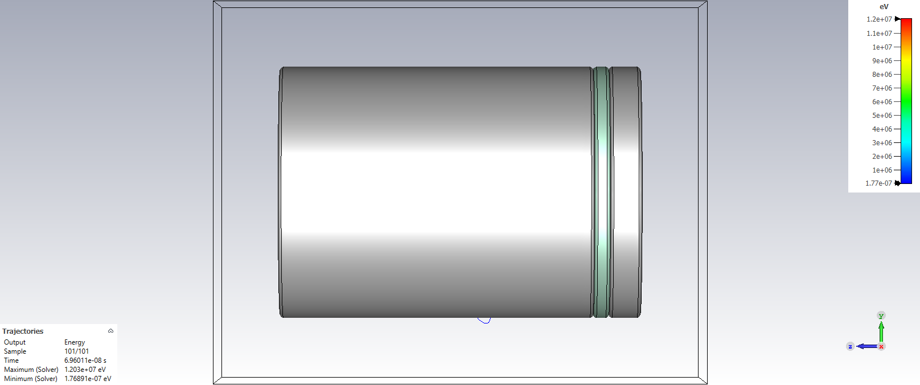

Simulation Results
Incident proton current
Is 80 mA.
Number of protons | Temperature values (eV) | Voltage applied to the electron suppressor (V) | Incident protons angle from the source | SEs escaping the FC (%)
105075 | 20 | -400 | 0$°$ | 0 (0 / 197811)
105075 | 50 | -500 | 0$°$ | 9.72e-3 (29 / 298372)
105075 | 50 | -700 | 0$°$ | 3.4e-4 (1 / 295050)
105075 | 50 | -1000 | 0$°$ | 0 (0 / 292402)

Slide 38
Alternative method

Slide 39



CST SE energy spectrum function
Ion-induced SE energy spectrum is generated on CST using this function:
Incident energy = 100 eV
Temperature = 7.5 eV
SEY = 0.0078

Slide 40


SE energy spectrum comparison
The spectra given below is taken from “Ion-induced Secondary Electrons Spectra from Clean metals surfaces” by D. Hasselkamp et al. (1987).
Important note: For light ion impact, the shape of the low-energy spectrum does not depend on the impact energy. (From a book called “Particle induced electron emission II”)

Slide 41


SE energy spectrum comparison: Copper
Tried to replicate the SE energy spectra from the paper with given parameters:
Incident energy = 500 KeV
Temperature = 2.4 $±$ 0.2 eV
SEY = 1.24 (for 500 KeV protons on Cu)
“Proton-induced secondary electron emission from elemental solids over the energy domain 1 keV–1000 MeV”.
Energy at peak of the spectrum (eV) | Width at half maximum (eV)
2.2 | 5.38
2.4 | 5.87
2.6 | 6.36

Slide 42


SE energy spectrum comparison: Aluminium
Tried to replicate the SE energy spectra from the paper with given parameters:
Incident energy = 500 KeV
Temperature = 2.0 $±$ 0.2 eV
SEY = 0.7 (for 500 KeV protons on Al)
“Proton-induced secondary electron emission from elemental solids over the energy domain 1 keV–1000 MeV”.
Energy at peak of the spectrum (eV) | Width at half maximum (eV)
1.8 | 4.40
2.0 | 4.9
2.2 | 5.38

Slide 43



















Unsuppressed Secondary Electrons
Idea was to calculate the ratio of unsuppressed electrons by integrating the SE energy spectrum.
Unsuppressed
electrons
Suppressed electrons

Slide 44
Potential barrier on FC
When 1KV voltage is applied to the secondary electron suppressor in the shape of a ring, the potential barrier is minimum at the centre of the FC entrance. Minimum potential barrier changes with the distance of the suppressor.
Distance from FC (mm) | Thickness of FC (mm) | Minimum potential barrier at 1KV voltage (V)
3 | 5 | -335.47751
5 | 5 | -340.69275
3 | 10 | -390.37244
5 | 10 | -386.51352
Minimum Potential Barrier

Slide 45
Ratio of unsuppressed electrons
Assuming electrons more than 300 eV could not be suppressed, ratio of unsuppressed electrons was calculated at different temperature values.
Potential barrier = -300 V: (Incident energy = 12 MeV)
Temperature (eV) | Integrated total electrons (= SEY) | Ratio of unsuppressed electrons
2.4 | 0.2 | 6.52e-53
7.5 | 0.2 | 1.74e-16
10 | 0.2 | 2.90e-12
20 | 0.2 | 4.9e-6
50 | 0.2 | 0.0174
100 | 0.2 | 0.1991
Ratio is same even when the incident energy is 3 MeV

Slide 46
Conclusions
Only the use of the electric field was studied, excluding the possibility of using the magnetic field.
1 KV voltage should be enough to suppress the maximum number of secondary electrons (SEs).
Ion-induced SEs were only taken into consideration for the analytical study of electron suppression.
Even though it could not be explicitly concluded from the CST simulations, it has been found from the literature that having an electron suppressor ring, with 5 mm thickness, at a 3 mm distance (isolated with an insulator) could be best.
And the bias ring could be made of Stainless Steel or Copper, isolated by the insulator made of Alumina ceramics.

Slide 47
Thank you!

