Slide 1
EDMS 3306199
J. Devine EP-DI-SO
Procedure for reset after an AUL trip in EHN1, H8b beamline
This procedure is for physics users or beam line operators (BE-EA-LE), who do not have a habilitation electrique. You can assist the competent services to turn the power back on, but you are not authorised to switch circuit breakers yourself.
How to tell if an AUL is pushed? Local power cut to H8b/GIF++ equipment only; general lighting in EHN1 remains on. If so…
Call the CCC TI desk on 72201. They do not receive any alarms from the AUL, but will be able to confirm if it is due to another cause. The operator may be able to assist directly, or can call in the EN/EL piquet service to help you.
When someone with the habilitation electrique has arrived, you may start the reset process.
Locate the AUL which was pressed, if possible. Depending upon the type of button, it can be reset either by turning the button, or inserting and turning a key in the keyhole. The TI operator/EL piquet has the correct key.
After the button has been reset, proceed to switchboard EXC404/HN1. The fault light will be lit if this is an AUL event. Open the switchboard and push the Effacement Defaut button for several seconds. The fault light should go out.
Proceed to EXD404/HN1 (far end of GIF++ control room barracks) and reset the tripped circuit breakers (404.02, 404.03)
Proceed to EXD430/HN1 (outside GIF++ control room). Push the reset button for 3s until you hear a click. Reset the circuit breaker with the handle on the front (lower to off, then raise to on).
Proceed to EXD3/HN1 (GIF++ assembly area). Open the switchboard and reset the circuit breaker.
Go to EXD402/HN1 (by control room opposite Morpurgo magnet). Reset fault with the button on the indicator panel and then reset the main circuit breaker.

Slide 2
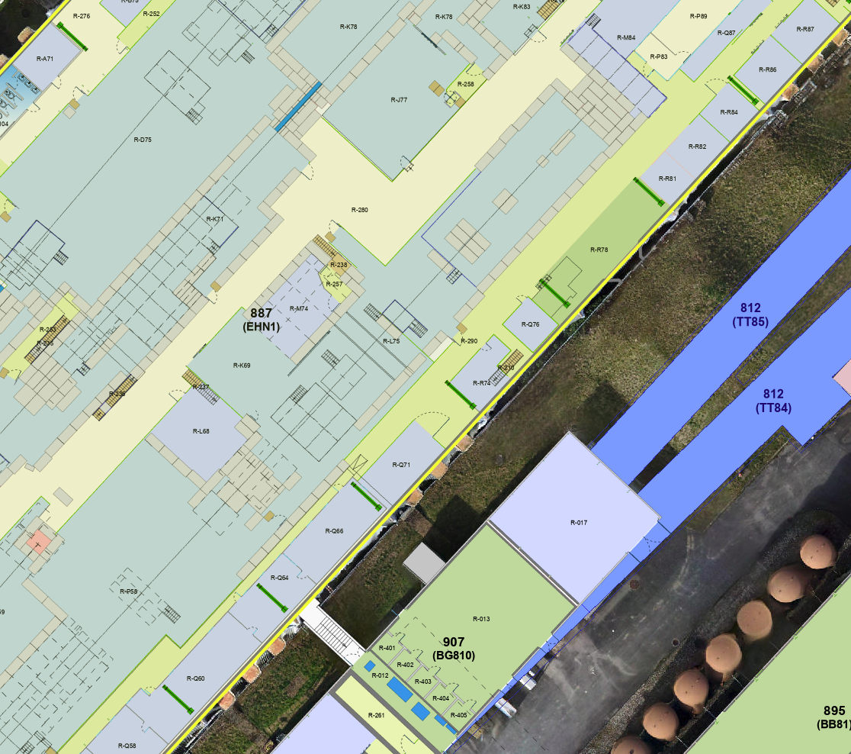
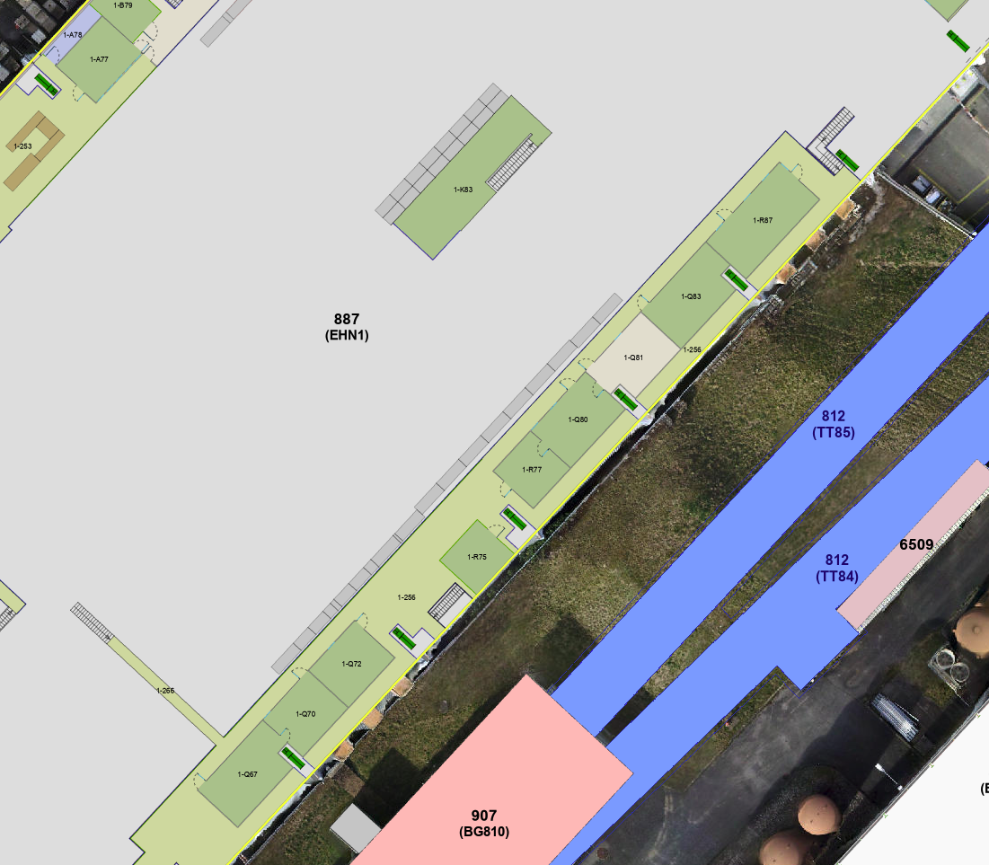
Ground floor EHN1
EXD3/HN1
EDMS 3306199
4
Location of equipment to reset in sequence. Note, failure to reset the AUL and EXC404/HN1 renders resupply of all switchboards impossible.
EXD430/HN1
3
2
1
EXC404/HN1
EXD404/HN1
5
EXD402/HN1
First floor EHN1

Slide 3
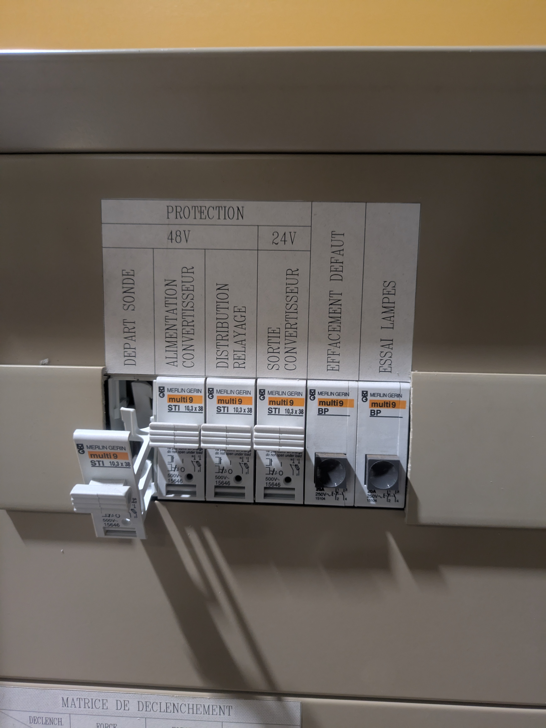
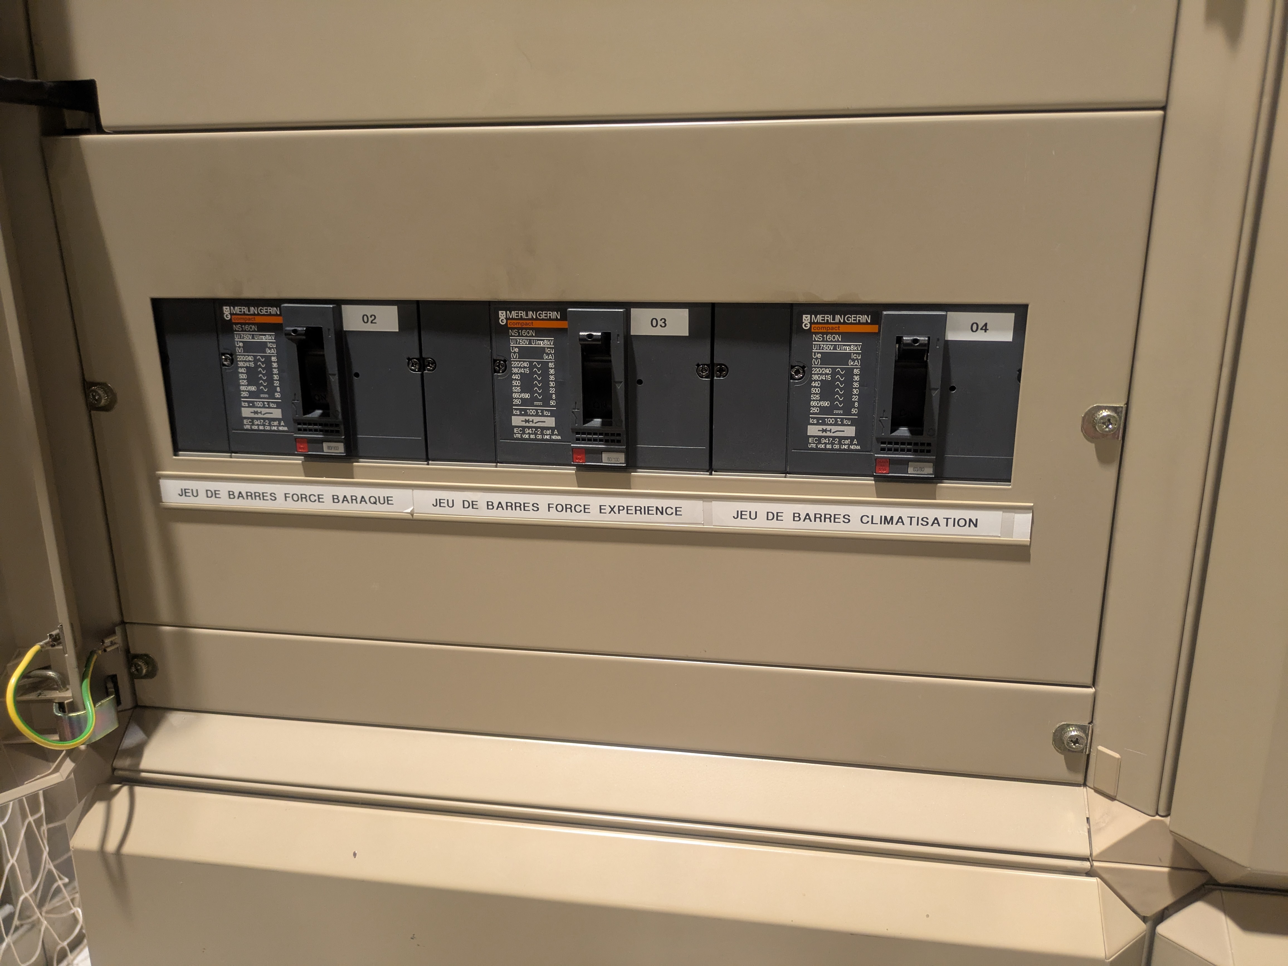
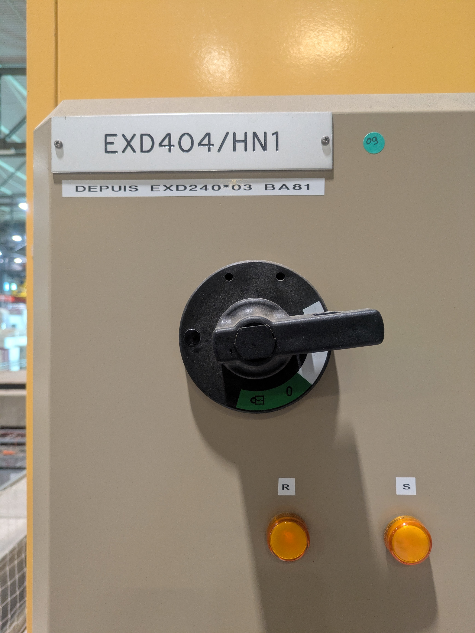
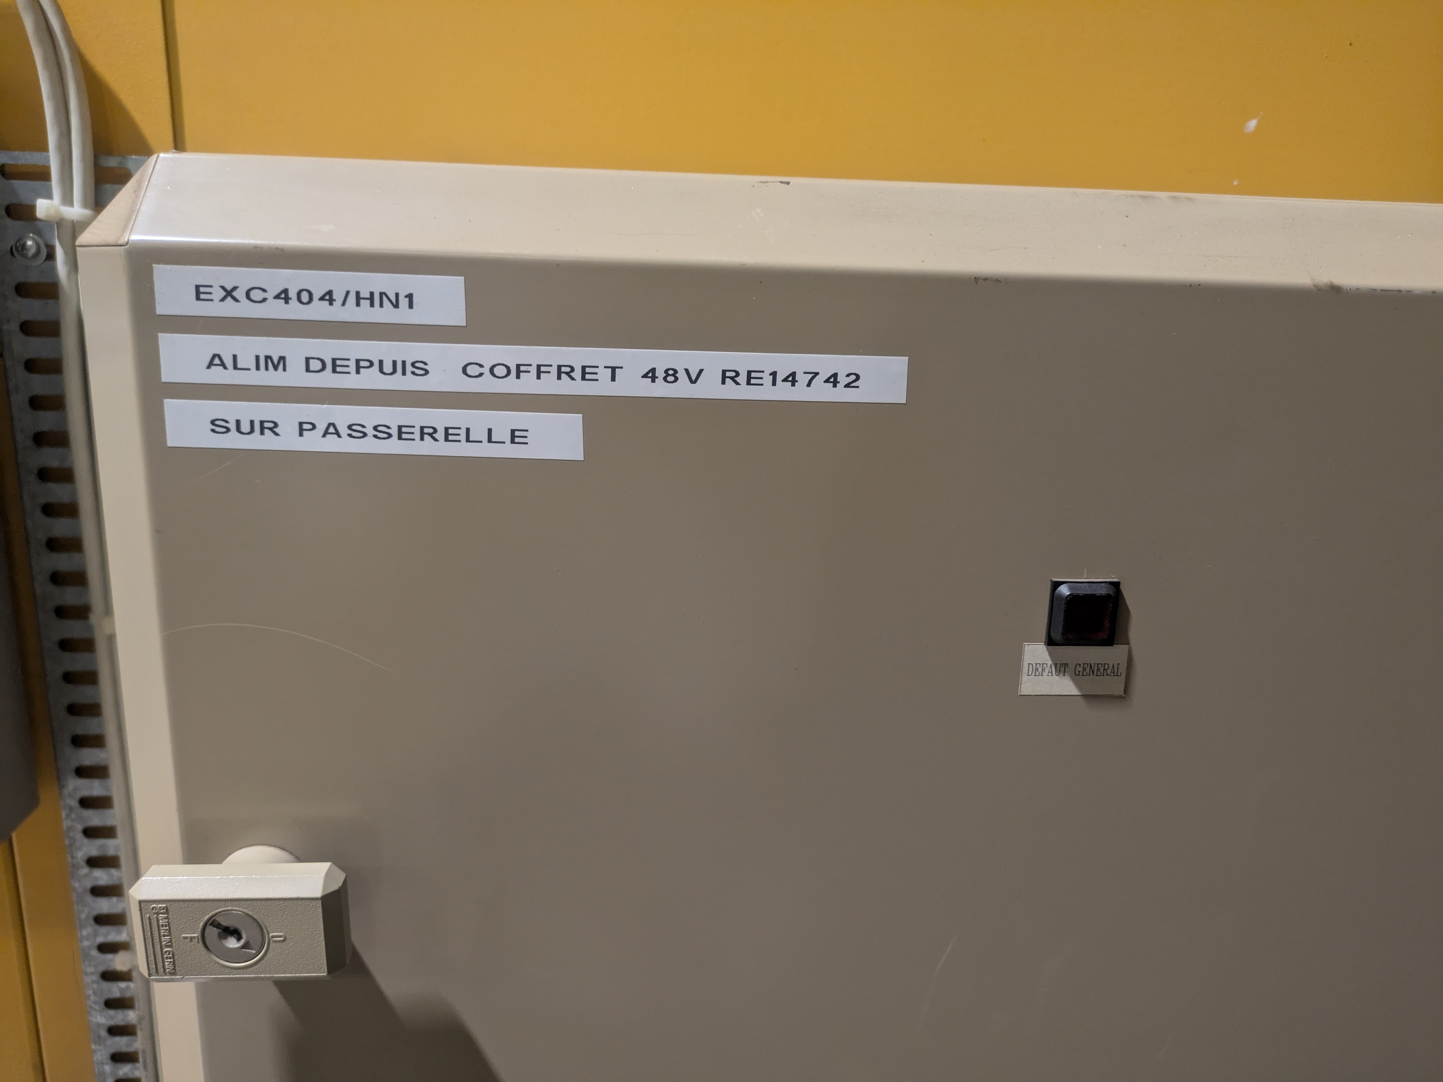
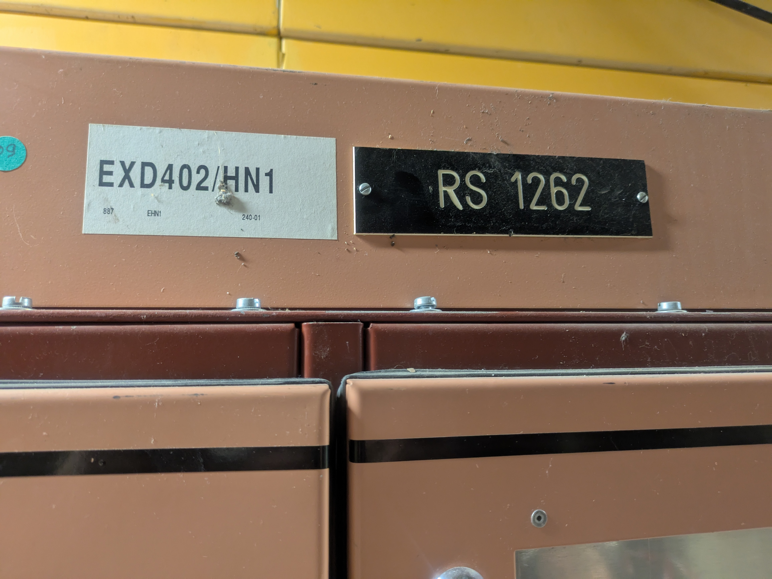
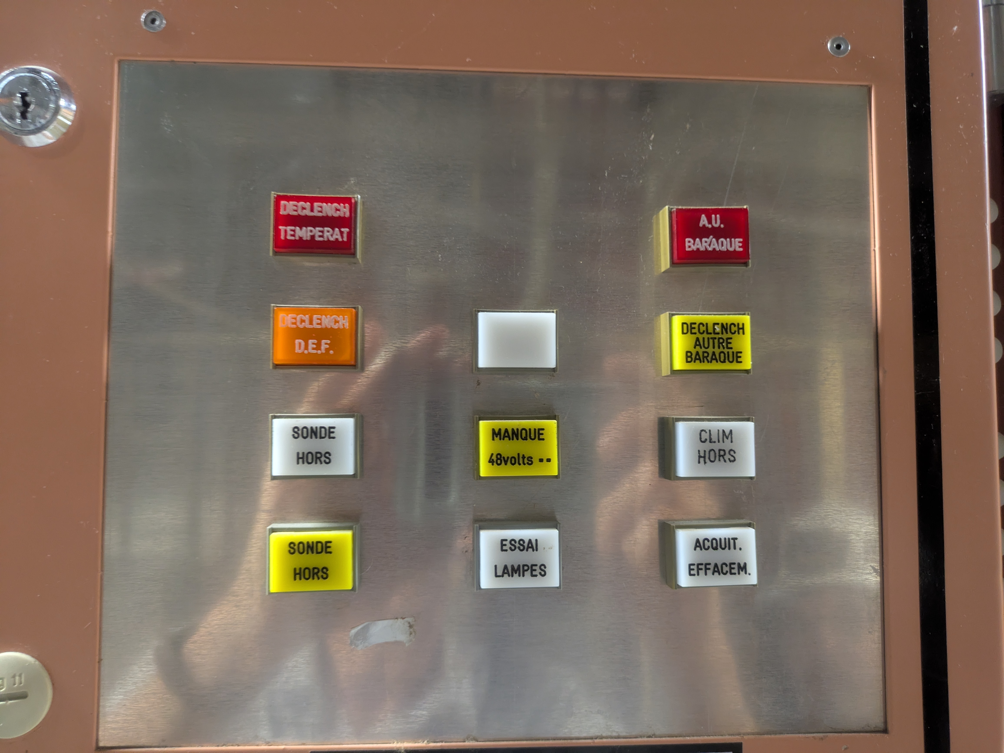
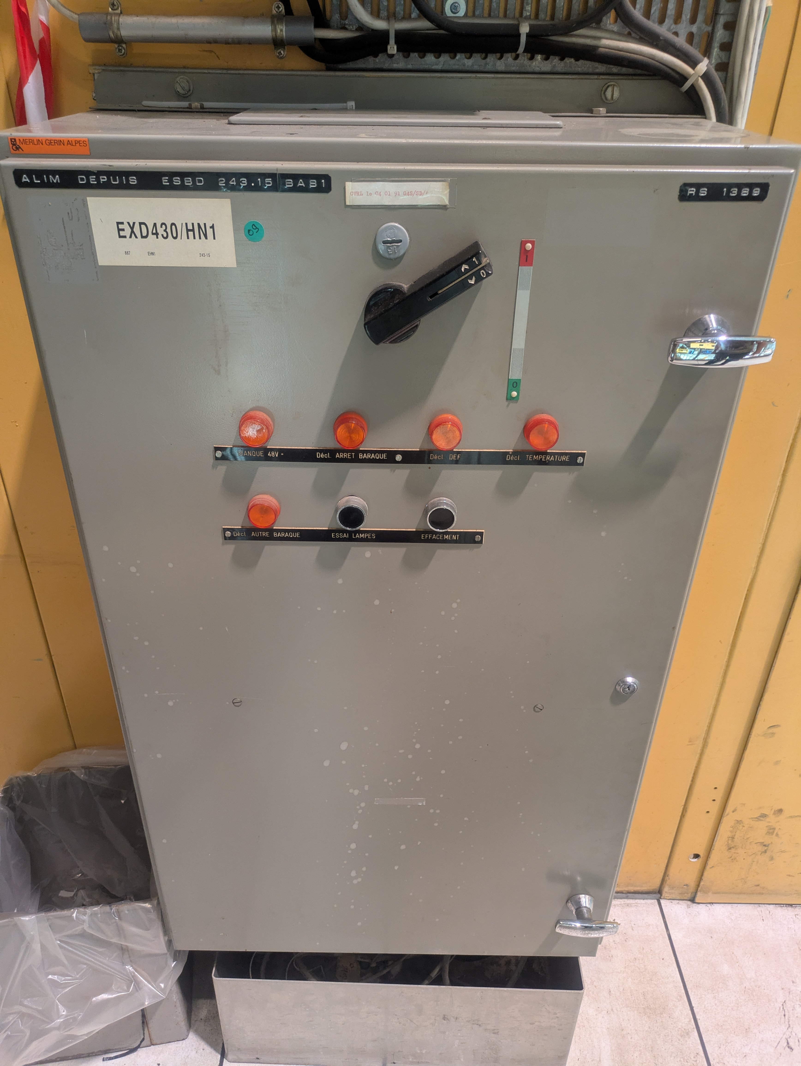
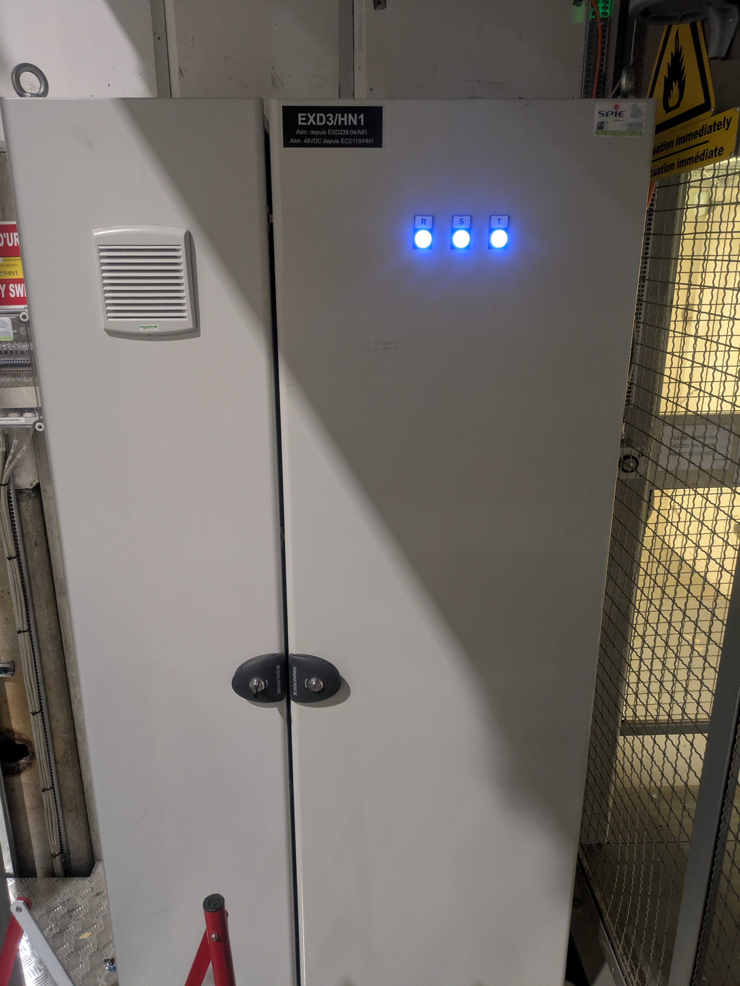
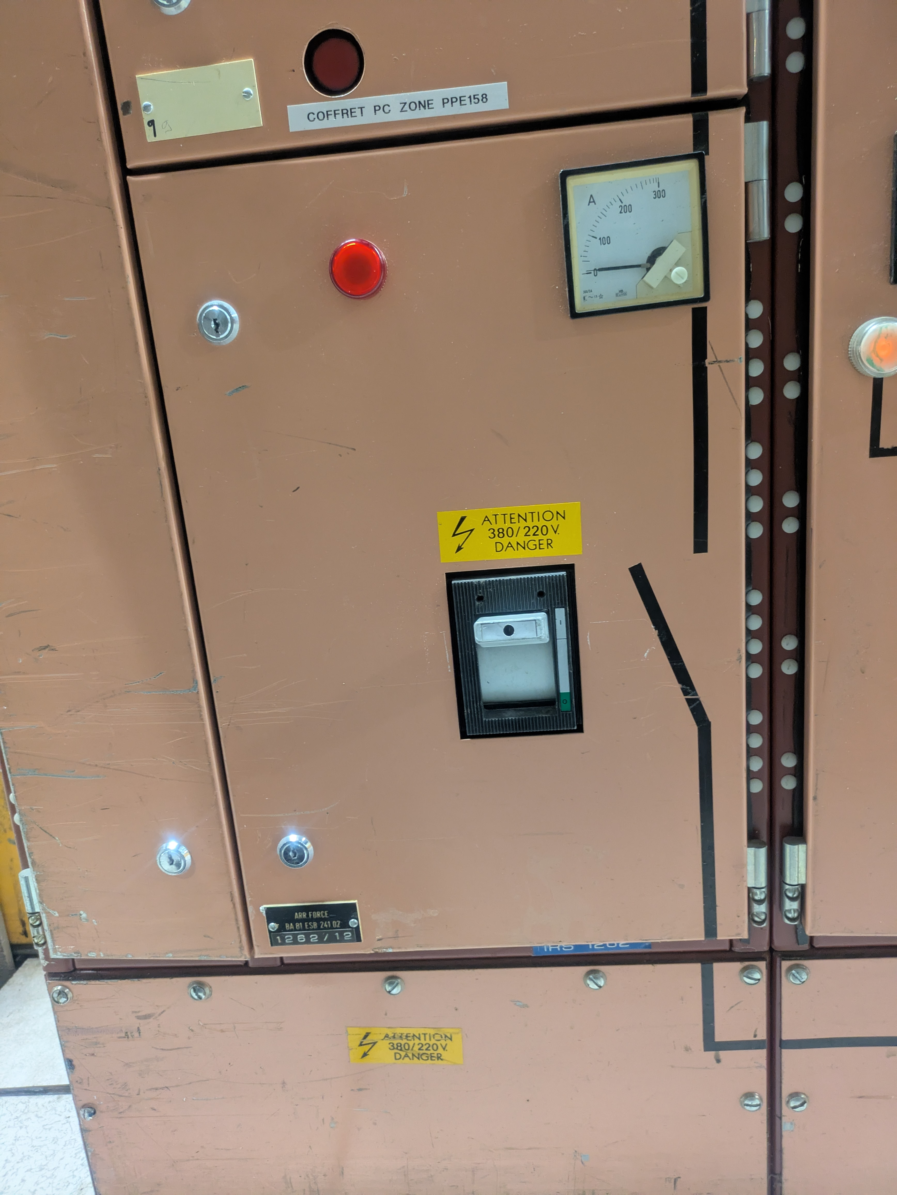
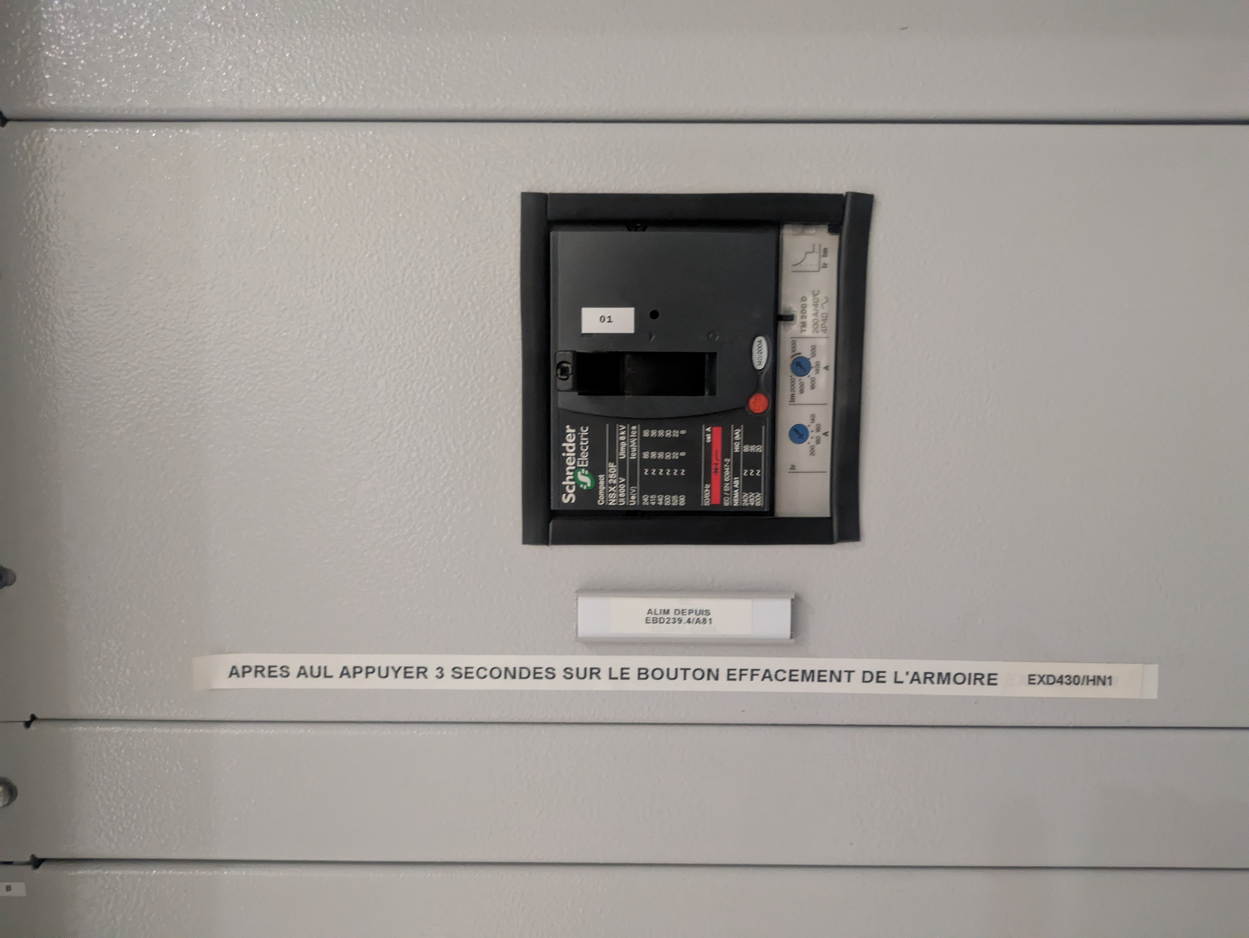
2
EXD404/HN1
1
EXC404/HN1
EDMS 3306199
5
EXD402/HN1
Far end of GIF++ control barracks
3
EXD430/HN1
Far end of GIF++ control barracks
4
EXD3/HN1
Outside GIF++ control room
GIF++ assembly area
near Morpurgo magnet

