Slide 1
Naming update of North Area devices
Dipanwita Banerjee
EATM – 185th Meeting
03 Jun 2025
Dipanwita Banerjee, Bastien Rae, Johannes Bernhard, Giulia Romagnoli, …..

Slide 2
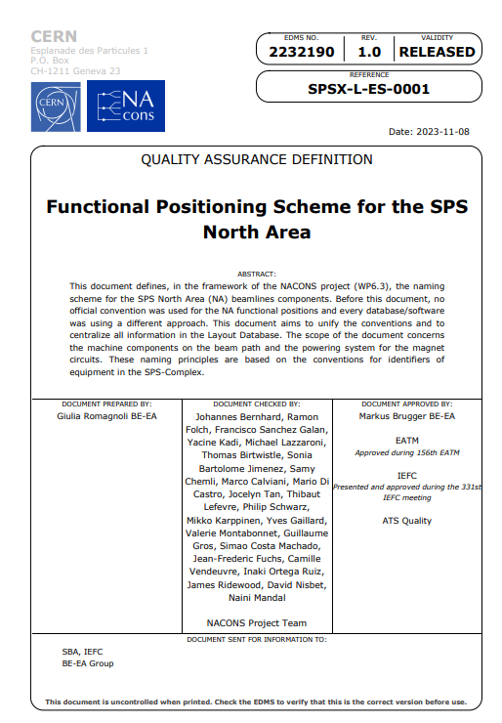
Functional Positioning Scheme for the SPS North Area
EDMS 2232190
First version: 2019-09-23
Released: 2023-11-10
We would like to do a follow-up status of the names of the funtional positions in the different database!

Slide 3
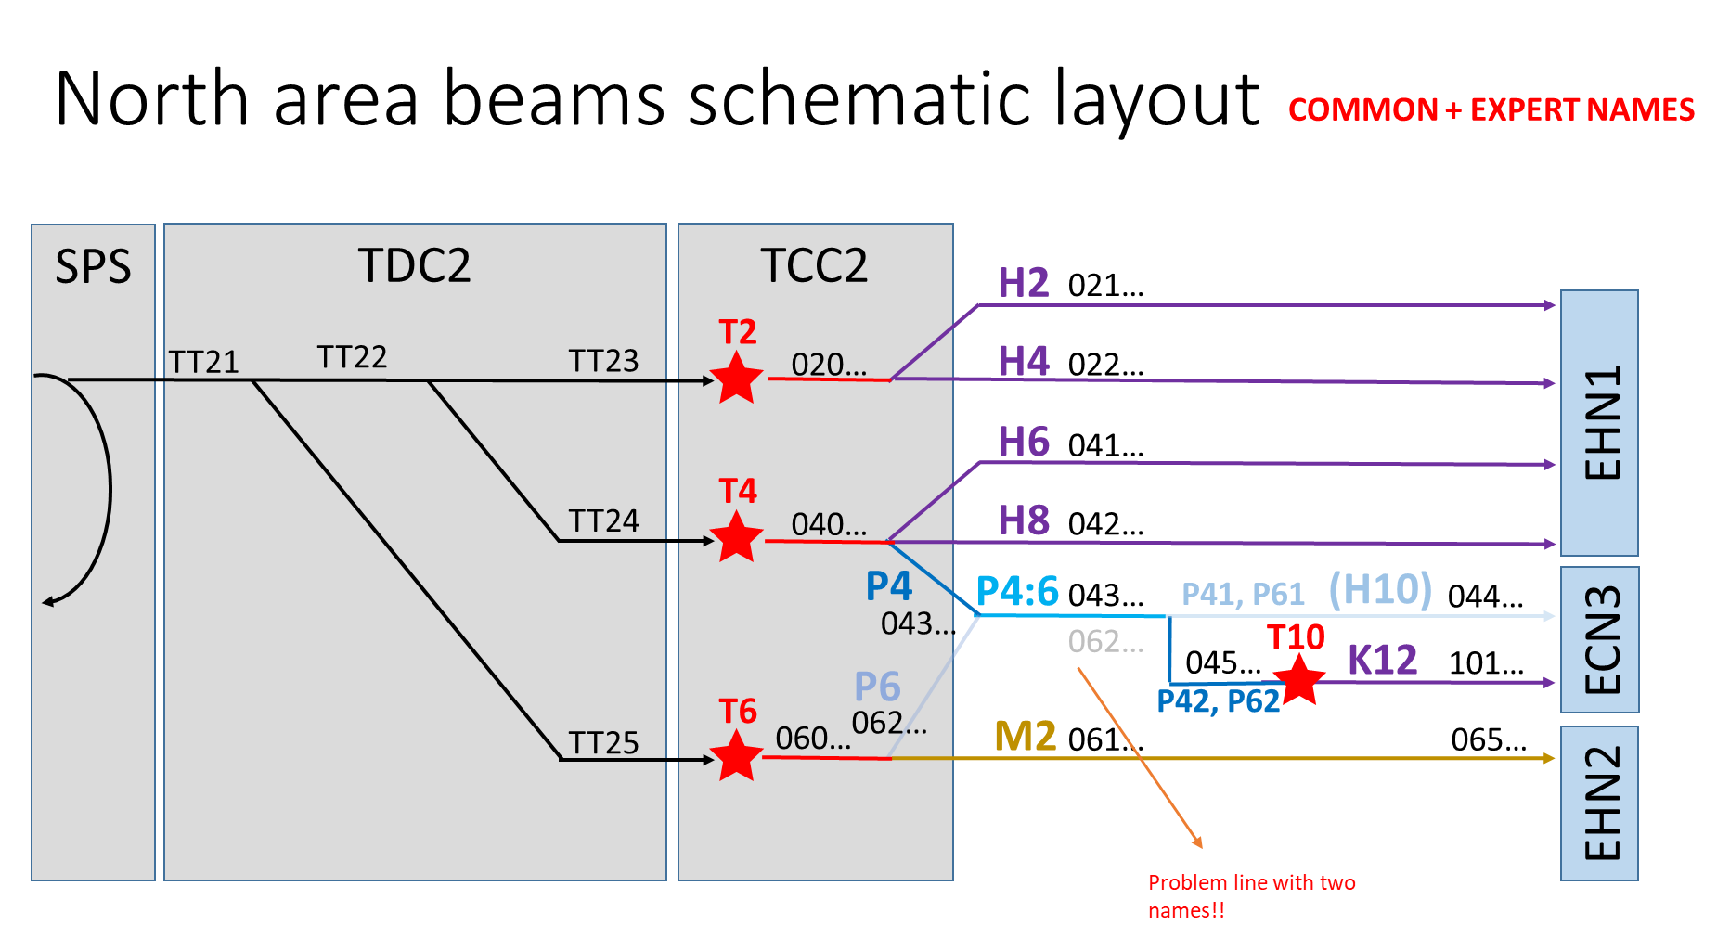
OLD Convention

Slide 4
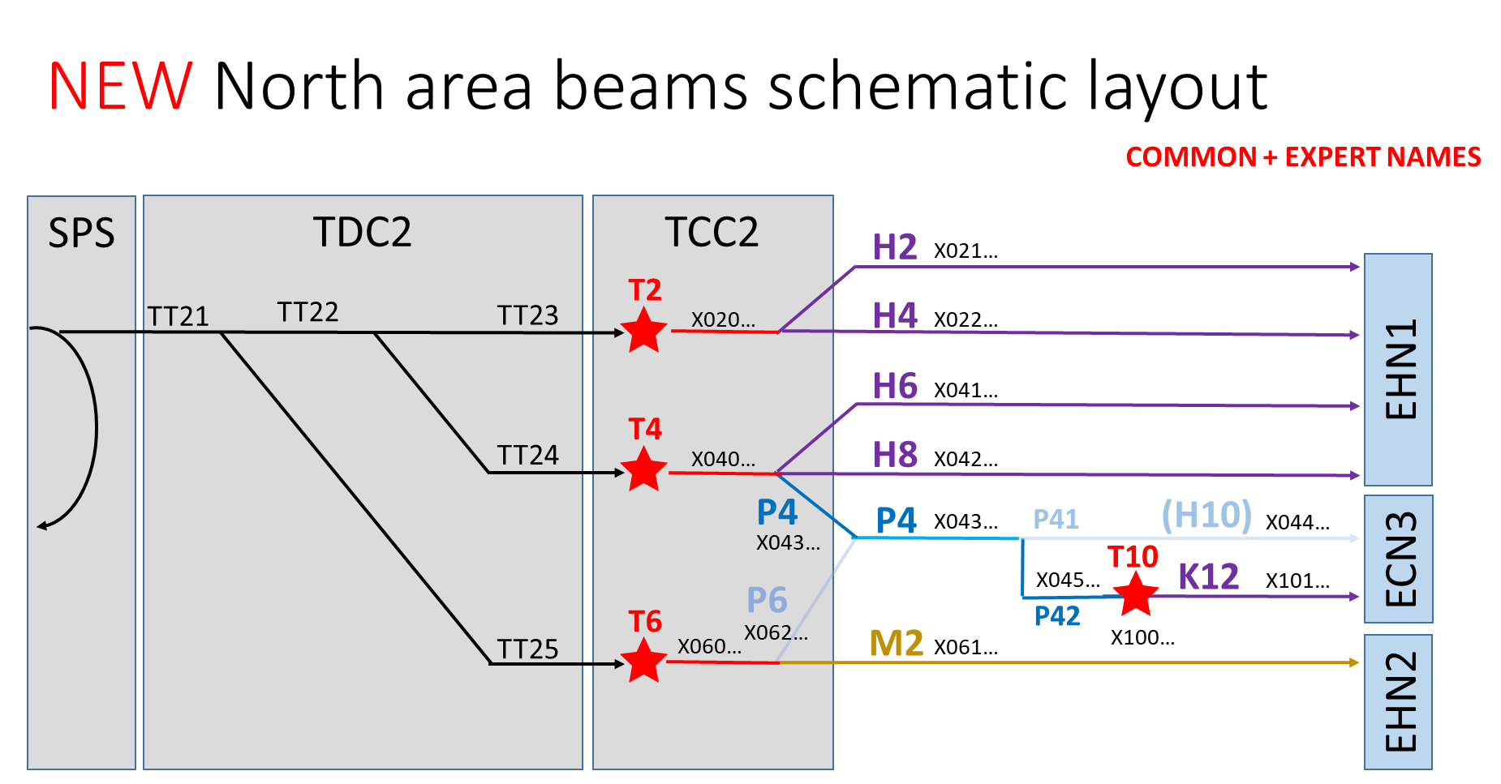
NEW Convention

Slide 5
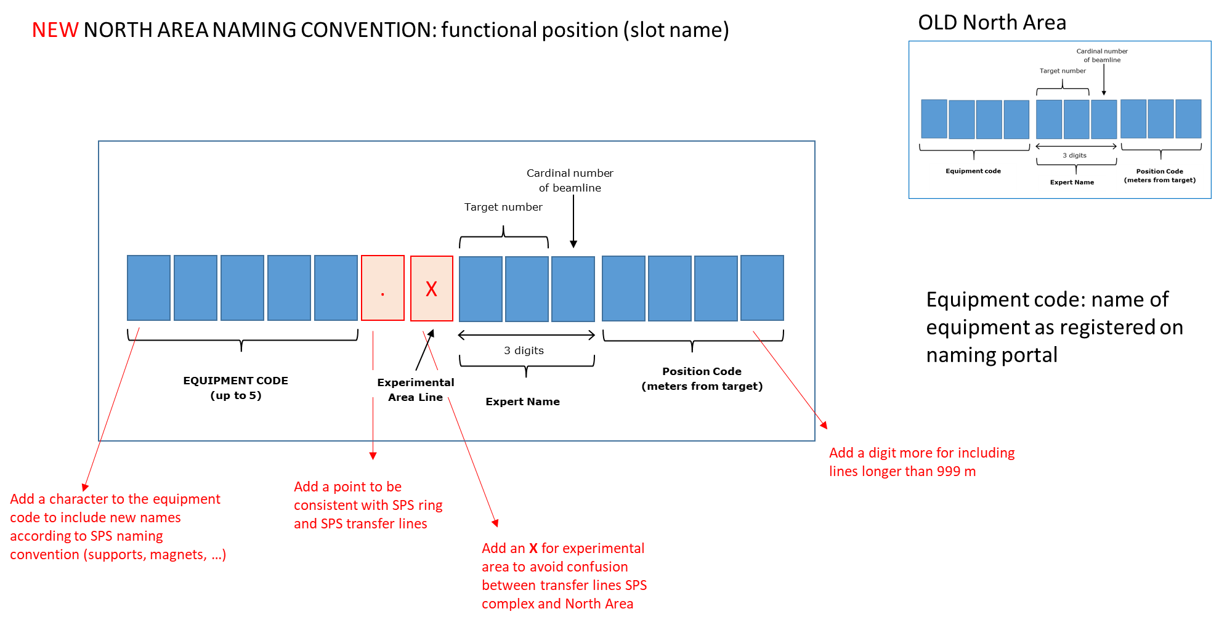
Functional Positions

Slide 6
Changes 1
Database/Change | Person responsible for the change | Person to notify after change is done | Status
Functional positions in Layout Database | Giulia Romagnoli | Giulia Romagnoli | DONE
Electrical circuits in Layout Database | Natalya Kahn | Giulia Romagnoli | DONE
Release naming convention North Area | Giulia Romagnoli | Giulia Romagnoli | DONE EDMS 2232190
Timber variables/NXCALS | Equipment groups | Giulia Romagnoli
Change and update the integration drawing | Vincent Clerc | Giulia Romagnoli | On going…
Update SPS operational applications | James Ridewood, Stephane Cettour Cave | Kevin Li
Cesar Software | Bastien Rae/Maciej Peryt | Bastien Rae | On going
MADx/Beatch optics file | Dipanwita Banerjee | Giulia Romagnoli | DONE

Slide 7
Changes 2
Database/Change | Person responsible for the change | Person to notify after change is done | Status
Controls Configuration Database (CCDB) | (FESA responsible for equipment) | Bastien Rae
EPC database | Yves Gaillard | David Nisbet | FUTURE (keep old names until new PC installation in LS3) see chapter 3.3 in EDMS 2232190.
PC Name Changes and RBAC access maps | Yves Gaillard | David Nisbet | FUTURE (keep old names until new PC installation in LS3) see chapter 3.3 in EDMS 2232190.
FGC device name | Raul Murillo | Raul Murillo
WIC GUI update | Richard Mompo | Bastien Rae
Safety Documents for EIS | Didier Chapuis | Christelle Gaignant | ????
Update cablothèque (M2 part with 065) | Eric Van Uytvinck | Sylvain Girod
RP survey files (add expert names as info) | Yann Pira | Giulia Romagnoli
Survey Files (Geode) | Camille Vendeuvre | Giulia Romagnoli | On going

Slide 8
Conclusions
Almost 2 years after the release of the new naming convention for the North Area EDMS 2232190 there are still databases not consistent and following the old version of it (or different ones ☺ )
ACTIONS:
Verify the status of the naming change in different databases
Contact people in charge of perform/verify the changes…
Create a EATM action
Follow-up status after the summer

Slide 9
THANK YOU!!

