Slide 1

CERN LPCC MC Meeting 7/10/2025 Jon Butterworth, UCL OBO the Contur developers, currently A. Buckley, JMB, J. Egan, C. Gütschow S. H. Jeon, M. Habedank, T. Procter, P. Wang, …
Contur Update

Slide 2

The idea
LHC measurements of particle-level differential cross sections have implications for BSM physics.
Make this information easily accessible.
Constraints On New Theories Using Rivet

Slide 3
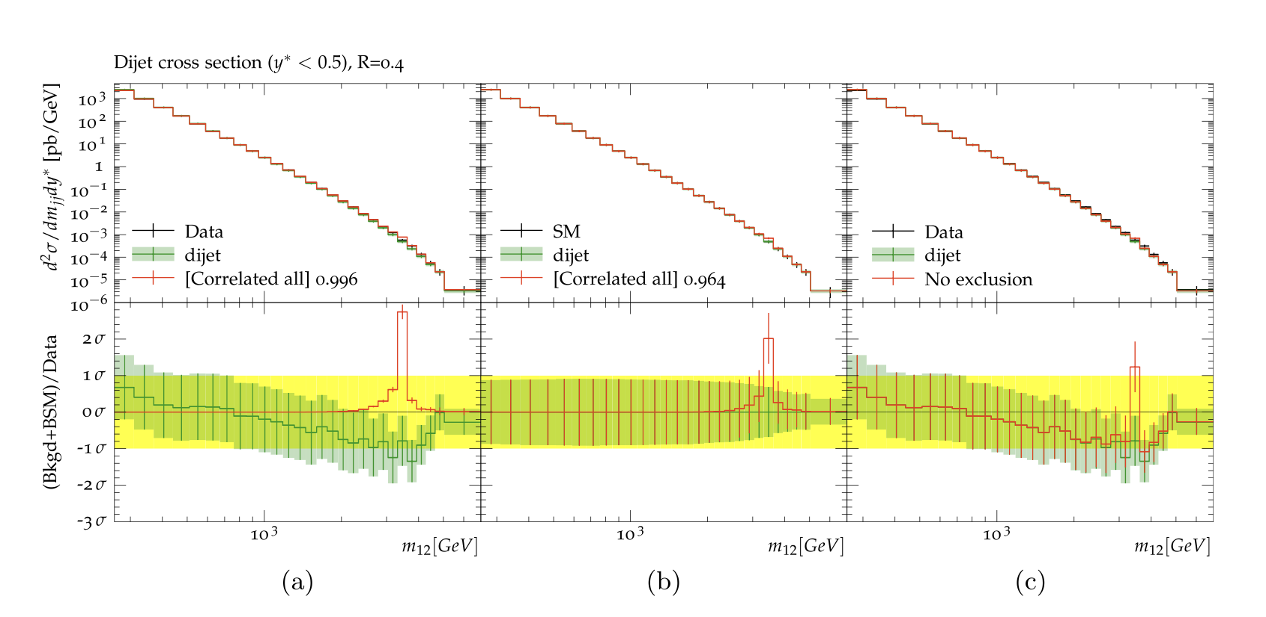
Contur arXiv:1606.05296, arXiv:2102.04377, arXiv:2505.09272
Extend the power of Rivet beyond the Standard Model
Signal-injection of final-state particles from Beyond-the-SM physics events into the fiducial phase space of measured cross sections in Rivet
From Altakach, JMB, Ježo, Klasen, Schienbein arXiv:2111.15406
Increasingly precise measurements and calculations together extend the reach
JMB, Grellscheid, Krämer, Sarrazin, Yallup; Buckley et al

Slide 4
What we have
Steering of scans for Herwig, Madgraph.
Native MadGraph interface to Contur & Rivet (O. Mattelaer, S. H. Jeon)
Big and growing library of SM predictions and measurements (100s)
Full use of experimental correlations where available
Expected and actual exclusion contours
Expected HL-LHC sensitivity estimate
SQlite DB for results
Latest: Contur 3.1.3, Rivet 4.1.1, Yoda 2.1.1

Slide 5
Most Recent Developments
Further improvements in database, speed
Yiming Li, B. Waugh
Further development toward interactive GUI,
F. Aldoussri, B. Waugh
Several new datasets and SM predictions
D. Bernard, E. Cooper, N. Fedev, B. Hussein, M. Roberts (UCL summer students) and P. Wang, J. Andersen
Continuing usability and reliability improvements
developers

Slide 6
SM predictions
INFO - 1643 distributions were checked.

Slide 7
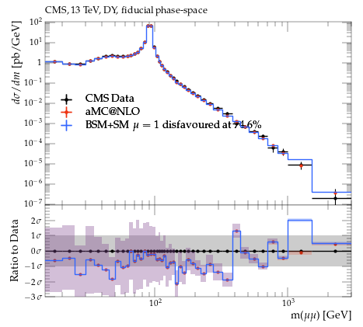
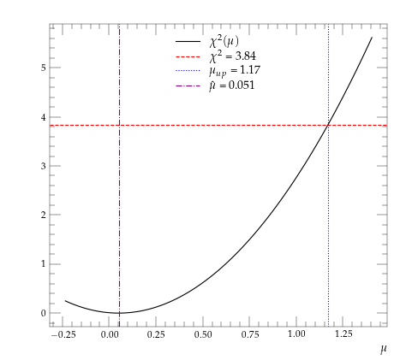
A bit less recent
Interface (J. Egan) to Spey (J. Araz, arxiv:2307.06996) allows us to obtain
CLs exclusion for signal strength µ=1
Best fit value of µ
One- or Two- sided 95% CLs interval on µ depending on whether µ is allowed to be negative.

Slide 8
Physics (2025 only)
Probing the coupling of axions to tops and gluons with LHC measurements, JMB, M. Cullingworth, J. Egan, F. Esser, V. Sanz, M. Ubiali 2508.21660
Local Baryon Number at the LHC, JMB, H. Debnath, J. Egan, P. Fileviez Perez, 2505.06341 , Phys.Rev.D 112 (2025) 1, 015012
t-channel dark matter at the LHC -- a whitepaper C. Arina, B. Fuks, L. Panizzi, et al 2504.10597 Eur.Phys.J.C 85 (2025) 9, 975
A measurement of the high-mass ττ production cross-section at √s = 13 TeV with the ATLAS detector and constraints on new particles and couplings ATLAS Collaboration 2503.19836 accepted, JHEP
Probing the sensitivity of semi-visible jets to current LHC measurements using the Contur toolkit A. Buckley, JMB, L. Corpe, C. Doglioni, D. Kar, C. Prat, S. Sinha, D. Wilson-Edwards, 2502.11237
Probing exotic long-lived particles from the prompt side using the Contur method, L. Corpe, A. Goudelis, S. Jeannot, S. H. Jeon, 2407.18710 JHEP 02 (2025) 033

Slide 9

Working toward
More efficient scanning of multidimensional phase space
More flexible fitting (EFTs, anomaly detection)
Better access to existing and improved SM predictions (and uncertainties)
E. Erdogan (CMS, MCnet/LPCC short-term student)
More data

