Slide 1
CERN EAM User Meeting
25 June 2025
CERN Asset & Maintenance Management Service
EAM.Support@cern.ch

Slide 2
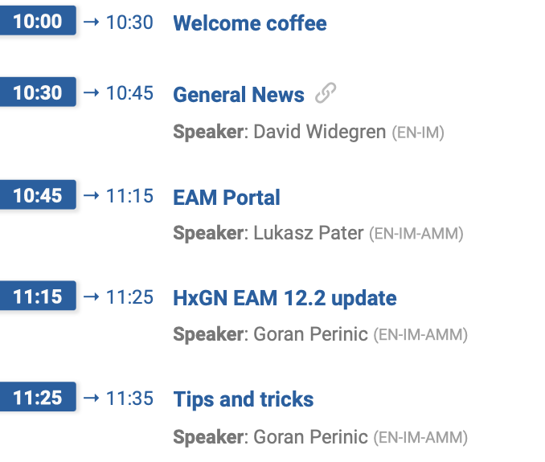
Agenda

Slide 3
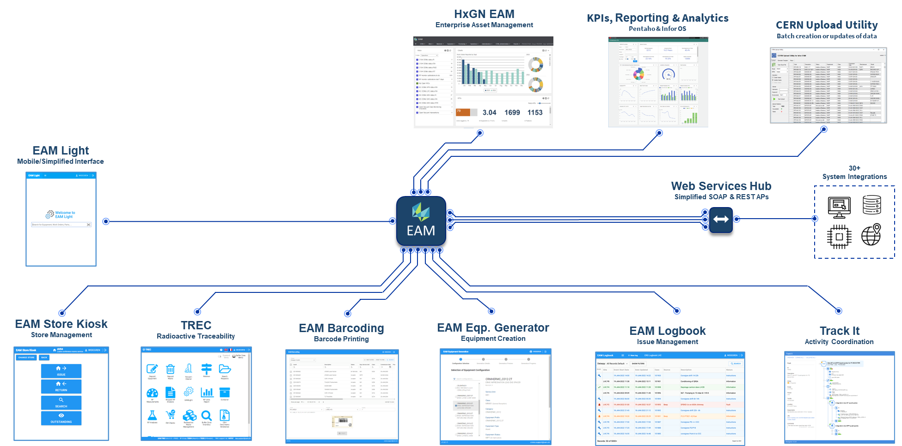
Our EAM Platform
Enterprise Asset Management
@ CERN

Slide 4
Our EAM Platform
Enterprise Asset Management
@ CERN

Slide 5
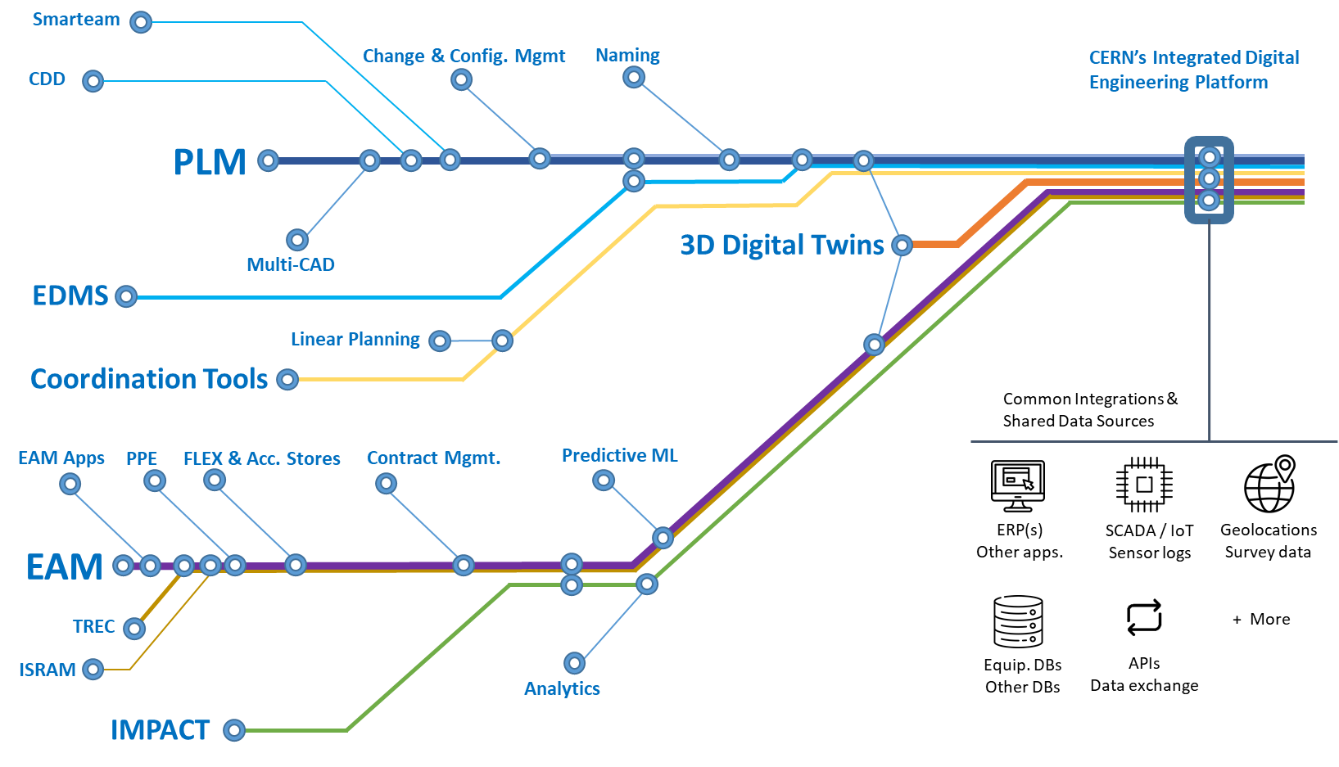
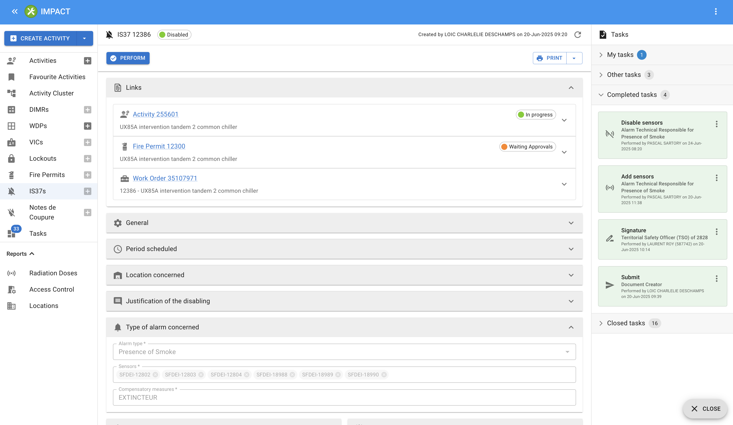
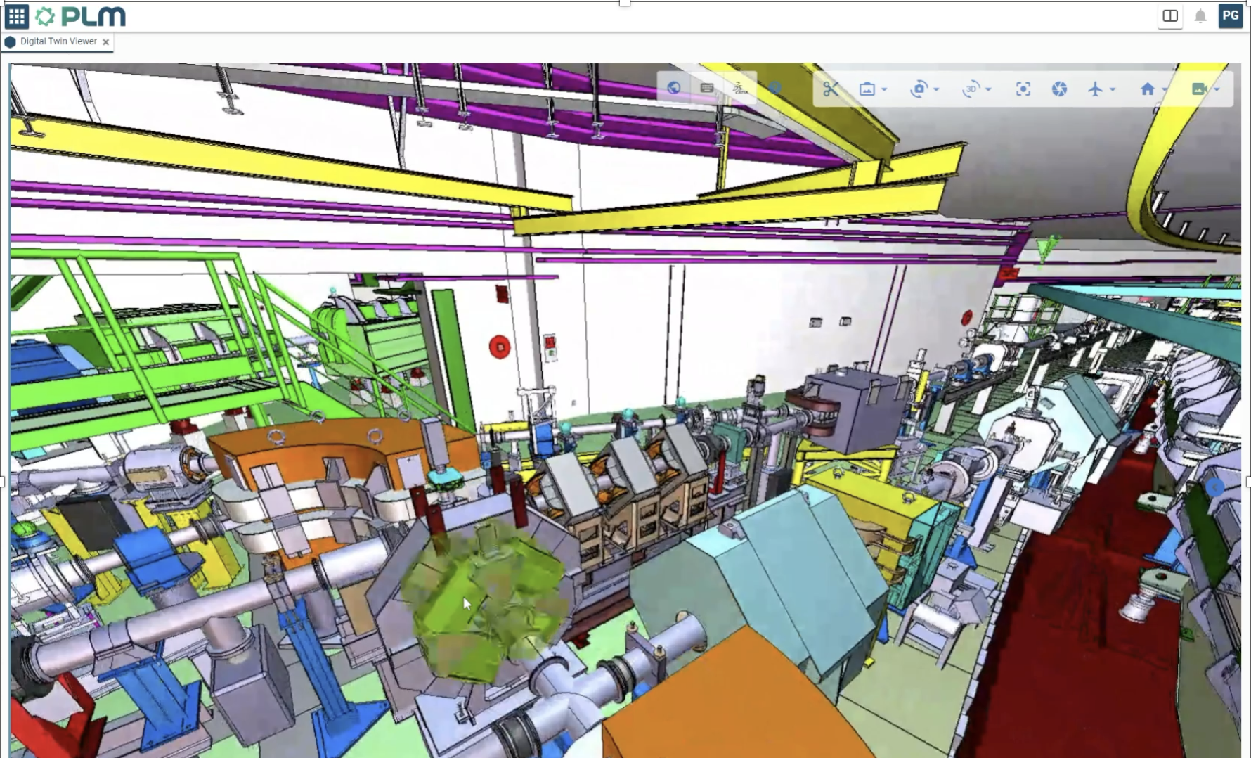
EAM remains a strategic core application in our portfolio
EAM is one of the strategic core components of the integrated engineering platform that the EN-IM group is moving towards.
Tighter integrations with other EN-IM apps;
IMPACT
Gradually providing more links and integrations with EAM.
PLM & 3D Digital Twins
3D Visualisation & navigation in both PLM and EAM data

Slide 6
The EAM footprint at CERN is growing even further
Additional functionality and legacy applications have recently or are in the processes of being added or merged onto the EAM platform.
  Norma DB
    Norma DB is being transformed to an application fully based on EAM and the EAM technology stack.
  ePool & Car Pool
    Legacy tools for reserving and renting equipment have been move into EAM based on standard functionality.
  CCC/TI Logbook
    The new CCC/TI logbook is developed based on the EAM Logbook with many UI enhancements.
  ESP Portal
    The Electrical Safety Project Portal and its functionality is to a large extent based on EAM functionality.
Extensions and enhancements are also resulting in improvements for all EAM users!

Slide 7

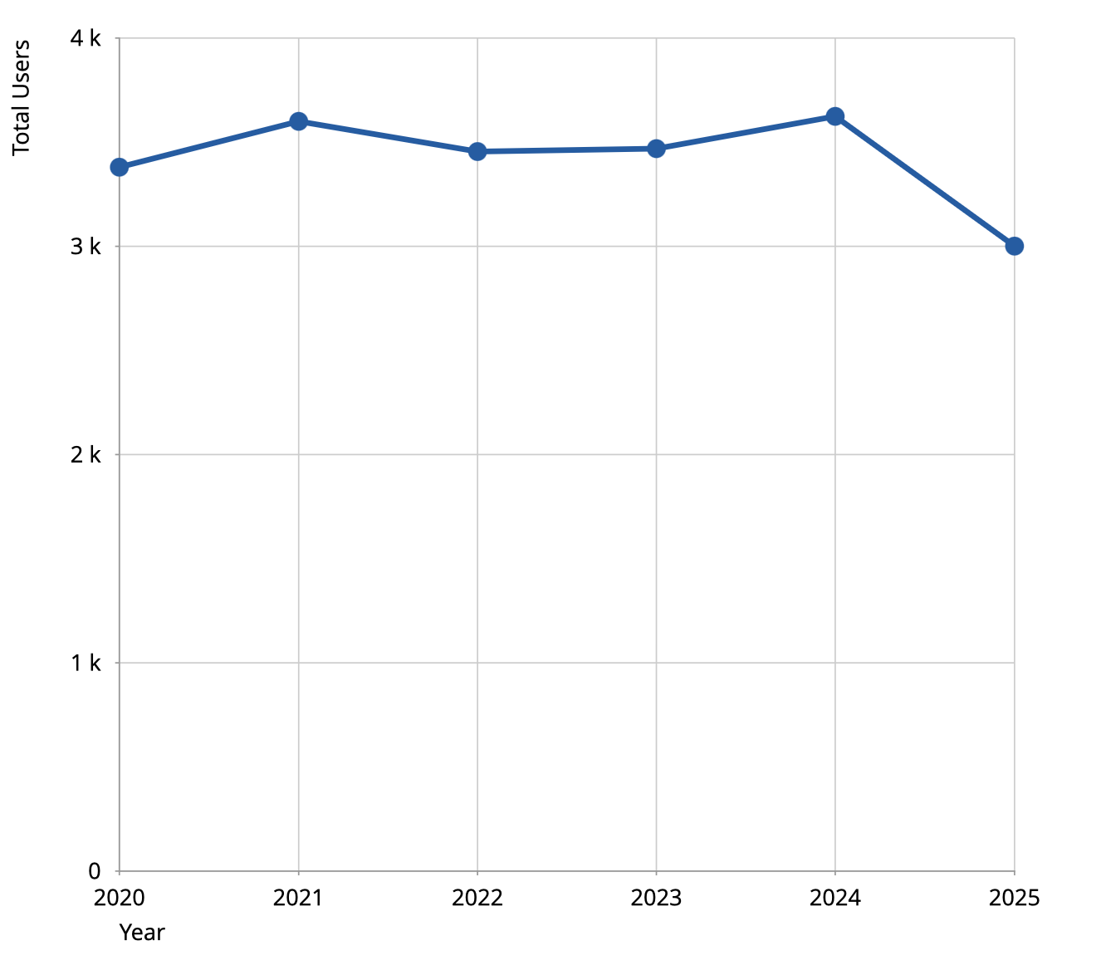
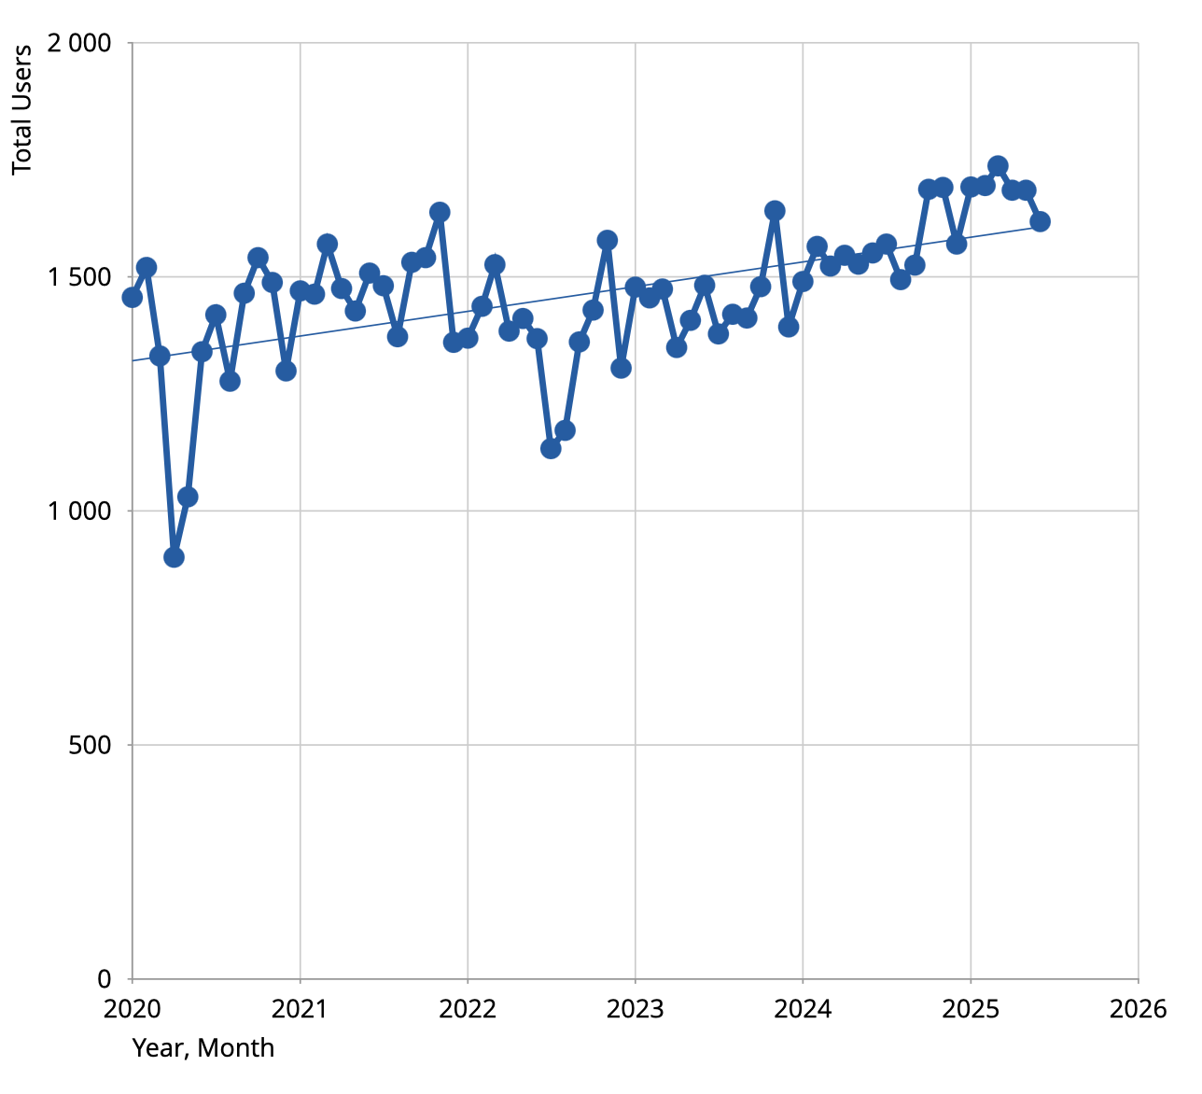


Number of users are stable. Usage is growing!
3.7k Users / Year
1.7k Active users / Month
>1 M Checklist Items / Year
>100 k Work Orders / Quarter
20 k Web Service Calls / Hour

Slide 8
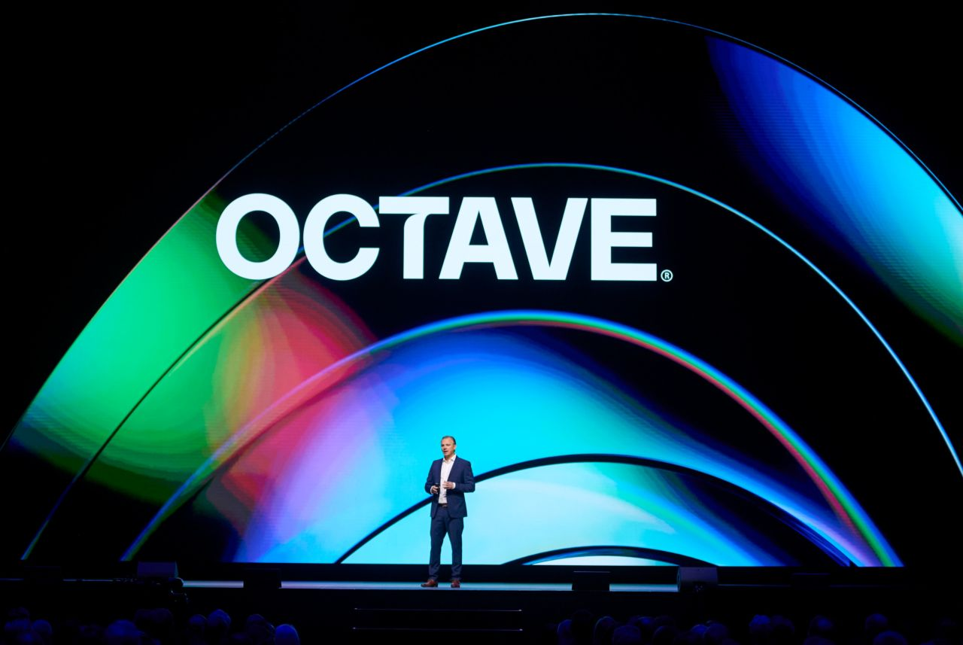
Hexagon will split into two companies
Announcement from Hexagon last week
  Hexagon will spin-off a company specialised on their software offering and it will include its;
    Asset Lifecycle Intelligence division (incl. EAM)
    Safety, Infrastructure and Geospatial division
    ETQ (Quality Management)
    Bricsys (CAD)
  The new company will be created Q1/Q2 2026 and will be called Octave.
  The product name HxGN EAM might change into Octave EAM, but we will continue to call it just EAM.

