Slide 1





Collimation considerations on IR apertures
G. Broggi^{1,2,3}, M. Boscolo^{2,3}, R. Bruce²
¹ Sapienza University of Rome, Italy ² CERN, Meyrin, Switzerland ³ INFN-LNF, Frascati, Italy
FCC-ee MDI meeting #67, 16/06/2025
Acknowledgements: K. Andre, M. Hofer, K. Oide

Slide 2
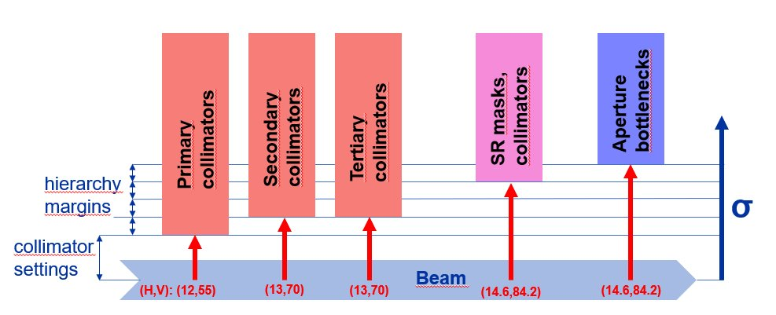
IR apertures: interplay with collimator settings
IR apertures determine the minimum beam-stay-clear (or aperture bottleneck)
Collimation system must protect the aperture bottleneck of the machine
  Collimator openings determined starting from minimum BSC
Machine errors, alignment tolerances, corrections, …
Specify quantities like:
Max closed orbit distortion
Max. beta-beating
Max. parasitic dispersion
Collimator settings set accordingly with sufficient tolerances to ensure that collimation hierarchy is respected
Minimum beam-stay-clear (aperture bottleneck) is estimated
Minimum hierarchy margin: ~200-300 um (~1 σ_{βx}, ~15 σ_{βy})
  H plane: primary collimator @ min. BSC - 2σβx
  V plane: primary collimator @ min. BSC - 30σβy
Larger IR apertures provide larger min. BSC
  Collimator openings can be increased
  Reduced impedance contribution from collimators
  Primary vertical collimator TCP.V.B1 gives the highest impedance contribution
16/06/2025
G. Broggi | FCC-ee collimation

Slide 3
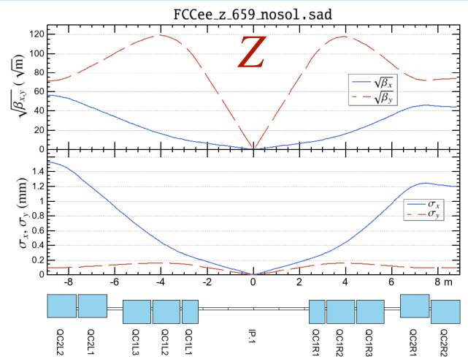
FCC-ee Z V25.2 GHC: current status
Tolerances (M. Hofer, Beam-stay-clear in the 4-IP layout and aperture constraints from top-up injection, FCC-ee Optics Design Meeting #153, 21/04/2022)
  10% max. β-beating
  250 um max. closed orbit distortion
Minimum beam-stay-clear at Z
  H plane: 11.5 σβx @ QC2L2
  V plane: 81.5 σβy @ QC1L2
Currently assumed QC* apertures
  QC1: 15 mm radius
  QC2: 20 mm radius
Primary betatron collimator settings
  H plane: 9.5 σβx (5.6 mm)
  V plane: 50 σβy (1.4 mm – sizeable impedance contribution: D. Gibellieri, FCC week 2025 talk)
QC1/QC2 aperture increase would allow larger vertical/horizontal collimator gaps
  Is this an option?
K. Oide
16/06/2025
G. Broggi | FCC-ee collimation

Slide 4
QC* aperture scan
Tolerances​
  10% max. β-beating​
  250 um max. closed orbit distortion
QC1 aperture [mm] | QC2 aperture [mm] | Min. BSC [σβx] | Min. BSC [σβy] | TCP.H half-gap [σβx (mm)] | TCP.V half-gap [σβy (mm)]
15 | 20 | 11.5 (QC2) | 81.5 (QC1) | 9.5 (5.6) | 50 (1.4)
20 | 25 | 12.5 (QC2) | 109.5 (QC1) | 10.5 (6.2) | 79.5 (2.2)
20 | 30 | 12.5 (QC0) | 109.5 (QC1) | 10.5 (6.2) | 79.5 (2.2)
current baseline
QC2 aperture increase to 25-30 mm radius would allow for larger horizontal collimator gaps
QC1 aperture increase to 20 mm radius would allow for larger vertical collimator gaps
  Likely more relevant, as TCP.V has the smallest half-gap and largest impedance contribution
16/06/2025
G. Broggi | FCC-ee collimation

Slide 5
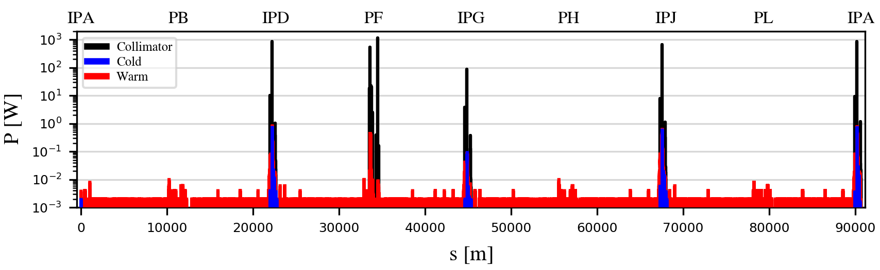
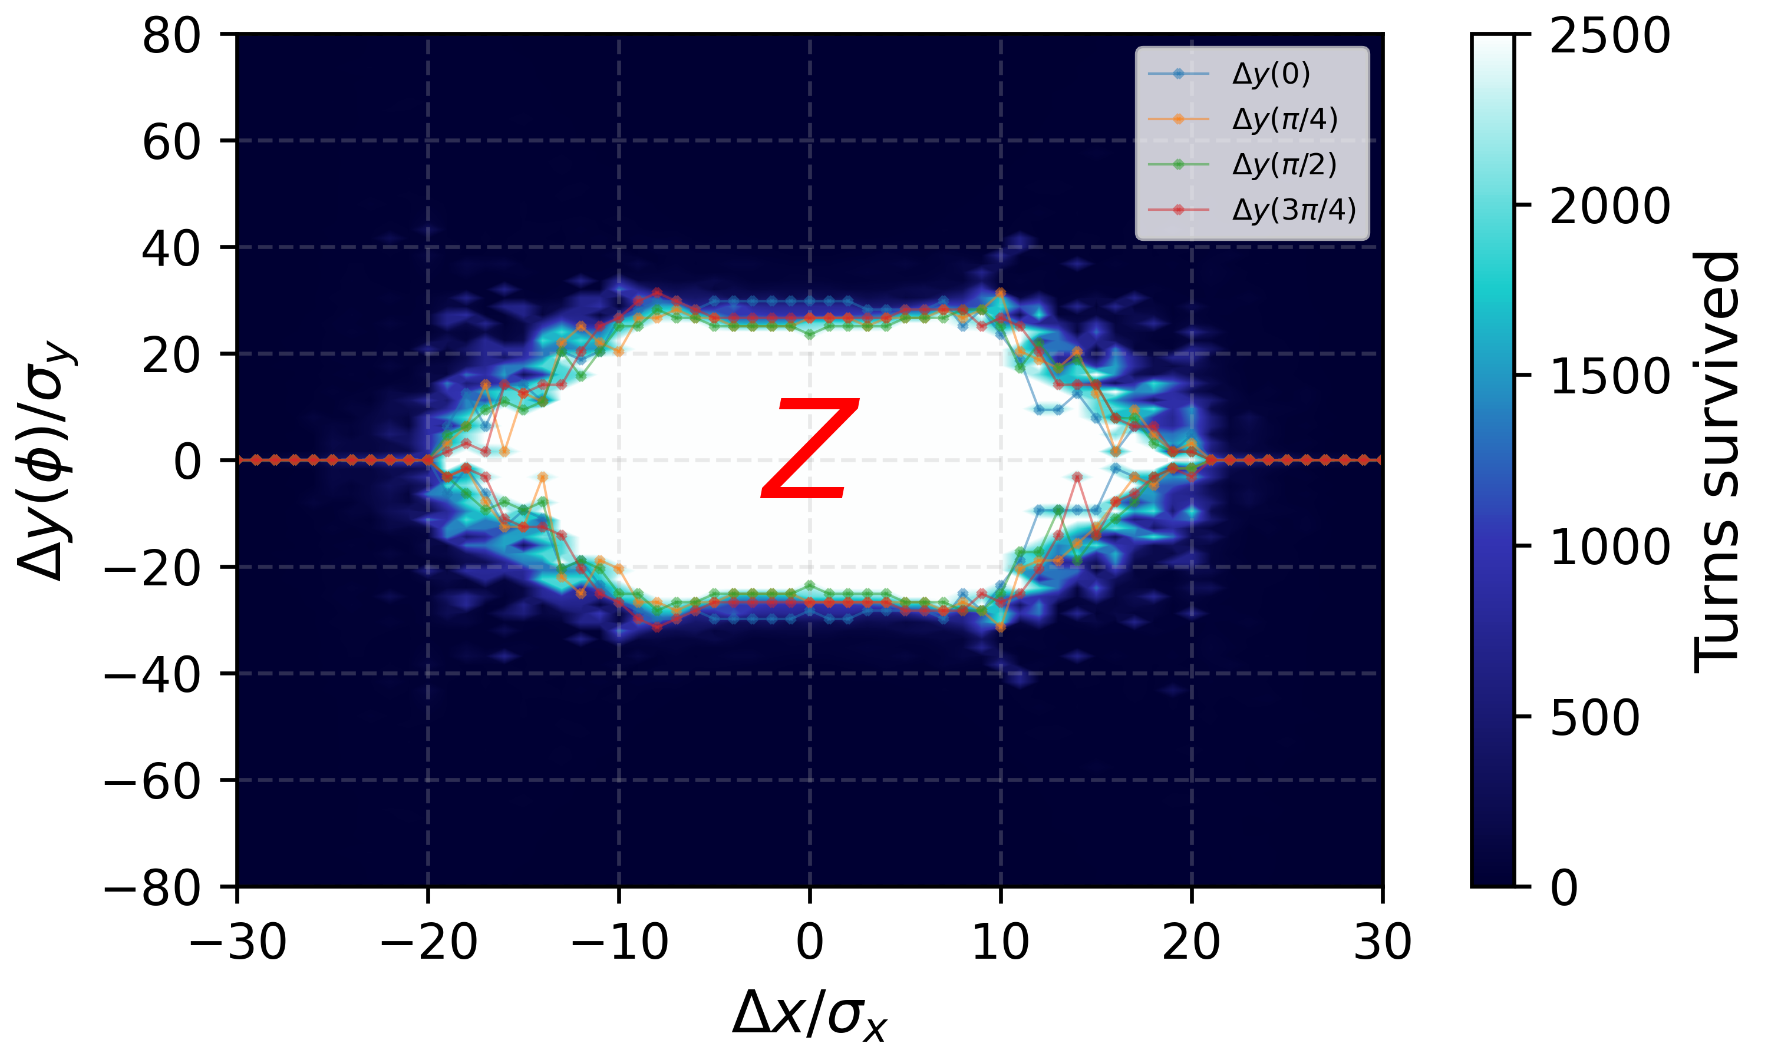
Collimator cut vs. DA
Currently, primary collimator cut is set regardless of the transverse DA limit
  V plane: chaotic dynamics between DA limit and primary vertical collimator (TCP.V) cut
  Losses no longer predominantly intercepted by the TCPs
  Comparable losses on TCPs and local protection tertiary collimators (TCTs) upstream of the IRs
Example: beam-residual gas Coulomb scattering losses in the FCC-ee (Z)
Ideally DA should be larger than the minimum BSC
TCP.V cut
FCC-ee Z V25.2 GHC transverse DA
(no quantum, no BB)
16/06/2025
G. Broggi | FCC-ee collimation

Slide 6
Outlook
IR apertures determine the minimum beam-stay clear (aperture bottleneck)
  Direct influence on collimator settings
Minimum beam-stay-clear at Z
  H plane: 11.5 σβx @ QC2L2
  V plane: 81.5 σβy @ QC1L2
QC2 aperture increase to 25-30 mm radius would allow for larger horizontal collimator gaps
QC1 aperture increase to 20 mm radius would allow for larger vertical collimator gaps
  Likely more relevant, as TCP.V has the smallest half-gap and largest impedance contribution
16/06/2025
G. Broggi | FCC-ee collimation

Slide 7
Thank you!
16/06/2025
G. Broggi | FCC-ee collimation

Slide 8
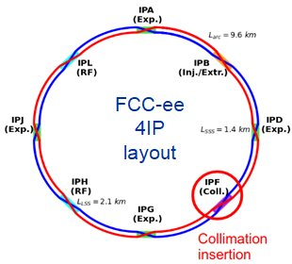
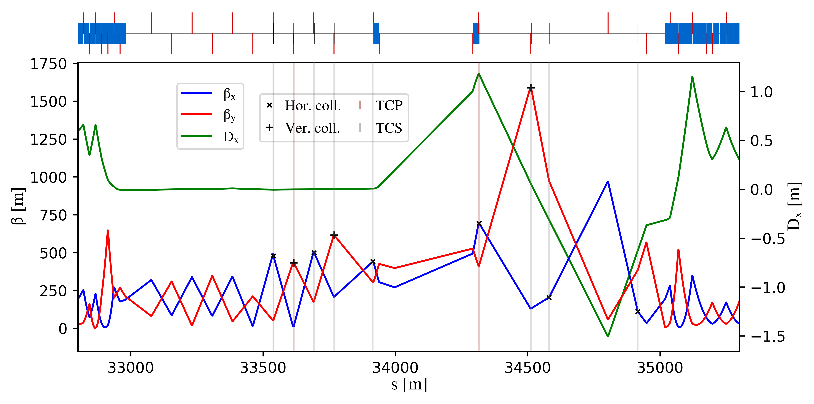
FCC-ee halo collimation system
Dedicated long straight section in PF
  Common technical insertion optics by K. Oide (V25.2 GHC - talk)
  Two-stage betatron and off-momentum collimation
  Ensure protection of the aperture bottlenecks in different conditions
    Aperture bottleneck at Z: 11.5σ (H plane), 81.5σ (V plane)
  First collimator design for cleaning performance
    Sizeable impedance increase driven by TCP.V collimator (D. Gibellieri, FCC week 2025 talk)
    Collaboration with optics, impedance, FLUKA, and engineering team to optimize the design
    First exploratory study on crystal collimation for FCC-ee (NIMA paper)
betatron
off-momentum
FCC-ee (Z) beam halo collimator parameters and settings
Name | Plane | Material | Length [cm] | Gap [σ] | Gap [mm] | δ_{cut} [%]
TCP.H.B1 | H | C-based | 25 | 9.5 | 5.6 | -
TCP.V.B1 | V | C-based | 25 | 50 | 1.4 | -
TCS.H1.B1 | H | Mo-based | 30 | 10.5 | 6.2 | -
TCS.V1.B1 | V | Mo-based | 30 | 65 | 2.2 | -
TCS.H2.B1 | H | Mo-based | 30 | 10.5 | 6.5 | -
TCS.V2.B1 | V | Mo-based | 30 | 65 | 3.6 | -
TCP.HP.B1 | H | C-based | 25 | 18 | 12.5 | 1.1
TCS.HP1.B1 | H | Mo-based | 30 | 28 | 11.0 | 3.5
TCS.HP2.B1 | H | Mo-based | 30 | 28 | 8.3 | 1.3
20/05/2025
G. Broggi | Collimation studies for the FCC-ee

Slide 9
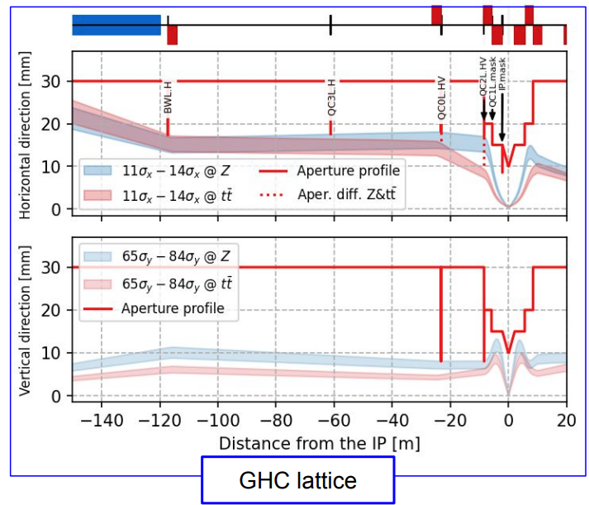
FCC-ee SR collimation system
Synchrotron radiation collimators around the IPs
  6 collimators and 2 masks upstream of the IPs
  Designed to reduce detector backgrounds and power loads in the inner beampipe due to photon losses
FCC-ee (Z) SR collimators parameters and settings (V25.2 GHC)
Name | Plane | Material | Length [cm] | Gap [σ] | Gap [mm]
TCR.H.WL.B1 | H | W-based | 10 | 11.5 | 20.4
TCR.V.C0.B1 | V | W-based | 10 | 81.5 | 7.1
TCR.H.C0.B1 | H | W-based | 10 | 11.5 | 25.0
TCR.H2.C0.B1 | V | W-based | 10 | 11.5 | 21.3
TCR.V.C2.B1 | V | W-based | 10 | 81.5 | 8.2
TCR.H.C2.B1 | H | W-based | 10 | 11.5 | 18.0
V24.3 GHC
SR collimator apertures = estimated aperture bottlenecks
Studies carried out by K. Andre up to V24.3 GHC
  FCC physics workshop 2025 talk
20/05/2025
G. Broggi | Collimation studies for the FCC-ee

Slide 10
Tertiary collimators
Beam loss simulations have shown that SR collimators or even final focus magnets may be exposed to beam losses
  SR collimators not primarly designed to intercept large beam losses: risk of damages/backgrounds
Two (H+V) tertiary collimators (TCTs) for local protection added
  Placed upstream of each IP
  s-location optimized for optimal phase-advance (multiple of π) between TCTs and
  Need for shower absorber downstream of TCTs to be studied
Further local protection devices (e.g., injection protection) to be studied by energy deposition (FLUKA), beam transfer and engineering team
SR collimators
aperture bottlenecks
FCC-ee (Z) collimation hierarchy
Hierarchy margins set to 100-300um
  ~1 σ_{βx}, ~15 σ_{βy}
Name | Plane | Material | Length [cm] | Half-gap [σ] | Half-gap [mm]
TCT.H.B1 | H | C-based | 25 | 10.5 | 2.4
TCT.V.B1 | V | C-based | 25 | 65 | 7.3
G. Broggi | Collimation studies for the FCC-ee

