Slide 1
Higgs ZH2l
Christos Vergis (he/his)
29 May 2025

Slide 2
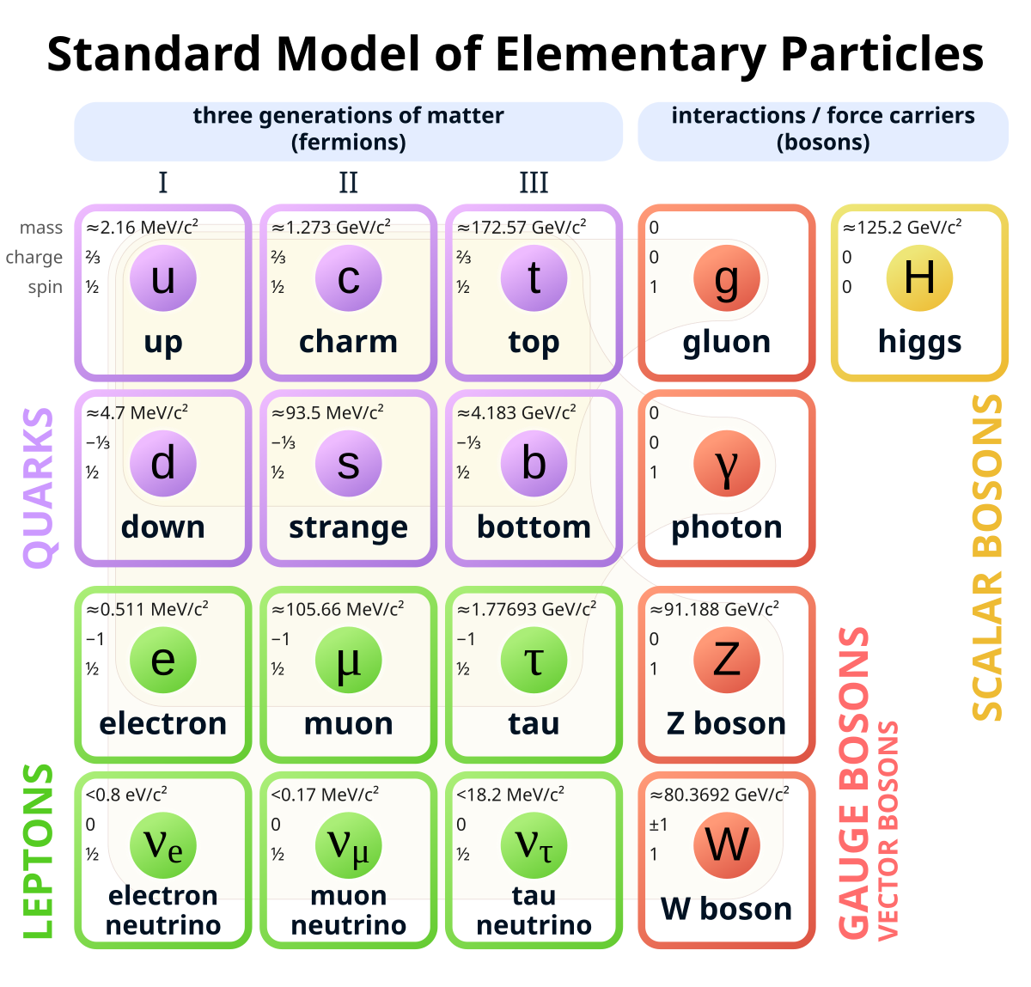
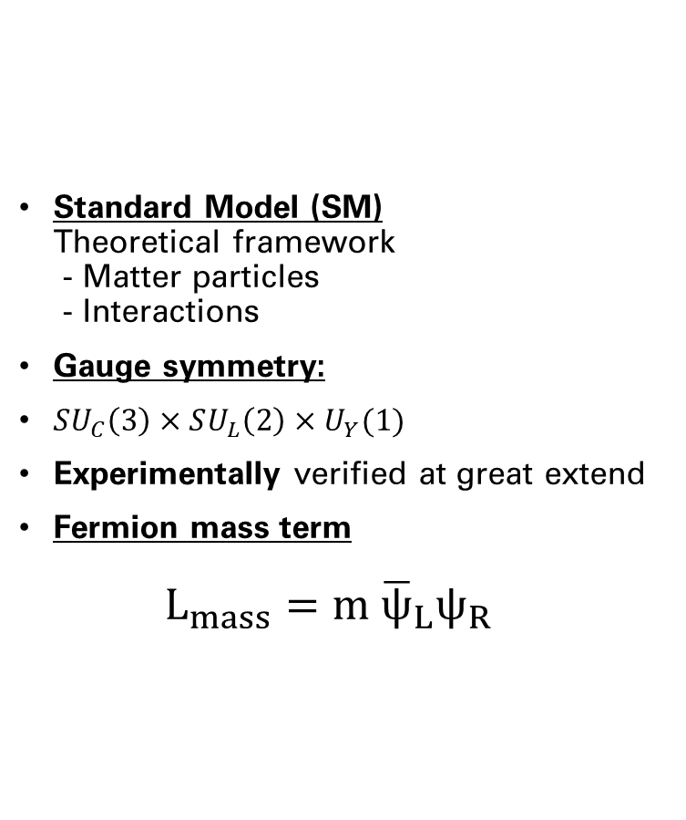
The Standard Model
Standard Model (SM)
Theoretical framework
- Matter particles
- Interactions
Gauge symmetry:
$SU_{C}\left(3\right)×SU_{L}\left(2\right)×U_{Y}(1)$
Experimentally verified at great extend
Fermion mass term
$L_{mass}=m {\overline{ψ}}_{L}ψ_{R}$

Slide 3
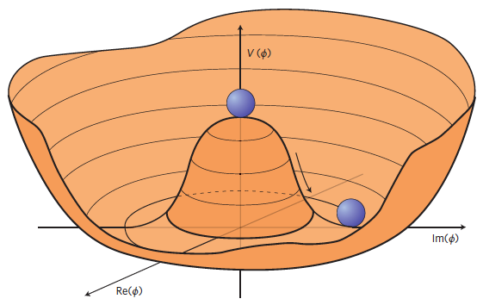
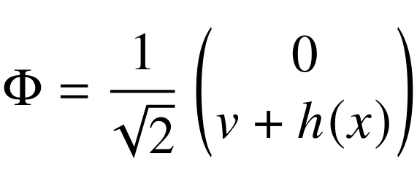
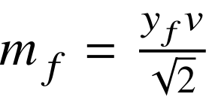




Spontaneous Symmetry Breaking
$$V\left(φ\right)=−μ^{2}φ^{⟊}φ+λ{\left|φ^{⟊}φ\right|}^{2}$$
ElectroWeak
$$SU\left(2\right)×U\left(1\right)$$
Spontaneous
Symmetry
Breaking
$$L_{yukawa}=y_{i}φ\overline{f_{i}}f_{i}$$
$$U_{Q}\left(1\right)$$
Electromagnetic Interactions (γ)
Massive gauge bosons
Massive fermions
Higgs Boson

Slide 4
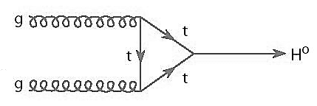
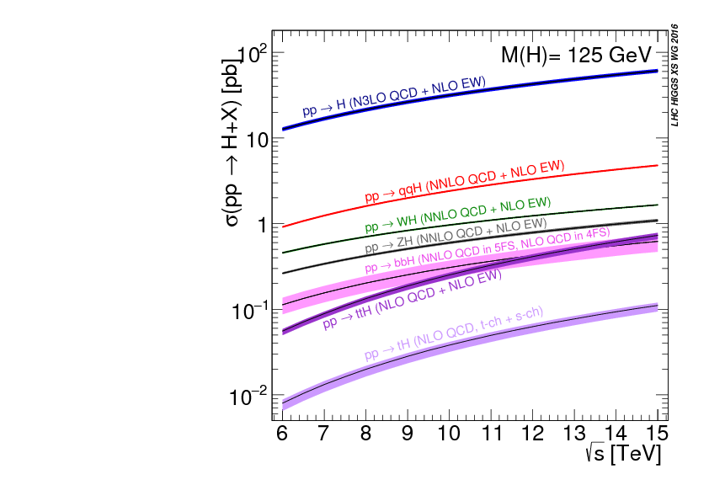
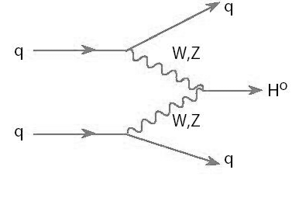
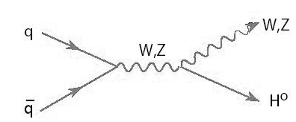
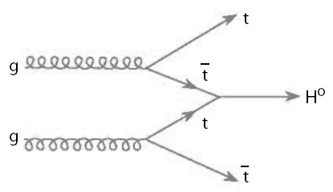
Higgs Production @LHC
Run 3
gluon-gluon Fusion (ggF)
Vector Boson Fusion (VBF)
V Brehmstrahlung (VH)
Top-associated
production (ttH)

Slide 5
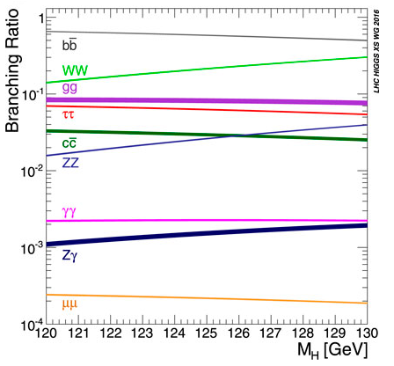
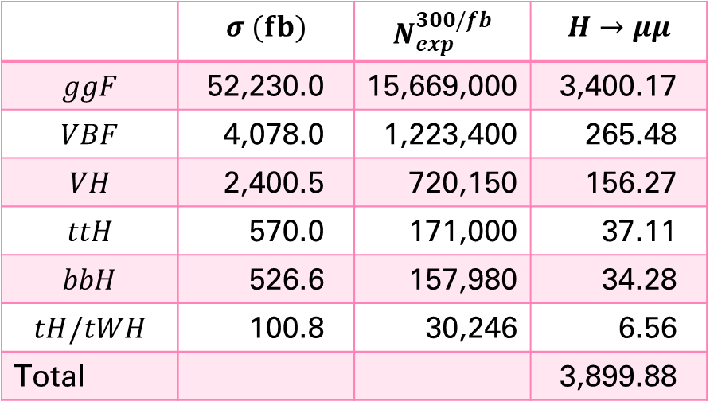
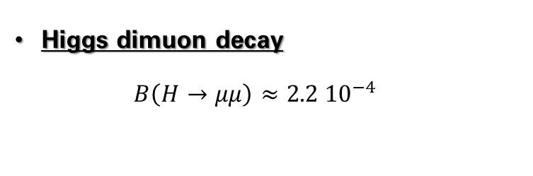
Higgs Decays
Higgs dimuon decay
$B\left(H→μμ\right)≈2.2 10^{−4}$
 | $$σ (fb)$$ | $$N_{exp}^{300/fb}$$ | $$H→μμ$$
$$ggF$$ | 52,230.0 | 15,669,000 | 3,400.17
$$VBF$$ | 4,078.0 | 1,223,400 | 265.48
$$VH$$ | 2,400.5 | 720,150 | 156.27
$$ttH$$ | 570.0 | 171,000 | 37.11
$$bbH$$ | 526.6 | 157,980 | 34.28
$$tH/tWH$$ | 100.8 | 30,246 | 6.56
Total |  |  | 3,899.88

Slide 6
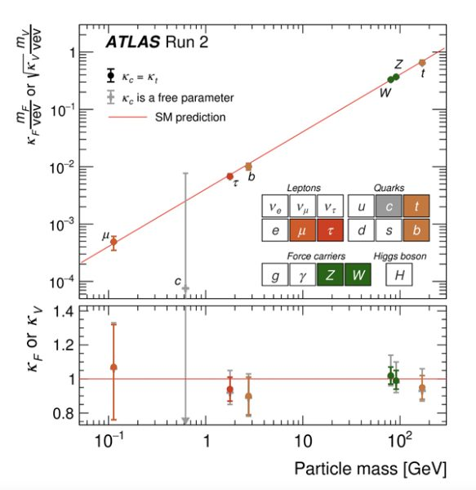

Higgs dimuons
Higgs decays to Z, W, γ (top), b, τ have been observed
SM prediction compatible with those measurements
Muons allow probing the 2nd generation couplings for first time

Slide 7
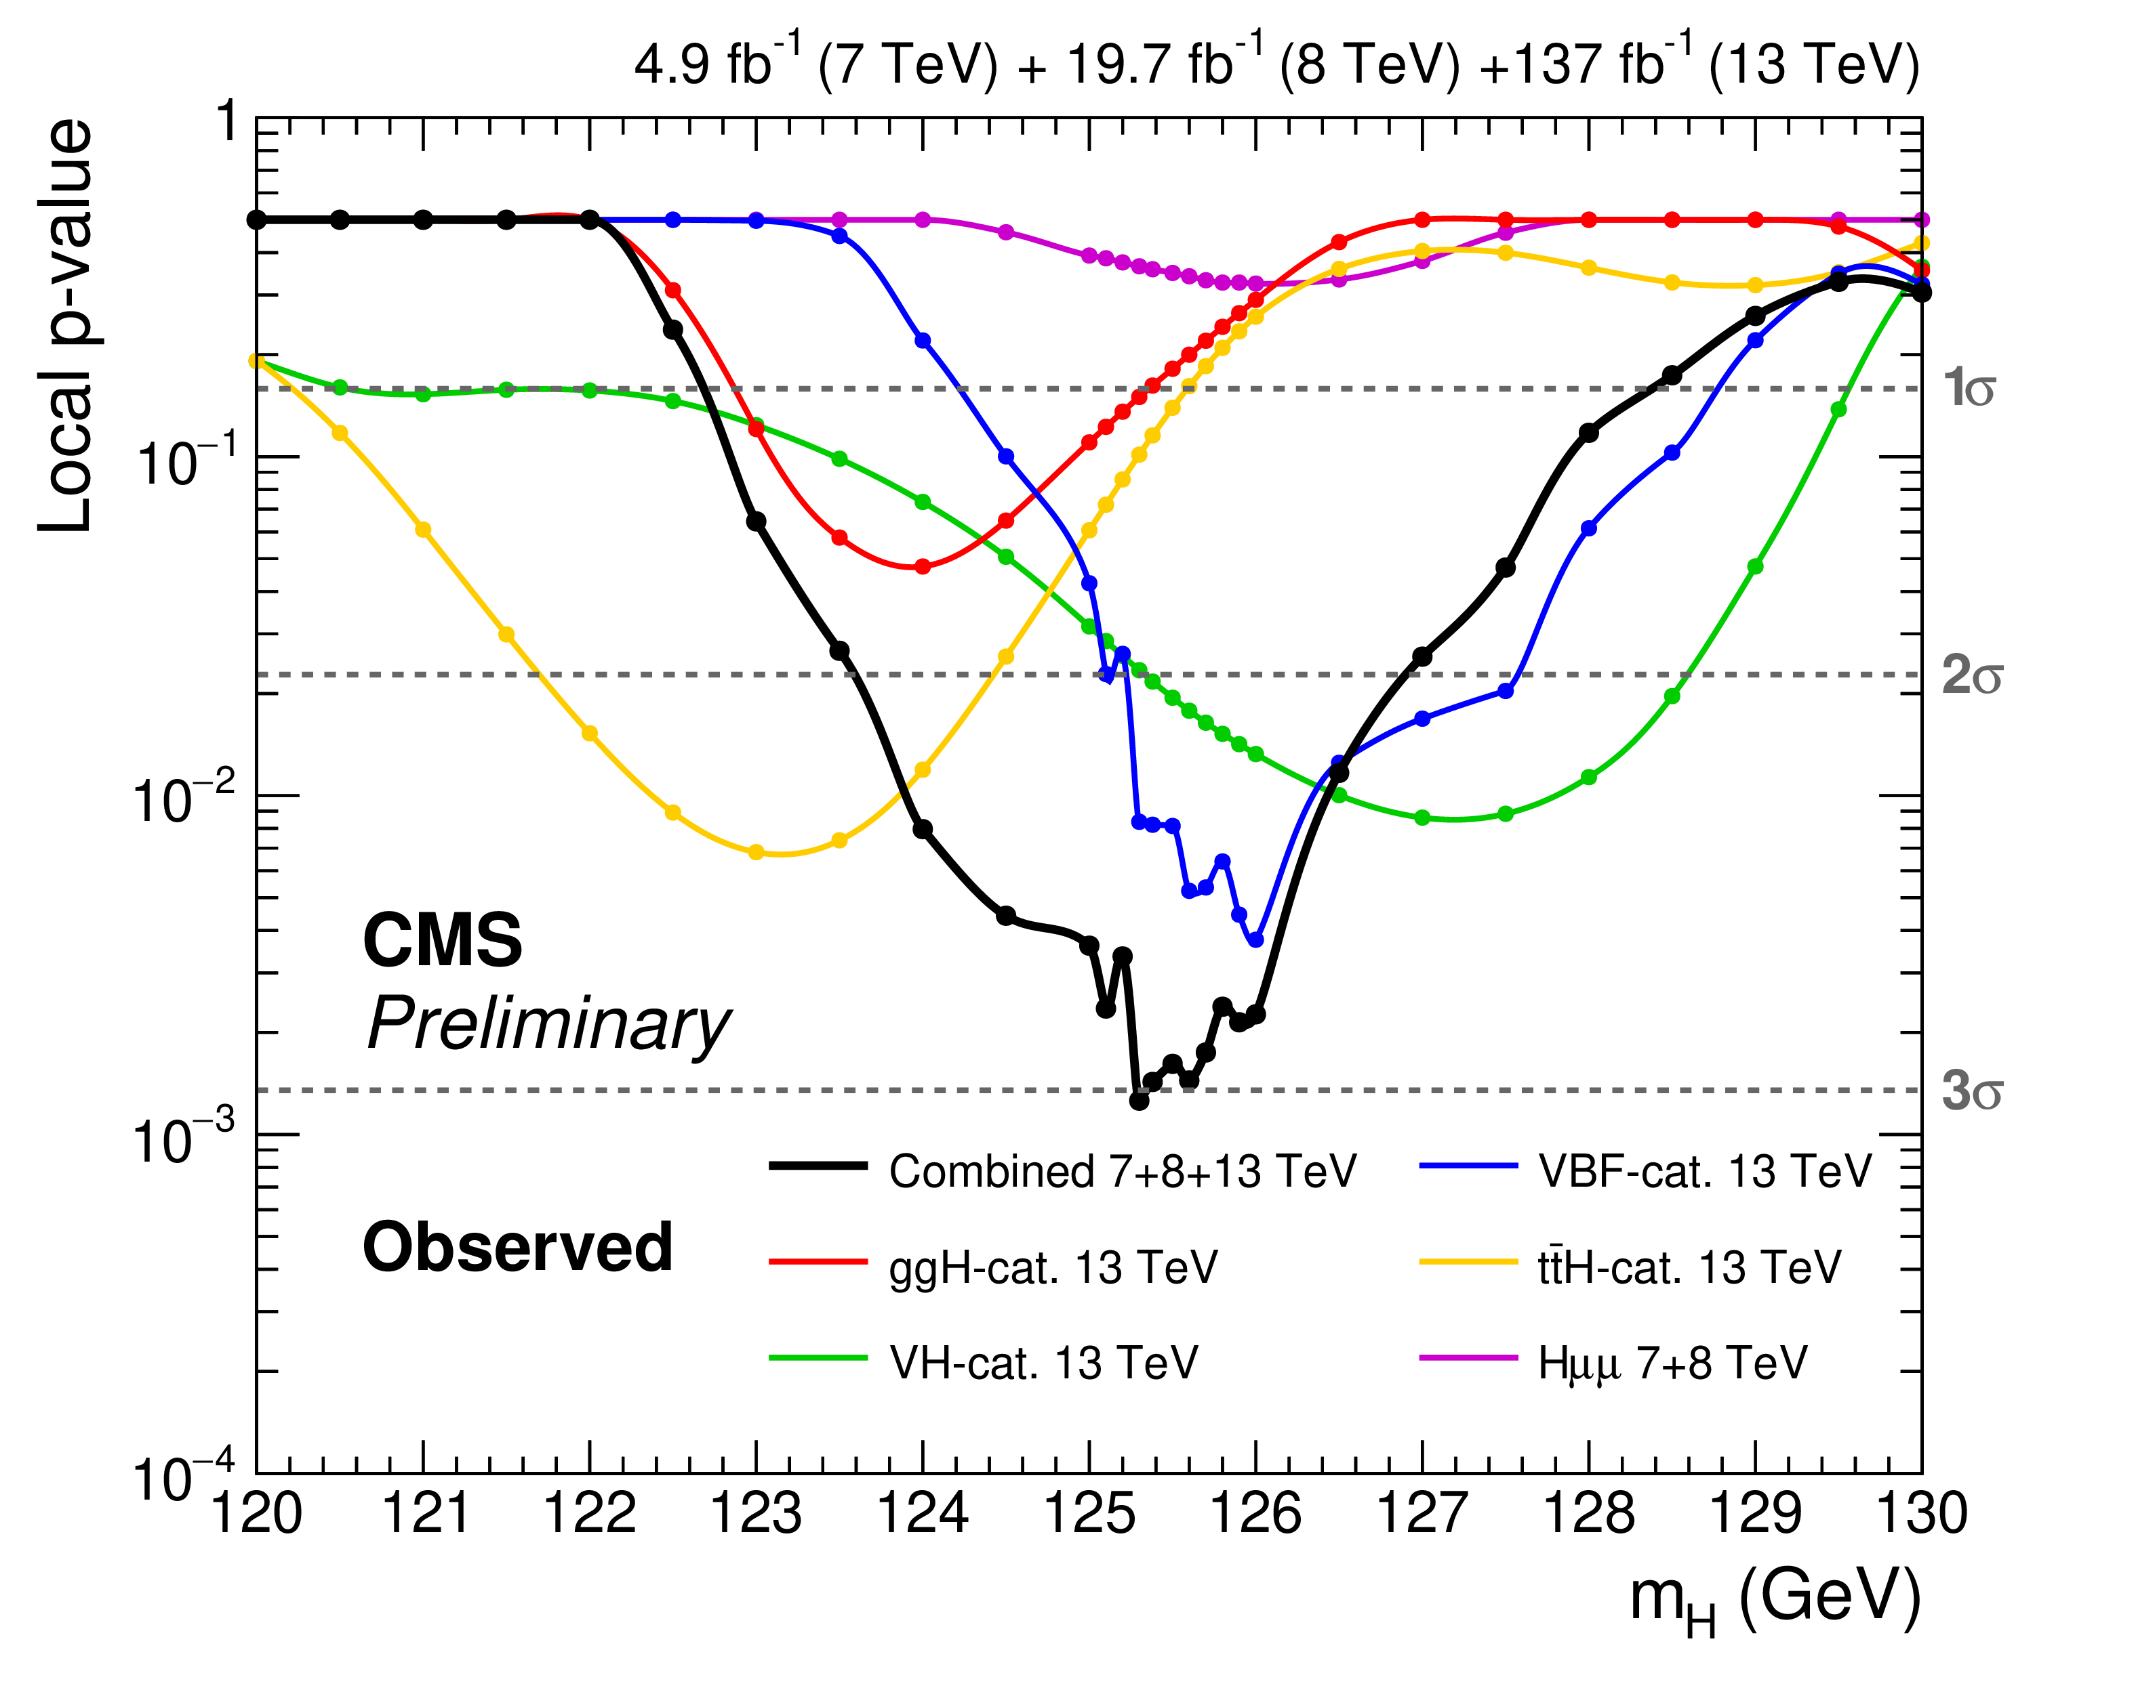
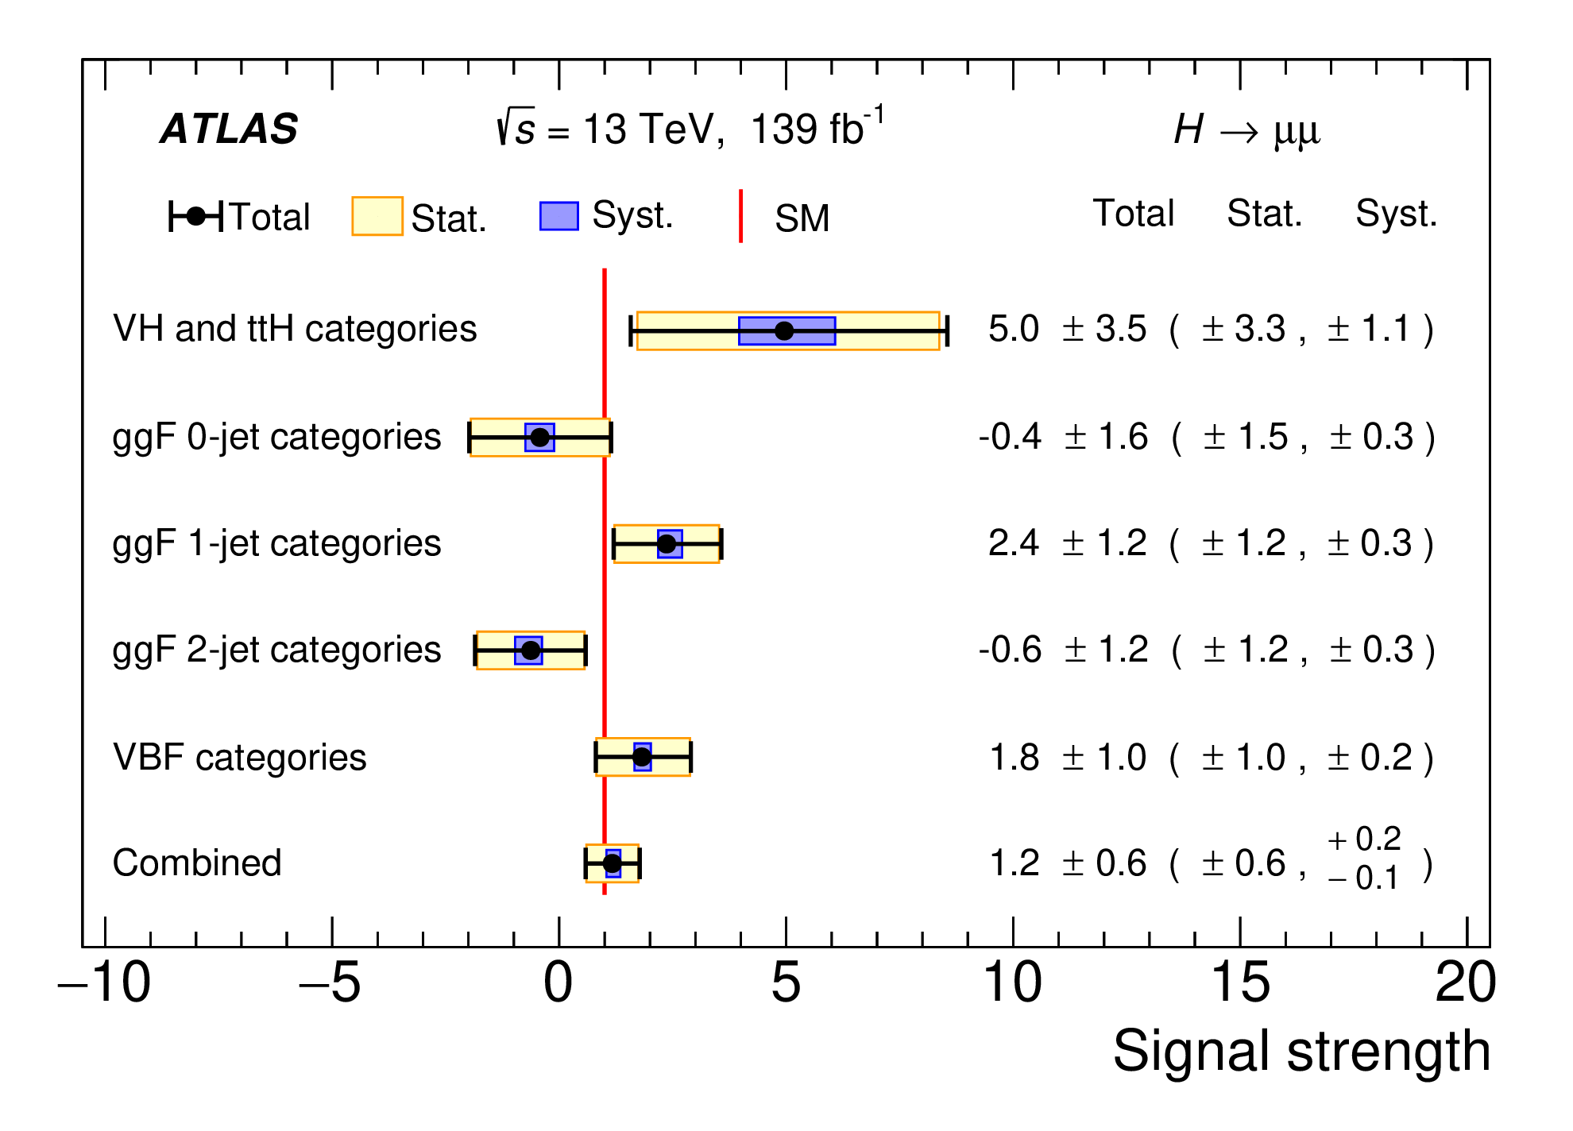
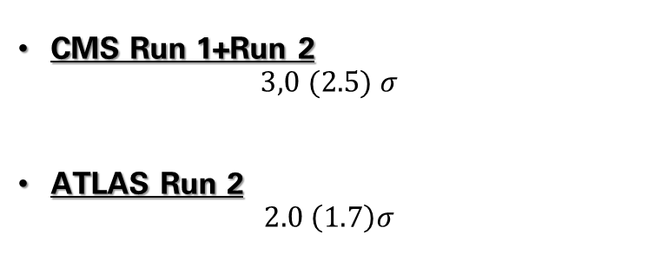
Higgs dimuon searches
CMS Run 1+Run 2
$3,0 (2.5) σ$
ATLAS Run 2
$$2.0 \left(1.7\right)σ$$

Slide 8
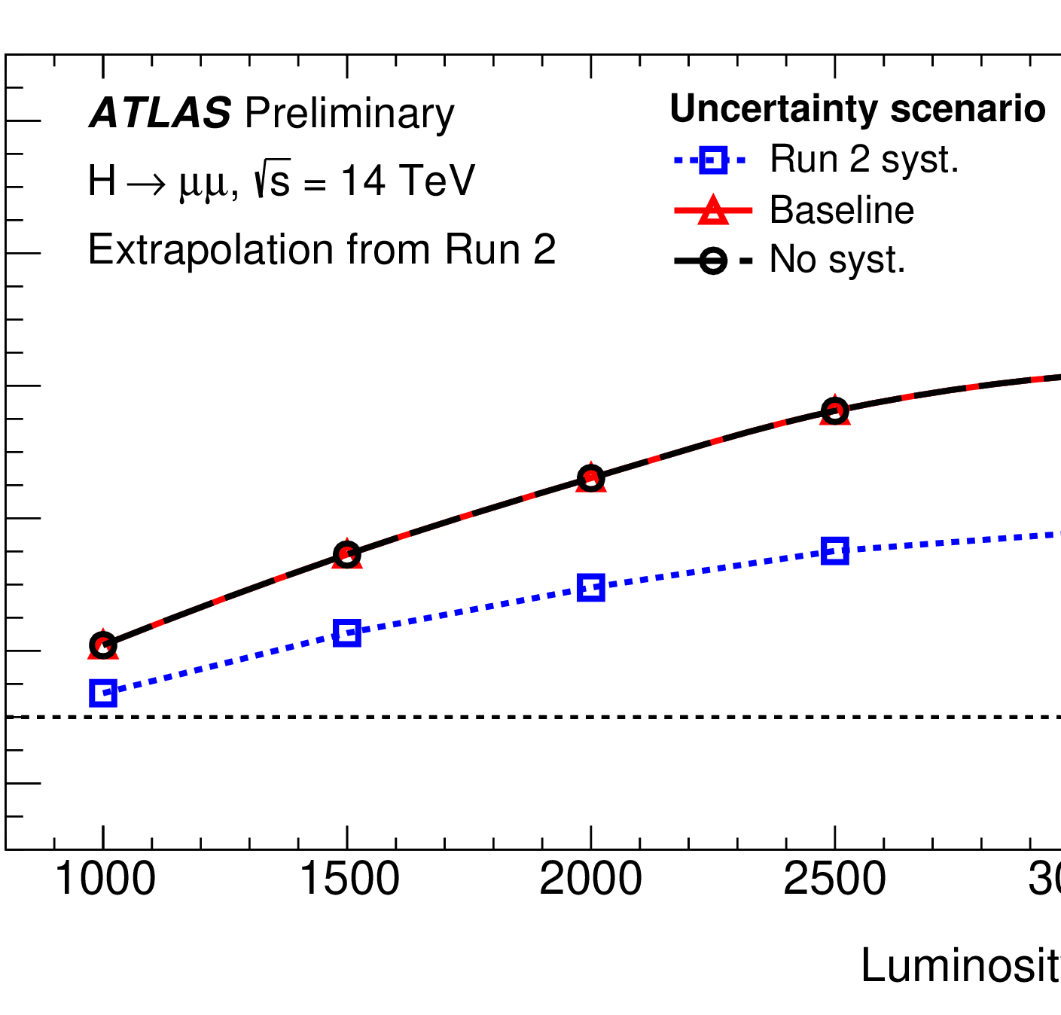
Future Projections
Higgs to muons will be observed at 1000 ifb if everything remains as it is
Possibility at 800ifb (Run2+Run3 combination of CMS and ATLAS)

Slide 9
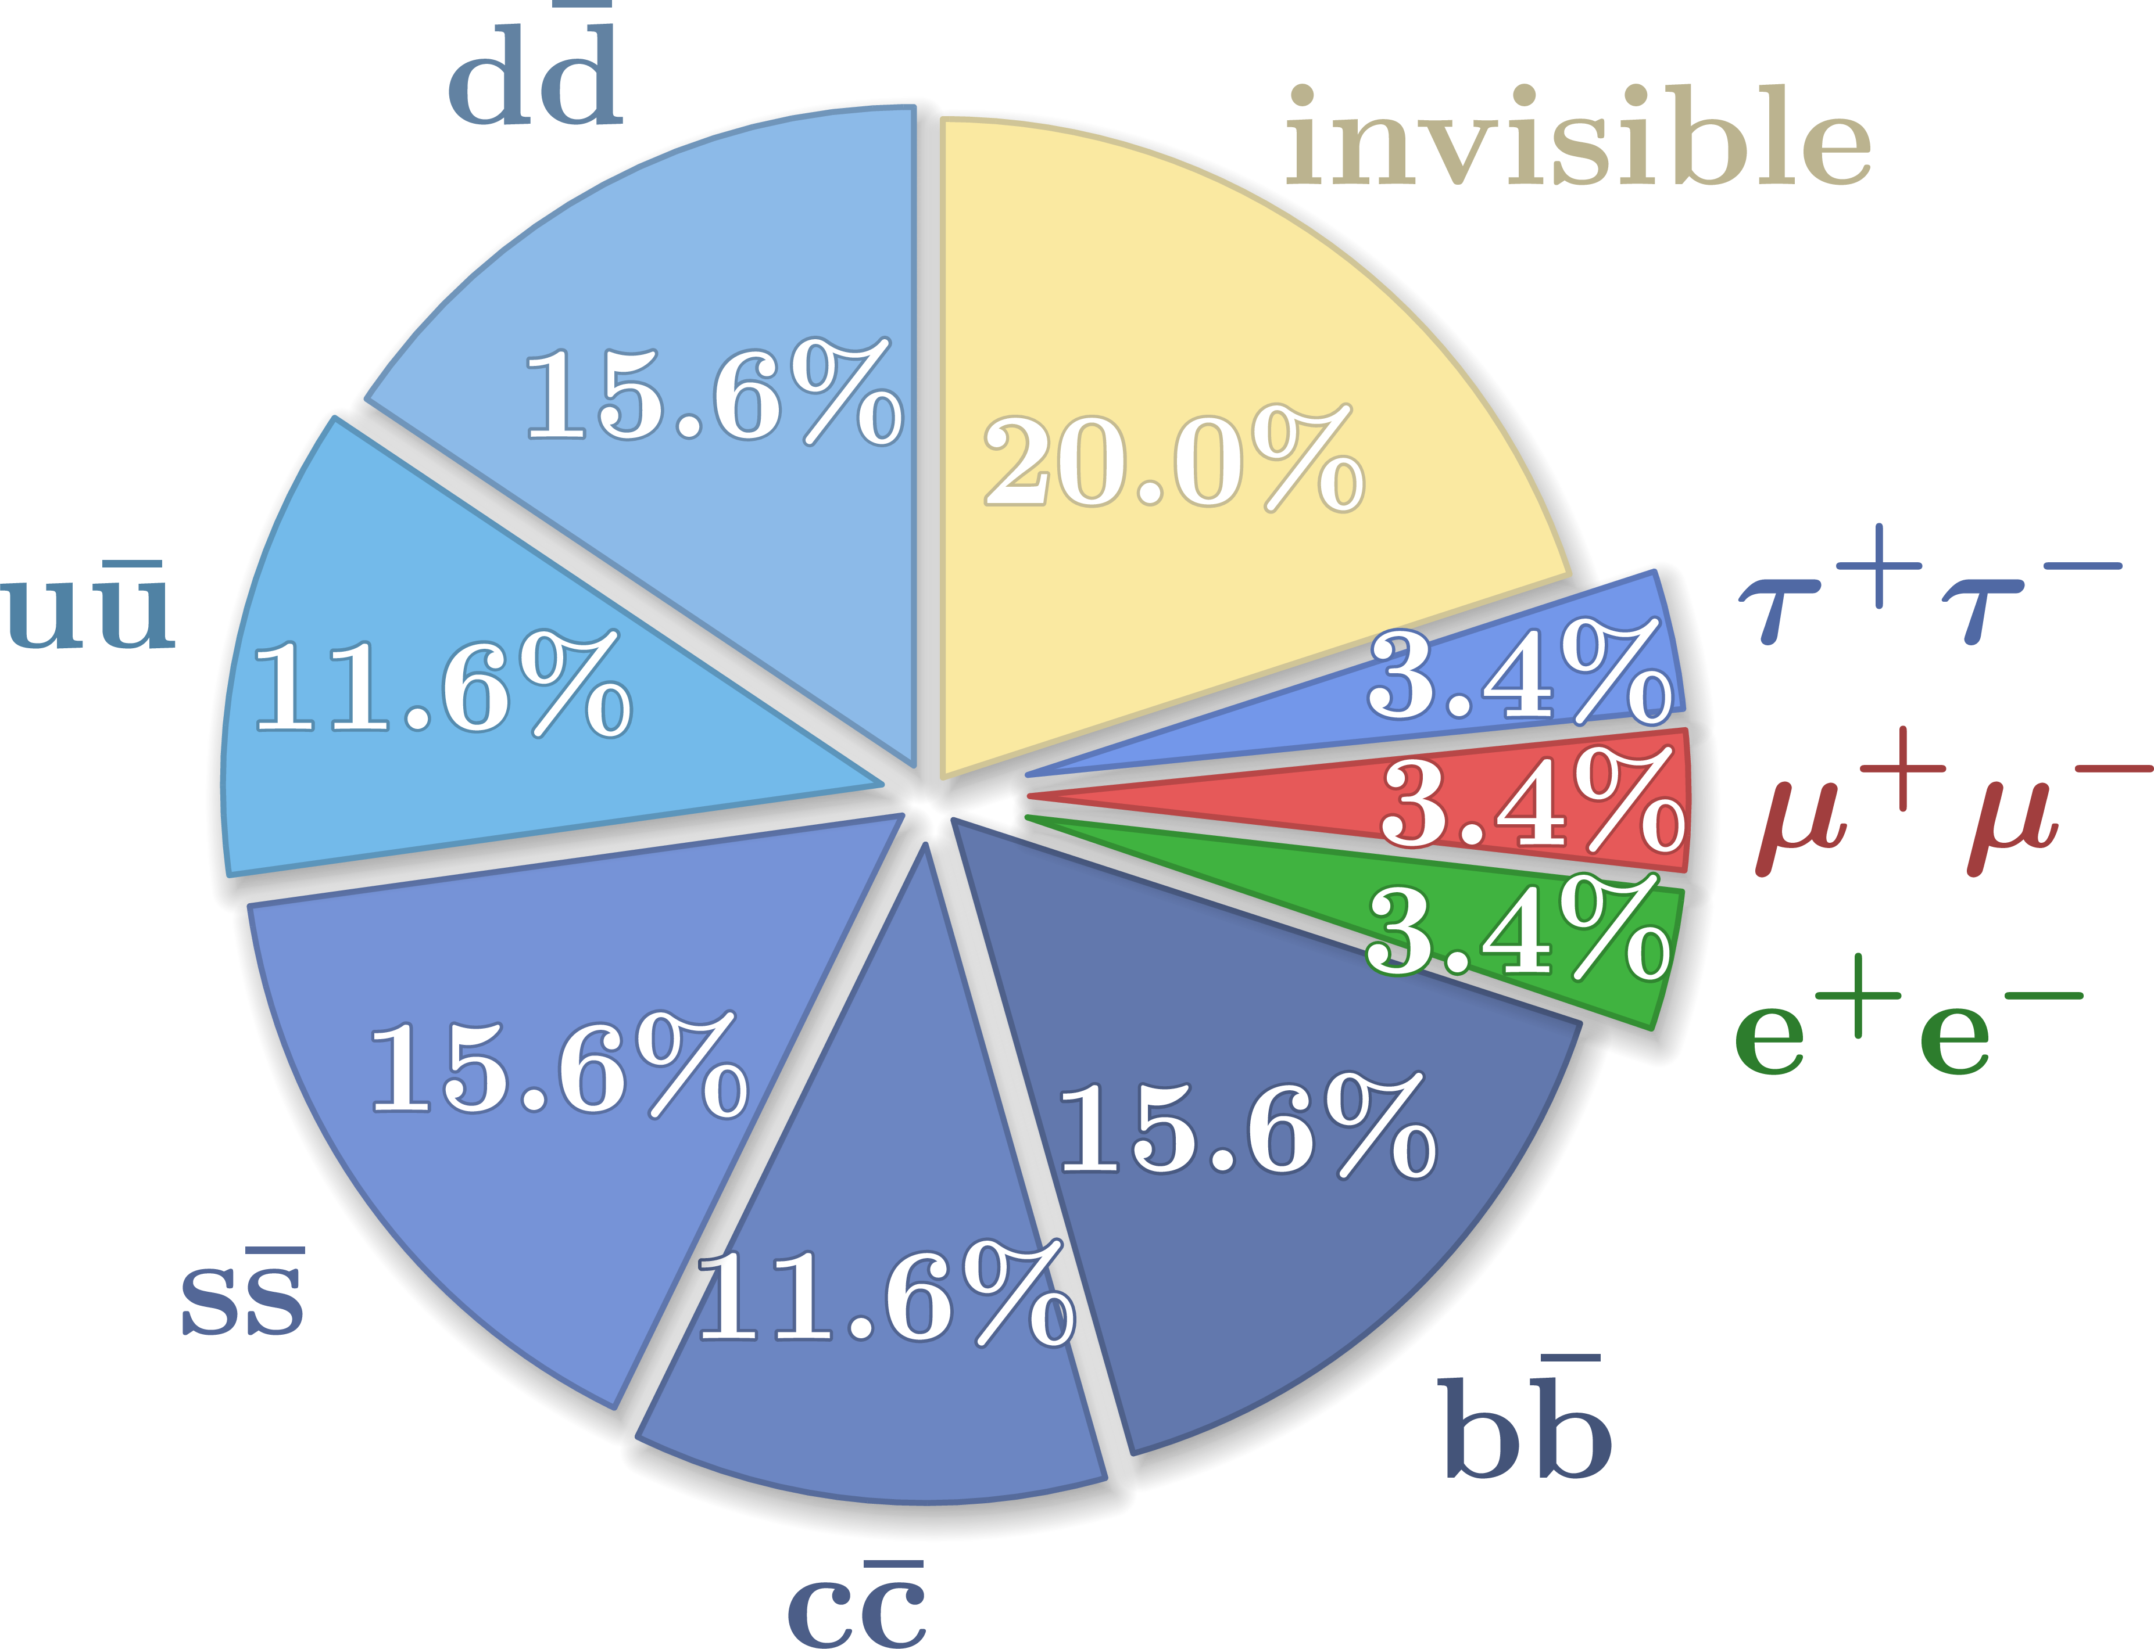
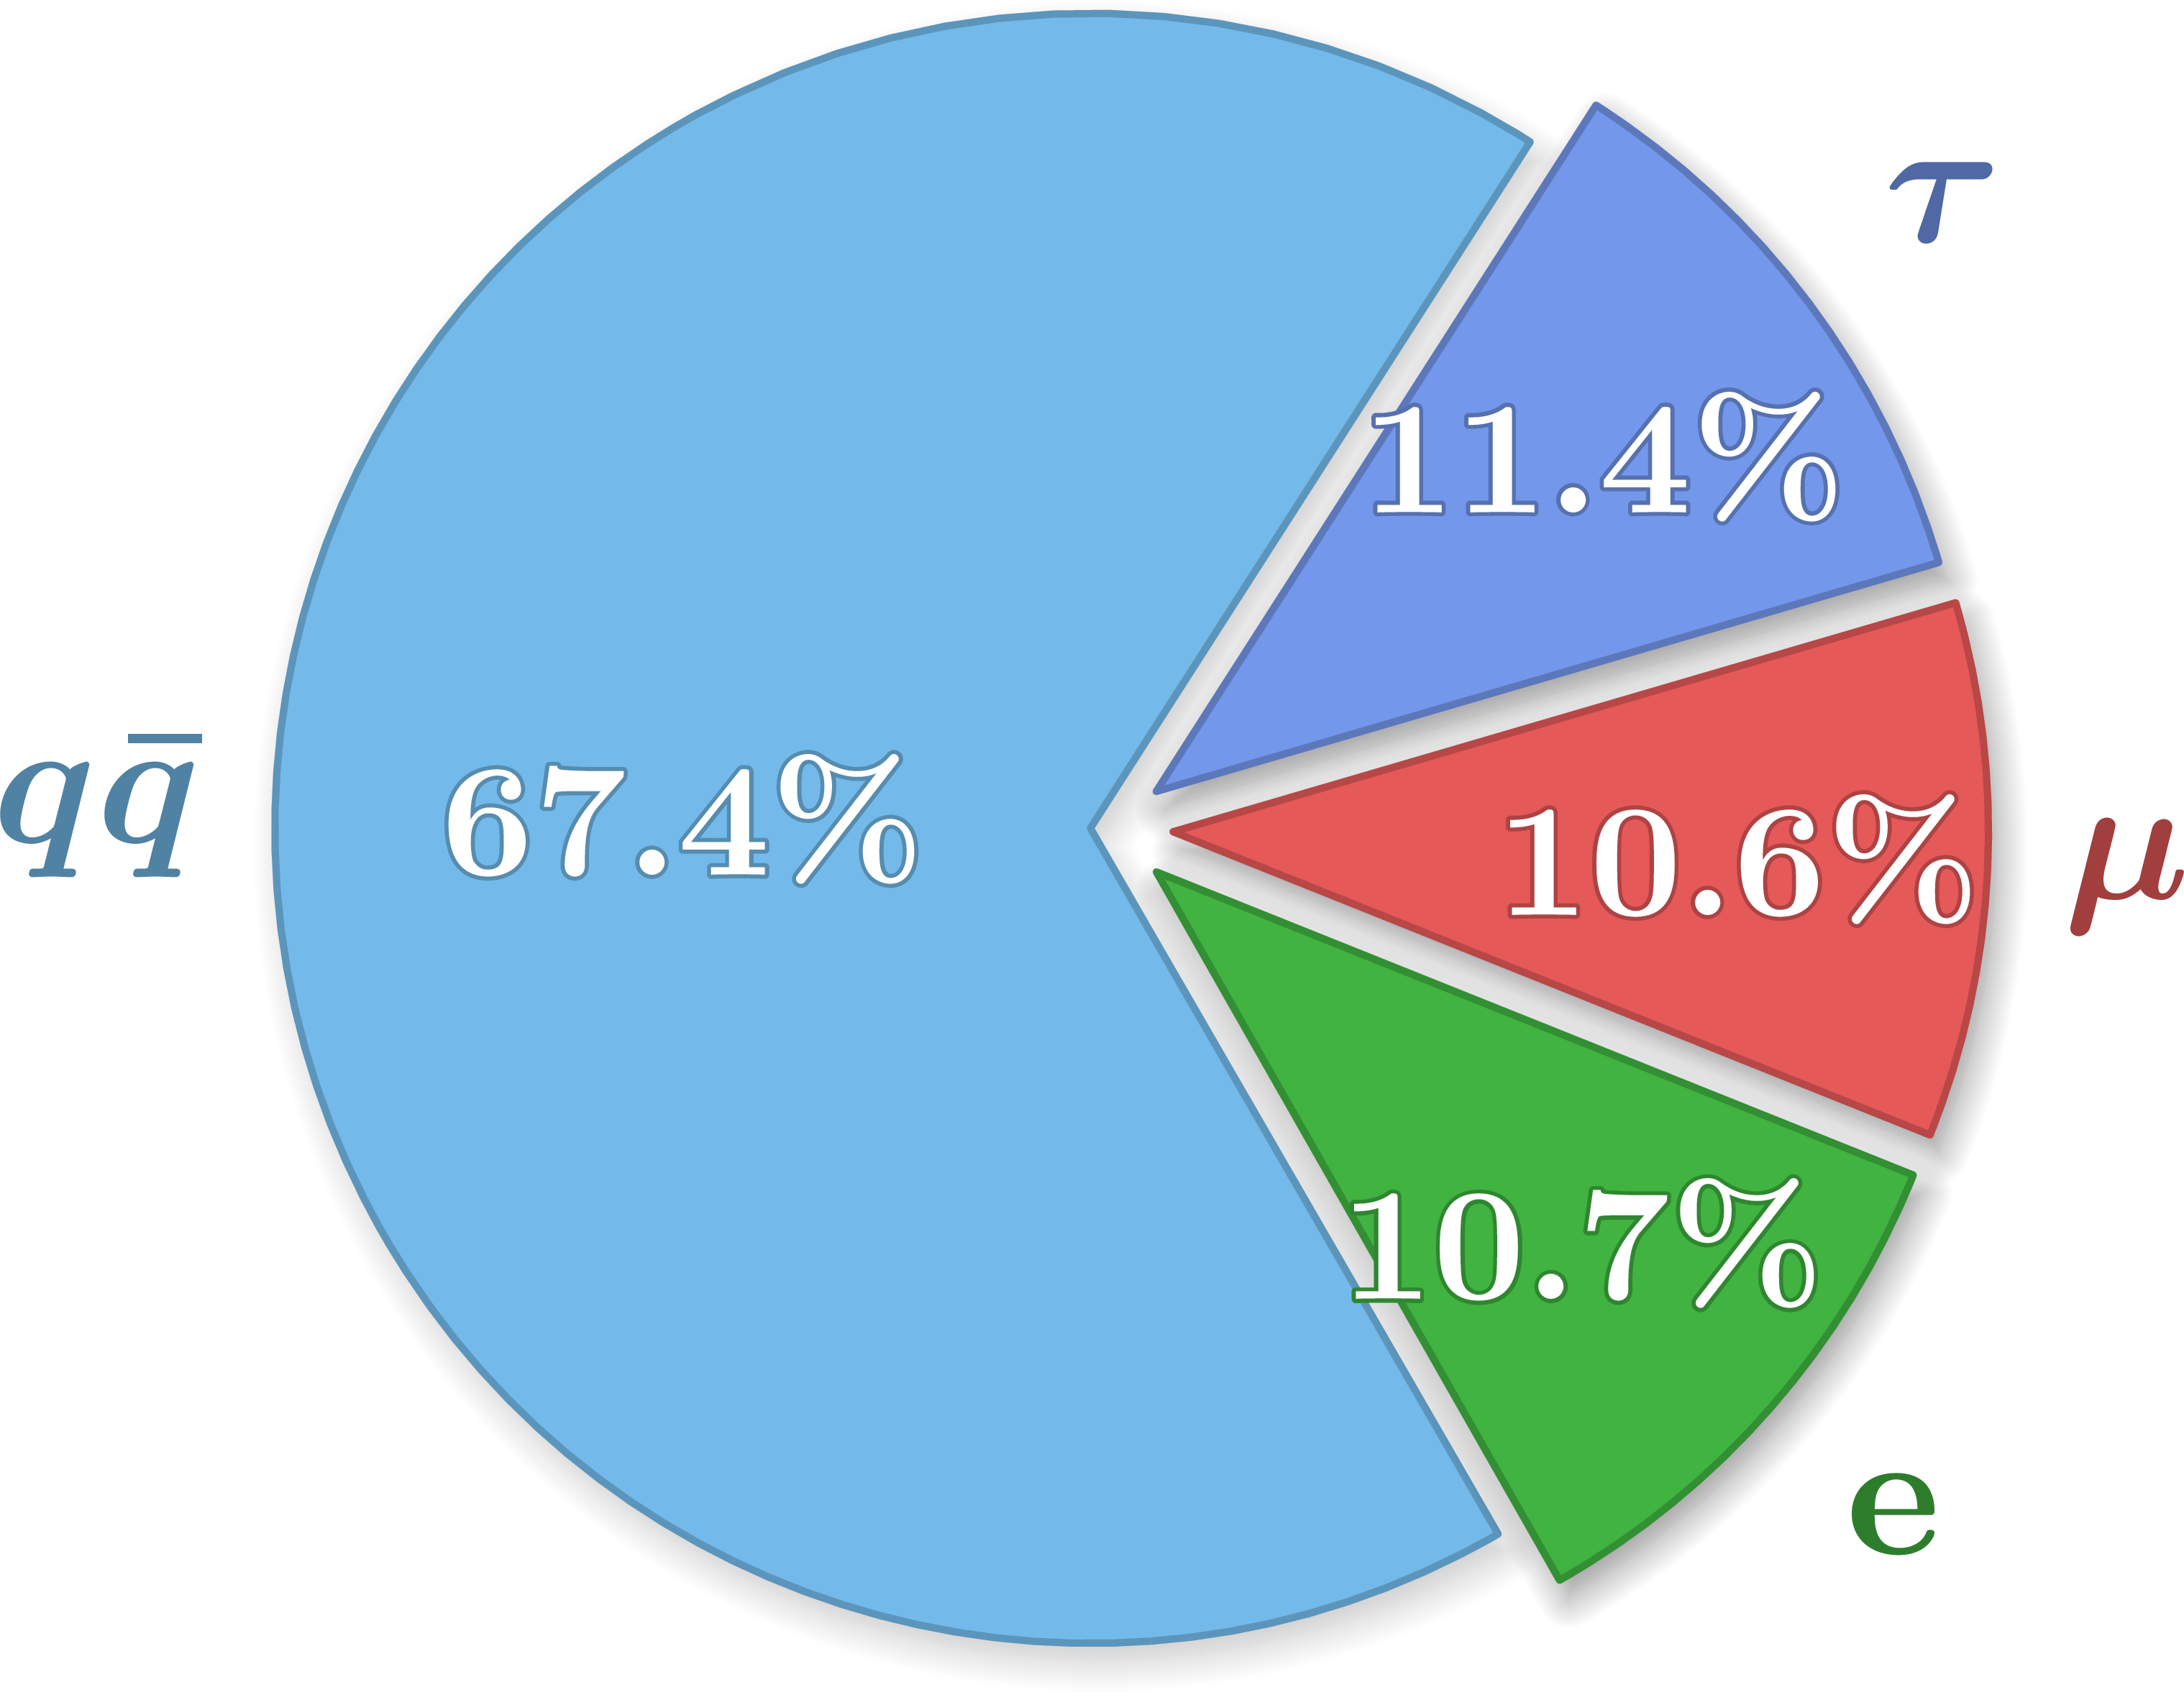
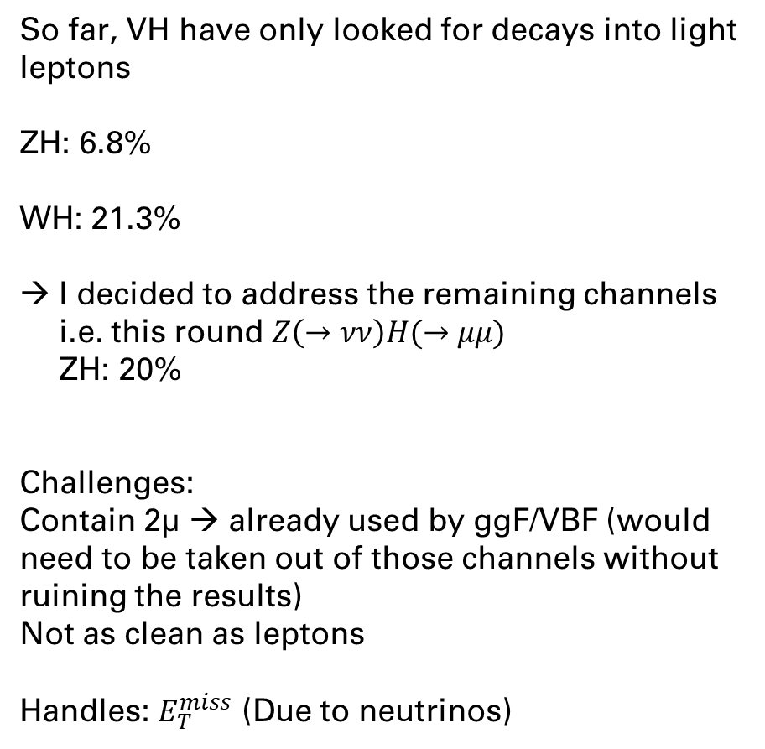
VH Decays
So far, VH have only looked for decays into light leptons
ZH: 6.8%
WH: 21.3%
I decided to address the remaining channels
i.e. this round $Z\left(→νν\right)H(→μμ)$
ZH: 20%
Challenges:
Contain 2μ → already used by ggF/VBF (would need to be taken out of those channels without ruining the results)
Not as clean as leptons
Handles: $E_{T}^{miss}$ (Due to neutrinos)

Slide 10
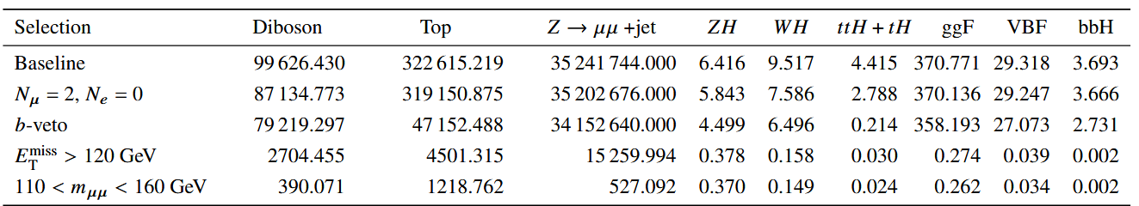

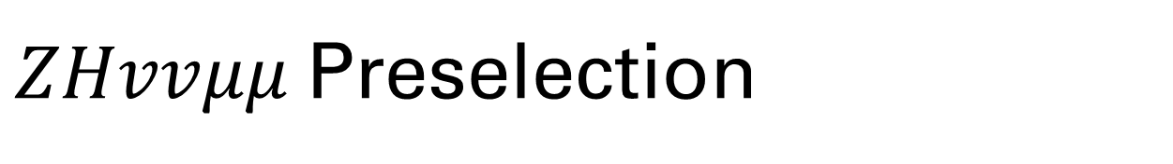



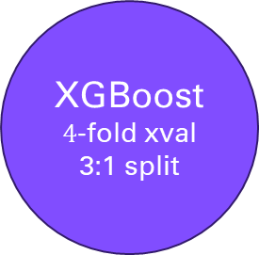

$ZHvvμμ$Preselection
Background rejection
Signal efficiency
$$\sim 255$$
$$\sim 265$$
$\sim \text{6686}$1
$$\sim 2\%$$
$$\sim 6\%$$
Max:20%
ZH2L-High
XGBoost
$4$-fold xval
3:1 split
Preselection
“ZH2L”
ZH2L-Low

Slide 11
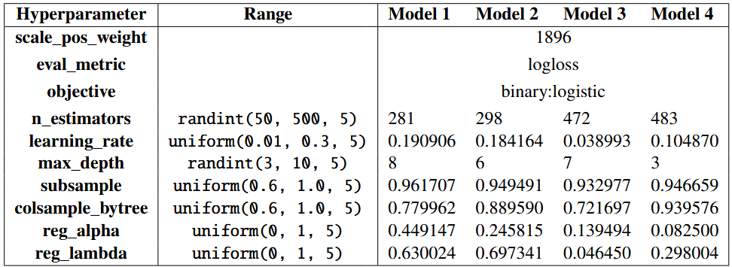
$ZHvvμμ$BDT Strategy
3-fold cross validation
In Random Grid Search
For Hyperparameter Optimization
→ Train Model
Test
Train
Train
Train
Fold 0
Test
Fold 1
Test
Fold 2
Test
Fold 3

Slide 12
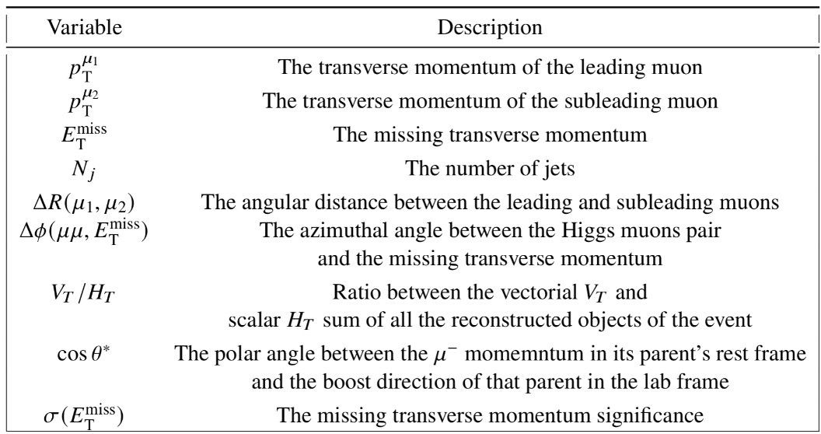
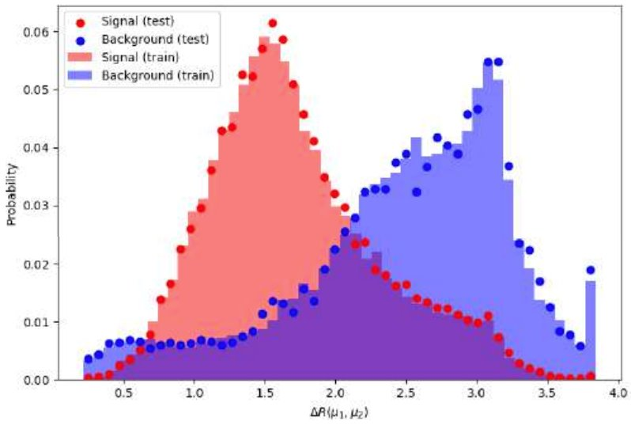
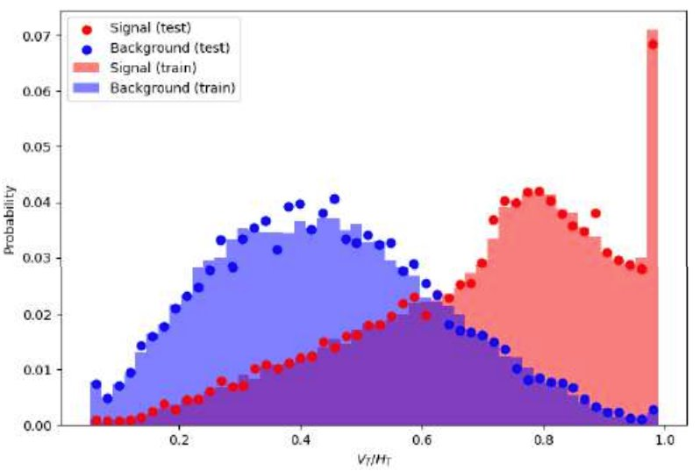
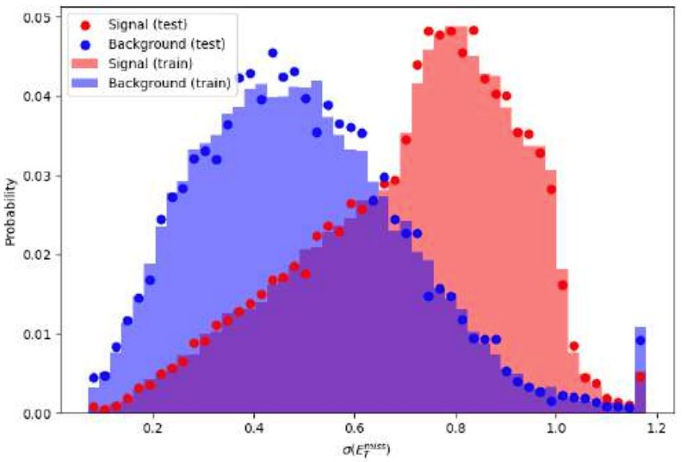
$ZHvvμμ$BDT Categorization - Features

Slide 13
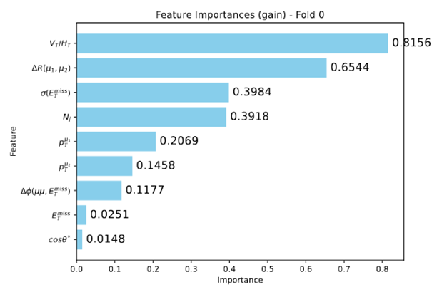
$ZHvvμμ$BDT Categorization – Features

Slide 14
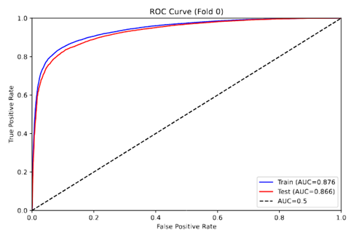
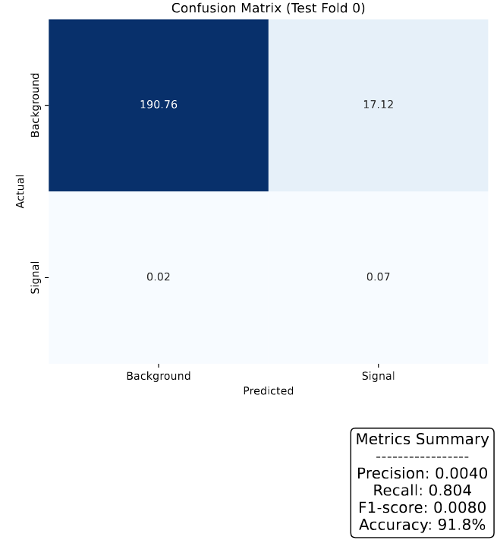
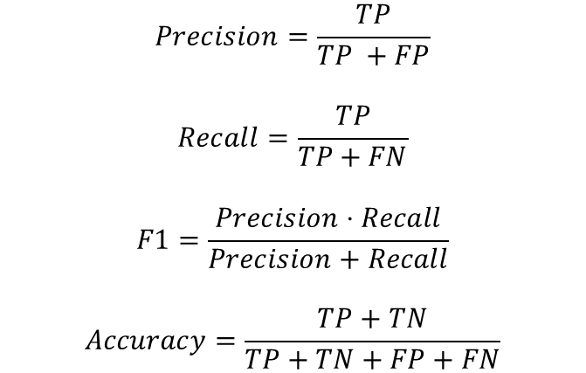
$ZHvvμμ$BDT Categorization – Performance
$$Precision=\frac{TP}{TP +FP}$$
$$Recall=\frac{TP}{TP+FN}$$
$$F1=\frac{Precision⋅Recall}{Precision+Recall}$$
$$Accuracy=\frac{TP+TN}{TP+TN+FP+FN}$$

Slide 15
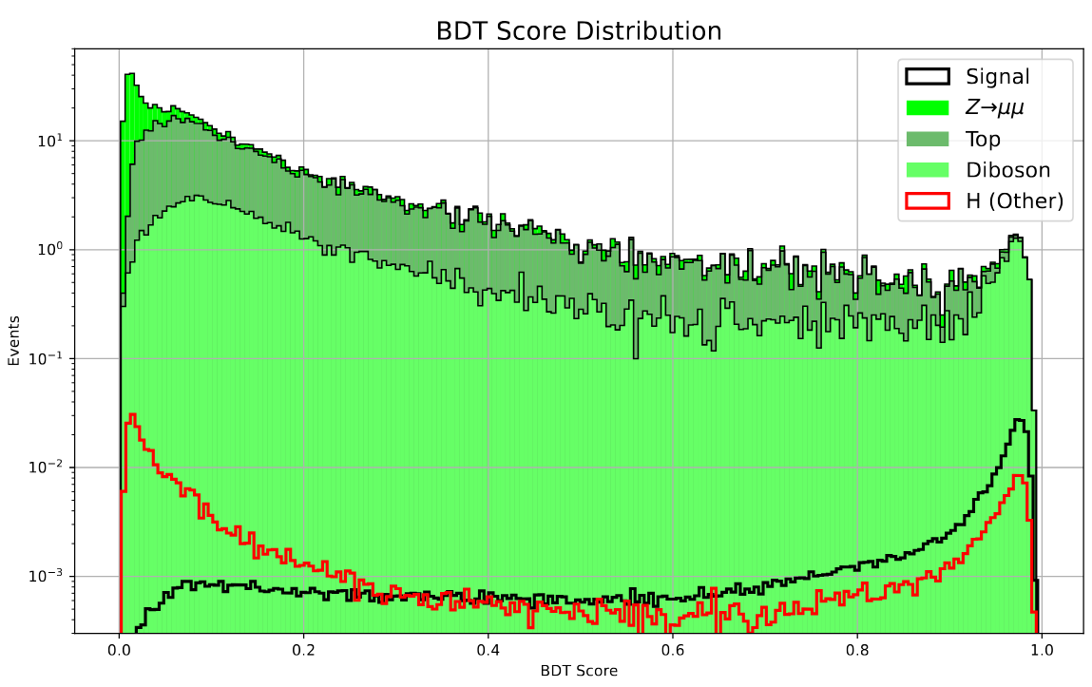
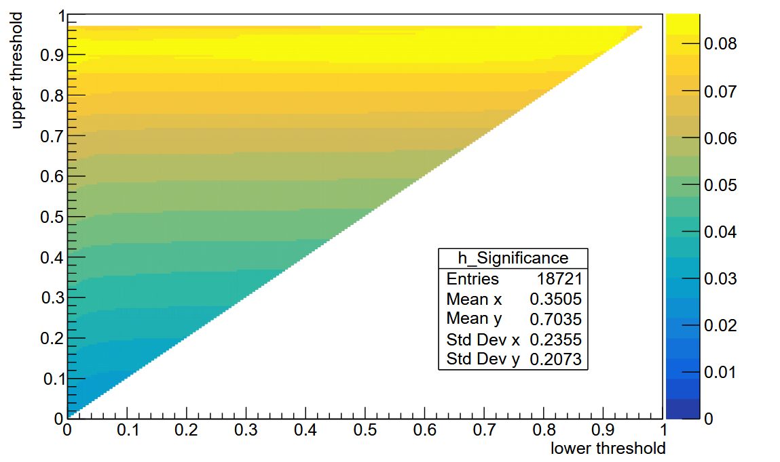
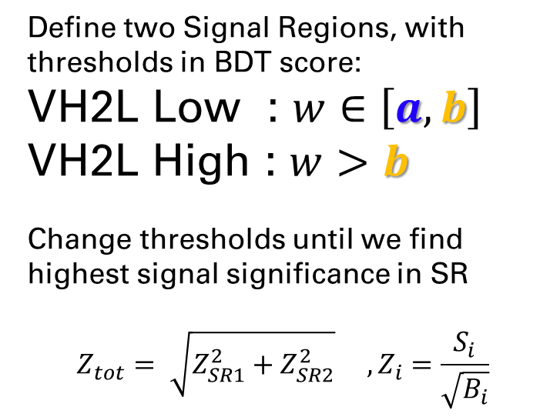
$ZHvvμμ$BDT Categorization - Selection
Define two Signal Regions, with thresholds in BDT score:
VH2L Low : $w∈\left[a, b\right]$
VH2L High : $w>b$
Change thresholds until we find highest signal significance in SR
$$Z_{tot}= \sqrt{Z_{SR1}^{2}+Z_{SR2}^{2}} , Z_{i}=\frac{S_{i}}{\sqrt{B_{i}}}$$
Best @ a = 0.755 , b = 0.925

Slide 16
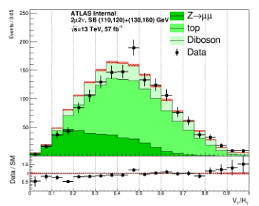
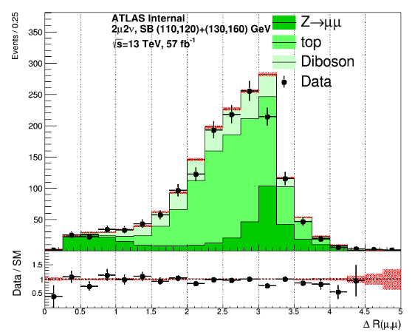
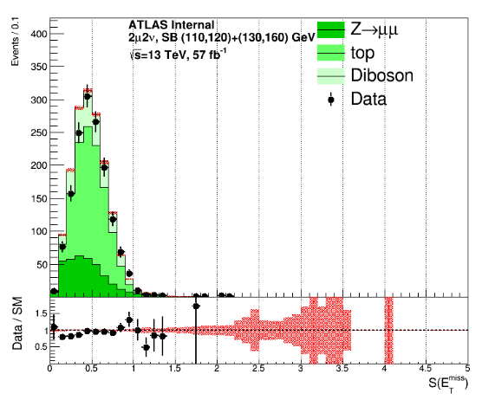
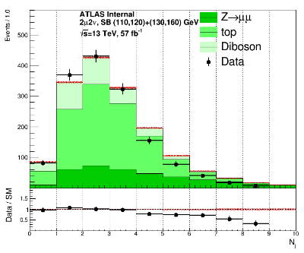

$ZHvvμμ$
Validations
Test in Sideband

Slide 17
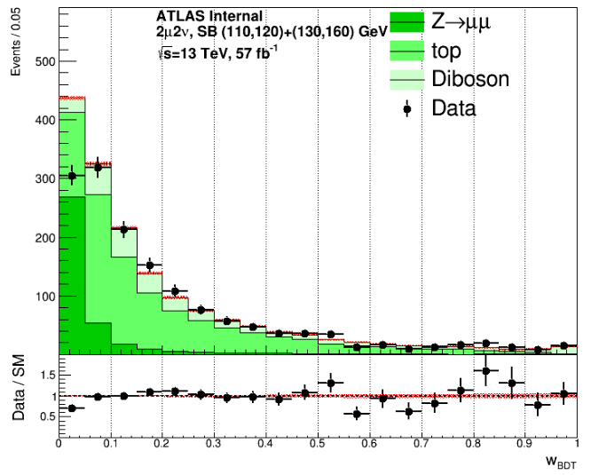
$ZHvvμμ$
Validations
Test in Sideband

Slide 18
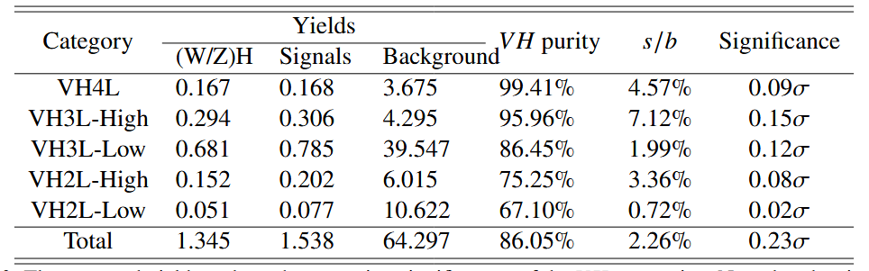
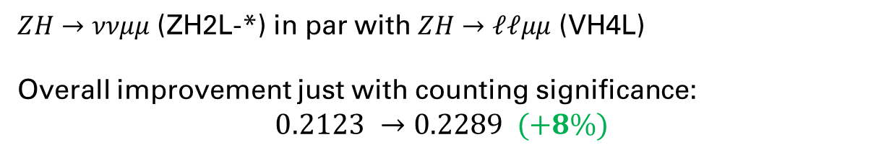
$ZHvvμμ$ Results @BDT
$ZH→ννμμ$ (ZH2L-*) in par with $ZH→ℓℓμμ$ (VH4L)
Overall improvement just with counting significance:
$$0.2123 →0.2289 (+8\%)$$

Slide 19
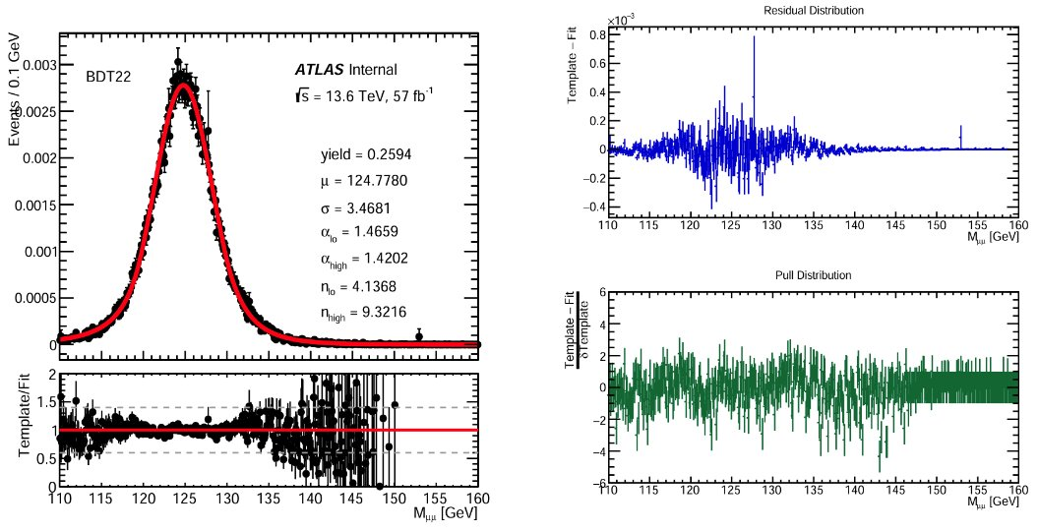
$ZHvvμμ$ Signal Modelling
Template - Fit

Slide 20
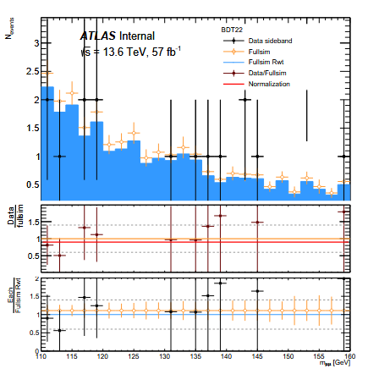
$ZHvvμμ$– Background Reweight

Slide 21
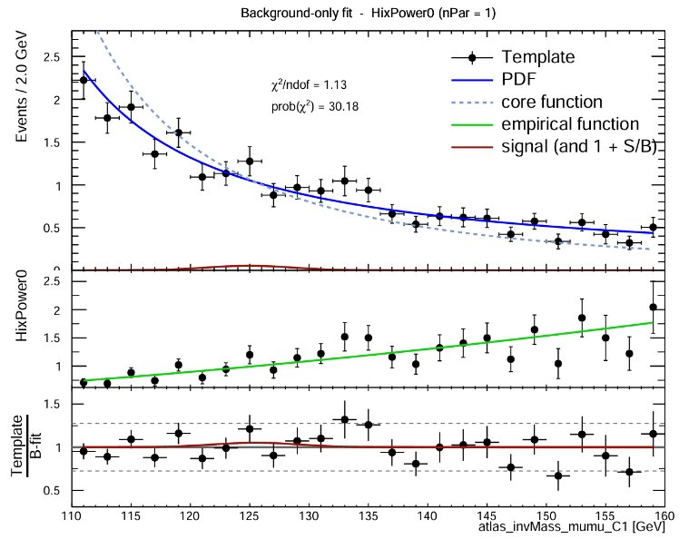
$ZHvvμμ$ Background Modelling
Convolution of
A core function meant to provide a theoretical assumption of an exponentially falling Z background
An empirical function to cover the rest discrepancies
Empirical chosen through spurious signal test

Slide 22
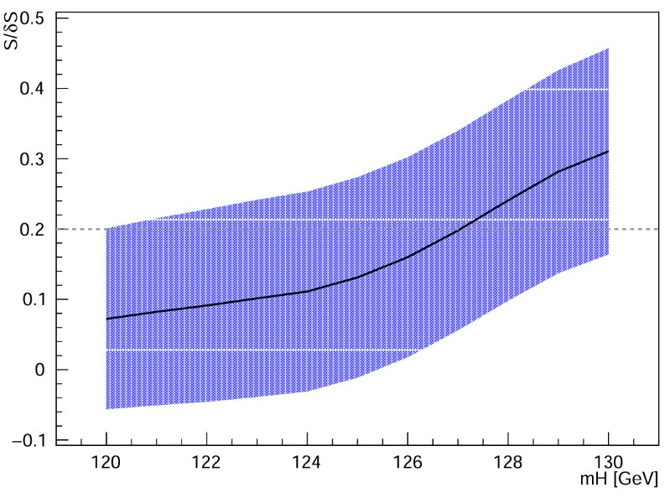
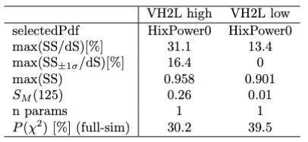
$ZHvvμμ$–Spurious Signal Test

Slide 23
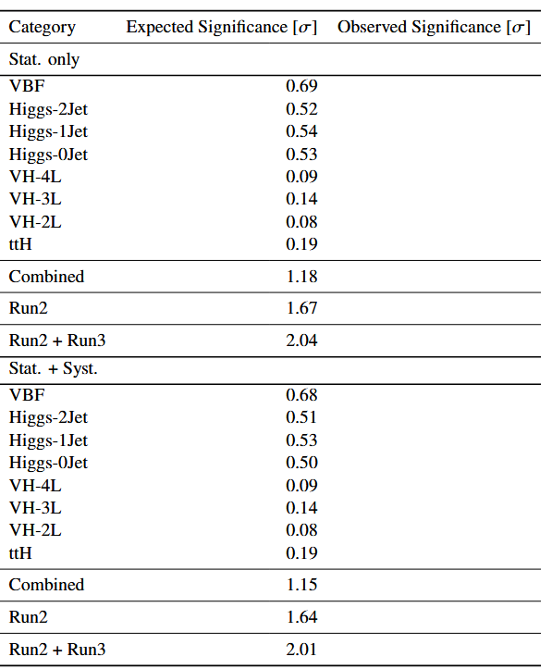
$ZHvvμμ$ Fit Results

Slide 24
ThanKS

Slide 25
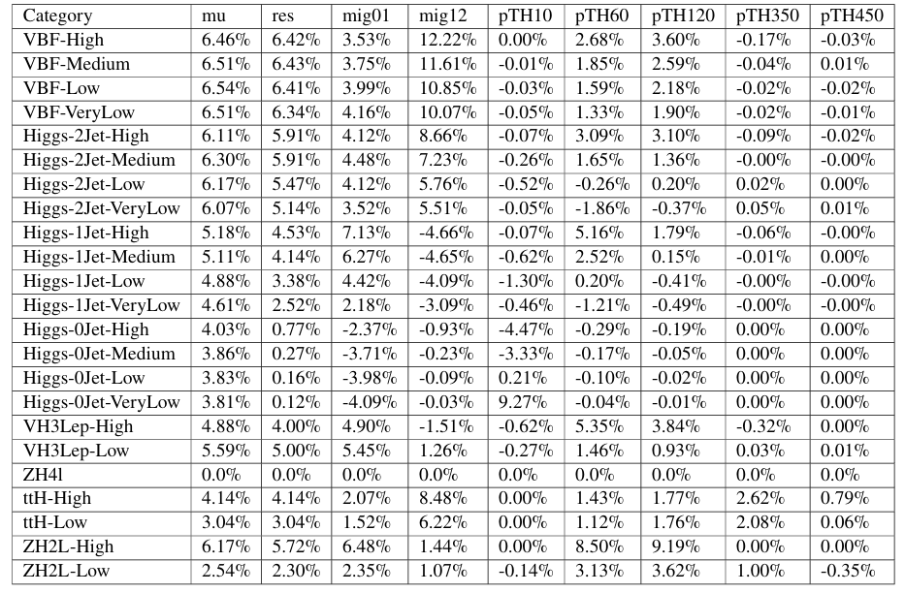

QCD Scale ggF

Slide 26

QCD Scale VBF

Slide 27


QCD Scale VH/ ttH
VH
ttH

Slide 28

PDF

Slide 29








VH2Lep Categorisation – BDT Training

Slide 30

$ZHvvμμ$BDT Categorization – Features

Slide 31

$ZHvvμμ$BDT Categorization – ROC curves

