Slide 1
11 T Dipole Project
Overview and Status
M. Karppinen TE-MSC
On behalf of CERN-FNAL collaboration
B. Auchmann, B. Holzer, L. Oberli,
L. Rossi, D. Smekens (CERN)
N, Andreev, G. Apollinari, E. Bartzi, R. Bossert,
F. Nobrega, I. Novitski, A. Zlobin (FNAL)

Slide 2
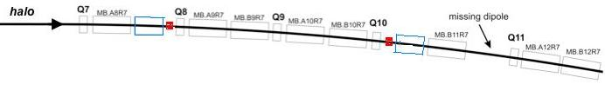
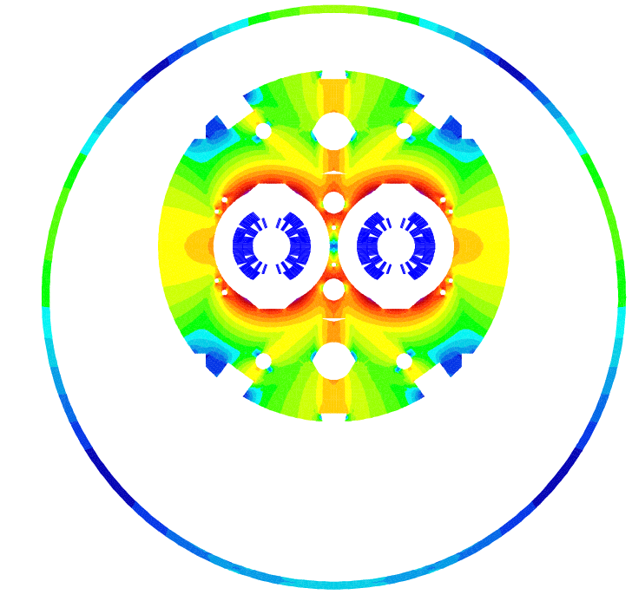
DS Upgrade
2017-18: Point-3,7 & IR-2
2020: IR1,5 as part of HL-LHC
MB.B8R/L
MB.B11R/L
11 T Nb₃Sn
∫BdL = 119.2 Tm @ I_{nom} = 11.85 kA
in series with MB
11 m Nb₃Sn
3 m Collim
(11.2 T x 10.6 m), L_{CM} ≈ 11 m, (MB -4.2 m) => 12 coldmass + 2 spares = 14 CM
2 x (11.2 T x 5.3 m), L_{CM} ≈ 11.5 m, (MB -3.7 m)
=> 24 coldmass + 4 spares = 28 CM
5.5 m Nb₃Sn
5.5 m Nb₃Sn
3 m Collim
5.5 m Nb₃Sn
3 m Collim.
5.5 m Nb₃Sn

Slide 3
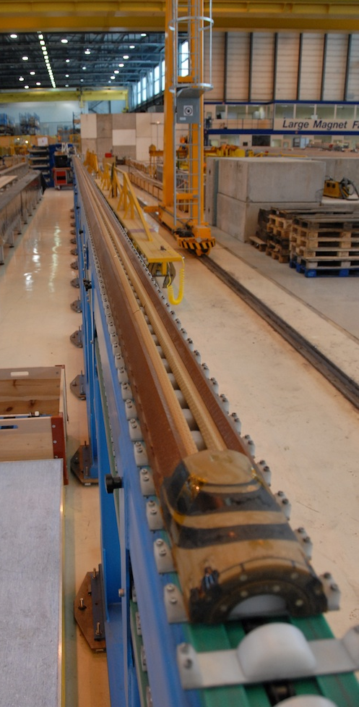
11 T Dipole Cold Mass
Cold mass length 5.5 m:
  FNAL have coil fabrication and collaring tooling up to 6 m
  Handling of 11 m coils is risky (250 kCHF of cable)
  11-m-long coils require cable unit length of 1200 m
Sagitta: 11 m – 5.0 mm, 5.5 m – 1.3 mm
  Ø60 mm aperture and straight cold mass
Integration in the LHC
  2-in-1 design, intra-beam distance 194 mm
  Bus-bar routing and heat exchanger location as MB
Schedule and cost
  Make use of existing tooling and infrastructure
  Parallel production lines at CERN and FNAL

Slide 4
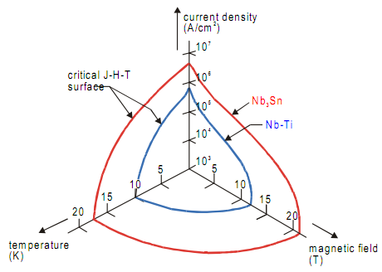
Nb₃Sn Superconductor
Nb₃Sn critical parameters (J_{c}, B_{c2} and T_{c}) very attractive for accelerator magnets
Requires (long) heat treatment @ 680 °C
  => Only inorganic insulation materials
Brittle, strain sensitive after reaction
Requires vacuum impregnation with resin
  => less efficient heat extraction by He
Magneto-thermal instabilities
  => small filaments, small strands, high RRR
Filaments ~50 µm (NbTi 6 µm)
  Persistent current effects
Cost ~5 x NbTi
Limited supply and only few suppliers

Slide 5
Nb₃Sn Accelerator Magnet R&D
Year | Laboratory | Magnet type (name) | Results
1967 | BNL | quadrupole | 85 T/m (3 T)
1979 | BNL | dipole | 4.8 T
1982 | CERN | quadrupole | 71 T/m
1983 | CEN/Saclay | dipole | 5.3 T
1985 | LBNL | dipole (D10) | 8 T
1986 | KEK | dipole | 4.5 T
1988 | BNL | dipole | 7.6 T
1991 | CERN/ELIN | dipole | 9.5 T
1995 | LBNL | dipole (hybrid D19H) | 8.5 T
1995 | UT | dipole (MSUT) | 11.2 T
1996 | LBNL | dipole (D20) | 13.3 T
2003 | LBNL | dipole (RD3c) | 10 T
2004-6 | Fermilab | dipole (HFDA05-07) | 10 T
2008 | LBNL | dipole (HD2) | 13.4 T
Both the performance and the technological aspects of the Nb₃Sn strands and accelerator magnets have significantly advanced.

Slide 6
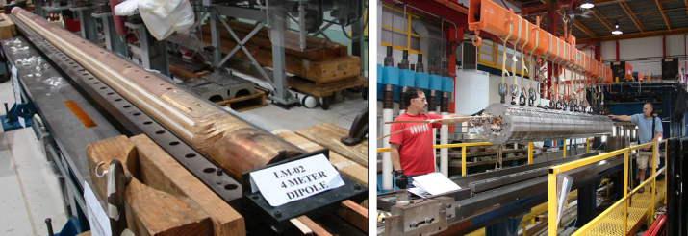
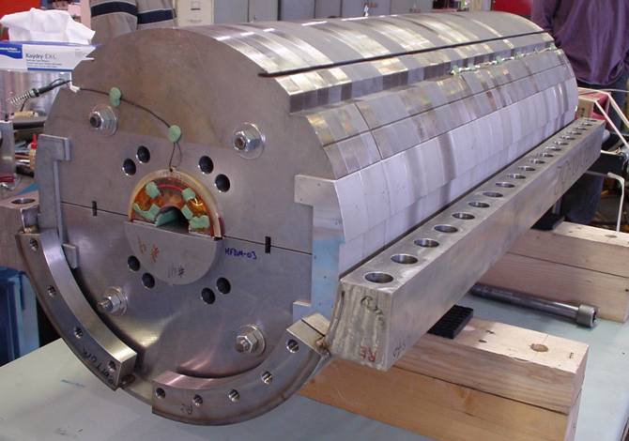
FNAL Nb₃Sn Dipole Mirror (4 m)
Fabrication methods
Tooling
Cold mass components

Slide 7
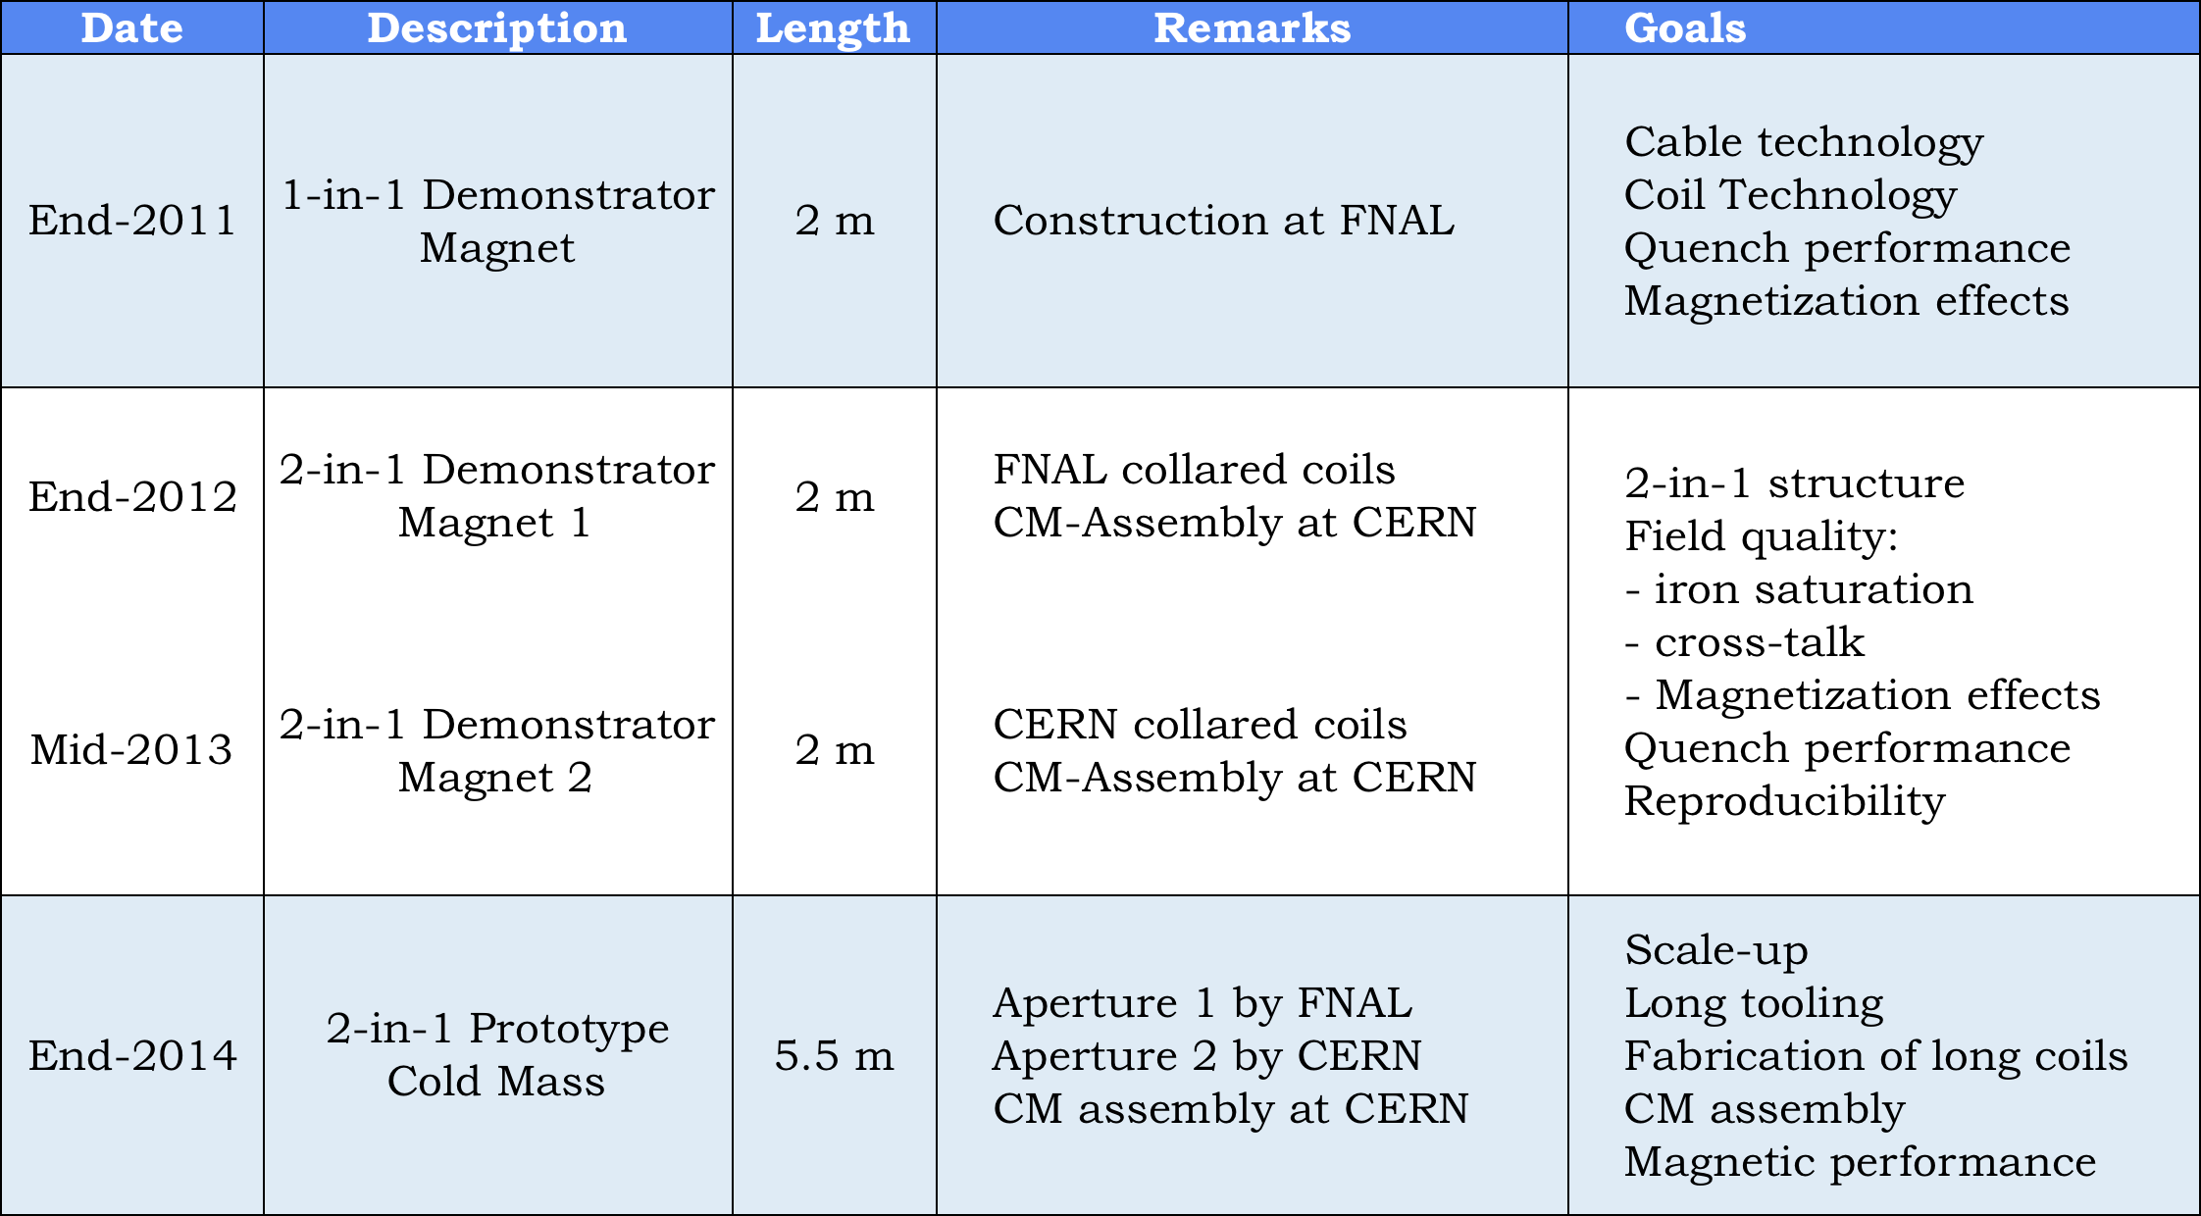
11 T Model Program

Slide 8
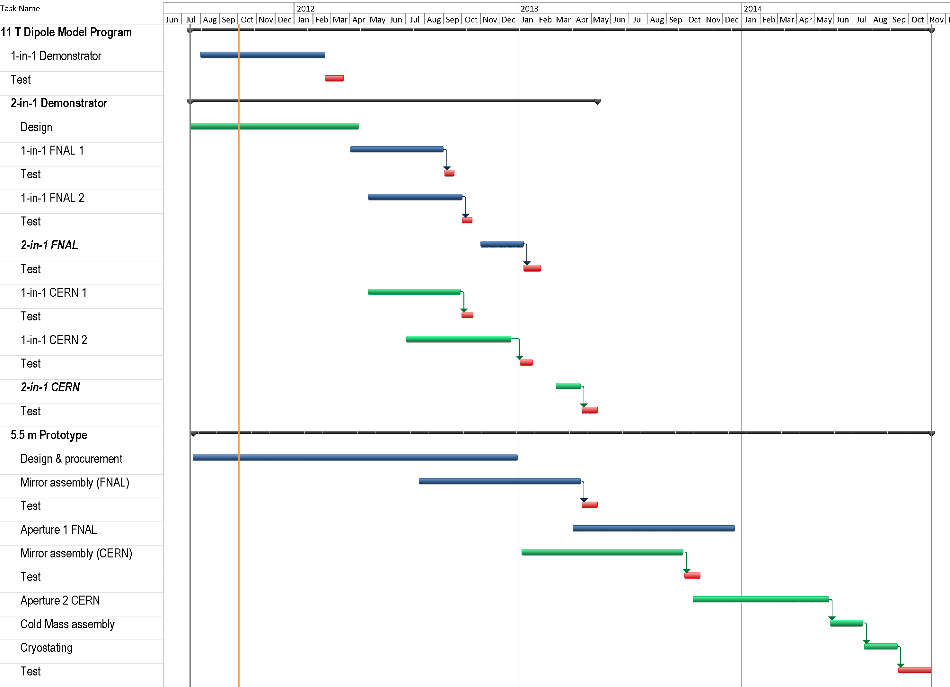
11 T Dipole Model Program

Slide 9
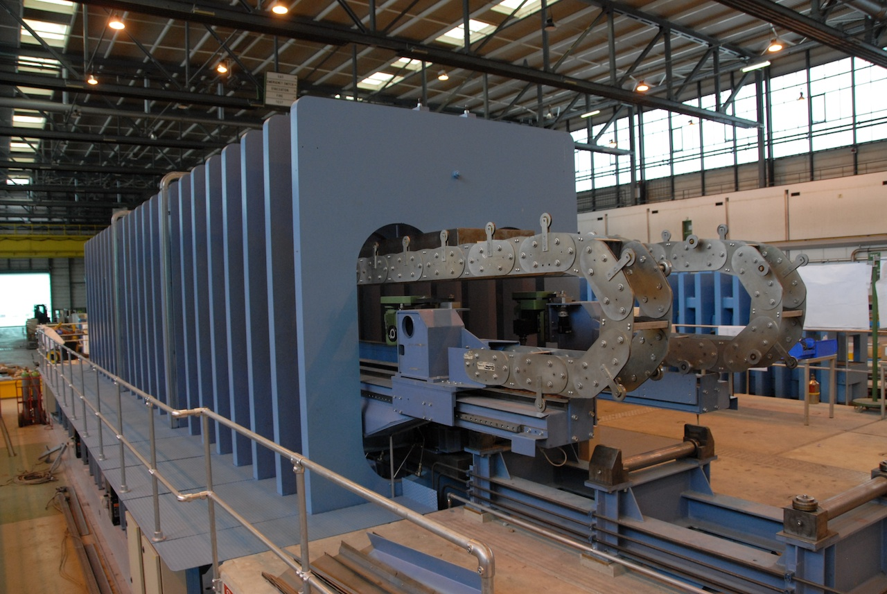
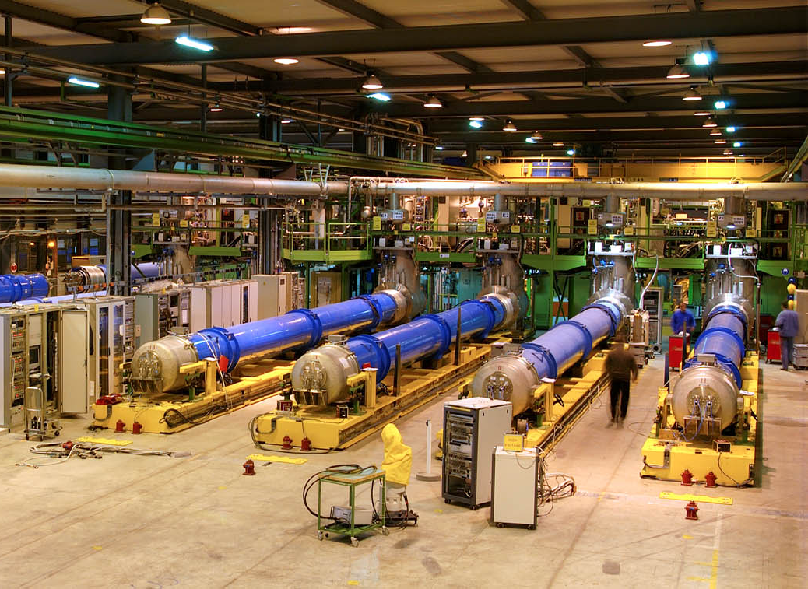
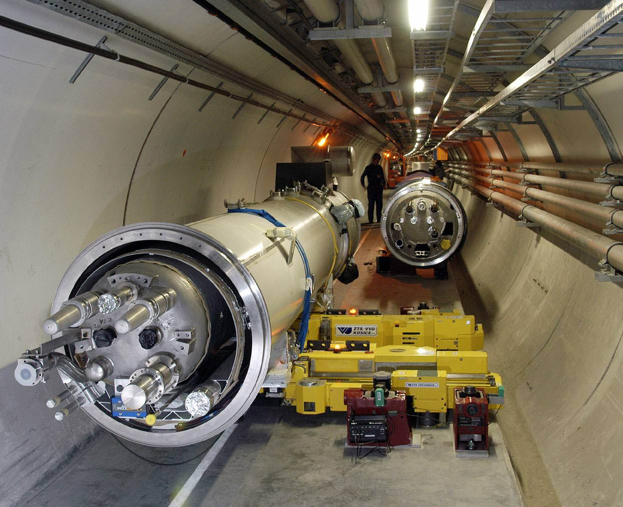
Production Phase 2014-17
Coil production (CERN & FNAL)
Collaring (CERN & FNAL)
Cold mass assembly (CERN)
Cryostat integration (CERN)
Testing (CERN)
Installation in the tunnel
Material cost for 28 off 5.5 m CM ~35 MCHF
3..4 years

Slide 10
1-in-1 Demonstrator Goals
Design and construction of a 2-m-long single aperture magnet, delivering 11 T at the LHC nominal operating current of 11.85 kA with 20% margin
Cable technology
  J_{c} degradation, I_{s}-data
Coil technology
  Fabrication procedures
  Insulation technology
Quench performance
  Operation margin
  Ramp-rate studies
Magnet protection
  Heater development
  Heater efficiency and delays
Coil Magnetization & coupling currents

Slide 11
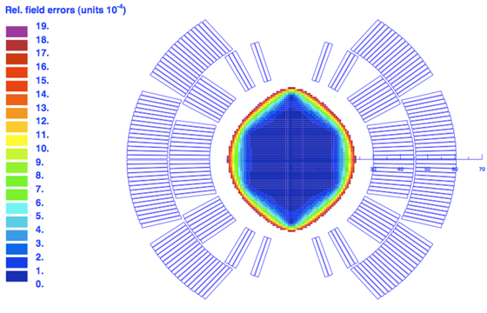
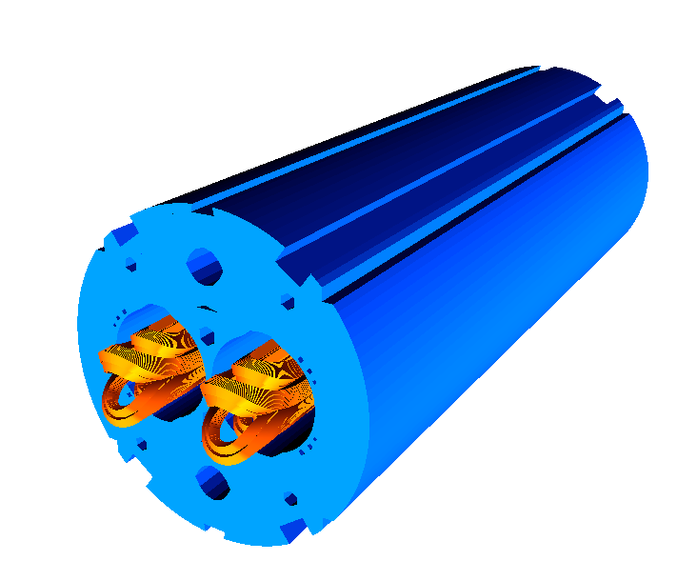
Coil Design
B₀(11.85 kA) = 11.21 T
B₀(11.85 kA) = 10.86 T
Coil optimization
  >11 T at 11.85 kA with 20% margin at 1.9 K
  Field errors below the 10⁻⁴ level
6-block design, 56 turns
  14.85 mm wide 40-strand Rutherford cable
  Several X-sections were analyzed with and without core
  Coil ends optimized for low field harmonics and minimum strain in the cable

Slide 12
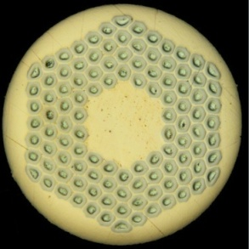

Cable Development & Strand Stock
40-strand Rutherford cable based on RRP-108/127 0.7 mm strand and with ~85% compaction for the 11 T Nb₃Sn demonstrator dipole has been developed
  Issues - large aspect ratio, low compaction
  FNAL roll the cable in two stages with an intermediate anneal (rectangular ➔ trapezoidal cross-section).
  CERN use single pass process.
Cable samples with and without a SS core
  I_{c} degradation well within the initial goal of 10 %
Cable unit length 205 m (2 m coil) or 600 m (5.5 m)
FNAL have 430 m cable
CERN have strand for three 2 m coils
FNAL ordered 2 x 45 km (Jan-12 & Jul-12)
CERN in process of ordering 2 x 45 km (delivery TBC)
Need ASAP low-performance strand for first practice coils at CERN

Slide 13
SC-strand & Cable needs
Model program:
1-in-1 Demo 3 coils 26 km
2-in-1 Demo FNAL 4 coils 34 km
2-in-1 Demo CERN 2^{(*}+4 coils 17^{(*} +34 km
5.5 m proto 10 coils 240 km
===========================================
Total strand 17+334 km
Cable for series magnets:
28 x 5.5 m 112 + 6 spare coils 71 km
  (+20% margin >3400 km of strand)
*) Practice coils

Slide 14
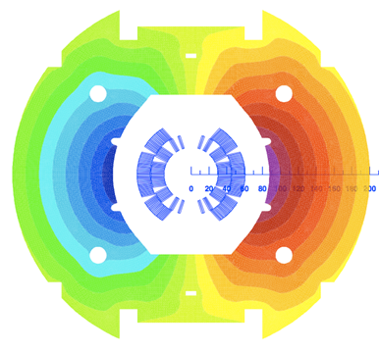
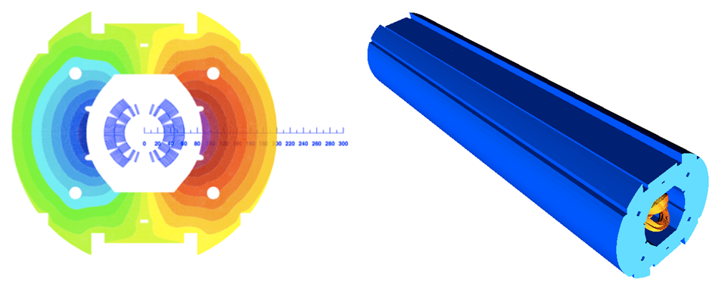
1-in-1 Demonstrator Parameters
Parameter | Value
Aperture [m] | 60
Nominal current I_{nom} [A] | 11850
Nominal bore field (with 400 mm yoke) [T] | 10.86
Short-sample bore field at 1.9 K [T] | 13.6
Margin B_{max}/B_{nom} at 1.9 K [%] | 25.4
Ultimate design field [T] | 12.0
Inductance at I_{nom} [mH/m] | 5.6
Stored energy at I_{nom} [kJ/m] | 473
F_{x} per quadrant at I_{nom} [kN/m] | 2889
F_{y} per quadrant at I_{nom} [kN/m] | 1570
Coil length [m] | 1.9
Magnetic length [m] | 1.79

Slide 15
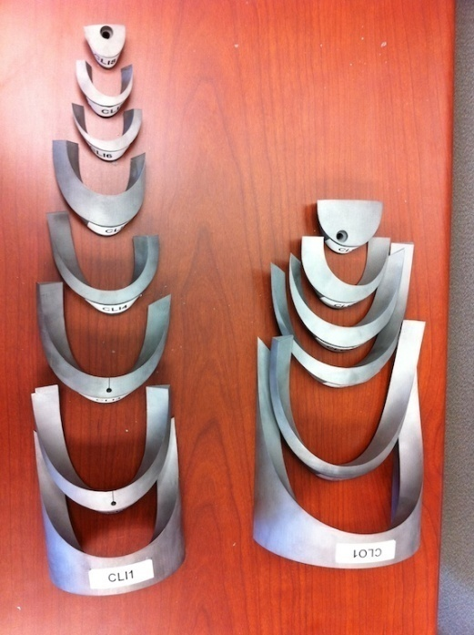
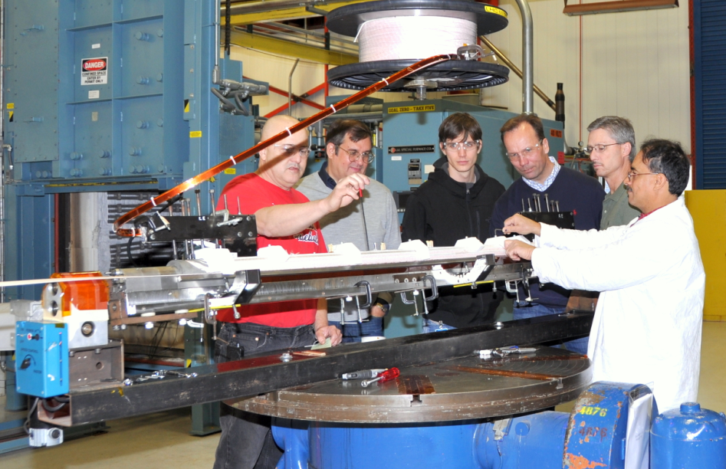
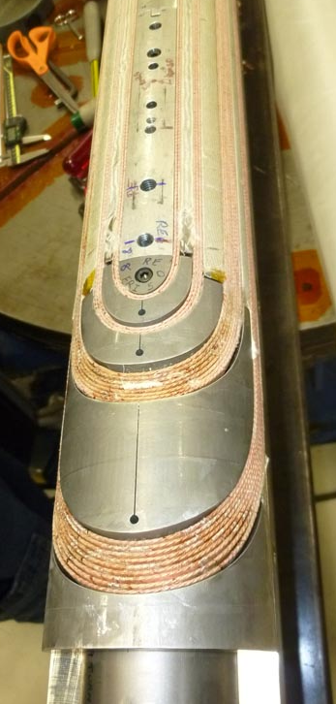
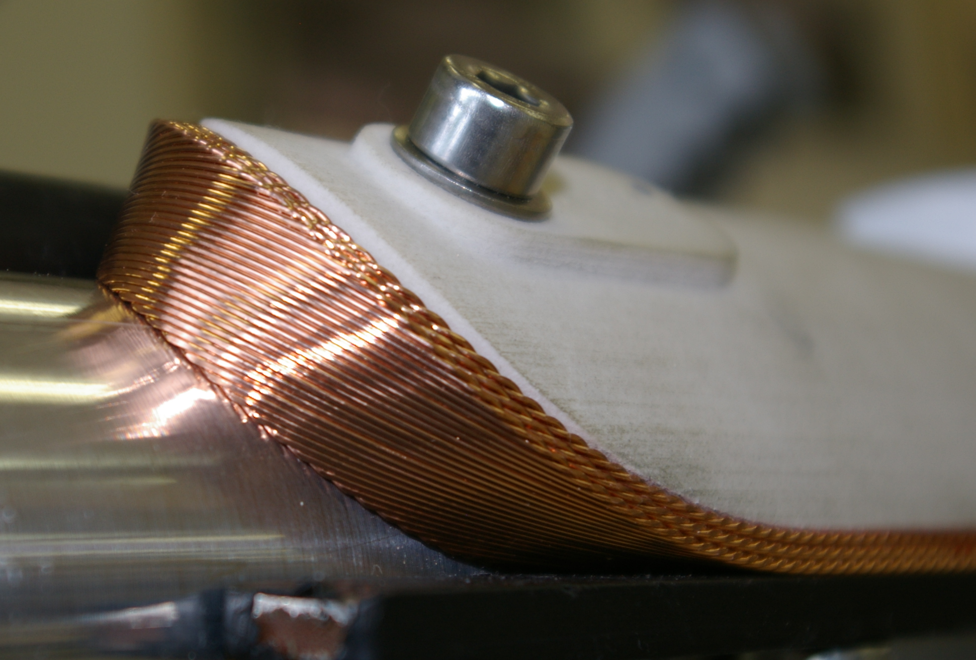
Coil Technology
Coil technology developed at Fermilab
Integrated Ti poles, st. steel end parts and wedges
2 m long practice coils:
  PC#1: Cu cable
  PC#2: Nb₃Sn cable (RRP-114/127)
  Practice windings to check the optimized cable and end parts
First real coil winding is being completed

Slide 16
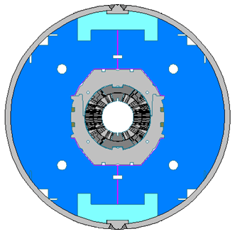
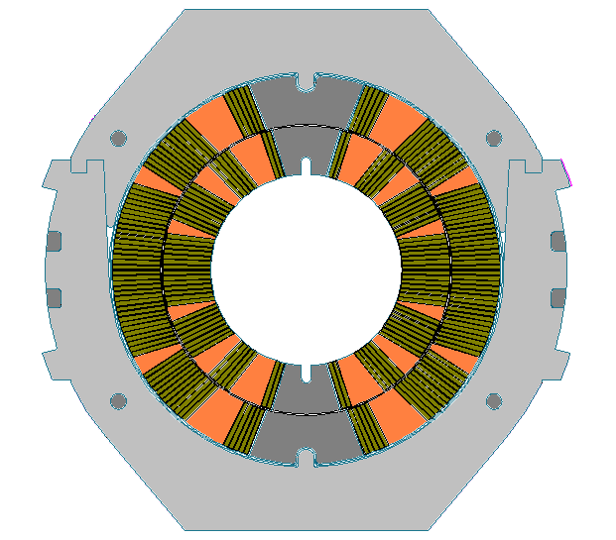
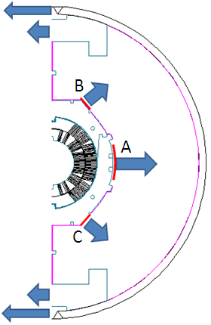
1-in-1 Demonstrator Mechanical Structure
Slightly elliptical stainless steel collar, 25-mm wide near mid-plane.
The vertically split iron yoke clamped with Al clamps.
The 12-mm stainless steel skin.
Two 50-mm thick end plates.
Maximum stress during assembly ~130 MPa to keep coil under compression up to 12 T bore field.
The mechanical structure is optimized to maintain the coil stress below 165 MPa - safe level for brittle Nb3Sn coils

Slide 17
1-in-1 Demonstrator Status
The engineering design and tooling are complete
40-strand cable developed and tested
2 unit lengths are available for coil winding
Coil fabrication procedures established
Coil fabrication tooling commissioned
Assembly tooling being procured
Winding of the first coil being completed
Mechanical structure is being procured
Next steps:
  Short mechanical model assembly End-Nov
  Collaring Jan-12
  Yoke assembly Feb-12
  Magnet test at FNAL Mar-12

Slide 18
2-in-1 Demonstrator Goals
Design and construction of a 2-m-long 2-in-1 magnet, delivering 11 T at the LHC nominal operating current of 11.85 kA with 20% margin
Quench performance
  Operation margin
  Ramp-rate studies
Transfer function matching with MB
Field quality
  Iron saturation
  Persistent current effects & passive correction
  Coupling current effects
  Magnetic cross-talk between the apertures
Magnet protection
  Heater development
  Heater efficiency and delays

Slide 19
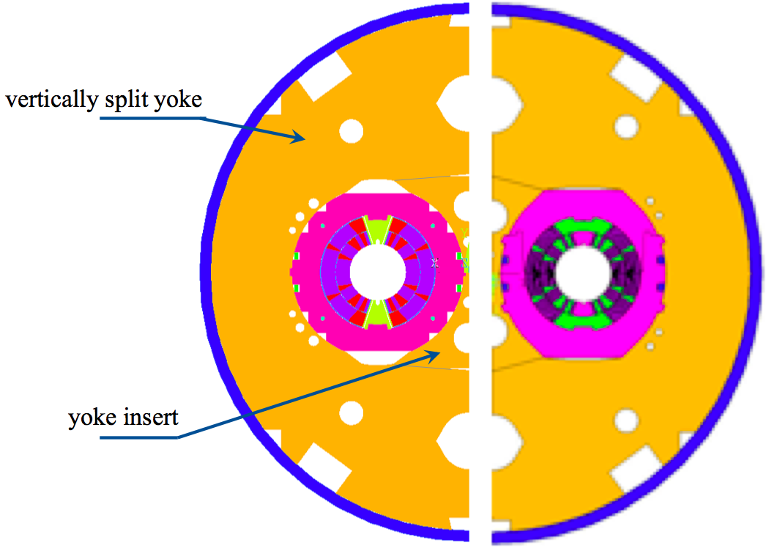
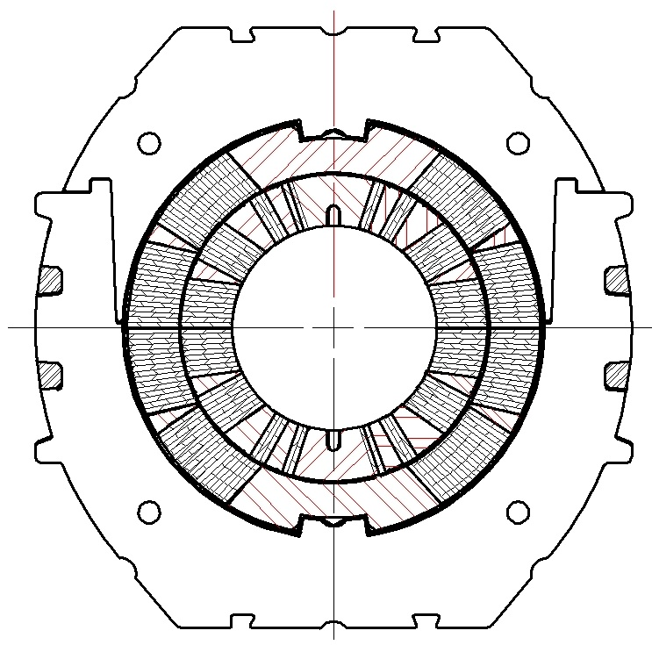
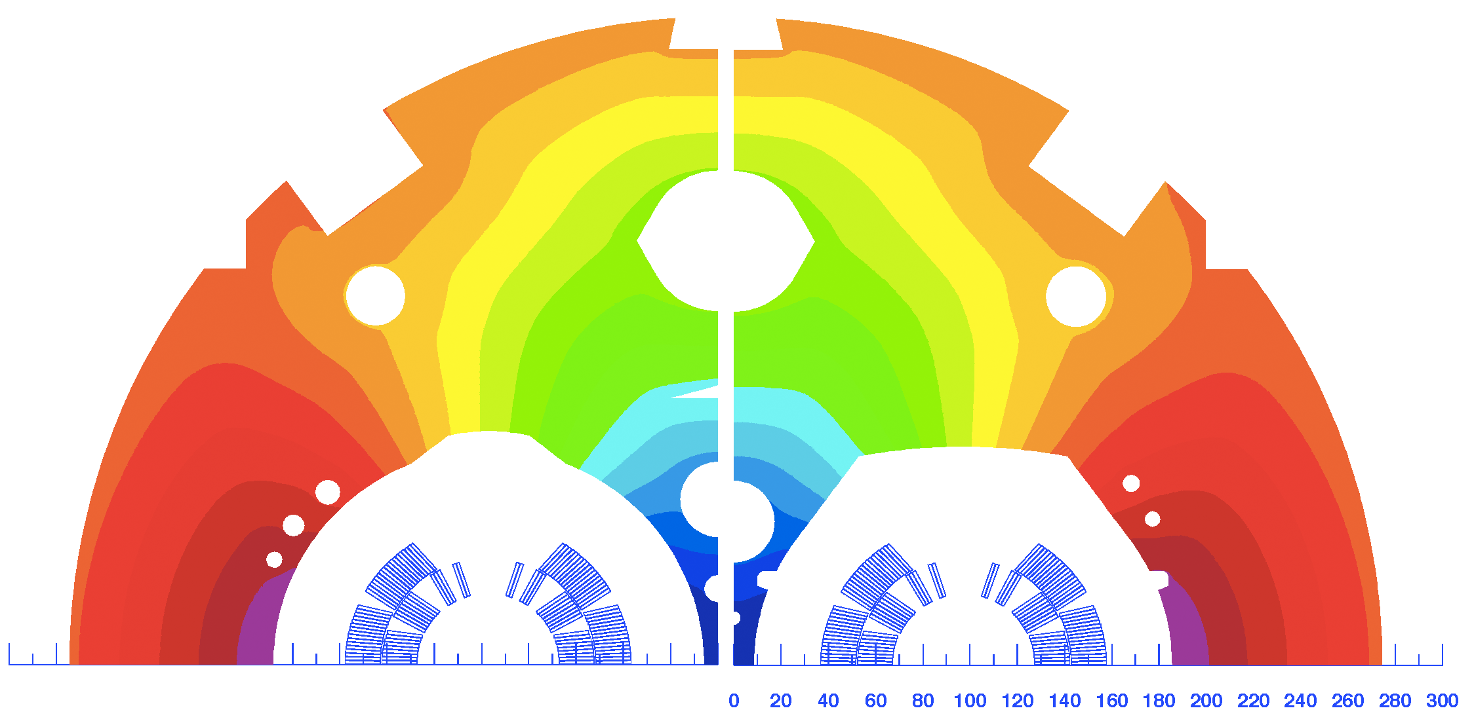
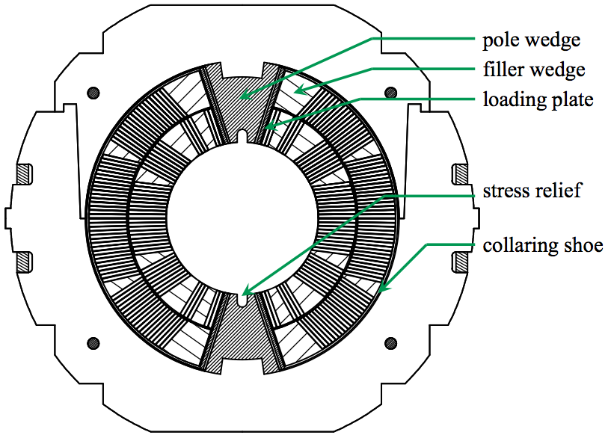
2-in-1 Demonstrator Design
Two alternative design concepts
Removable Pole Design
Integrated Pole Design

Slide 20
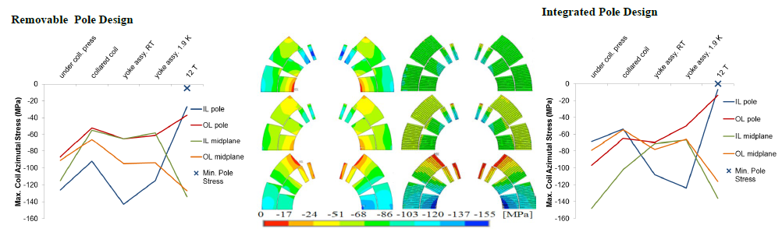
2-in-1 Demonstrator FEA
After CM assembly at 293 K
At 1.9 K, I = 0 A
B₀ = 12 T
Mechanical design challenges
  First twin-aperture Nb₃Sn dipole
  Coil pre-stress and Lorentz force management inside the LHC iron yoke.
  Lorenz forces are almost 2X higher than in MB
Both design concepts meet the mechanical design goals
  Coil stress below 150 MPa during the assembly process
  Coil remain under compression up to 12 T

Slide 21
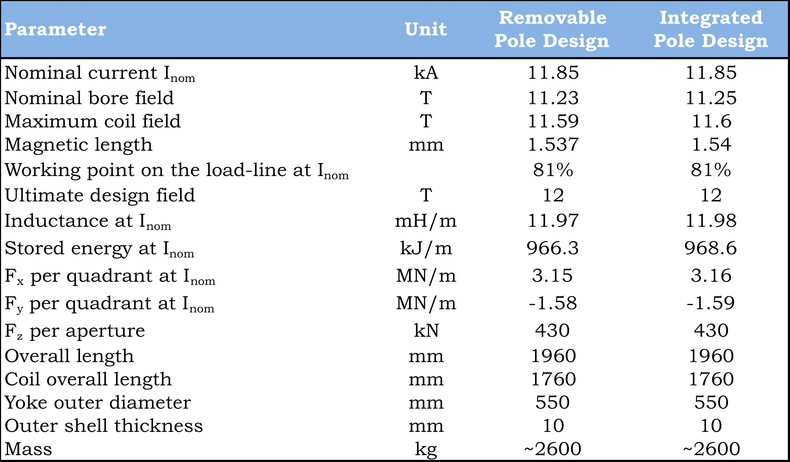
2-in-1 Demonstrator Paramteres

Slide 22
2-in-1 Demonstrator status & Plans (1/2)
Engineering design of the magnet is in progress
  Collared coil from 1-in-1 demonstrator
  “Conventional” collaring with coil pre-loading at the poles
2-in-1 magnet with FNAL coils
  Coils for 1st aperture Mar..Jul-12
  Cold test of 1st aperture Sep-12
  Coils for 2nd aperture Apr..Jul-12
  Cold test of 2nd aperture Oct-12
  Mechanical model Oct..Dec-12
  2-in-1 CM assembly at CERN Jan-13
  2-in-1 cold test at CERN Feb-13

Slide 23
2-in-1 Demonstrator status & Plans (2/2)
CERN tooling (based on FNAL design)
  Winding tooling in procurement
  Reaction, impregnation, and assembly tooling being designed
2-in-1 magnet with CERN coils
  First practice coil (Cu) Dec-12
  First practice coil (Nb₃Sn) Feb-12
  Mechanical model (1-in-1) Mar..Apr-12
  Coils for 1st aperture May..Aug-12
  Cold test of 1st aperture Oct-12
  Coils for 2nd aperture Jul-12..Nov-12
  Mechanical model (2-in-1) Oct..Dec-12
  Cold test of 2nd aperture Jan-13
  2-in-1 CM assembly Mar-13
  2-in-1 cold test Apr-13

Slide 24
5.5 m Prototype Plans
FNAL
  Practice coils Aug-12..Jan-13
  Mirror assembly Mar-13
  Mirror test Apr-13
  Coils for FNAL aperture May..Nov-13
  Collared coil Dec-13
CERN
  Practice coils Jan..Jul-13
  Mirror assembly Aug-13
  Mirror test Oct-13
  Coils for CERN aperture Oct-13..May-14
  Collared coil Jun-14
  CM assembly Aug-14
  Cryostat assembly Sep-14
  Cold test Oct..Nov-13

Slide 25
Summary
11 T Nb₃Sn dipole magnets for the LHC upgrades are being developed by Fermilab/CERN collaboration
  additional cold collimators
  other applications
The construction of the 1-in-1 demonstrator magnet has started and the engineering design of the 2-in-1 demonstrator is well underway.
Tooling design for 5.5 m coils has started at FNAL
SC strand supply is on the critical path of the model program
The integration into the LHC is common effort with the (cryo-) collimator R&D.
The time scale of the planned upgrade is challenging and requires parallel production lines at CERN and at FNAL.

