Slide 1
Expected Field Quality in the 11-T Dipole
B. Auchmann, TE-MSC
on behalf of the CERN-FNAL collaboration
B. Holzer, M. Karppinen, L. Oberli, L. Rossi, D. Smekens (CERN)
N. Andreev, G. Apollinari, E. Barzi, R. Bossert, V. Kashikin,
F. Nobrega, I. Novitski, A. Zlobin (FNAL)
HQ test data from
M. Marchevsky (LBL): HQ01e Quench Performance
G. Chlachidze (LBL): HQM01 Test Results
X. Wang (LBL): Summary of HQ01e Magnetic Measurements, Version 0a

Slide 2
Contents
What are the design goals in terms of:
  Transfer function
  Field quality
  Magnet protection
What are the challenges?
  Based on HQ, MSUT, HFDA experience and ROXIE simulations.
How do we inted to cope with them?
  Based on simulations.
2

Slide 3
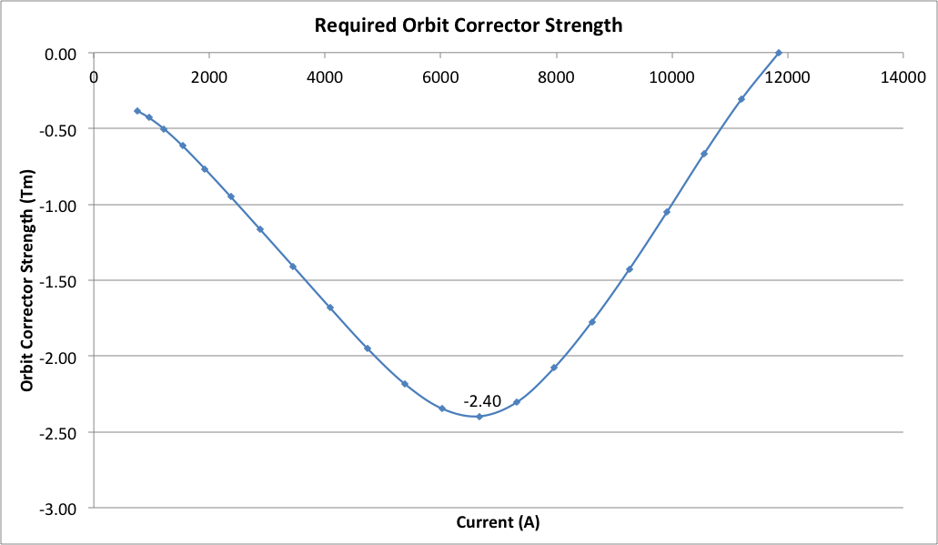
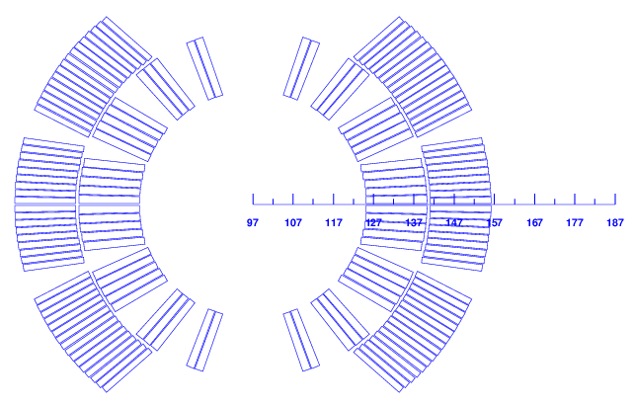
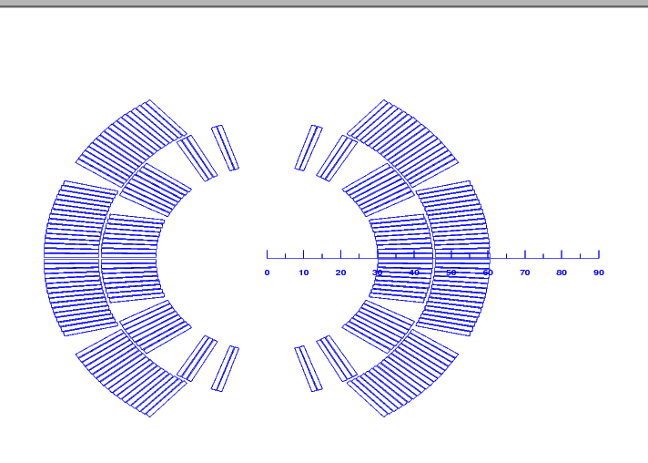
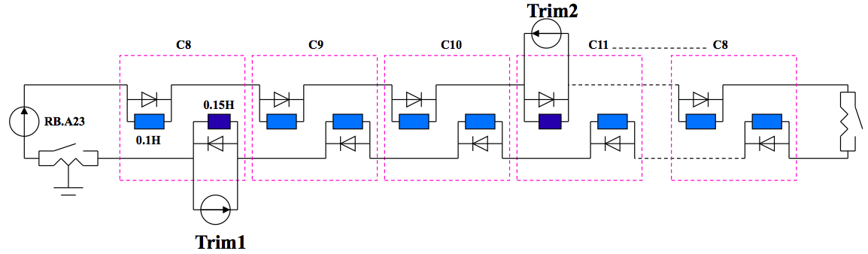
Transfer Function
A discrepancy between MB and 11 T is inevitable:
  More turns than MB (56 vs. 40) ➔ 11 T dipole is stronger low field.
  More saturation ➔ reduction of transfer function at high field.
Remedy:
  No space for correctors (~ 1 m MCBC/MCBY needed).
  300 A trim power converter.
  Preferred: monopolar to avoid voltage peaks that perturb QPS.
MB
11 T
Courtesy of H. Thiessen

Slide 4
Field Quality
What effects need to be considered?
  Geometric from coil transport current.
  Yoke saturation, cross-talk.
  3D field quality.
  Persistent current effects.
  Cable eddy currents.
  Decay and snapback.
  Coil deformation during assembly, cool-down,
  and powering.
Notes:
Verify 5!! Too strict!!! Please!!!

Slide 5
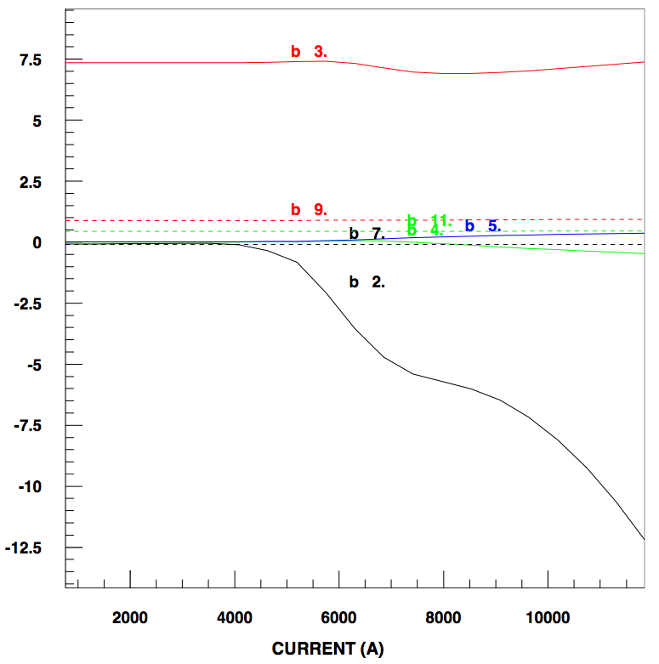
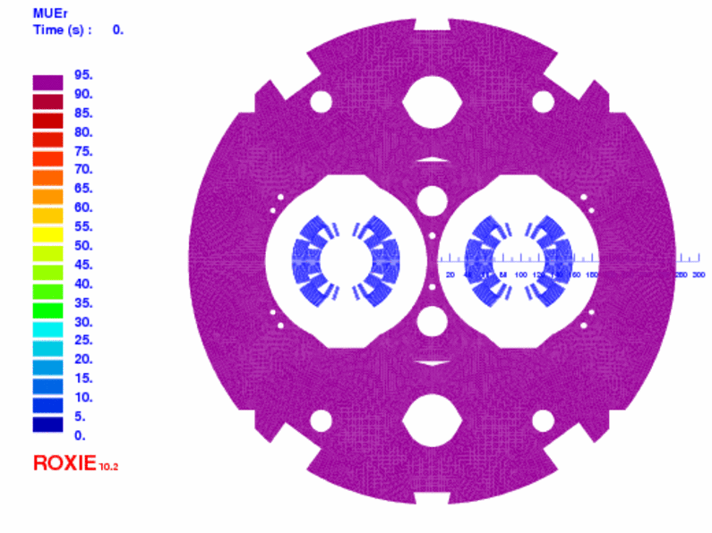
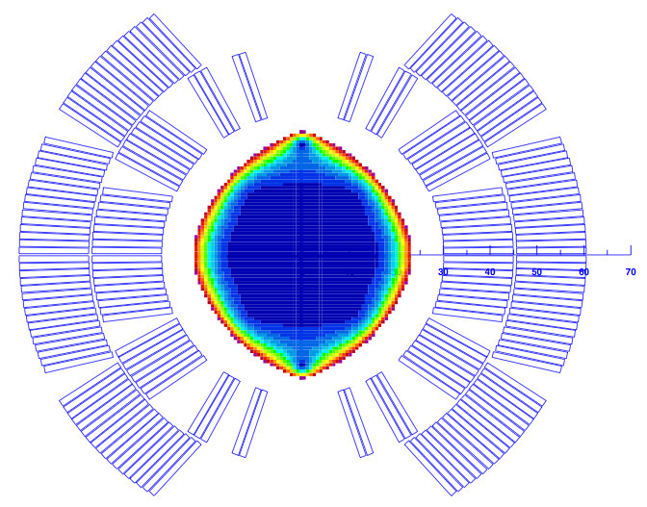

Coil and Yoke
Coil geometric multipoles < 1 unit @ 17 mm.
Yoke design
  The cut-outs on top of the aperture reduce the b₃ variation by 4.7 units as compared to a circular shape.
  The holes in the yoke reduce the b₃ variation by 2.4 units.
  The two holes in the yoke insert reduce the b₂ variation from 16 to 12 units.
  Remedy for b₂: thinner collars are being studied.

Slide 6
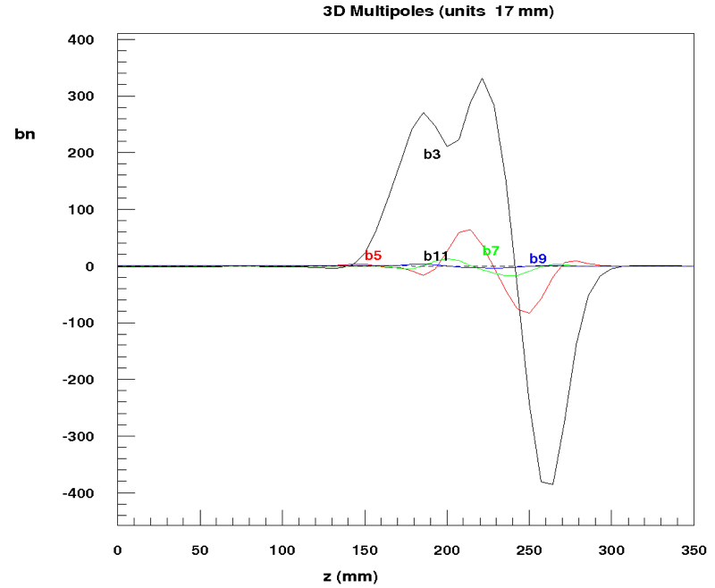
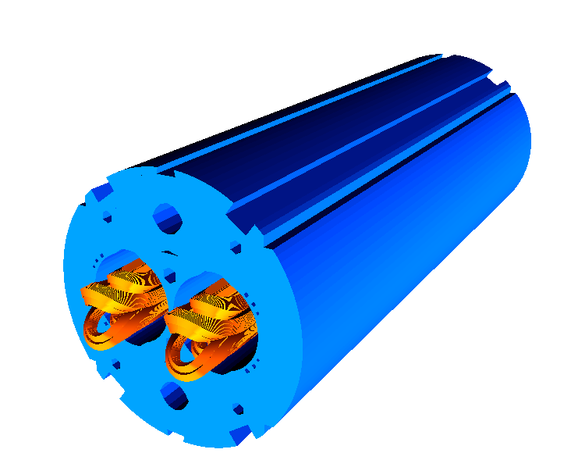
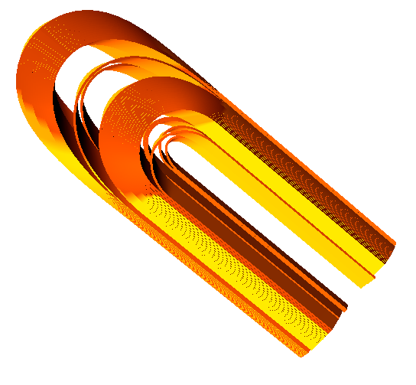
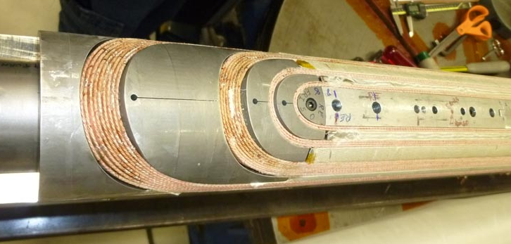
3-D Field Quality
3-D integrated harmonics vs. 2-D harmonics @ I_{nom}
  Optimized 3-D coil design.
  Cross-talk in the ends ➔ increase in b₂.
  Need to control winding accuracy.
 | 2-D | 3-D
b₂ | -12.5 | -15.8
b₃ | 7.4 | 7.4
b₅ | 0.4 | 0.6
b₇ | -0.1 | -0.2
b₉ | 0.9 | 0.8

Slide 7
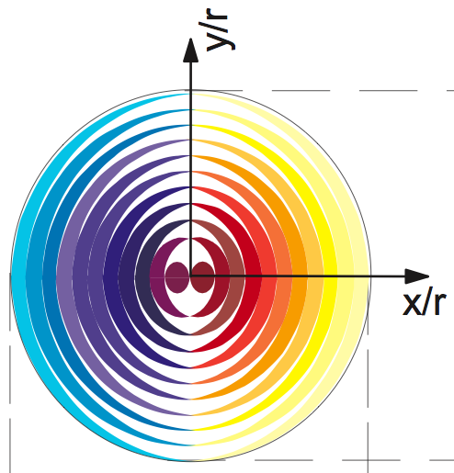
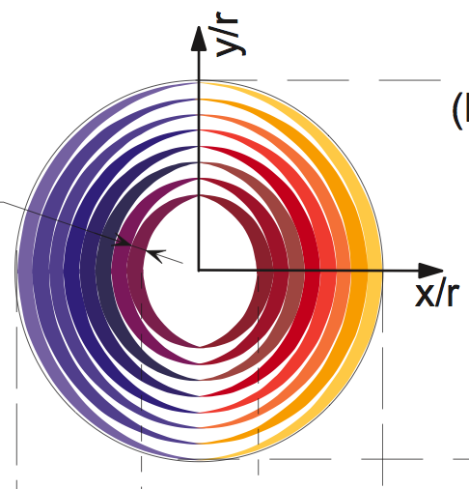
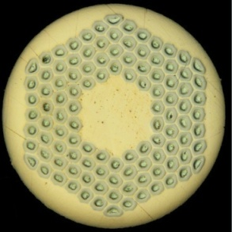
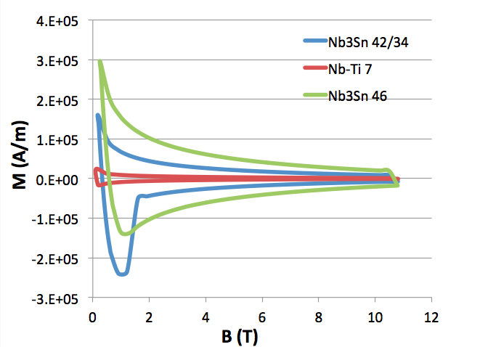
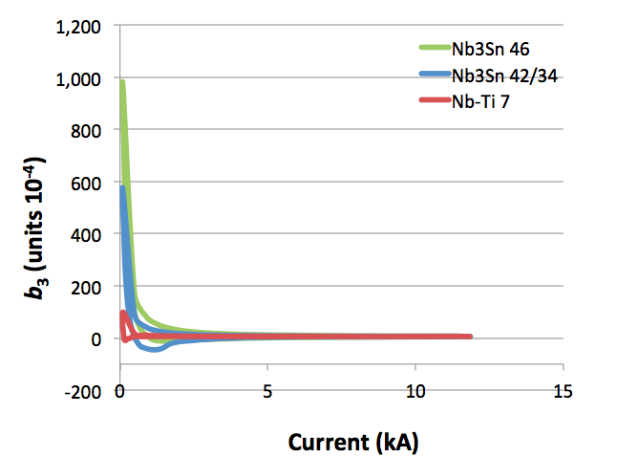
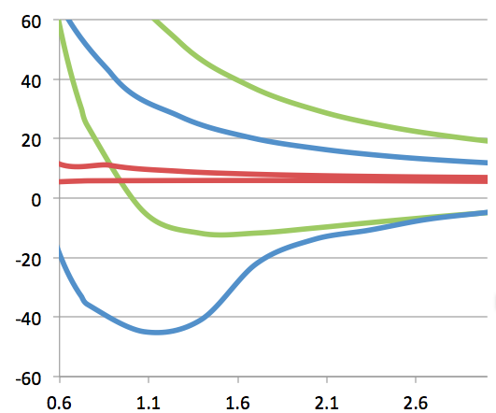
Persistent Currents 1/3: Nb₃Sn & Nb-Ti
Strand magnetization:
  7μm fil. Nb-Ti
  46μm fil. Nb₃Sn
  d_{in} = 42 μm / d_{out}= 34 μm. fil. Nb₃Sn
Nb₃Sn
d_{inner}
d_{outer}
I_{inj}
Notes:
Redo this slide!!!

Slide 8
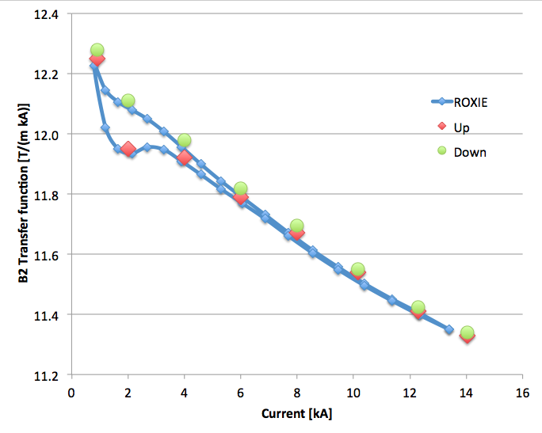
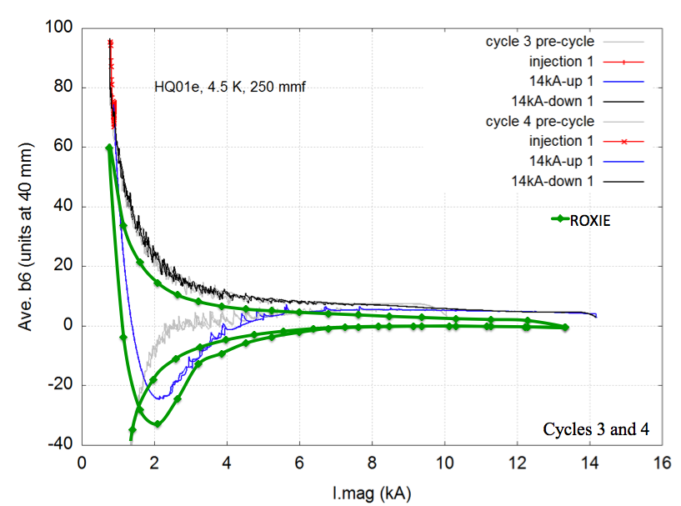
Persistent Currents 2/3: HQ
HQ experience:
  0.8 mm RRP 2 coils with 70 μm filaments and
  2 coils with 52 μm filaments.
  ROXIE persistent current simulation based on
  LBL J_{c} fit and crude assumptions
  70 μm fil.: d_{in} = 58 μm / d_{out}= 46 μm and
  52 μm fil.: d_{in} = 42 μm / d_{out}= 34 μm.
Nb₃Sn
d_{inner}
d_{outer}
[1]
Notes:
Check cu/sc ratios!!!
Add references!!!

Slide 9
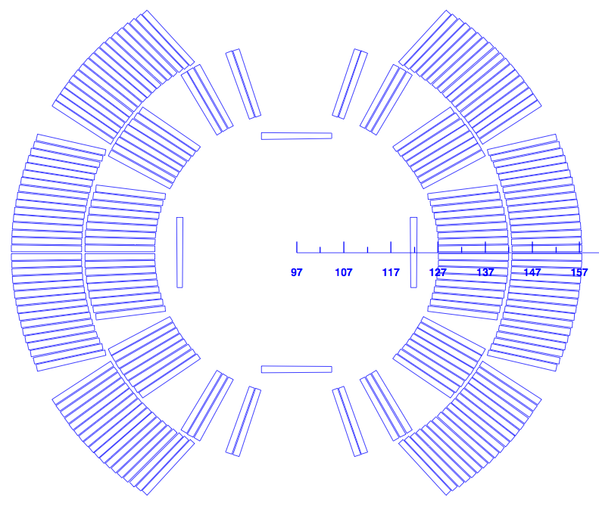
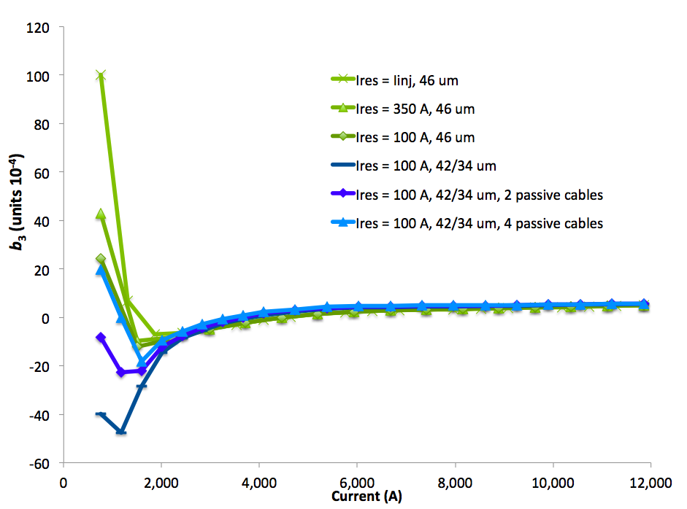
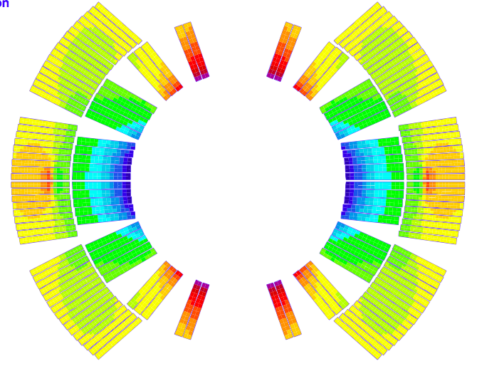
Persistent Currents 3/3: 11 T
Strand J_{c} and M characterization for 0.7 mm RRP 108/127
in preparation with B. Bordini.
Expected range for 11 T:
  Full filaments ➔ ok for reset current 0-100 A.
  d_{in} = 42 μm / d_{out}= 34 μm ➔ passive correction,
  more optimization possible.
Result is within reach of spool-piece correctors.
  Integrated B₃ difference 11-T/MB ~ 0.03 Tm < 0.052 Tm of MCS.
passive strands
b₃ due to strand
magnetization in MB
[4]

Slide 10
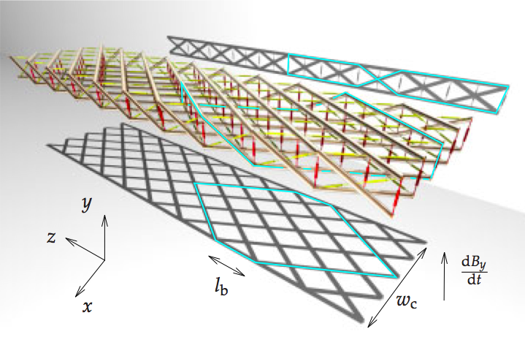
Cable Eddy Currents 1/3
Dominant effects in cable without core:
  Inter-filament coupling negligible
  w.r.t. inter-strand coupling.
  Cross-over resistance R_{c} defines
  dominant mode.
R_{c} varies by orders of magnitude.
  HFDA measurements: 4 – 500 μΩ.
  MSUT estimates: 1.2 μΩ. Called it “Eddy-Current Machine”!
  HQ calculations: 0.4 – 6 μΩ.
Reproducibility is an issue.
Decay and Snap-back
  Interplay of boundary-induced coupling currents and
  strand magnetization.
  BICCS are ISCCs on large loops,with long time constants.
[8]
[7]
Notes:
Ask Ezio on Rc & Snapback correlation?

Slide 11
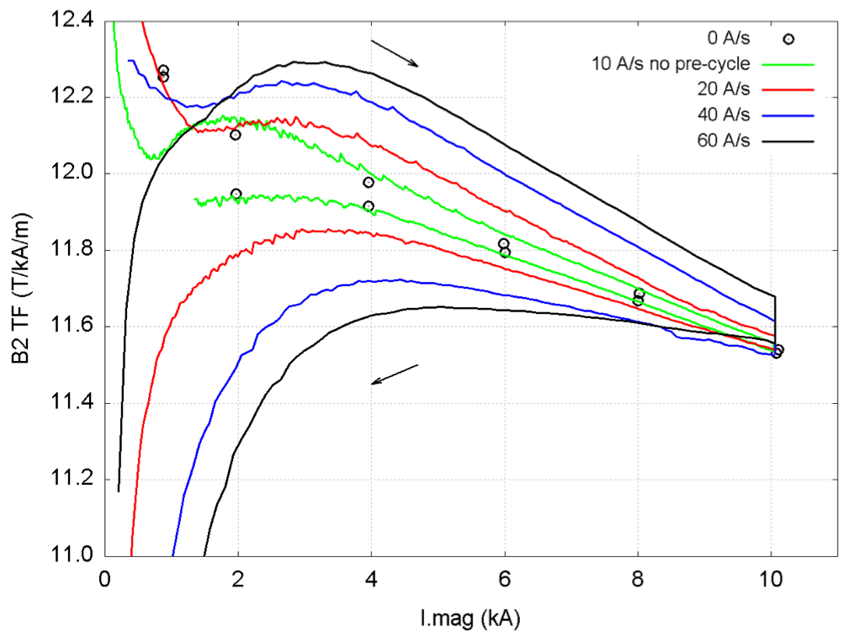
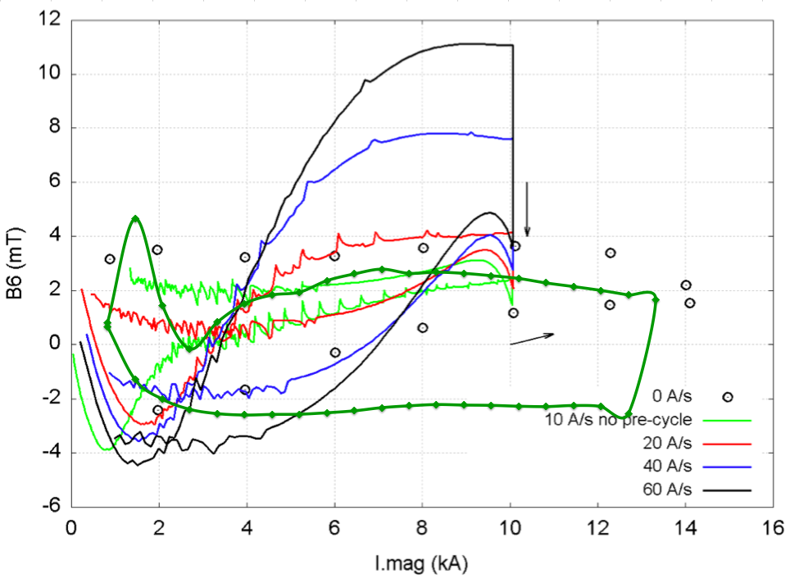
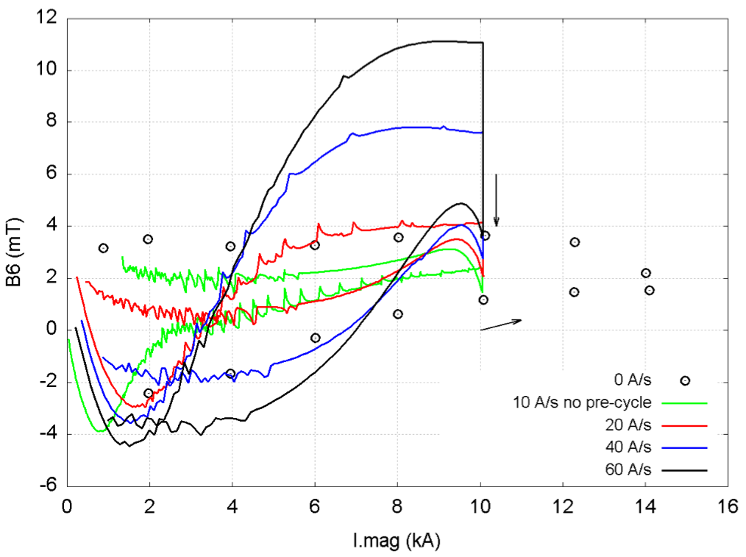
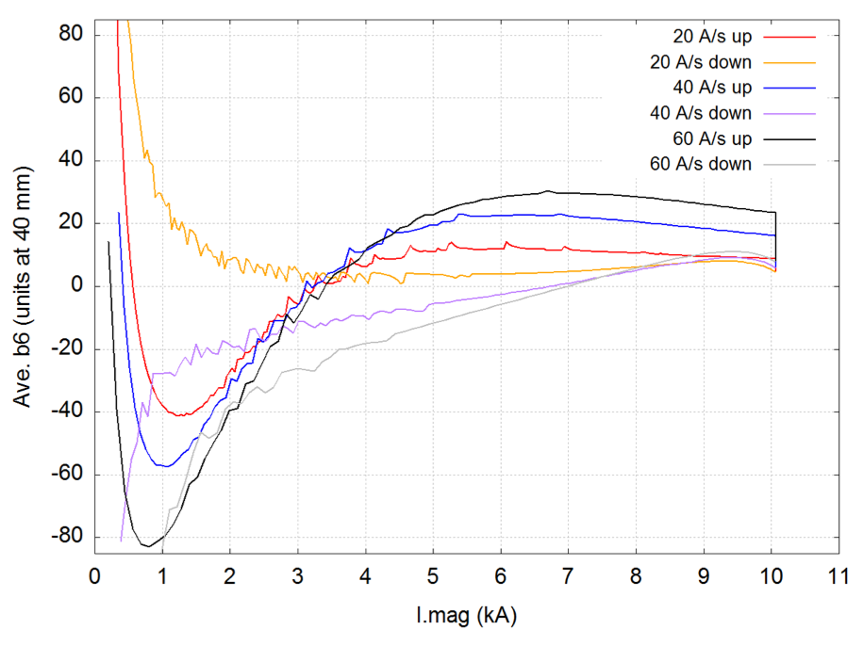
Cable Eddy Currents 2/3: HQ
HQ experience measurements.
  Cannot be reproduced in simulations.
  Need R_{c} ~ 0.4 μΩ to get similar orders of magnitude.
  Large snap-back?
  Should be independently confirmed at CERN soon!
Transfer Function
Sextupole
Relative Sextupole
Black curve (measured) and
green curve (simulated)
correspond to 60 A/s ramp rate.
[1]

Slide 12
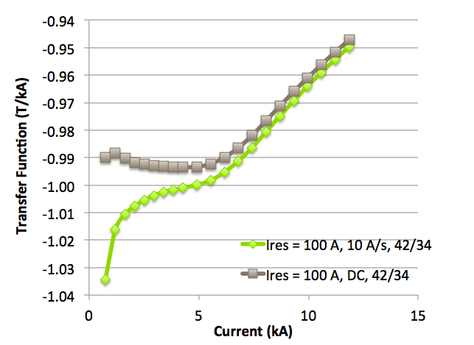
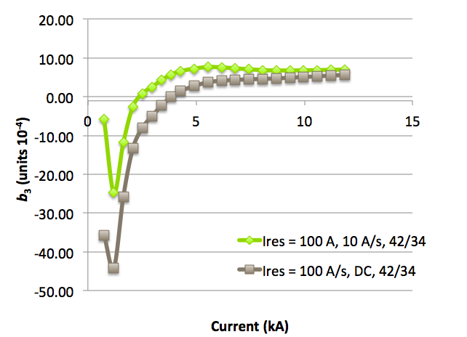
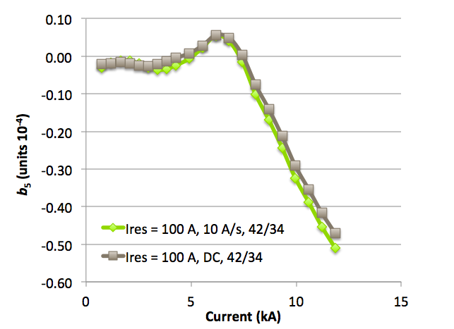
Cable Eddy Currents 2/2: 11 T
ISCCs in 11 T magnet
  Based on R_{c} = 0.4 μΩ we give presumably worst-case field quality for the 11-T dipole.
  “Field advance” of ~ 4% due to ISCCs clearly visible
  in transfer function.
Probably need a cored cable to increase R_{c}.
Need to measure snap-back at injection with
and without cored cable.
Transfer Function
Sextupole
Decapole
DC
10 A/s

Slide 13
Field Quality Requirements
Beam-dynamics boundary conditions
see talk by B. Holzer:
  B₁ matches MB.
  |b₃| below 20 units, correctable by spool-piece correctors.
  |b₂| below 16 units.
  |b₅| below 5 units.
  …
  to be confirmed by B. Holzer for updated error tables.
We can deliver with
  trim power converter,
  part-compensation in coil geometry,
  passive persistent-current compensation,
  adapted precycle (trim power converter),
  and cored cable.

Slide 14
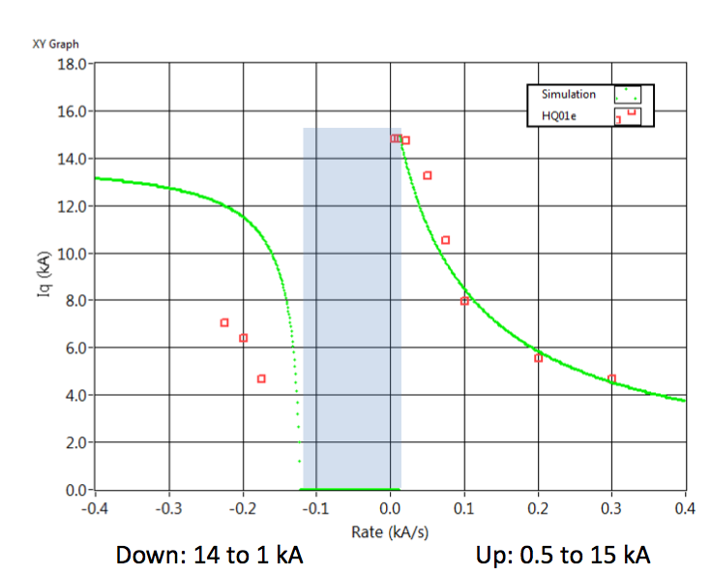
Surviving a Fast Power-Abort 1/2: HQ
HQ tests by M. Marchevsky, LBL and ROXIE simulations ( ).
  Positive ramps reproduced with R_{c} = 6 μΩ.
  No cooling in the model ➔ in reality R_{c} < 6 μΩ.
[2]
Notes:
References!

Slide 15
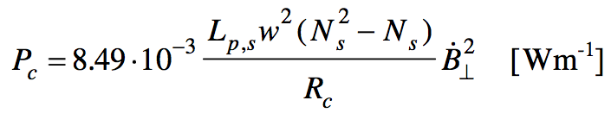
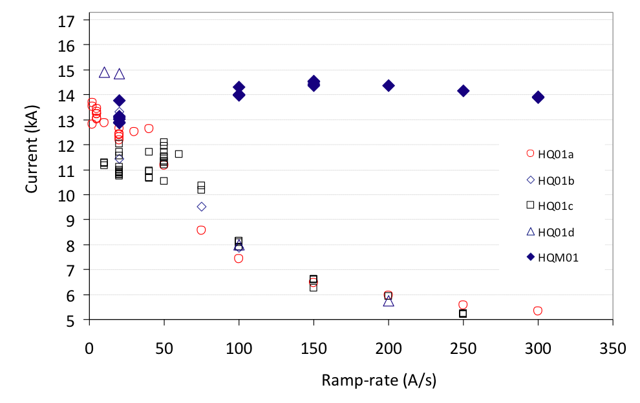
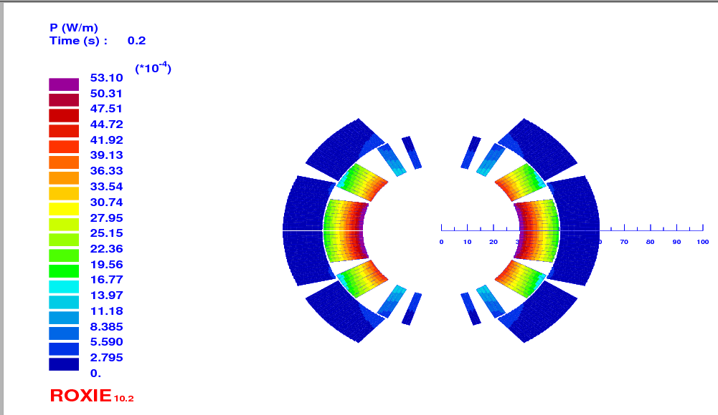
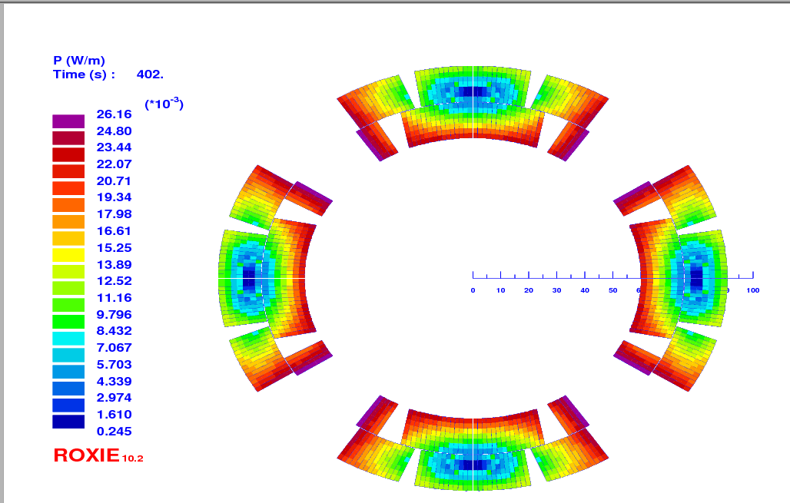
Surviving a Fast Power-Abort 2/2: 11 T
 | HQ | 11 T
No. of strands | 35 | 40
Twist pitch (mm) | 102 | 90-111
R_{c} (μΩ) | 6 | 7.5
Op. Temp. (K) | 4.5 | 1.9
Losses in midplane turn (mW) | 75 | 130
Higher losses and
smaller heat capacity.
11-T quenches in simulations
already at 11 kA!
Cored cable in HQM01 proved
effective.
[3]
[9]
Loss distribution in 11 T and HQ cross-section

Slide 16
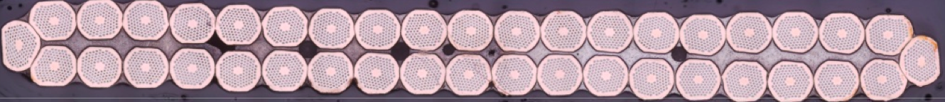
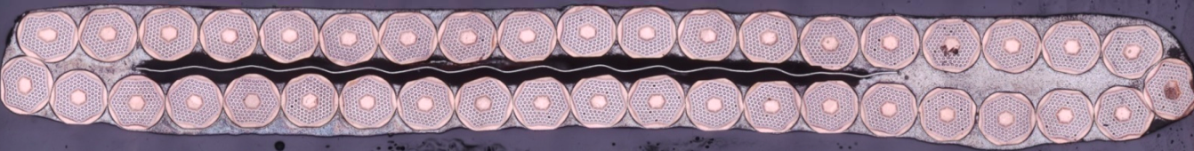
Cored Cable pro & con
SIS300 experience with core: R_{c} from μΩ to mΩ!
Successful cabling tests for cored 11 T cable
with 9.5 mm x 25 μm core.
Pros:
  Fast-power abort stability.
  Snap back reduction.
  Supression of ramp-rate dependence of field quality.
  Increased reproducibility.
Cons:
  Less quench back for protection.

Slide 17
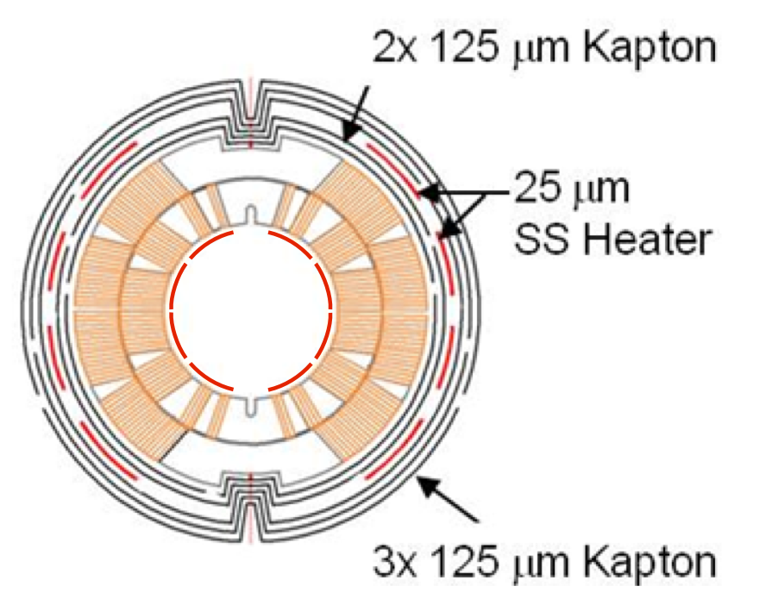
Magnet Protection
Design goals:
  Max. 400 K (to be discussed).
  Redundant heater systems.
  Robust (enough) detection thresholds.
Collaboration with LARP
  HQ results are being studied.
Simulation results for 25 ms from
quench to full heater efficiency, RRR = 200
  T_{peak} = 480 K for outer-layer (OL) low-field heaters.
  T_{peak} = 360 K for OL high-field heaters.
  T_{peak} = 450 K for OL low-field heaters with quench-back.
  T_{peak} = 300 K for intra-layer low-field heaters.
Single-aperture demonstrator will help to validate the model.
  Heaters between inner and outer layer should be studied,
  tested in short-model coil (11-T SMC).
  Temperature measurements and refined thermal model to improve peak temperature estimates.

Slide 18
Conclusion
Transfer function: trim power converter
Field Quality
  Yoke: thinner collars, part-compensation in coil layout.
  3D: by design ok, check field quality based on real winding.
  PCs: solutions exist for a range of assumptions.
  ISCCs: most likely we need a cored cable.
  Snap back: too early to quantify – cored cable should help.
  Coil deformation: will be studied shortly.
Magnet protection
  Develop fast and efficient heaters, possibly between layers.
  Use SMC as test bed.
  With test results: determine thresholds for QPS and nQPS.
Thanks to LARP for sharing data!
Notes:
Check ISCCs on transfer function!!!!

Slide 19
Literature
Literature
  X. Wang, Summary of HQ01e Magnetic Measurements, Version 0a, LBL Internal Note, 09/08/2011.
  M. Marchevsky, HQ01e Quench Performance, HQ Meeting 2011/08/10.
  G. Chlachidze, HQM01 Test Results, HQ Meeting 2011/08/10.
  E. Barzi et al., Passive correction of the persistent current effect in Nb3Sn accelerator magnets, IEEE Transactions on Applied Superconductivity, Vol. 13, No. 2, June 2003.
  C. Völlinger et al., Compensation of Magnetization Effects in Superconducting Accelerator Magnets, IEEE Transactions on Applied Superconductivity, Vol. 12, No. 1, March 2002.
  M. Wilson et al., Cored Rutherford Cables for the GSI Fast Ramping Synchrotron, IEEE Transactions on Applied Superconductivity, Col. 13, No. 2, June 2003.
  A. den Ouden et al., Application of Nb3Sn Superconductors in High-Field Accelerator Magnets, IEEE Transactions pn Applied Superconductibity, Vol. 7, No. 2, June 1997.
  A. Zlobin et al., R&D of Nb3Sn Accelerator Magnets at Fermilab, IEEE Transactions on Applied Superconductivity, Vol. 15, No. 2, June 2005.
  A. Verweij. Electrodynamics of Superconducting Cables in Accelerator Magnets. PhD thesis, University of Twente Enschede, 1995.
  ROXIE, http://cern.ch/roxie.

