Slide 1
CERN-HFM conductors rationale
L. Bottura
With thanks to L. Oberli, Th. Boutboul, B. Bordini
and “the crowd” in the Superconductors Laboratory
Meeting on 11T dipole conductor
CERN/FNAL
October 4th, 2011

Slide 2
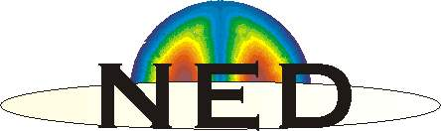
NED targets
By courtesy of Th. Boutboul
The main goal of NED was to launch the R&D necessary to design and build a Nb₃Sn based 15 T magnet
On basis of preliminary magnetic design and protection considerations, NED specifications for the strand were chosen:
  Diameter 1.250 mm
  Eff. filament diameter < 50 µm
  Cu-to-non-Cu ratio 1.25 ± 0.10
  Filament twist pitch 30 mm
  non-Cu J_{C} 1500 A/mm² @4.2 K & 15 T
  minimum critical current 818 A at 15 T
  RRR (after heat treatment) > 200
Very challenging specifications!

Slide 3
NED promises
By courtesy of Th. Boutboul
PIT strand: I_{c} ~ 1400 A, J_{c} ~ 2500 A/mm² (12 T) for 675 ºC/84 h
Optimization launched at CERN. Results: 320 h @ 625 ºC
  12 T and 4.2 K: I_{c} > 1500 A, J_{c} > 2700 A/mm², + 10 %!!
  15 T and 4.2 K: I_{c} > 818 A (NED spec.), J_{c} ~ 1500 A/mm²

Slide 4
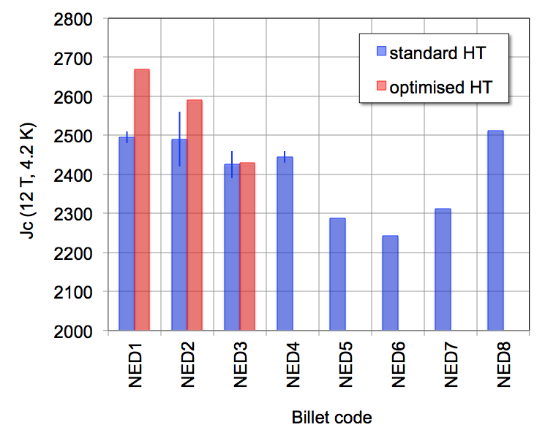
NED program results – 1/3
Jc of PIT wire produced within the scope of the NED R&D
Best performance was achieved optimizing the heat treatment for low plateau temperature (625 °C) and long times (320 hrs)
The production has gone through a technology transfer process clearly visible in the measured performance
Clear improvement with present stable manufacturing conditions

Slide 5
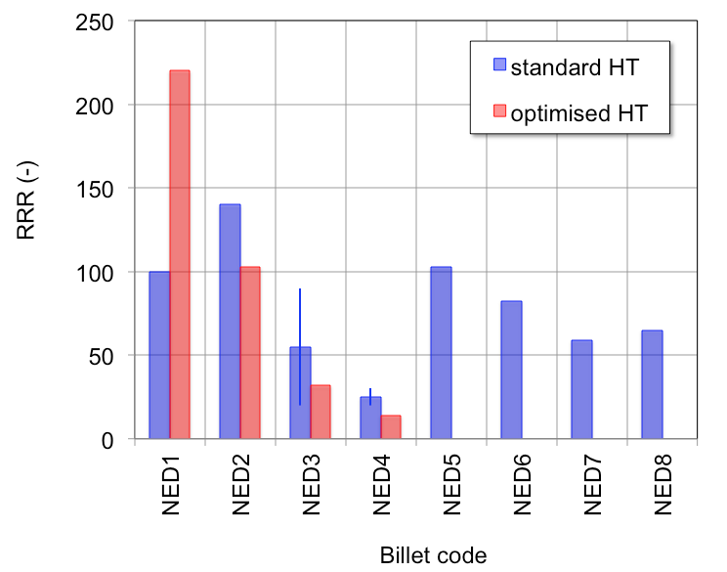
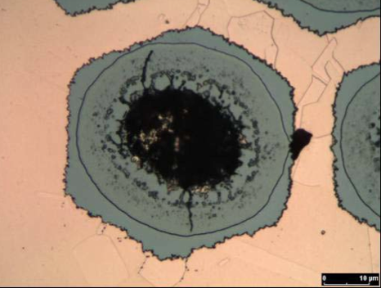
NED program results – 2/3
Excellent RRR values at the beginning of the R&D, much degraded at later times
Optimization of Jc leads to a marked decrease of RRR
This has been traced to the presence of hot-spots in the strand

Slide 6
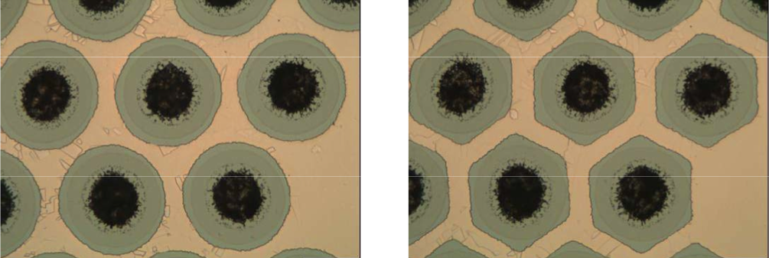
NED program results – 3/3
Modified strand architecture to improve the use of the real estate, and increase the optimization margin for J_{C} at acceptable RRR
For any given strand architecture based on react-able barriers there is an intrinsic limit in the maximum RRR achievable

Slide 7
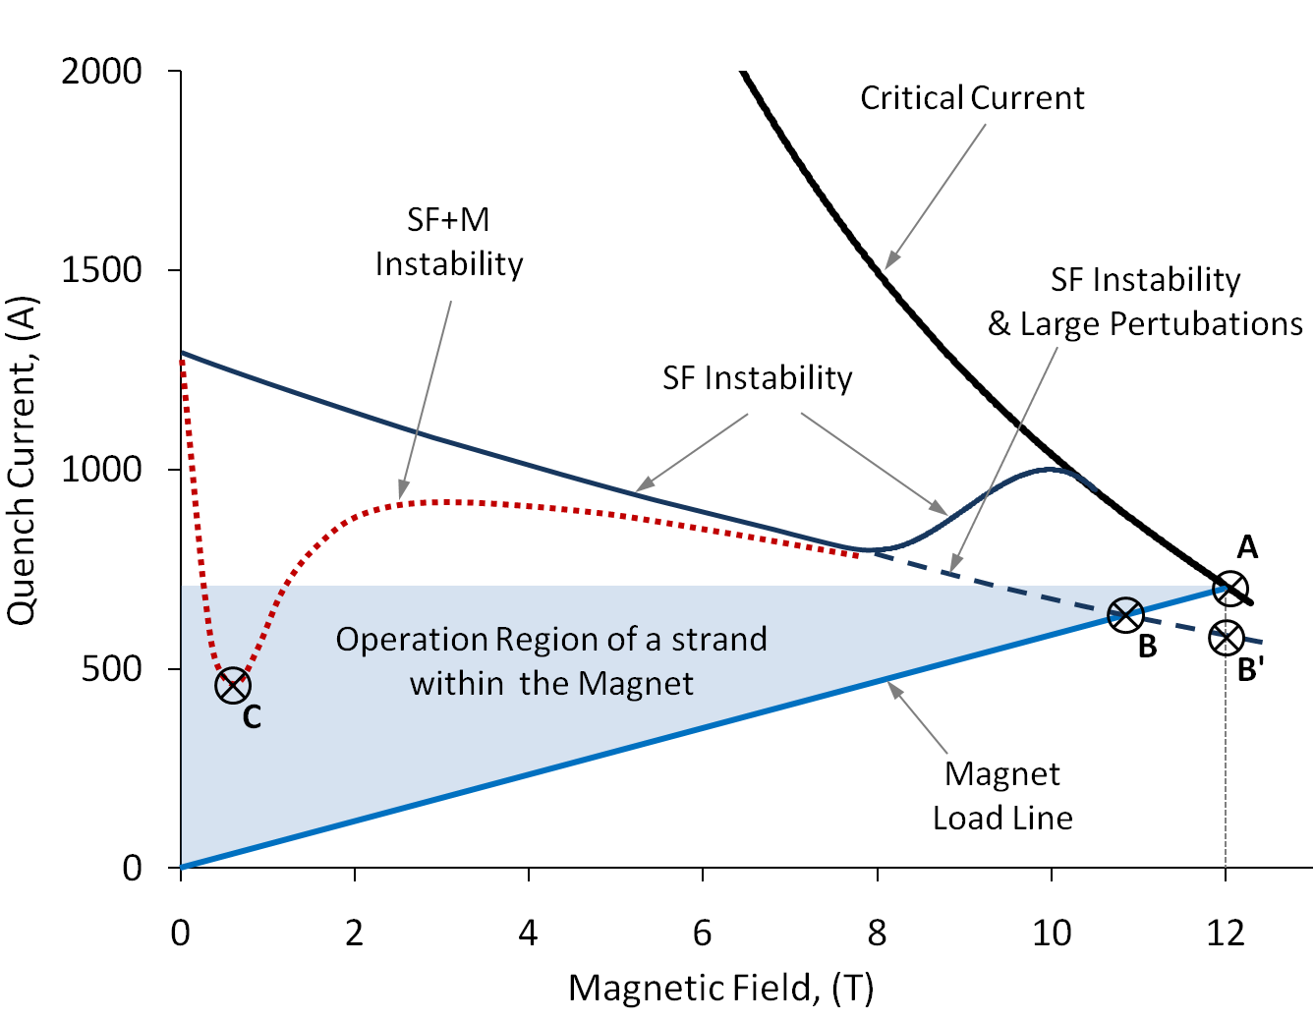
Magneto-thermal stability
By courtesy of B. Bordini

Slide 8
Magneto-thermal stability cook-book
Reduce the critical current of the strand to the minimum required for magnet performance (range of 2500 A/mm², not much above)
Reduce the strand diameter (1 mm and smaller) and the diameter of the multi-filamentary region
Achieve a local RRR of the order of 100

Slide 9
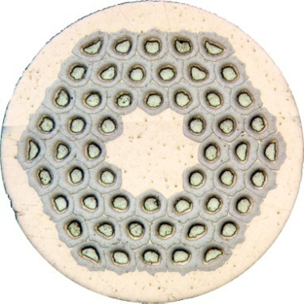
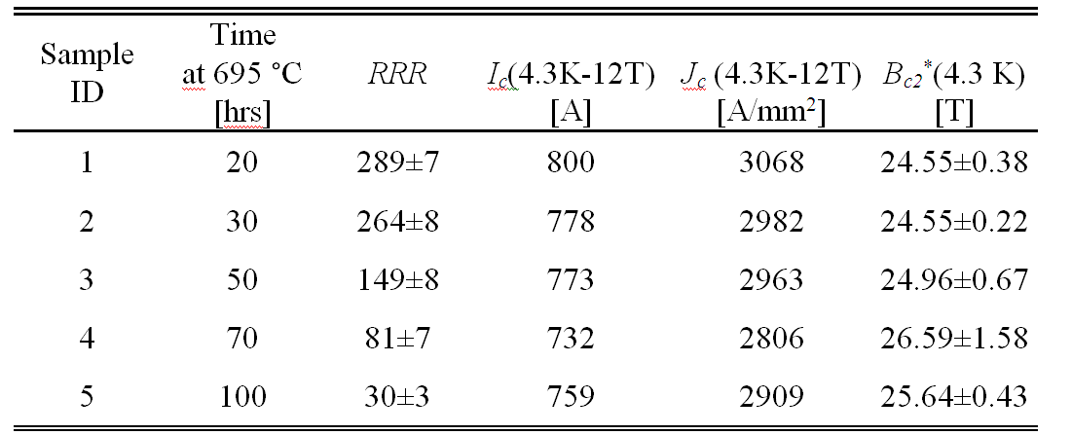
Effect of RRR on stability – 1/4
By courtesy of B. Bordini
0.8 mm 54/61 RRP® Nb₃Sn strand
Samples were prepared using the same strand (copper to non copper ratio ~ 0.92;effective filament size of ~ 80 μm)
Heat treatment chosen in order to obtain different values of the RRR without significantly changing the critical current

Slide 10
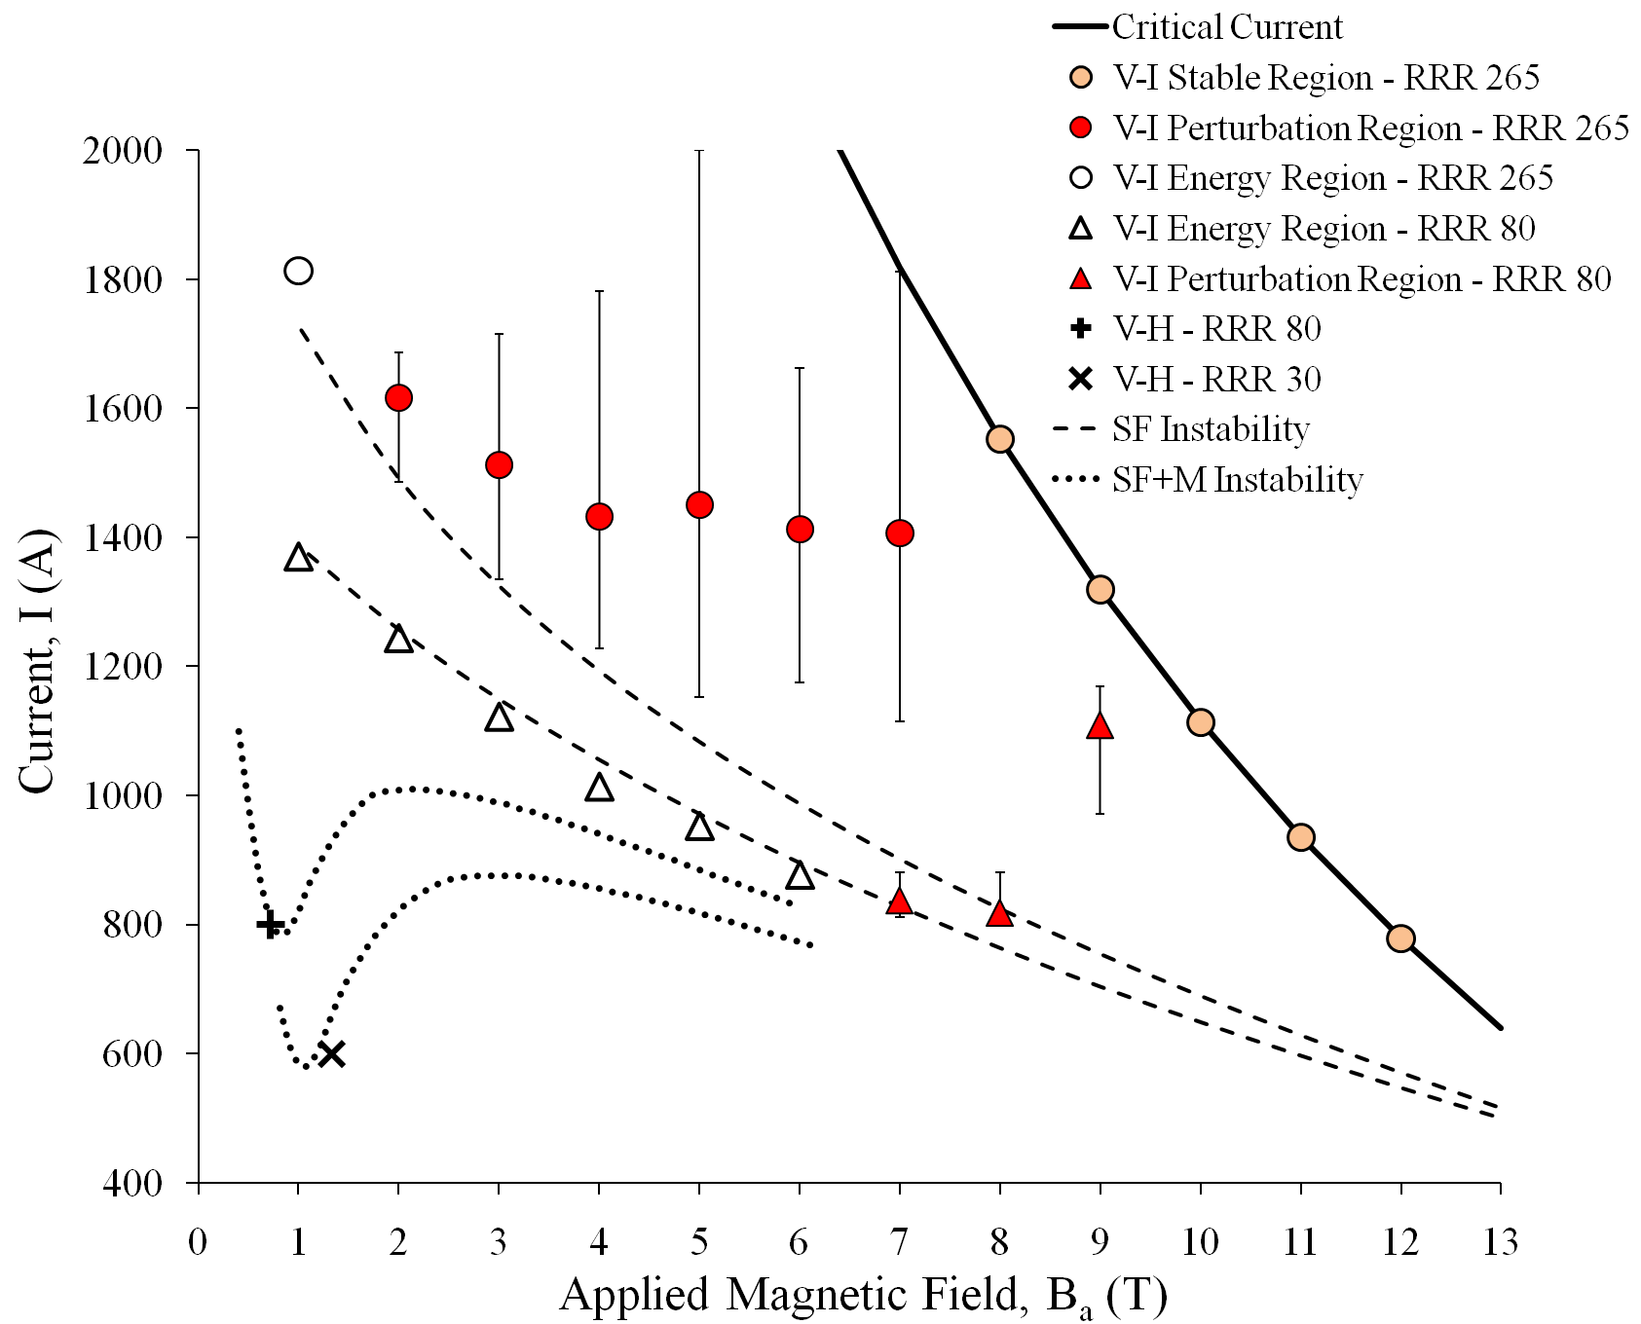
Effect of RRR on stability – 2/4
By courtesy of B. Bordini
‘Perturbation region’: the quench current depends on the energy of the tiny perturbation acting on the strand (big variation of quench currents can occur)
‘Energy Region’: the quench current mainly depends on the potential energy stored in the current distribution
V-H measurements at low fields shows that the minimum quench current significantly decrease by reducing the RRR below 100
4.2 K

Slide 11
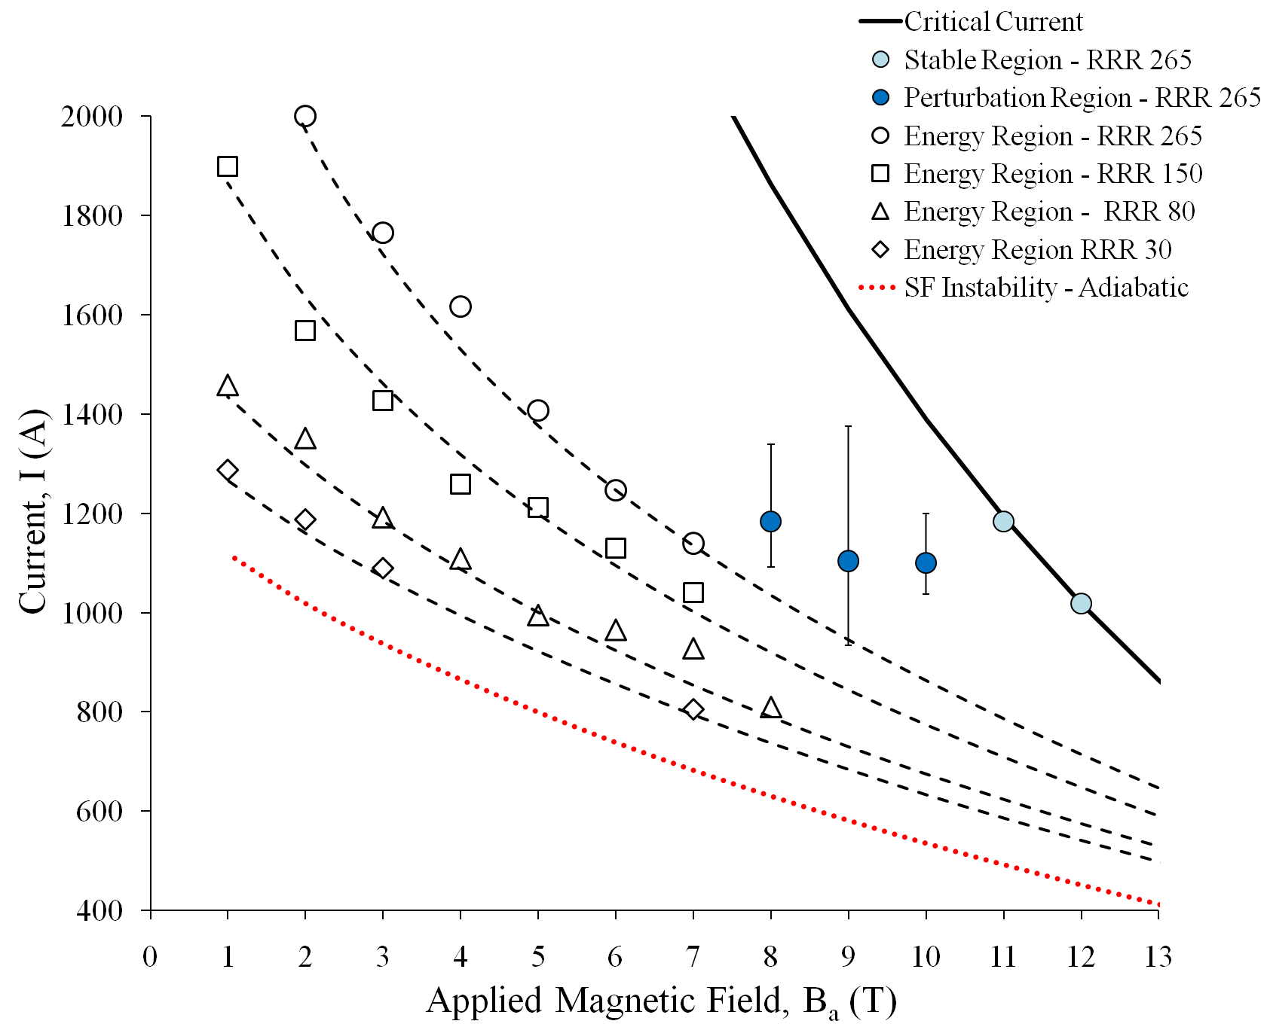
Effect of RRR on stability – 3/4
By courtesy of B. Bordini
At 1.9 K and with the same type of perturbation, the larger J_{c} and the smaller C_{p} of the wire (with respect to the values at 4.3 K) extend the ‘energy region’ and move the ‘perturbation region’ towards higher magnetic fields.
The semi-analytical model is in good agreement with the experimental data in the ‘energy region’
1.9 K

Slide 12
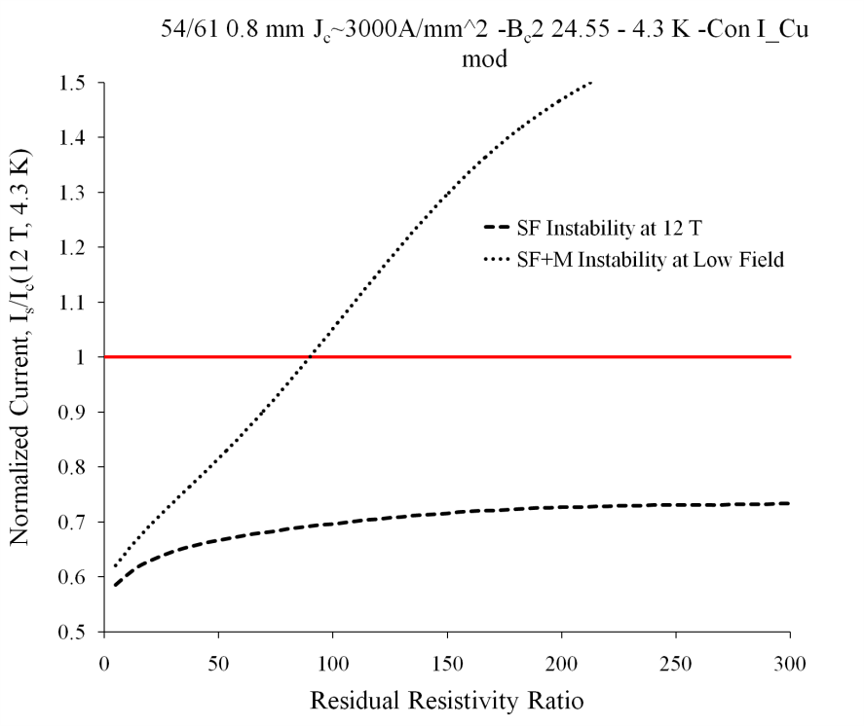
Effect of RRR on stability – 4/4
By courtesy of B. Bordini
The quench current at 4.3 K was computed for the minimum in the low field region (point C ) and for 12 T in the case of self-field instability and large perturbations (point B’ ).
For RRR larger than 100, the instability at low field (in the case of the considered conductor) is not a problem for a magnet designed to work at 12 T (or larger fields).
The high field instability does not improve much increasing the RRR above 100.

Slide 13
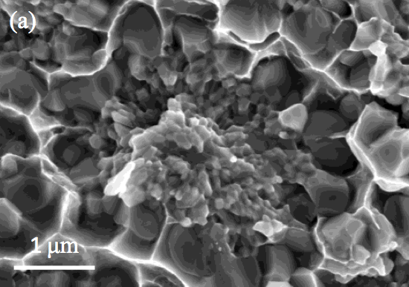
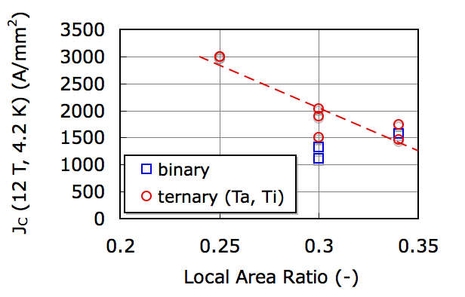
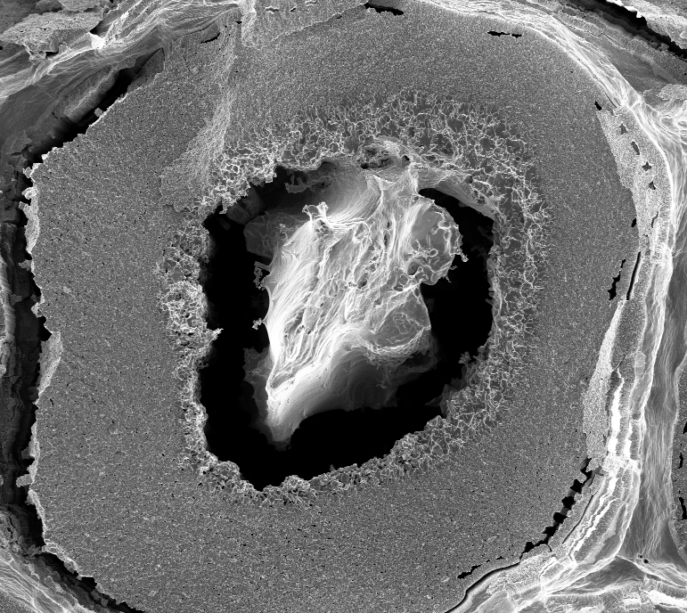
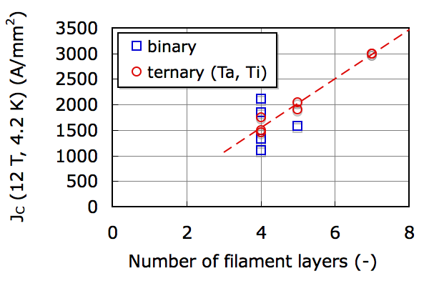
Microstructure and real estate
By courtesy of I. Pong and L. Oberli
Strand center
Fine grains
Coarse grains

Slide 14
A summary of what (we think) we understood
The initial NED specifications were possibly too demanding for stable performance in a magnet environment
There is an intrinsic interplay of critical current density, filament diameter, and RRR, equivalent to a critical surface for the overall performance of a given strand

Slide 15
Performance targets for Nb₃Sn
Performance
Peak field
Cost
J_{C} (kA/mm²)
1
1.5
Target performance:
Jc > 3 kA/mm²
D_{fil} < 20 μm
RRR > 100
2
2.5
PIT
3
3.5
target
Magnetization Field Quality
Stability
4
10
200
20
150
50
100
100
50
RRP
RRR (-)
D_{fil} (μm)
Stability Protection

Slide 16
Present strand specifications
 |  | NED (achieved) | FReSCa-II | DS-MB
Strand diameter | (mm) | 1.25 | 1 | 0.7
Sub-element diameter | (μm) | 50 | 50 | 30*
Copper:non-Copper | (-) | 1.25 | 1.25 | 1.15
J_{C}(12 T, 4.2 K) | (A/mm²) | 2740 | 2500 | 2650
J_{C}(15 T, 4.2 K) | (A/mm²) | 1530 | 1250
n-index | (-) | > 30 | 30 | 30
RRR | (-) | 220 | 150 | 100
Piece length | (m) | > 1000 | 800 | 800
(*) one of the main topics of the discussion today

Slide 17
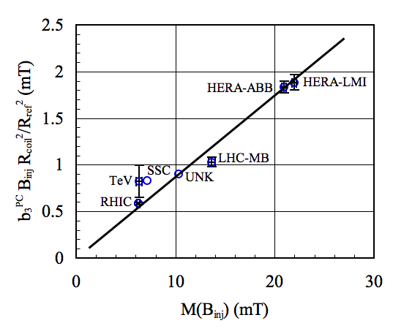
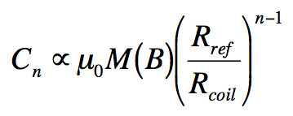
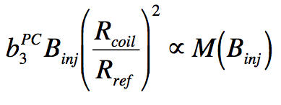
Magnetization related matters
Generic multipole (approximate integration in a coil of radius R_{coil}):
Case of sextupole in a dipole magnet:
Scaled persistent current b₃^{PC} vs. strand M in dipoles for all SC synchrotrons to date

Slide 18
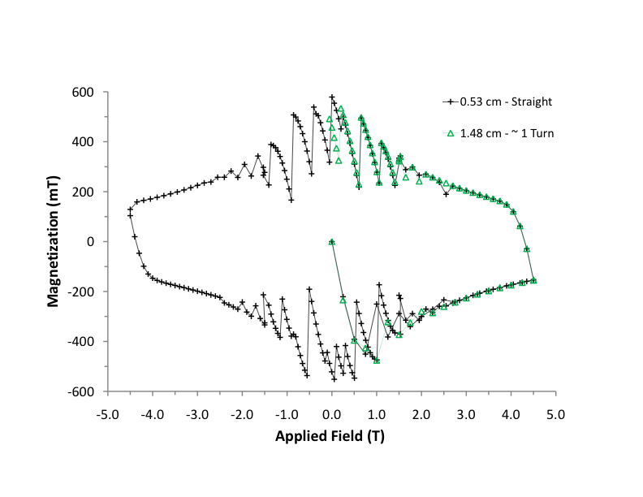
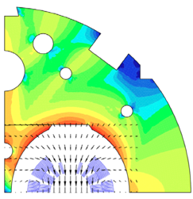
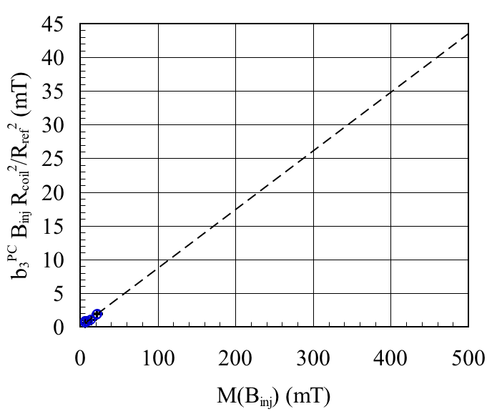
Expected field quality
OST-RRP 54/61
M ≈ 500 mT
δM ≈ 200 mT
b₃ ≈ 300 units !!!
What is the actual field error ?
What can be tolerated and corrected ?

Slide 19
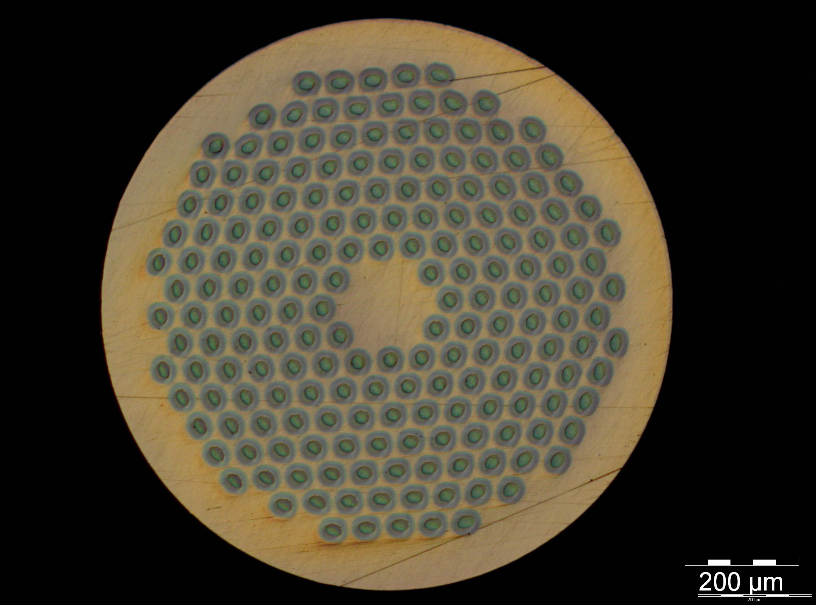
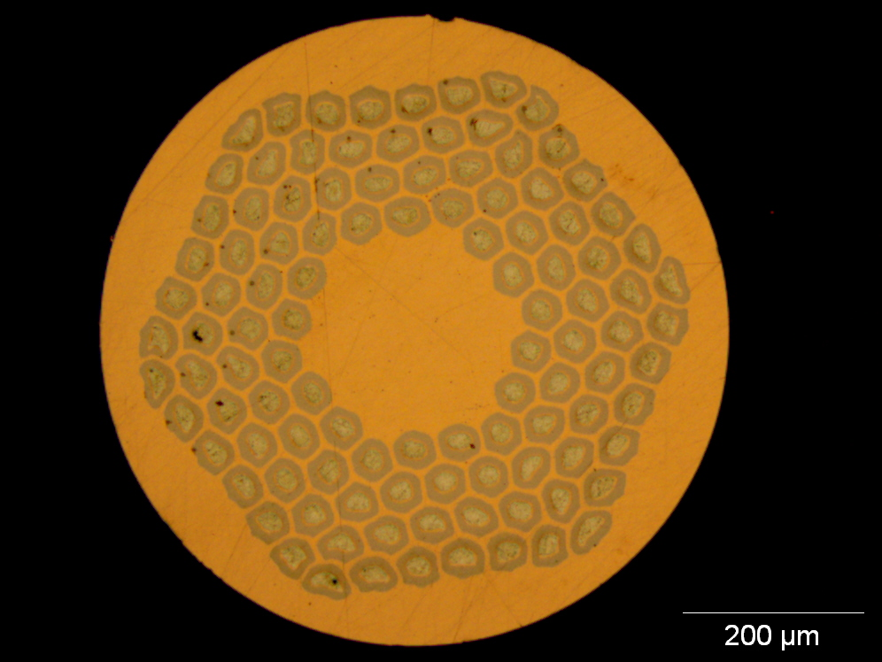
On-going strand work
0.7 mm, 108/127 stack RRP from OST
1 mm, 192 tubes PIT from Bruker EAS
Work is on-going on a new strand architecture (169 stack) to reduce the filament diameter to 52 μm at 1 mm strand diameter, and 35 μm at 0.7 mm strand diameter
R&D started for an alternative architecture with filaments of 30 μm at 0.7 mm strand diameter

Slide 20
Questions
Do we agree on specifications (strand, cable) for magnet R&D and magnet production ?
Material lead time is long (> 12 months), and we are already late. How do we manage/share the present stock ?
What is the procurement strategy beyond the magnet R&D ?

