Slide 1
Cable development at CERN for the 11 T dipole
Luc Oberli
Outline:
Goals for the cable development at CERN.
Main parameters of the cable.
Cable development work for a cable width of 15.1 mm
and for a cable width of 14.7 mm.
Future cable development work.

Slide 2
Goals for the cable development at CERN
Optimization of the cable parameters for a cable made either with RRP or PIT strands
in order to minimize the Ic degradation and to get a cable mechanically stable for winding.
Determination of the cabling parameters to fabricate a cable with a core (not addressed up to now).

Slide 3
Main parameters of the cable
Width | 15.1 mm | 14.7 mm
Number of strands | 40 | 40
Mid-thickness | 1.269 mm | 1.269 mm
Thin edge | 1.165 mm | 1.168 mm
Thick edge | 1.373 mm | 1.370 mm
Keystone angle | 0.79º | 0.79º
t/2d thin edge | 83.2 % | 83.4 %
t/2d thick edge | 98.1 % | 97.8 %
Compaction factor | 83.9 % | 86 %
Transposition pitch | 100 mm | 100 mm

Slide 4
Cable development work for the 11 T dipole cable
The keystoned cables are made at CERN in one pass.
7 cabling runs performed to optimize the cable parameters.
Hard copper wires of 0.7 mm nominal diameter and
RRP strands 108/127 used for the cable development
(Filament diameter is ~ 46 micrometers)
No cable fabrication made with PIT strands which are not available.
First 3 runs dedicated to develop a cable with a width of 15.1 mm to minimize the Ic degradation.
Last 4 runs dedicated to fabricate a cable with a width of 14.7 mm to improve the mechanical stability of the cable.

Slide 5
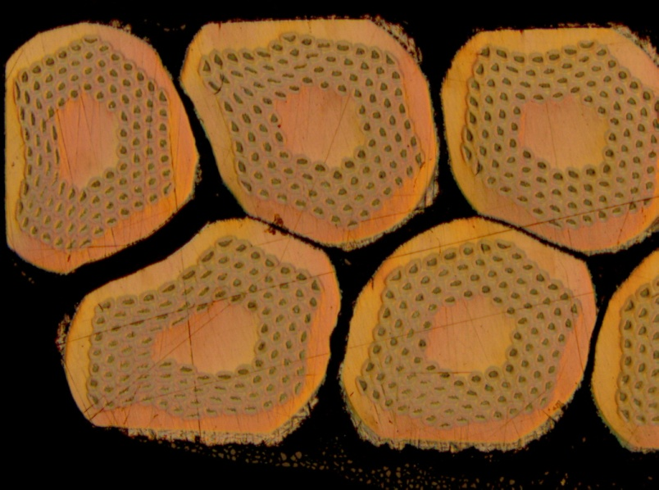
Cable development for a cable width of 15.1 mm
Nb₃Sn Cable fabricated with a width of 15.1 mm and a mid-thickness of 1.28 mm, keystone angle not measured.
The transposition pitch was reduced to 90 mm to have a cable without gaps between the strands, but the cable does not appear to be mechanically very stable. The stability of the cable was
improved by decreasing the transposition
pitch to 80 mm, but the cable is less flexible
and highly nervous.
Ic degradation is close to zero (result obtained on 4 extracted strands)
- 1.7 %, + 1 %, + 0.6 %, + 0.94 %

Slide 6
Cable development for a cable width of 14.7 mm
Nb₃Sn Cable fabricated with a width of 14.7 mm, a mid-thickness of 1.268 mm and a keystone angle of 0.71º
The transposition pitch was fixed to 100 mm. The mechanical stability of the Sc cable is quite good as seen by manual bending, but no winding test have been done with the Sc cable (short piece length of 10 m).
The winding tests done with a Cu cable having a keystone angle of 0.88º , but with a mid-thickness of 1.24 mm to have enough compaction on the thick edge, were successful either with a transposition pitch of 90 mm or 100 mm ( tension between 10 kg and 35 kg).
Another Cu cable having the specified dimensions, a keystone angle of 0.8º and a mid-thickness of 1.268 mm was fabricated with a transposition pitch of 95 mm; cable having a very good quality (not used up to now for winding tests).

Slide 7
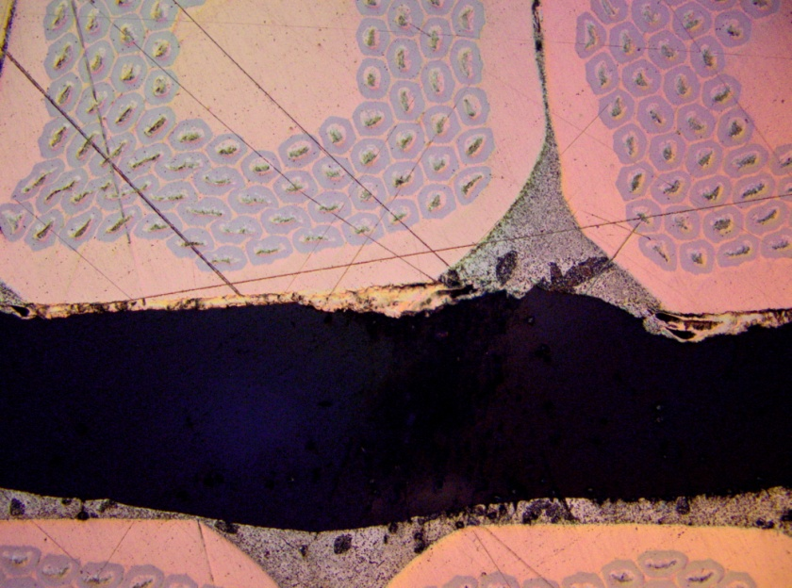
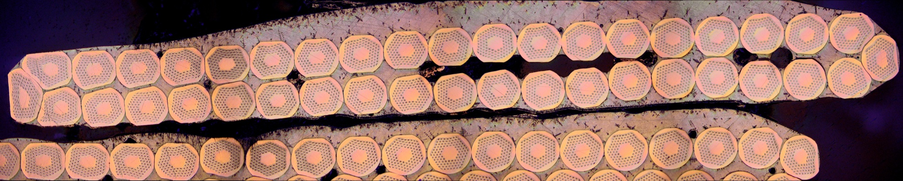
Ic degradation of the 14.7 mm wide cable
Average Ic degradation is 2.6 %
(result obtained on 6 extracted strands)
- 6 %, - 2 %, - 0.8 %, - 5.6 %, - 1.3 %, + 0.1 %

Slide 8
Next step for cable development
The next step for the cable development is to fabricate a cable with a keystone angle of 0.65º and a mid-thickness of 1.269 mm, in order to increase the mechanical stability of the cable and to decrease further the Ic degradation.

Slide 9
Main Characteristics of the cable
 | 11 T dipole | 11 T dipole | LARP’s HQ | 11 T dipole | 11 T dipole
Width | 15.1 mm | 14.7 mm | 15.13 mm | 14.7 mm | 14.7 mm
Mid-thickness | 1.269 mm | 1.269 mm | 1.430 mm | 1.269 mm | 1.254 mm
Thin edge | 1.165 mm | 1.168 mm | 1.331 mm | 1.186 mm | 1.148 mm
Thick edge | 1.373 mm | 1.370 mm | 1.520 mm | 1.352 mm | 1.350 mm
Keystone angle | 0.79º | 0.79º | 0.75º | 0.65º | 0.79º
t/2d thin edge | 83.2 % | 83.4 % | 83.1 % | 84.7 % | 82.0 %
t/2d thick edge | 98.1 % | 97.8 % | 95.4 % | 96.6 % | 96.5 %
Compaction factor | 83.9 % | 86 % | 85.2 % | 86 % | 87.3 %
Transposition pitch | 100 mm | 100 mm | 100 mm | 100 mm | 100 mm
According to Dan Dietderich, LARP’s HQ cable is mechanically stable but only marginally. The LARP’s HQ cables have a thick edge deformation ratio (t/2d) = 0.95 – 0.96
Notes:
I have taken as an example the LARP’s HQ cable which is considered by Dan Dietderich to be mechanically stable but only marginally.
A decrease of the mid-thickness will compact more the cable and in particular the thick edge but the total compaction increase by 1.7 % and the thin edge strain ration increase to

Slide 10
Thank you for your attention !

