Slide 1
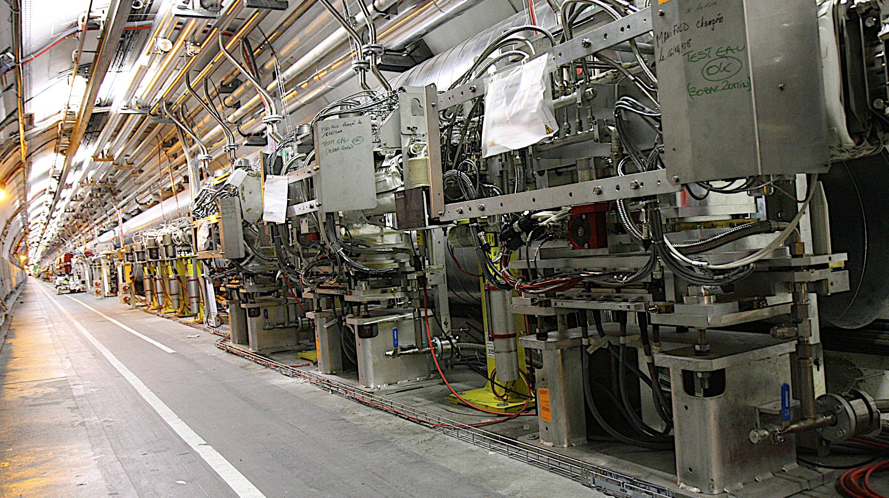
Scope of the Meeting: the Framework of the Collimation Project
R.W. Aβmann
Meeting on Interface
11 T - Cold Collimation
5 Oct 2011, CERN
3 Primary Collimators in Betatron Cleaning (IR7)

Slide 2
The Collimation Project Team
& Close Collaborators
Results on phase I collimation are outcome of lot of work performed over last 9 years by the following CERN colleagues:
O. Aberle, J.P. Bacher, V. Baglin, G. Bellodi, A. Bertarelli, R. Billen, V. Boccone, A.P. Bouzoud, C. Bracco, H. Braun, R. Bruce, F. Burkart, M. Cauchi, J. Coupard, D. Deboy, N. Hilleret, E.B. Holzer, D. Jacquet, J.B. Jeanneret, J.M. Jimenez, M. Jonker, J. Jowett, Y. Kadi, K. Kershaw, G. Kruk, M. Lamont, L. Lari, J. Lendaro, J. Lettry, R. Losito, M. Magistris, A. Masi, M. Mayer, E. Métral, C. Mitifiot, N. Mounet, V. Parma, R. Perret, S. Perrolaz, V. Previtali, C. Rathjen, S. Redaelli, G. Robert-Demolaize, C. Roderick, S. Roesler, A. Rossi, F. Ruggiero, M. Santana, B. Salvachua, R. Schmidt, P. Sievers, M. Sobczak, J.P. Tock, K. Tsoulou, G. Valentino, E. Veyrunes, H. Vincke, V. Vlachoudis, T. Weiler, J. Wenninger, D. Wollmann, …
Crucial work also performed by collaborators at:
EuCARD/ColMat partners (see GSI talk), TRIUMF (D. Kaltchev), IHEP (I. Baishev & team), SLAC (T. Markiewicz & team), FNAL (N. Mokhov & team), BNL (N. Simos, A. Drees & team), Kurchatov (A. Ryazanov & team).

Slide 3
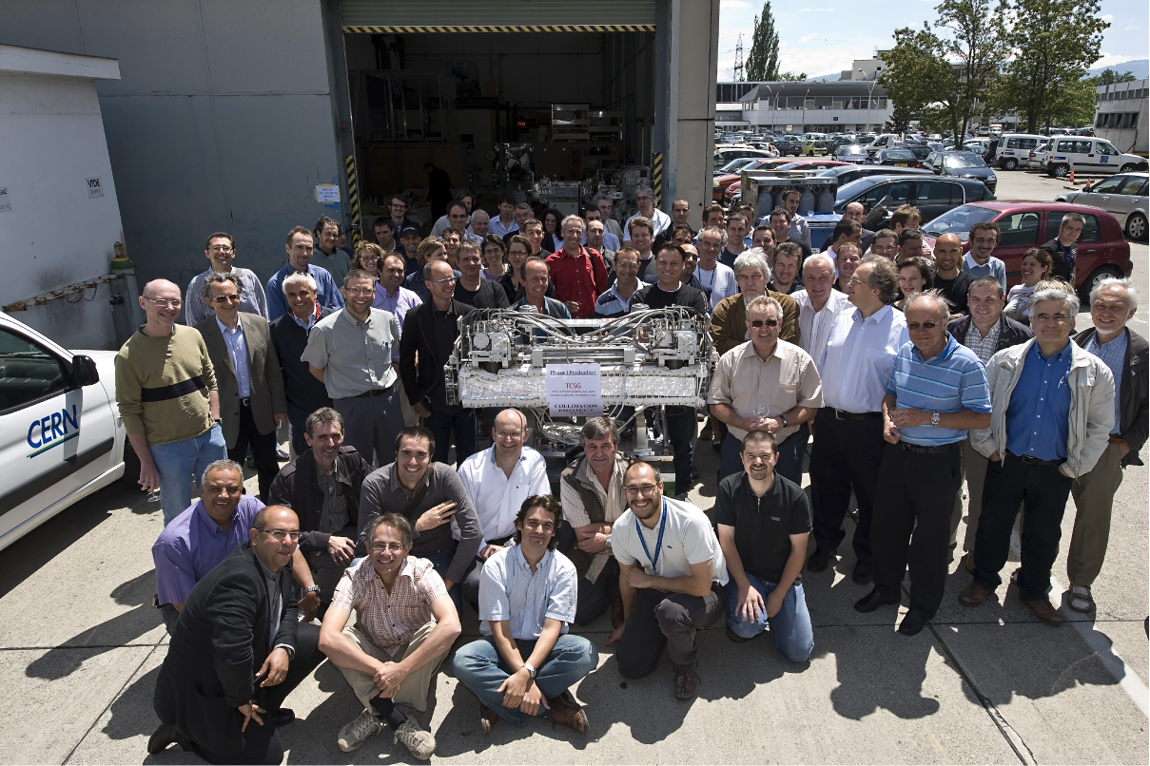
The Last Phase 1 Collimator

Slide 4
Many PhD‘s & Fellows Related to Collimation
This challenging topic attracts many excellent students and fellows!
PHD‘s (some later fellows):
C. Bracco, M. Brugger, M. Cauchi, A. Dallocchio, D. Deboy, L. Lari, V. Previtali, G. Robert-Demolaize, G. Valentino, ...
Master students:
F. Burkart, ...
Fellows:
R. Bruce, S. Redaelli, B. Salvachua, T. Weiler, D. Wollmann, FLUKA fellows for collimation, ...

Slide 5
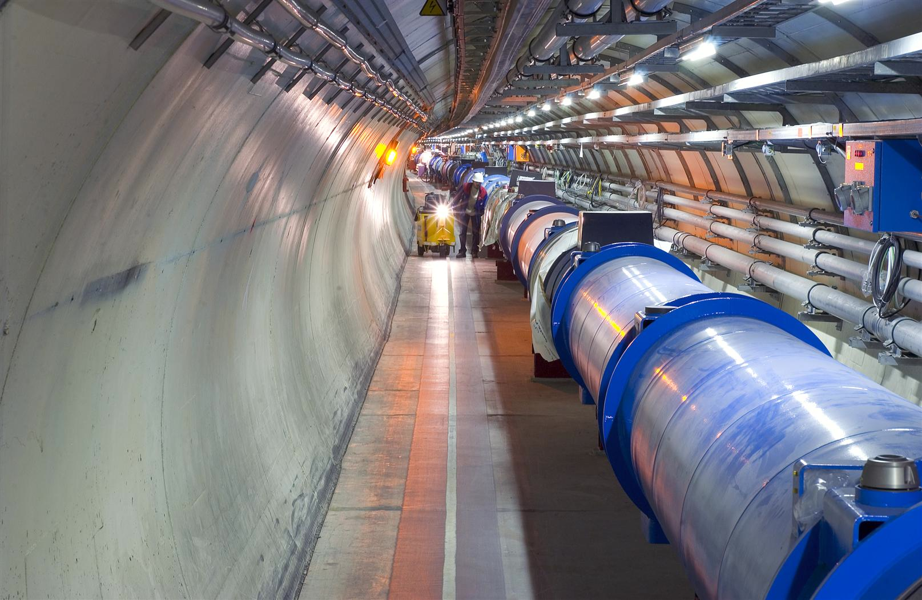
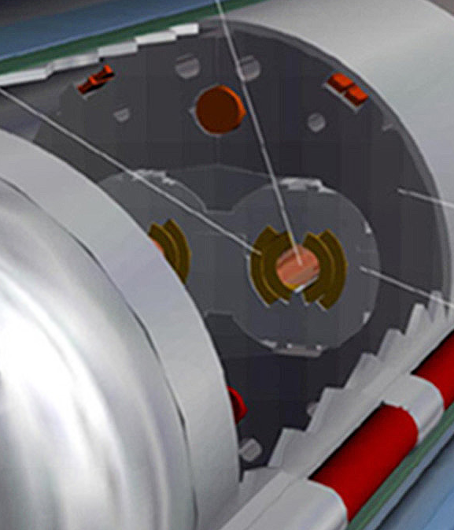
Quench Limit of LHC Super-Conducting Magnets
Nominal design at 7 TeV
Beam
362 MJ
56 mm
SC Coil:
quench limit
5-30 mJ/cm³

Slide 6
Quench Limit of LHC Super-Conducting Magnets
Situation at 3.5 TeV (on September 26, 2010)
Beam
6.2 MJ
Not a single beam-induced quench at 3.5 TeV yet!
LHC beam is about 60,000,000 times above quench limit of super-conducting magnets (per cm³)! Of course, diluted…
56 mm
SC Coil:
quench limit
15-100 mJ/cm³

Slide 7
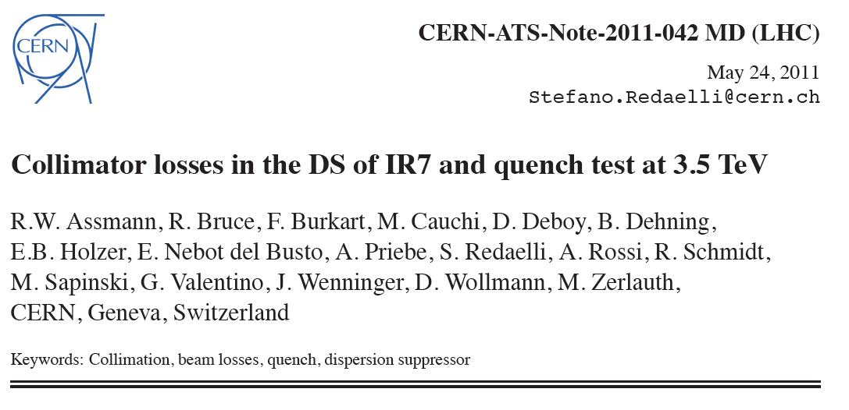
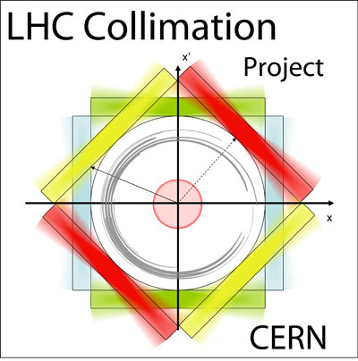
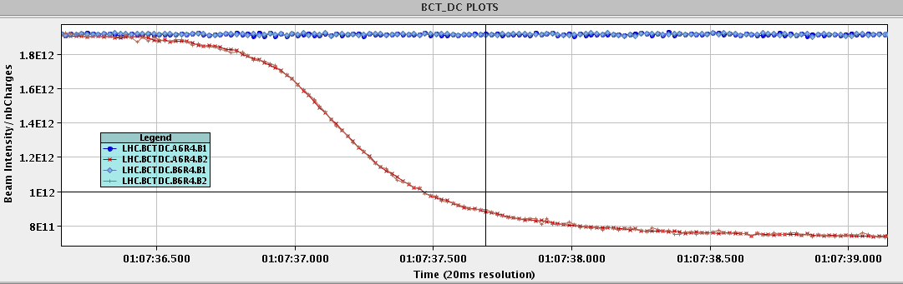
16 bunches, 3.5 TeV
Provoked beam loss: beam blow up on 1/3 resonance
Loss rate:
9e11 p/s @ 3.5 TeV → 505 kW

Slide 8
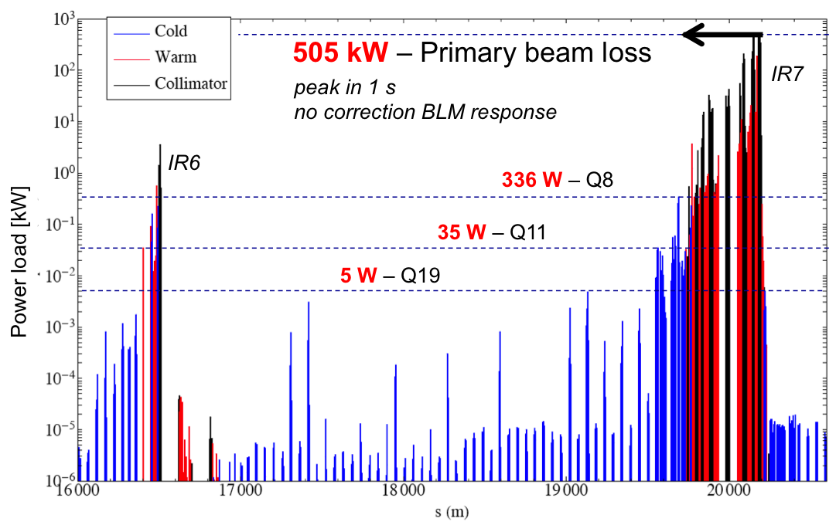
Leakage into SC Magnets
3.5 TeV operational collimator settings (not best possible)
No quench of any magnet!

Slide 9
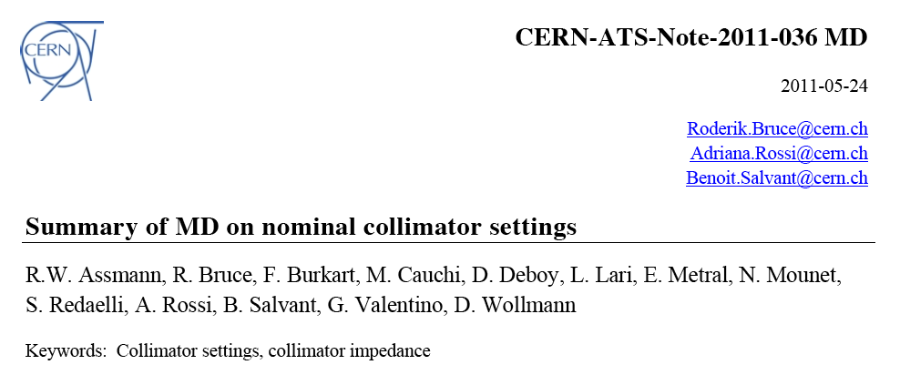
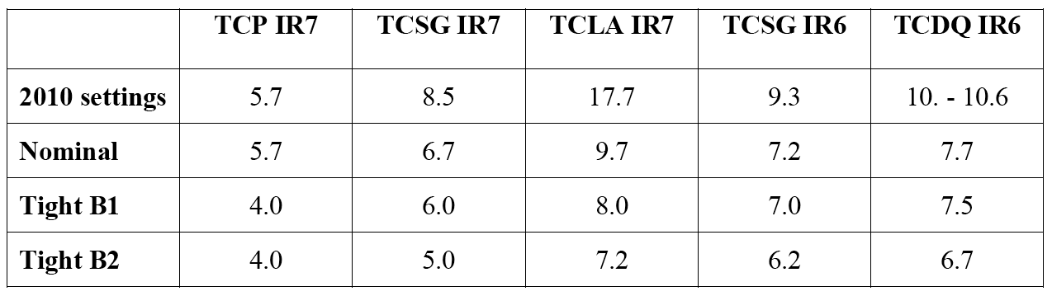
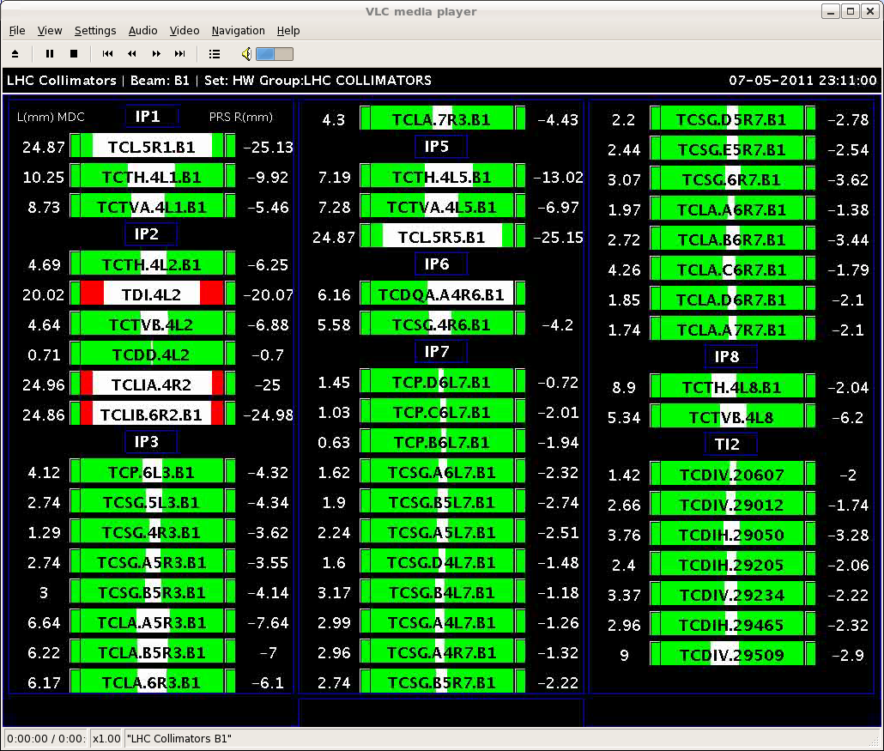
Settings in nominal beam sigma at 3.5 TeV
Settings in mm at 3.5 TeV for tightest collimator settings achieved (beam 1)

Slide 10
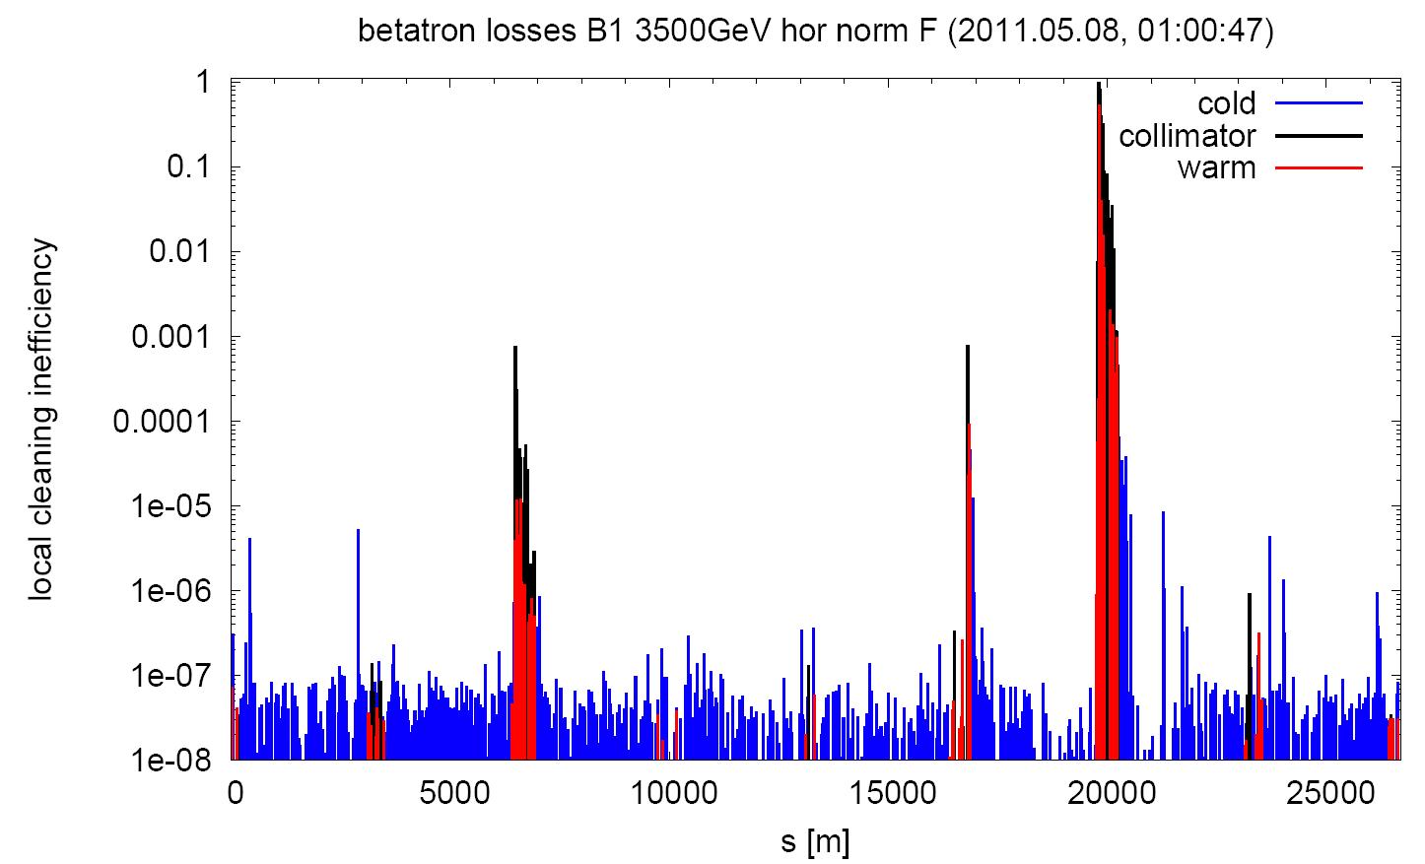
Observed Losses (Normalized to Primary Collimator)
99.995 %

Slide 11
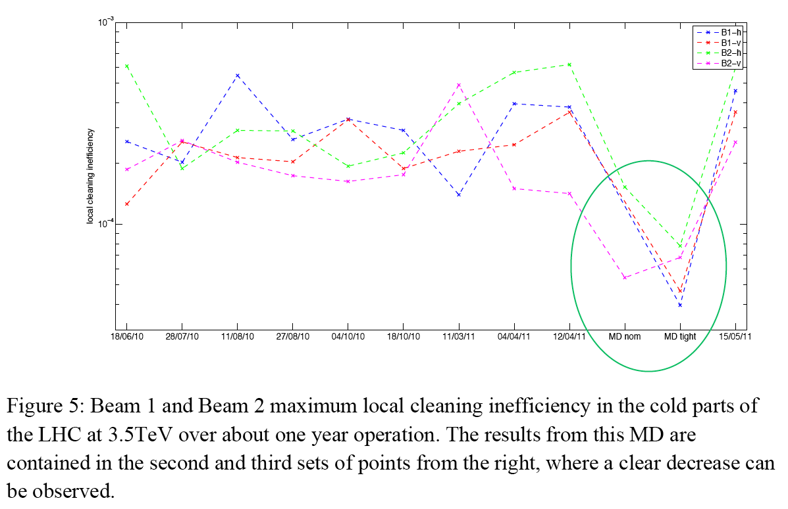
(In) Efficiency Reached (Coll → SC Magnet)
99.960 %
worse
99.995 %
MD
better

Slide 12
LHC Collimation Status & Outlook
The LHC collimation problem has been solved for nominal beam:
  Design goals for nominal intensity and 7+7 TeV beams were demonstrated.
  Better than design cleaning efficiency was shown.
In addition gain from lower than specified beam losses.
Some improvements are ongoing (e.g. minimize collimation setup time):
  Faster collimation setup with direct feedback from beam loss monitors (2011/12 christmas stop).
  IR2 collimator move (2011/12 christmas stop).
  Replacement of IR1/2/5/8 tertiary collimators and IR6 collimators with BPM collimator design → faster setup, lower beta* (long shutdown 1).
  Radiation measures: remote handling, easy handling, remote survey, ...
  R&D on low impedance materials (collimation phase 2, for LS2)
  R&D on new solutions: hollow e-beam lens, crystal coll., non-linear coll.
On long-term (LS2, performance > nominal) expect to become limited by fundamental losses into LHC dispersion suppressors:
  Protect dispersion suppressor collimators in IR1/2/3/5/7/8

Slide 13
Work Ahead for DS Collimation Concept
Specify cases for collimation (p intensity, ion intensity, lifetimes,
p-p luminosity, Pb-Pb luminosity, any other future use cases) for IR1/2/3/5/7/8 independently, including HL-LHC parameters!
Define candidate locations for DS collimators, candidate material and candidate jaw length (also 1-sided vs. 2-sided).
Define gaps for DS collimators.
Simulate collimation efficiency (SixTrack with Collimation) for defined cases. Vary parameters (material, length, gaps).
Possibly iterate location until losses for all cases are reliably intercepted (study 1 versus 2 collimators per DS).
Once OK for beam losses, define reference case (material, length, gaps, locations). Define power load. Try to have one collimator solution.
Calculate energy deposition (FLUKA) and heating for defined cases, including accident cases.
Calculate jaw temperature and cooling. Check response to accident cases (ANSYS). Define design reference case.
Check impedance and trapped modes (RF simulations).
Iterate if necessary.
Freeze design.

Slide 14
Collimation Work Organization
Collimation project management & project meeting
Collimation upgrades in DS’s and IR’s: Studies and specifications
DS upgrade technical feasibility
Phase 1 studies and improvements
  includes BE studies crystal coll, coll with BPM’s, hollow e-beam lens
Collimator design and production

Slide 15
Upgrade Dispersion Suppressors
Assumed solutions: 11T or IR3-type (magnet movements)
Scope: IR1, IR2, IR3, IR5, IR7 for proton and ion losses
DS upgrade specification:
  Forum: Upgrade specification meeting
  Mandate: Specify jaw material & length, collimator gaps & precision, collimator locations and power loads, performance improvement
  Scope: loss simulations, tracking with protons and ions, energy deposition, radiation impact, optics studies, operational studies
  Runs until specification is provided
DS upgrade technical feasibility:
  Forum: Technical integration meeting (V. Parma & J.P. Tock)
  Mandate: Feasibility of installing cold collimators, housed in cryo-assemblies, in the continuous cryostat during LHC LS2
Collimator design for dispersion suppressors (warm/cold) → Coll Design Meeting

Slide 16
Conclusion
The LHC collimation system is very powerful but cannot protect the LHC dispersion-suppressors (long predicted, due to basic physical limits).
On the long term (for much beyond nominal performance, e.g. for HL-LHC) we will need to protect the dispersion suppressors against losses from collimation insertions and collisions.
11T magnets provide an elegant solution to the problem (preferred). Backup solution is the movement of magnets and use of missing dipole space (much less elegant).
A lot of work is ahead to work out a detailed a solution and to prove that the 11T solution with collimator delivers the required performance:
  Collimation efficiency and power loads for future requirements (nominal is not enough).
  Behavior of cold surfaces under power load, cooling, ...
  Technical feasibility of integration of a long collimator into an 11T assembly.
Developments must be advanced in parallel to explore all possible issues early. Plan for success.
We have all the tools and experience to advance this efficiently.

Slide 17
Thank you
... Now more details from Adriana...

Slide 18
DS Upgrade Technical Feasibility
What ? Feasibility of installing really cold collimators, housed in cryo-assemblies, in the continuous cryostat during LHC LS2, as required by collimation (pt.1, 2, 3, 5 and 7)?
Goals
  Analyze potential schemes of cold collimators coupled to 11 T magnets;
  Identify potential show stoppers, either related to the implementation of the layout schemes or related to operational aspects of the associated technical systems (vacuum, cryogenics, machine protection, alignment, etc).
  Identify potential needs for R&D with its associated effort and timeline.
How? Set-up a Working Group coordinated by MSC-CMI (V.Parma, J.Ph.Tock as alternate), meeting every 2-3 weeks with the following proposed participants by system:
  Collimators:, EN-MME
  Vacuum : V Baglin, TE-VSC
  Cryogenics : R.Van Weelderen, TE-CRG
  11 T magnets: M Karppinen TE-MSC
  Machine Layout & Integration: V.Parma (J.Ph.Tock),TE-MSC
  HL LHC coordinator : L Rossi (TE-HDO)
  Collimation project leader or representative
Reporting? to the Collimation Management Meeting. Technical feedback and requests to the specification meeting.

