Slide 1
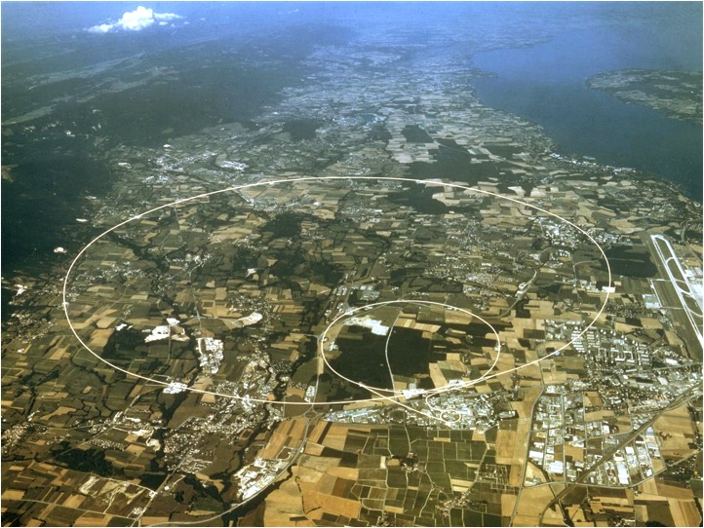
"Nb3Sn Dipoles in LHC ... a philosophical contemplation"
Bernhard Holzer,
CERN
IP5
IR 7
IP8
IP2
IP1
*

Slide 2
... what are we talking about ???
replace two standard dipoles in the dispersion suppressor region
by stronger ⬅➔ shorter Nb₃Sn dipoles to gain space for Ralph
Mikko Karppinen

Slide 3
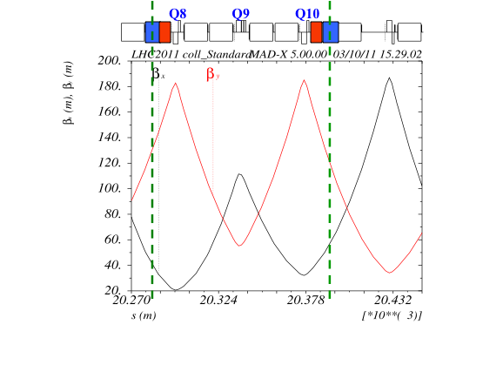
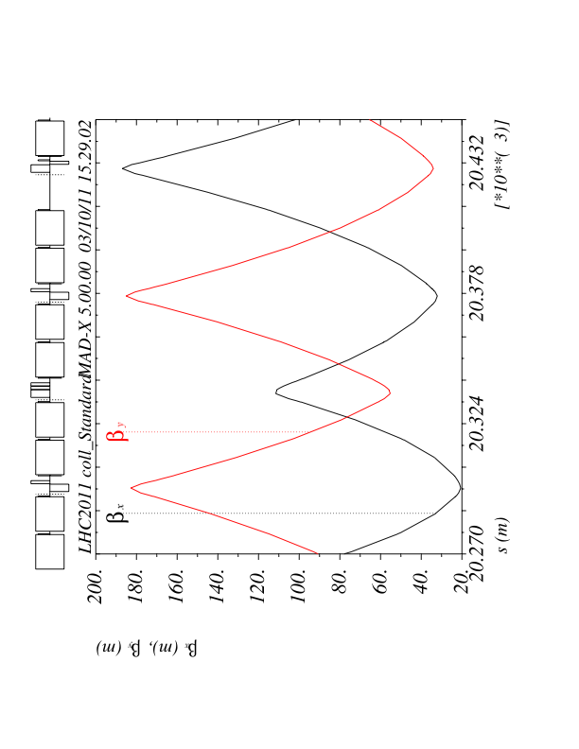
Where are we ?
IP2 & IP7
Example: IP7 R
Q8 Q9 Q10
Previous Option:
1 x 11m Nb3Sn Dipoles, shifted
Present Option:
2 x 5.5m Nb3Sn Dipoles
separated

Slide 4
Cryo-collimator
3061
1541
Courtesy of D. Ramos

Slide 5
Effects to be expected:
* magnets are shorter than MB Standards → change of geometry
distortion of design orbit
* R-Bends ⬅➔ S-Bends → edge focusing
distortion of the optics
tune shift, beta beat
* nonlinar transfer function (3.5 TeV) → distortion of closed orbit
to be corrected locally ??
dedicated corrector coils ??
trim power supply ??
* feed down effects from sagitta ?
* field imperfections: effect on dynamic aperture ?
Analytical approach / Mad-X / Sixtrack Simulations

Slide 6
1.) R-Bernd / S-Bend: a (small) optics problem
the “edge focusing”
Quadrupole Error in the Lattice
optic perturbation described by thin lens quadrupole
quad error
ideal storage ring
ρ
z
●
x
s
Quadrupole Error in this case:
Edge Focusing effect of Dipole
ϕ/2
ϕ/2

Slide 7
Edge Foc Effect:
for the two effects (entrance / exit)
of two dipoles we obtain ...
effect on beam optics is small !!!

Slide 8
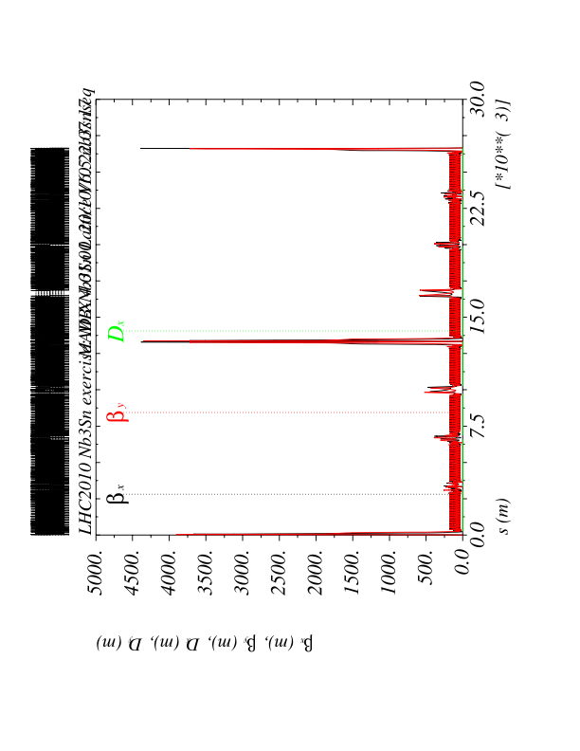
Edge Foc Effect: Optics distortion / Tune shift

Slide 9
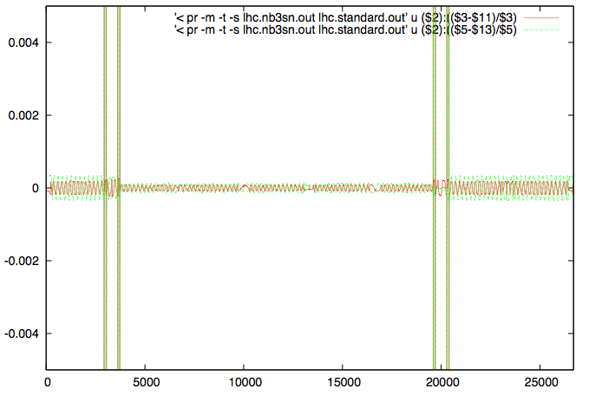
Edge Foc Effect: MADX calculation: optics distortion
beta beat:
tune shift:
for 8 magnets
Δβ/β
remember
tolerance for beta beat
Δβ/β=20%

Slide 10
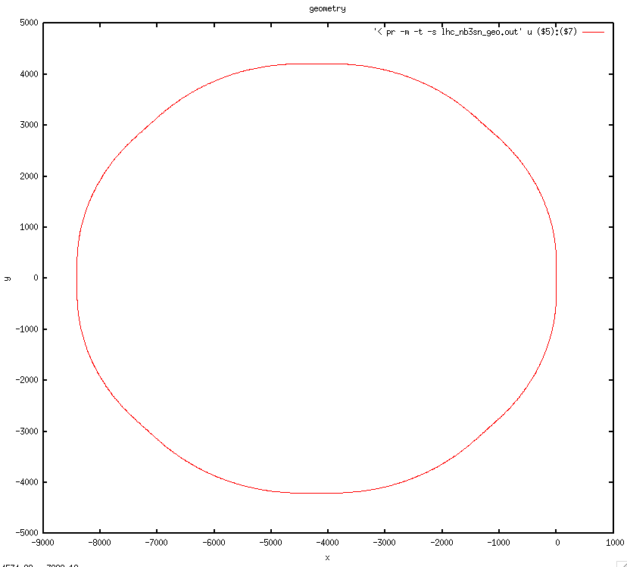
2.) Shorter Magnet: Change of Design Orbit
... global LHC geometry
Standard LHC
Nb₃Sn LHC
z
x
it’s still quite a ring !!

Slide 11
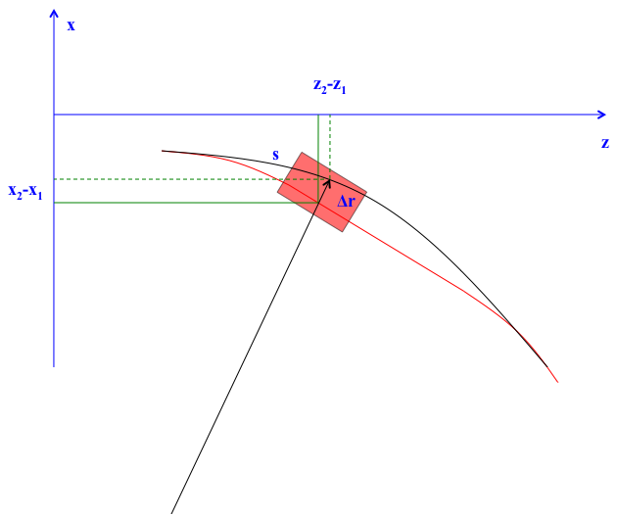
2.) Shorter Magnet: Change of Design Orbit
... local geometry
do we need a radial re-alignment ?
mad-x “Survey”

Slide 12
Δx
r1
Standard LHC
r
MbNb3Sb LHC
φ
We expect a difference of ≈ 6.5 mm !!!!

Slide 13
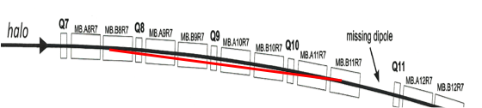
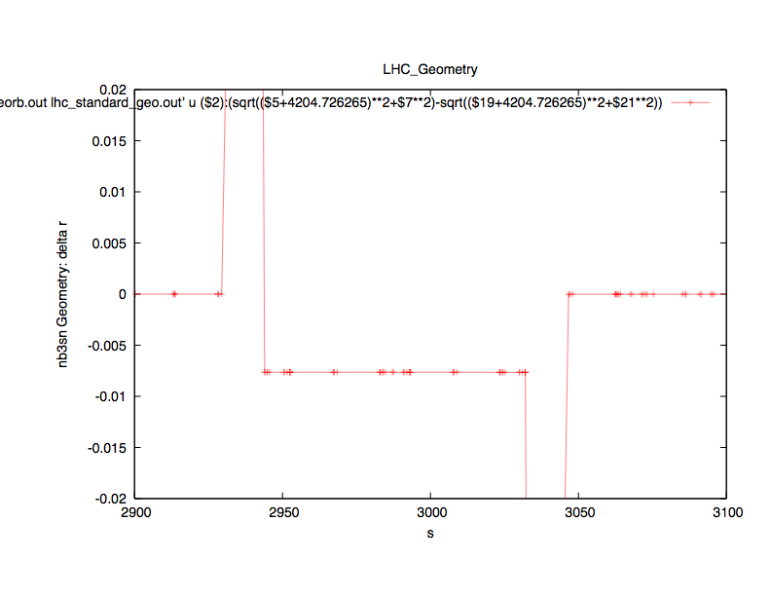
difference in radial coordinate
standard LHC – Nb3Sn LHC
local result
Δx ≈7 mm

Slide 14
3.) Sagitta:
Δr = s
l
ρ
φ
aperture ?
feed down effects !!!
Feed Down Effects:
Bdl I b_{3(syst)} b_{3(pc)} Σb₃ Bρ
450 GeV 7.7 Tm 758 A 13.96 +95.8 109.8 1.5*10³ Tm
3.5 TeV 59.6 Tm 5639 A 13.99 -4.72 9.27 1.2*10⁴ Tm
7 TeV 119.1 Tm 11517 A 13.37 +0.44 13.81 2.3*10⁴ Tm

Slide 15
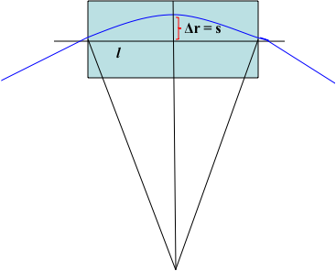
Feed Down Effects:
worst case l = 11.3 m
s = 7.2mm
Quadrupole Error:
Tuneshift:
Beta Beat
 | k₁l | ΔQ | Δβ/β
450 GeV | 2.79*10⁻³ | 0.031 | 20%
3.5 TeV | 2.35*10⁻⁴ | 0.00262 | 1.76%
7 TeV | 2.41*10⁻⁴ | 0.00268 | 1.80%
Phase 1 D1 | b3=3*10⁻⁴ | 0.0059 | 3.9%
per Magnet
considered as
tolerance limit (DA)
... considerably larger than the edge focusing story !!!
Do we have to expect problems concerning the multipoles ? YES

Slide 16
4.) The Story of the Transfer Function ...
a closed orbit problem
calculate the ideal (nb3sn) machine
flatten the experiment bumps, switch off LHC-B, ALICE etc
assign field error to nb3sn dipoles
correct the orbit
plot the residual error
what are we talking about ...
treated not as a geometrical problem but as a orbit problem → can be corrected.

Slide 17
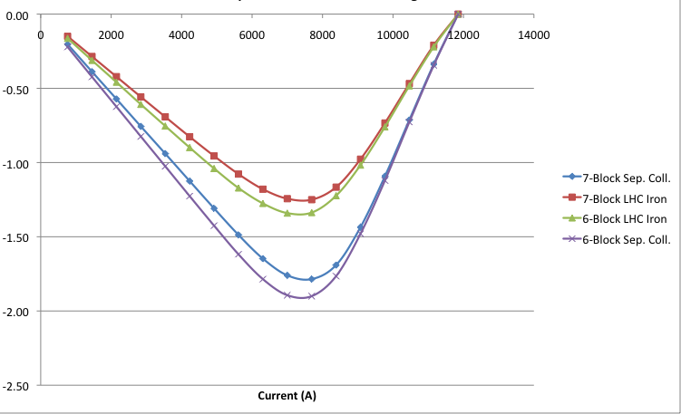
The “non-linear” Transfer Function

Slide 18
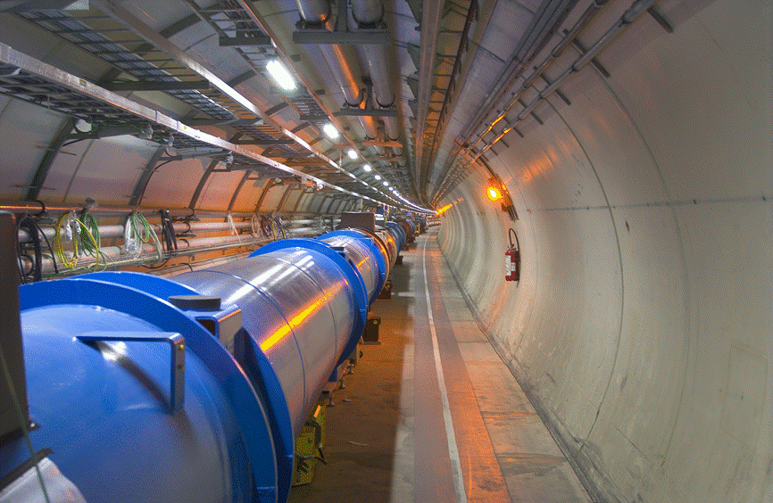
again: ... 10 seconds for the contemplation:
Nb3Sn Transferfunction:
worst case (... around 3.5 TeV) = 2.7% lack in main field
rough estimate: → Δx ≈ 13 mm

Slide 19
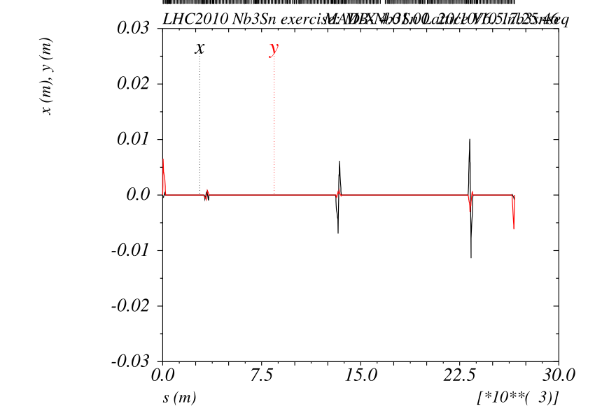
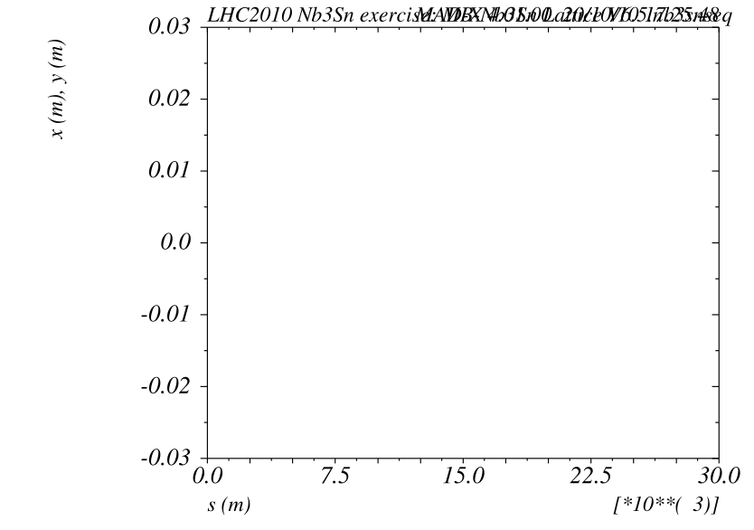
4.) The Story of the Transfer Function ...
a closed orbit problem
ideal machine
with exp bumps
... and without exp bumps

Slide 20
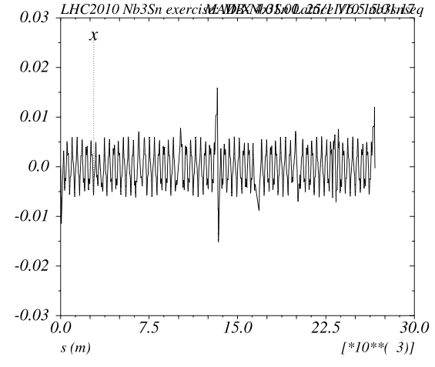
4.) The Story of the Transfer Function ...
a closed orbit problem
effect of nb3sn field error (1.5 Tm)
two dipoles
distorted orbit,
but partially compensated in a closed 180 degree bump
ΔΦ = 4.545 ≈ modulo180 degree
one Nb3Sn magnet
Δx ≈ ± 15 mm

Slide 21

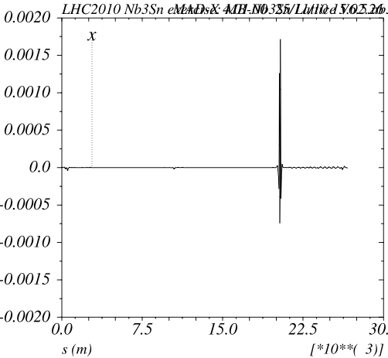
4.) The Story of the Transfer Function ...
a closed orbit problem
effect of nb3sn field error (1.5 Tm)
two dipoles
distorted orbit,
and corrected by the “usual methods”
x(m)
x(m)
Δx ≈ -0.5 ... + 1.5 mm
→ ≈ 5 σ at 3.5 TeV
two Nb3Sn magnets
corrected by 20 orbcor dipoles

Slide 22
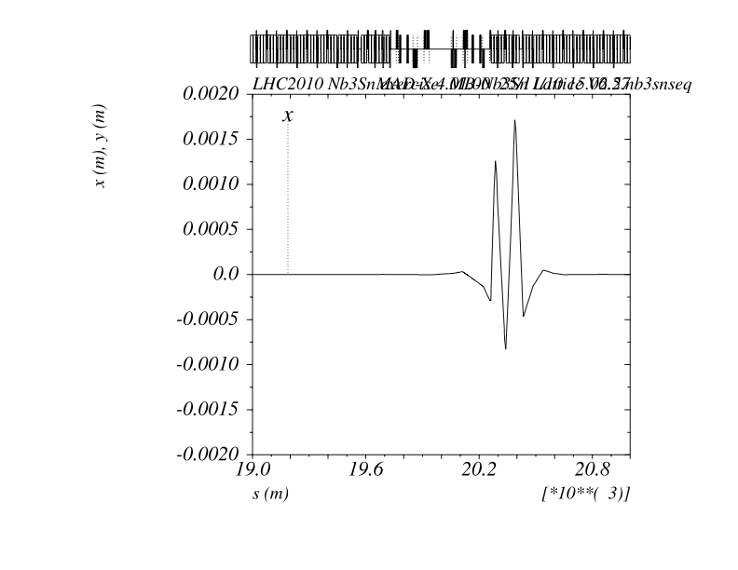
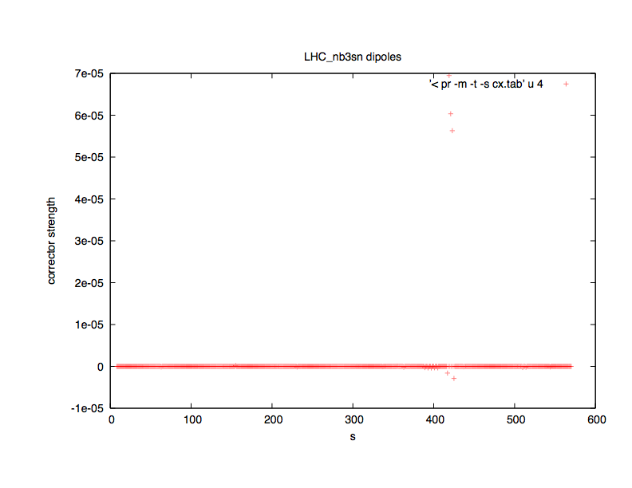
4.) The Story of the Transfer Function ...
a closed orbit problem
field error corrected by 3 (20) most
eff. correctors
zooming the orbit distortion
... local distortion due to
Δϕ ≈ 4.545 phase relation,
closed by MCBH correctors
MCBH corrector strength:
available: 1.900 Tm
needed: 0.805 Tm
= 42 %
!

Slide 23
4.) The Story of the Transfer Function ...
a much better solution: additional “trim” power supply
Trim2
C8
C9
C10
C11
C8
0.15H
RB.A23
0.1H
Trim1
Main Power Converter
TRIM Power Converters
Total inductance: 15.5 H (152x0.1H + 2x0.15H)
Total resistance: 1mΩ
Output current: 13 kA
Output voltage: 190 V
Total inductance: 0.15 H
Total resistance: 1mΩ
RB output current: ±0.6 kA
RB output voltage: ±10 V
(+)
Low current CL for the trim circuits
Size of Trim power converters
(-)
Protection of the magnets
Floating Trim PCs (>2 kV)
coupled circuits
Courtesy of H. Thiessen

Slide 24
non-local correction: dedicated MCBH in an free part of the lattice
does not change the picture: there will always be a inner orbit distortion
in the order of several mm ... the only question is how localised
we can keep the problem
Mikko Karppinen

Slide 25
5.) Nb3Sn Dipole: Multipole Errors:
scaled from the MB experience
Systematic errors
Current (A) | B1 | b2 | b3 | b4 | b5 | b6 | b7
763 | -0.7325 | 2.50 | 13.96 | 0.02 | -0.24 | 0.00 | 0.29
1456 | -1.3977 | 2.50 | 13.96 | 0.02 | -0.24 | 0.00 | 0.29
2149 | -2.0628 | 2.50 | 13.96 | 0.02 | -0.24 | 0.00 | 0.29
2842 | -2.7279 | 2.50 | 13.96 | 0.02 | -0.24 | 0.00 | 0.29
3535 | -3.3930 | 2.50 | 13.96 | 0.02 | -0.24 | 0.00 | 0.29
4228 | -4.0581 | 2.49 | 13.96 | 0.02 | -0.24 | 0.00 | 0.29
4921 | -4.7231 | 2.48 | 13.97 | 0.02 | -0.24 | 0.00 | 0.29
5614 | -5.3875 | 2.45 | 13.99 | 0.02 | -0.23 | 0.00 | 0.29
6307 | -6.0499 | 2.28 | 14.03 | 0.01 | -0.23 | 0.00 | 0.29
7000 | -6.7075 | 1.84 | 14.15 | -0.01 | -0.23 | 0.00 | 0.29
7692 | -7.3565 | 1.05 | 14.31 | -0.04 | -0.21 | 0.00 | 0.29
8385 | -7.9928 | -0.21 | 14.36 | -0.10 | -0.18 | 0.00 | 0.29
9078 | -8.6120 | -2.13 | 14.21 | -0.21 | -0.17 | -0.01 | 0.29
9771 | -9.2204 | -4.43 | 13.97 | -0.31 | -0.15 | -0.01 | 0.29
10464 | -9.8212 | -6.94 | 13.68 | -0.41 | -0.14 | -0.02 | 0.29
11157 | -10.4160 | -9.68 | 13.37 | -0.51 | -0.13 | -0.02 | 0.30
11850 | -11.0060 | -12.49 | 13.06 | -0.58 | -0.13 | -0.02 | 0.30
... in the usual units, i.e. 10 ⁻⁴ referred to the usual ref radius = 17mm

Slide 26
Nb3Sn Dipole: Multipole Errors:

Slide 27
NbTi Dipole: Multipole Errors:

Slide 28
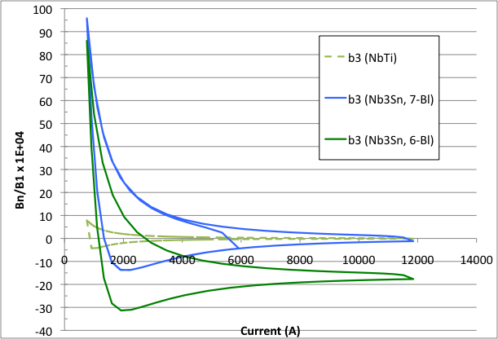
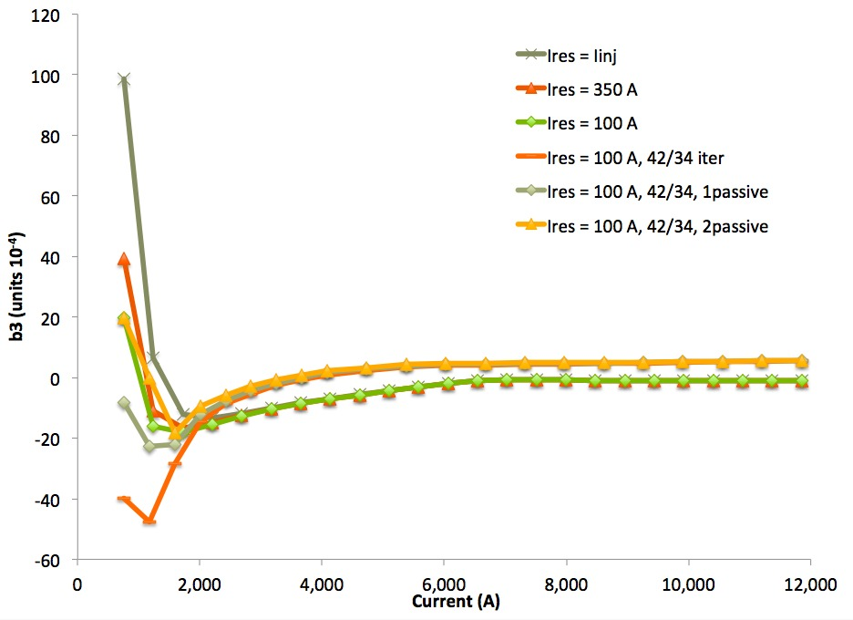
The persistent current problem:
tracking studies needed
b3 remanence as a function of precycle (pre-injection plateau)
B. Auchmann

Slide 29
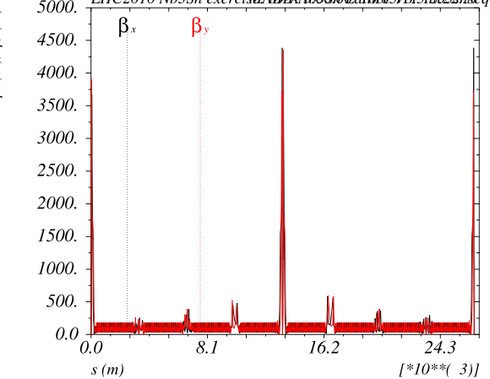
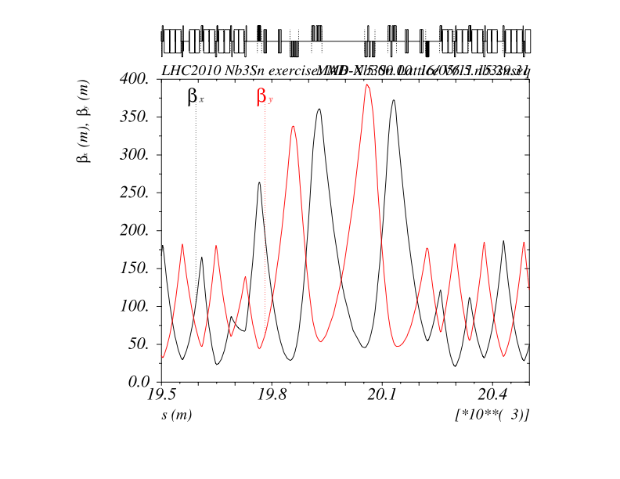
optics situation
collision optics, 7 TeV

Slide 30
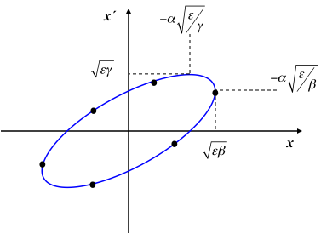
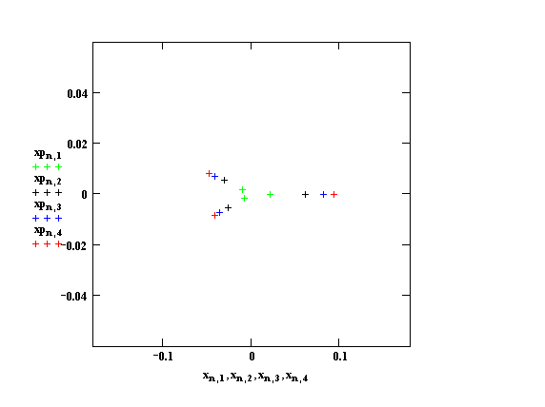
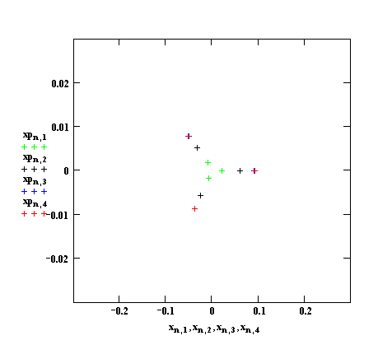
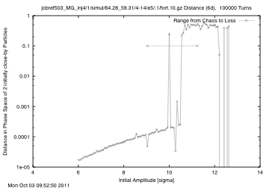
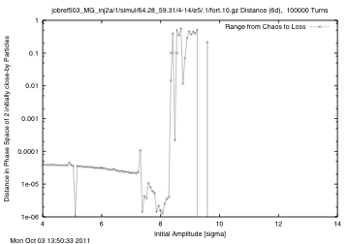
Tracking Studies:
Dynamic Aperture determined via stability
/ survival time
theory: phase space ellipse
defined by optical parameters
ideal, linear machine
strong b3 multipole
b3 = 98, full & local correction
b3 = 98, no correction

Slide 31
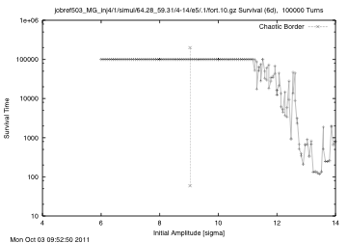
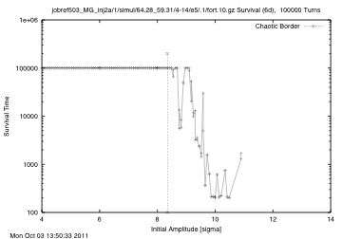
Tracking Studies:
Dynamic Aperture determined via stability / survival time
b3 = 98, full & local correction
b3 = 98, no correction
survival time ... measured in number of turns ... gives an indication of the influence of the
non-linear fields on the ( an- ) harmonic oscillation of the particles.
For the experts:
60 seeds, 10^5 turns, 4-14 σ in units of 2,
30 particle pairs, 17 angles
y
x

Slide 32
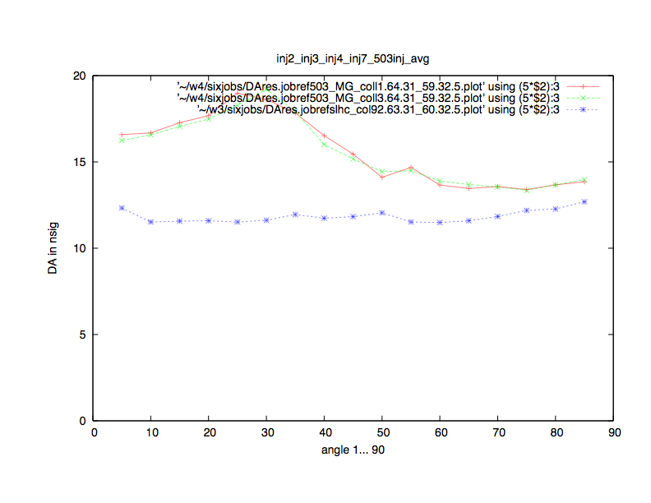
Field Quality: Dynamic Aperture Studies
collision optics, 7 TeV, 2 IP’s = 8 dipoles
dyn aperture luminosity optics, 7 TeV, minimum of 60 seeds
dynamic aperture for ...
ideal Nb3Sn dipoles (red)
full error table (green)
and for completeness: limits in DA for the
phase 1 upgrade study (blue)
for the experts: the plot shows the minimum DA for the 60 error distribution seeds used
in the tracking calculations.

Slide 33
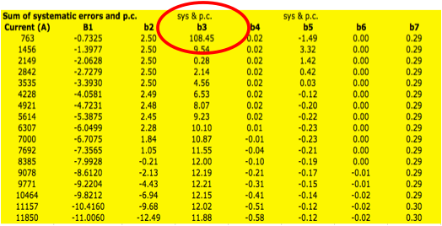
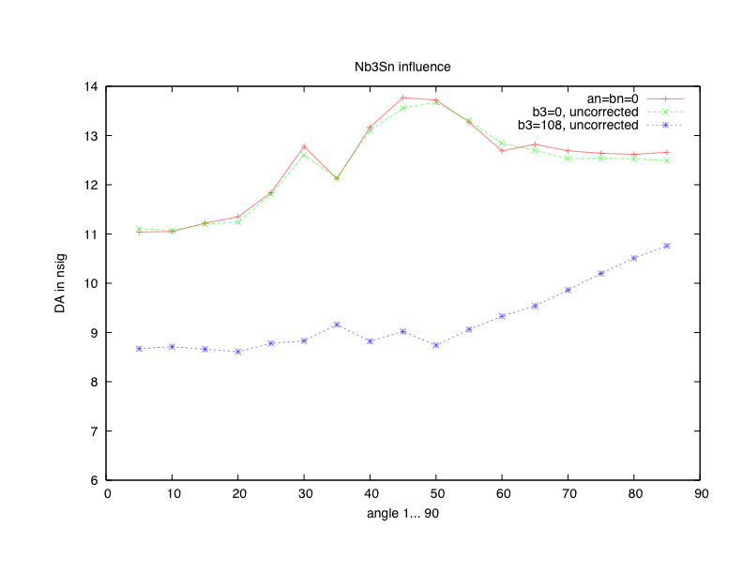
Field Quality: Dynamic Aperture Studies
injection optics, 450 GeV, no special spool piece correctors
influence of b3 values, 2 IP’s = 8 dipoles
dyn aperture injection optics, minimum of 60 seeds
dynamic aperture for Nb3Sn
full error table (blue)
b3 = 0
an = bn = 0
for the experts: unlike to the collision case: at injection the b3 of the Nb3Sn dipoles is the driving
force to the limit in dynamic aperture.
Higher order multipoles have only a very small impact on the DA.
Scan of b3 to find the tolerance limit

Slide 34
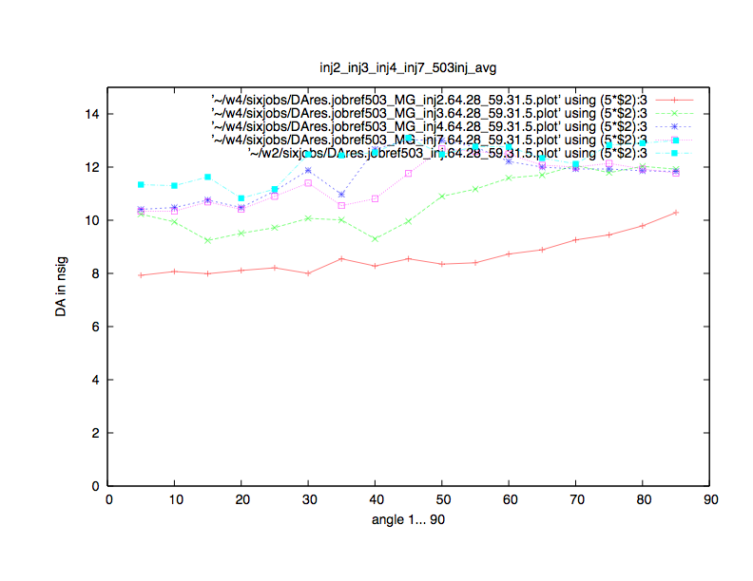
Field Quality: Dynamic Aperture Studies
injection optics, 450 GeV, no special spool piece correctors
scan of b3 values, , 2 IP’s = 8 dipoles
dyn aperture injection optics, minimum of 60 seeds
dynamic aperture for Nb3Sn case:
full error table (red)
b3 reduced to 50% (green)
b3 reduced to 25% (violett)
b3 = 0
and to compare with:
present LHC injection
for the experts: unlike to the collision case: at injection the b3 of the Nb3Sn dipoles is the driving
force to the limit in dynamic aperture.
A scan in b3 values has been performed and shows that values up to b3 ≈ 20 units are ok.
There is not much difference between b3=0 and perfect Nb₃Sn magnets !!
Alternative solution: strong local spool piece corrector ...

Slide 35
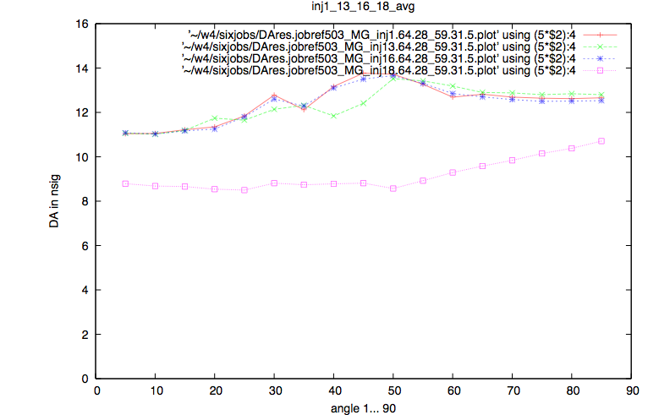
Field Quality: local b₃ correction
injection optics, 450 GeV, special spool piece correctors for the Nb₃Sn
dyn aperture injection optics, average of 60 seeds
ideal Nb3Sn magnets (all a_{n}=b_{n}=0)
a_{n}=b_{n}=Nb₃Sn values but b₃ = 0
b₃=full, local compensation
b₃ =full, no correction
for the experts: if b₃ is corrected locally the Nb₃Sn behave like (nearly) ideal magnets
Higher order multipoles do not have a strong influence on the DA
A strong “mcs” like compensator is needed at every Nb₃Sn.

Slide 36
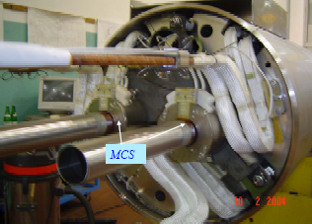
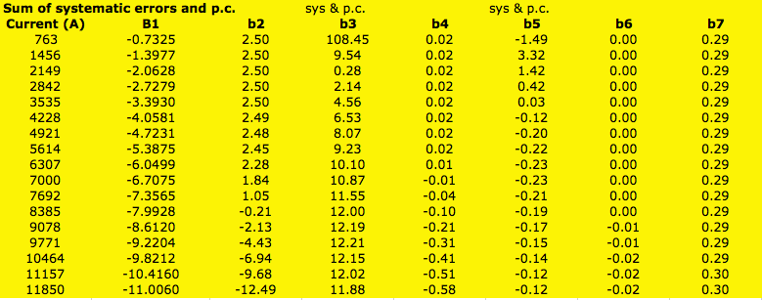
local b₃ correction
some numbers to confuse the audience
Standard MCS: l = 110 mm
g₂ = 1630 T/m²
Standard pc contribution: NbTi b₃ = 7.9 units
pc contribution: Nb₃Sn b₃ = 108 units,
compensation via MCS: k₂ l = 0.412 /m²
g₂ = 5618 T/m² ... without snap back contribution
? what about higher
multipoles
?? what about the skews
??? what about reality

Slide 37
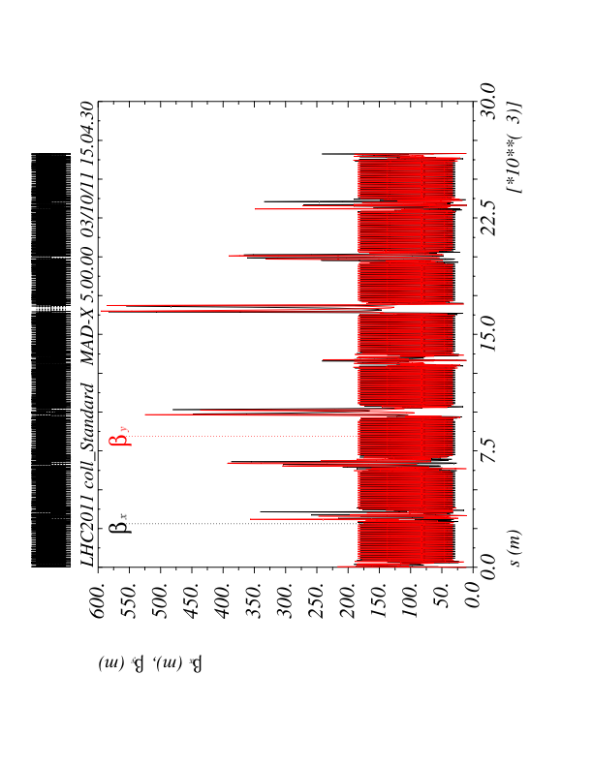
Field Quality: non-local b₃ correction
Q8 Q9 Q10
spool piece correctors at the quads

Slide 38
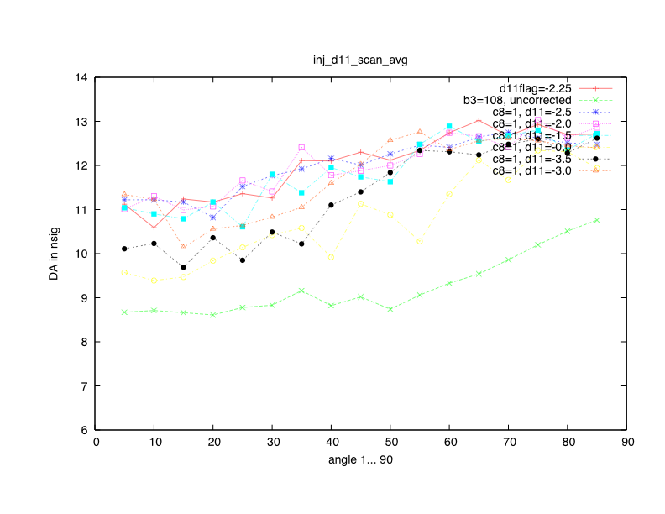
Field Quality: non-local b₃ correction
injection optics, 450 GeV, special spool piece correctors placed at the quads
local correction of b3 at B8
scan of non-local spool piece
corrector, located at Q10

Slide 39
Resume Nb3Sn dipoles
have (nearly) no effect on the linear beam optic
have (nearly) no effect on the LHC global geometry
local geometry has to be discussed
have a strong influence on the orbit that can be
corrected outside the dipole pair using a considerable
fraction of the available corrector strength but a large orbit
distortion (5σ) remains between the dipole pairs
would be a great idea to install trim power supply to compensate
the effect and forget about the problems !!!
multipoles are enormous (mainly b3):
They have only small impact at high energy,
At 450 GeV injection they are too strong and have to be either reduced to
roughly 20 units or compensated by strong spool piece correctors.

Slide 40
To be done:
Repeat the DA calculations & local compensation for the actual
Dipole option (1 * 11m, 2 * 5.5m .... 3 * 4711 m )
... and the number of IP’s
Follow up of actual multipoles
Bernhard Auchmanns improved precycle,
results of first actual magnet measurements
uncertainties / systematics
pc contributions
Summarise all this in a HL-LHC report
in progress

