Slide 1
Cold Collimator Preliminary Study at CERN:
Issues and Challenges
Preliminary Meeting on 11 T - Cold Collimation Interface
05.10.2011
Alessandro Bertarelli (EN-MME) on behalf of the Collimation Design Team

Slide 2
Outline
Context
Alternative designs of DS collimators
Cold Collimator Preliminary Design
Issues and challenges
Conclusions

Slide 3
Context
This presentation is almost entirely based on the pre-study carried out in May-June 2010 for LS1 DS Collimators.
Two different technical approaches were assessed for the design of DS collimators:
        Warm collimator with cold-warm transitions and cryogenic by-pass.
        Cold collimator with jaws at cryogenic temperature.
Cold Collimator study abandoned once the alternative design (Warm Solution) was endorsed by the July 2010 Review. Many critical aspects not thoroughly treated yet. Take all provided information with due caution …
Cold Collimator preliminary design has been developed by D. D. Ramos (Engineer) and Ch. Mucher (Designer). They should get the credits …

Slide 4
Functional Specification
Main goal:
Gain a factor ~10 in (peak) power deposition on DS magnets (SC coils) both for protons and ions
Major complication for Collimator design
  Two jaws per collimator (because of back-scattering and positive Δp/p for ion fragments).
  1m long Tungsten jaw.
      40 W (steady-state), 200 W max (10 s transient) per jaw.
      Jaw stroke 0÷25 mm (horizontal). No vertical adjustment.
      Jaw tapering 100 mm.
      Jaw flatness ~50μm (manufacturing) + 50μm (in working conditions) .
      UHV Compliant

Slide 5
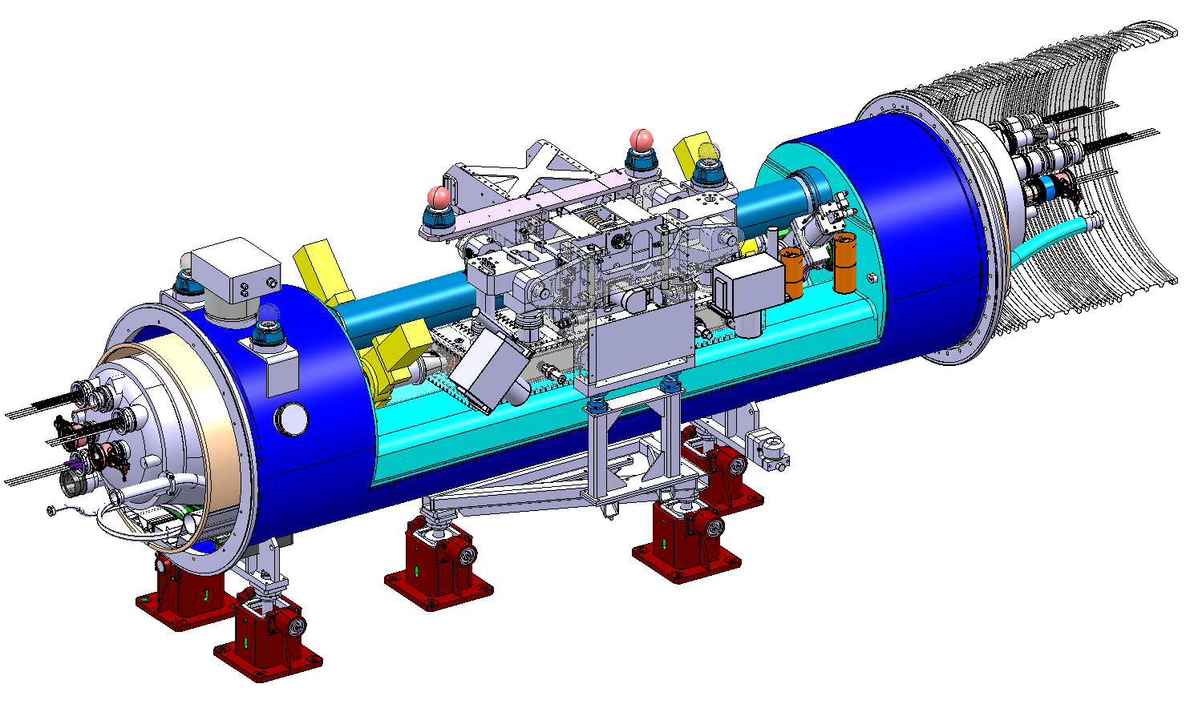
Pre-Design 1: Warm Collimator Assembly
Standard Inteconnects
Warm Collimator Module (TCLD)
Cryogenic By-pass (QTC)
Collimator independent support
Total length 4.5 m
Solution endorsed by the Collimation Review (July 2010)
Design approved by Technical Review (May 2011)
Cryogenic By-pass (QTC) under prototyping

Slide 6
ColD Collimator: Very First Ideas
2009 Conceptual Review: movable beam pipe with integrated one-sided jaw
Warm Actuation system outside the cryostat
ABANDONED!
(TWO JAWS REQUIREMENT )
Notes:
6

Slide 7
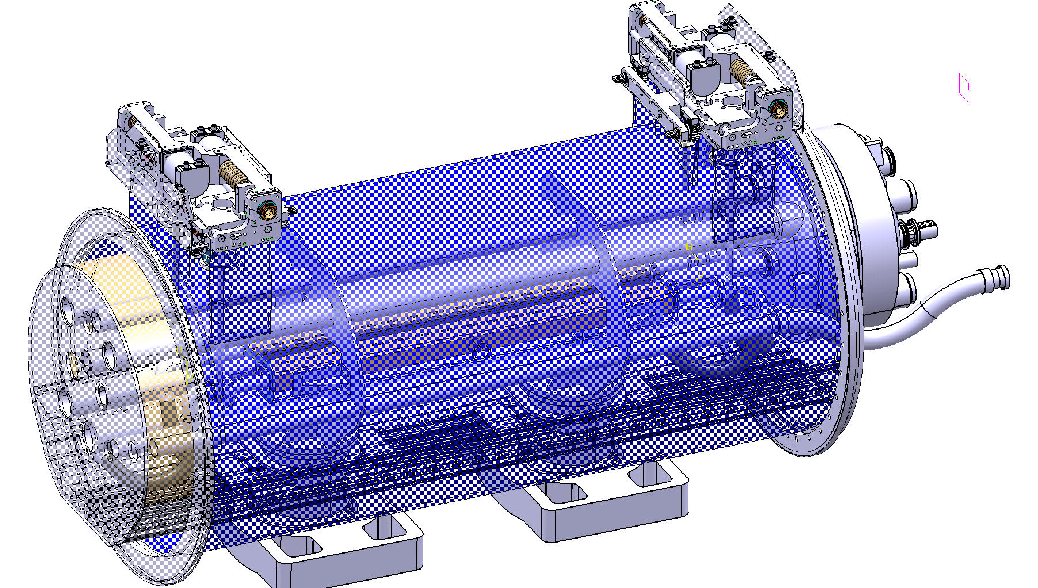
Pre-Design 2: ColD Collimator
External actuation system
Special Cryostat
Jaw driving shafts
Cold Mass
(for bus-bar lyras)
Features/Issues
Total length between interconnection plans: 3.1 m
Actuation system outside cryostat ⇨ Accuracy of jaw positioning?
Special cryostat. No W bellows sliding possible.
Lyras required to compensate bus-bar contraction ⇨ taken up by adjacent 11T magnets?

Slide 8
Cold Jaw operating temperature
He inlet to outlet
Heat diffusion gradient
Features/Issues
Evacuating 200 W is only possible relying on line E (50-65 K) ⇨ Cooling by-pass
In order to avoid pressure instabilities due to C0₂, collimator must be kept above 80 K (see V. Baglin’s talk) ⇨ He heaters required.

Slide 9
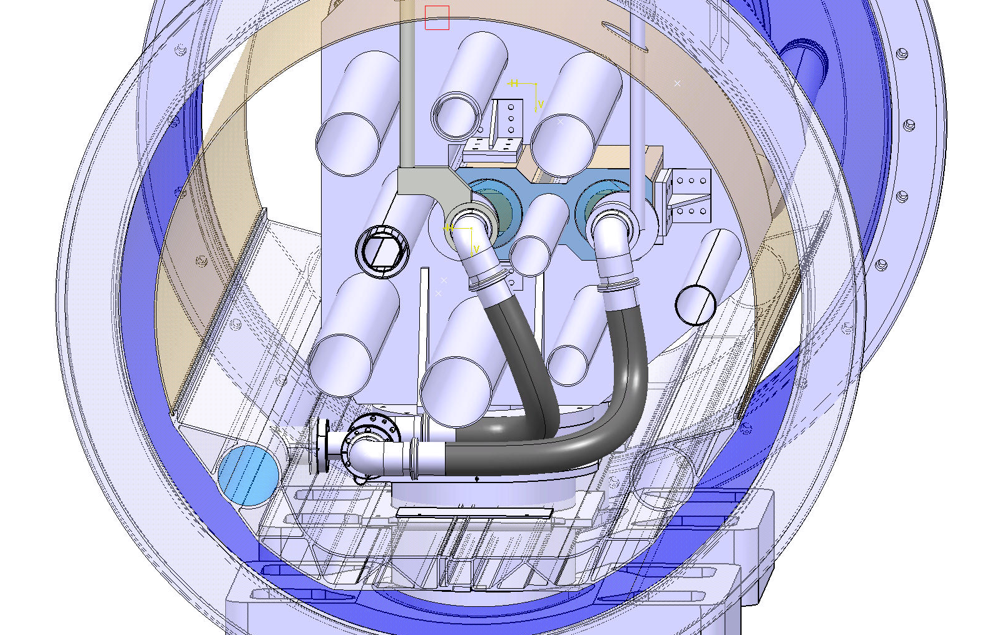
Pre-Design 2: Cold Collimator
He heater (from ~50 K to > 80 K)
Features/Issues
He by-pass flow to be minimized to reduce heating power.
Bringing He from 50 to 80 K costs as much power as cooling the jaw.
Active control necessary for He heaters ⇨ Reliability?
Active flow regulation devices might be required ⇨ Complexity, Reliability?
E line
(50-65 K)
Cooling by-pass (from E-line)
Flow regulation devices?

Slide 10
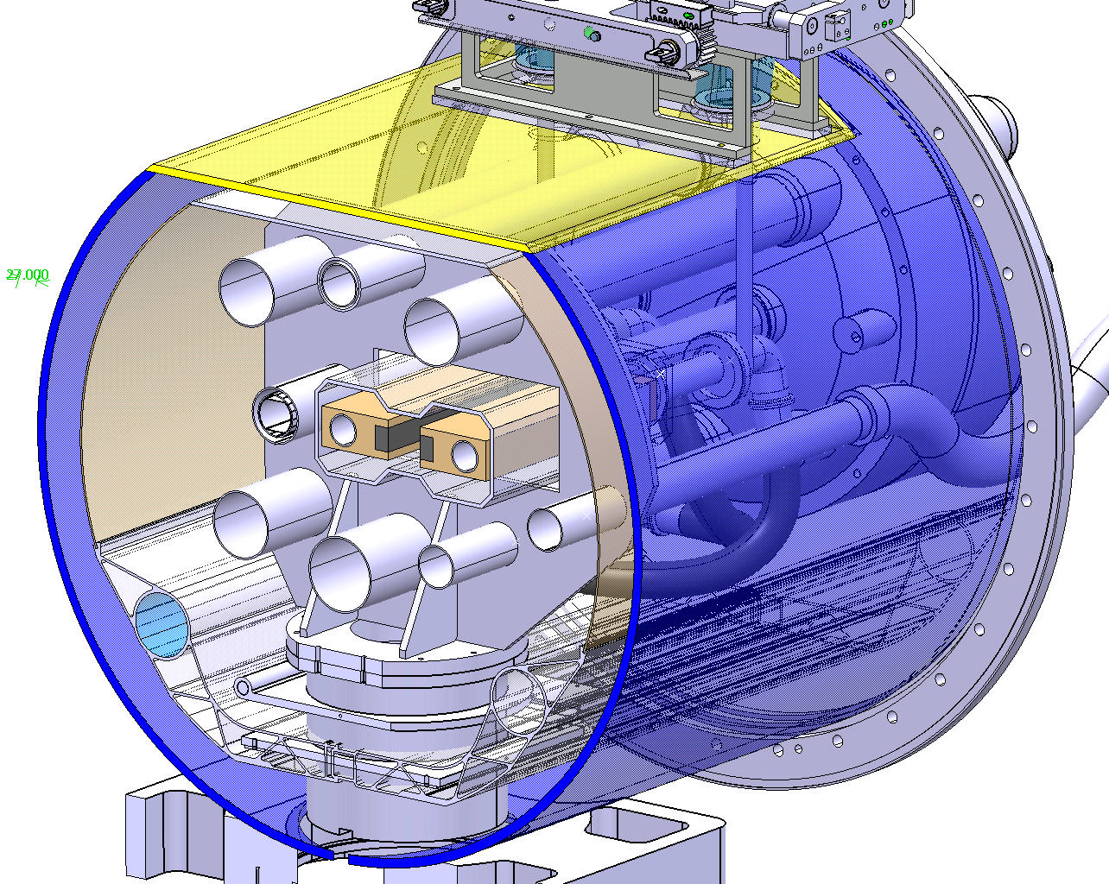
Pre-Design 2: Cold Collimator
W Jaw
Cu Jaw Support
He Cooling Pipe
Issues
Jaw operating temperature 100 ÷130 K
Tungsten becomes very brittle at low temperatures ⇨ can it be replaced by Cu? Others?
Cryo-pumping surface at ~3K plus 80 K screen required around jaws. Design issue?
Design of RF sliding contacts at 100 K?
Additional RF-induced heat loads?
E line
(50-65 K)

Slide 11
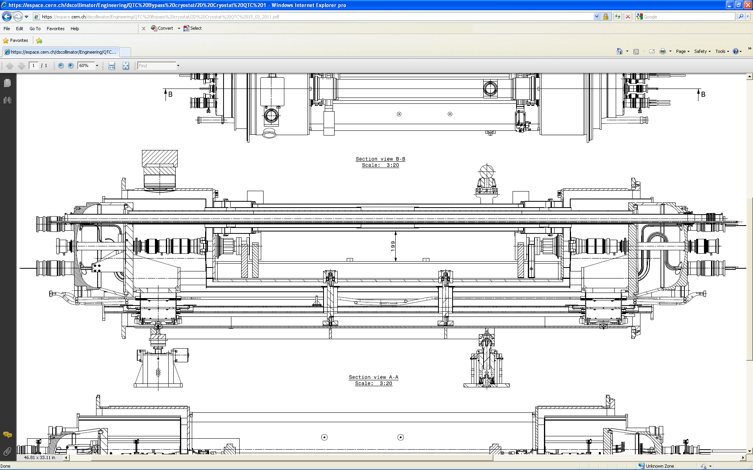
Alternative proposals
Can one replace the small cold masses of the Cryogenic by-pass by 2 Nb3Sn Magnets?
Are alternative bus-bar routings possible (e.g. everything on top of cold collimators)?
~3.4 m
5.5 m Nb₃Sn
5.5 m Nb₃Sn
Warm Collimator

Slide 12
Potential showstoppers for Cold Solution
Beam vacuum operation at 100K.
Tungsten brittleness at low temperature.
Reliability of active devices for by-pass cooling circuit operating in cold and UHV (Heaters and valves).
Possible additional heating from RF impedance.
Issues with moving or sliding parts in cryogenic environment (e.g. RF contacts).

Slide 13
Summary
Preliminary study of a cold collimator was carried out in May-June 2010. It was based on assumptions and schedule no longer applicable.
This development was abandoned at a very early stage. Many critical issues are still to be solved.
Total length of the pre-design is 3.1 m. Jaw operating temperature is 100-130 K. Heating He from E-line above 80 K is necessary.
Design optimizations are possible in particular if 11 T Magnets integrate collimator requirements such as bus-bar lyras and routing.
Some pending issues may potentially constitute showstoppers for the cold design.
Experience gathered by GSI may help in tackling some of the issues, namely operation at ~ 100 K.
Jaw entirely made up of copper may reduce risks related to Tungsten brittleness.
Alternative solutions like warm collimator with an optimized magnet interface could still be considered.

Slide 14
  Thank you for your attention!

Slide 15
  Bonus Slides!

Slide 16
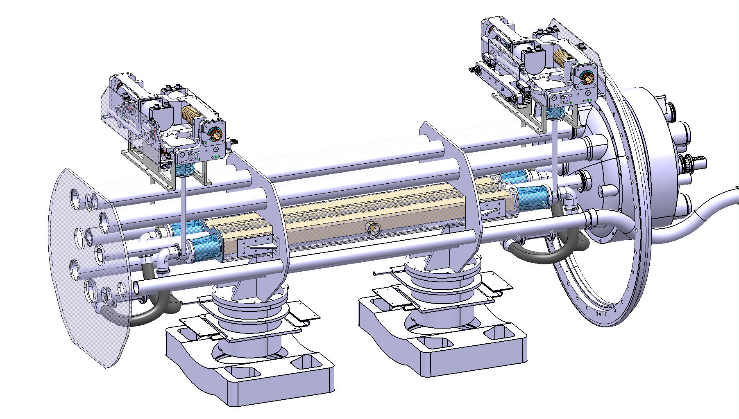

Slide 17
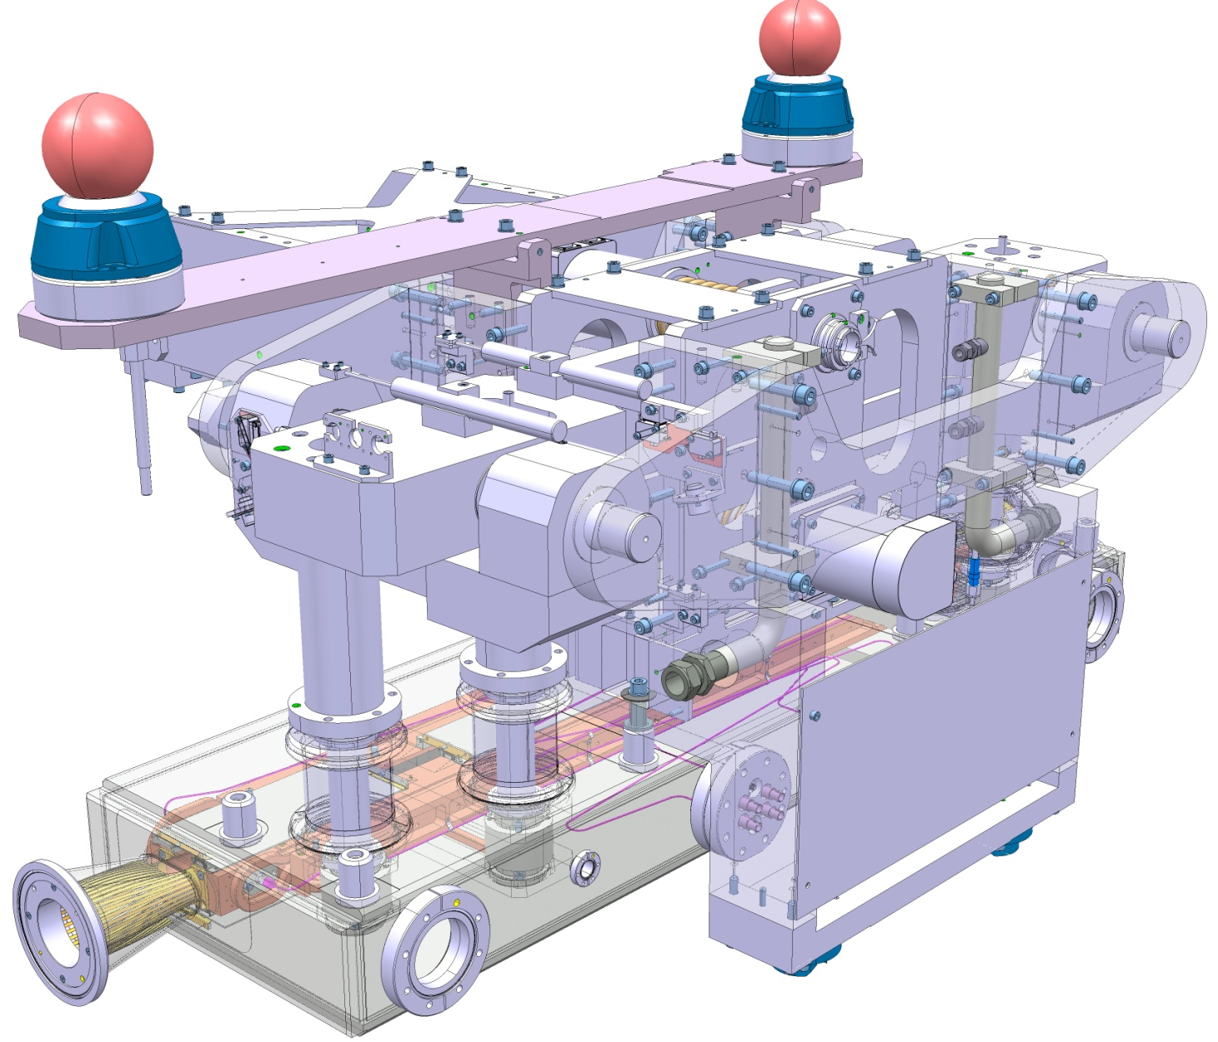
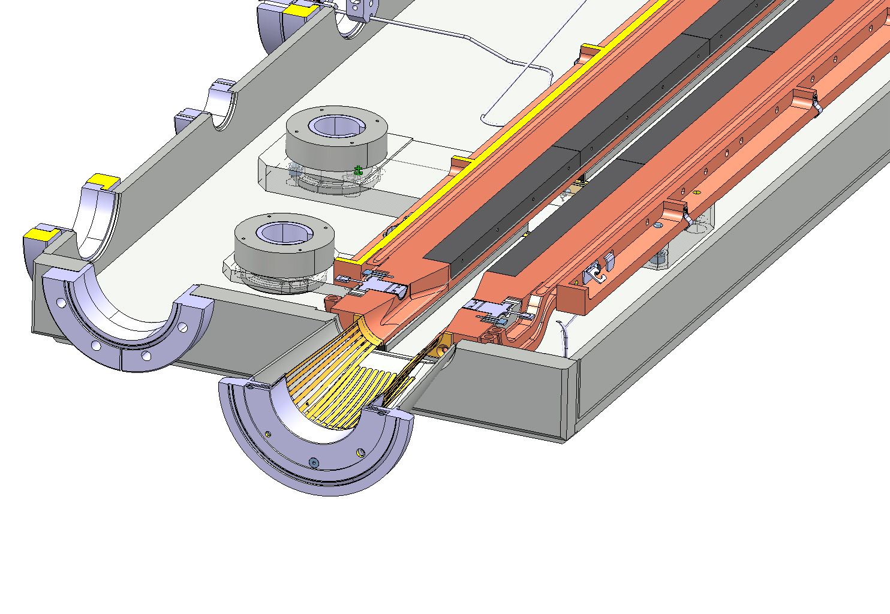
Pre-Design 1: Warm Collimator Module
Tungsten Blocs
Beam

Slide 18
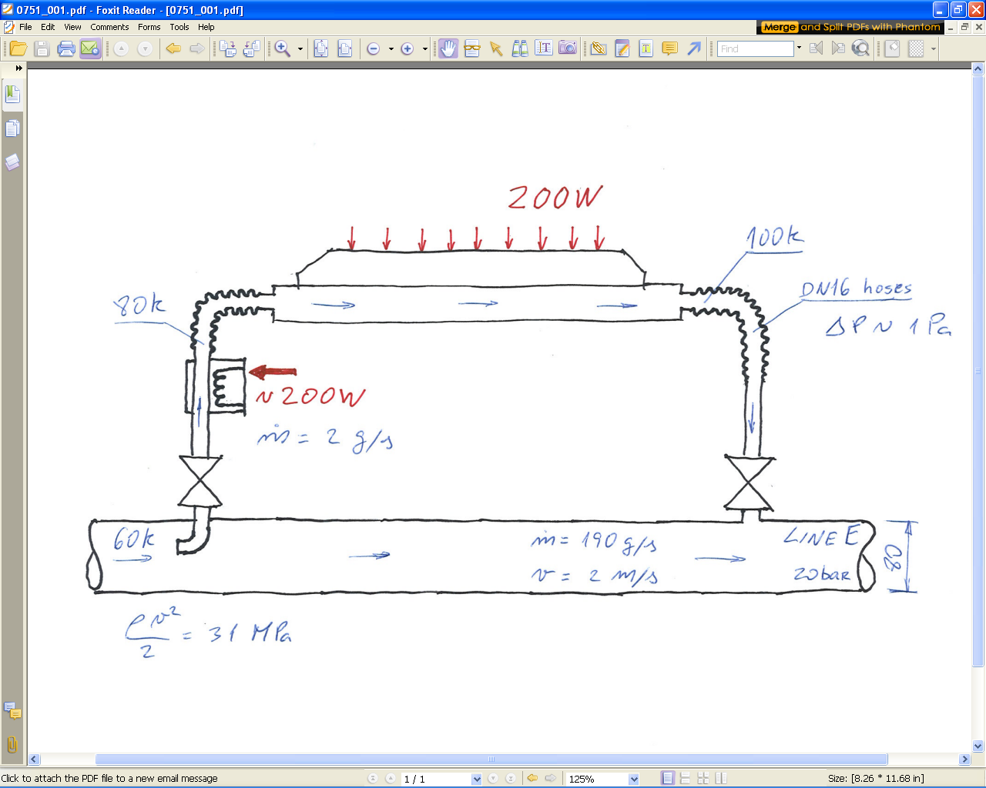
Cooling bypass design
Heater to raise line E helium from 60 K to 80 K
Minimum flow to extract 200 W keeping the outlet below 100 K
Controlled flow or on/off valves (less efficiency)?
35 mm pipe would result in wall ΔT ~ 36 K (average). Larger surface is required!
Active control of heater power
Dynamic pressure is sufficiently high; no need to add a restriction in line E

