Slide 1
Cold Collimator + 11T magnet: cryostat & integration issues
(first thoughts)
V.Parma, J.Ph.Tock
CERN, TE-MSC

Slide 2
Outline
The Cold Collimator Feasibility Study (CCFS) working group
From warm collimators (reminder) to cold collimators
Machine Integration: technical systems affected
Possible 11 T magnet layouts and consequence on collimator integration
IR specificities
Powering
Summary

Slide 3
Mandate of the CCFS Working Group
(Cold Collimator Feasibility Study)
Scope of the work:
Verify the feasibility of installing cold collimators, housed in cryo-assemblies, in the continuous cryostat during LHC’s Long Shut Down 2 (or later SD), as required by collimation in several machine IR’s (pt.1, 2, 3, 5 and 7)
Specific goals:
Analyze configurations of cold collimators coupled to 11 T magnets;
Identify potential show stoppers, either related to the implementation of the layout schemes or related to operational aspects of the associated technical systems (vacuum, cryogenics, machine protection, alignment, etc).
Identify potential needs for R&D with its associated effort and timeline.
Provide a final recommendation for the opportunity of a cold collimator project, with a draft timeline.
WG composition (by system reponsibility):
Collimators: A.Bertarelli, EN-MME; F.Cerutti, EN-STI
Vacuum : V.Baglin, TE-VSC
Cryogenics : R.Van Weelderen, TE-CRG
11 T magnets: M.Karpinnen, TE-MSC
Machine optics, (R.Assmann, BE-OP)
Machine Layout, Cryostat & Integration: V.Parma (J.Ph.Tock),TE-MSC
And ex-officio participants:
Collimator project leader (R.Assmann, BE-OP)
HL LHC project leader (L.Rossi, TE)

Slide 4
List of topics on the table
Topics:
IR Integration specificities (space availability, PC locations,…)
Collimator length (as function of material, efficiency,…)
11 T magnet specificities (strength vs.lenght, trim & powering, quench protection,…)
Possible cryostat layouts (11 T common integration, individual cryostats,…)
Vacuum T and operation aspects
Cryogenic margins (heat load limitations, extraction capacity from 11 T magnet & collimator, operation aspects,…)
Collimators @ cryo T (materials, RF heat deposition,…)
Collimator mechanisms @ cryo T (jaws alignment, precision,…)
Reliability & Maintainability (failure scenarios, down-time,…)
…
Next meeting on 11th October next:
Layouts options and IR integration specificities (V.Parma+J.Ph.Tock)
11 T magnet main parameters (M.Karppinen)

Slide 5
Warm collimators in the DS of IR3: our baseline
IP3
R33
RZ33
R34
11L3
10L3
9L3
8L3
7L3
QRL
Q11
Q10
Q9
Q8
Q7
DQS
Conn.cryostat
DFBA
TCLA
BTVM
4’500 mm
46 mm
4’500 mm
QRL
Q11
Q10
Q9
Q8
Q7
DQS
Short Conn.cryostat
New
Collimator assembly (LTC)
New
Collimator assembly (LTC)
DFBA
TCLA
BTVM
was aimed at Shut-Down 2012-2013 (no time for 11 T magnets!)
move 24 existing magnets and DFBAs (considered critical but feasible)
→ not needed for SD1 anymore, project postponed

Slide 6
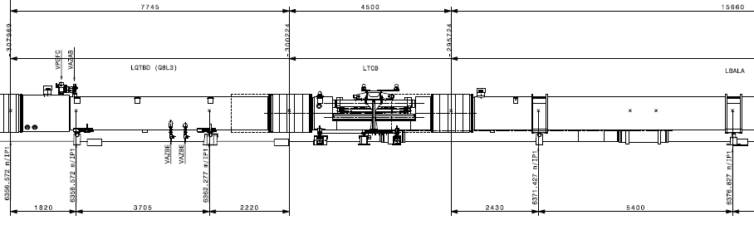
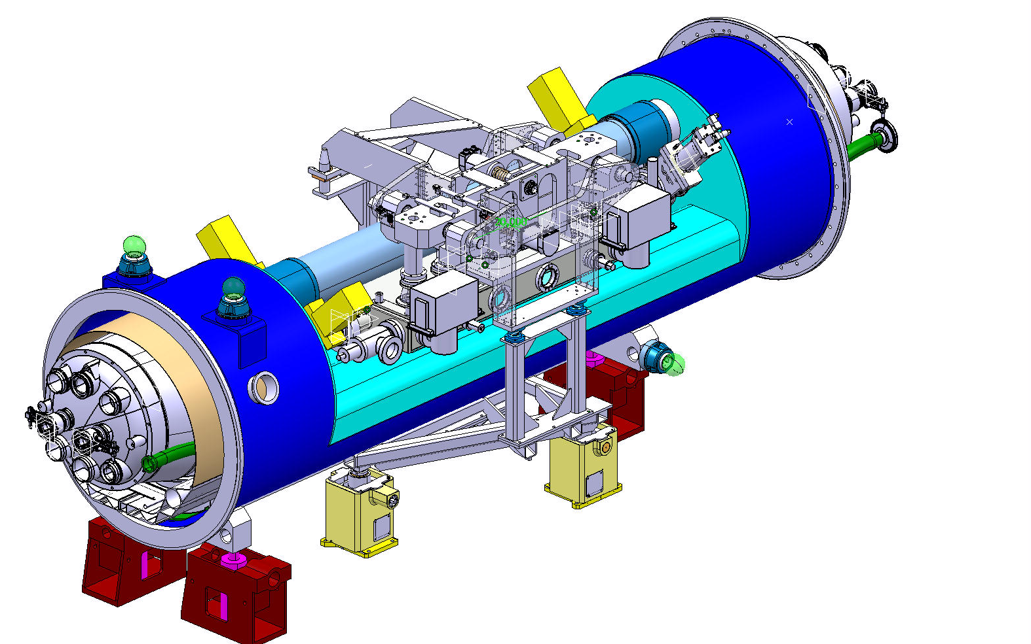
DS Collimator Assembly (LTC)
Q8
MB
LTC
(Y.Muttoni, EN-MEF)
Collimator Module (TCLD)
W jaw length → 1 m
overall length 4.5 m
ineffective length due to:
  Bus bars routing
  Cold-Warm transitions
Cryostat (“by-pass”)
(QTC)
1 prototype cryostat
is under construction
(D.Ramos, EN-MME)

Slide 7
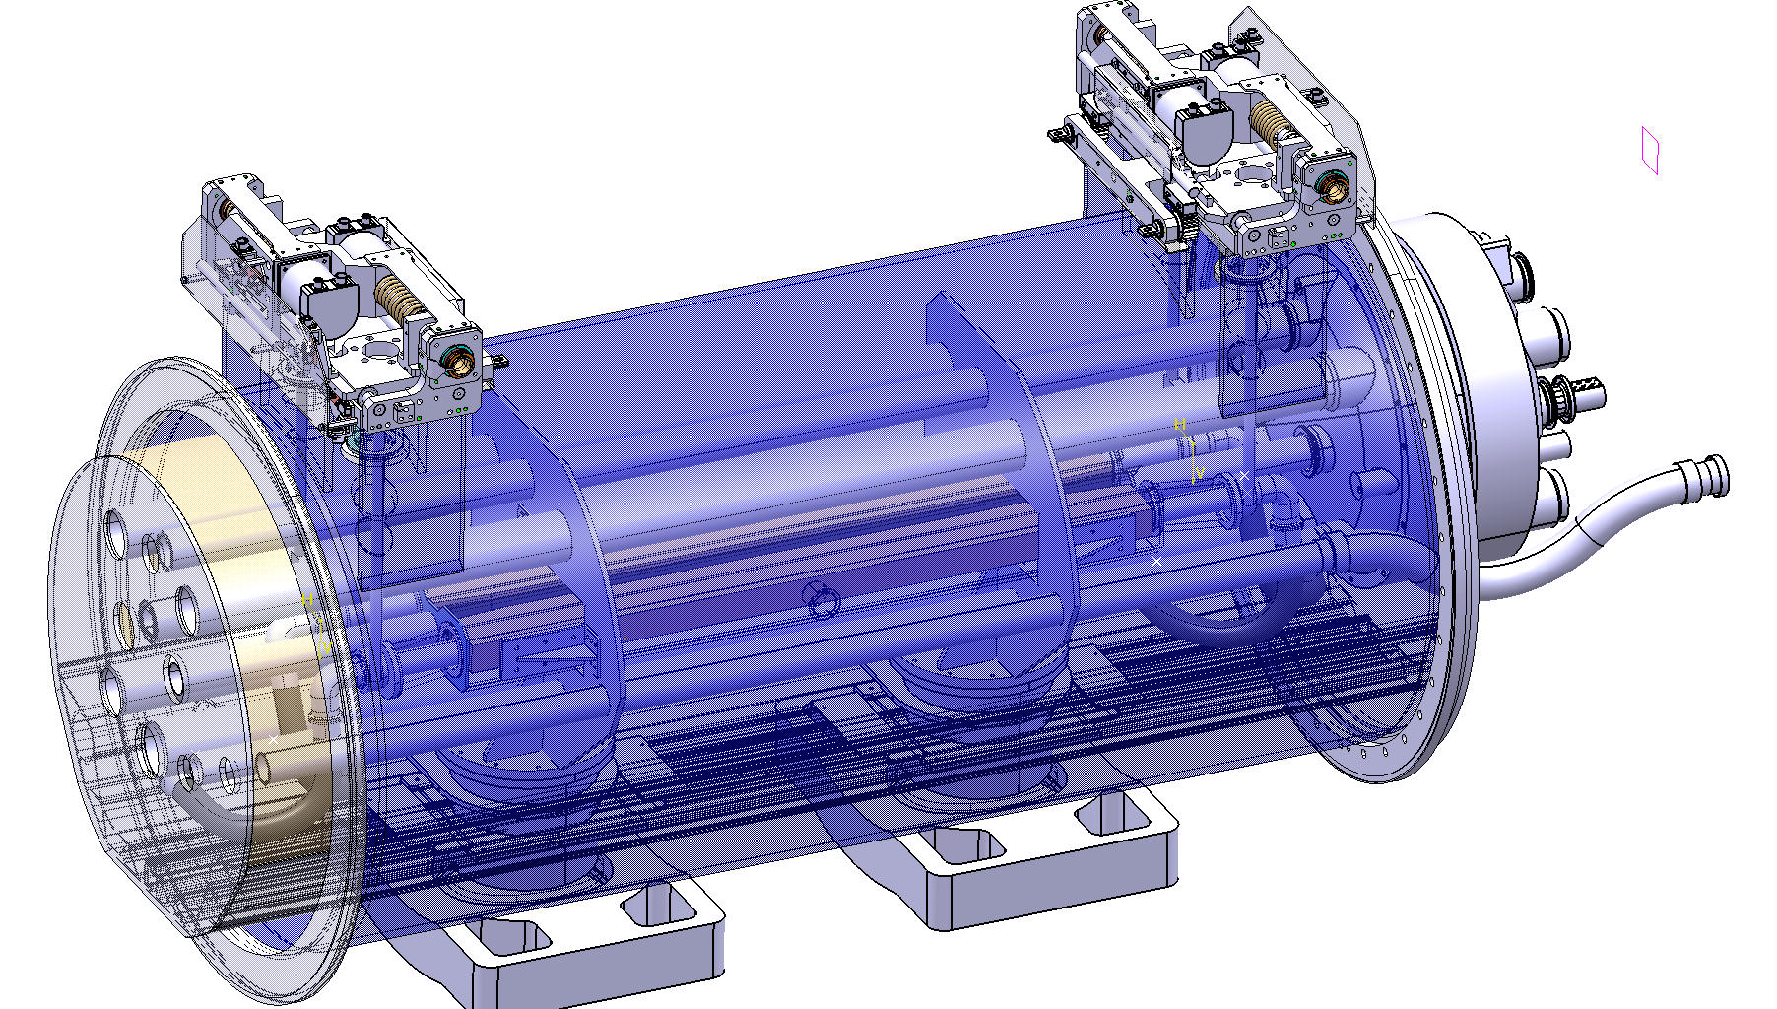
Cold collimator Pre-study (2010)
Cold mass
External actuation system
D. Duarte Ramos
Ch. Mucher
Cold jaws

Slide 8
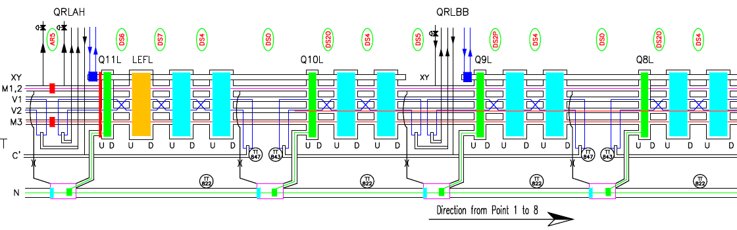
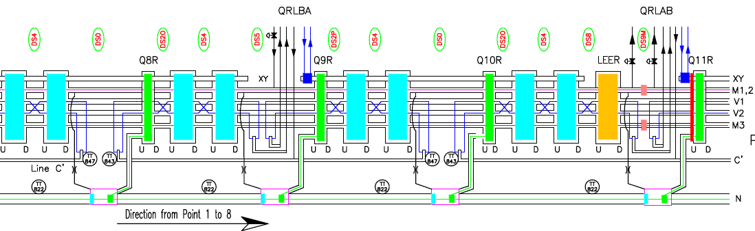
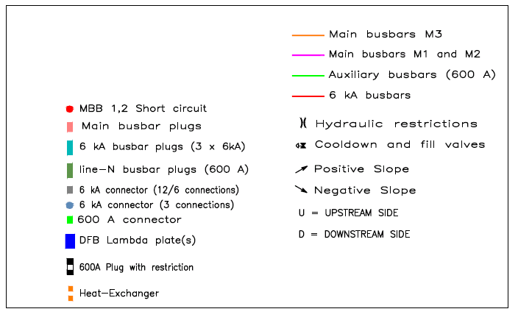
Primary technical systems affected by inserting the LTCs (3 L and 3 R)
3 Left
LTC
LTC
3 Right
LTC
LTC

Slide 9
Systems to be “bridged”
Maintain functional continuity of:
Beam lines (beam vacuum):
V1, V2
Electrical powering:
M1, M2, M3 and corrector spools (magnet powering)
Aux.BB line (line N, only 600 A cables, correctors powering)
Cryogenics:
Pressurised HeII bath (line L)
Sub-cooled HeII (lines X, y)
C’, KD1, KD2 lines (4.5 K) for IR3L; none for IR3R (but needed to thermalise cryostat components)
Thermal shield line (line E)
Insulation vacuum:
Insulation vacuum (line W)
X
Y
M1
M2
V1
V2
K2
K1
M3
N
E
C’
W
(courtesy: D.Ramos)

Slide 10
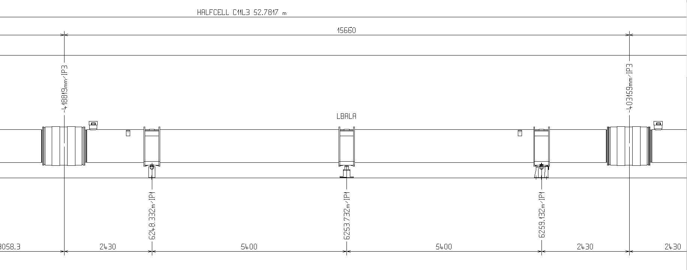
Dipole tunnel integration layout
Remove and replace 1 (or 2) MB
Possibly preserve standard interconnect
→ 15’660 mm (IC plane to IC plane) space constraint

Slide 11
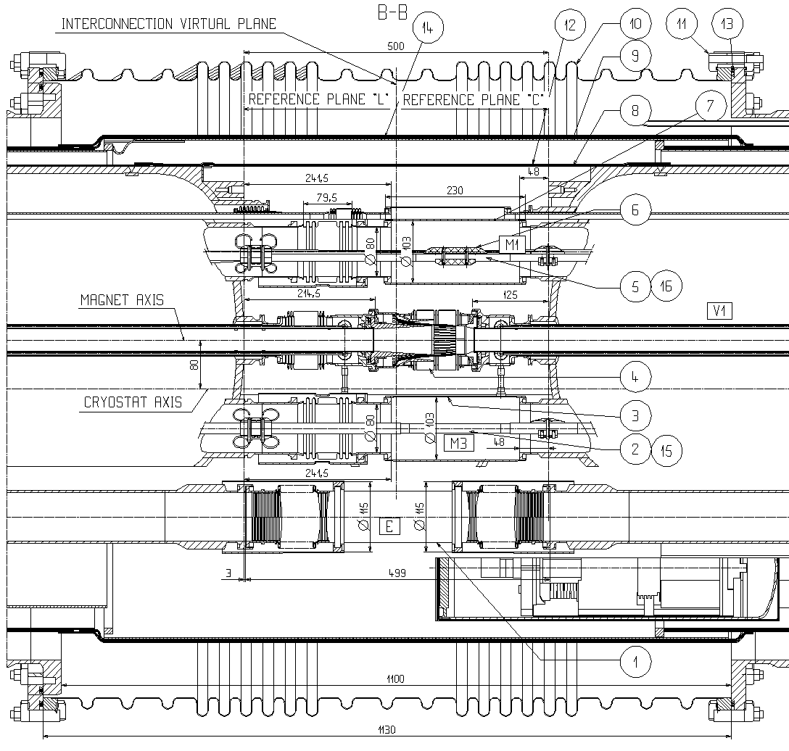
Dipole-Dipole interconnect

Slide 12
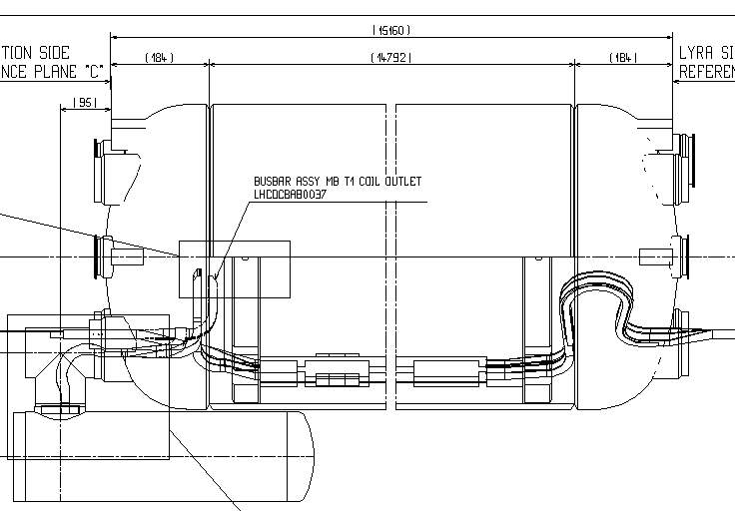
Typical bus bars arrangement in MB
~ 225
Drwg LHCDCBAB0001

Slide 13
Longitudinal layout (Option 1)
15’660 (IC to IC plane)
11’450 (CM length)
11’000 (magnet length)
Line X (H.exch.)
10’600 (magnetic length)
3’000 ? (collimator)
beam tubes
Line M
(B.Bar line)
250
~225
225
480
480
Note: no space included for correctors

Slide 14
Longitudinal layout (Option 2)
15’660 (IC to IC plane)
11’950 (CM length)
5’700
5’700
Line X (H.exch.)
5’300
5’300
3’000 ? (collimator)
beam tubes
Line M
(B.Bar line)
250
~225
~100
225
230
230
CM is 500 mm longer (2 end plates+connection space)
Note: no space included for correctors

Slide 15
Longitudinal layout (Option 3)
15’660 (IC to IC plane)
6’150 (CM length)
6’150 (CM length)
5’700
5’700
Line X (H.exch.)
5’300
2’400 !! (collimator)
5’300
beam tubes
Line M
(B.Bar line)
250
~225
225
~225
225
250
~230
~230
Collimator space reduced by 600 mm (w.r.t option 2)
Note: no space included for correctors

Slide 16
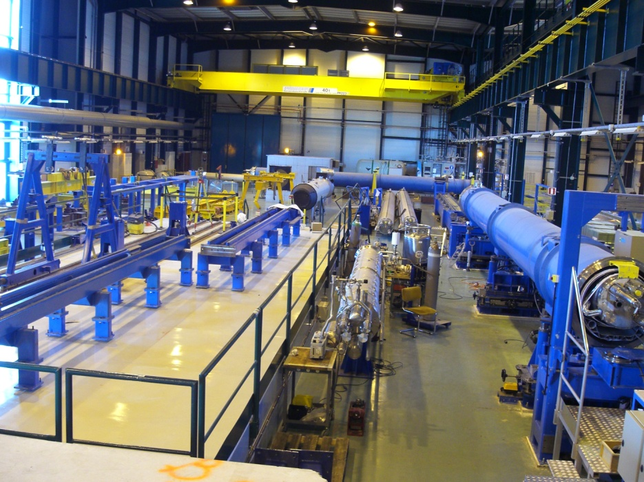
LHC “cryostating” methods
SSS-type for shorter/lighter cold masses (up to ~ 9 m long):
  Can be lifted from cold mass ends
  Cryostat vacuum vessel on 2 cold supports posts
Dipole-type for longer units (>9m):
  Cannot be lifted from cold mass ends
  2 support posts preferred, whenever possible (isostatic)
  3 support posts inevitable for very long cold masses
5.3 m
2 supports
3 supports
11.3 m

Slide 17
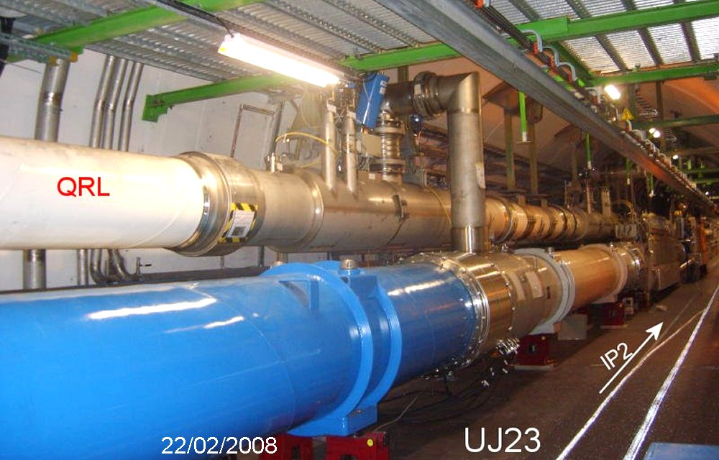
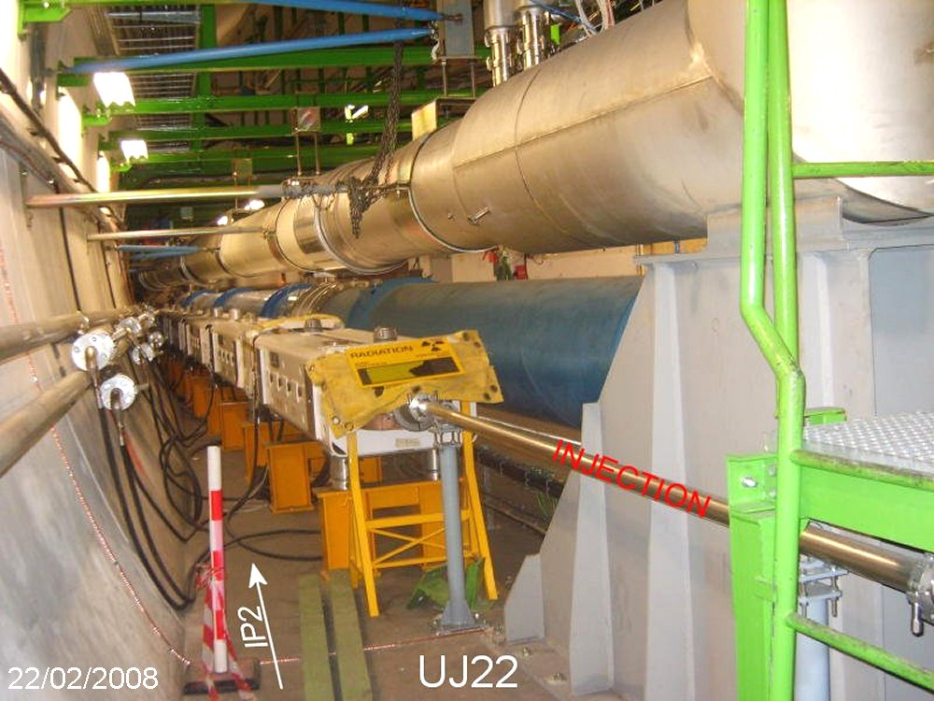
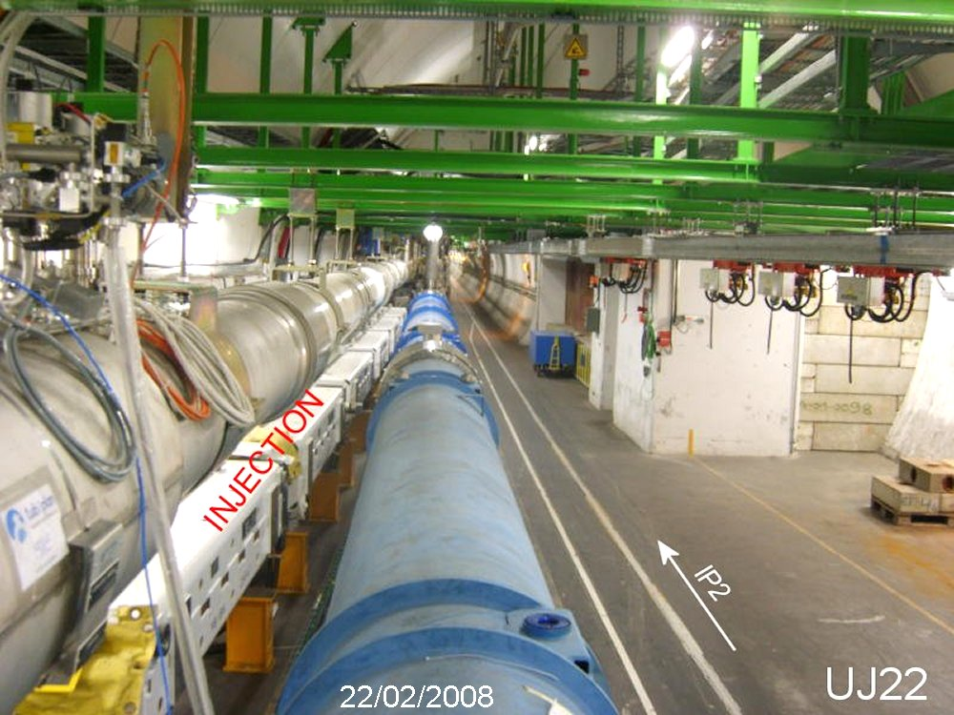
IR specificities
(J.Ph.Tock)
For Pts 1,3,5,7 : The DS zones are very similar in terms of layout (not studied in details)
IR3 : Checked and validated ;
See drawings LHCLJ_3U0035 to 0045
IR2 could necessitate a different collimation optics : only one collimator
Left of IR2, there is the injection line and the QRL that are constraining differently the available space
Differences in design, tooling, procedures, …

Slide 18
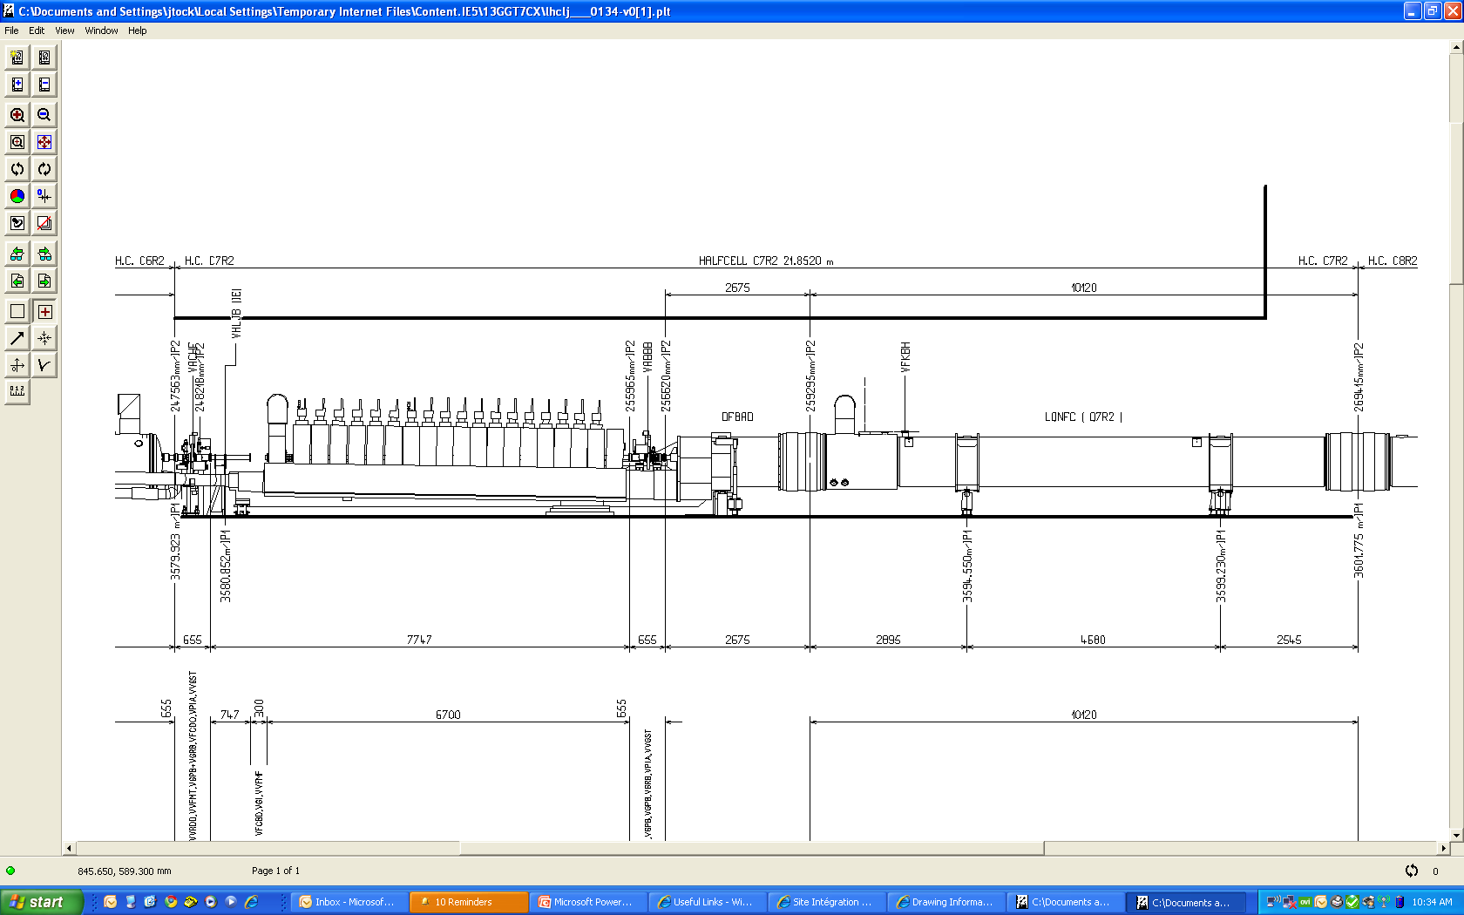
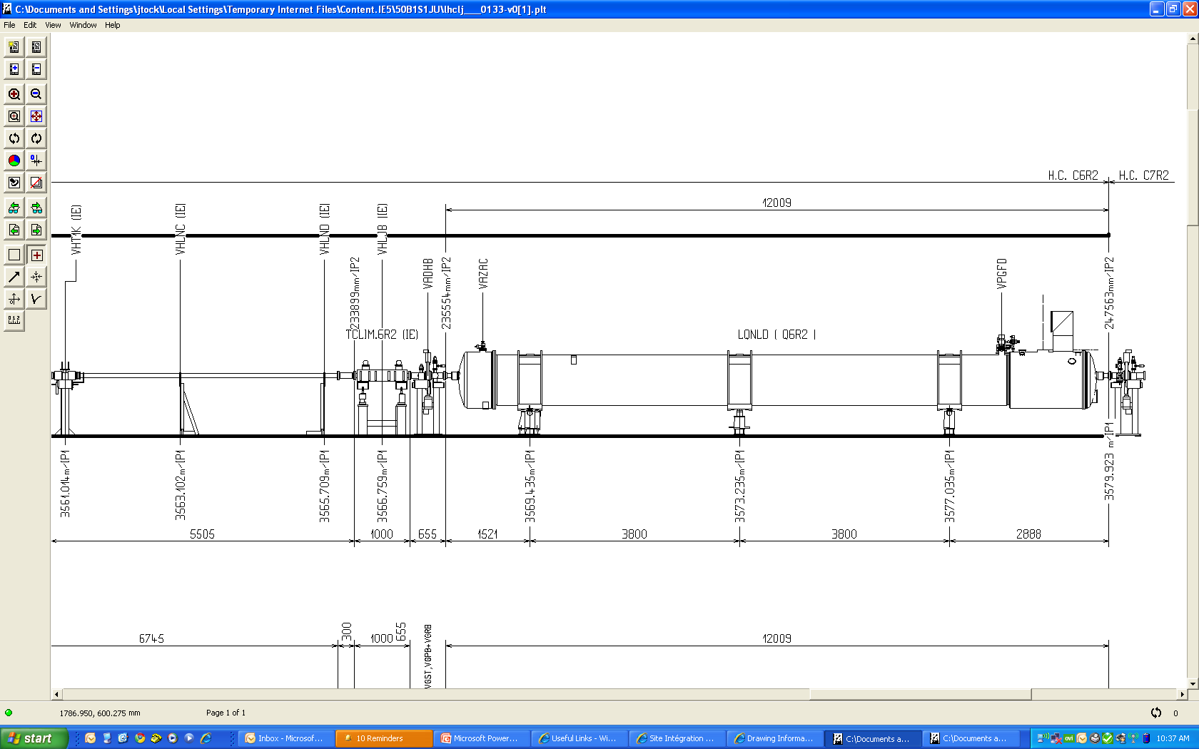
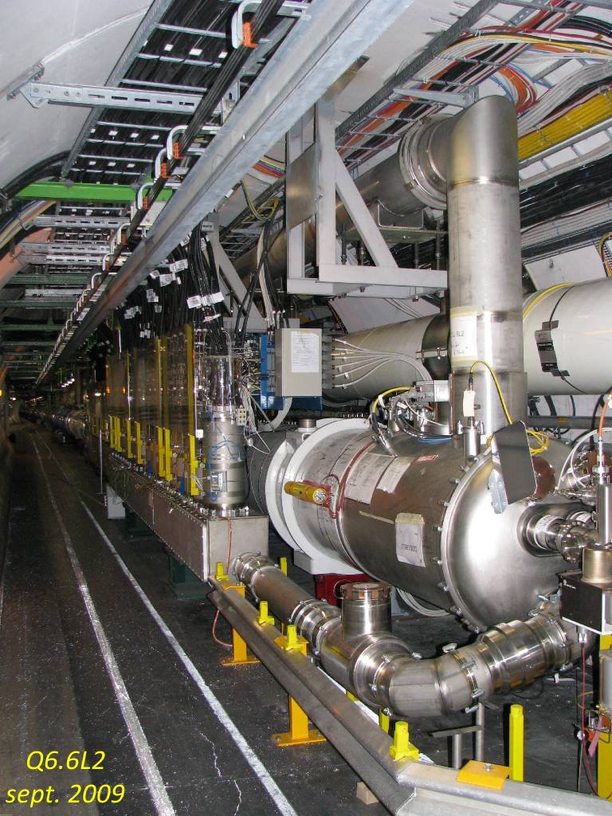
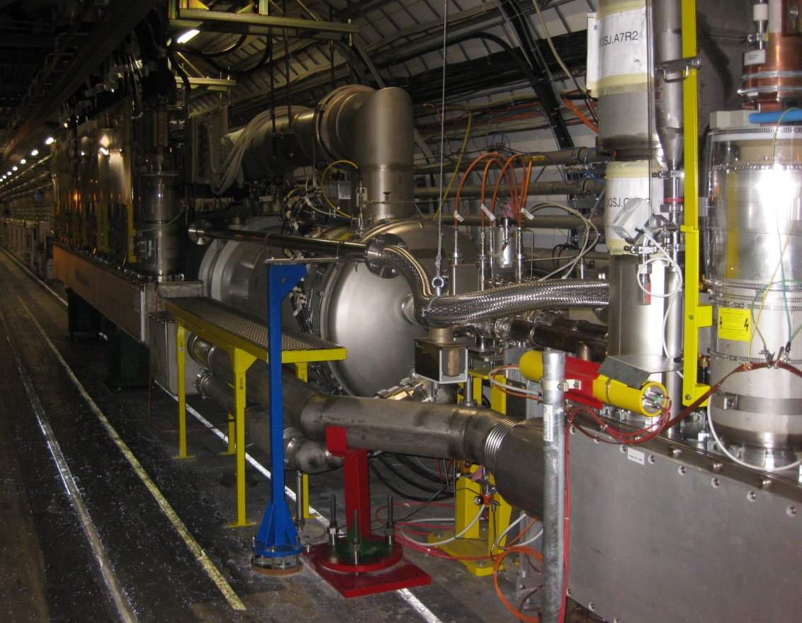
IR2 specificities
DFBAs at P2 are also feeding Q6 so if cryomagnets have to be displaced, this would be heavier
DSL2
DSR2
(J.Ph.Tock)

Slide 19
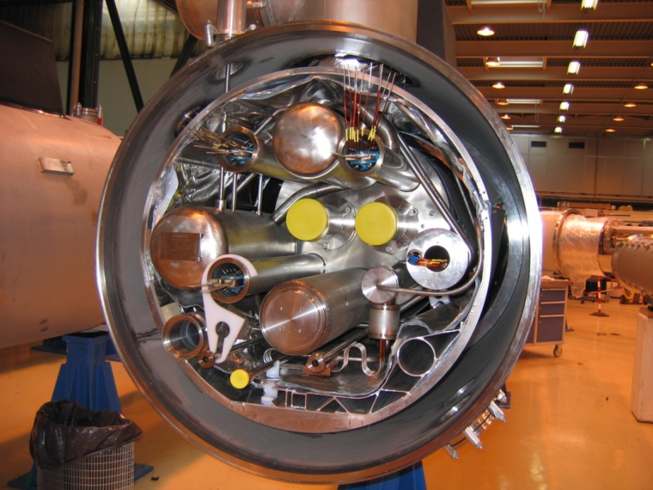
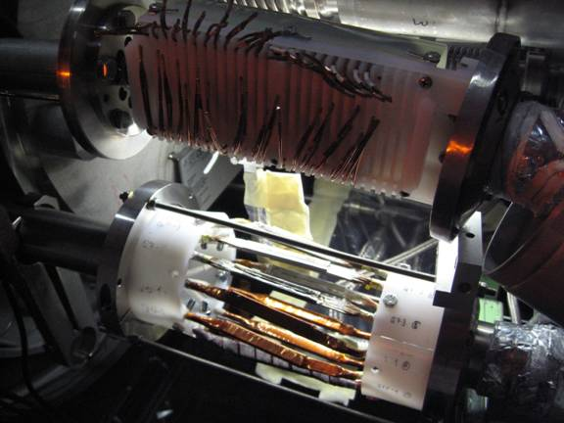
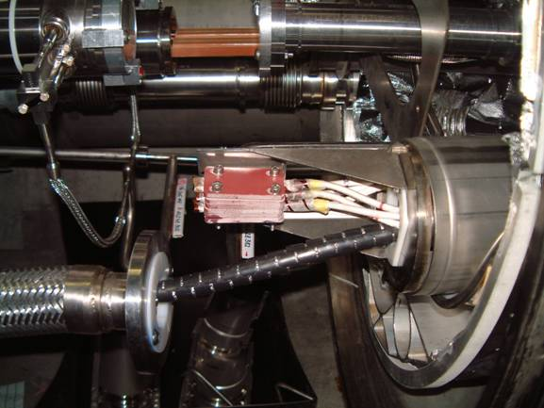
Powering of correctors/trims
LHC SSS
Powering of correctors / trim. 300 to 600 A (?):
Local feeding (as for DCF in SSS):
  Conduction cooled leads?
  Other solutions?
Via DFBs (or future SC link in IR1,5,7) ?
  Line N (up to 1 pair of 600 A spares), new IC boxes or new line N bundle
  or Line M (3 pairs of 600 A spare spool wires)
DCF conduction cooled leads (60 or 120A)
600 A wires
6 kA wires
IC boxes
IC boxes
(input J.Ph.Tock)

Slide 20
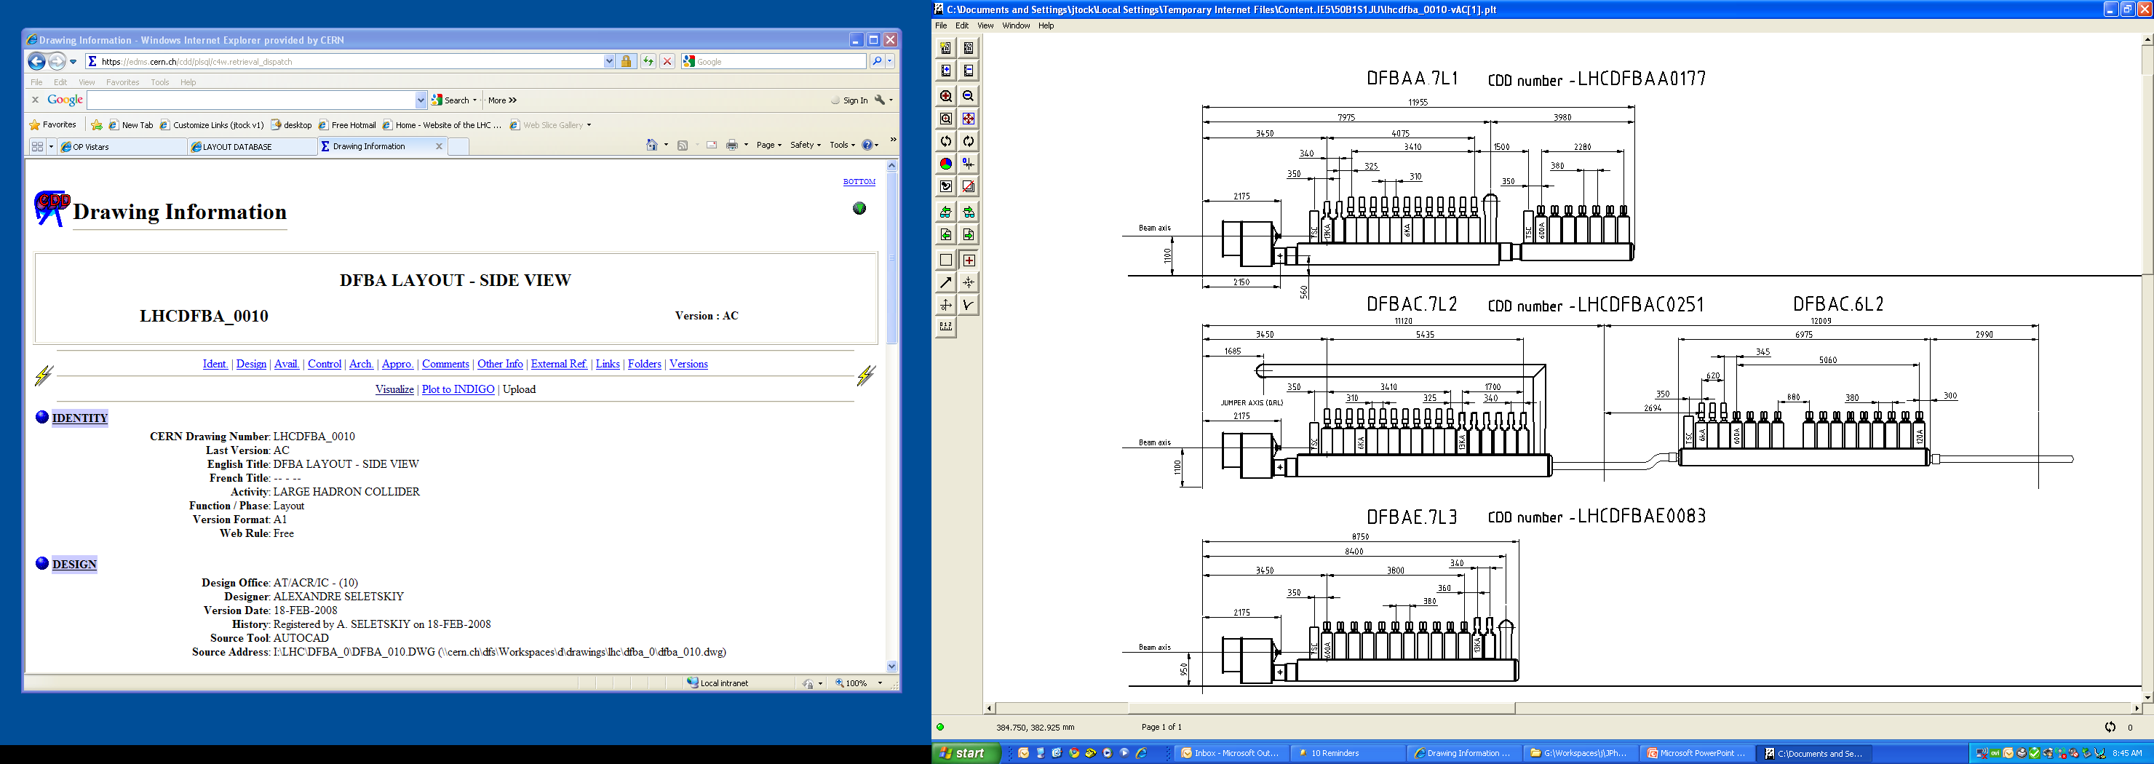
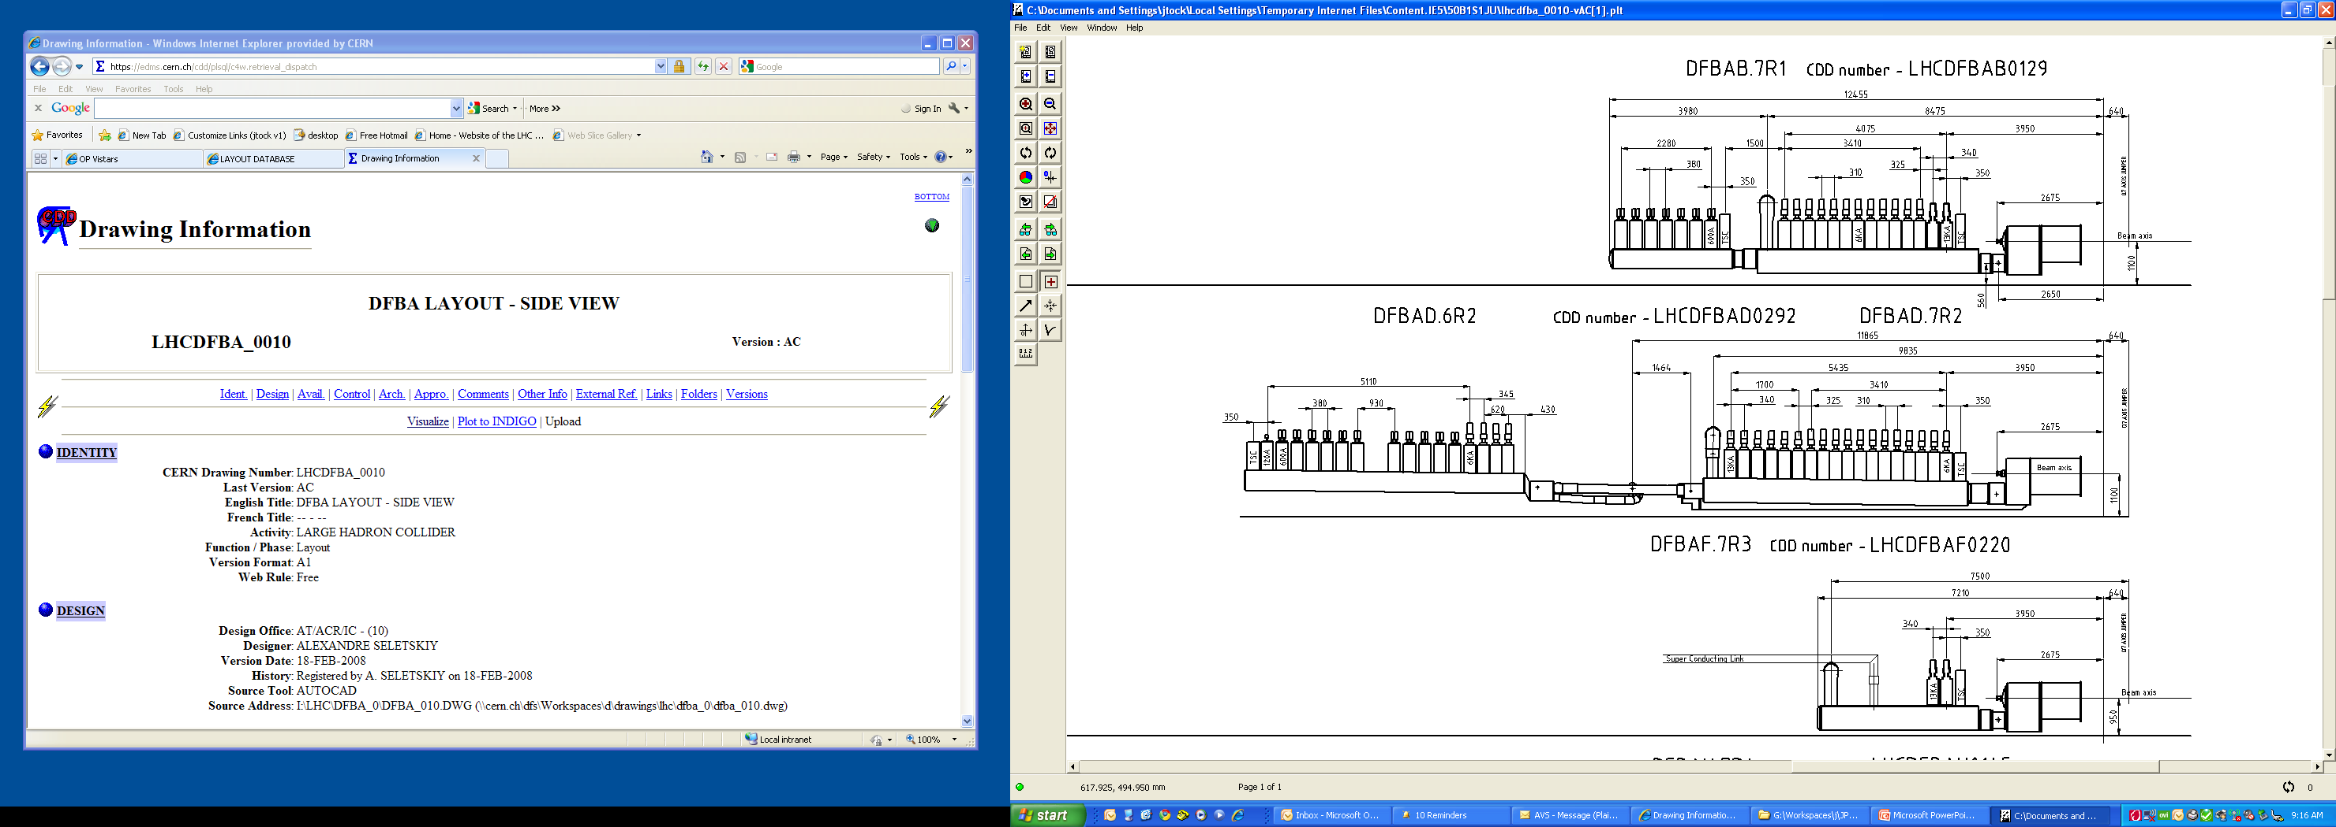
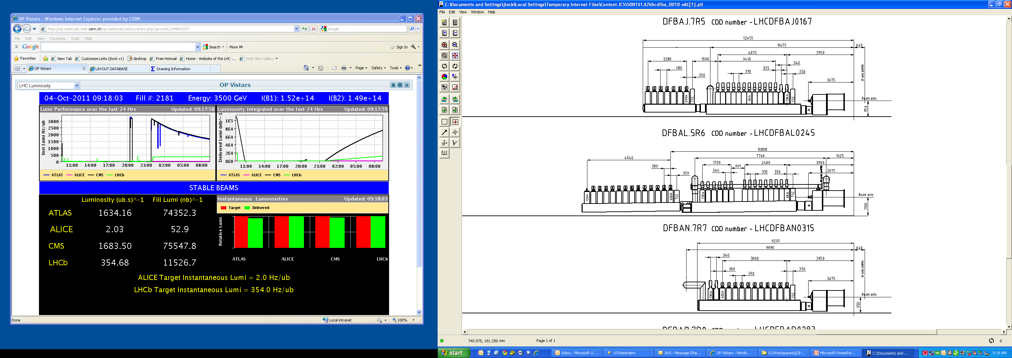
Differences are coming from the DFBA type and the elements on the IR side.
P3 for reference:
P1 (5):
(J.Ph.Tock)

Slide 21
Differences are coming from the DFBA type and the elements on the IR side.
P2 (Very different):
DFBAs at P2 are also feeding Q6 so if cryomagnets have to be displaced, this would be heavier
(J.Ph.Tock)

Slide 22
Summary
CCFS working group has just started (give us time!)
5-6 months time to identify (or rule out!) possible show stoppers
Warm collimator remains an option, to be coupled with 11 T magnet
Replacement of 1 (or 2) MB → preserve IC to IC space
Preliminary 11T+collimator layouts show a more compact arrangement with a single CM, but none can be excluded so far
IR 1,3,5 and 7 are comparable in terms of layout, IR2 is special (QRL and injection line)
Powering of trims/correctors (300-600A?). Need must be clarified, but options with local feedthroughs or using existing spools and DFBA (modified,or SC links in IR1,5,7), can be investigated

Slide 23
Spare slides

Slide 24
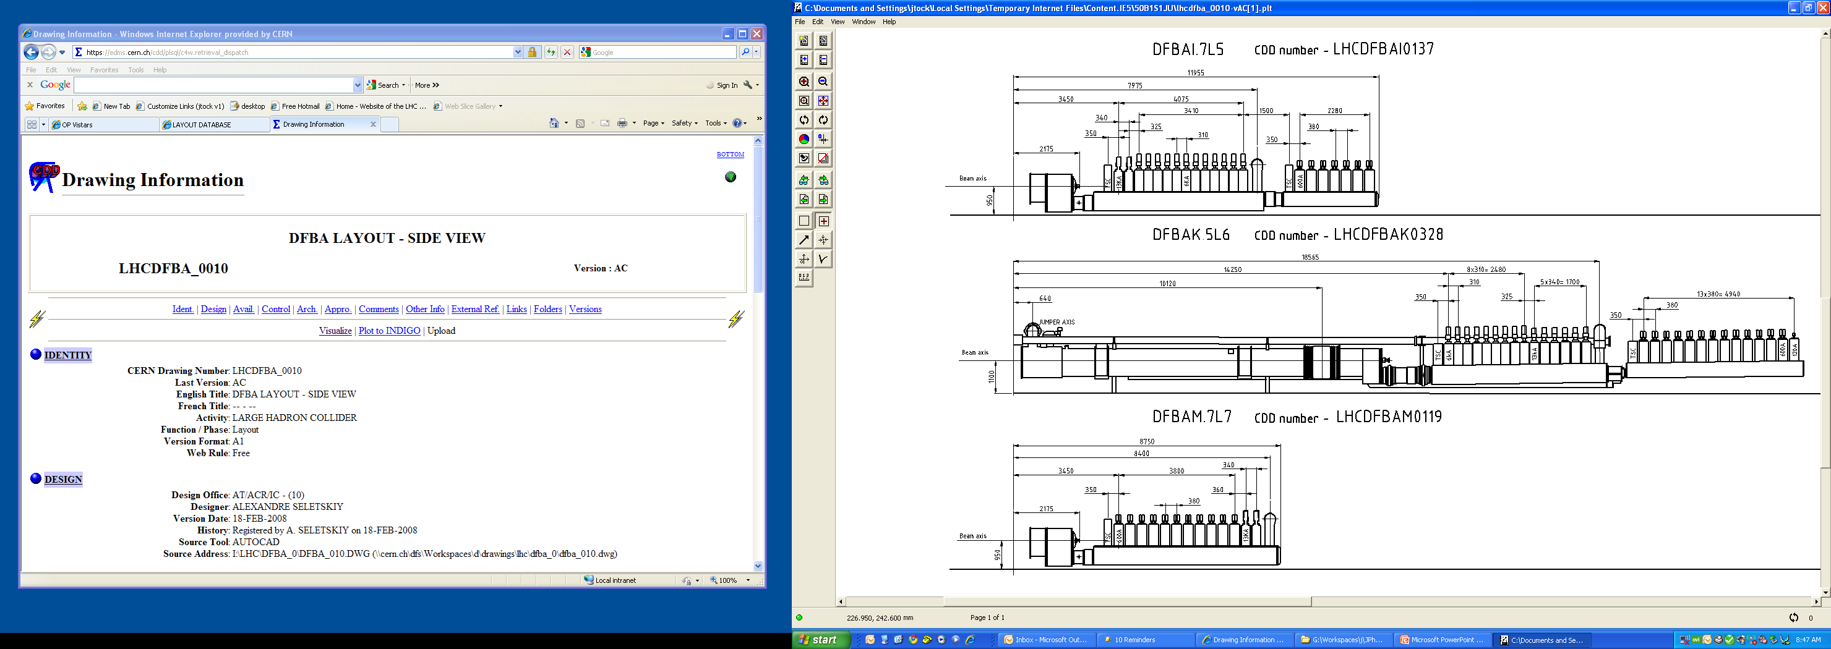
Differences are coming from the DFBA type and the elements on the IR side.
(J.Ph.Tock)

Slide 25
Differences are coming from the DFBA type and the elements on the IR side.
(J.Ph.Tock)

Slide 26
Differences are coming from the DFBA type and the elements on the IR side.
(J.Ph.Tock)

Slide 27
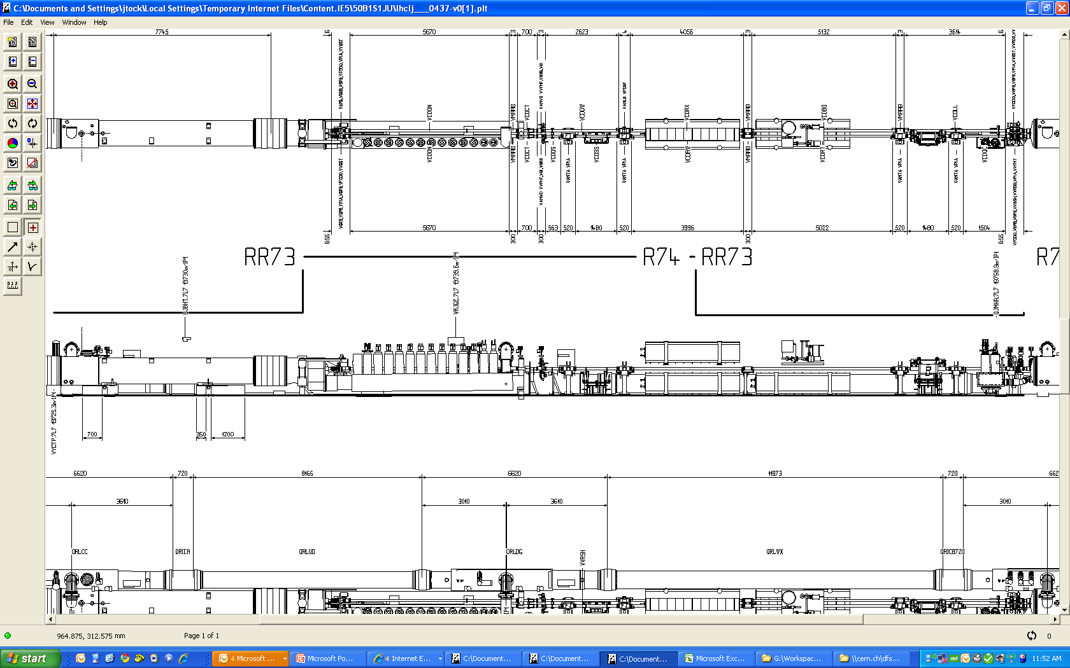
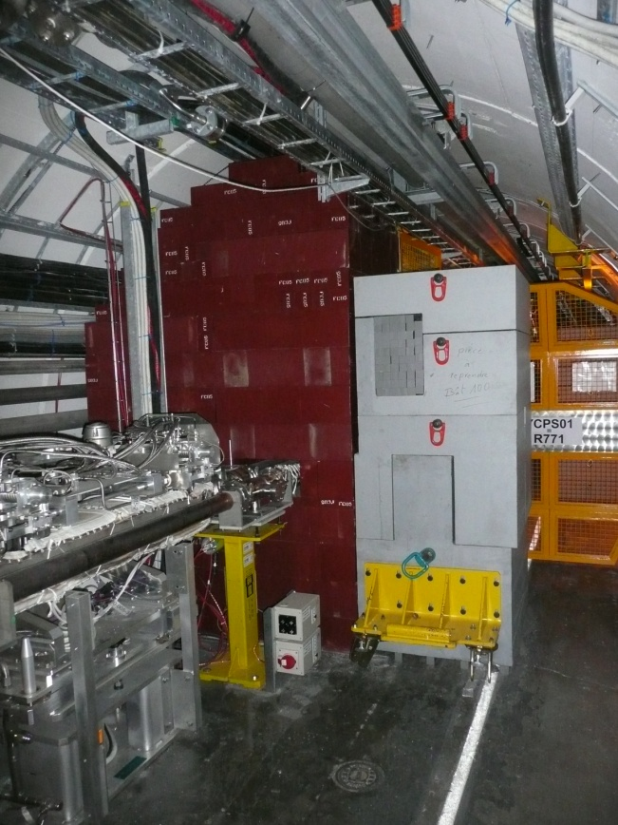
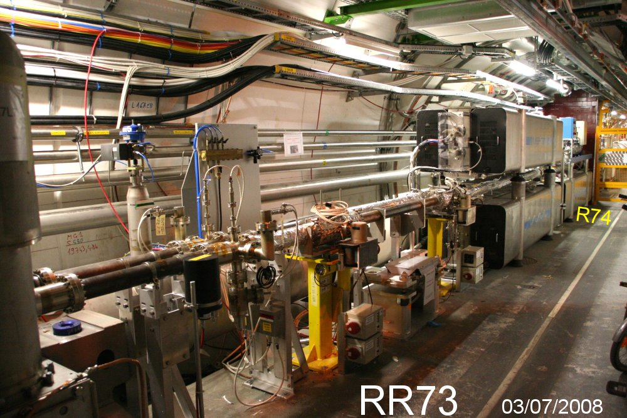
Differences are coming from the DFBA type and the elements on the IR side.
P7 : DFBA OK but space available …
(J.Ph.Tock)

