Slide 1
Interface of the 2x5.5 m 11 T Cold Masses
M. Karppinen TE-MSC
On behalf of CERN-FNAL collaboration
B. Auchmann, B. Holzer, L. Oberli,
L. Rossi, D. Smekens (CERN)
N, Andreev, G. Apollinari, E. Bartzi, R. Bossert,
F. Nobrega, I. Novitski, A. Zlobin (FNAL)

Slide 2
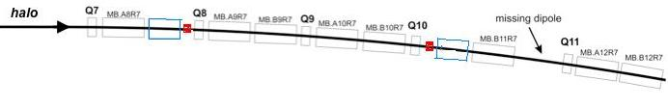
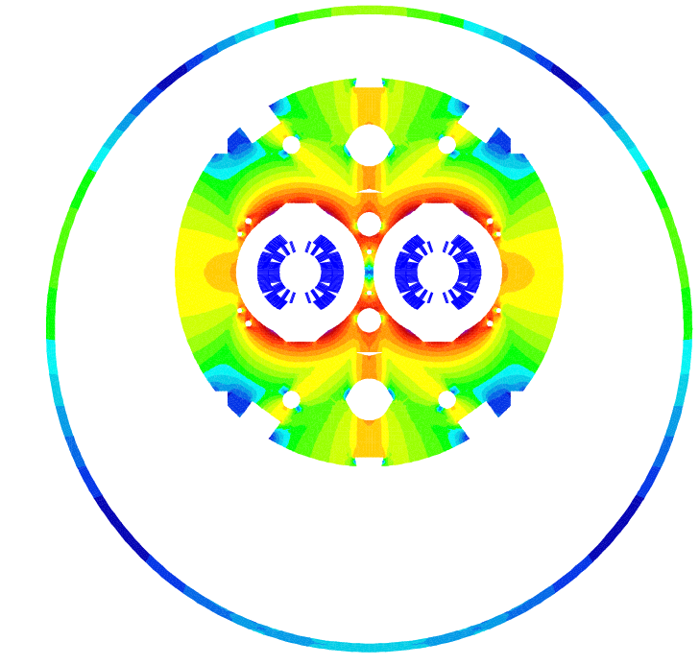
DS Upgrade
2017-18: Point-3,7 & IR-2
2020: IR1,5 as part of HL-LHC
MB.B8R/L
MB.B11R/L
11 T Nb₃Sn
∫BdL = 119.2 Tm @ I_{nom} = 11.85 kA
in series with MB
11 m Nb₃Sn
3 m Collim
(11.2 T x 10.6 m), L_{CM} ≈ 11 m, (MB -4.2 m) => 12 coldmass + 2 spares = 14 CM
2 x (11.2 T x 5.3 m), L_{CM} ≈ 11.5 m, (MB -3.7 m)
=> 24 coldmass + 4 spares = 28 CM
5.5 m Nb₃Sn
5.5 m Nb₃Sn
3 m Collim
5.5 m Nb₃Sn
3 m Collim.
5.5 m Nb₃Sn

Slide 3
Cryo-collimator
3061
1541
Courtesy of D. Ramos

Slide 4
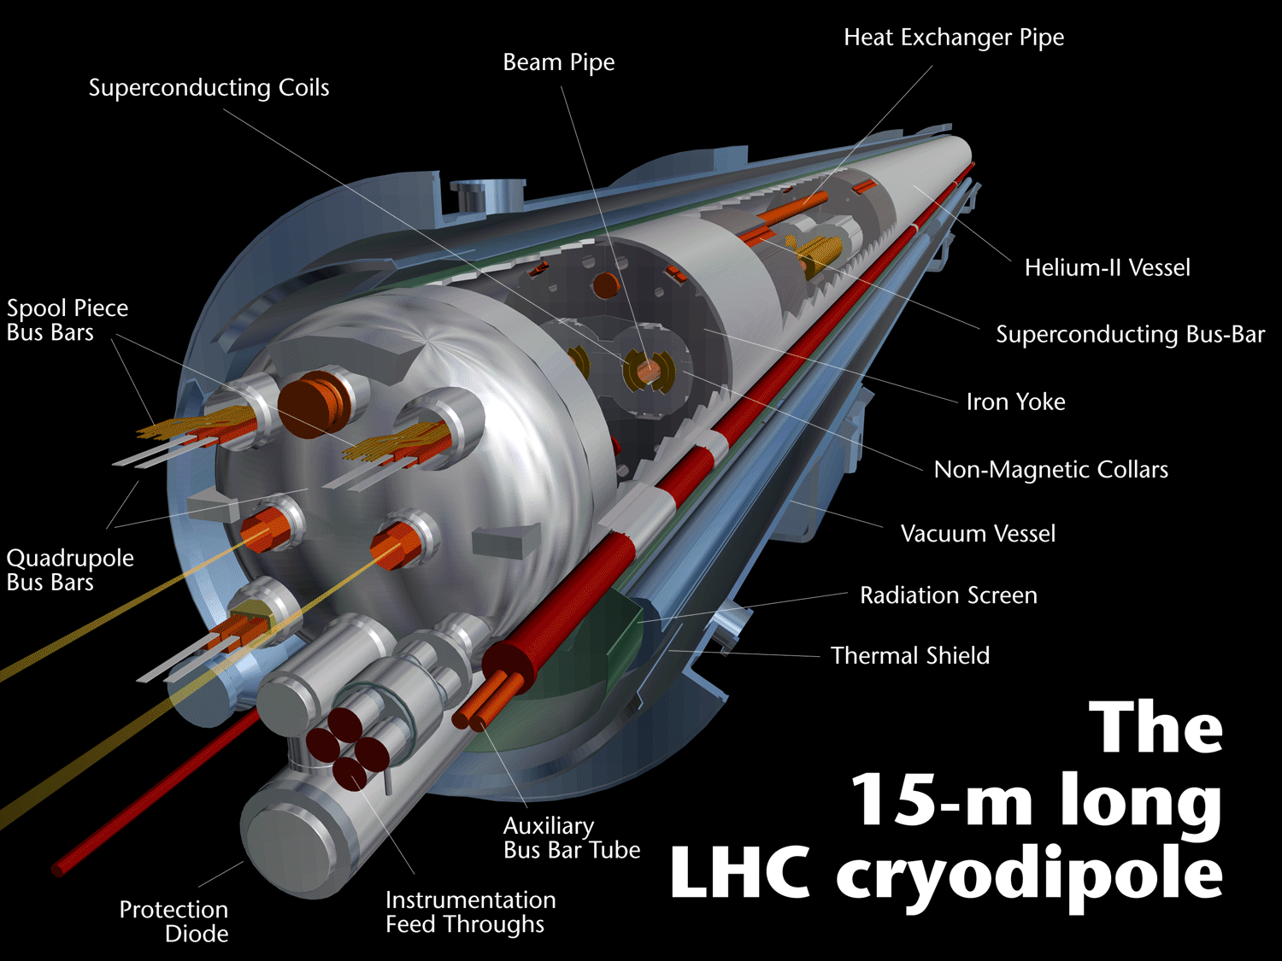
CM integration:
Alignment
Bus-bar routing
Expansion lyras
600 A correctors powering
300 A trim powering
Dedicated QPS system
Cryo integration:
Collimator location
Collimator tuning
Collimator maintenace
Cryogenic separation

Slide 5
Open questions
Cold mass integration
  Alignment of the 5.5 m CM (straight – with an angle)
  Bus-bar lay-out and integration
    Dedicated to each 5.5 m CM
    Splices
    Expansion loops
  Heat exchanger integration
Collimator
  Minimum dimensions
  Operation requirements
  Access and maintenance requirements
Cryo-assembly
  Magnet services: trim powering, correctors, QPS, instrumentation
  Collimator location and screening from magnets
  Space requirements
  Interconnects

